Slide 1
Electronics and DAQ WG Meeting (1/15/2026)
Announcements, Schedule, News
Priorities and Plans for 2026
  Project Driven Tasks
  Discussion of Technical/Collaboration Needs and Priorities

Slide 2
Schedule
1/20-1/23 - Collaboration Meeting
  Tuesday Plenary Sessions:
    Morning:
      General Collaboration / Project Status
    Afternoon:
      Software/Computing
  Wednesday: Parallel Sessions:
    Morning:
      CALOROC (Electronics + detector by detector application)
      FarForward (1/2 Mechanical, 1/2 Electronics AC-LGAD tests / ASICs / Service Hybrid)
      Streaming Computing (Calibration Workflow / Echelon 0-1 interface / Orchestration / Reconstruction)
      Physics Session (Jets, and HF, pTDR Physics Analysis)
    Afternoon
      Mechanics and Integration
      Physics (pTDR Physics Analysis)
      PID Cross-Cutting WG (Detector Status)
      Electronics, Readout and DAQ (Electronics Status / Data Volumes, Pico Daq / Mini Daq Discussion)
  Thursday Plenary Sessions:
    Morning:
      Collaboration Council
    Afternoon:
      Plenary - Panel Discussions / Open Mic
  Friday
    Morning - Plenary
      Assorted General Interest (pTDR, Tracking, Backgrounds) & Closing
    Afternoon – Parallel
      Excursion
      AI in EPIC
      Cross Cutting Calorimetry WG
      Exclusive, Diffraction and Tagging PWG

Slide 3
Schedule
RHIC Operations End and R&R Starts (Moving Target, currently February 6th, 2026)
Detector Baseline Review: February 3-5, 2026
Director’s EIC Review: March 9-12, 2026
DOE Independent Project Review of the EIC Project Status: 4/28-5/1, 2026
DOE CD-2 Approval for Detector (Hope for ~End of 2026)
Goal for CD-3 is by end of 2027 – need to start planning FDR’s and expect similar review schedule in 2027 aimed towards CD-3
PDR for Slow Controls – “Planned for Spring 2026”
  Some progress…
    2025: Slow Controls Scope Workshop with EIC Controls (13 November 2025) · Indico
    Need more complete scope definition
      Distinction between controls (EPICs control of detector)
      Safety Systems (PLC based interlocks and safety controls)
      Overlap between EIC Controls and ePIC’s controls.
      Overlap between scope in Detector Control Accounts vs Slow Controls Integration Control Account.
      Needs to be defined and will need change control request procedure
60% Design Level
+ Project Documentation
(Schedule, Cost, Basis of
Estimate, QA plans,
Interface Documents,
Risks, ETC…)

Slide 4
Schedule
Internal Assessment Reviews of Each ASIC/Discrete to be scheduled soon
  Model would be similar to internal review of the GTU done last November
    Internal GTU Review (5 November 2025) · Indico

Slide 5
Priorities for 2026
Slow Controls
  Scope – Define with EIC Controls – Monthly Meetings
  Scope – Define with Detector CAMs
  More specific with equipment that needs to be controlled for each detector
    Specific maps of equipment locations
  EPICs testbed in lab at BNL
    Control examples
    DB interfaces
    Alarms interface
  Distinguish properly safety/interlocks from EPICs control
  DAQ slow control interface (IOCs for FEB data exchange)
Define to start Change Control Process

Slide 6
Priorities for 2026
ASIC Internal Assessments
Further refinement of RDO plan – moving towards FDR
  Generic RDO → application to MAPS
  Aggregation method
  Protocol (Organization of FELIX/Readout Computer operation)
    Low Level Protocol: (lpGBT / FULL / private)?, (FEC5, FEC12)?
      Define single standard, or at least define which standard to use for which detector!
    High Level protocol:
      Data format for each ASIC is mostly known, but not documented in a single place for ePIC. Document!
      List of fast commands for each ASIC to be specified and documented
      Header formats, specification of which components add headers and what types
      Specification of detailed time ordering of hits, and algorithms, definition of which components perform this.
    Ethernet vs PCI readout of FELIX (BNL LDRD w/ Hao Xu has approval to move to full proposal stage)
Testbeds
  Setup lab with small-scale computer farm to evaluate TF building
  FLX-155 when available
  Evaluation of RCDAQ/CODA component use
  AI integration – Model Context Protocol test bed?
  Definition of Run Control Model (needed for input to orchestration test beds for SRO)

Slide 7
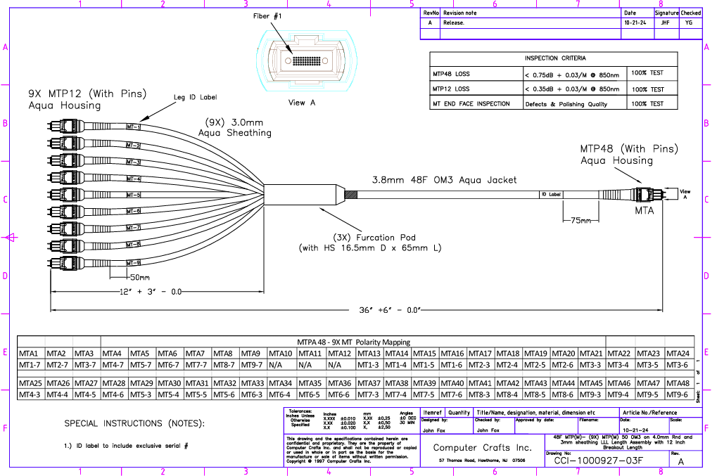
Priorities for 2026
Fiber / Cable Plans
  Plan for detector currently to use MTP12 → MTP48 (Dropping some fibers not needed by lpGBT)
  We will have similar dropping of fibers from some detectors due to different use of lpGBT (1 TX fiber vs 4 TX) in the mapping to the trunk fiber
  Need realistic plan for this mapping for FDRs

Slide 8
Priorities for 2026
Other Priorities – Collaboration or Project Needs?

