Slide 2
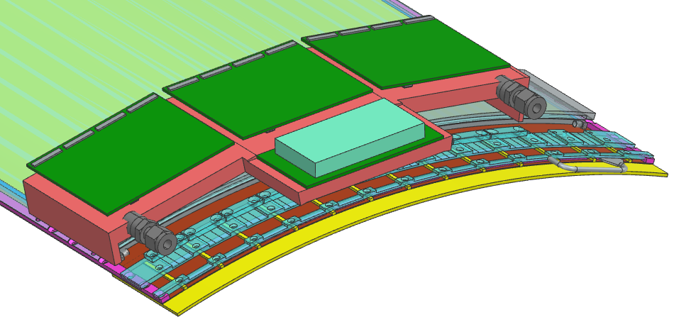
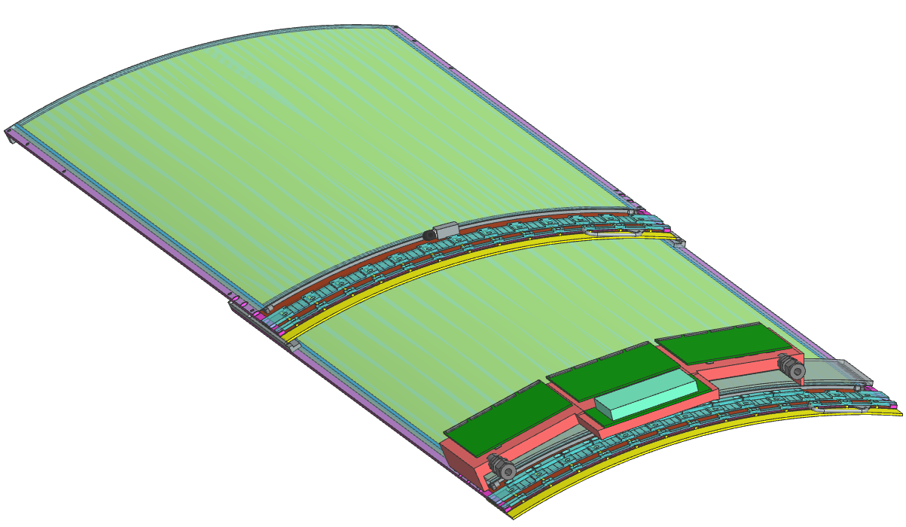
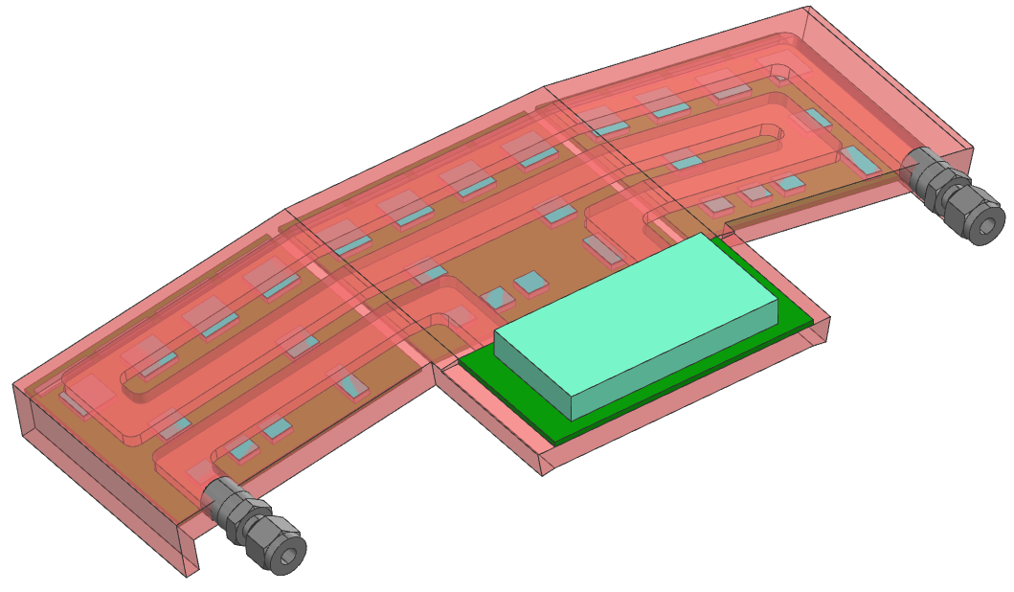
One Cooling Block per section →2 Tiles (6x SLASA Board + 1x Power Board)
Potentially: 3D printed in copper

Slide 3
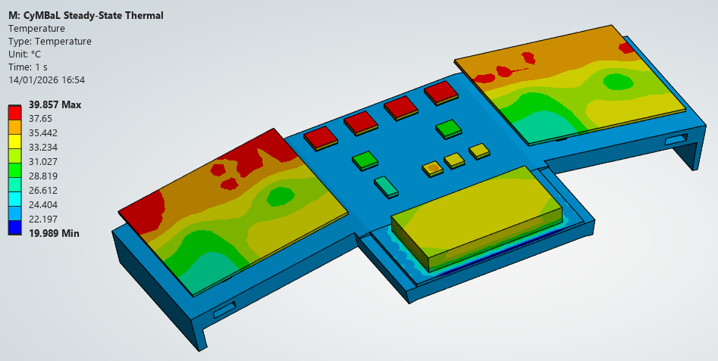
SALSA current of 1.5 A:
3 l/min
Tin 22°C, Tout 22.66 ° C
ΔP 0.03 bar

