Slide 1
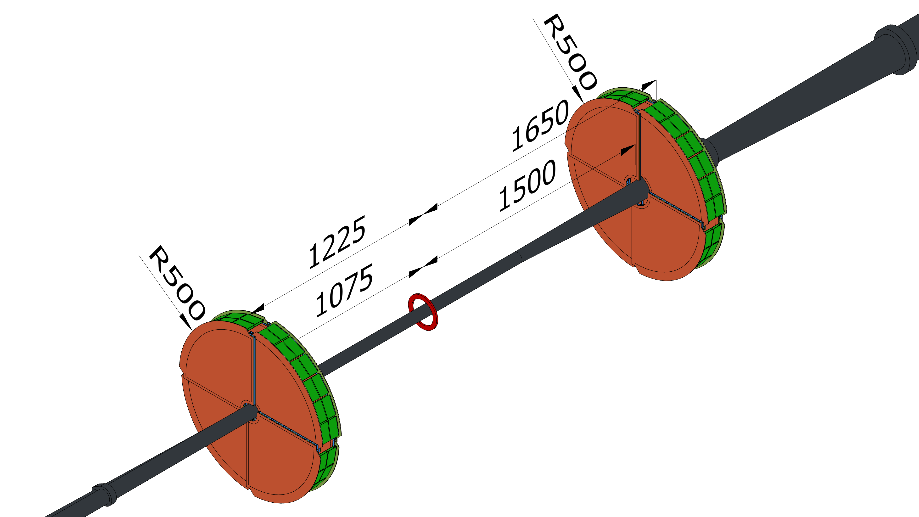
ECT Overview
4 | Disks
16 | Quadrant modules
24576 | Data channels
BEAM PIPE
EAST
HADRON
FORWARD
SIDE
× 2 DISKS
IP
WEST
ELECTRON
BACKWARD
SIDE
Complying with the envelope released on 03/03/2025
× 2 DISKS

Slide 2
ECT Overview
4 | Disks
16 | Quadrant modules
24576 | Data channels
R450
BEAM PIPE
1485
EAST
HADRON
FORWARD
SIDE
20480
1235
R450
× 2 DISKS
IP
WEST
ELECTRON
BACKWARD
SIDE
Complying with the envelope released on 03/03/2025
9-22-2025
× 2 DISKS

Slide 3
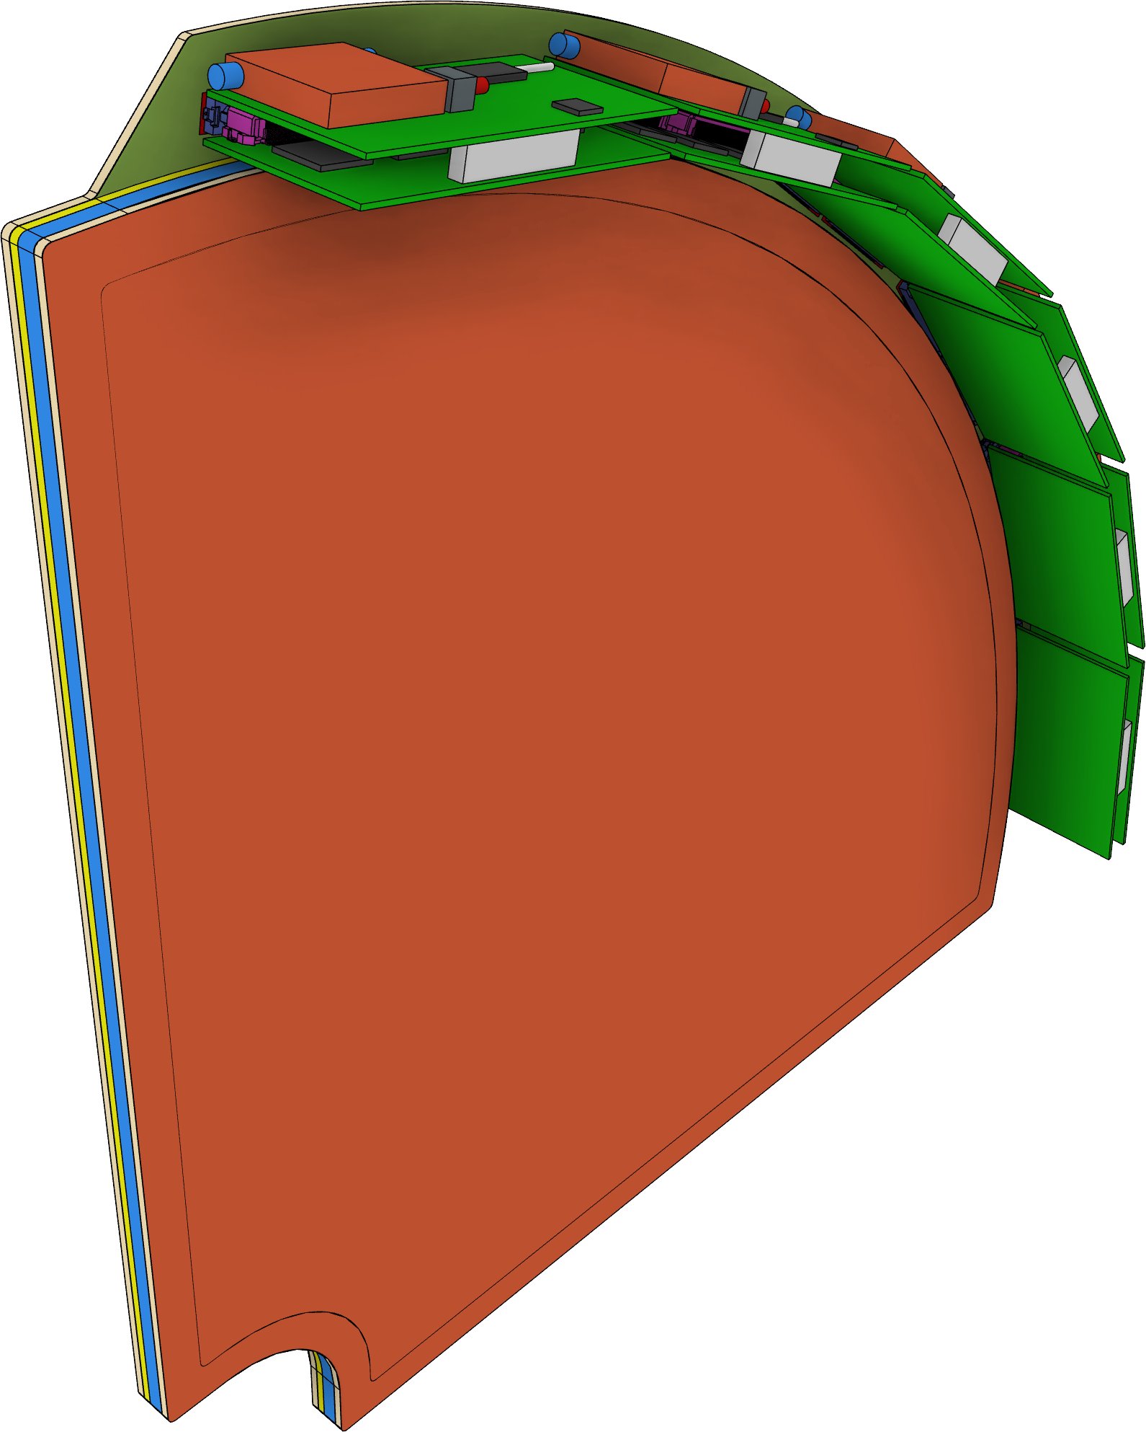
Quadrant Concept
Cutouts for services
At 0°, 90°, 180°, and 270°
5
6 FEBs per quadrant located in the service rim
4x SALSA ASICs per FEB
2x Hirose FX20-140P Connectors per FEB
Fiber-reinforced epoxy frames define the gas gap and reinforce the outer support panels
Lightweight sandwich-structured composites for anodes/cathodes’ structural supports
Variable cutout to cope with the asymmetric beam pipe (Ø 100, 130, and 180)

Slide 4
PCB and AA after the Redesign
PREVIOUS DESIGN
CURRENT DESIGN
6 FEB
Slots
5 FEB
Slots

Slide 5
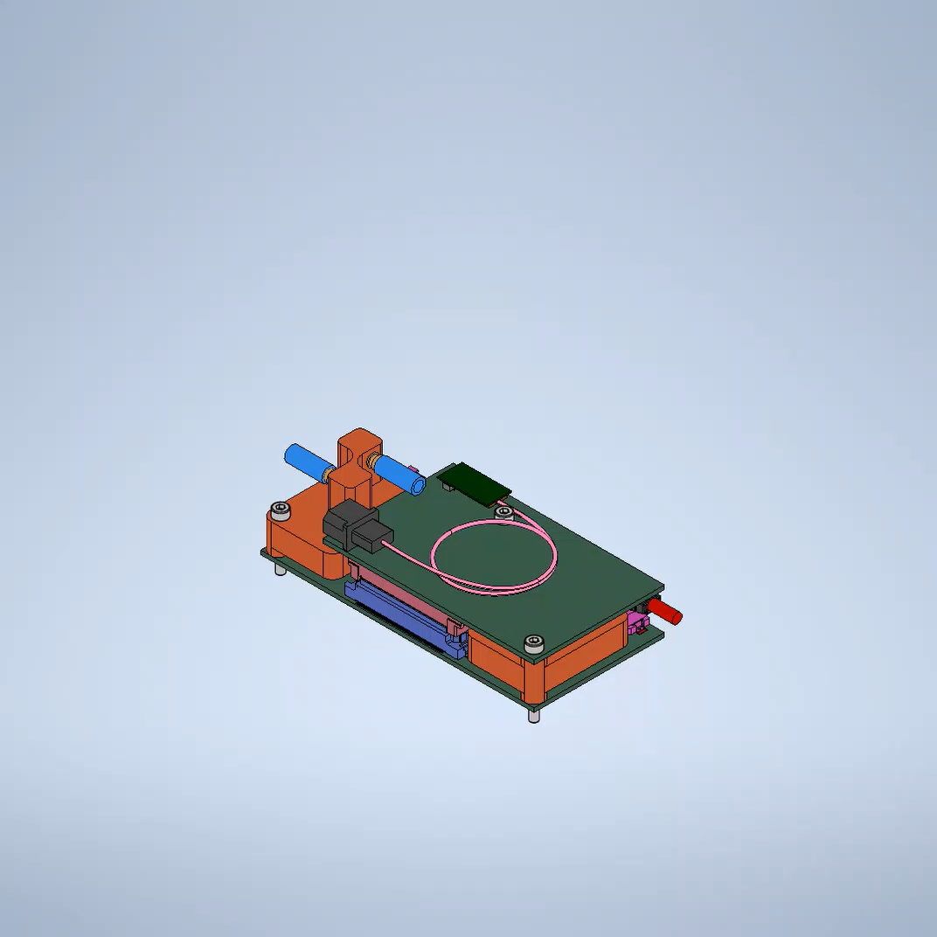
New FEB Model
HEATSINK
FE2:
1x lpGBT
2x LDO
1x VTRx+
DC/DC Conv.
FE1:
4x SALSA
2x LDO

Slide 6
Cooling Strategy
All 5 heatsinks in a module connected in series with pipes running close to the outer rim
No. 2 Ø6x4 PU pipe per module as inlet/outlet for the cooling chain
All major heat sources are mounted on the top/bottom face of FE1/FE2 to face the heatsink

Slide 7
Heatsink
Welded
Barbed Tube Connectors
Ø6x4 PU Pipes
4x3 machined groove
Preliminary proposal, no simulation has been run yet
Quite bulky and difficult to manufacture → We will be working on alternative cooling solutions

Slide 8
Services Estimates

