Slide 1

BEAM TEST @ DESY
Satoshi YANO

Slide 2
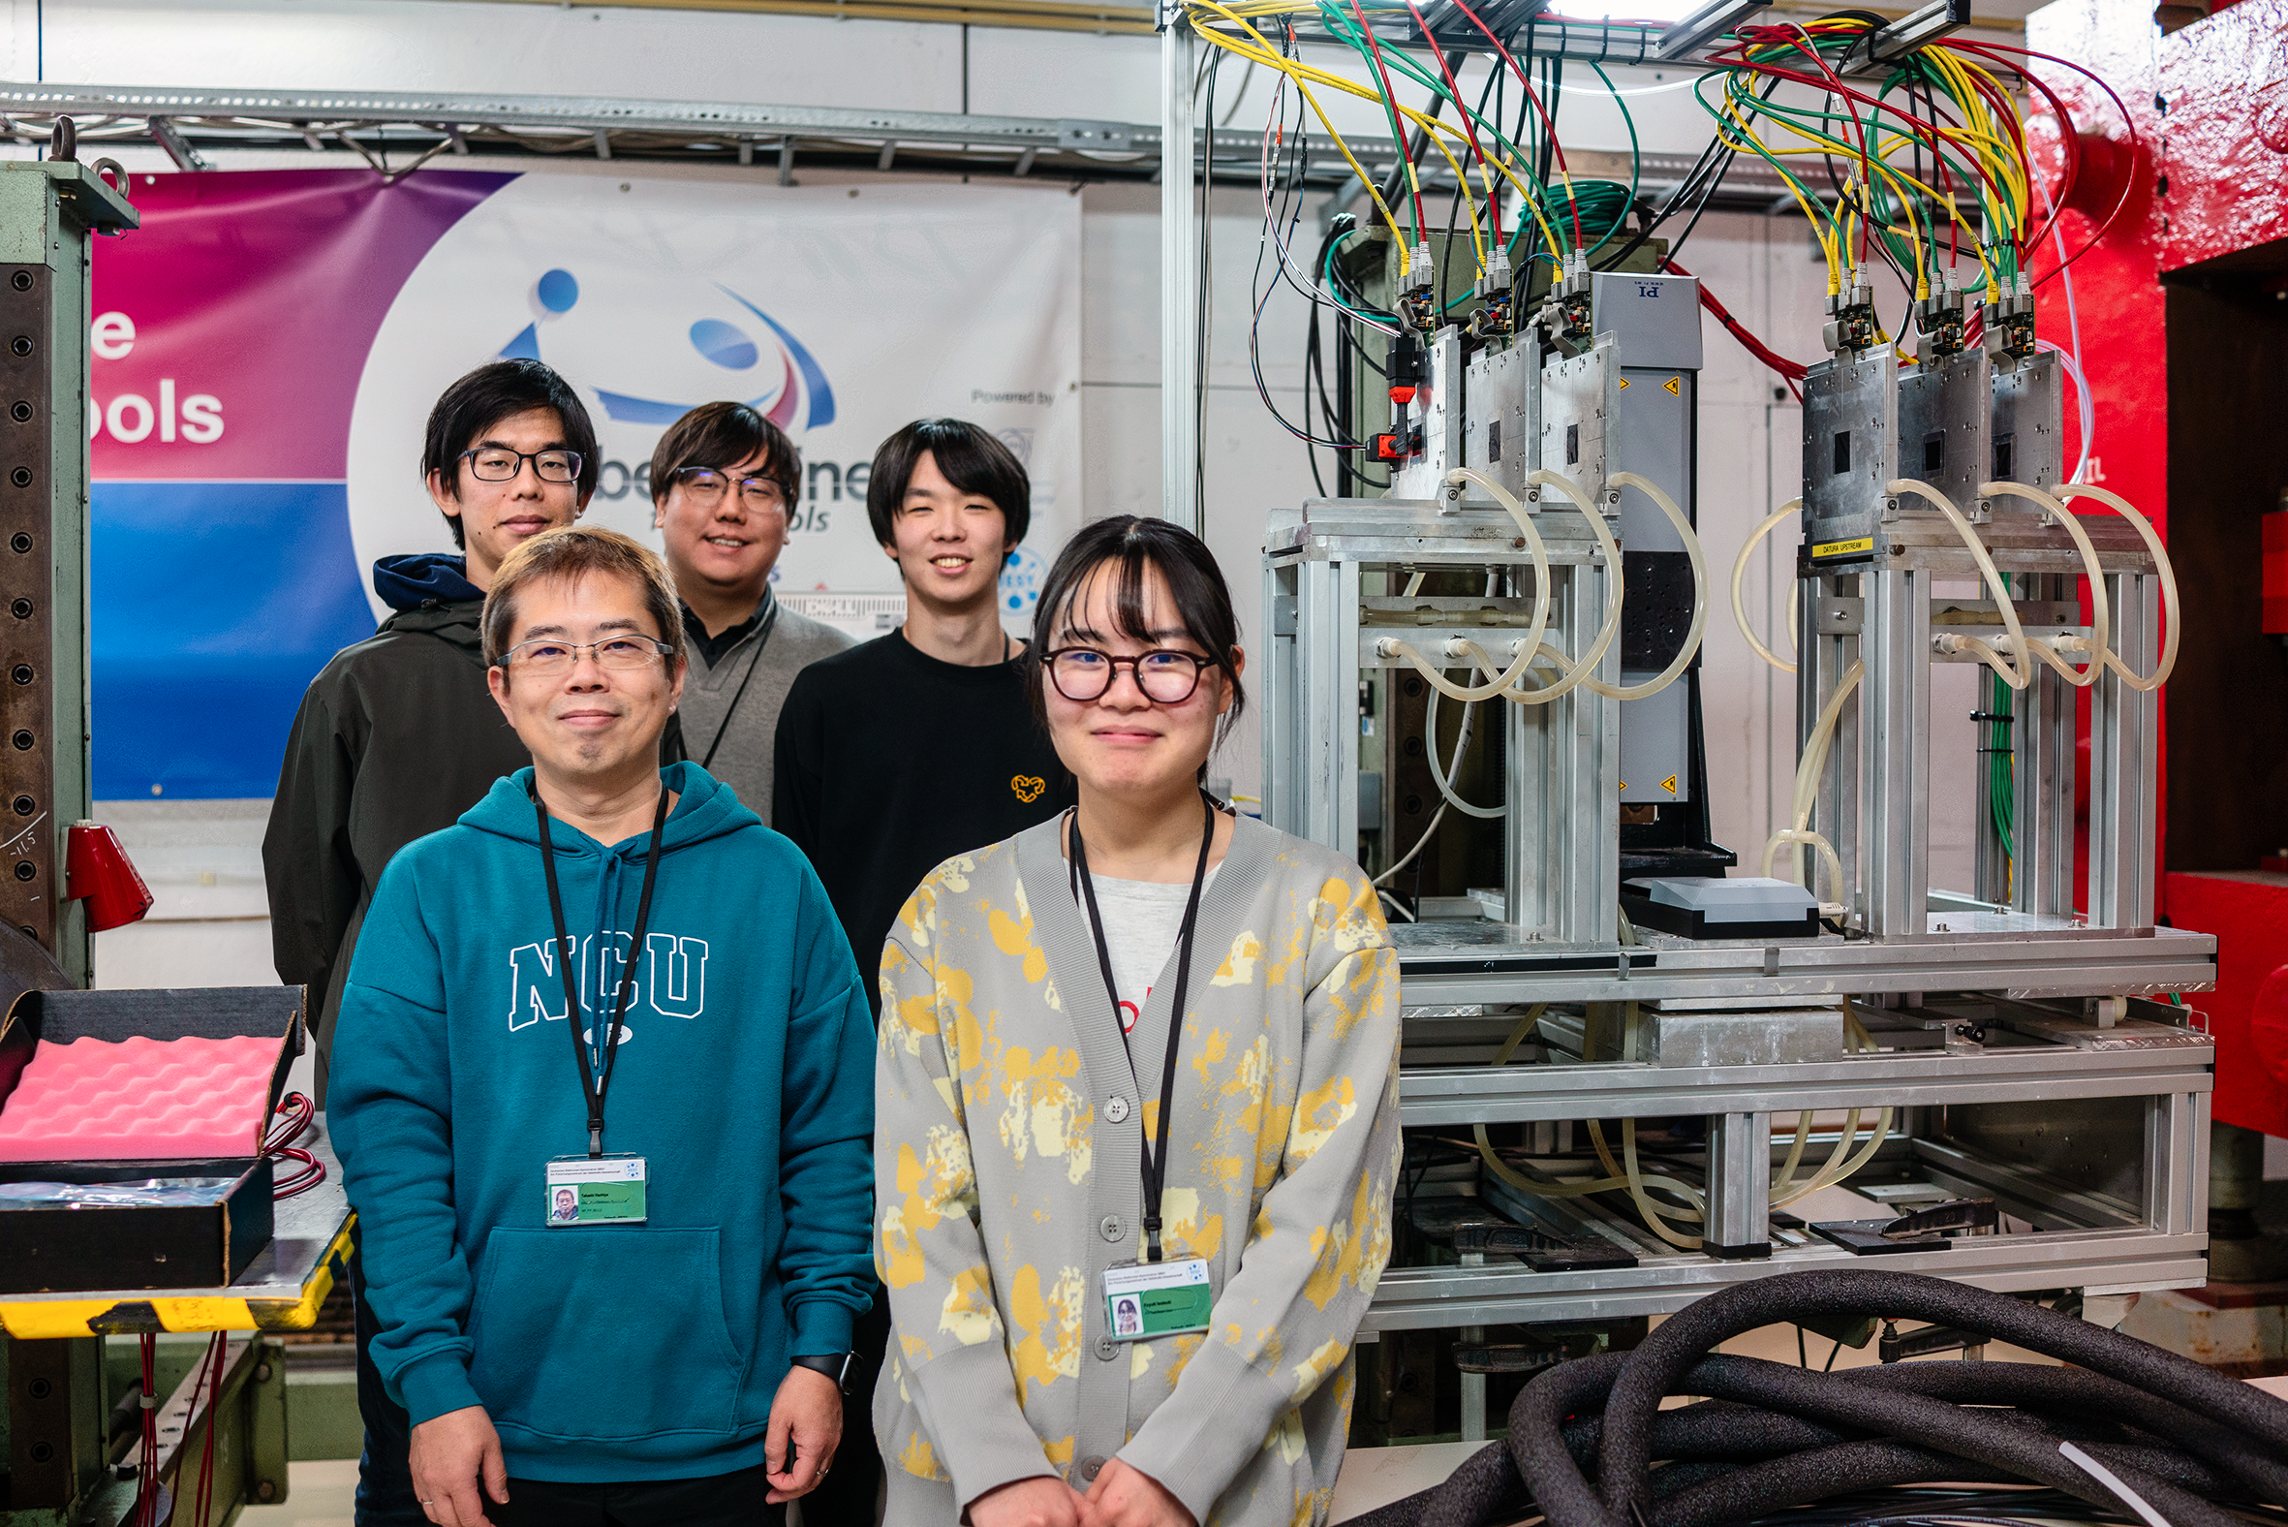
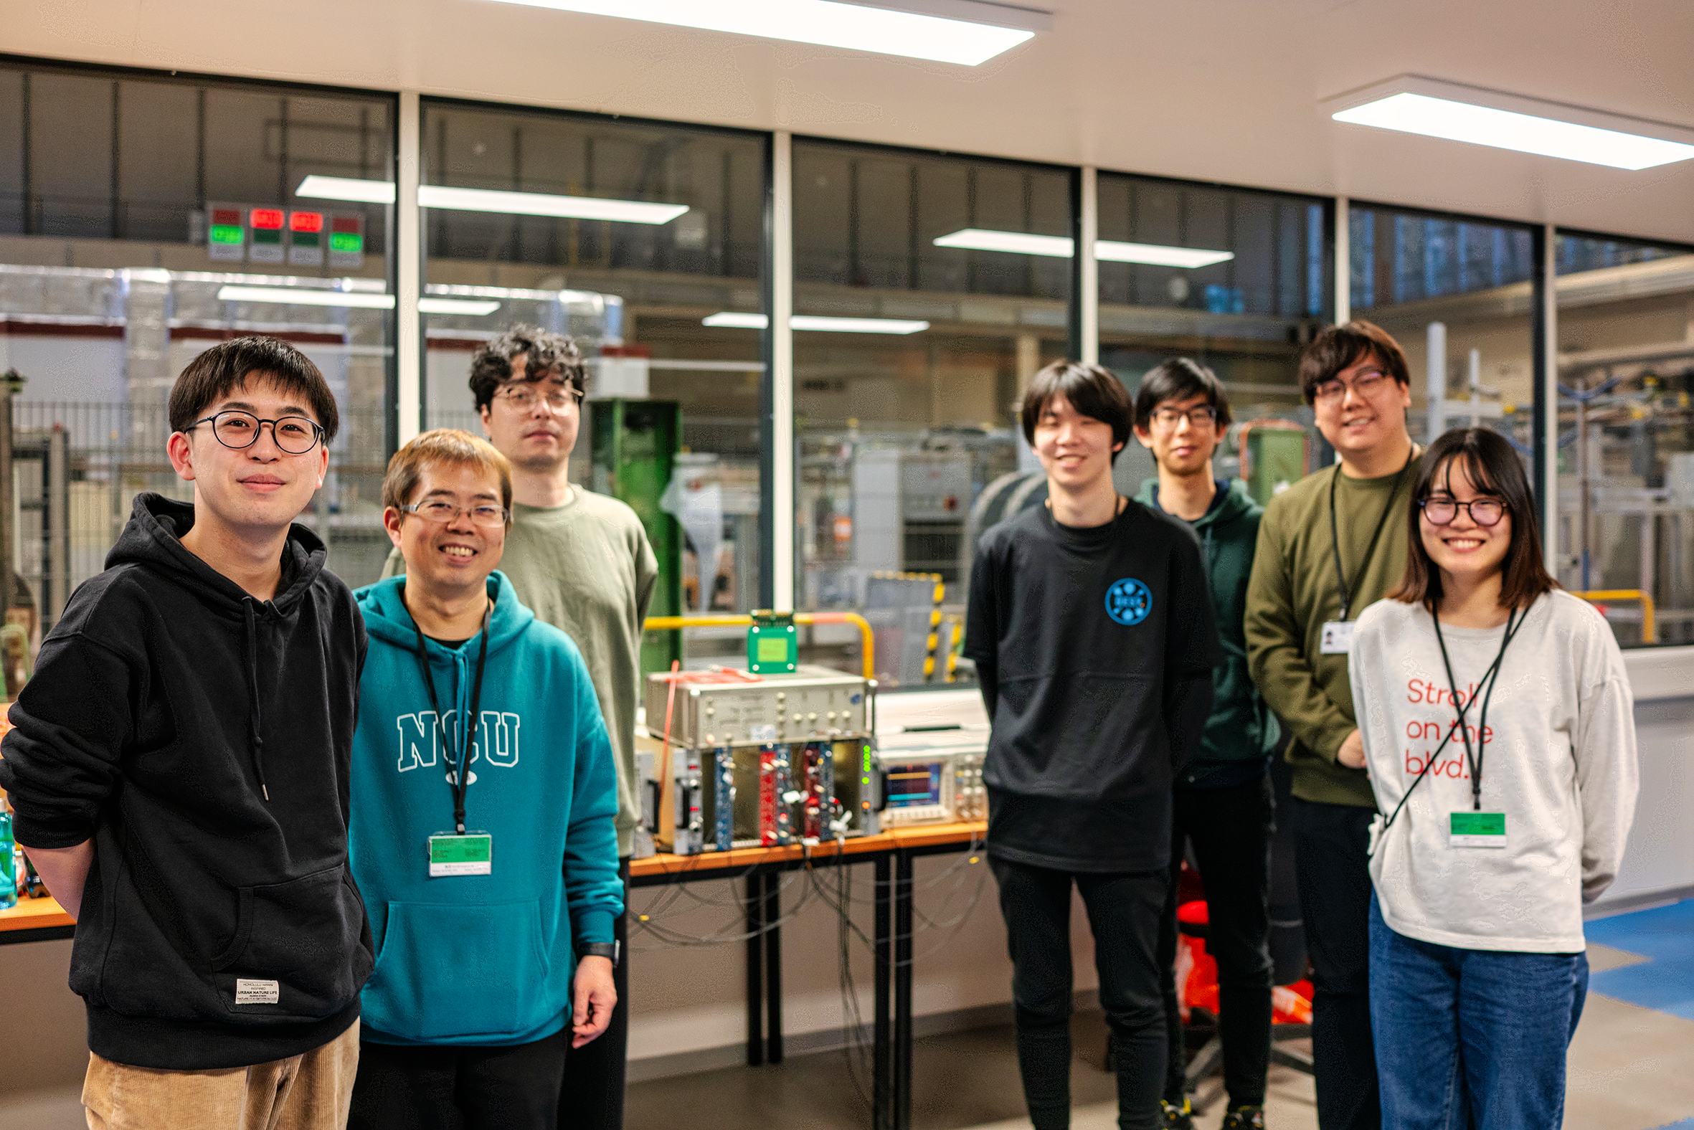
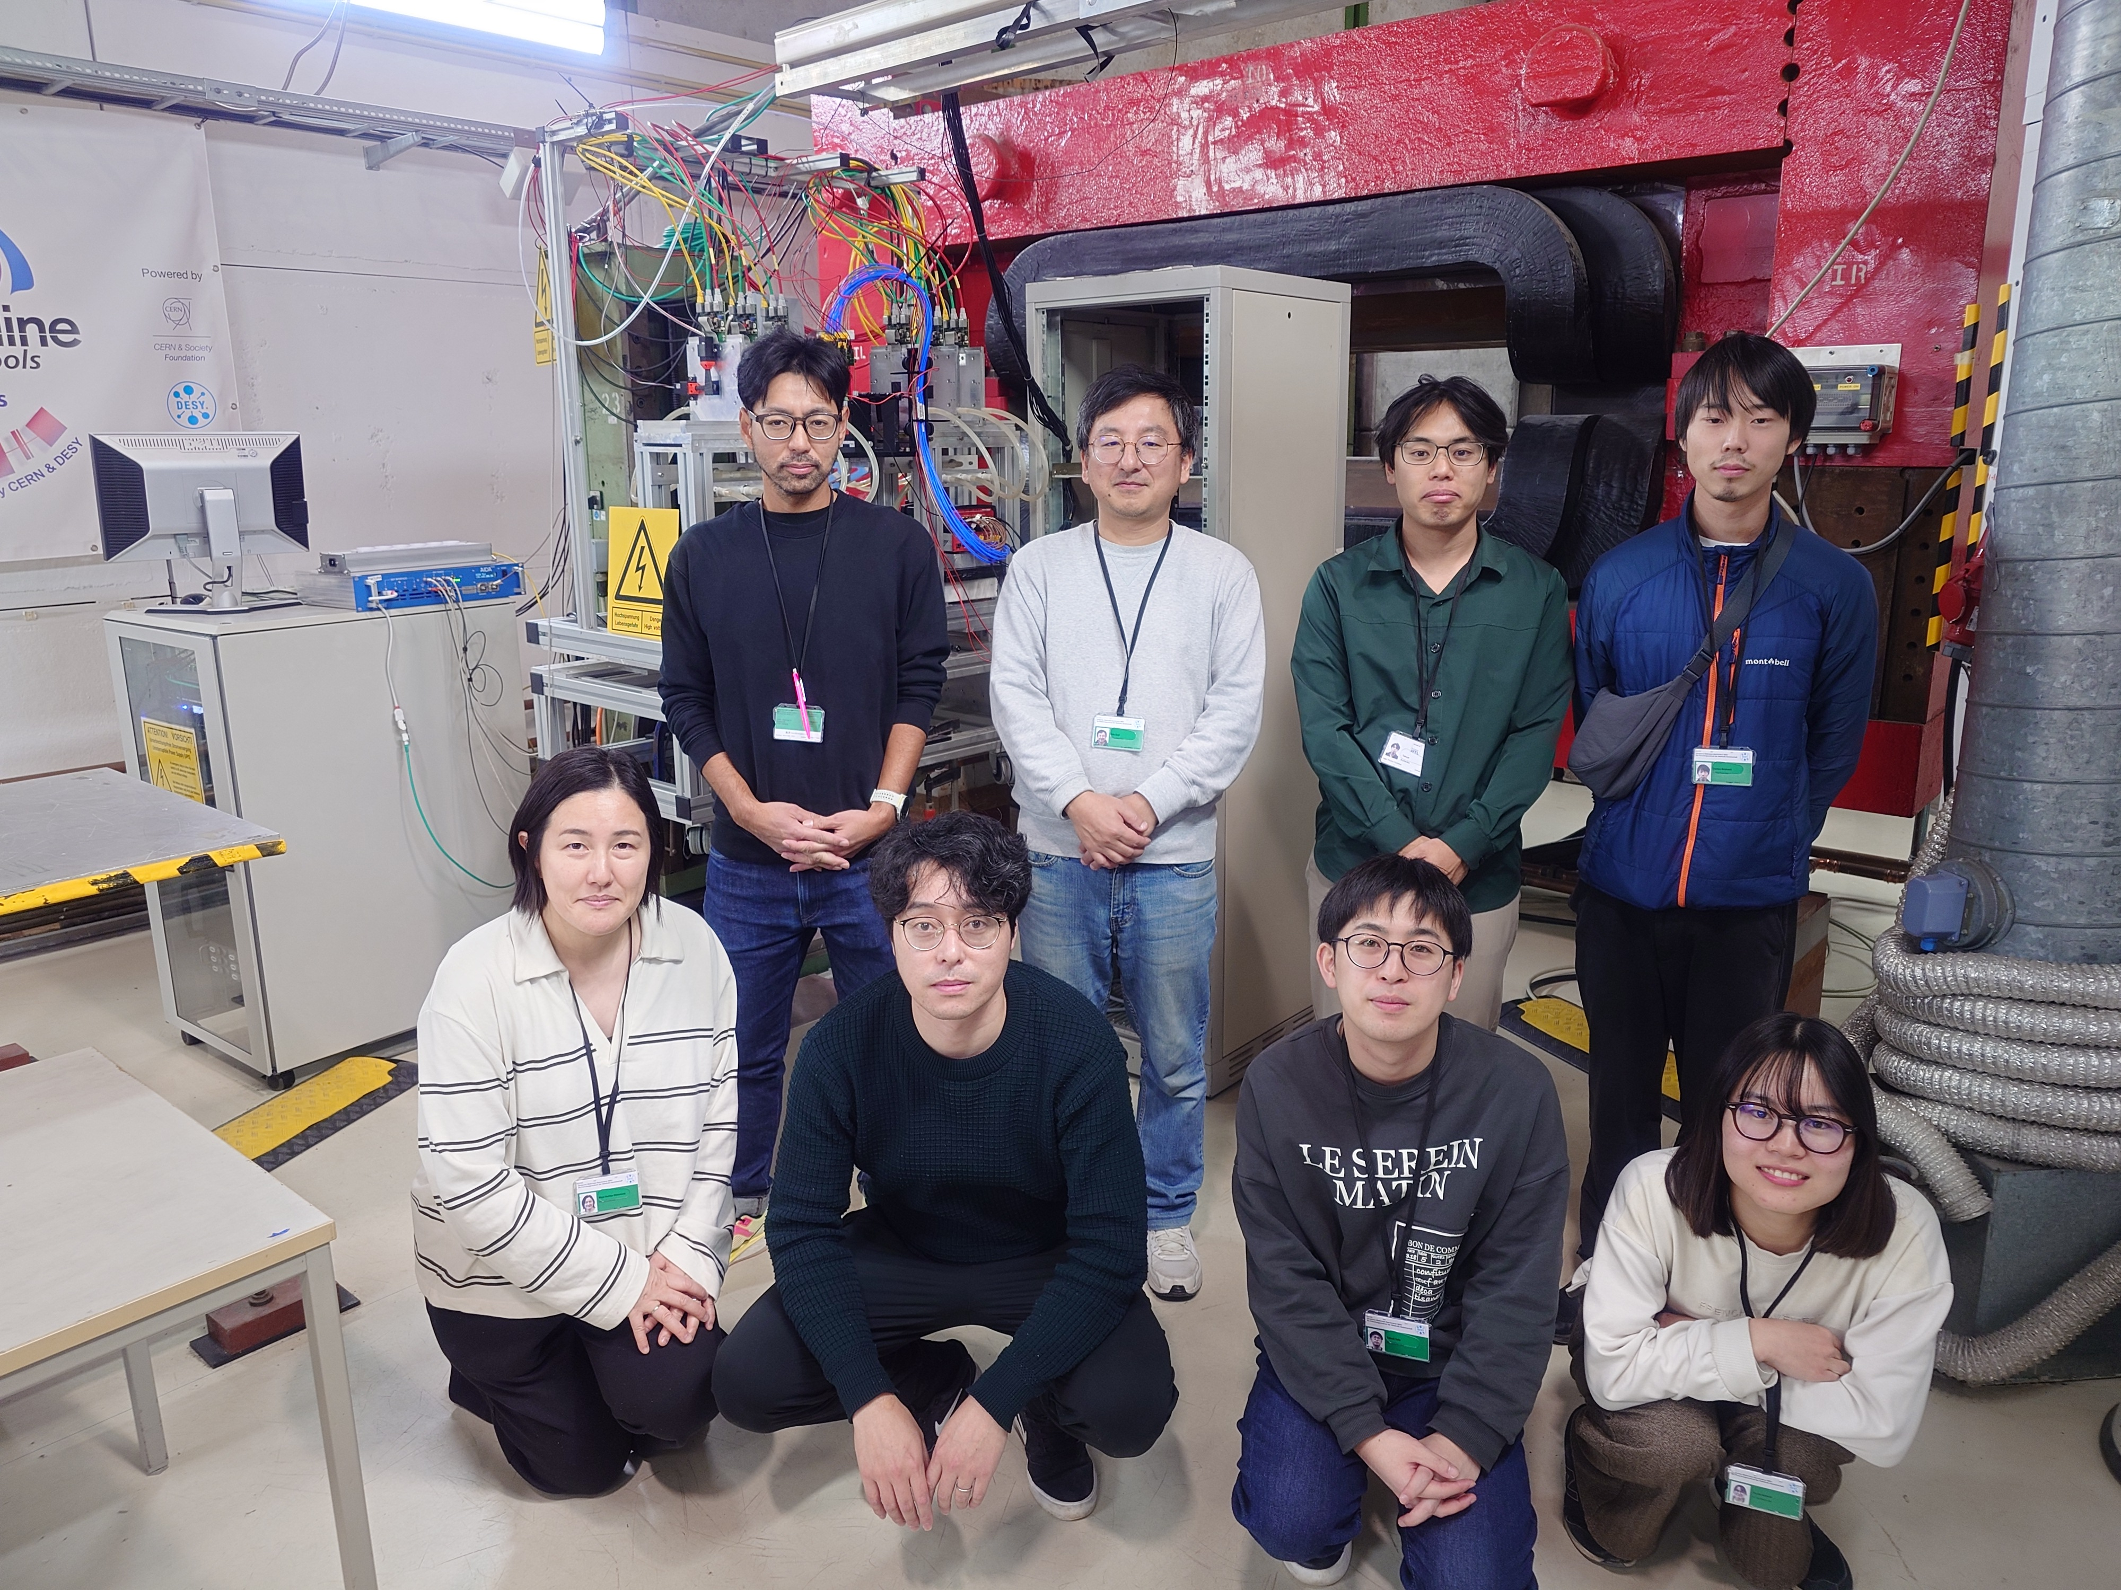
DESY Beam-Test Campaign
Schedule:
Pre-commissioning: Dec. 1st to 7th
Commissioning: Dec. 8th to 14th
Beam-Time: Dec. 15th to 21st
Pre-commissioning
Commissioning
Beam-Time

Slide 3
Setup for Strip-Type AC-LGAD
EUDRBs
Telescope DAQ PC
DUT DAQ PC
DIGITIZER
DIGITIZER
BUSY
AC-LGAD
TRIGGER
Scintillator
AC-LGAD
Scintillator
AC-LGAD
Scintillator
COINCIDENCE
TLU
TRIGGER

Slide 4
Setup for Pixel-Type AC-LGAD
EUDRBs
Telescope DAQ PC
DUT DAQ PC
DIGITIZER
DIGITIZER
BUSY
DC-LGAD
TRIGGER
Scintillator
AC-LGAD
Scintillator
AC-LGAD
Scintillator
COINCIDENCE
TLU
TRIGGER

Slide 5
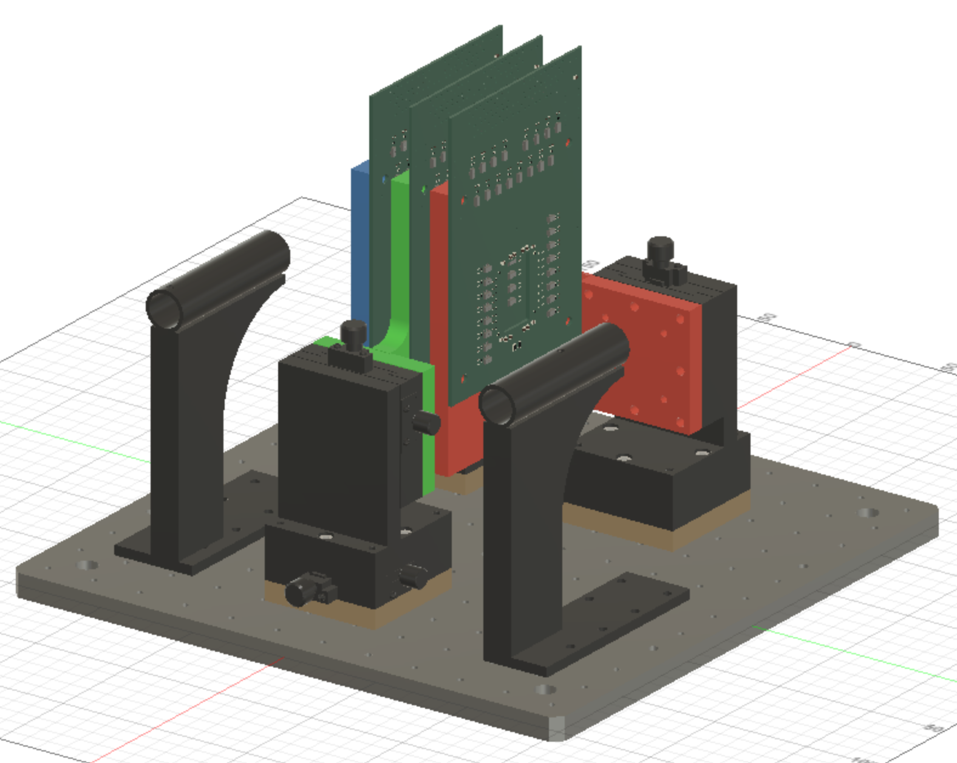
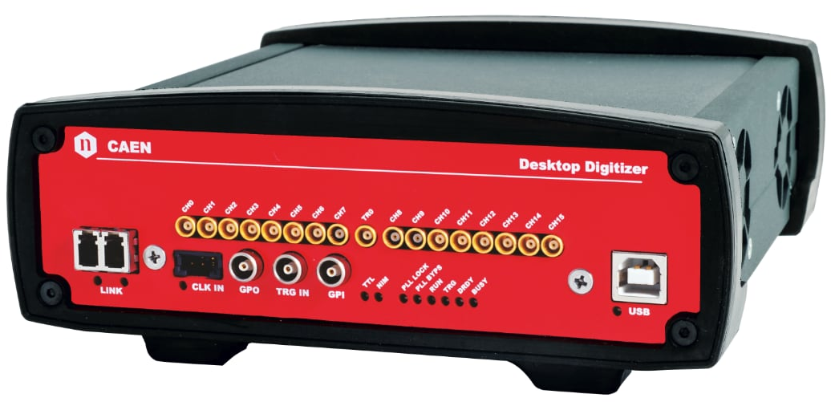
DUT Coordination
y (Row)
Sensor_2 (0,0,40mm)
Sensor_1 (0, 0, 20mm)
Sensor_0 (0, 0, 0)
DT5742
16ch 500MHz 5GS/s
X 2
x (Col)

Slide 6
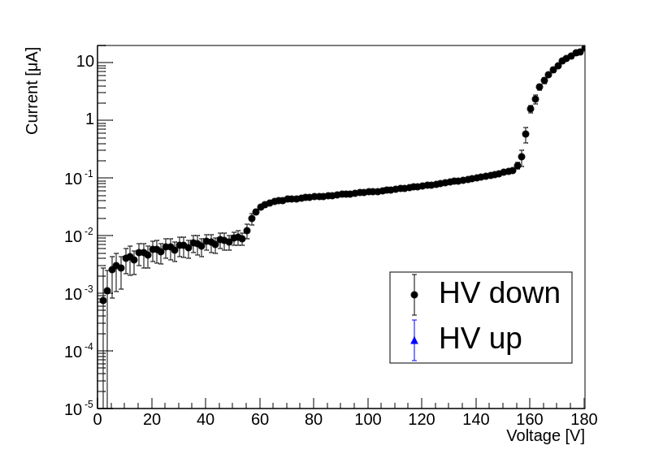
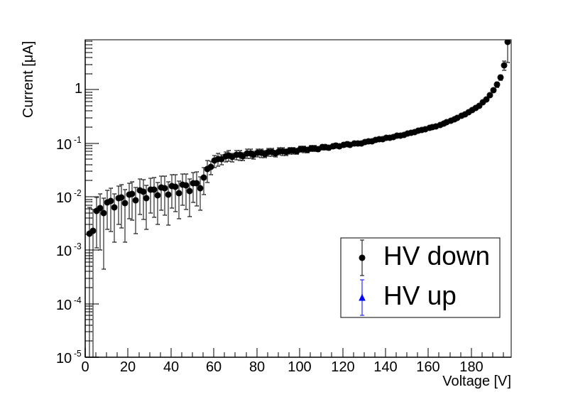
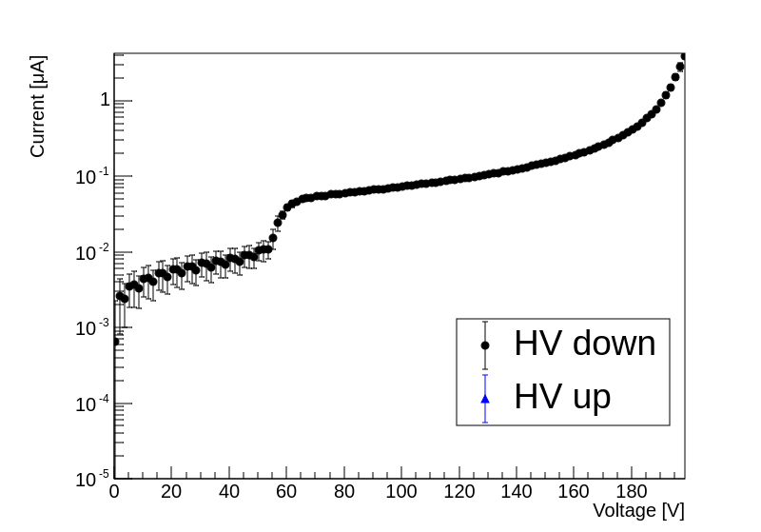
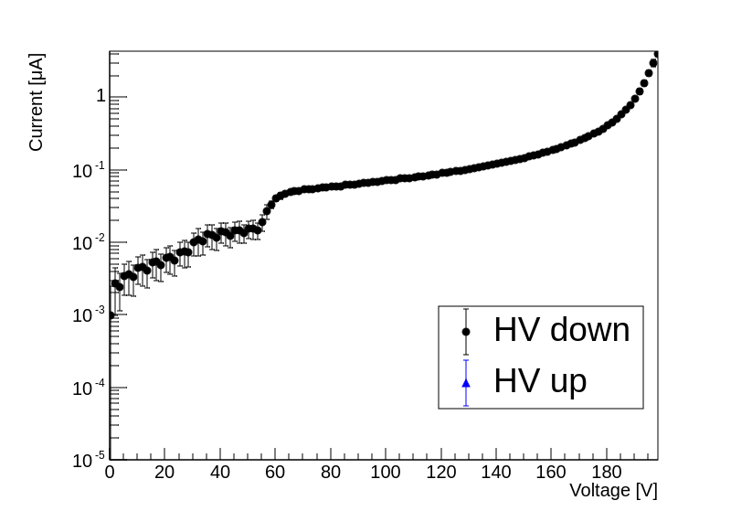
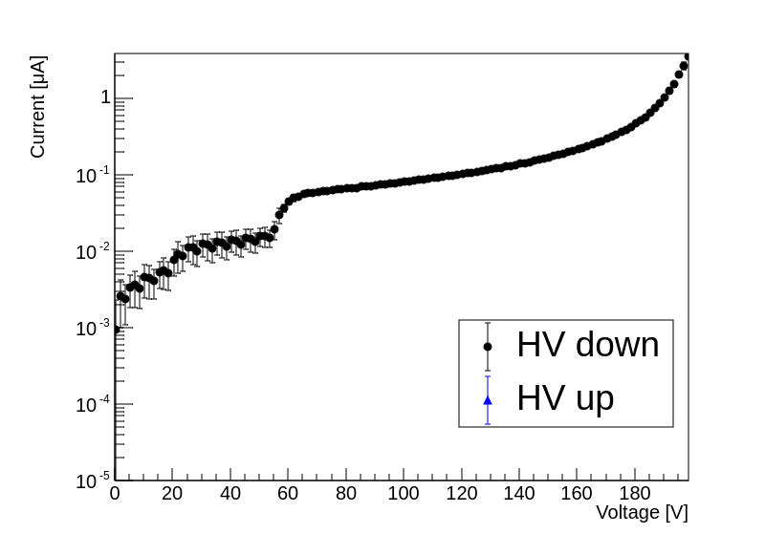
Baseline Strip Sensors
Five sensors have been bonded
Classified by voltage value at which leak current reaches 1μA
4 Class-S (1μA @ BV>=190V)
1 Class-C (1μA @ 160<BV<170V)
Class-C
Class-S
Class-S
Class-S
Class-S

Slide 7
Setup for Resolution Measurement Channel Mapping (Pattern-2)
DAQ00
DAQ01
CH0
CH7
TR0
CH8
CH15
CH0
CH7
TR0
CH8
CH15
CH1
CH3
CH5
CH7
CH15
CH13
CH11
CH9
CH1
CH3
CH5
CH7
CH15
CH13
CH11
CH9
CH1
CH3
CH5
CH7
CH15
CH13
CH11
CH9
CH0
CH2
CH4
CH6
CH14
CH12
CH10
CH8
CH0
CH2
CH4
CH6
CH14
CH12
CH10
CH8
CH0
CH2
CH4
CH6
CH14
CH12
CH10
CH8
Sensor0 (Board#1)
Sensor1 (Board#4)
Sensor2 (Board#3)
col1
col0
col1
col0
col1
col0
Strip0-33 (DAQ1-CH4)
Strip1-33 (DAQ0-CH6)
Strip0-33 (DAQ1-CH9)
Strip1-33 (DAQ0-CH11)
Strip0-33 (DAQ1-CH14)
Strip0-33 (DAQ0-CH1)
Strip0-32 (DAQ1-CH3)
Strip1-32 (DAQ0-CH5)
Strip0-32 (DAQ1-CH8)
Strip1-32 (DAQ0-CH10)
Strip0-32 (DAQ1-CH13)
Strip1-32 (DAQ0-CH15)
Strip0-31 (DAQ1-CH2)
Strip1-31 (DAQ0-CH4)
Strip0-31 (DAQ1-CH7)
Strip1-31 (DAQ0-CH9)
Strip0-31 (DAQ1-CH12)
Strip1-31 (DAQ0-CH14)
Strip0-30 (DAQ1-CH1)
Strip1-30 (DAQ0-CH3)
Strip0-30 (DAQ1-CH6)
Strip1-30 (DAQ0-CH8)
Strip0-30 (DAQ1-CH11)
Strip1-30 (DAQ0-CH13)
Strip0-29 (DAQ1-CH0)
Strip1-29 (DAQ0-CH2)
Strip0-29 (DAQ1-CH5)
Strip1-29 (DAQ0-CH7)
Strip0-29 (DAQ1-CH10)
Strip1-29 (DAQ0-CH12)

Slide 8
Setup for Resolution Measurement Channel Mapping (Pattern-3)
DAQ00
DAQ01
CH0
CH7
TR0
CH8
CH15
CH0
CH7
TR0
CH8
CH15
CH1
CH3
CH5
CH7
CH15
CH13
CH11
CH9
CH1
CH3
CH5
CH7
CH15
CH13
CH11
CH9
CH0
CH2
CH4
CH6
CH14
CH12
CH10
CH8
CH0
CH2
CH4
CH6
CH14
CH12
CH10
CH8
Sensor0 (Board#1)
Sensor2 (Board#3)
Strip0-35 (DAQ0-CH8)
Strip1-35 (DAQ1-CH7)
Strip0-34 (DAQ0-CH7)
Strip0-34 (DAQ0-CH15)
Strip1-34 (DAQ1-CH6)
Strip1-34 (DAQ1-CH14)
Strip0-33 (DAQ0-CH6)
Strip0-33 (DAQ0-CH14)
Strip1-33 (DAQ1-CH5)
Strip1-33 (DAQ1-CH13)
Strip0-32 (DAQ0-CH5)
Strip0-32 (DAQ0-CH13)
Strip1-32 (DAQ1-CH4)
Strip1-32 (DAQ1-CH12)
Strip0-31 (DAQ0-CH4)
Strip0-31 (DAQ0-CH12)
Strip1-31 (DAQ1-CH3)
Strip1-31 (DAQ1-CH11)
Strip0-30 (DAQ0-CH3)
Strip0-30 (DAQ0-CH11)
Strip1-30 (DAQ1-CH2)
Strip1-30 (DAQ1-CH10)
Strip0-29 (DAQ0-CH2)
Strip0-29 (DAQ0-CH10)
Strip1-29 (DAQ1-CH1)
Strip1-29 (DAQ1-CH9)
Strip0-28 (DAQ0-CH1)
Strip0-28 (DAQ0-CH9)
Strip1-28 (DAQ1-CH0)
Strip1-28 (DAQ1-CH8)

Slide 9
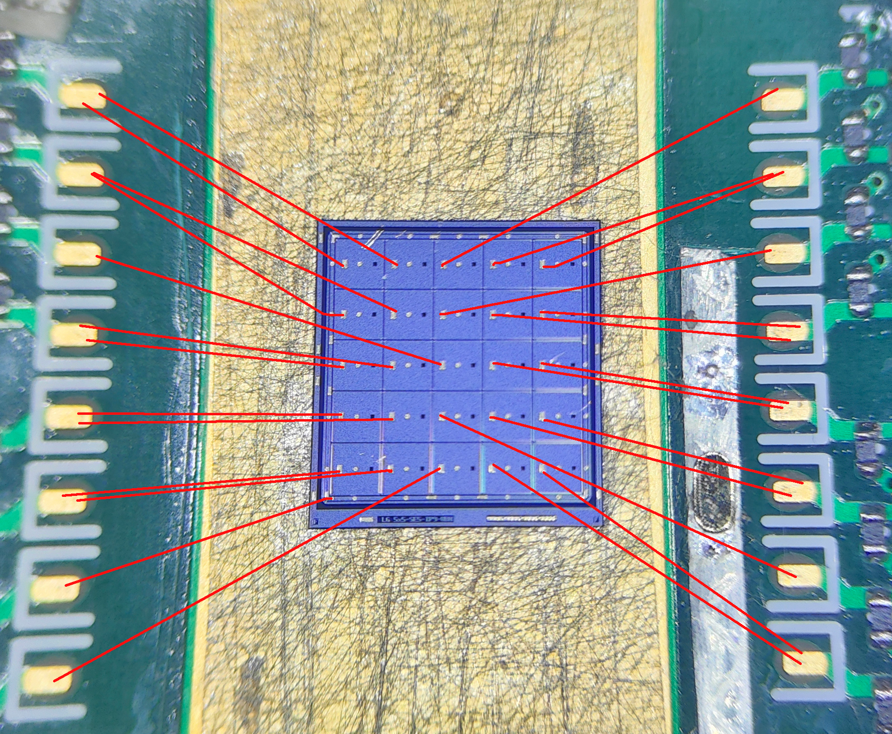
DC-LGAD

Slide 10
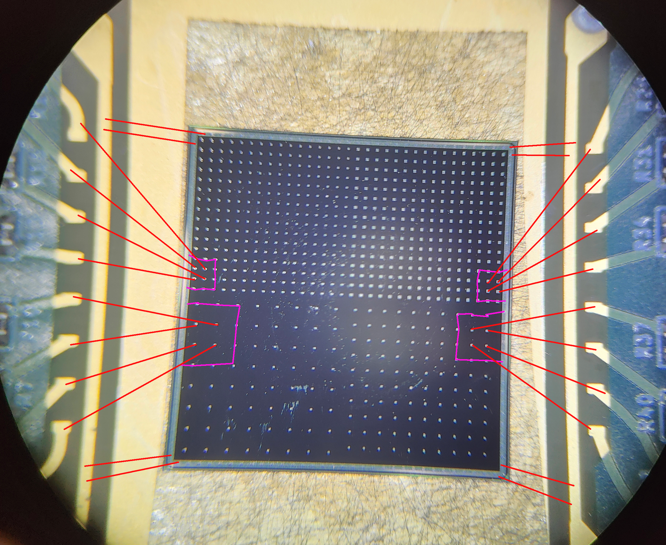
AC-LGAD

Slide 11
Setup for Resolution Measurement Channel Mapping (Pixel-Setup)
DAQ00
DAQ01
CH0
CH7
TR0
CH8
CH15
CH0
CH7
TR0
CH8
CH15
Trigger (DAQ0-CH0)
Trigger (DAQ1-CH15)
DB-CH7 (DAQ0-CH6)
Strip0-15 (DAQ1-CH5)
DB-CH7 (DAQ0-CH11)
Strip0-15 (DAQ1-CH9)
BD-CH7 (DAQ0-CH15)
BD-CH15 (DAQ1-CH13)
DB-CH6 (DAQ0-CH5)
Strip0-14 (DAQ1-CH4)
DB-CH6 (DAQ0-CH10)
Strip0-14 (DAQ1-CH8)
BD-CH6 (DAQ0-CH14)
BD-CH14 (DAQ1-CH12)
DB-CH5 (DAQ0-CH4)
Strip0-13 (DAQ1-CH3)
DB-CH5(DAQ0-CH9)
Strip0-13 (DAQ1-CH7)
BD-CH5 (DAQ0-CH13)
BD-CH13 (DAQ1-CH11)
DB-CH4 (DAQ0-CH3)
Strip0-12 (DAQ1-CH2)
DB-CH4 (DAQ0-CH8)
Strip0-12 (DAQ1-CH6)
BD-CH4 (DAQ0-CH12)
BD-CH12 (DAQ1-CH10)
DB-CH3 (DAQ0-CH2)
Strip0-11 (DAQ1-CH1)
DB-CH2 (DAQ0-CH1)
Strip0-10 (DAQ1-CH0)
DB-CH9 (DAQ0-CH7)
Strip0-8 (DAQ1-CH14)

Slide 12
Statistics of Test-Beam @ DESY 2025
Statistics for Strip (Triggered Event)
Nominal HV Run
5.6 GeV
3 Class-S Sensors: 10ch/10ch/10ch (Pattern-2)
All 185V: ~2x10⁶
HV Scan Run
5.6 GeV
3 Class-S Sensors: 10ch/10ch/10ch (Pattern-2)
Side 185V + Middle 175V/160V/150V: ~2x10⁶ each
Positioning Measurement Run
5.6 GeV
2 Class-S Sensors: 15ch/15ch (Pattern-3)
185V: ~2x10⁶
Class-C Sensor Run
5.6 GeV
3 Class-S Sensors: 10ch/10ch/10ch (Pattern-2)
160V: ~2x10⁶
Low Energy Run
3.6 GeV
3 Class-S Sensors: 10ch/10ch/10ch (Pattern-2)
All 185V: ~12 x10⁶
Low Energy HV 200V Run
3.6 GeV
3 Class-S Sensors: 10ch/10ch/10ch (Pattern-2)
All 200V: ~12 x10⁶
Statistics for Pixel (Triggered Event)
Small Pixel Nominal HV-1 Run
5.6 GeV
Small-Pixel: 20um/30um
HV: 110V/150V ~6x10⁶
Small Pixel Nominal HV-2 Run
5.6 GeV
Small-Pixel: 20um/30um
HV: 100V/130V ~6x10⁶
Big Pixel Nominal HV-1 Run
5.6 GeV
Small-Pixel: 20um/30um
HV: 100V/160V ~6x10⁶
Big Pixel Nominal HV-2 Run
5.6 GeV
Small-Pixel: 20um/30um
HV: 80V/140V ~6x10⁶
+ADC Calibration Run
Iinject Pulse: 10/20/30/40/50/60/70/80/90/100/150/200/250/300mV
Into all channels

Slide 13
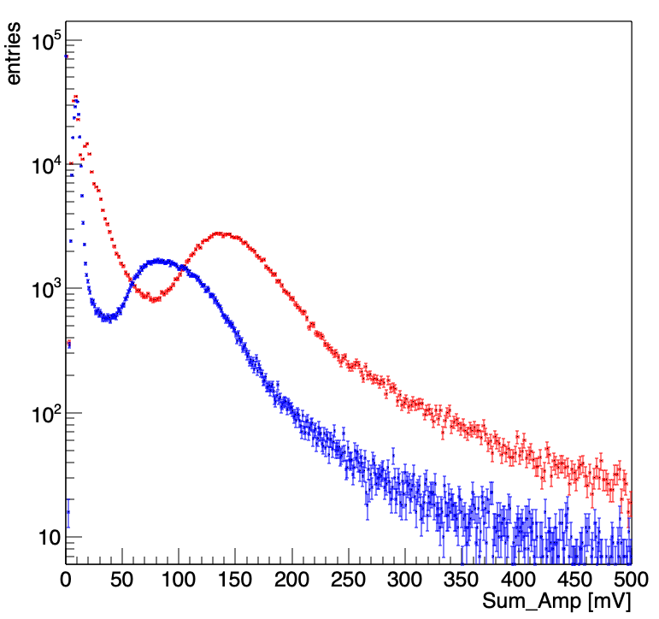
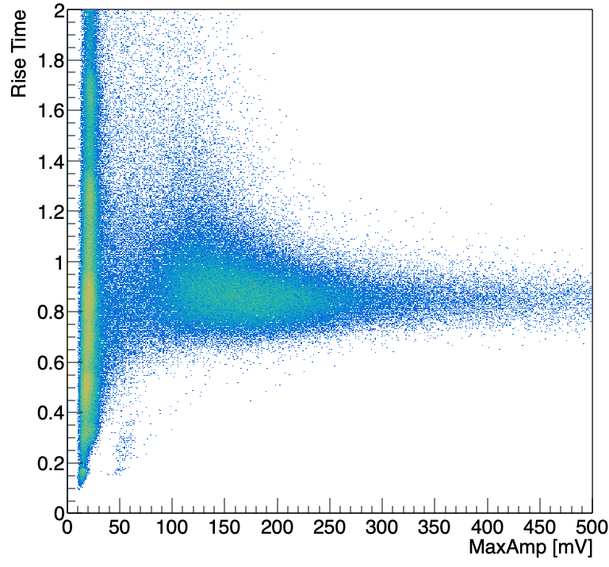
Ongoing DUT Analysis
Maximum Strip Amplitude
Sum Amplitude
MPV (Max-STrip): 80~90mV
Rise-Time (10%-90%)~850 ps
Due to BW (500MHz) Limitation?

Slide 14
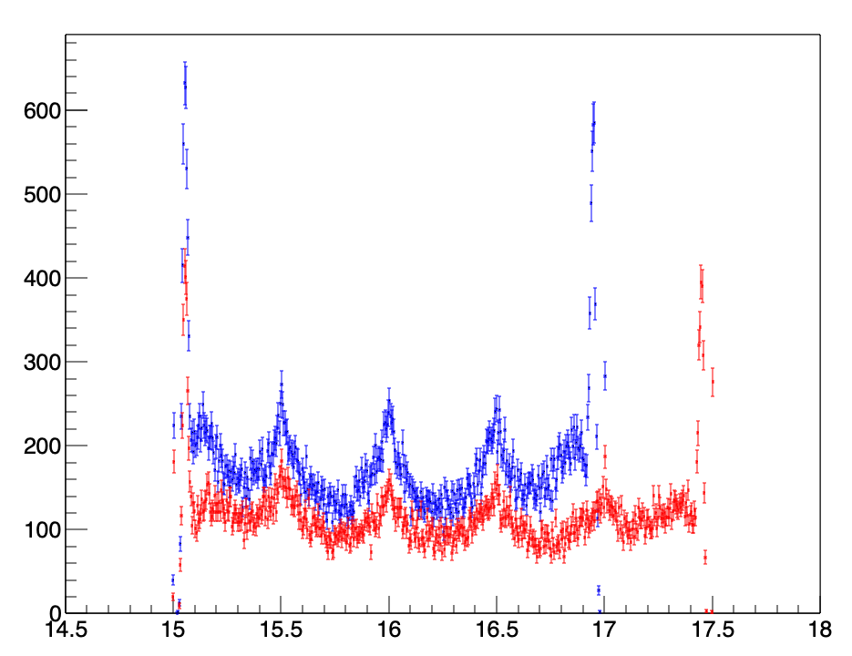
Ongoing DUT Analysis
Col0
Col1
Weighted Position-Row [mm]

Slide 15
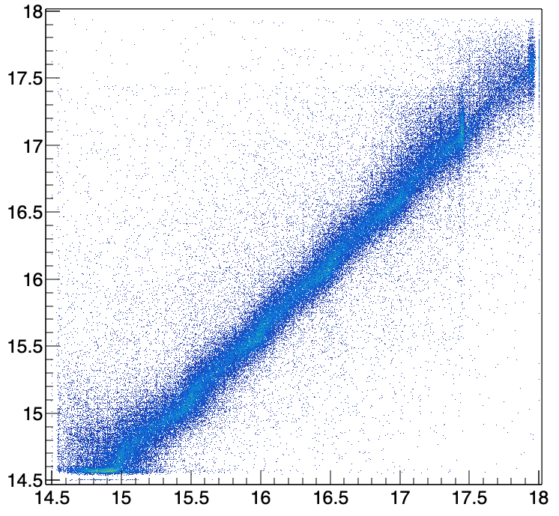
Ongoing DUT Analysis
Weighted Position-Row Sensor1 [mm]
Weighted Position-Row Sensor0 [mm]

Slide 16
Backup

