Slide 1
BHCal Electronics
Eric J. Mannel
January 16, 2026

Slide 2
Numerology I
32 BHCal Sectors
  29 unmodified
  3 modified for the chimney
Tiles (channels) per sector :
  Full sectors: 24x10 = 240
  Chimney Sectors: 21x10 = 210
  Total tiles: 240x29 + 210x3 = 7590
Caloroc Chips
  36 channels per chip
  8 Chips per sector (288 channels)
  Minimum chips required: 32 Sectors x 8 chips = 256
Front End Electronics Boards (FEBs)
  4 CaloRoc chips per FEB
  2 FEBs per sector: 256 channels total, 240 channels required per Sector
  64 FEBs (2 per sector) + spares

Slide 3
Numerology II
LED Monitoring/Calibration/Testing
  240 fibers (1 per tile)
  2 LED driver boards per sector assuming 1 per ½ sector
Temperature Monitoring
  32 boards, 1 board per sector
  ? Channels per sector
Power
  LV for the Caloroc Boards, 64 Channels
  Bias for the SiPMs, 64 channels
  LV for LED Boards and Temperature read out, 96 channels?
Mechanics:
  Electronics Boxes
    1 FEB per box
    1 LED Driver board per box
    2 boxes per sector
    64 total boxes
  1 Temp box per sector, 32 boxes
  Connection interfaces as needed- Power, Bias, Fiber, etc.

Slide 4
Block Diagram for Full Sector
240 Tiles (48 sPHENIX towers 5 tiles/tower)
120 fibers
120 Coax connection to SiPMs
?? Channels
120 fibers
120 Coax connection to SiPMs
LED DB
(120 Channels)
FEB
(144 Channels)
Temperature
Readout
System
LED DB
(120 Channels)
FEB
(144 Channels)
Trigger
Trigger
LV
Bias
Data
LV
Bias
Data
LV
5V?
SC
LV
SC
LV
Data
SC

Slide 5
LED Driver Board
sPHENIX oHCal
  5 tiles ganged together
  Each tile in a tower was illuminated with a different LED
  Resulted in 5 LED “salt shakers” per ½ sector
  24 Fibers per “salt shaker”
  1 LED Driver Board/5 shakers per ½ sector
  5 PIN diodes for monitoring, readout through IB board
  Power, trigger provided by IB board
EPIC
  Individual tile readout
  FEB provides trigger that is fanned out to LED Driver Board
  Options
    One LED and Shaker can per ½ sector. Requires new fiber bundles
    Reuse sPHENIX fibers and 5 shaker heads
    Use extra caloroc ADC channel(s) for monitoring PIN diode
X 24 fibers
+6V LV
X5
Trigger x5
X 24 fibers
Pin Diode x 5
LV
X 120 fibers
Trigger x5
Pin Diode

Slide 6
Electronics Box
2 Boxes per Sector
  1 FEB Board
  1 LED Board
  Interface board(s) for LV, Bias and Data/SC connections
  Opening(s) for SiPM cables and LED fibers to the tiles
  What might a box look like ?
Fiber opening
SiPM cable opening
Optical Fibers
SiPM Cables
LED Board
FEB
Data Fibers
Slow Control
LV and Bias
Interconnect board

Slide 7
Items that are BHCal Responsibility (I)
SiPM (provided by another group?)
SiPM PCB (8K)
SiPM board assemble (8K)
SiPM Signal cable (8K)
SiPM mounting block (1K, assume ~10% loss in R&R)
LED Driver boards, 2 per sector, 64 required
  New design, layout and fabrication
  New cans, or recover from sPHENIX boards? 320 required
LED Fiber Assemblies:
  Assume that the sPHENIX bundles are used, 320 required
  10% spares?

Slide 8
Items that are BHCal Responsibility (II)
Sector Covers
  Reuse what we can from sPHENIX (192 required)
  Need replacements for damaged covers (10%), 20
Hardware, TBD
  Screws, bolts & nuts, Tape…
Temperature monitoring: system design, fabrication, installation, cables
Test/Validation Stand
  Rack
  Power supplies
  Cables
  Scopes

Slide 9
What’s Not BHCal Responsibilty
SiPMs
CaloROC boards
Optical Fibers for CaloROC boards
Power Cables for CaloROC boards
Cable trays and strain relief for fiber optics and power cables
Mechanical mounting hardware for the sectors

Slide 10
Costing- Very Preliminary
8000 RF Cables: $28K (quote)
8000 PCB assemblies (Turnkey): $89K based on sPHENIX iHCal order 2021 where BNL provided SiPMs and RF Cables.
Electronics Boxes: $2K (catalog price)
Hardware: $1K (estimate)
Replacement Covers: $5K material (estimate)
Fiber cans: $6K (estimate)
70 LED Driver Boards (Turnkey excluding fiber cans): $21K (Based on sPHENIX order 2020)
Engineering time: 80 hours- LED Boards, SiPM Boards, temperature monitoring
Machining time: 40 hours
Replacement Fiber Assemblies: M&S TBD
Temperature Monitoring System: M&S TBD

Slide 11
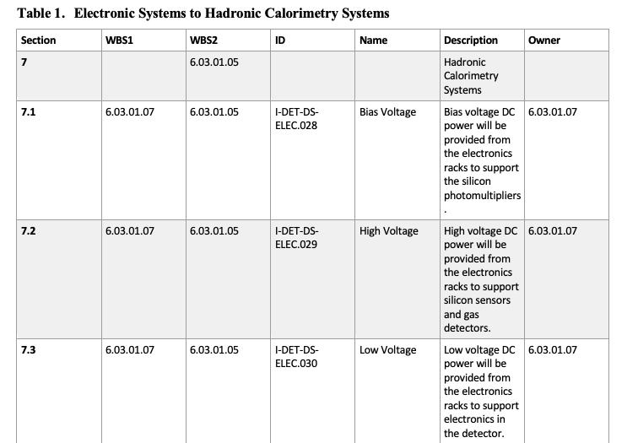
ICD’s
The last ICD that I saw was rather sparse:
Need to work with project management to flesh out the ICDs to make sure all the interfaces are accounted for.

Slide 12
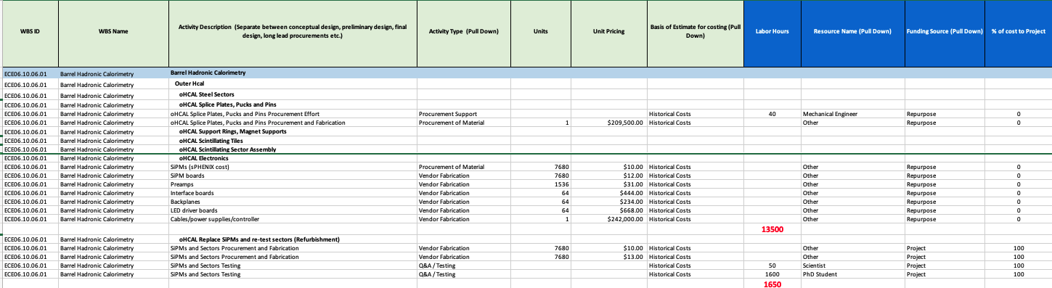
P6
Last P6 that I saw was also rather sparse (From Elke in June 2025)
Need to work with project management to get a more realistic draft P6 for BHCal refurbishment

Slide 13
Summary
Current cost estimate for the BHCal refurbishment is ~$175K
  Only account for M&S, no engineering time, estimate is ~$160K
  Some estimates are based on past efforts 10+ years ago
  Need a better better understanding of:
    LED system
    Temperature monitoring
  What has been missed?
BHCal Leadership needs to work with EPIC project management to:
  Review and update P6 for BHCaL
  Review and update ICDs FOR BHCAL
  Review and update the WBS FOR BHCal
There are a number of links on the electronics and DAQ WG Indico page that might be of interest: https://indico.bnl.gov/event/31255/

