Slide 1
Mitigating Systematics in Rubin LSST Weak Lensing Galaxy Samples using Wide Field Spectroscopy
Principal Investigator(s): Joseph DeRose
List of the proposal participants and their organizations if other than NPP:
ECA eligibility: Yes
Proposal term from: 10/26 to: 10/28
Annual funding: FY27 $250k FY28 $250k

Slide 2
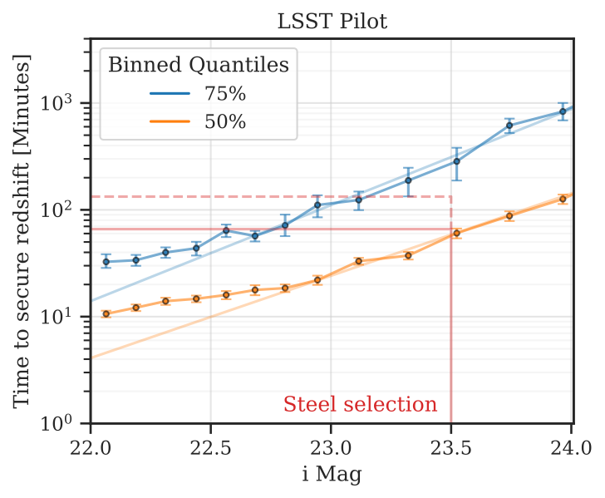
Description of the LDRD Proposal
Redshift distribution of galaxies used for weak lensing studies must be known precisely for accurate cosmological interpretation.
  <1% level biases in estimation of these distributions will severely bias dark energy constraints from LSST. Only proven way to achieve this accuracy is through direct spectroscopy.
Need to average over many galaxies. Sample optimization done during planning of LSST (Gold sample) prioritized faint, extremely numerous galaxies.
  <75% of these galaxies can be directly calibrated via spectroscopy.
  Conversely, can cherry picking galaxies that are easy to redshift and still achieve required densities. Catch is that selection can only depend on properties observed by Rubin. Main question is how to do this and preserve high number density?

Slide 3
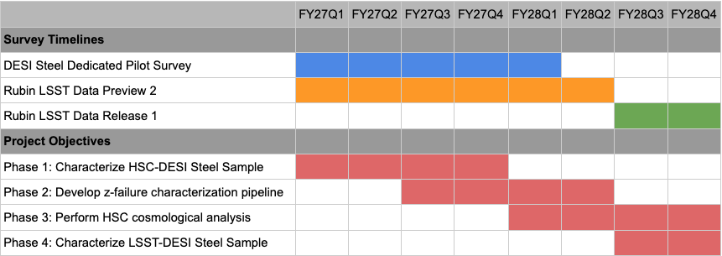
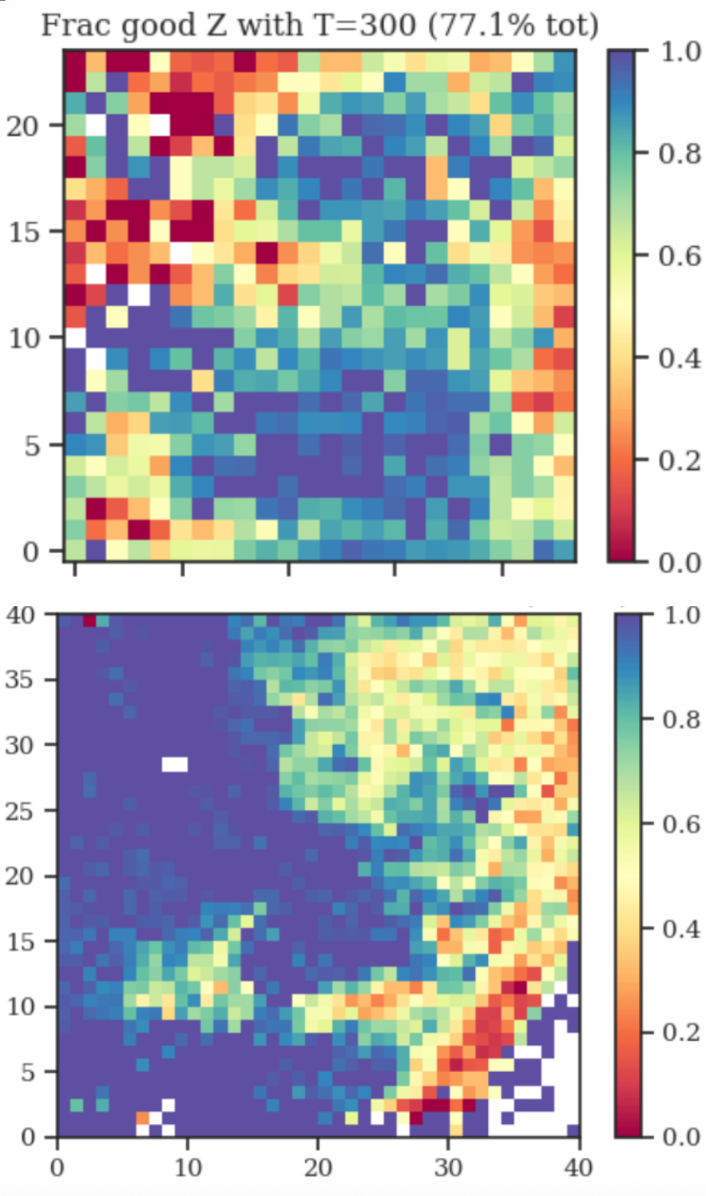
Deliverables & Timeline
I have been awarded 12 hours of dedicated DESI time to begin characterizing a Steel sample selected with existing Hyper Suprime Cam (HSC) data. This proposal is organized around exploiting this data, with the help of a postdoc who this proposal will fund, and is divided into four phases:
Characterize DESI spectroscopic success rates, i.e. the fraction of targeted galaxies for which we obtain a secure redshift, as a function of HSC photometry and DESI exposure time defining a selection boundary that results in a sample with >95% spectroscopic success rate. Use AI/ML techniques (potentially Foundation model).
Develop methodology to characterize small fraction of redshift failures using alternative methods to spectroscopy.
Use this new sample to reanalyze HSC weak lensing as a proof of concept for future Rubin analyses.
Apply the machinery developed on HSC data to newly available Rubin data once available in 2028.
Projected characterization
w/ dedicated
pilot survey
Current level of characterization

Slide 4
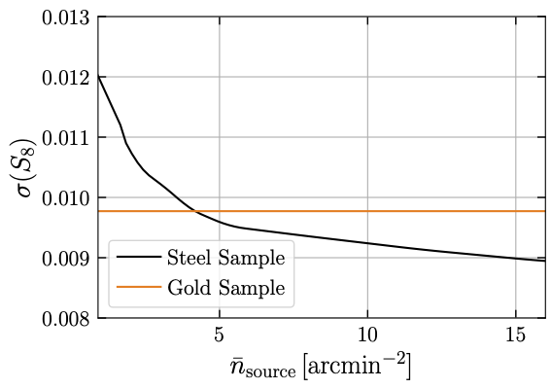
Intellectual Merit Summary
Redshift distribution uncertainties will be the dominant systematic for LSST weak lensing science. Current LSST plans for redshift calibration (Gold sample) are not tailored to the strengths of existing spectroscopic resources. Our proposed Steel sample explicitly accounts for these strengths, while delivering improved constraining power over Gold assuming realistic levels of systematic uncertainty.
This work:
  will significantly boost the constraining power of LSST analyses, mitigating the primary source of systematic error in weak lensing measurements of dark energy with LSST, and making the Steel sample the primary weak lensing sample in LSST.
  is a key step towards realizing synergies between spectroscopic (DESI) and photometric (LSST) galaxy surveys, which were prioritized by the P5 report (Section 4.2.3-4).
  will lay the groundwork for unlocking the constraining power of even denser galaxy samples by developing the methodology to constrain additional systematics beyond redshift errors. This will be the topic of my ECA.

Slide 5
Return on Investment or Potential Future Funding
  This LDRD will provide proof of concept studies for my ECA application (see later in this presentation).
  Significant AI/ML aspects of this work will develop expertise within BNL cosmology group that will increase future probability for AI/ML related DOE funding.
  Will get the BNL cosmology group involved in DESI-II, and eligible for DESI-II project funding for related work.
  Significant involvement in DESI-II will lead to potential for larger infrastructural involvement in Spec-S5, the next generation spectroscopic facility prioritized by P5. This involvement will bring in additional Spec-S5 related funding streams.

Slide 6
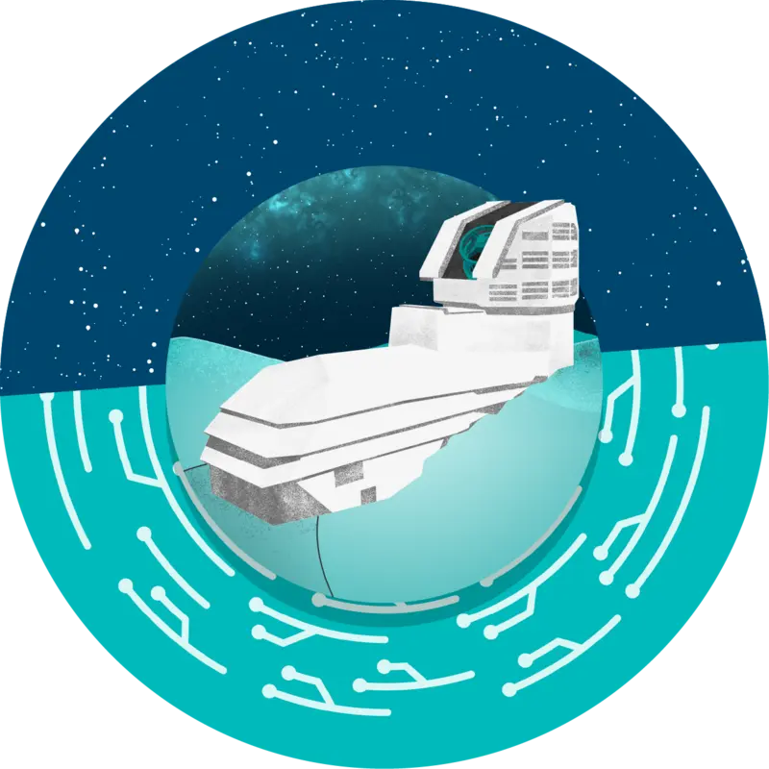
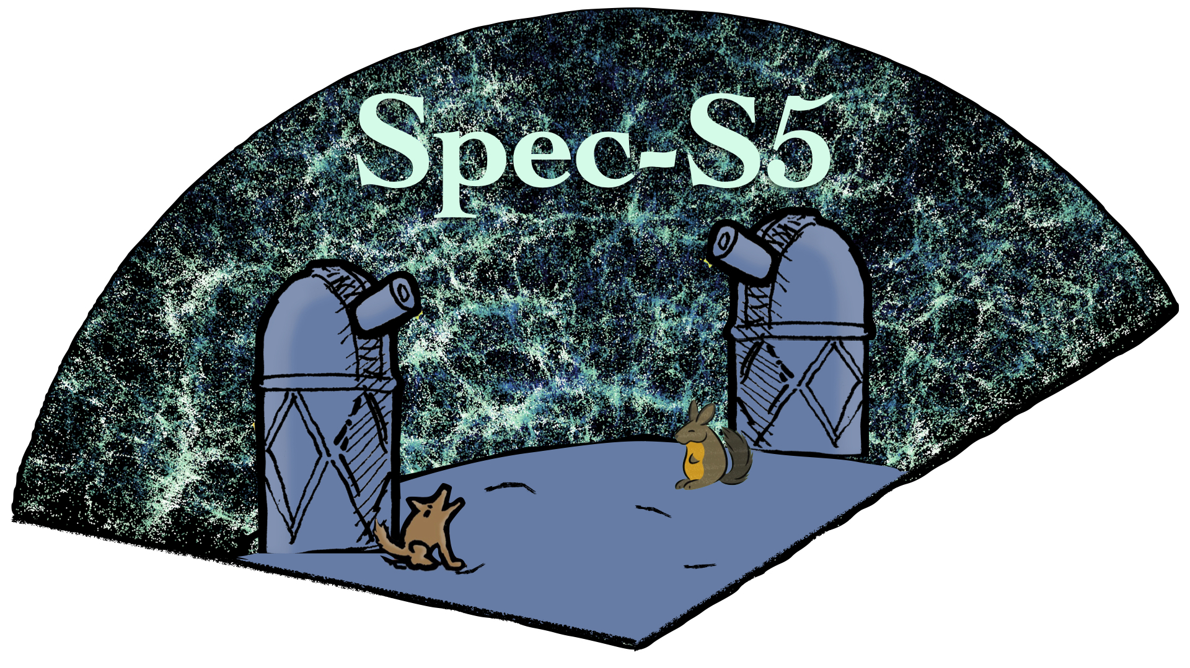
The Broader Impact on the Laboratory
This work is highly synergistic with BNL LSST shape measurement efforts. It will make BNL the lead laboratory on key infrastructural tasks in galaxy shape measurement and redshift estimation, but also provide high impact scientific studies allowing us to attract strong postdocs.
Will take advantage of new funding streams to develop an AI Foundation model for cosmology, which may be useful in defining the Steel sample selection in a high dimensional observable space.
This work is being integrated into DESI-II planning, and will give BNL a scientific point of leadership within DESI-II to go with potential instrumentation involvement and eventual bridge into involvement in Spec S5.

Slide 7
Names of Suggested BNL Reviewers
Paul O’Connor
Paul Stankus
Juan Estrada
Peter Denton

Slide 8
If ECA Eligible – How this LDRD Benefits Your Application
If successful, the sample developed by this proposal will be the primary lensing sample used in Rubin. Analyses of the first year of Rubin data using this sample should come out in 2029. PI intends to re-apply for the ECA in 2028 and 2029 to maximize number of chances, so this work is ideally timed with this.
Will also give PI a leadership role in DESI-II, which is slated to begin in 2029. Extensions of this work using DESI-II and LSST data will be the main topic of ECA proposal.
Will further boost PI’s stature within the LSST DESC and DESI collaborations.
Will result in four high profile publications which will be lead by PI and the postdoc funded through this work.

Slide 9
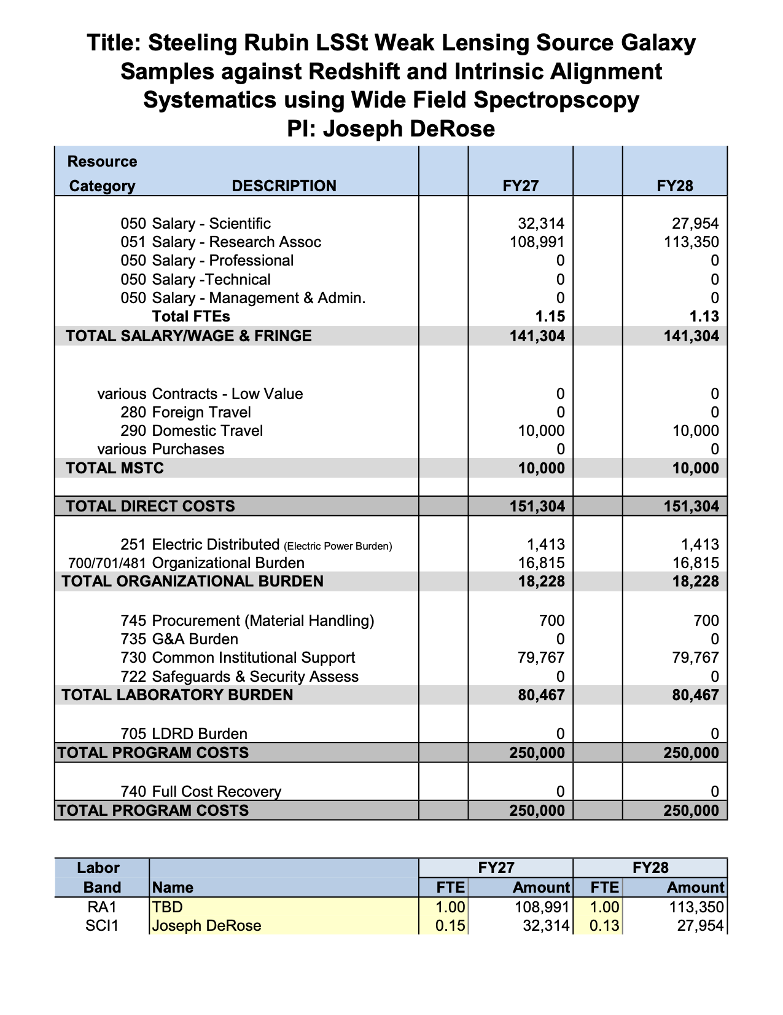
LDRD Funding Table from BOM

