Slide 1
FY27 NPP LDRD-B Proposal
Validating Next-Generation Tracking Technology by Enabling Test Beams at the Booster R-line
serving DOE Nuclear Physics and High Energy Physics detector test beam needs
PIs: Xiaodong Jiang (CAD), Abraham Tishelman-Charny (Physics)
Participants: Michael Sivertz (CAD), Michael Begel (Physics), Stefania Stucci (Physics),
Valerio Dao (SBU), Giacinto Piacquadio (SBU), Minori Fujimoto (SBU)
ECA eligibility: NA
Proposal term: 10/1/2026 - 9/30/2028
Annual funding: FY27 $250k, FY28 $250k.
2/5/2026

Slide 2
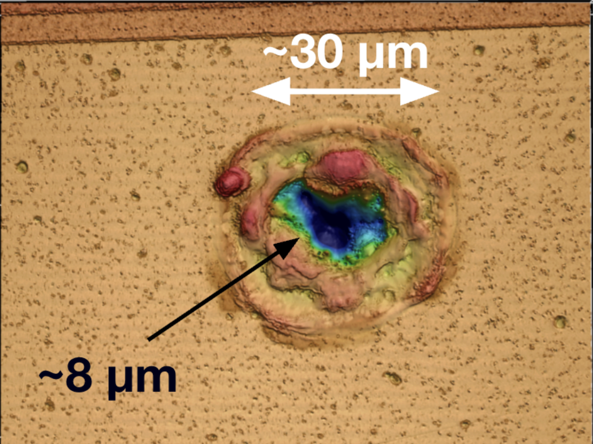
Description of the LDRD Proposal:
Iterate design and build Silicon Carbide Low Gain Avalanche Detectors (SiC-LGAD).
Build tracking-stations at the Booster R-line (NSRL), validate SiC-LGAD through beam tests.
Main Goals: through beam tests, investigate Single-Event-Burnout and mitigate risks of SiC-LGAD, enhance test beam capacity at NSRL to support future radiation tests.
SiC-LGAD state-of-the-art detector: wide bandgap semiconductor material, high thermal conductivity, low intrinsic noise levels and high breakdown voltages…
thin active layer, ultrafast 20-30 ps: position+time 4D-tracking for multi-collisions.
robust performance in high radiation fields, ideal for space mission, beam monitoring etc.
operate at room temperature: eliminate cooling systems, reduce material budgets.
Possible limitations on SiC-LGAD: Single-Event Burnouts inflict permanent fatalities. Craters like
This Work: the first investigation
of Single-Event-Burnout in SiC-LGAD
R&D approach: match beam tracks in real-time with failures on SiC-LGAD detectors.

Slide 3
Methods: enhance test beam capacity at Booster R-line to validate BNL’s SiC-LGAD detectors.
add four tracking stations over 1 m, 50 μm pitch in (x,y).
detectors under test (SiC-LGAD)
tracking station #1
#4
#3
#2
x
x
x
x
x
beam
σ_{x ,}σ_{y}: 50μm
match beam tracks in real-time to pinpoint failures on SiC-LGAD detectors
Booster R-line (NSRL) with high flux proton and heavy ion beams: verify new detector designs and benchmark performance (efficiency, resolution). optimize detectors/electronics under extreme operation conditions, assess radiation damages with high exposure.
Milestones and Deliverables:
FY27: build a prototype tracking telescope, covers ~cm², DAQ capacity 10 kHz.
FY28: complete four tracking stations, covers ~10 cm², DAQ capacity100s kHz.
Iterate design, build and test SiC-LGAD, publications on Single-Event-Burnout, and impacts on spatial/time resolution.
.
Personnel and Responsibilities:
CAD: engineering design, tracking stations, beam test and operations. 0.2 FTE scientist.
BNL Physics: SiC-LGAD detectors & readout, simulations and AI in tracking. 0.3FTE postdoc.
SBU Physics: tracking stations and software, detector calibration (in-kind contribution).
Procurements: material for tracking stations.

Slide 4
Intellectual Merit
Make the first SiC-LGAD spatial+time resolution measurement, as a function of radiation exposure. the first investigation of Single-Event-Burnout in SiC-LGAD.
Impact critical decisions on future detectors (EIC, HL-LHC, FCC etc) :
Define new, critical constraints when designing and operating SiC-LGAD and other devices at future high luminosity detectors.
Matching beam ion tracks in real-time to pinpoint failures on devices
Enable precision tests in many high radiation applications: space electronics, nuclear industry, beamline monitoring, high exposure medical therapy…
BNL leads in Nuclear and High Energy Physics
A local test beam for detectors is a tremendous boost to BNL capacity by providing an accessible testbed for innovative instrumentation and technology.
Position BNL as the leader of future particle tracking technology.
2028 FCC decision, 2028-2035 will be crucial R&D period

Slide 5
Returns on Investment
Return-I: a DOE supported detector test beam program at BNL
serving NP and HEP detector test needs (EIC ePIC, HL-LHC, FCC etc).
(M. Begel presented to Office-of-Science 8/8/2025, positive responses from NP&HEP Office)
Test beam facilities are critical for validating detectors and components.
Other facilities will have multi-year downtimes: FNAL, LANL, CERN, (DESY).
Next-generation detector designs (SiC-LGAD etc) urgently need testing to feedback into long term critical decisions in DOE projects. ePIC Collaboration stated: “a beam test facility at BNL would be a significant reduction of risk for ePIC”.
Return-II: a detector test beam will attract users world-wide to BNL.
NSRL will continue to operate during EIC construction (2026-2035).
Return-III: significant savings on future BNL operation costs with local test beams.
Return-IV: opens new market and bring new revenue to BNL
Precision high radiation tests at NSRL (user fee currently @$5k/hour)..
Potential Future Funding: state-of-art SiC-LGAD detector developments and applications (DOE Office-of-Science HEP, Energy Frontier, Advanced Tech R&D).

Slide 6
The Broader Impact on the Laboratory
Enhance Laboratory’s Core Capabilities: Accelerator and Detector Science and Technology. A local test beam facility for detectors is a tremendous boost to BNL capacities by providing an accessible testbed for innovative ideas and state-of-the-art detectors .
Position BNL as the leader in particle tracking technology (SiC-LGAD).
Training of the next-generation experts on particle detectors.
Serving DOE Nuclear Physics and High Energy Physics detector test beam needs (NSRL will be the only available hadron test beam facility in US for a long time)
Open new market and bring new revenue to BNL from precision high radiation tests at NSRL: space electronics, nuclear industry, high exposure medical therapy… (currently @$5k/hour, users include SpaceX, Blue Origin, Boeing, Defense Industry etc.)
Impact decision on National Security (Golden Dome) space radiation test facility (a.k.a. HEET@BNL)
Grow local semiconductor industry (SiC: critical for high-efficiency power conversion).
July,2025, Stony Brook University – onsemi partnership $20 million semiconductor R&D facility for SiC

Slide 7
Names of Suggested BNL Reviewers
Jin Huang (Physics)
Mary Bishai (Physics)
Haixin Huang (CAD)
Guang Yang (Discovery Directorate)

Slide 8
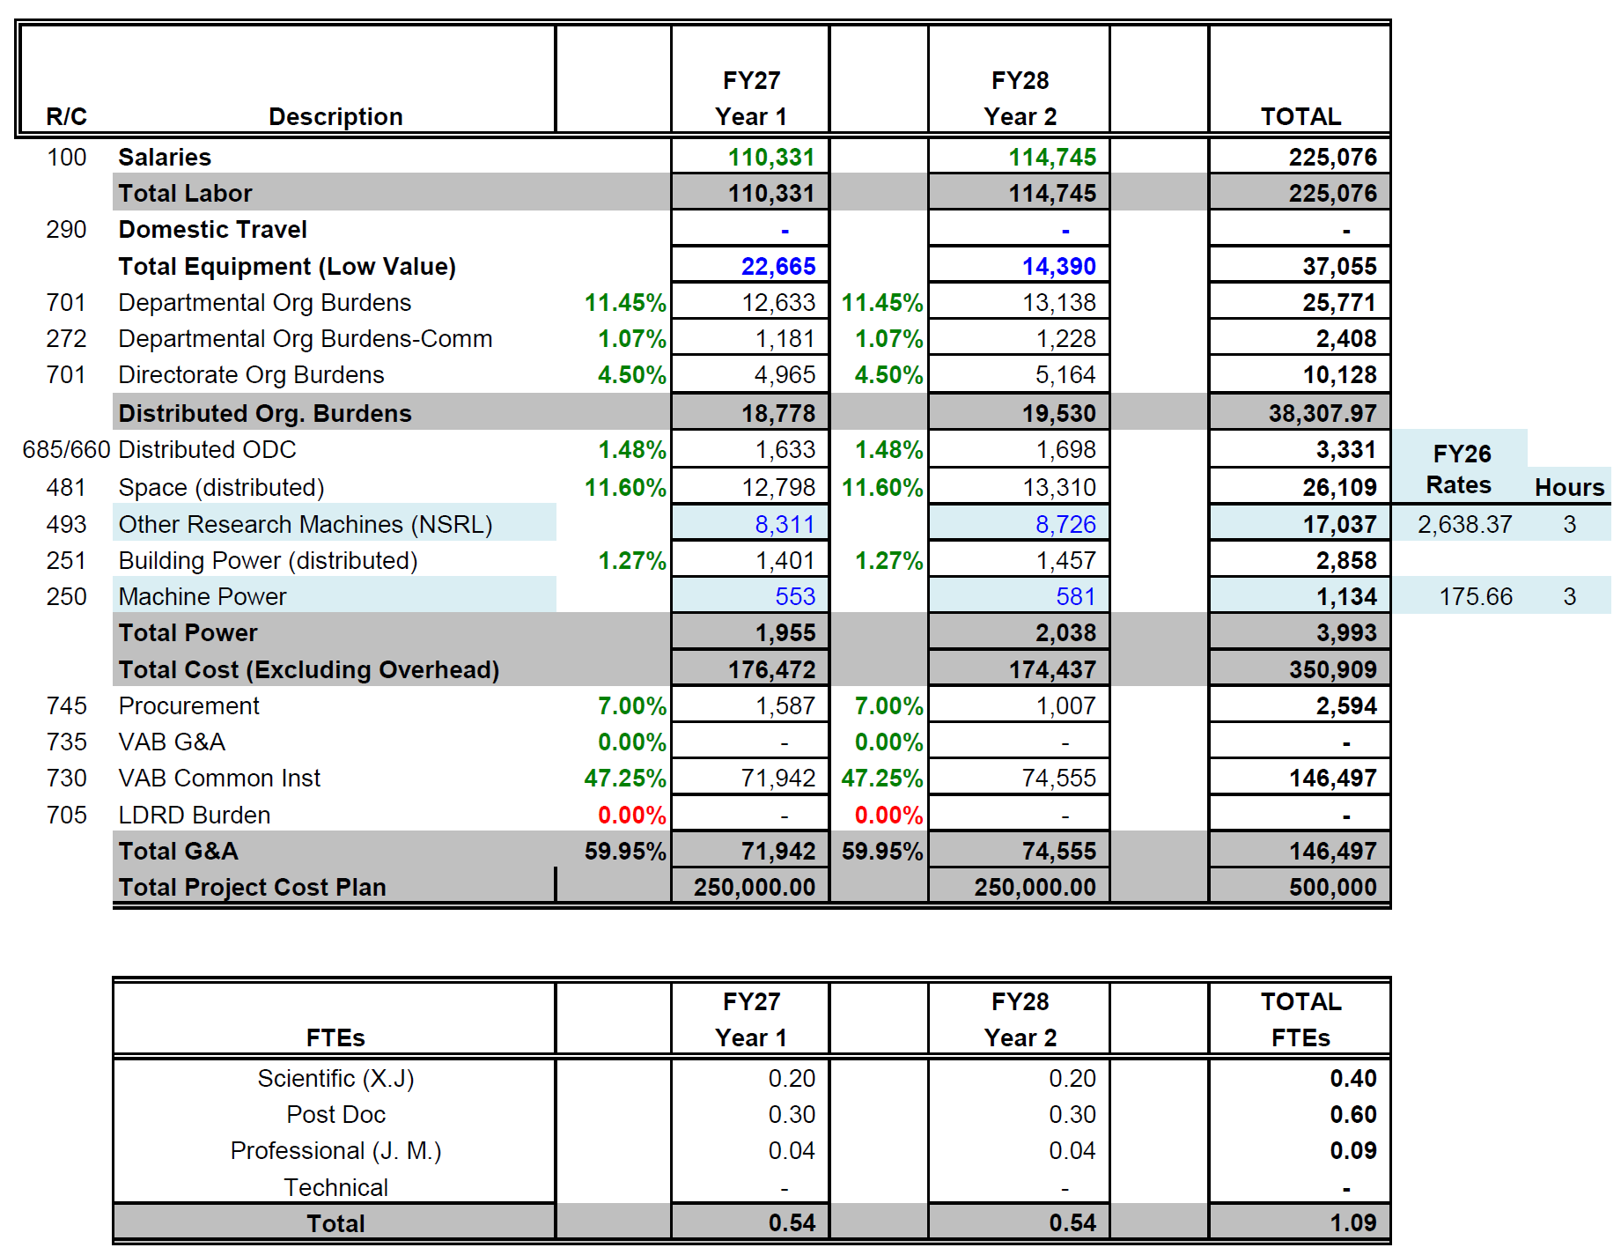
Funding Table FY27: $250k FY28: $250k
3 hr/yr NSRL test beam time
Labor/year:
0.2 scientist
0.3 postdoc
0.04 engineer

Slide 9
Summary
BNL’s next-generation SiC-LGAD tracking technology need to be validated through beam testing.
Make the first SiC-LGAD spatial and time resolution measurement as a function of radiation exposure. The first investigation of Single-Event-Burnout in SiC-LGAD. Matching beam ion tracks in real-time with failures on detector.
There’s an urgent need of test beam for detectors at BNL. Adding event-by-event tracking capability, NSRL beamline can serve DOE Nuclear Physics and High Energy Physics detector test needs.
BNL leads in Nuclear and High Energy Physics. A local test beam for detectors is a tremendous boost to BNL capacity by providing an accessible testbed for innovative instrumentations and technology.
Open up new market and bring new revenue to BNL from precision high radiation tests at NSRL.

Slide 10
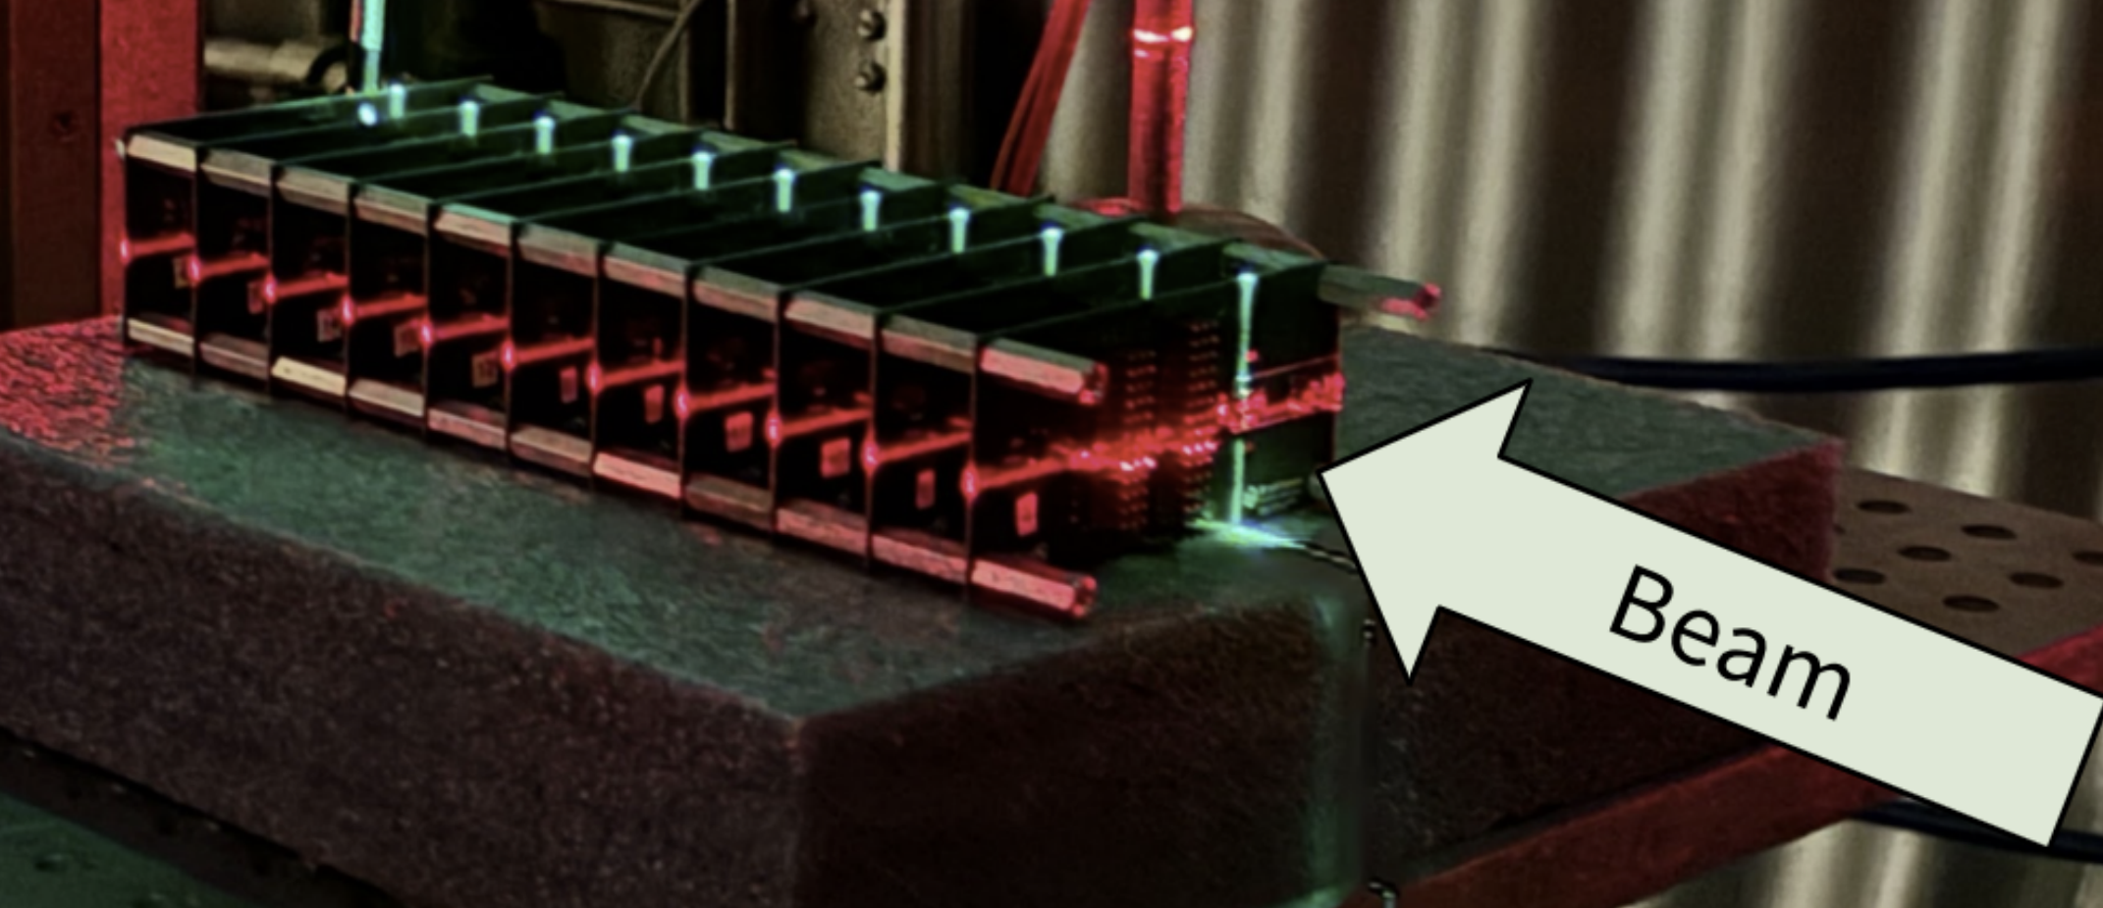
Serving HEP/NP community, NSRL beam is best suited for tests of charge particle tracking detectors, radiation hardening of detectors and front-end electronics.
For example, BNL/Physics group completed a SiC-LGAD tracking detectors radiation damage test.
August,2024, a stack of SiC-LGAD and complementary PiN diodes were irradiated with 2.5 GeV protons at fluences up to 3.33×10¹⁴ p/cm² (JINST 20 P12008 BNL, LBNL, North Carolina State).
However, NSRL beamline currently has no particle tracking capability.
was not able to perform tracking quality studies, quantify position resolution as a function of radiation exposure, corresponding to 5yr, 10yr HL-LHC operation.

