Slide 1
High Data Rate Fiber‑Optic Transmission for HEP/NP Detectors
Principal Investigator(s): Sergio Rescia, Instrumentation Dept.
List of the proposal participants and their organizations:
G. Deptuch, P. Mukim, S. Mandal, P. Purohit, T. Tsang + technical help, Instrumentation Dept
H. Chen, M. Pleyer, S.Rajagopalan, M. Zhao, Physics Dept.
Proposal term from: 1 Oct 2026 to: 30 Sept 2028
Annual funding: FY27 $600,000 FY28 $600,000 FY29 $600,000
Notes:
THE RESEARCH TEAM The team combines expertise in microelectronics, detector instrumentation, and optical systems. The Instrumentation Division microelectronics group (G. Deptuch, P. Mukim, S. Mandal) will lead SiPh integration and system architecture. T. Tsang will contribute deep experience in electro‑optic devices and optical testing at room and cryogenic temperatures. Physics Department collaborators (H. Che, M. Pleyer, S. Rajagopalan) will help defining detector‑level requirements and ensure alignment with current and future experimental needs.

Slide 2
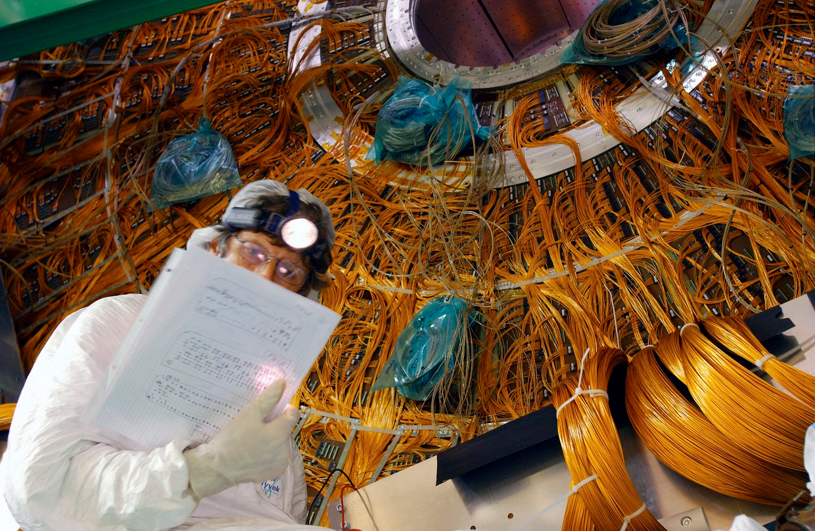
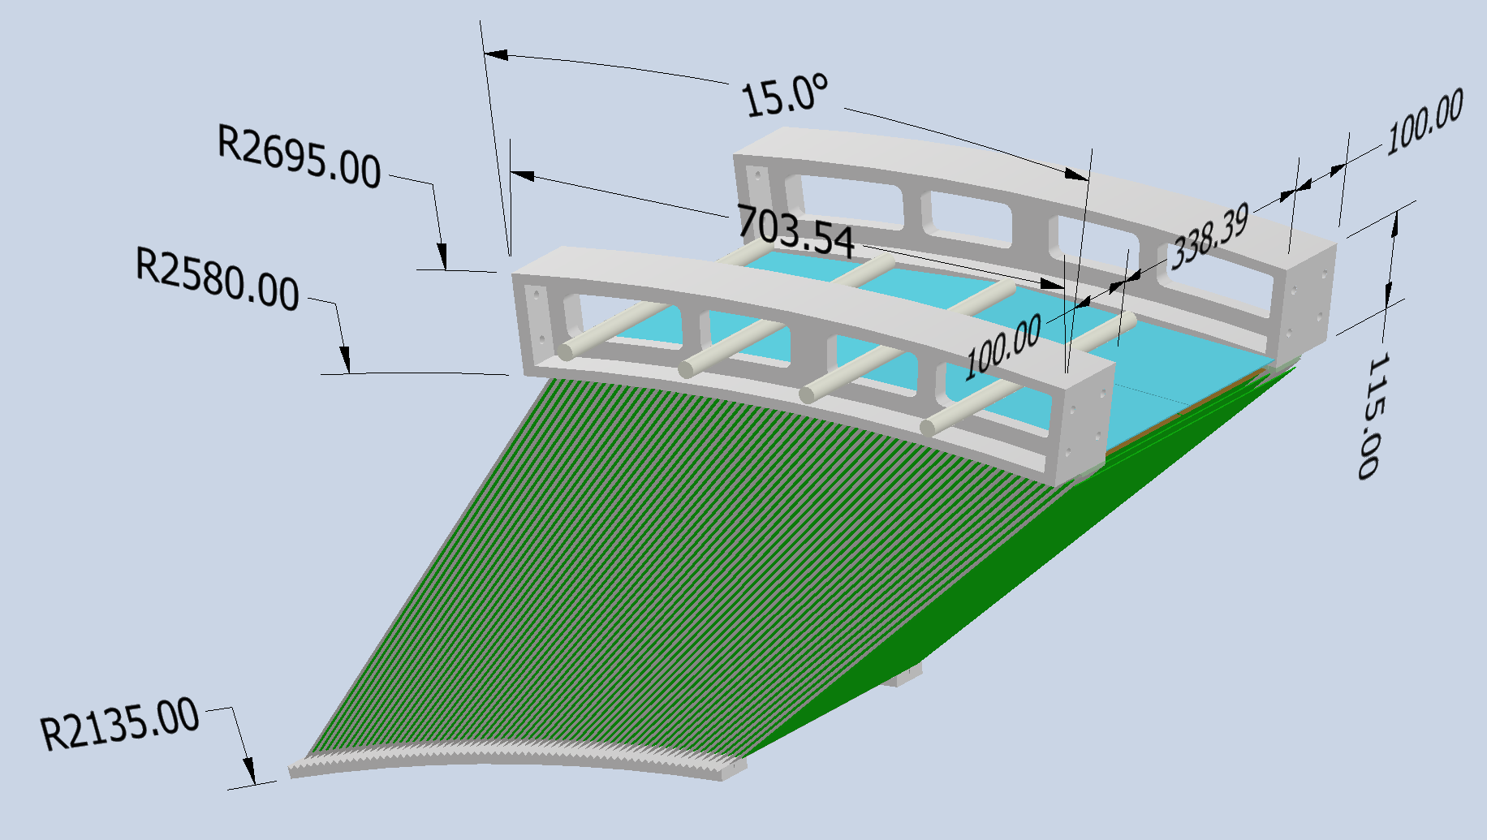
The Challenge: The "Cables Crisis"
Theme: Future experiments like FCC-ee and DUNE require millions of readout channels inside the cryostat. Trackers require low mass, thin conductors. Rare event experiments need to reduce radioactive background, hence cables.
The Barrier: Conventional copper cabling is a dead end. For Allegro/Idea ecal, engineering models show cables occupying >150% of available service volume.
Scientific Justification: Without a breakthrough, the "rat's nest" of cables creates massive thermal loads and reduces space for other services (e.g. cooling), making high-precision calorimetry mechanically impossible.
cables

Slide 3
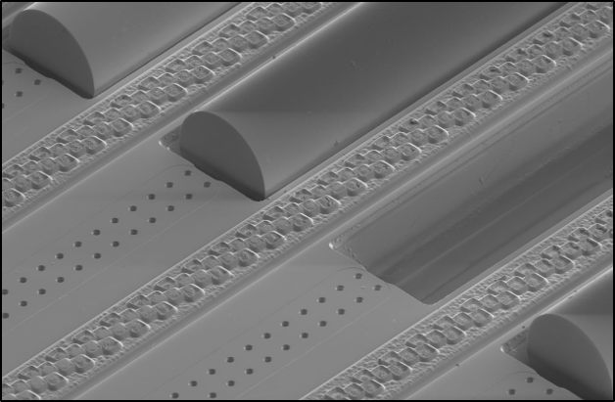
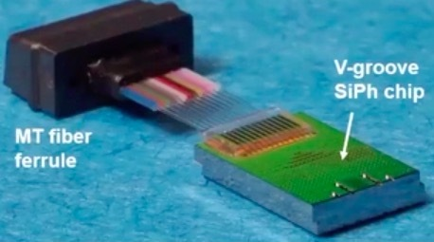
Solution: Cryogenic EO Modulators
Goal: Develop a beam-test ready, ultra-low power (< 100 fJ/bit; 10-20 fJ/bit possible) optical transmitter operating at LAr temperature and room T.
The Innovation: Utilize Commercial SiPh & Thin-Film Lithium Niobate (TFLN) modulators to achieve 100 Gb/s per fiber (62 μm diameter).
Impact: Replaces bulky copper with hair-thin fibers, enabling high-density feedthroughs and in-situ fiber joining instead of bulky connectors to ease detector assembly and improve reliability. This solves the “scalability” (lack of physical volume) constraint and secures the path for future physics discoveries.
62 μm
Figure 2: Prototype Silicon Photonics Transmitter
Notes:
Also mention cost and failure risk of connectors

Slide 4
HOW DOES THE PROPOSED RESEARCH ENHANCE THE LAB STRATEGY?
LDRD enhances BNL’s and 5P strategic priorities in understanding the building blocks of the universe
LDRD will develop know-how for next‑generation experiments
LDRD will enable BNL in designing more capable detectors, while reducing cost and power consumption
Establishing leadership in detector‑integrated EO data transmission will positions BNL at the forefront of advanced instrumentation for future HEP/NP experiments,
Technology developed by the LDRD will play a role in virtually all future HEP/NP experiments, including at EIC
Only a focused effort toward the development of hardware which is beam test ready will succeed in persuading HEP/NP physicist to make the quantum jump from copper to light
Notes:
HOW DOES THE PROPOSED RESEARCH ENHANCE THE LAB STRATEGY? The proposed research directly supports BNL’s strategic priorities in understanding the building blocks of the universe and developing know-how for next‑generation experiments. Low‑power, high‑bandwidth optical interconnects are a critical enabling technology for future neutrino experiments (e.g., DUNE Modules 3 & 4), precision collider detectors at FCC‑ee, and the ePIC detector at the Electron‑Ion Collider. By removing cabling and connectors (and their associated cost, mass and failure risk), this work enables more capable detectors while reducing cost and power consumption. Establishing leadership in detector‑integrated silicon photonics positions BNL at the forefront of advanced instrumentation for future HEP/NP experiments, including at EIC.

Slide 5
THE RESEARCH TEAM
Team | Role/expertise
Sergio Rescia, PI Instr. Dept | HEP detector design and readout, HEP data acquisition, cryogenic electronics, rad hard electronics
G. Deptuch, P. Mukim, S. Mandal, P. Purohit, T. Tsang + technical help Instrumentation Dept | Expertise in electronic and electro-optical design. Detector readout. T. Tsang for optical device testing, radiation effects on optical devices. Technical help for layout and testing
H. Chen, S. Gao, M. Pleyer, S.Rajagopalan, M. Zhao Physics Dept. | Detector requirements, detector integration expertise to develop requirements and specs for EO
Notes:
THE RESEARCH TEAM
Who is on the team and what expertise do they bring to the team? Show that the team is complete to achieve the goals of the research The team combines expertise in microelectronics, detector instrumentation, and optical systems. The Instrumentation Division microelectronics group (G. Deptuch, P. Mukim, S. Mandal) will lead SiPh integration and system architecture. T. Tsang will contribute deep experience in electro‑optic devices and optical testing at room and cryogenic temperatures. Physics Department collaborators (H. Che, M. Pleyer, S. Rajagopalan) will help defining detector‑level requirements and ensure alignment with current and future experimental needs.

Slide 6
WHY BNL?
BNL has a long‑standing leadership role in major HEP and NP experiments (ATLAS, DUNE phase I and II), EIC, etc.
BNLis actively engaged in planning for future detectors at the FCC
BNL combines strong in‑house microelectronics capabilities, detector expertise, and optical science talent, creating a unique environment for rapid, system‑level innovation
The proposed LDRD leverages commercially available silicon photonics and TFLN technologies while addressing detector‑specific challenges that are unlikely to be tackled by industry alone
Instrumentation Dept. is home of he recently approved Electro-Photonic Integrated Platform for Near-Sensor Processing in Extreme Environments (El-Pho) lead by Grzegorz Deptuch, which is leading longer-term R&D on silicon photonics and electro-optics and is acquiring a portfolio of instrumentation and software tools that will be essential for the success of the LDRD
Notes:
WHY BNL: Is there an advantage to performing at BNL the research proposed or programs that might grow from it? Do we have talents or facilities that make BNL uniquely qualified to achieve the goals?
BNL has a long‑standing leadership role in major HEP and NP experiments, including ATLAS, DUNE, and EIC, and is actively engaged in planning for future detectors at the FCC‑ee. The laboratory combines strong in‑house microelectronics capabilities, detector expertise, and optical science talent, creating a unique environment for rapid, system‑level innovation. This project leverages commercially available silicon photonics and TFLN technologies while addressing detector‑specific challenges that are unlikely to be tackled by industry alone. Success will position BNL as a leader in next‑generation optical readout technologies with broad impact across the laboratory’s experimental portfolio.

Slide 7
Draft LDRD Funding Table
Silicon Photonics processes (Global Foundries 45nm SiPh) are very expensive, about $350,000 for a multi-chip run
Design and layout for SiPh requires ad-hoc add-on tools, also quite expensive
Thin Film Lithium Niobate is not yet a mainstream technology, and only a small number of foundries have the technology to cover the full manufacturing cycle, including fiber attachment. The quote I got to develop and prototype a low driving voltage TFLN modulator is $75,000. These devices are in essence integrated circuits: the expectations is that as the technology matures, the prices will be in the range of complex ASICS (~$1500/IC, tested)
Notes:
For each of three years what are main funded items

