Slide 1
Electronics and DAQ Workfest Summary
January 2026 Collaboration Meeting
Wednesday Afternoon (1/22/26)

Slide 2
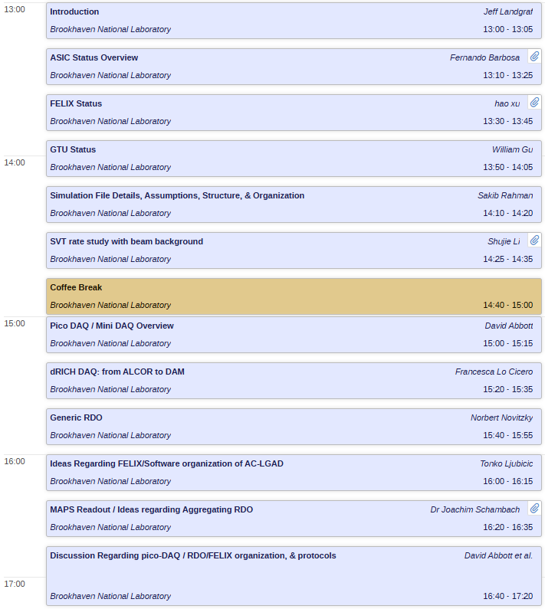
The Talks
ASIC Status / Overall DAQ Progress
Backgrounds in SVT
FELIX / RDO Discussions

Slide 3
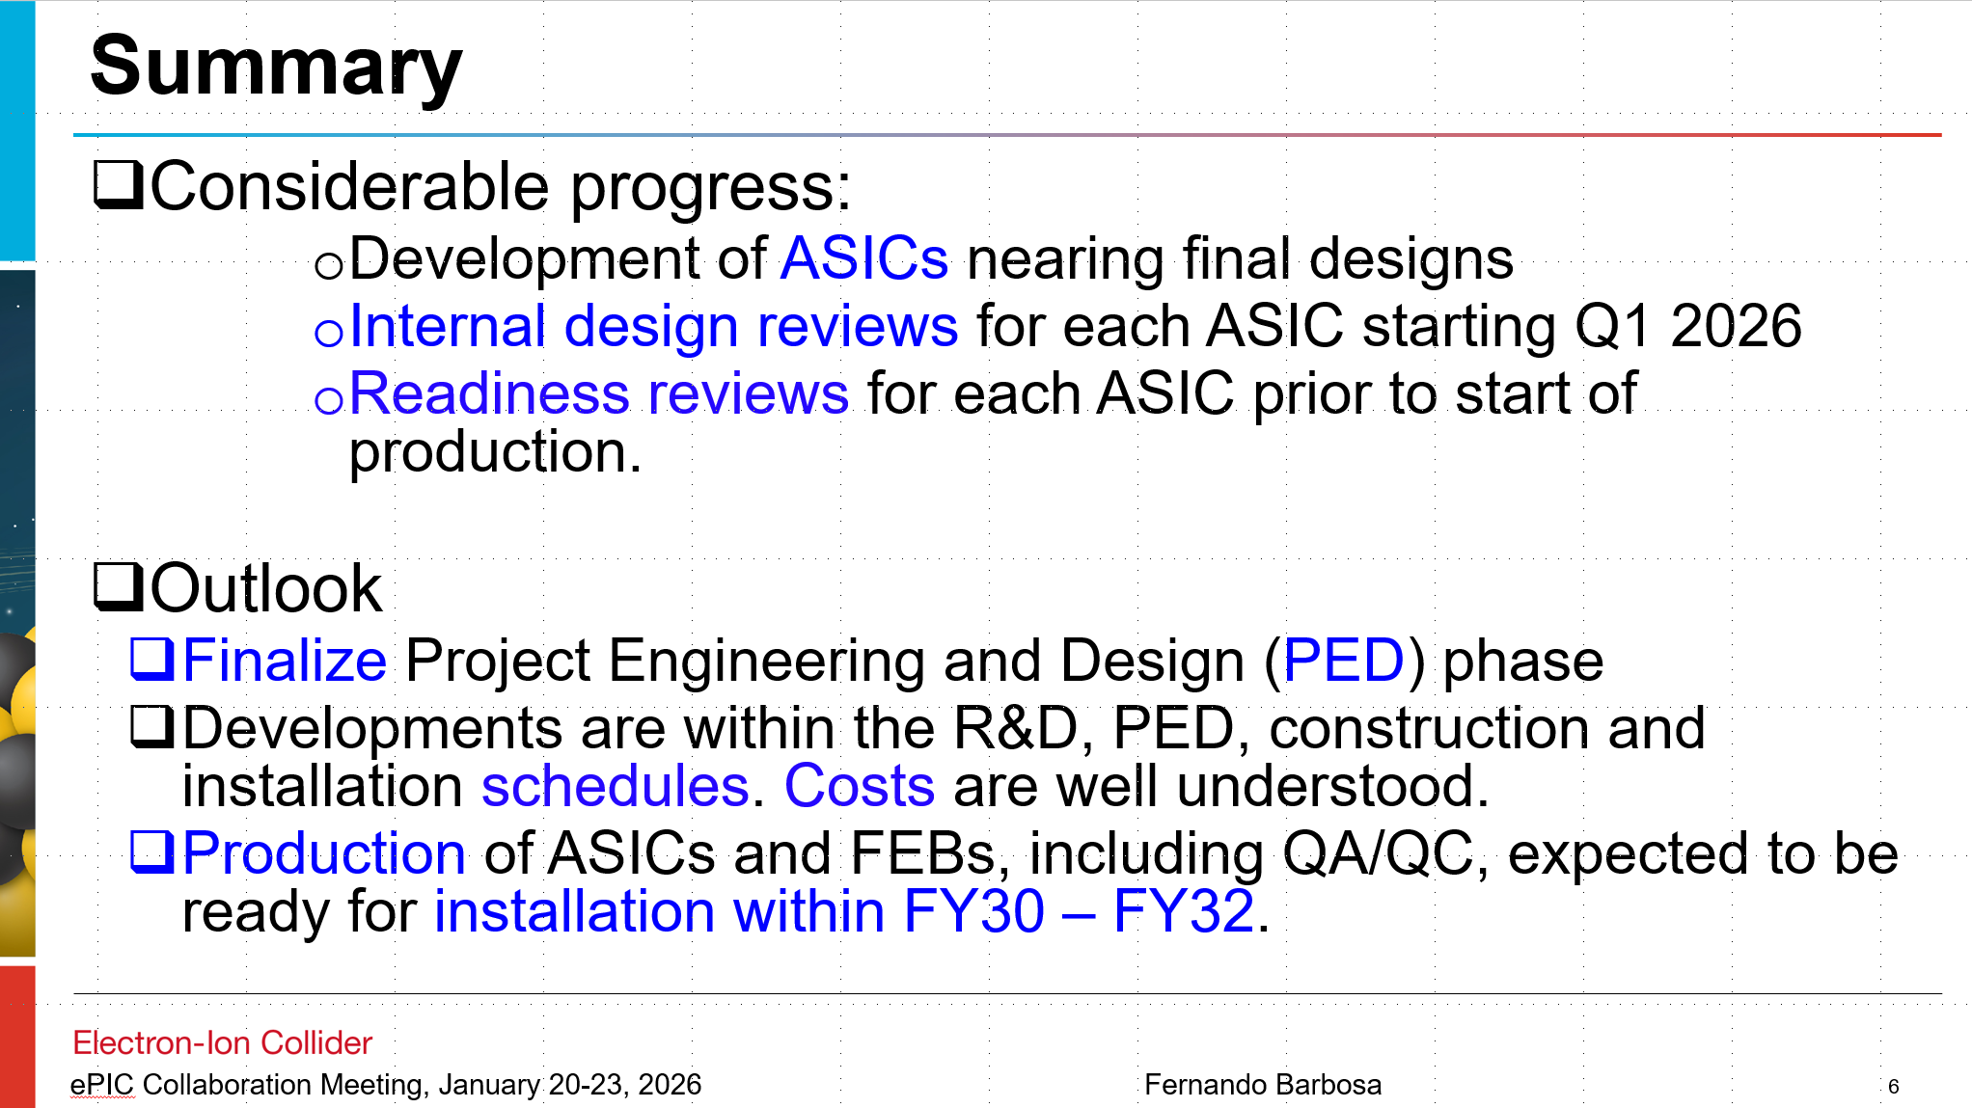
ASIC Status Summary (Fernando Barbosa)
High level overview given:
Dedicated CALOROC Session
EICROC talks in far-forward
FCDF discussions in PID
Monthly ASIC status meetings in DAQ WG

Slide 4
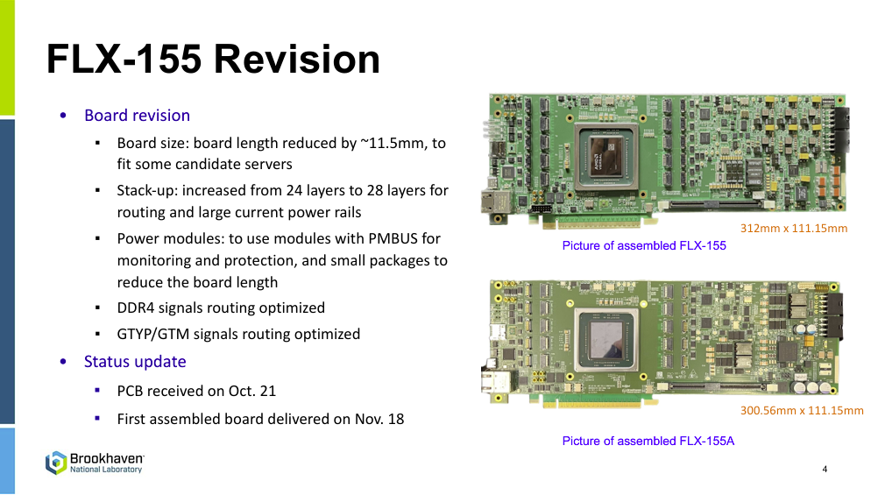
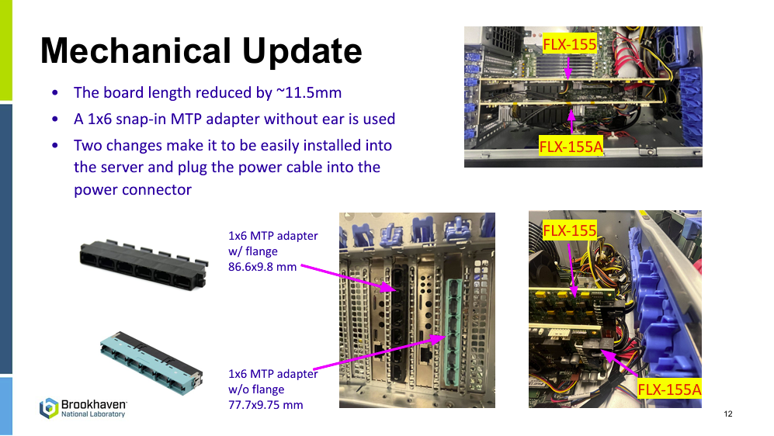
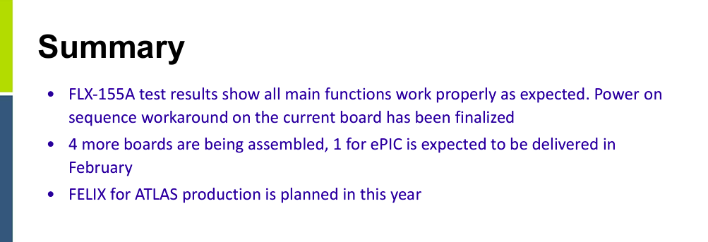
FLX-155 Summary (Hao Xu)

Slide 5
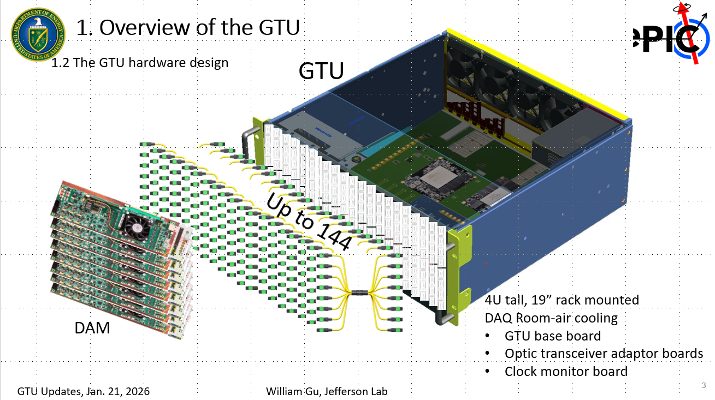
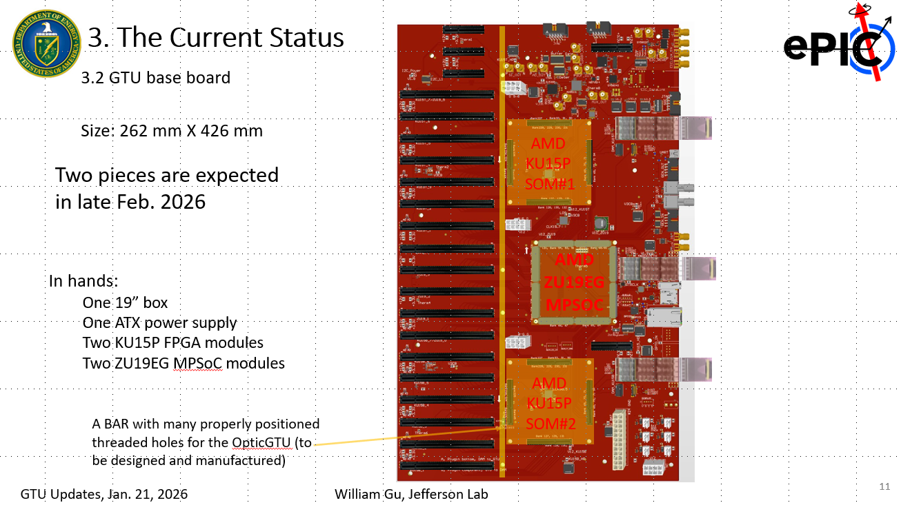
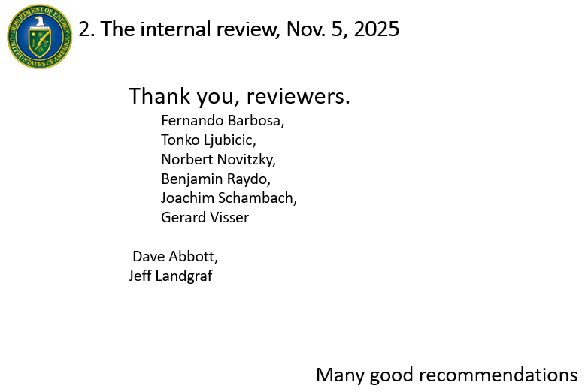
GTU Status (William Gu)

Slide 6


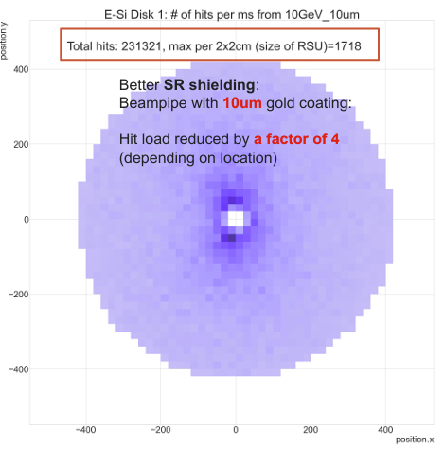
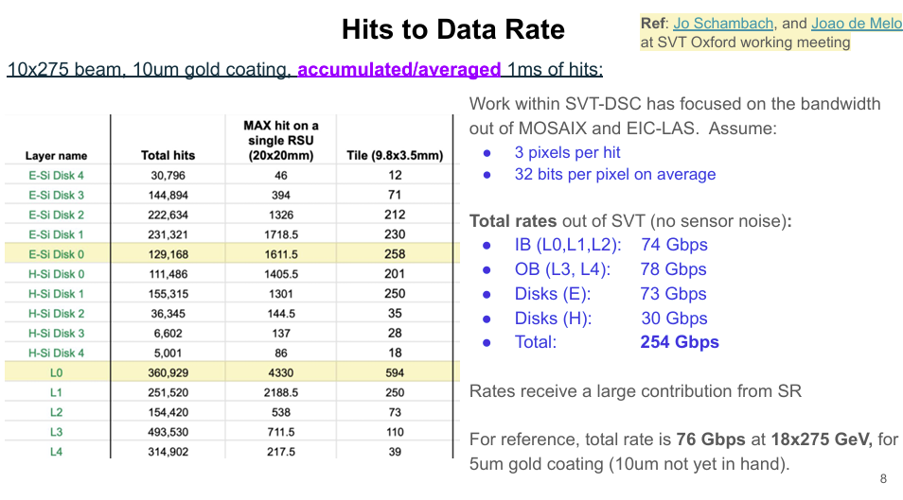
Backgrounds (Sakib Rahman, Shujie Li)
1. General Data Rate Discussions:
DAQ did a first pass at using the simulations to predict data rates, and determine the distribution in the detectors to find limiting hot-spots
However, data simulations are not really the business of DAQ, instead DAQ will provide maximum hit rates that can be handled and depend upon the detector groups to apply these to their own detectors.
2. Summary of Synchrotron
Radiation Status:
Current beamline simulation results not yet available
Modifications to date have helped dramatically
Current Simulations
5um gold leaves rates too high
10um reduces by x 4
Still 4 x higher band-width than DAQ “expects”
Still 4 x higher than SVT can readout in most sensitive region
We will follow developments closely (hoping for x4 reduction). If not, then we must look for other solutions…

Slide 7
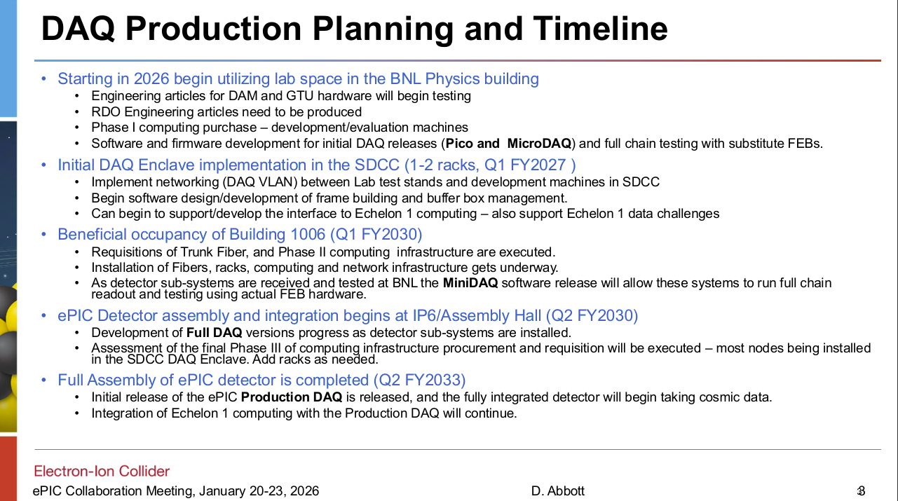
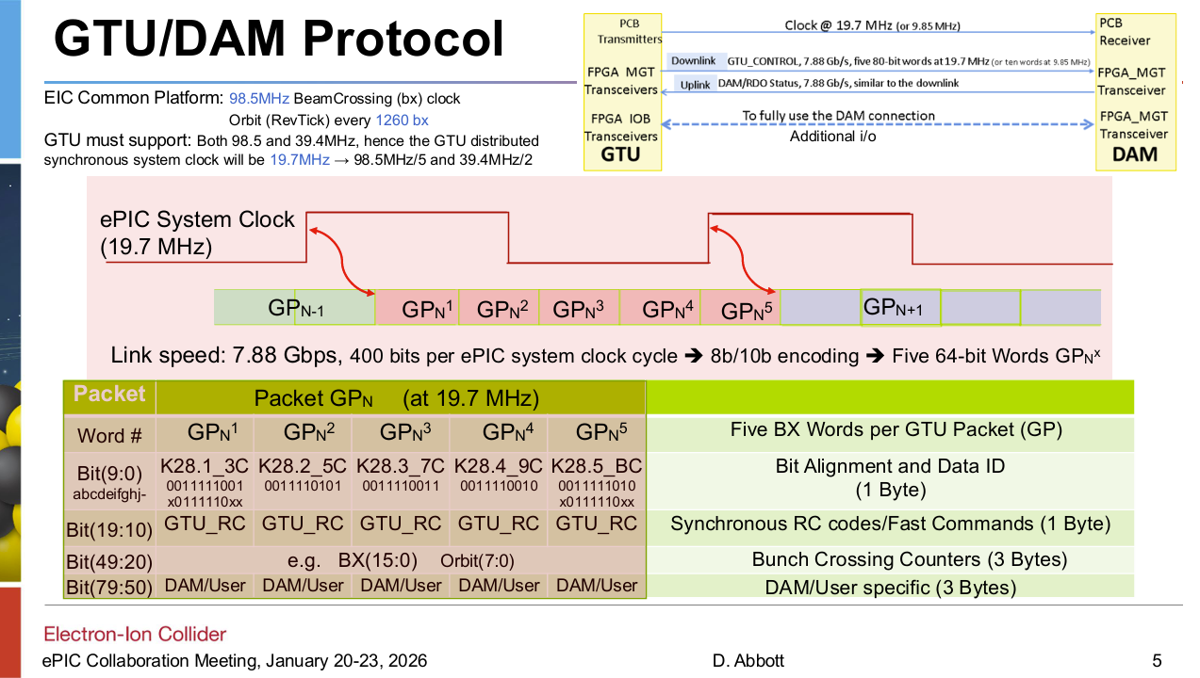
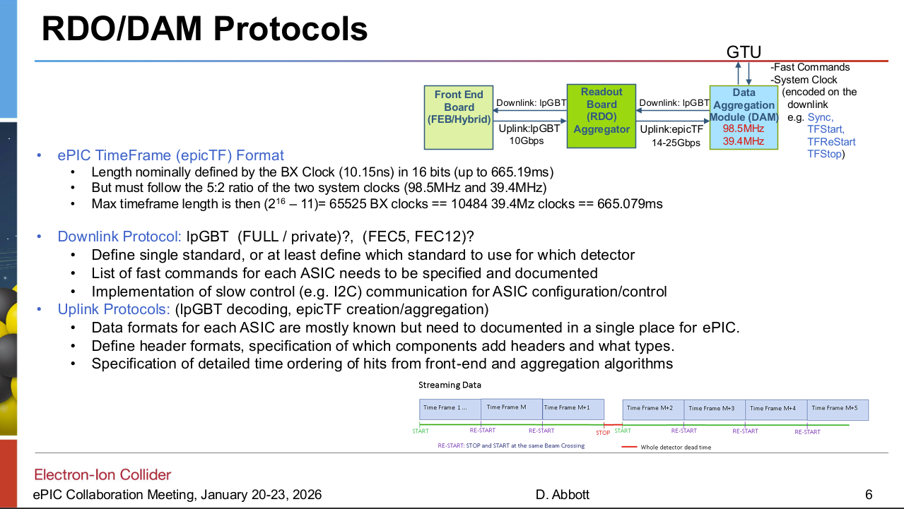
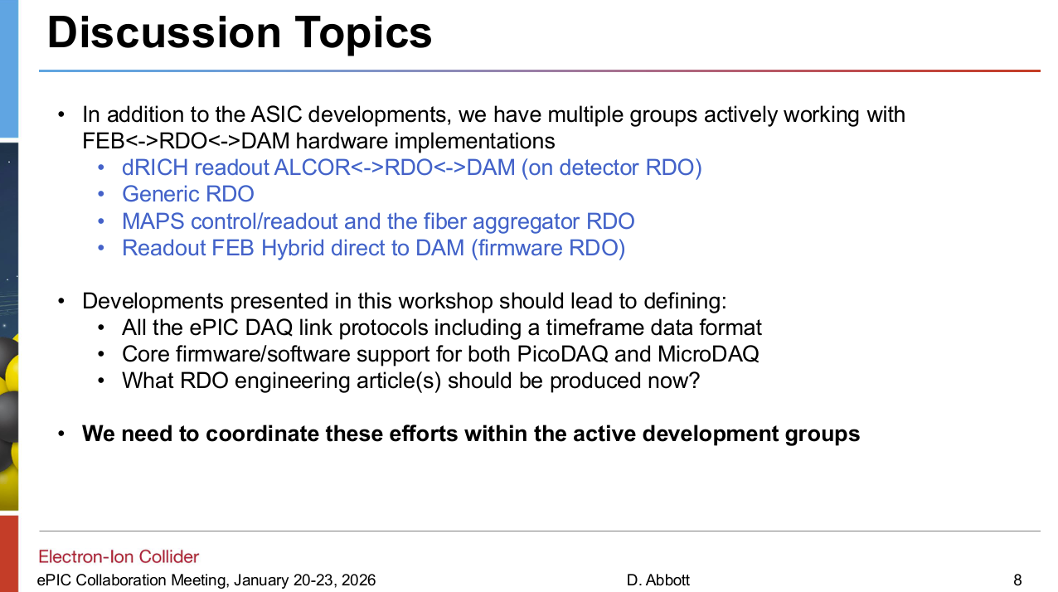
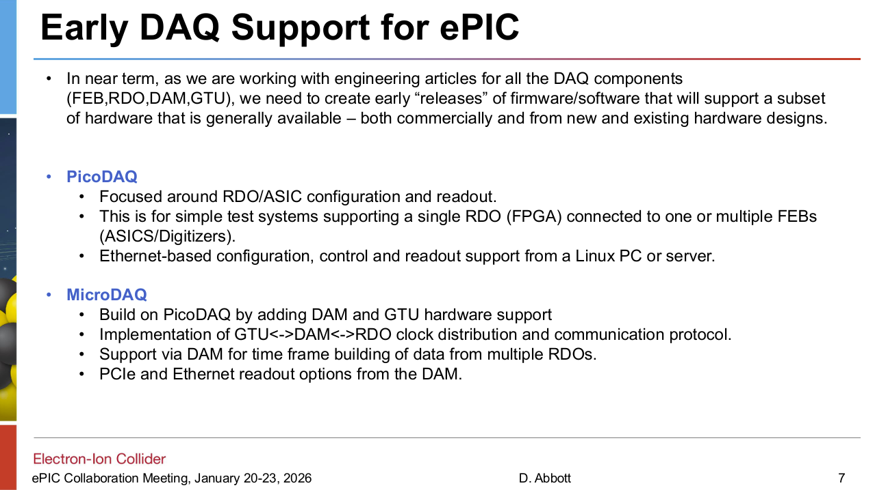
DAQ Overview & Plans (Dave Abbott)

Slide 8
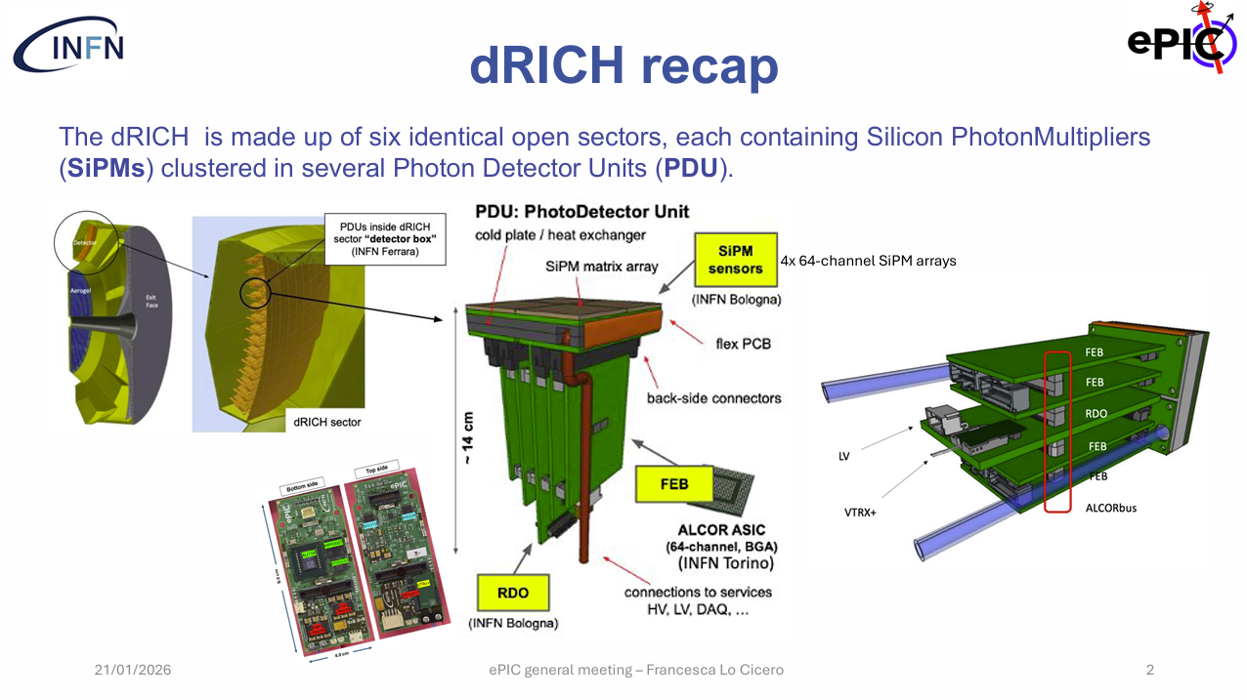
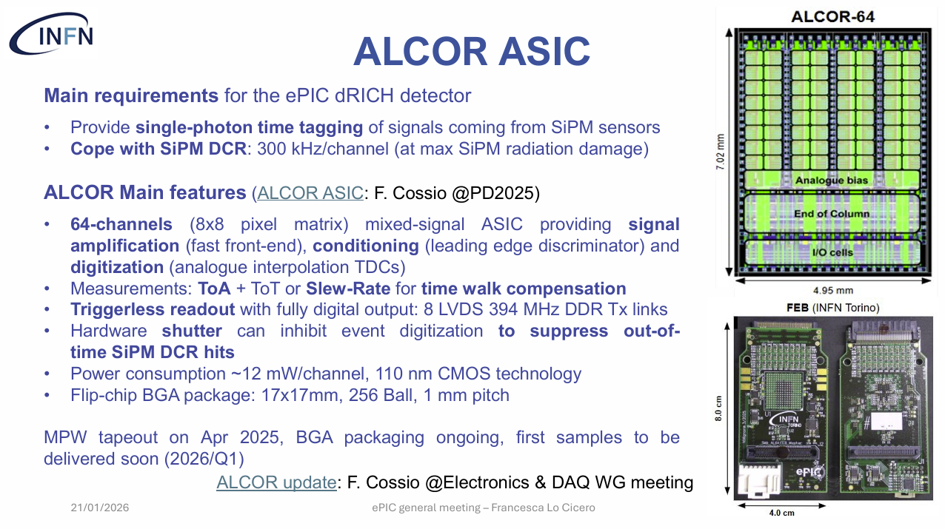
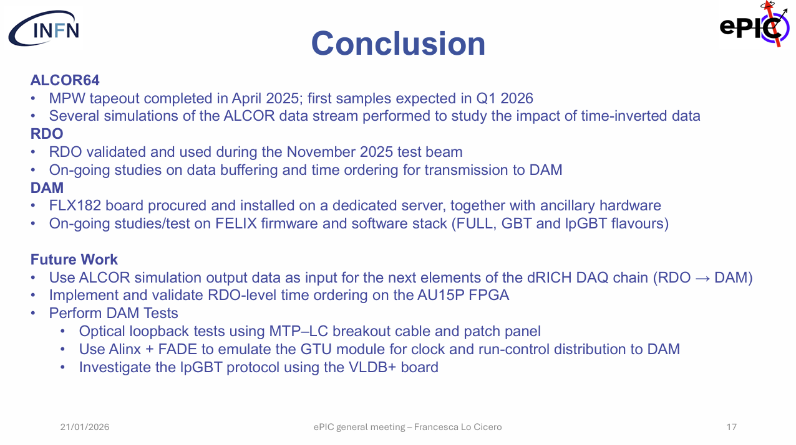
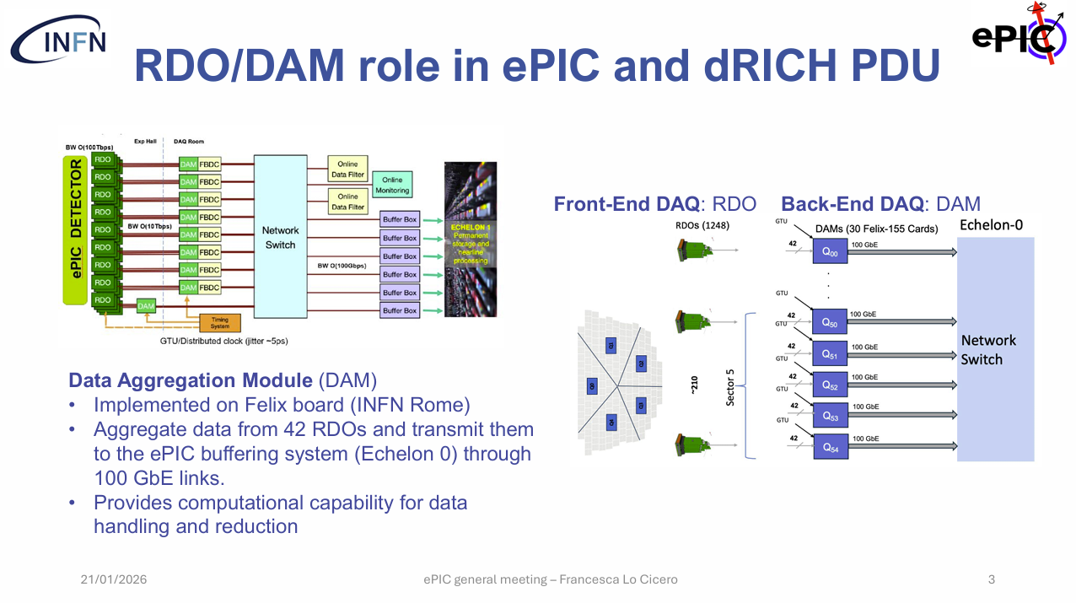
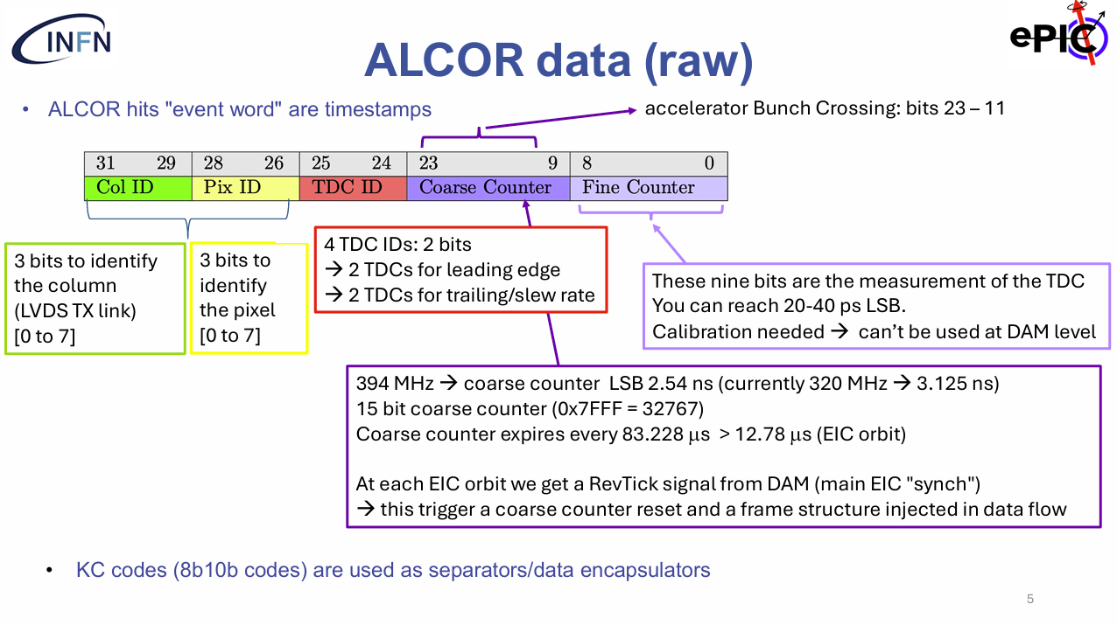
dRICH DAQ (Francesca Lo Cicero)

Slide 9
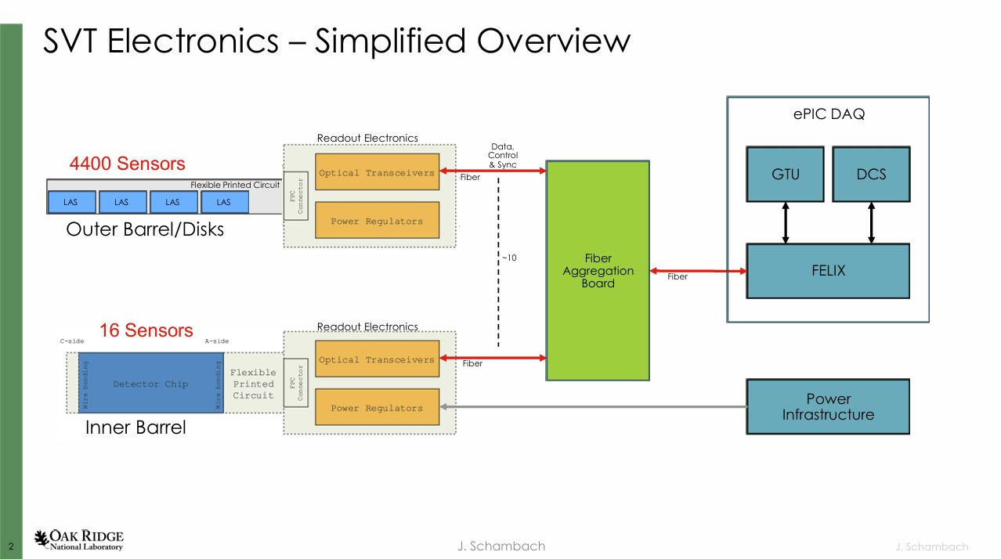
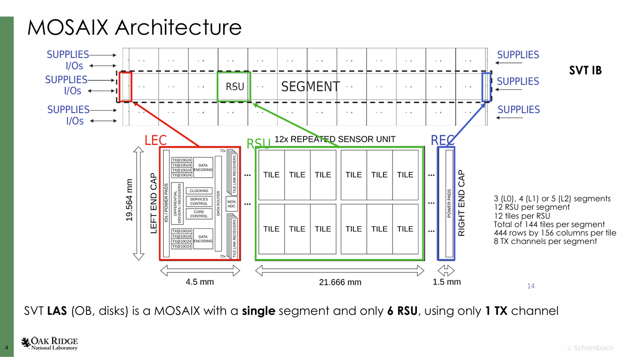
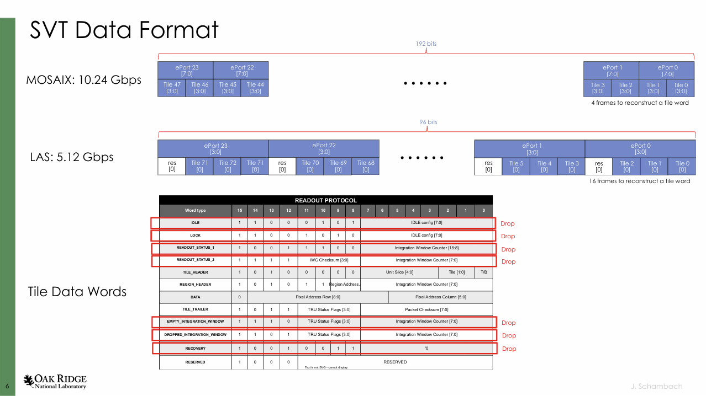
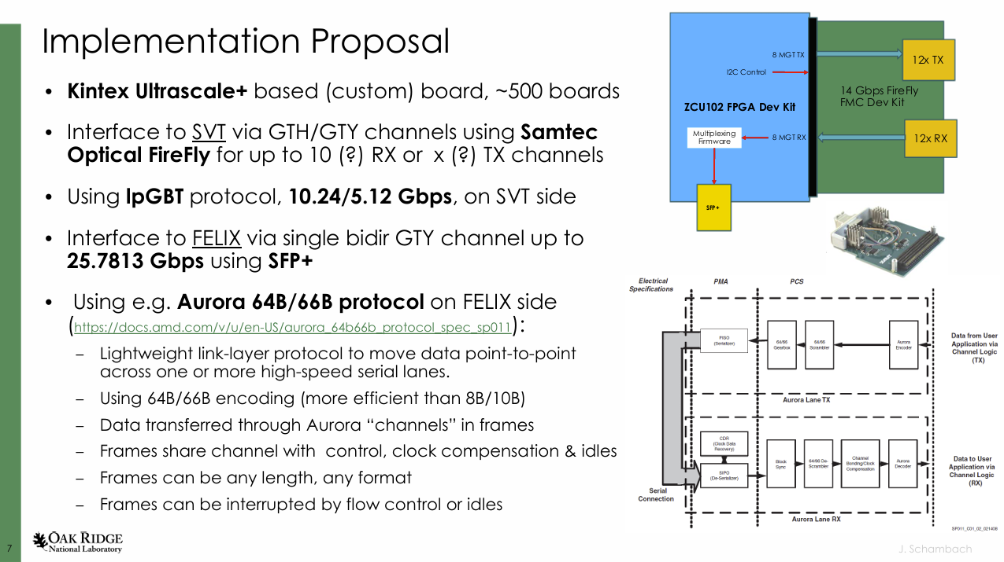
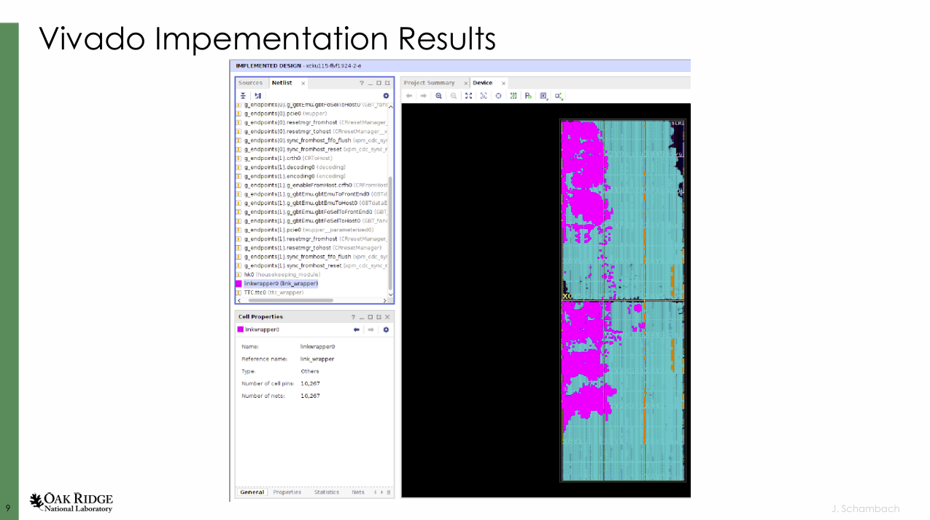
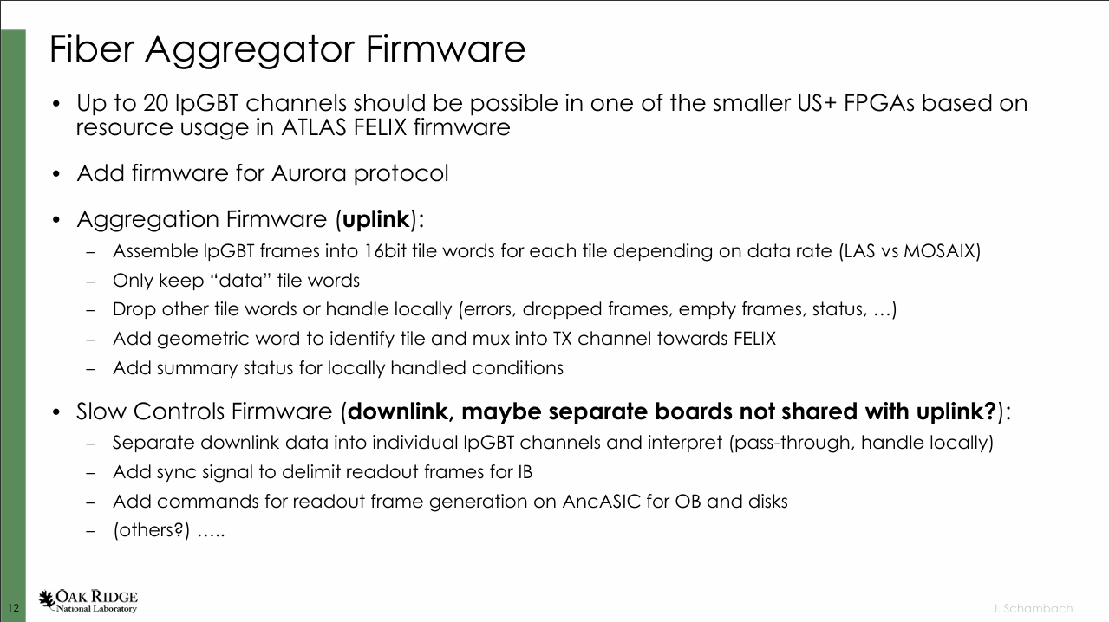
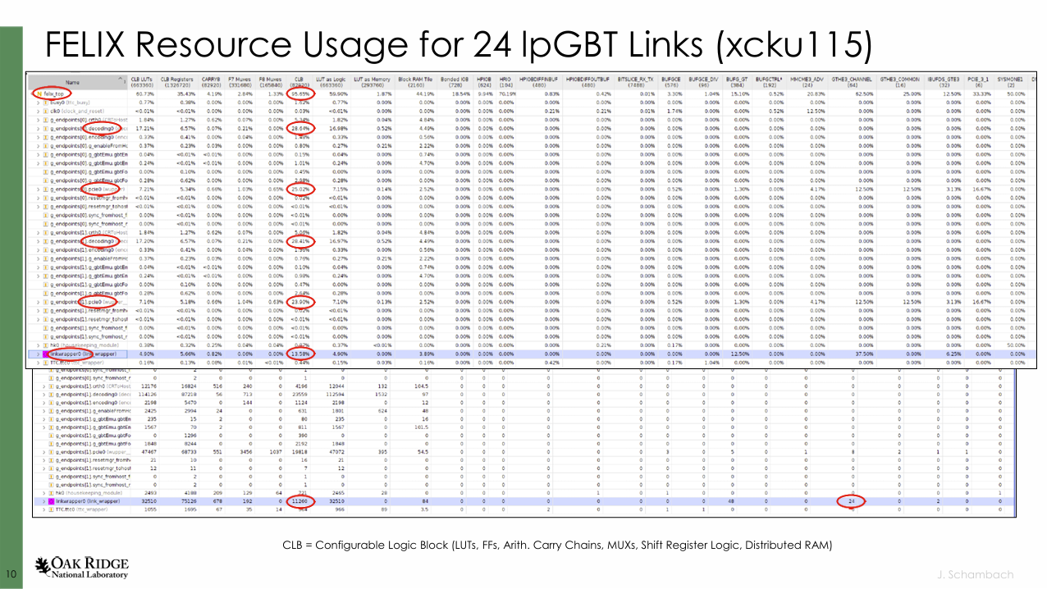
SVT Fiber Aggregation (Jo Schambach)

Slide 10

Thoughts on FELIX Development (Tonko Ljubicic) and (Discussion)
Discussion on how to progress with the definition of the FELIX firmware details for the ePIC DAQ
Numerous specific details need to be resolved:
Protocols
lpGPT vs FULL vs Aurora64B/66B
Forward Error Correction model
40 MHz vs 100 MHz
48 port implementation
Filter Algorithms
Downlink Fast commands / Slow Control Information
Complex environment at moment:
Test board versions of GTU/FELIX/RDO
FLX 172 from sPhenix
2 x FLX 182 in hand at JLAB/INFN
Limited FLX 155 test articles soon
Need test stands (likely with need to share among groups)
→ Need dedicated expert
Contact person for detector – FELIX integration
Understand details of specific detector needs
Adapt for ePIC (cut up / extend) ATLAS code
Liaison with FELIX firmware/software group

