Slide 1
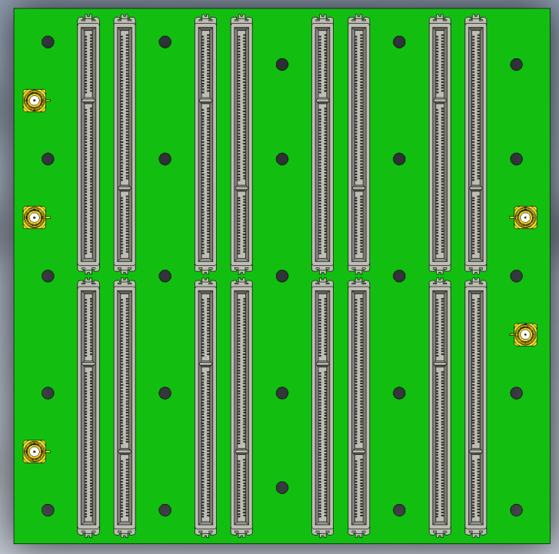
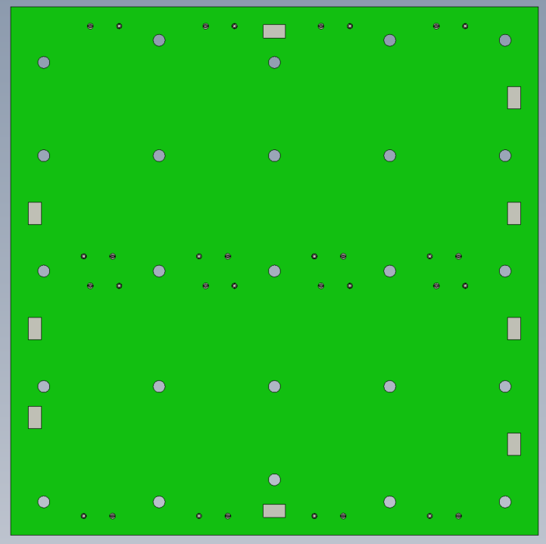
PCB STEP File
These 3 mounting holes offset by 5mm
Gives 4mm clearance to screw
Top corner offset to prevent mis-installation if PCB is rotated 180°
5x3mm pads added for interposer or dual pogo pin locations
Have 1mm placeholder height for export compatibility
Bottom GND is offset to prevent shorting ground th HV if board is rotated 180°
Extry Top
Exit Bot
Extry Top
PC
Exit Top
Exit Top
PC
Exit Bot
w/ input connector
Exit Bot
w/ input connector
Exit Bot
GND
Entry Bot
Exit Bot
Entry Bot
1/27/2026
1

