Slide 1
Far-Forward / Far-Backward
Detector Integration
Jonathan Smith (JLAB), Ron Lassiter (JLAB),
India Krehbiel (JLab),
February 2, 2026

Slide 2
Primary Updates Outline
Lumi Dipoles
Low Q2 Tagger Table Options
Upcoming

Slide 3
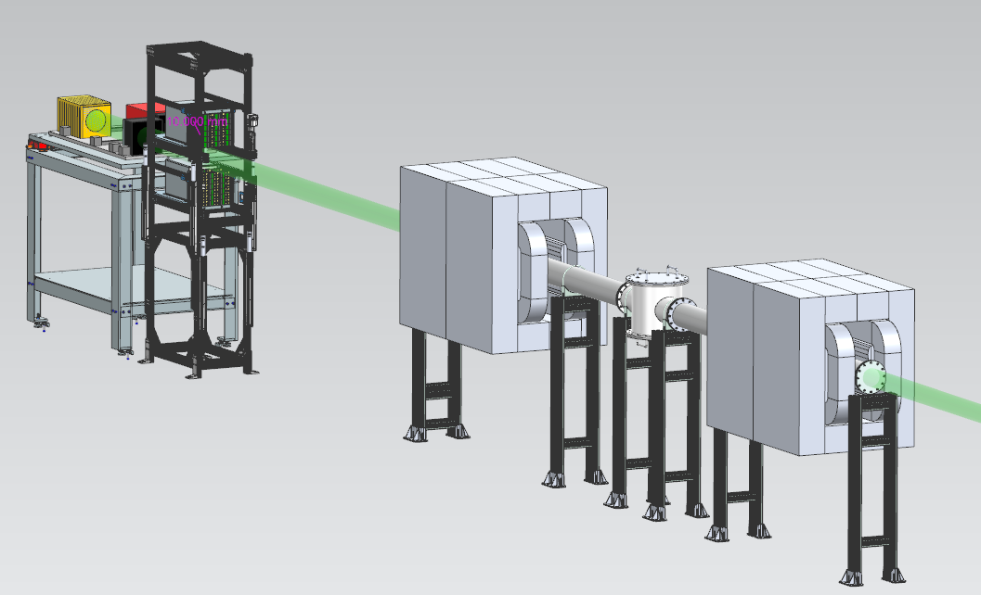
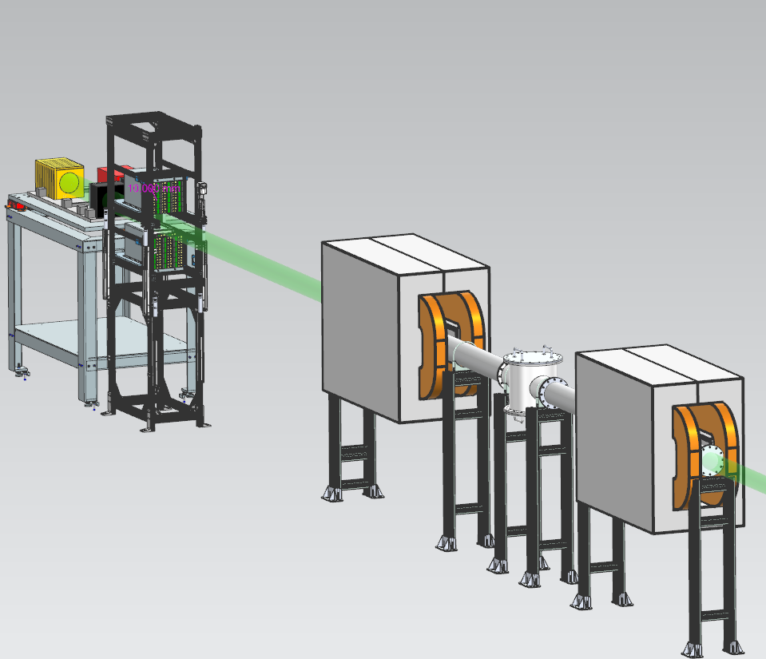
Lumi Dipole Updates
Previous Lumi Dipole Model
Updated Lumi Dipole Model

Slide 4
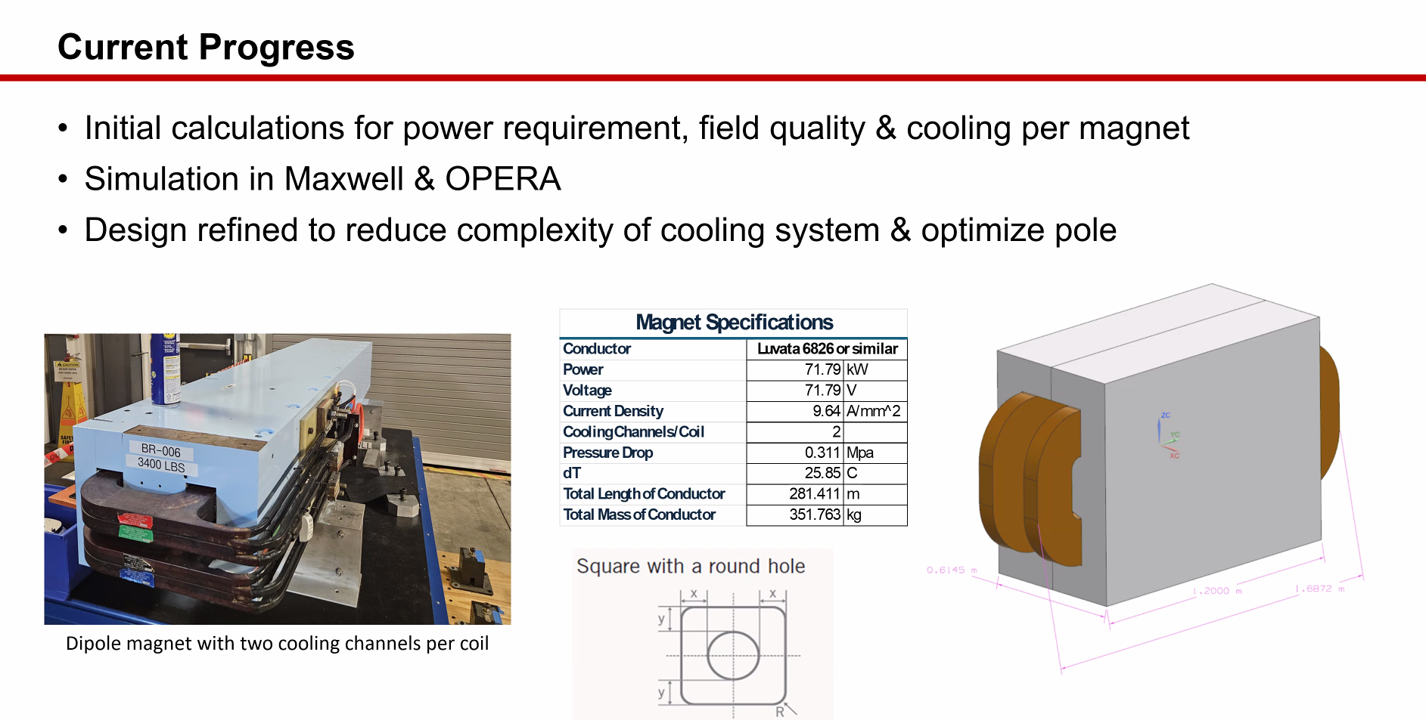
Lumi Dipole Updates
Slide courtesy of Ian Gildea & Sandesh Gopinath
Magnet Division, JLAB

Slide 5
Lumi Dipole Working Progress
Update the mounting supports for the Dipoles. Current 80/20 frame is an existing stand-in.
Karim shared drawings from previous projects to use as a ‘go-by’.

Slide 6
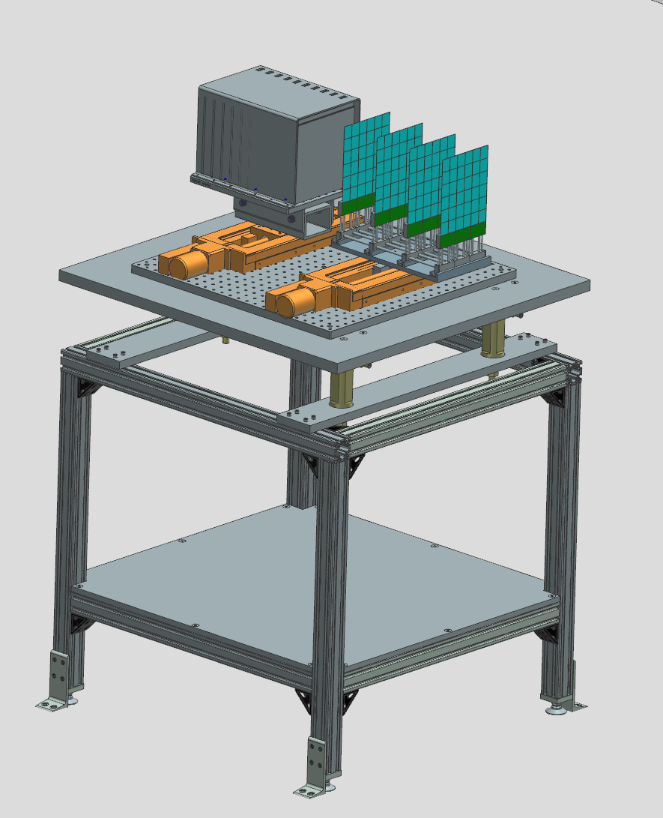
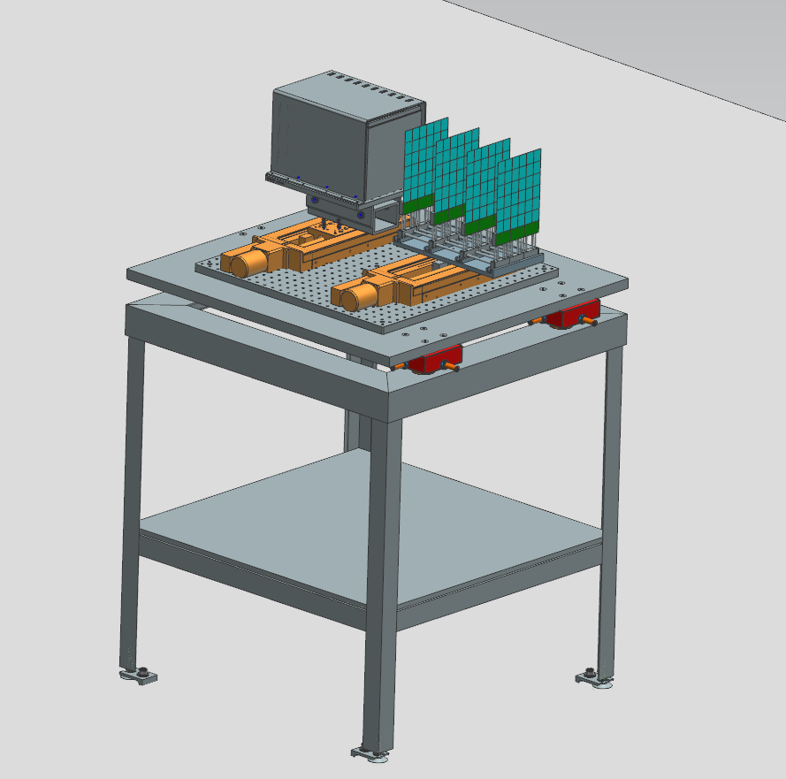
Low-Q2 Tagger Tables – Which one to use?
Aluminum Profile
80/20 Profile

Slide 7
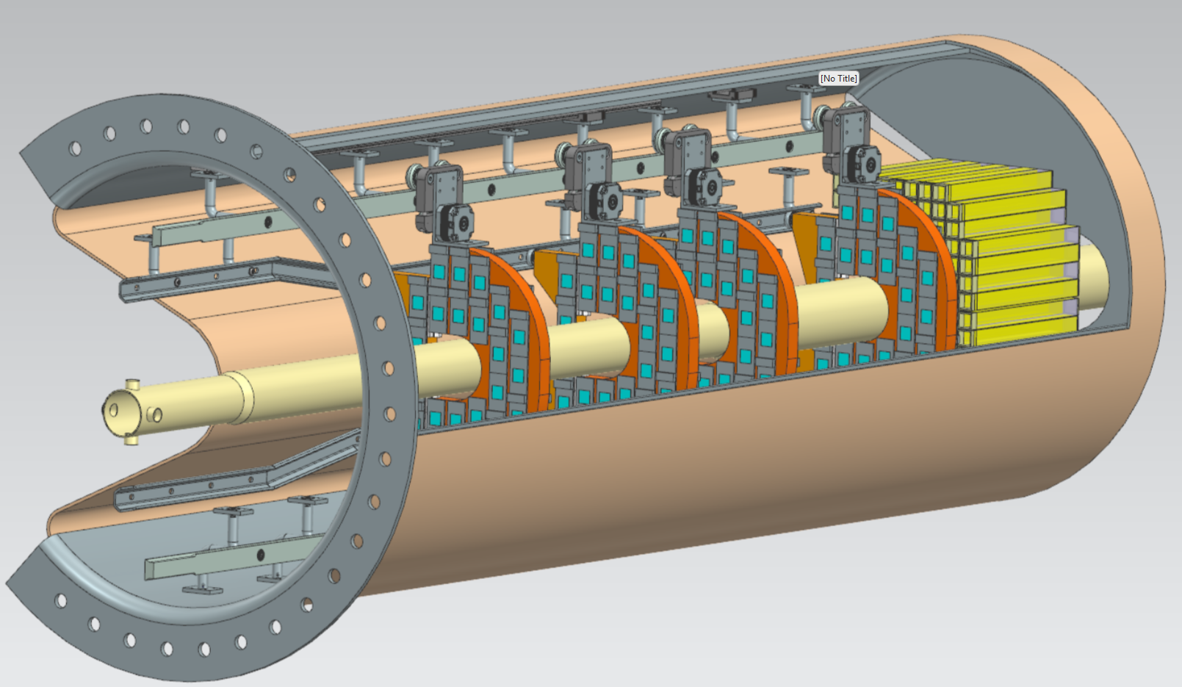
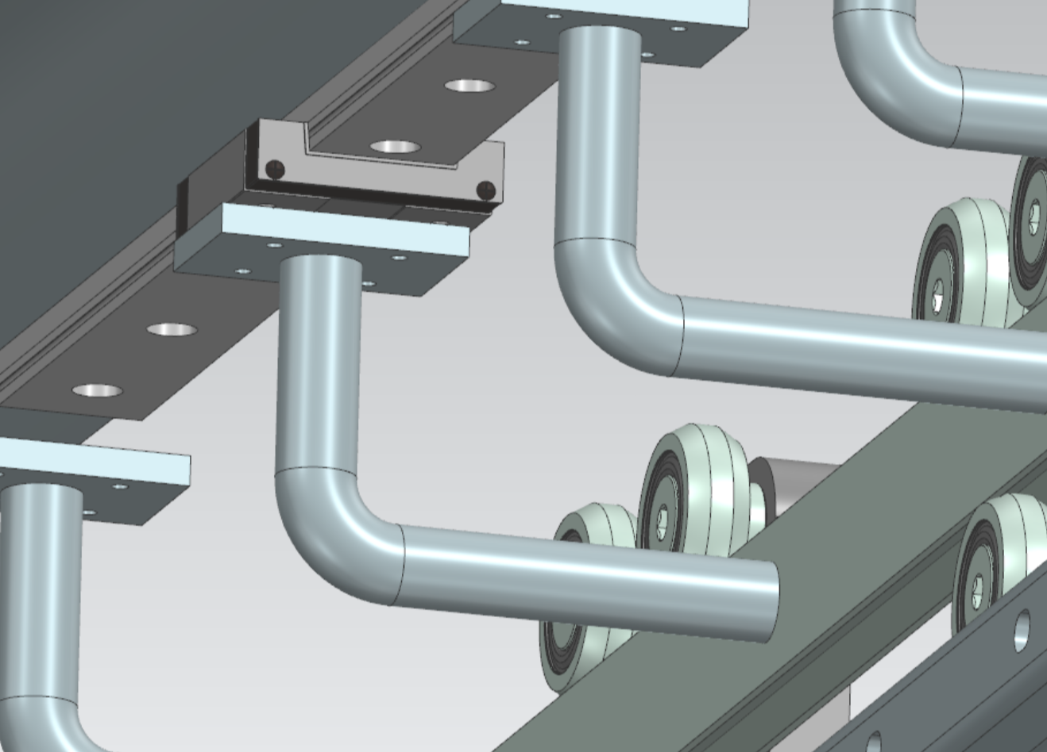
Early Concept – B0 Detector Mounting Rail
NOTE: Work in progress. Multiple unknowns at this time. Will provide future updates as design matures.

Slide 8
Current Ongoing Activities
All activities related to the Roman Pots/OMD Integration are currently ‘on hold’ due to the current uncertainties with the IR Design.
ZDC discussion scheduled for Wednesday to talk about lifting table options (One table vs two tables)
Preparing for PDR3. Far-Backward and Far-Forward topics have been split between two discussions:
Far-Backward Region – April 20-24. Page Turn scheduled for March 30th
Far-Forward Region – Summer 2026

Slide 9
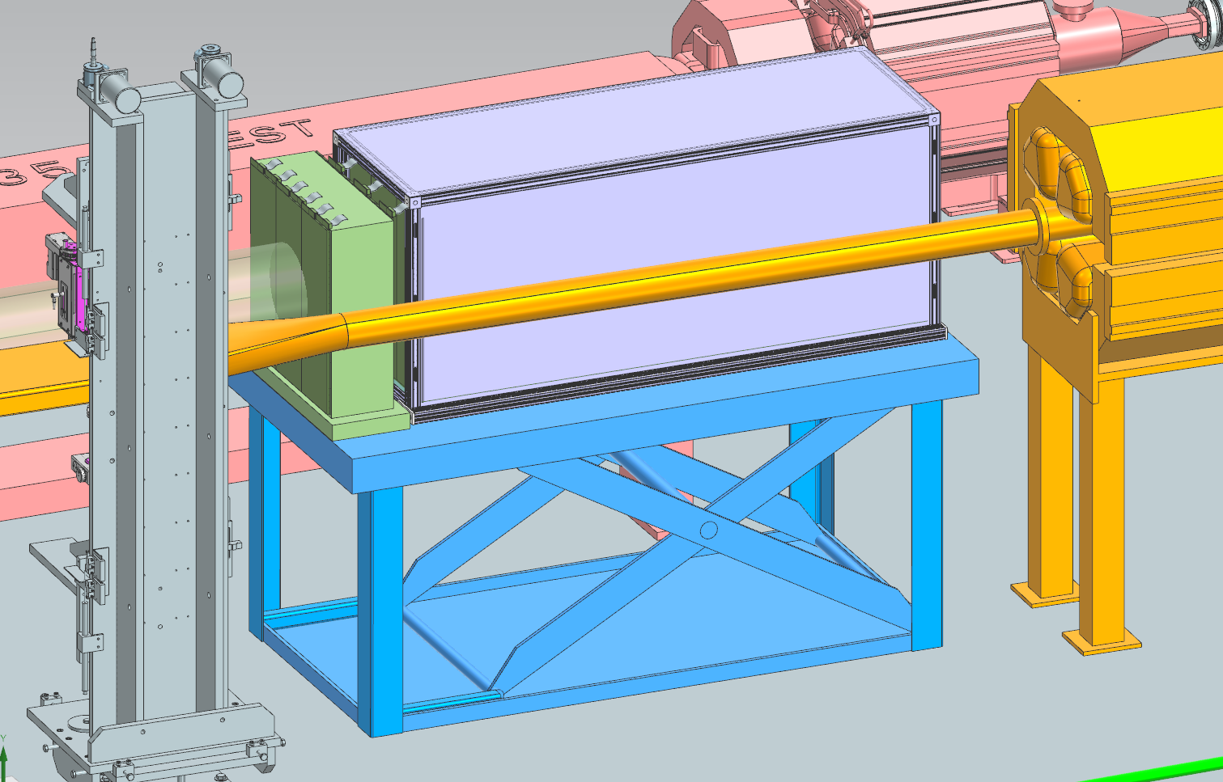
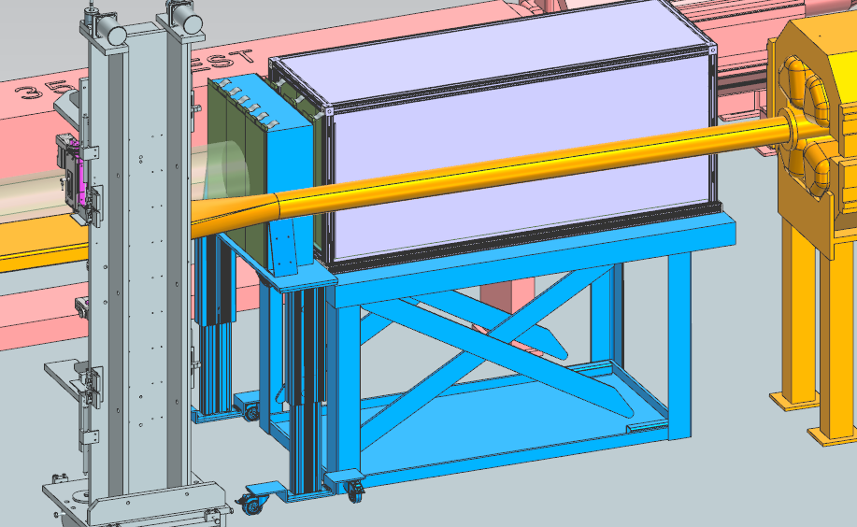
ZDC Updates – Current Discussions
Single Lift Table
Dual Lift Tables

