Slide 1
Discussion for EEEMCal and pfRICH and PST mount on GST
Initial concepts and progress
27 Feb 2026

Slide 2
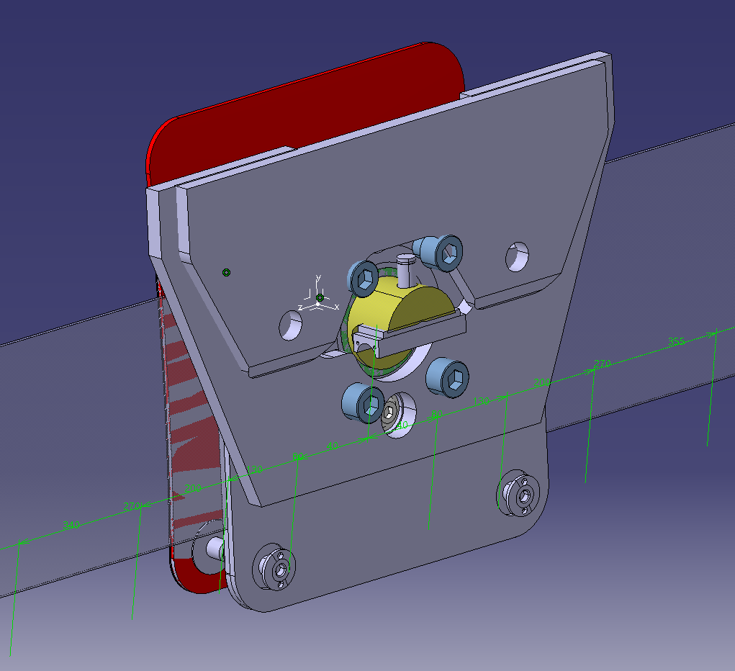
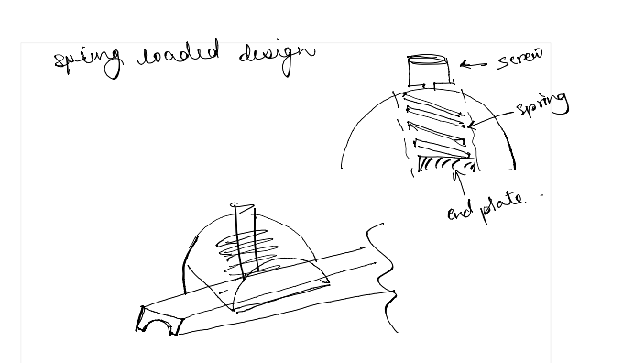
Version 3 of the slider foot concept
The red plate attaches to the EEEMcal structure
Comments received on this version –
Need it to be a “rolling” foot instead of a sliding foot
The adjustment for EEEMCal is just to get it “in the volume”
Adjustment for PST package needs to be more accurate since that has the beam pipe
Ignore this plate… just realized I forgot to hide this when taking a screenshot
Spring loaded mechanism to ensure that the sliding mechanism is always in contact with the Rails and does not “jump” while sliding along Z
These 4 bolts allow for movement in the X-axis
These two bolts allow for rotation about local the “z” axis

Slide 3
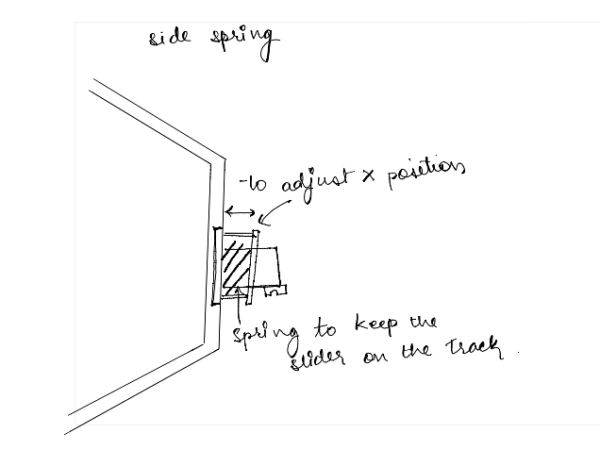
Version 3 of the slider foot concept
The red plate attaches to the EEEMcal structure
The track groove is changed from a round CFRP tube/rod into conical shape per BNL engineering request
Ignore this plate… just realized I forgot to hide this when taking a screenshot
Spring loaded mechanism to ensure that the sliding mechanism is always in contact with the Rails and does not “jump” while sliding along Z
This is pressure plate for spring to restrict and adjust motion in X
Spring and roller system to allow for breathing in X direction

Slide 4
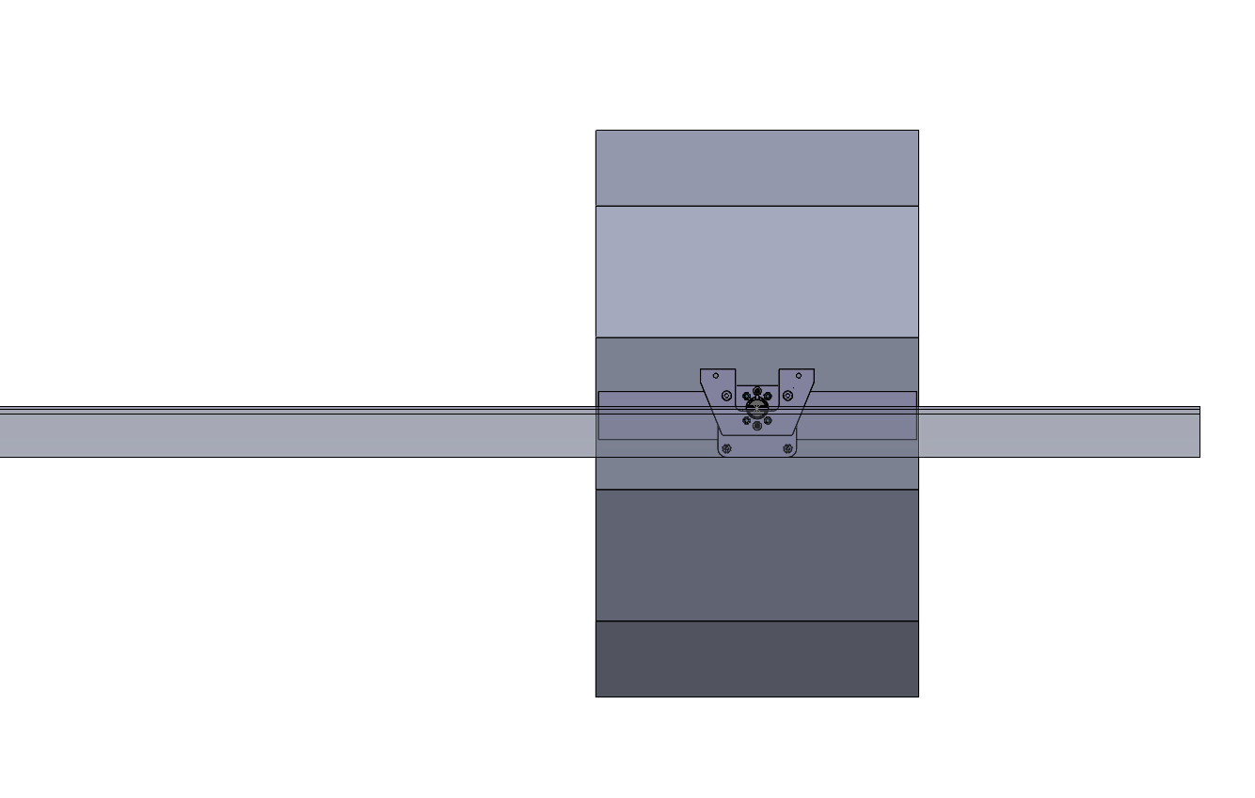
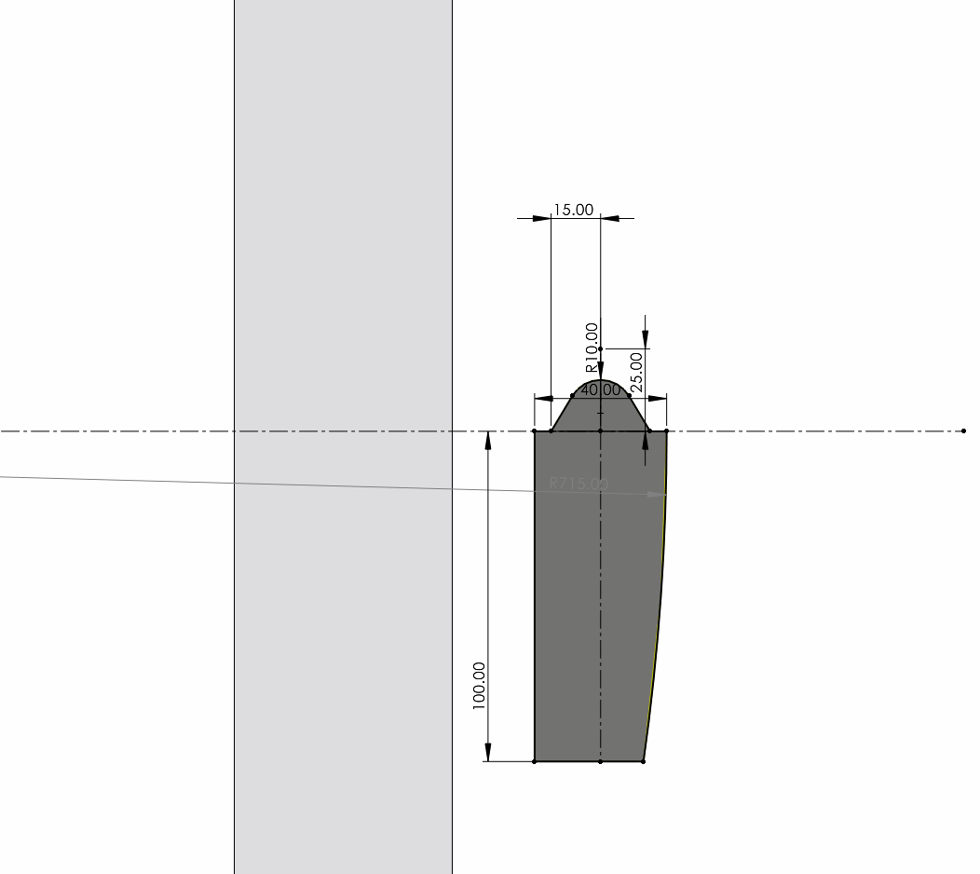
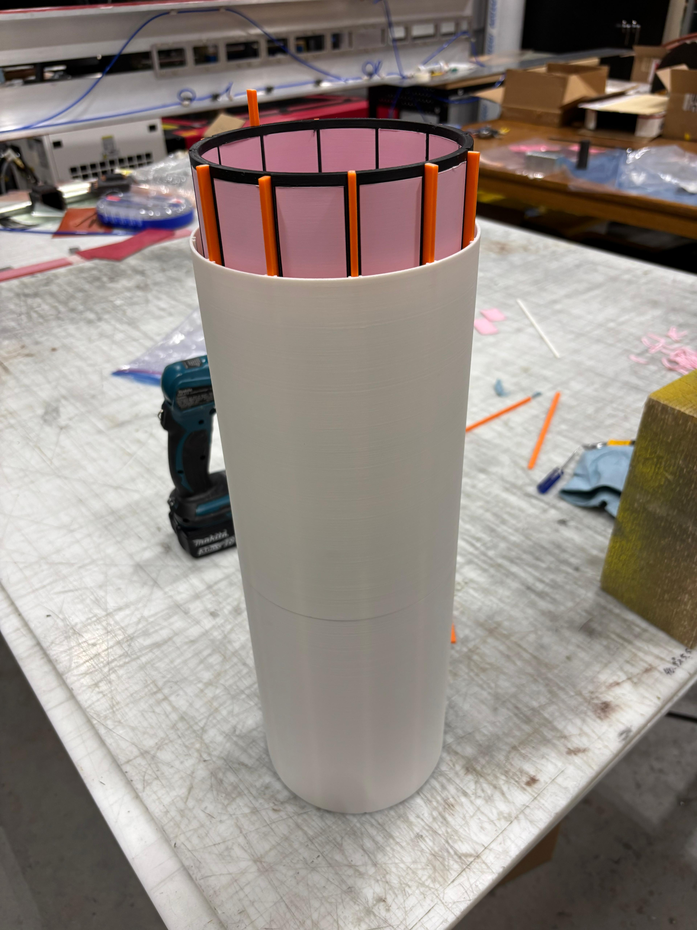
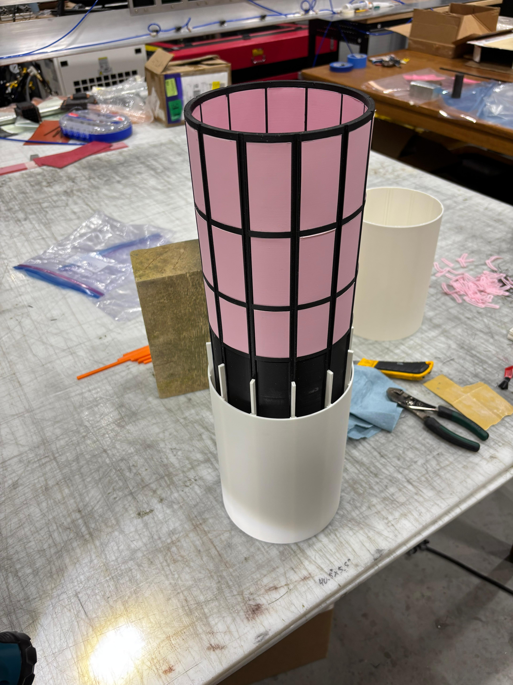
Prototyping progress at Purdue
This is what the design in the EEEMCal geometry looks like.
You can have 1 foot per side – or 2 foot per side – being decided by the FEA and prototypes currently in progress at Purdue
On-going work –
FEA of the new conical rails for GST
Prototyping of the mounting mechanism in 1:10 scale including rails and adjustment mechanism of the GST
Refinement of the mounting mechanism for the EEEMCal and other inner detectors
1:10 scale 3D printed prototype

Slide 5
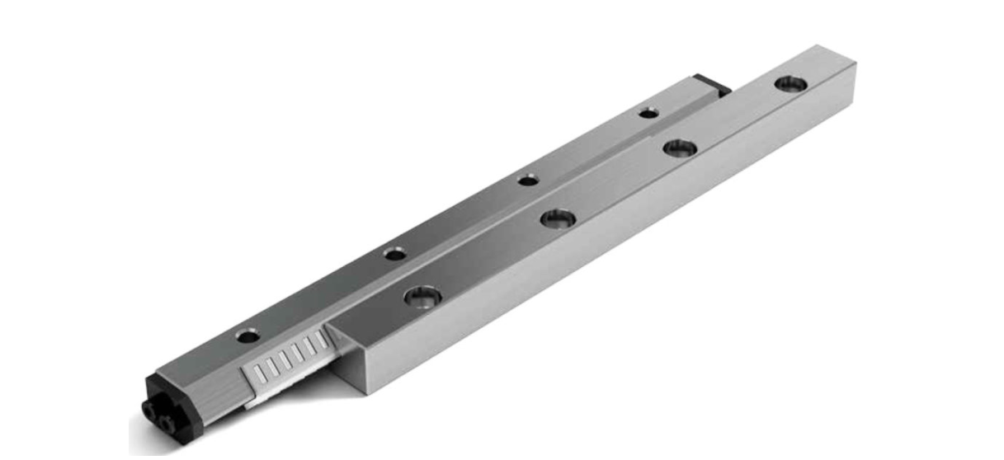
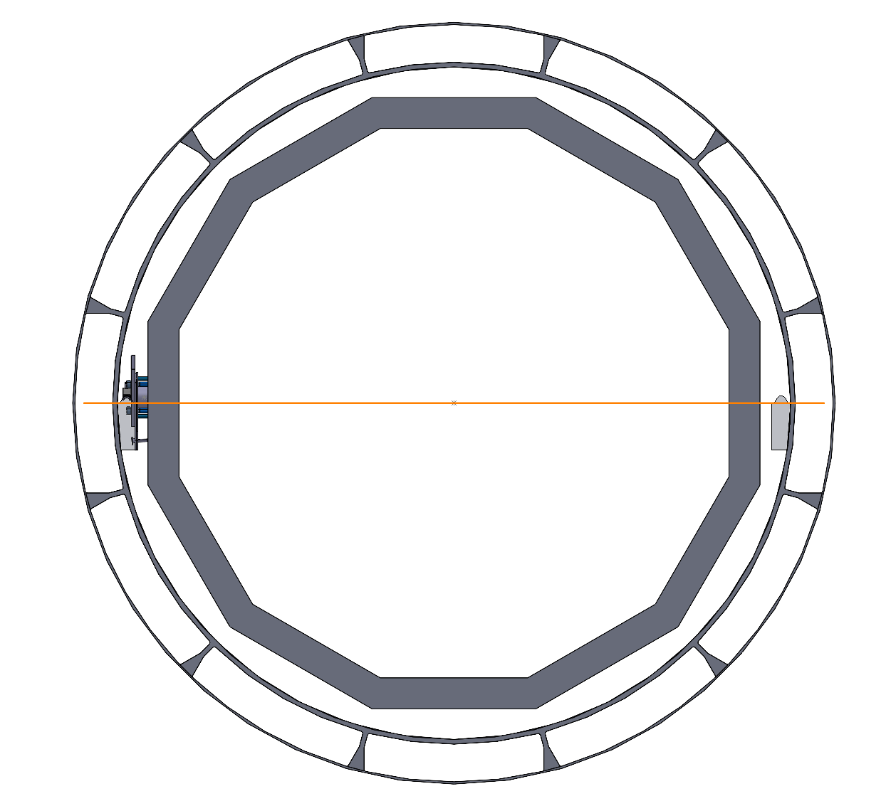
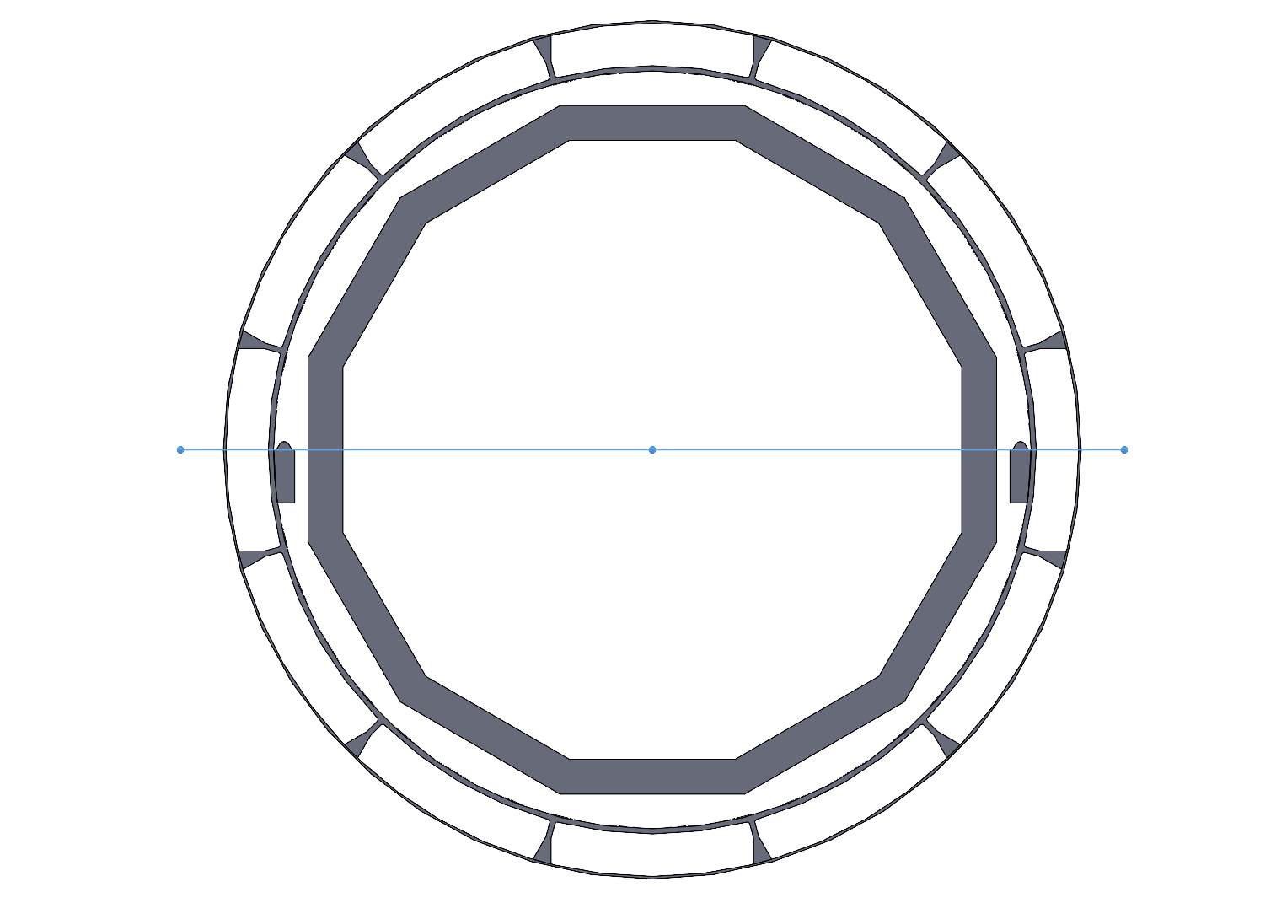
Updated rails to use needle linear bearings
This is the best available for the application
Can take upto 5000 kg
But no off the shelf part available for this
Working with 2 companies for the quotes and possibilities of custom designed linear bearings
NRB bearings is willing to come up with custom solutions for GST – trying to set up a meeting with them in early march
https://www.nrbbearings.com/index.htm
https://www.schneeberger.com/fileadmin/documents/downloadcenter/01_product_catalogues_company_brochures/01_Linear-_and_profiled_guideways/03_Linear_bearings_and_recirculating_units/Linearbearings_-_Product_catalogue_EN.pdf
https://www.linearmotiontips.com/what-are-needle-roller-linear-bearings/

Slide 6
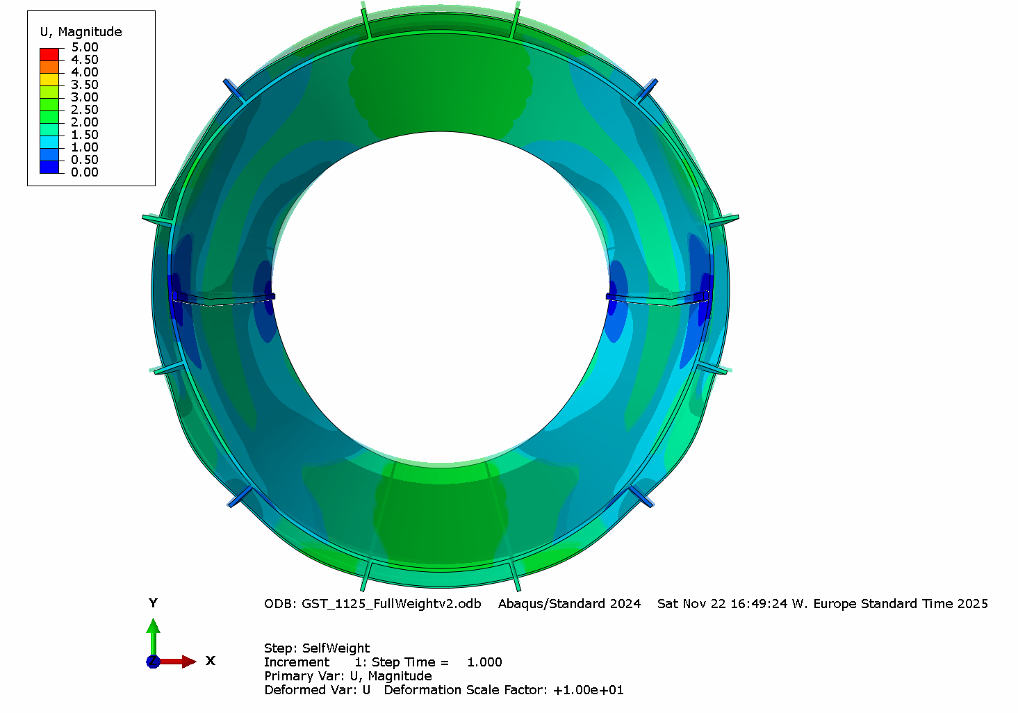
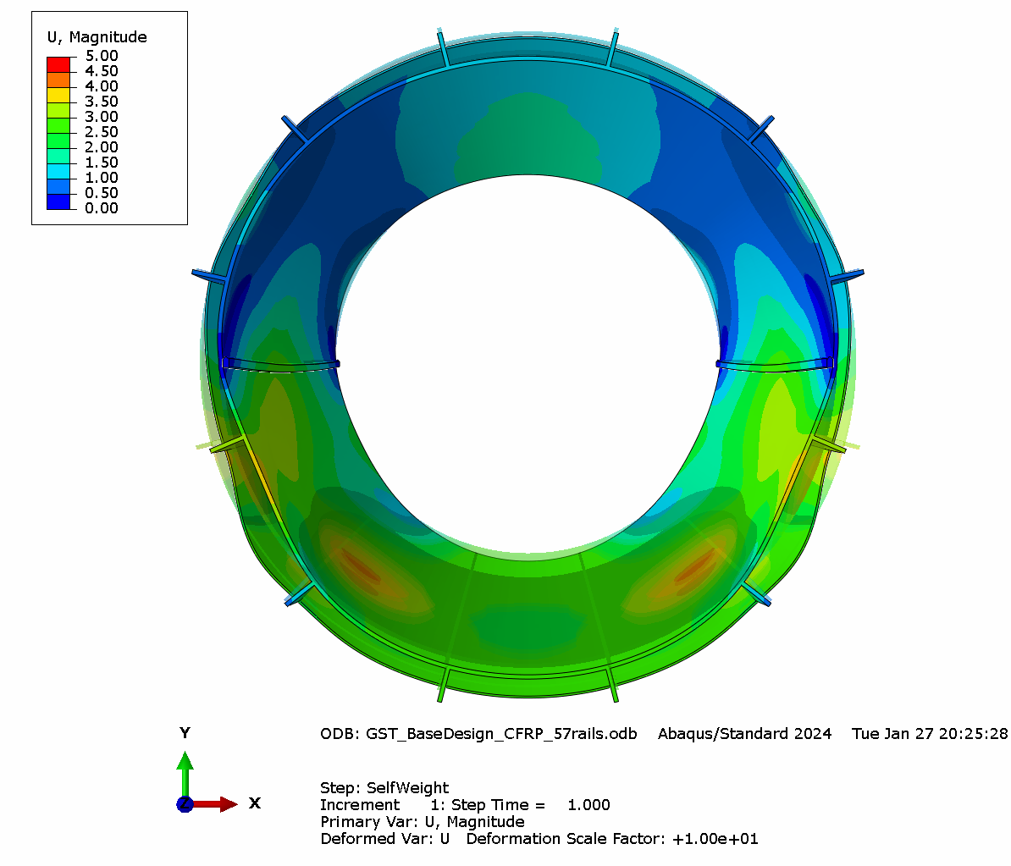
Simulation results for GST
EEEMCal supported at 3 & 9 o’clock
EEEMCal supported at ~ 5 & 7 o’clock

Slide 7
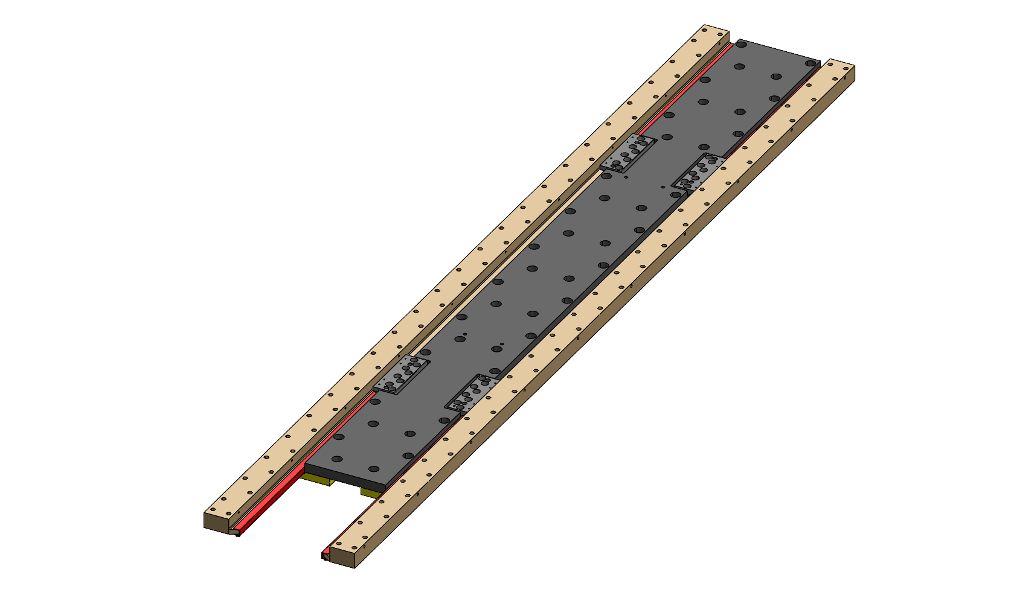
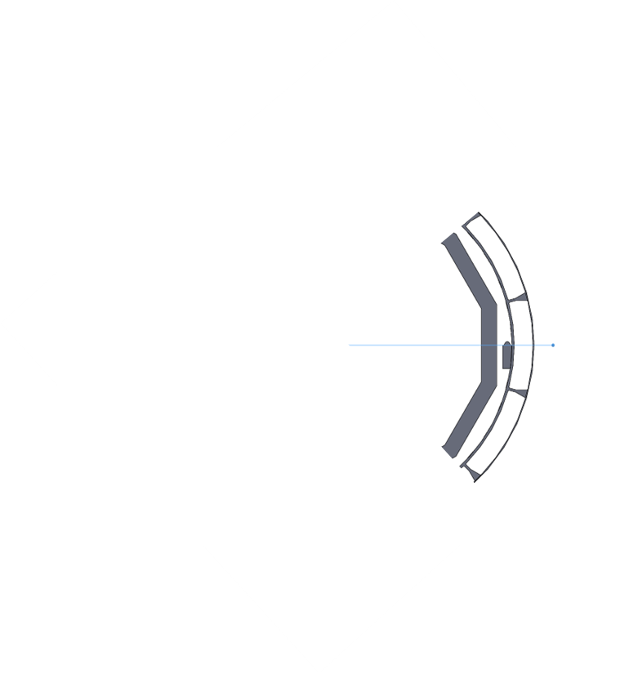


Mounting mechanism design – preliminary for quartz HPDIRC crystals into GST
Very preliminary adaptation from the HGCAL mounting mechanism for CMS.
Still working out the details – stress analysis for crystals
Coming up next work –
Full scale 3 drawer prototype of GST with rails and inserts for HP-DIRC
(well I guess not the EEEMCal part of this picture)
Delrin sliders with ball bearings
Back plate to support the crystals – major load carrying mechanism
Rails that will mount on the GST beams to support HP-DIRC and outer MPGD
Kinematic mounts (still need to design and find)
Current team working on GST
Andy Jung
Sushrut Karmarkar (Engineer)
Anish Tilak (PhD student)
David Vasilev (UG intern)
Gavin Forrest (UG intern)

Slide 8
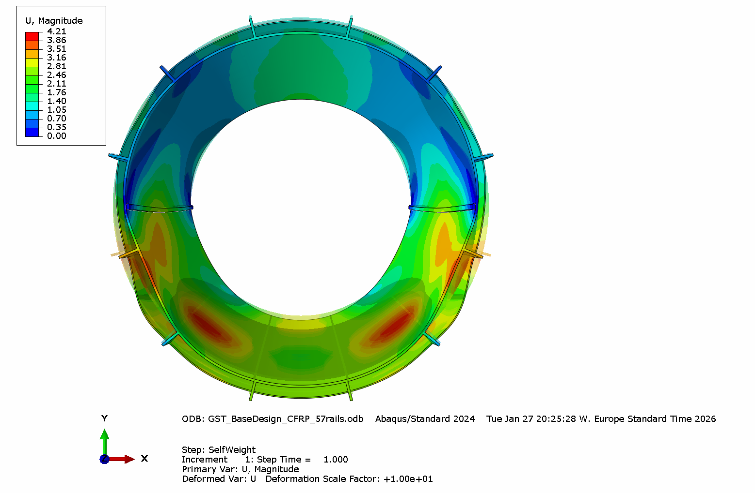
Simulation results for GST

Slide 9
Minutes of meeting and to-do
EEEMCal support at 3 & 9 o’clock is better for HPDIRC – create an interface document with requirements from GST mechanics that can be shared for the design of each sub-detector
Get a timeline from now to August to get the baseline design ready and delivered
Monday 2nd March – share this EEEMCal mounting design (as shown in this slides) with the larger group – also pfRICH
2 weeks from now – Friday meeting 13th March – design for the GST adjustment banana brackets – internal review
Find out what is needed for the HP-DIRC sliders by having another engineering meeting with the group – to be set by BNL Engineering team
TOF and Cymbal – drawers and mounting mechanisms for services and trays
Barrel EMCal structural design needs or requirements to make it manufacturable

