Slide 1
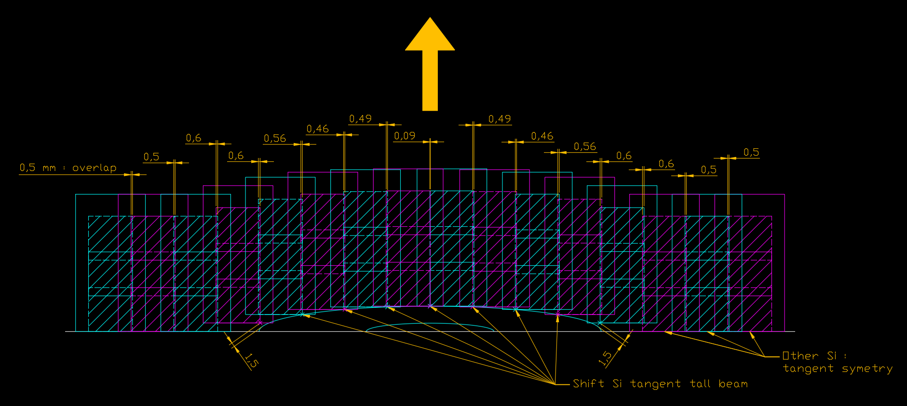
Roman Pots
Studies of sensor shape adaptation
according to beam size

Slide 2
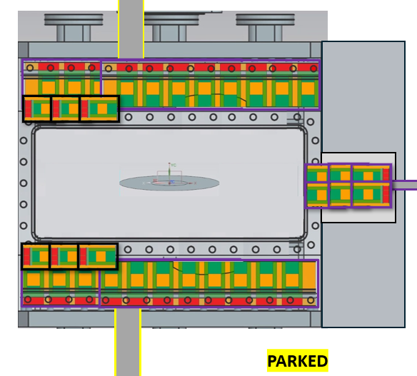
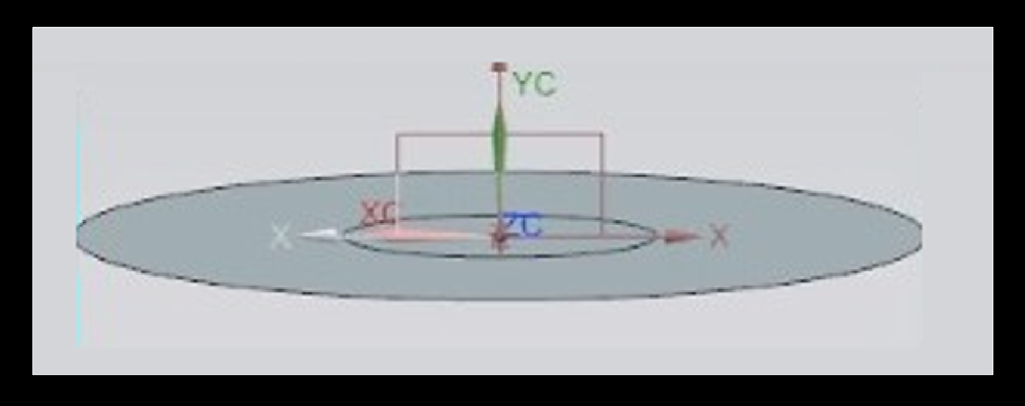
Plot beams from file “Roman-pot-configs-121525.pptx” (Screen capture)

Slide 3
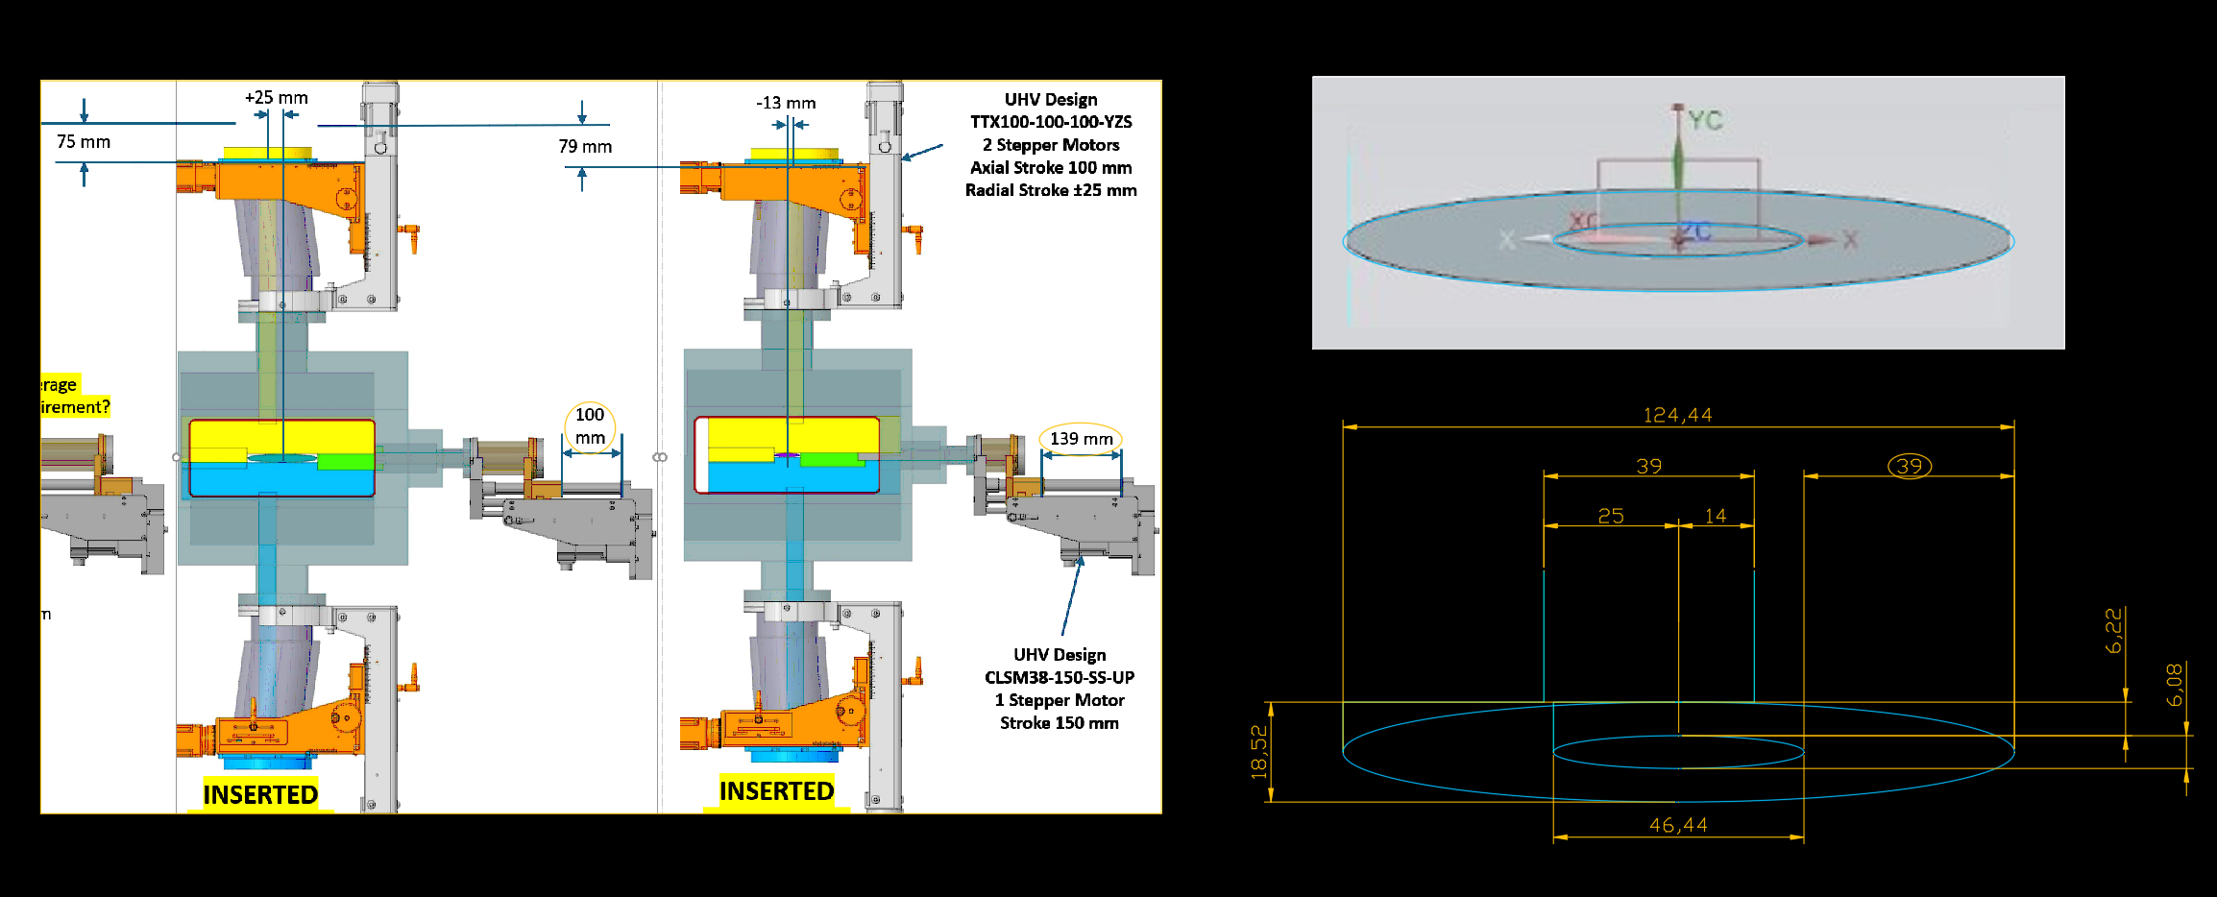
Scale beams with horizontal delta mouvement 39 mm

Slide 4
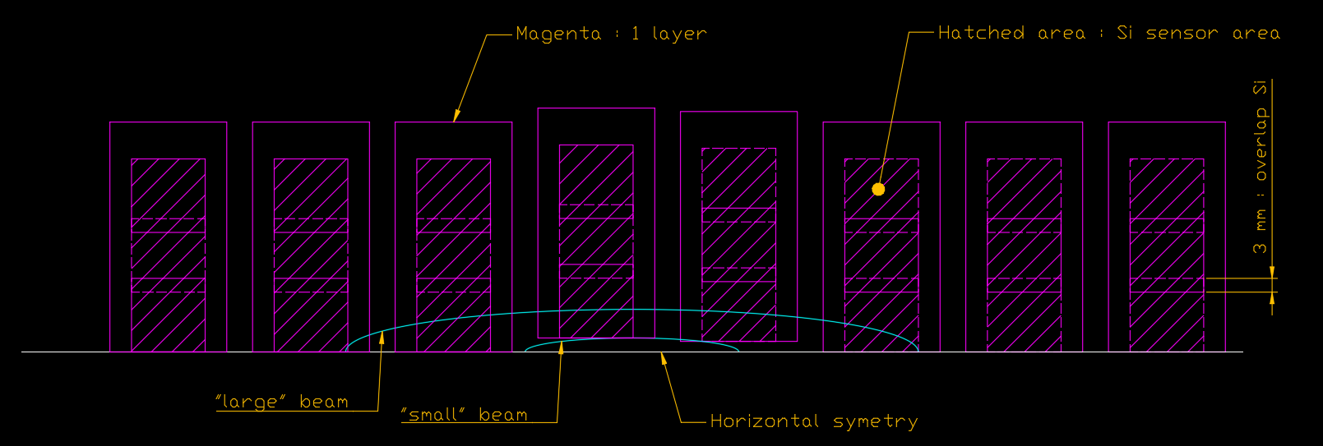
Draw modules layer

Slide 5
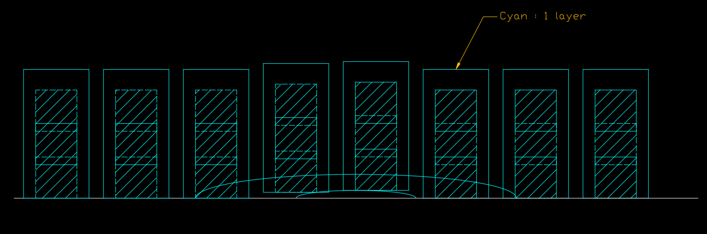
Draw modules layer

Slide 6
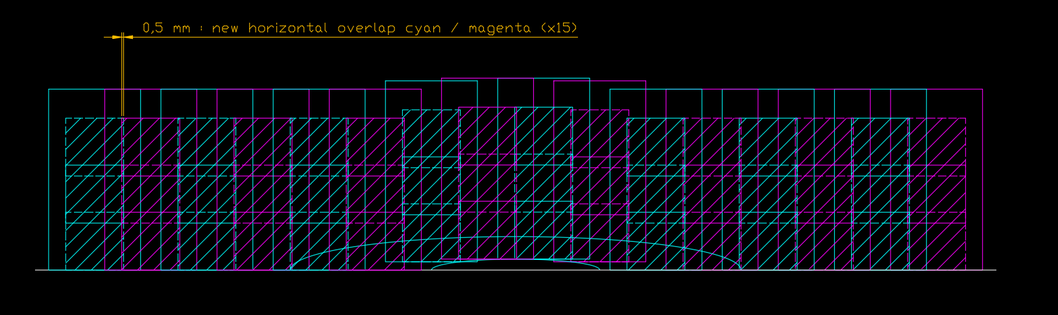
2 layers together

Slide 7
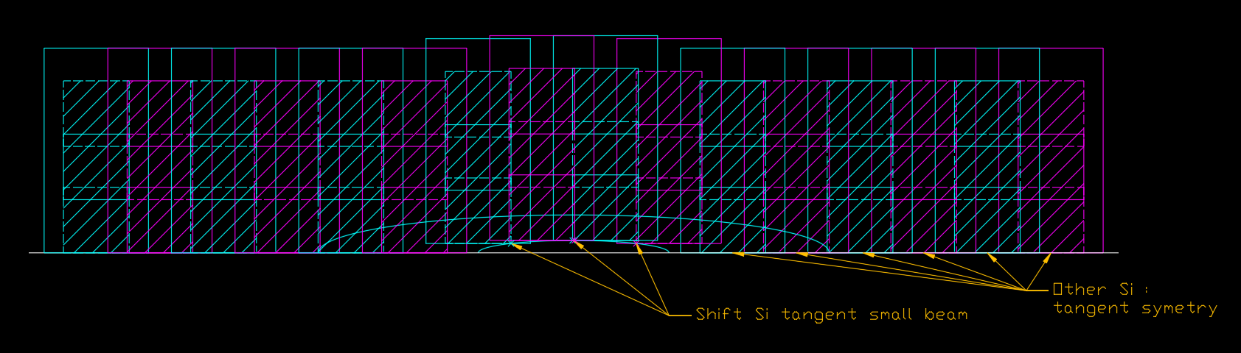
Sensor shape 1 : small beam

Slide 8
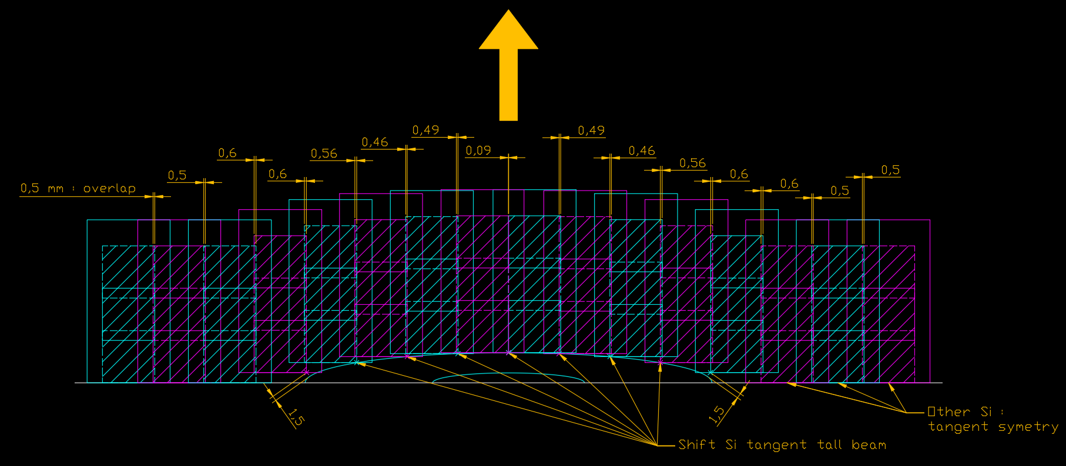
Central movement : Sensor shape 2 for tall beam

Slide 9
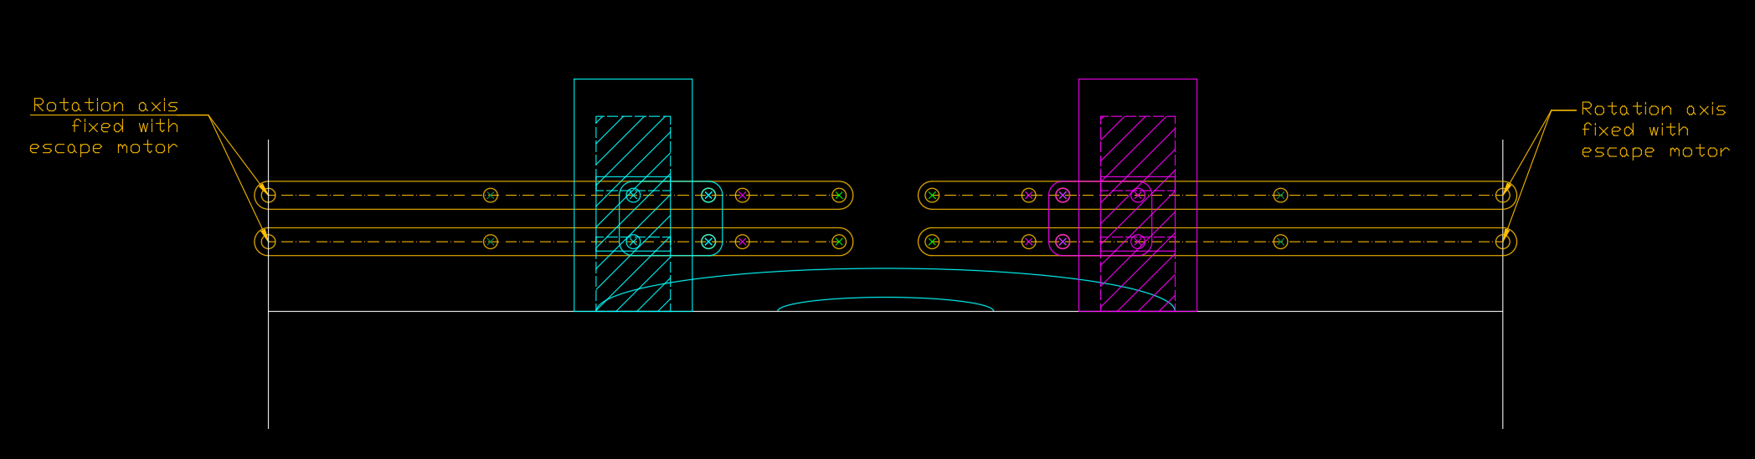
Mechanism principle : the parallelogram

Slide 10
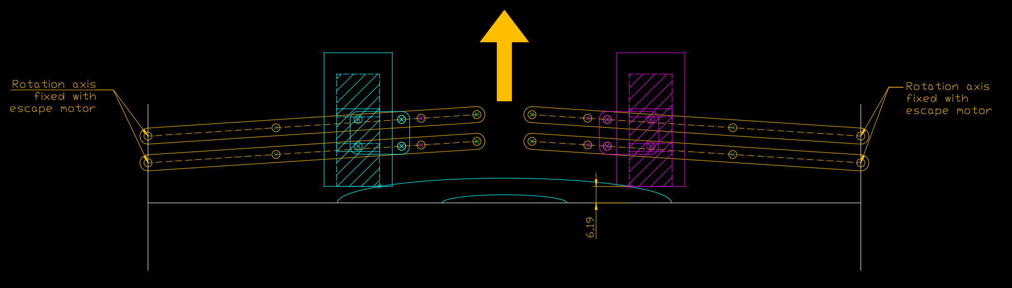
Mechanism principle : the parallelogram

Slide 11
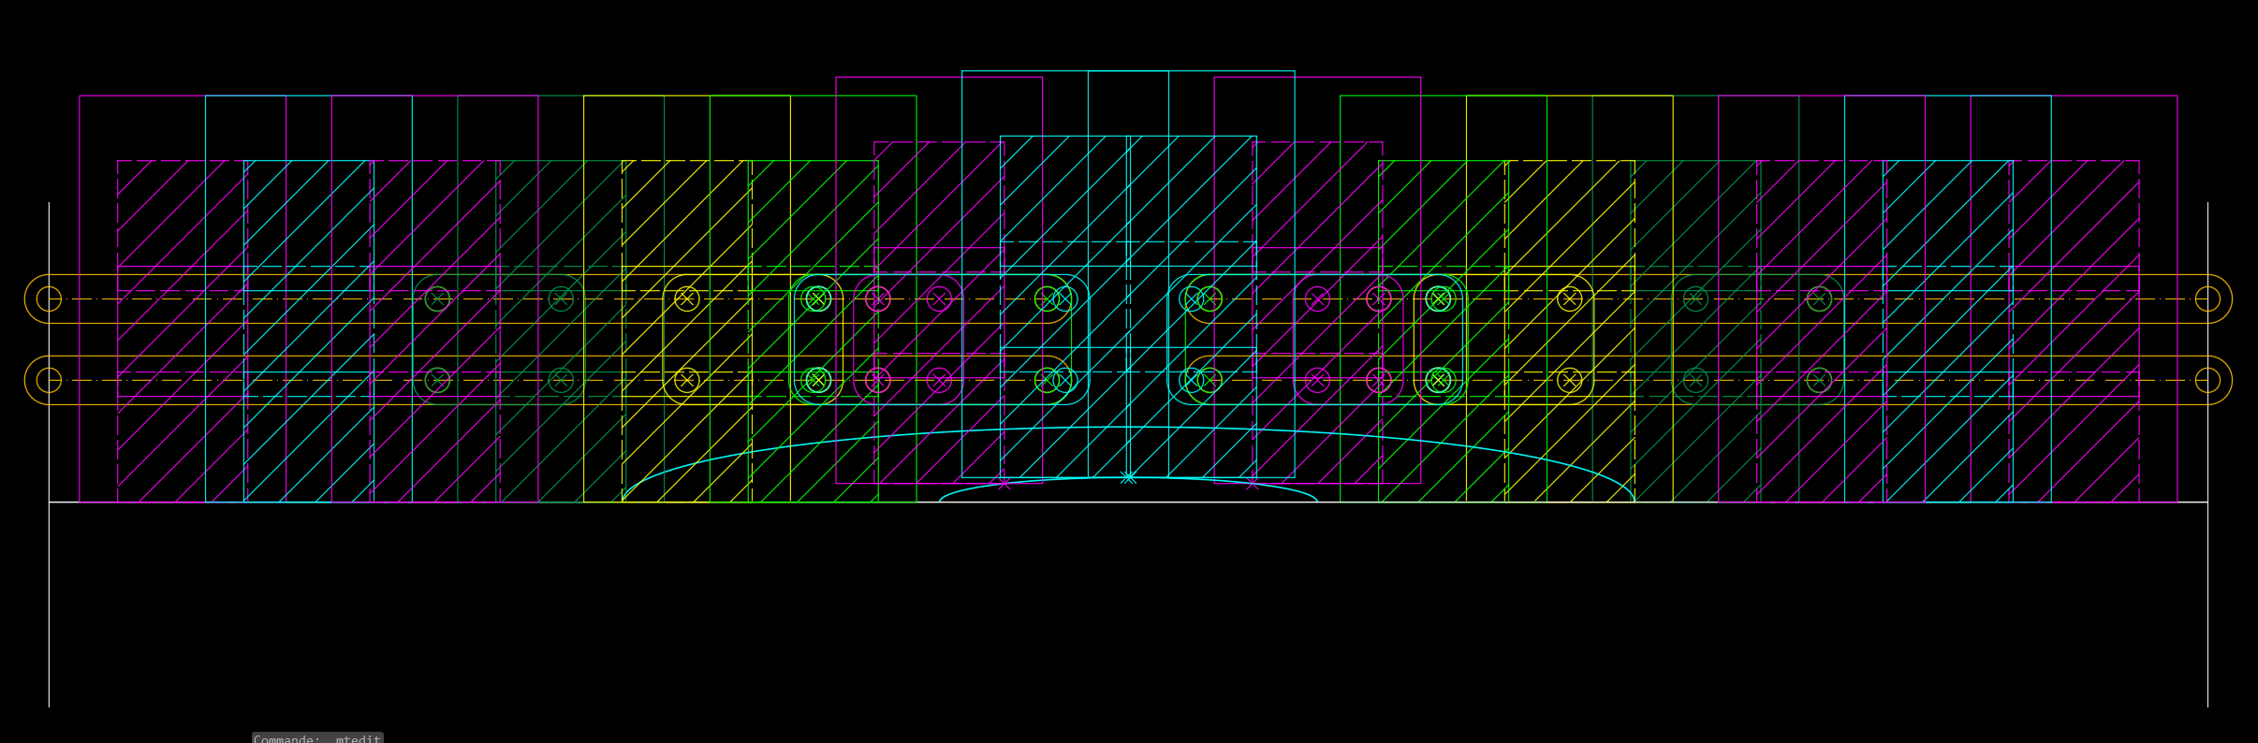
Shape 1 all modules with different colors

Slide 12
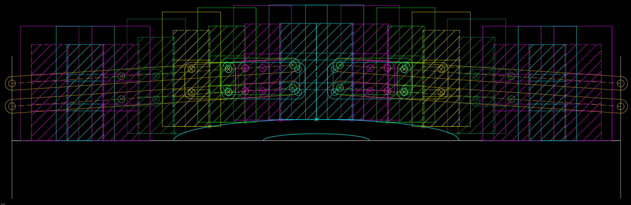
Shape 2 all modules with different colors

Slide 13
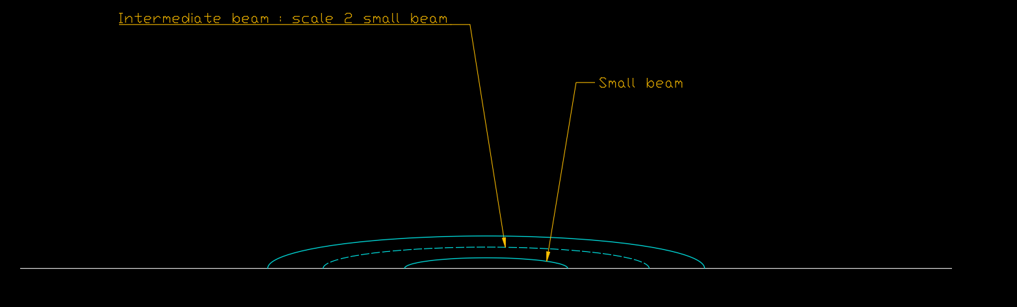
Study with intermediate size beam

Slide 14
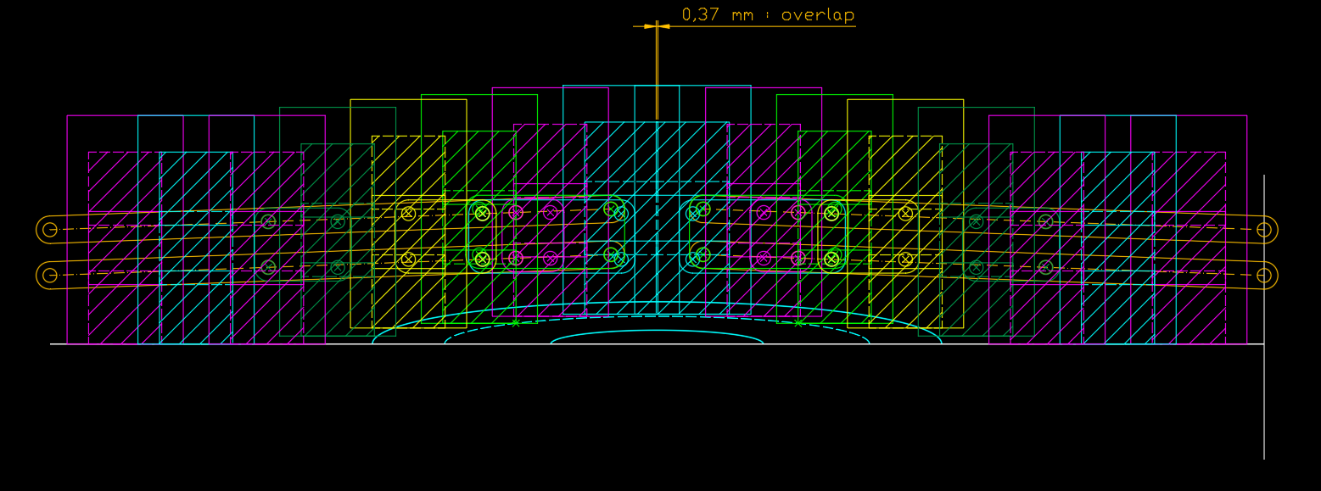
With the same mechanism, study with intermediate size beam

Slide 15
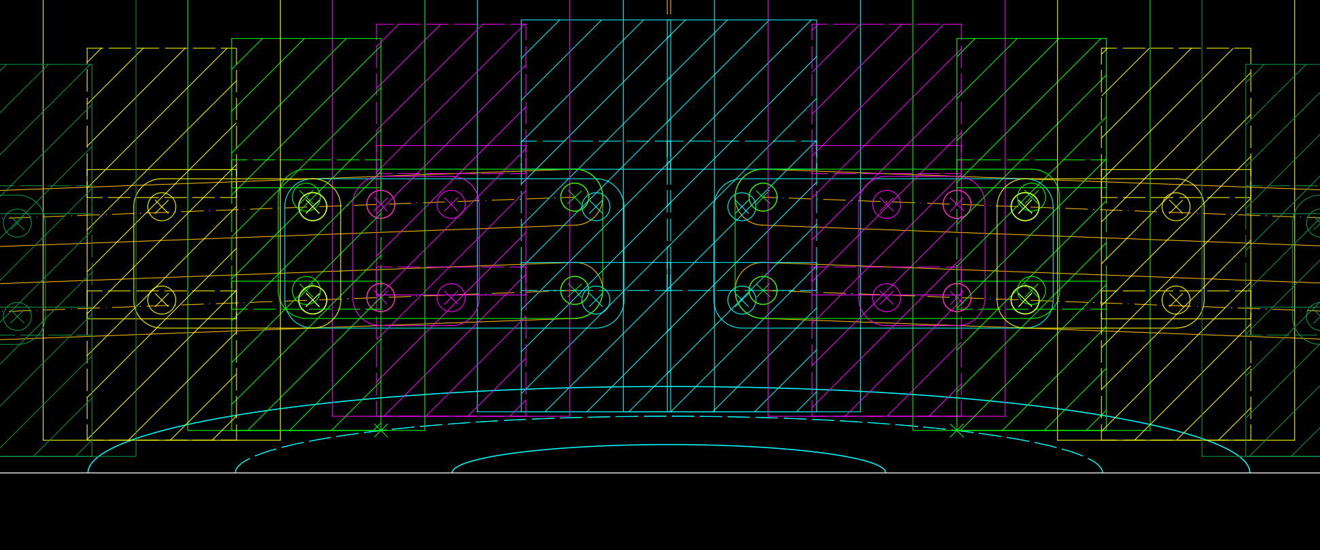
With the same mechanism, study with intermediate size beam

Slide 16
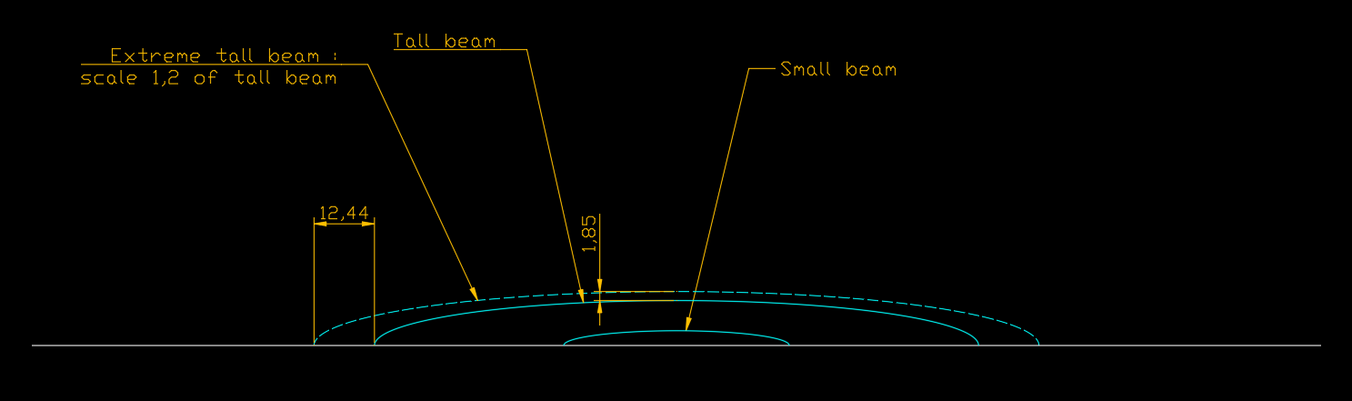
Study with extreme tall size beam

Slide 17
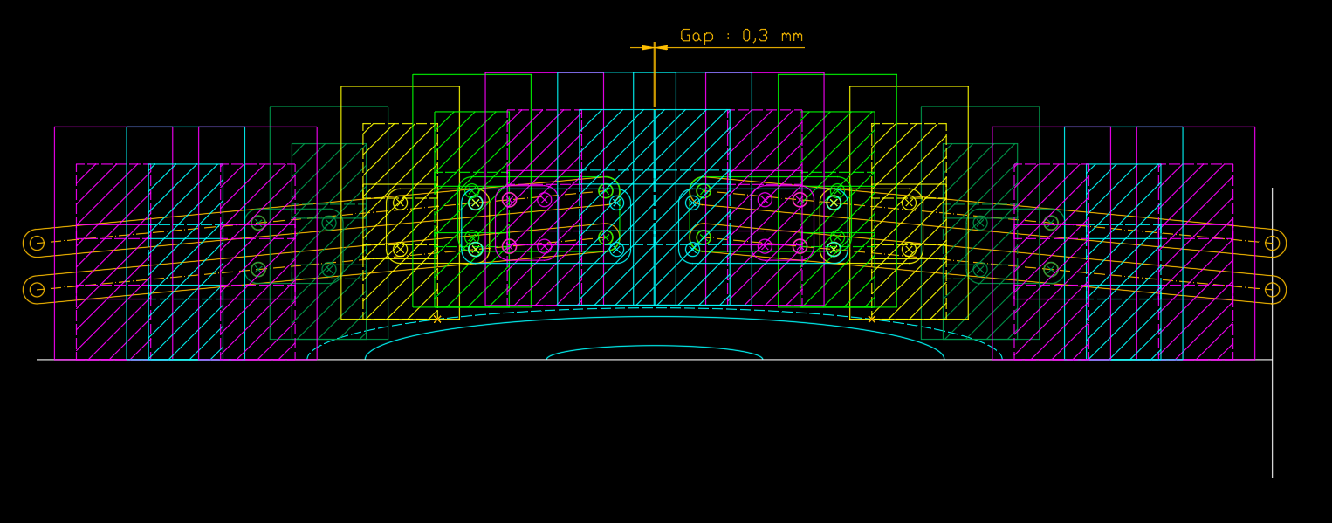
With the same mechanism, study with extreme tall beam

Slide 18
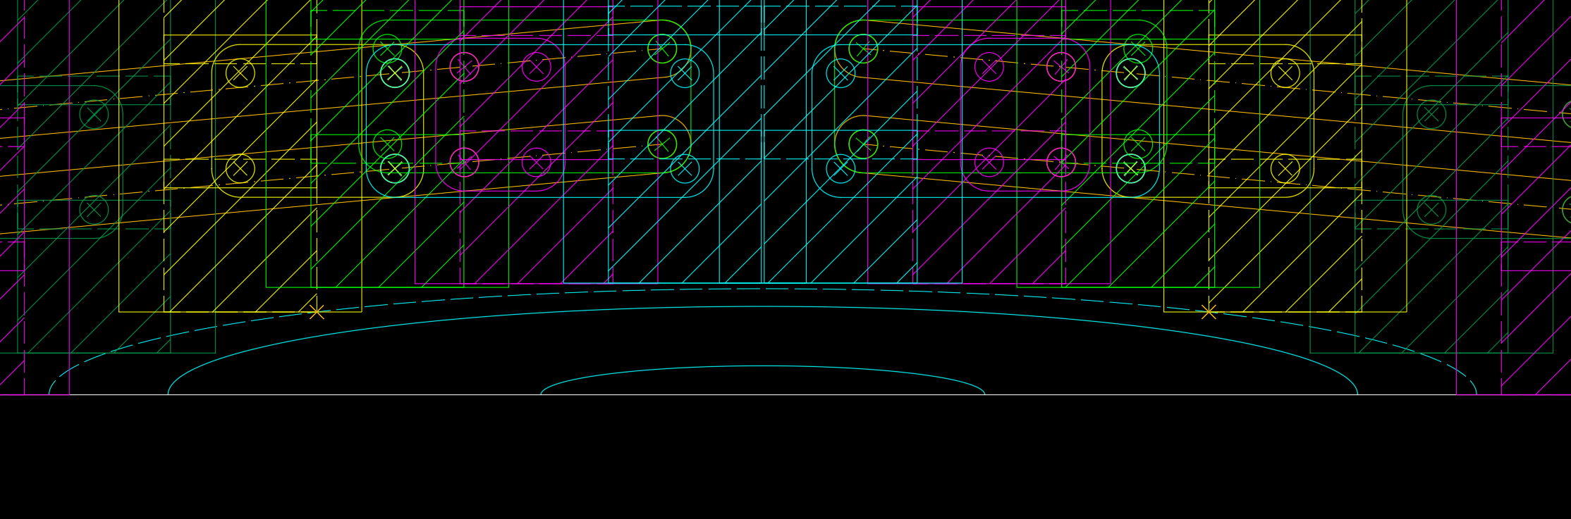
With the same mechanism, study with extreme tall beam

Slide 19
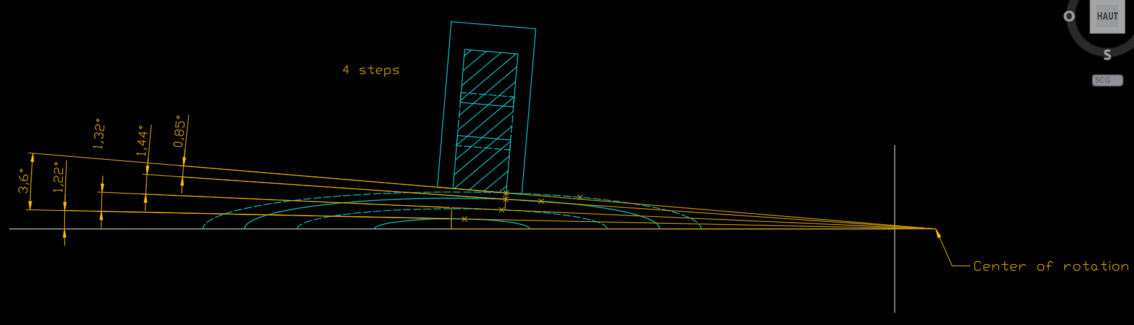
Study ongoing an another mechanism : rotation around a point

Slide 20
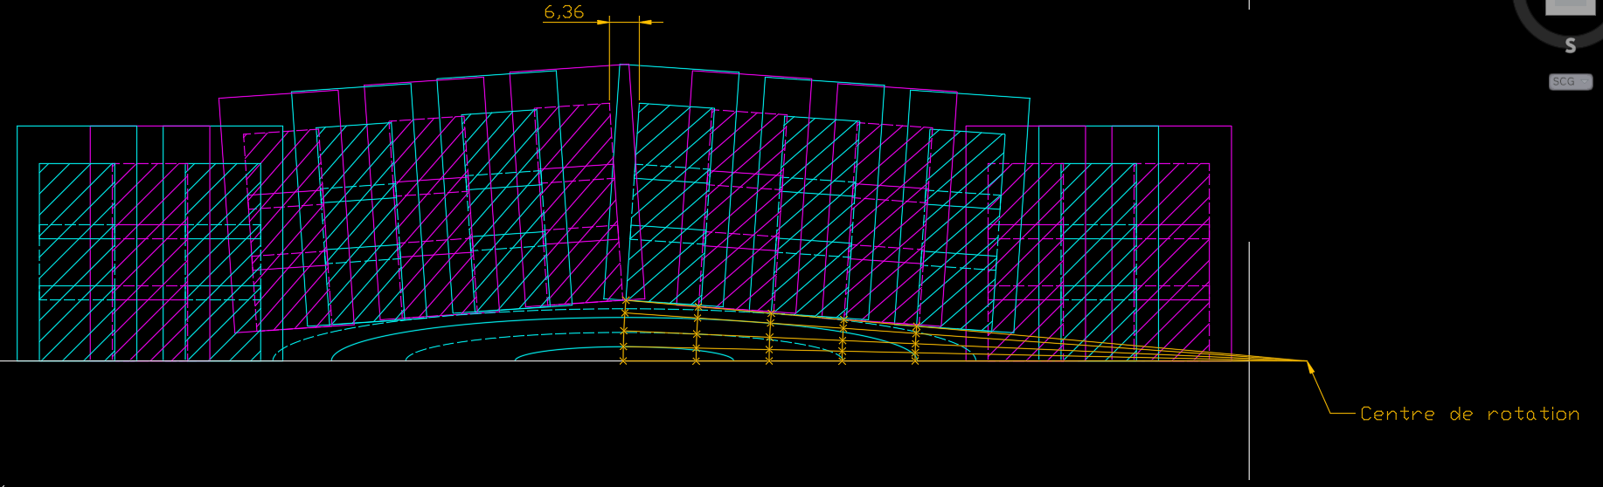
Study ongoing an another mechanism : rotation around a point

Slide 21
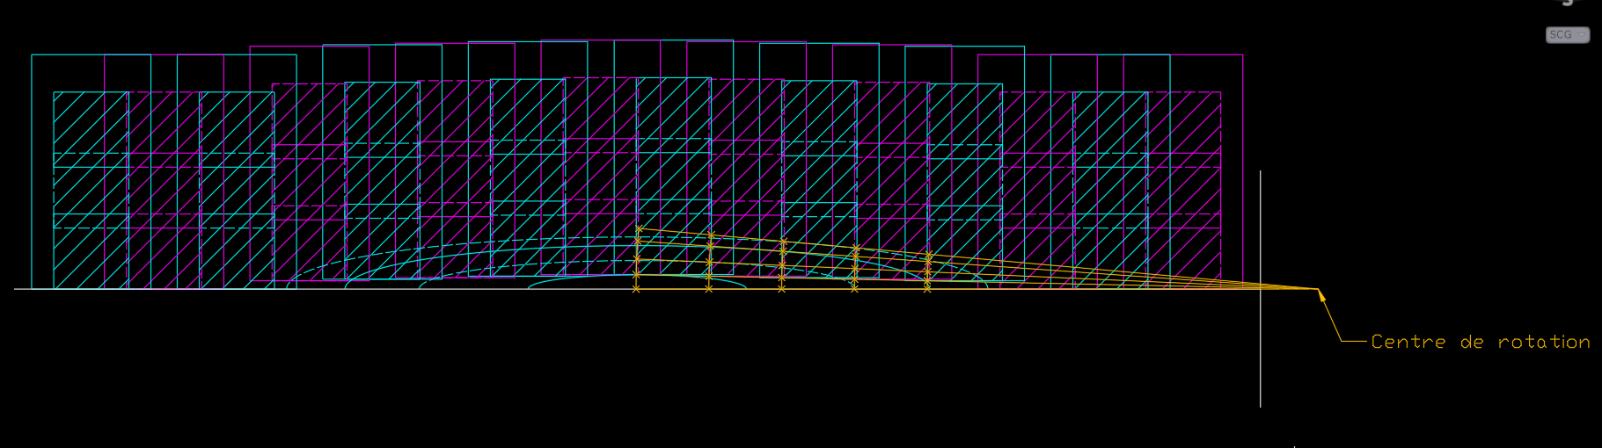
Study ongoing an another mechanism : rotation around a point

Slide 22
Summary
We propose a solution to adapt the shape of the Roman Pots to the beam
Necessitates a single motor
Can reasonnably adapt to intermediate shapes
Can stay in a single vaccum chamber
Can be placed out of the way of the cooling and electronics connections
Needed for more advanced studies
What are the strategic area(s) for the physics around beams ?
What are the expected beam sizes ?
What horizontal overlap is preferable ?
Do we want a vertical overlap between the bottom and the top layers ?
How much space is needed for the connectors ?

Slide 23
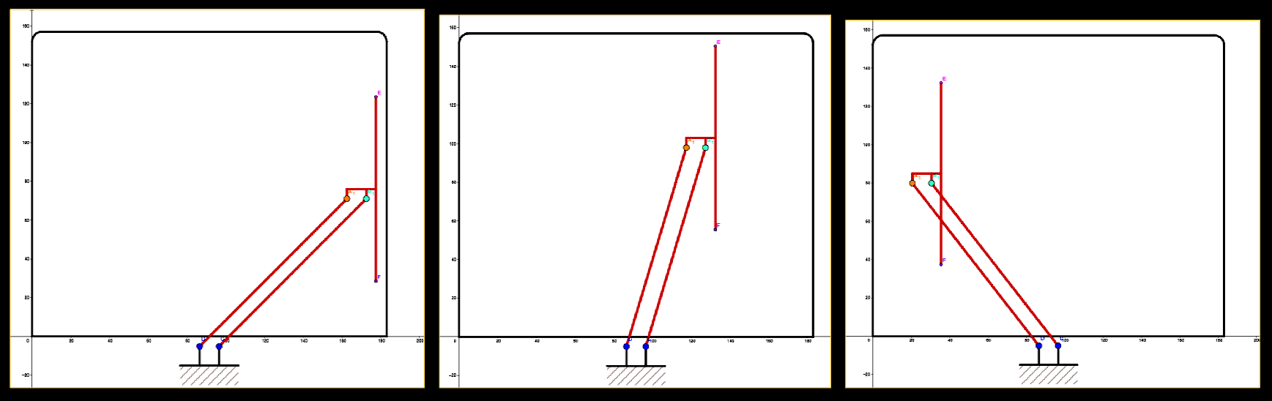
The parallelogram Exemple : bus wiper blade

