Slide 1
AC-LGAD + EICROC testing @ BNL
Alex Jentsch (BNL) on behalf of the BNL team
Alessandro Tricoli, Gabriele Giacomini, Ashik Ikbal, Souvik Paul, Maya Mancini, Prashanth Shanmuganathan, Prithwish Tribedy
ePIC Collaboration Meeting
Jan 20th to 24th, 2026

Slide 2
Overview of BNL involvement
Goal was to apply AC-LGAD technology to far-forward detectors → Roman pots, OMD, B0 tracking (this came later).
Natural choice for BNL to be involved in the FF detectors given the machine design and tight requirements for the detectors to operate in the vacuum, in the accelerator magnet, etc.
Since then, BNL has focused on the integration & planned construction of the Roman pots and OMD and the testing of the AC-LGADs + EICROC.

Slide 3
Recent activities
TCT scans of sensors and of bump-bonded assembly (using etched sensor).
Testing with radioactive source → jitter measurements.
Testing with IR laser → jitter measurements.
All of this work has focused on the analog output from the EICROC or using the Fermilab testboards with low-noise preamps.
Focus for the next few months is on work on TDC (with the new EICROC firmware) and work needed for testbeam prep in early Summer (assuming SPS beam time is greenlit).
  Setup of RBv1 test chain with EICROC1.
  Test of first bump-bonding with large AC-LGAD and EICROC1.
  Preparation of assemblies for testbeam (e.g. wire-bonding 32x32 sensors to test boards, bench tests, tests of readout chain with digitizers).

Slide 4
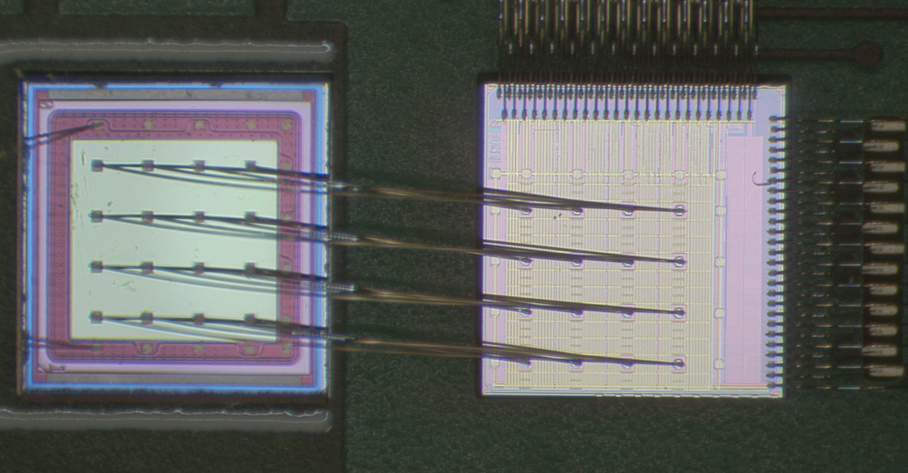
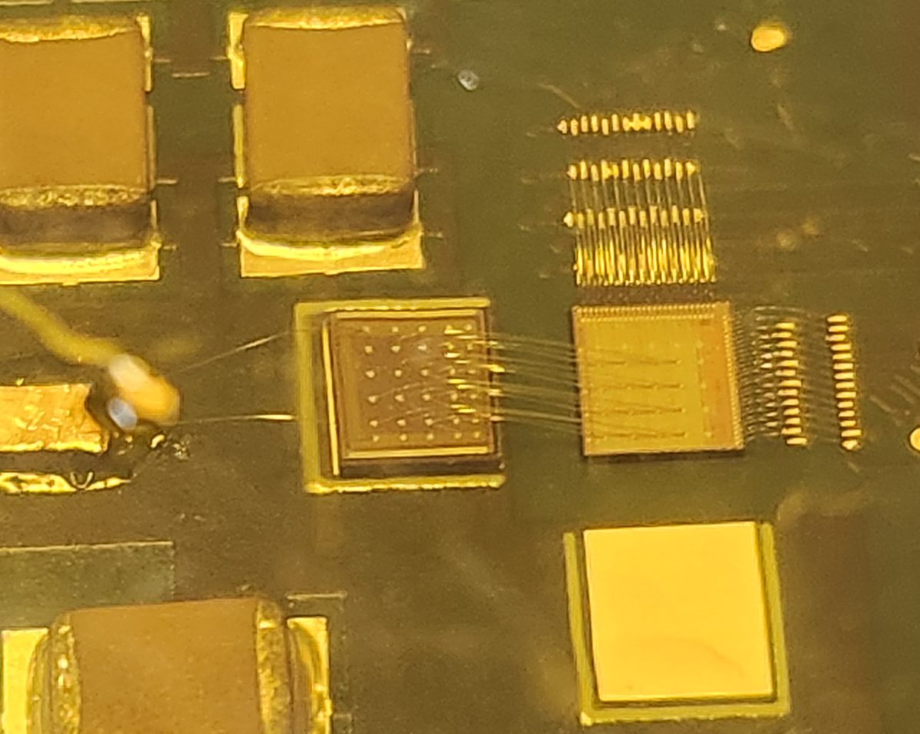
Implementation of AC-LGADs for FF Tracking
AC-LGAD
EICROC0
BNL AC-LGAD:
500x500 um² pixel pitch
100x100 um² metal electrode
30um active thickness
EICROC ASIC proposed for pixilated AC-LGADs.
  Uses infrastructure from ALTIROC (used for DC-LGADs in ATLAS) and HGCROC (I2C)
  Currently only 4x4 channel version exists, 32x32 (full channel count) in production (to arrive in Feb./March 2026).
  Also used in FTOF (or any pixilated AC-LGAD detector).

Slide 5
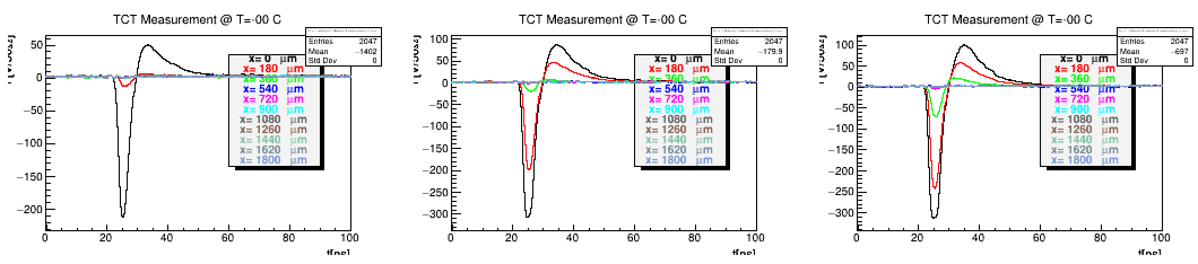
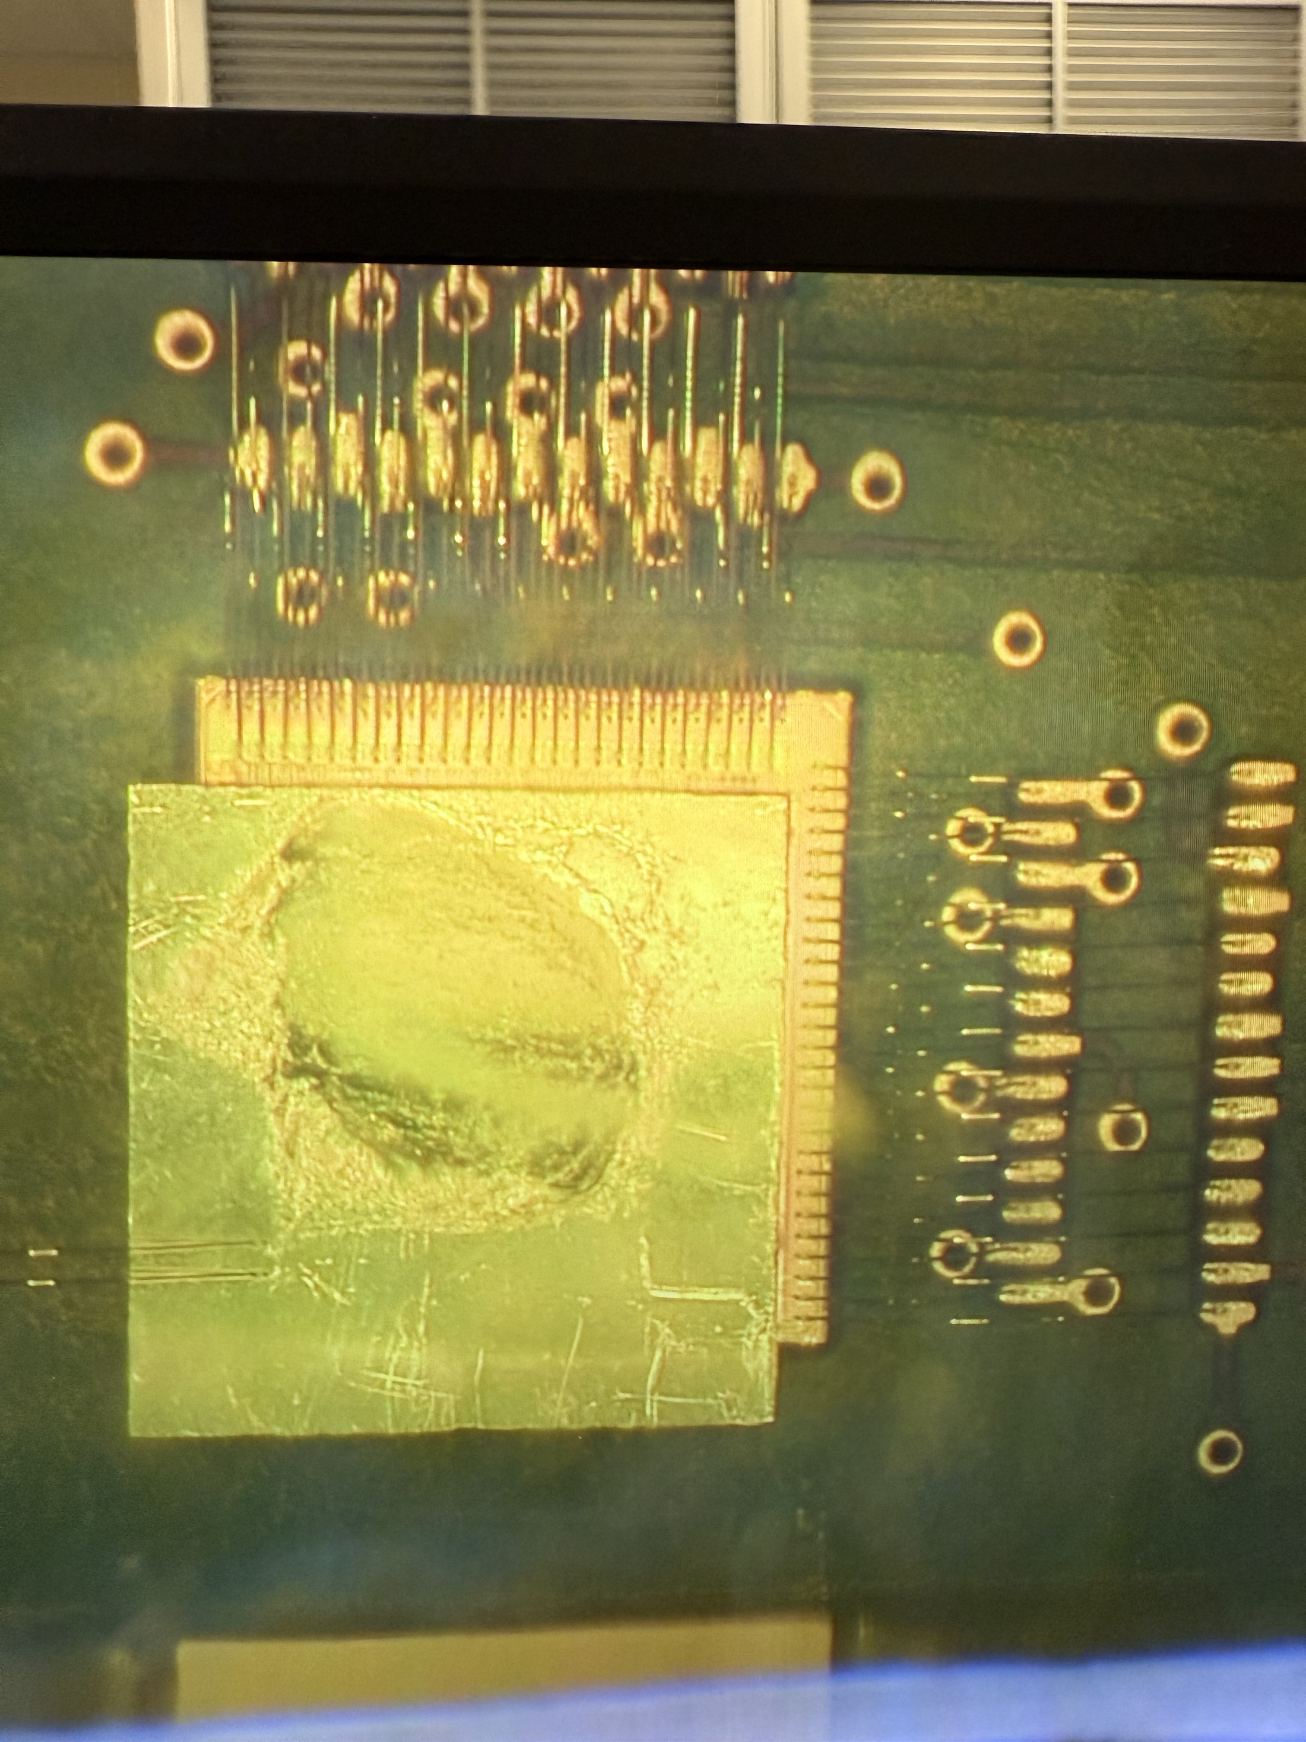
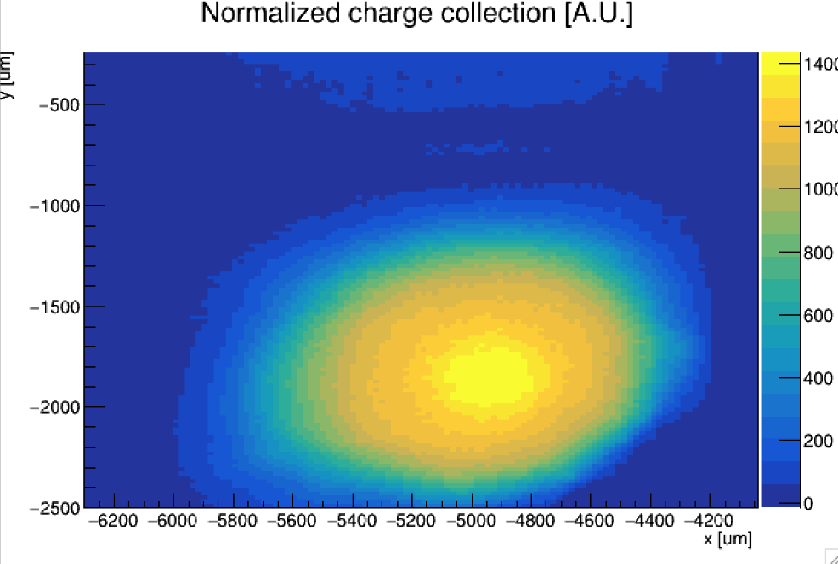
AC-LGAD Testing → AC-LGAD + EICROC0
V [mV]
V [mV]
V [mV]
t[ns]
t[ns]
t[ns]
AC-LGAD (HPK) “etched” to remove portions of the backplane which normally block incident TCT IR light from the laser in a bump-bonded assembly.
  Etching by Simone Mazza from UCSC.
TCT is useful for doing position dependent measurements (e.g for spatial resolution), and for probing uniformity of charge collection and gain.
Etched, bump-bonded assembly.

Slide 6
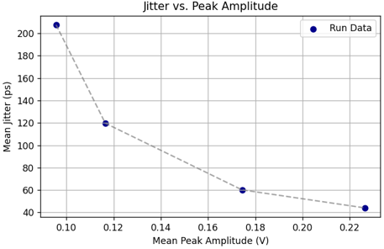
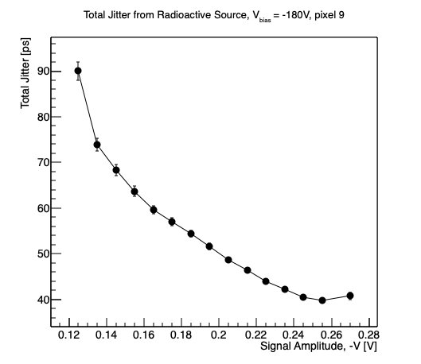
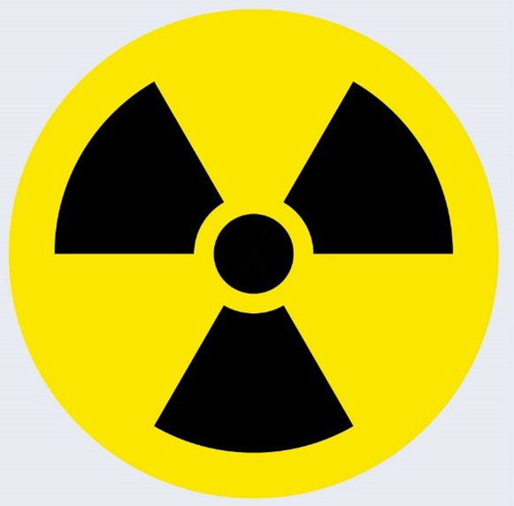
AC-LGAD Testing → AC-LGAD + EICROC0
Laser measurements (variable laser power)
Sr-90 radioactive source
Jitter measured using full bump-bonded sensor + ASIC (readout with commercial Xilinx FPGA board).
  Jitter of sensor ~ 10ps; EICROC (TDC) via charge injection ~ 10-15ps.
Total jitter (via analog output of EICROC test board) ~ 40ps – why?
  Likely from hybridization and/or non-optimal analog readout → under study.

Slide 7
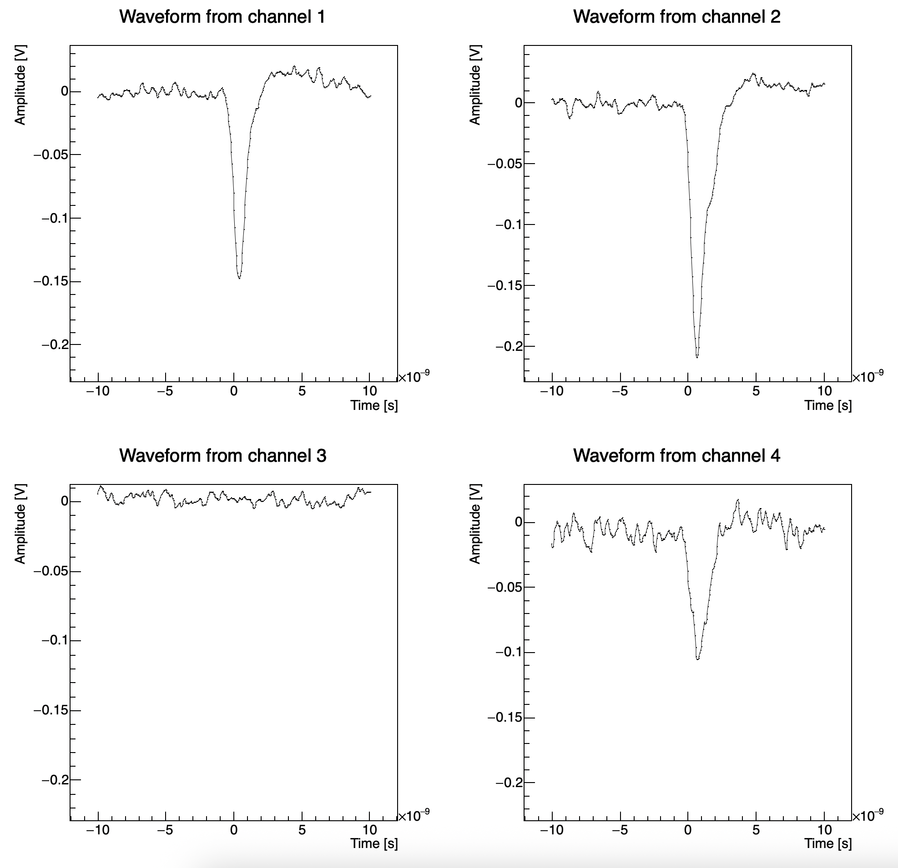
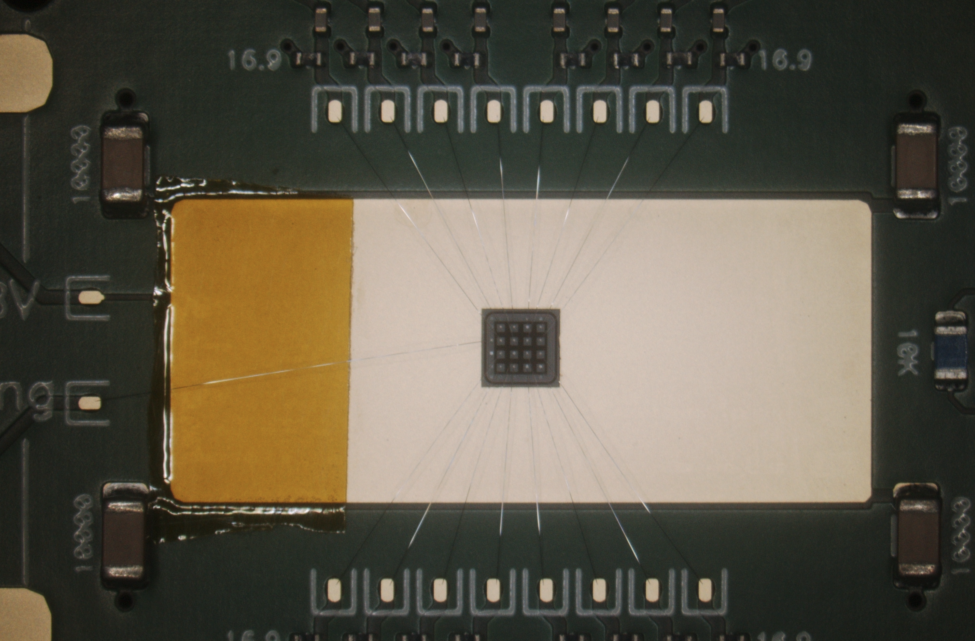
AC-LGAD Testing → AC-LGAD + Fermilab Board
AC-LGAD wire-bonded to Fermilab test board with low noise preamplifiers.
Sensor assembly placed under Sr-90 source and 4 channels readout at once.
  4 pixels in center of sensor.
Teledyne LeCroy 4-channel oscilloscope used to readout analog output from board.
  Channel 1 used as trigger with low threshold.
Goal was to measure the jitter from the pixel with maximum amplitude in each event.
7

Slide 8
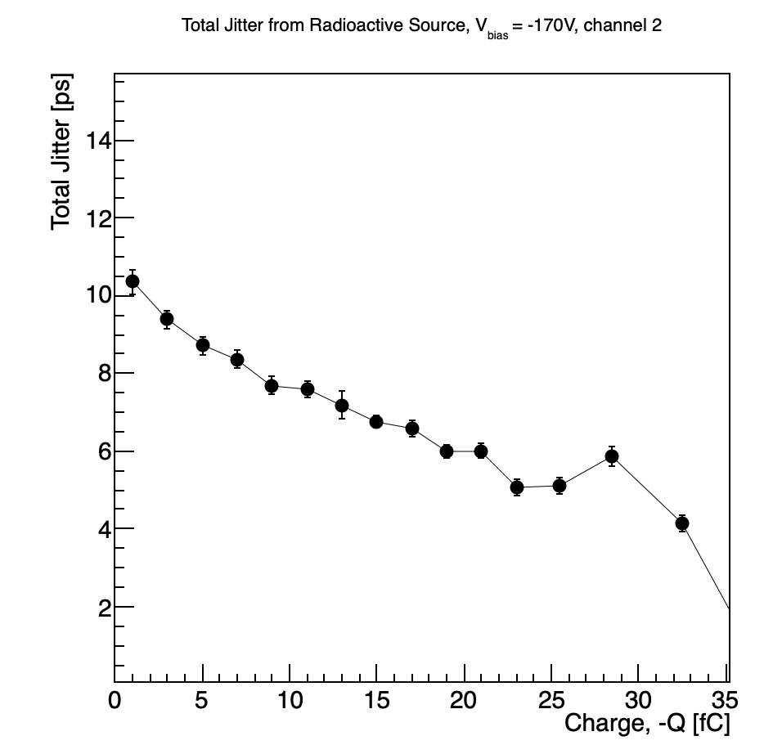
AC-LGAD Testing → AC-LGAD + Fermilab Board
Results with a single pixel taken as a baseline.
Analog signal amplitude converted to charge by integrating waveform over time over the signal region.
  Integral then divided by preamp gain (100) and preamp impedance (50 Ohms) to convert to fC.
Jitter of sensor found to be consistent with previous measurements of similar AC-LGADs.
8

Slide 9
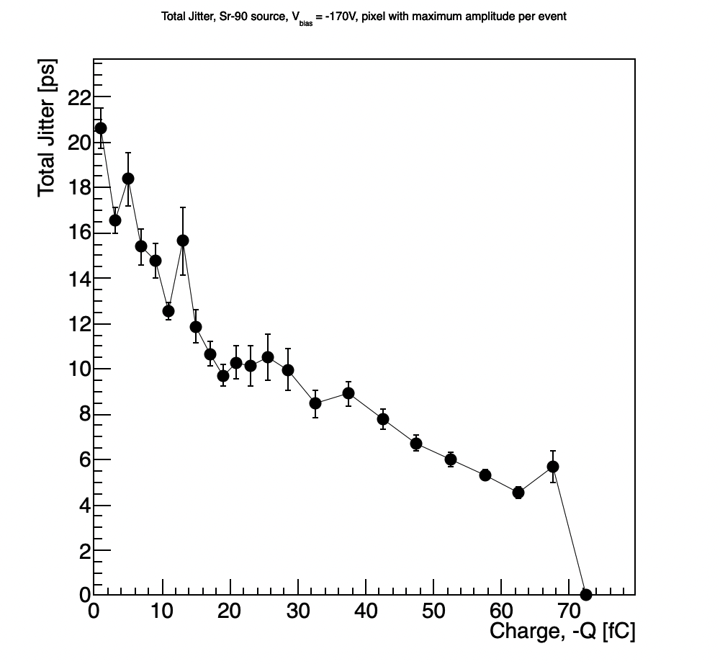
AC-LGAD Testing → AC-LGAD + Fermilab Board
Jitter calculated using multiple pixels, with a focus on the pixel with maximum amplitude from each event.
  Results also found to be consistent with previous measurements.
Jitter measured here using a 30um HPK sensor (same as the other tests) wire-bonded to a Fermilab test board with fast, low-noise preamps.
  Much lower jitter observed.
Jitter measured here by reading out 4 pixels, with one serving as a trigger with a very low threshold, and taking the pixel with the maximum amplitude in each event – those were then used to calculate jitter as a function of charge.
  Waveform time-integrated, and then divided by preamp gain (100) and impedance (50 Ohms)
9

Slide 10
Overall testing plans for AC-LGADs @ BNL
Sensor and ASIC testing between TOF/auxiliary subsystems leverages workforce from all groups.
  Example (currently happening):
    HPK sensors characterized (IV curves) at UCSC (and potentially UIC),
    shipped to BNL for testing with EICROC + laser/sources,
    RBv1 developed by Rice, then sent to BNL (arrived in Dec. 2025),
    sensor/ASIC integration tested at BNL with FPGA; Rbv1 setup tested in parallel (in-progress; see discussion by Tonko),
    when EICROC1 received (Feb./March 2026), integration with RBv1 tested,
    all groups use results for e.g. test beam planning at SPS.
QA needs for sensors/modules for pixilated systems understood (for common items).
  Sensors, ASICs, readout, hybridization, etc.

Slide 11
Some comments on needs for testbeam(s)
Current testbeam setups use sensors + analog boards w/ preamps, which are then read out by external digitizers.
Work needs to be done to test large pixel sensors to assess performance (some may be done in March testbeam, but need to solidify goals).
We have put in a request for SPS test beam → closer to real-life EIC beams (hadrons at high energy).
  Primary goal is to test AC-LGADs w/ ASICs to assess current full-chain performance (for example, EICROC1 + 32x32 HPK AC-LGADs + RBv1 FEB).
  This is ambitious to say the least → sensor performance goals still not met from other campaigns can still be achieved with this testbeam.
    Testing with 4x4 sensors + EICROC0?
  What other goals should we aim to achieve here?
Future (~ 2 weeks) AC-LGAD cross-cutting meeting will discuss goals, needed resources, institutional support, etc. to assure a successful SPS campaign (assuming SPS approves the beam time; still waiting to hear from them).

Slide 12
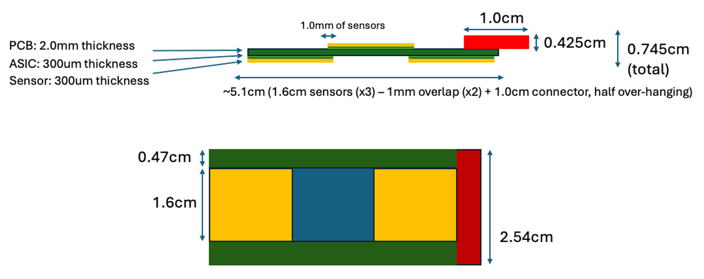
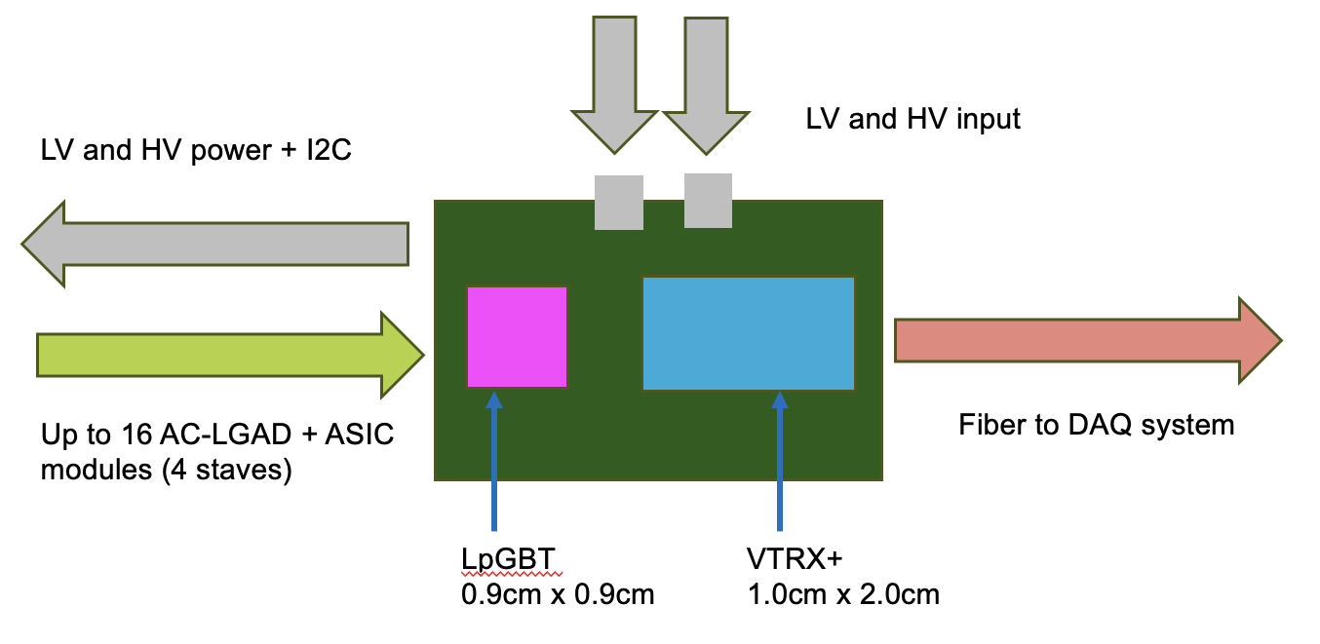
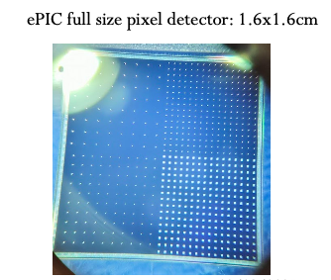
Implementation of AC-LGADs for FF Tracking
Readout needs to be separated from sensor/ASIC board to obey physical constraints for far-forward subsystems.
*Stave dimensions will be updated once EICROC1 schematic is in-hand.
Far-forward sensor “staves”
  (3) 1.6cm x 1.6cm AC-LGADs with 500um pixel pitch
  bump-bonded to EICROC1/2 ASICs
  staggered on a two-sided PCB to provide full active-area coverage.
  These sensors have 32x32 channels, matching the EICROC1/2.
    Currently have 32x32 channel sensors from HPK which are under test.

Slide 13
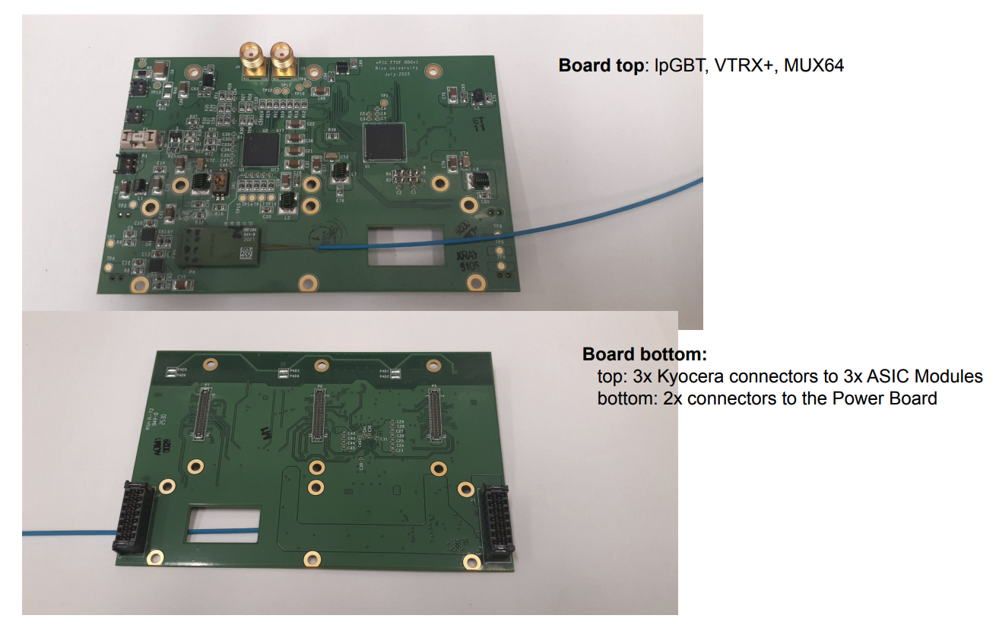
Implementation of AC-LGADs for FF Tracking
Tonko Ljubicic (Rice Univ.)
*Stave dimensions will be updated once EICROC1 schematic is in-hand.
Far-forward sensor “staves”
  (3) 1.6cm x 1.6cm AC-LGADs with 500um pixel pitch
  bump-bonded to EICROC1/2 ASICs
  staggered on a two-sided PCB to provide full active-area coverage.
  These sensors have 32x32 channels, matching the EICROC1/2.
    Currently have 32x32 channel sensors from HPK which are under test.
Strong synergy with TOF: front-end + power board will be the same as FTOF.
  Only difference is sensor stave/module, and the separation of the FEB for flexibility for FF detector needs.
Presently optimizing choice of readout board “flavor” which works best for auxiliary detector needs.

Slide 14
Broad timeline of AC-LGAD activities (non-exhaustive)
Action Item | Current Status | Dates (expected completion) | Notes
4x4 BNL and HPK sensors tested at Fermilab | Complete | 2020 to Summer 2022 | Established timing resolution ~ 20ps and spatial resolution ~ 20um (7x better than normal for pixel pitch due to charge sharing)
EICROC0 testing with charge injection | Mostly complete (jitter still under study) | Summer 2023 to now (Feb. 2026) | Tested analog and digital output, measured jitter, tested linearity of ADC Firmware does not support external trigger; will be updated to enable this with EICROC1
4x4 sensor testing with EICROC0 | Mostly complete (jitter still under study) | Summer 2023 to now (Feb. 2026) | Testing has been done with AC-LGADs wirebonded to EICROC0 – noise unacceptably high. Now using bump-bonded assemblies. Tested with TCT and Sr-90 source. Jitter from individual components small (10-15ps) – total jitter from analog output of EICROC0 testboard with AC-LGADs bump-bonded high – under study now.
Testing of full-size 32x32 channel HPK sensors | In-progress | Summer 2025 to now (Summer 2026) | IV curves measured and breakdown voltages identified; production yield > 90%; first test beam @ DESY in December 2025; hope for test beam @ SPS in Summer 2026; Lab testing underway (laser, source)
RBv1 setup and initial tests | In-progress | Summer 2025 to now (Spring 2026) | Work done to validate setup at Rice; setup being established at BNL to test EICROC1 with two different readouts after receipt of ASIC
Testing of EICROC1 | Not started | March 2026 to Fall 2026 | Will test with FPGA setup as done with EICROC0; aim is to test with RBv1 (lpGBT-based readout) as soon as EICROC1 is received.
Full-chain tests (32x32 sensor with EICROC1 and RBv1) | Not started | Late Spring 2026 – TBD (end of 2026) | Goal is to have initial full chain testing done by Summer if EICROC1 testing + RBv1 setup is successful.

