Slide 1



University of Hawai‘i at Mānoa in ePIC TOF / AC-LGADs
First slides taken from Proposal to join ePIC in spring 2025
Jennifer Ott
ottjenni@hawaii.edu
AC-LGAD meeting Feb 19, 2026

Slide 2
Background
Department of Physics and Astronomy: strong presence in high-energy physics at the Belle II experiment, neutrino physics including protoDUNE and KAMLand-Zen, instrumentation in gaseous detectors and detector readout
Instrumentation Development Lab → Varner Lab
Recent collaborative hires in Physics // Electrical & Computer Engineering, with nominal emphasis on ML/AI in front-end electronics: Zepeng Li (Phys) and Jennifer Ott (ECE)
New tenure-track faculty in Electrical & Computer Engineering, cooperating graduate faculty in Physics & Astronomy
Previously postdoctoral researcher at SCIPP / UC Santa Cruz
Involvement in ePIC started in 2022/2023 in eRD112 and eRD109, subsequently in TOF: AC-LGAD sensor characterization, evaluation of ‘3rd-party ASICs’ from Nalu Scientific LLC and Anadyne, Inc.
Commitment to ePIC according to tasks and need: ~20-30% of eligible time

Slide 3
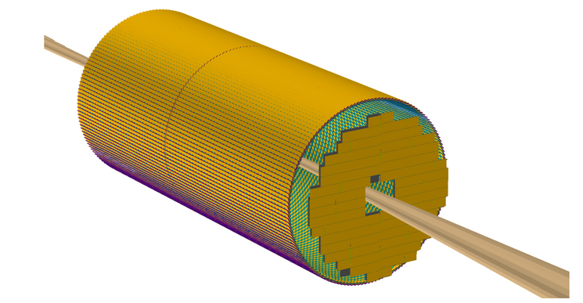
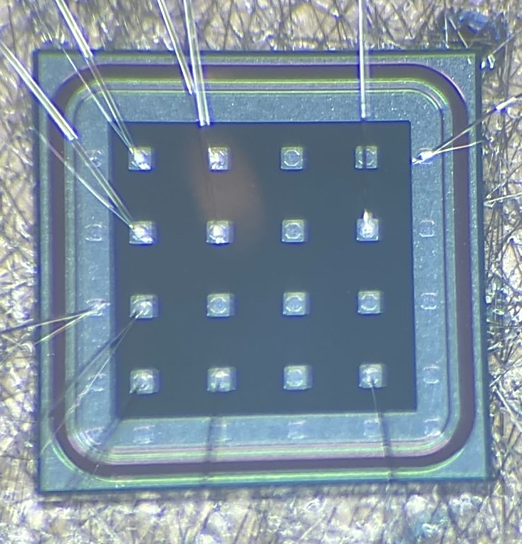
Research interests and contributions to ePIC
Barrel TOF
Strip sensor modules, similar to STAR tracker
Focusing on the Time-of-Flight Particle ID (TOF) system
Barrel TOF: strip AC-LGAD sensors
Forward TOF (and Roman Pots): pixelated AC-LGAD sensors
Envisioned:
Graduate student
0.1-0.2 FTE of a postdoc shared with other projects
‘Vertically integrated project’: involving undergraduate students at various levels over several years
Pending EPSCoR proposal:
Postdoc with ca. 0.5 FTE
Additional graduate student ‘full-time’ on ePIC/EIC
Forward TOF
Similar to CMS ETL
Not funded

Slide 4
Research interests and contributions to ePIC
Barrel TOF
Strip sensor modules, similar to STAR tracker
Focusing on the Time-of-Flight Particle ID (TOF) system
Barrel TOF: strip AC-LGAD sensors
Forward TOF (and Roman Pots): pixelated AC-LGAD sensors
Goal: advance towards full-sized forward-TOF sensors = pixelated sensors in 32x32 geometry to match EICROC readout chip
This could include a role of sensor coordinator for fTOF, similar to Simone Mazza (UCSC) for bTOF: working together with Mathieu Benoit (ORNL)
Finalization of electrode geometry and pitch for fTOF
Channel count; minimizing metallized area ↔ sufficient signal-to-noise ratio and rise time between pads
Sensor thickness, n+ layer resistivity, electrode shape (crosses?)
Technically JO has been named sensor coordinator, but responsibilities and practical impact have been unclear / very small through fall-winter 2025, also due to impossible meeting times
Forward TOF
Similar to CMS ETL

Slide 5
Research interests and contributions to ePIC
Barrel TOF
Strip sensor modules, similar to STAR tracker
Focusing on the Time-of-Flight Particle ID (TOF) system
Barrel TOF: strip AC-LGAD sensors
Forward TOF (and Roman Pots): pixelated AC-LGAD sensors
Completion of the Hamamatsu pixel fabrication, expected by the end of 2025:
Testing of sensors
Hybridization, testing of sensors + EICROC1
Characterization of new sensor productions
FBK production
Potential sensor production with a Taiwanese vendor, if this is still being considered
Forward TOF
Similar to CMS ETL
Not in scope anymore (?)

Slide 6
Research interests and contributions to ePIC
Contribute to the interfacing of the ASIC, primarily EICROC for fTOF (but possibly also other chips for the barrel-TOF) with the front-end and readout board prototypes
ASIC control and readout in modules (‘module board’ prototypes)
Explore background and zero suppression, as well as hit clustering and e.g. ToA correction on the front-end, potentially by using Machine Learning
Global integration of the TOF system: extraction of timestamp/t0, integration of TOF data with Tracking?
Involvement in development of software, firmware, or simulation/reconstruction – also depending on the interests of the postdoc(s) and graduate student(s)
What is feasible at UH and needed in BTOF or FTOF for construction/production?
Sensor QC
ASIC QC
Hybridization / Module QC

Slide 7
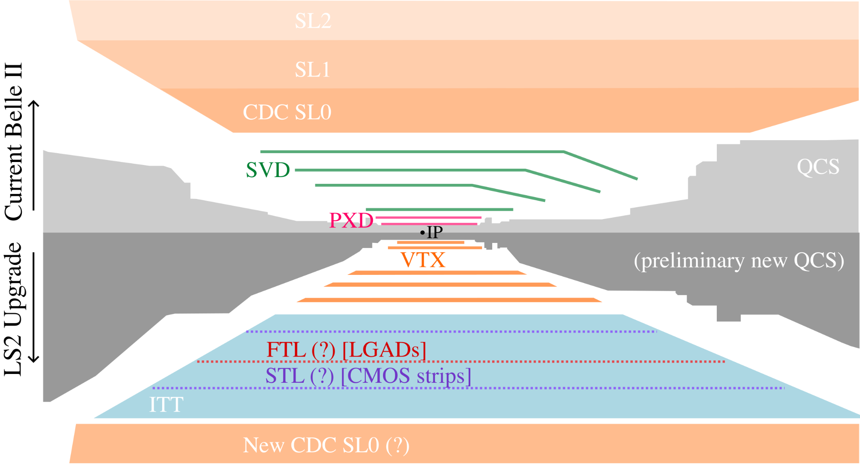
Research interests and contributions to ePIC
Dialogue and liaison-ing with Belle II
Focus on strips for barrel time-of-flight layer due to Belle II detector geometry
Synergistic research, even though not formally in the scope of ePIC:
Characterization of the Nalu HP-SoCv3 chip, which has been funded through JLab/EIC-R&D: completing the deliverables of the previous fiscal year; collaborate on next generation of this chip family
Generic fast-timing sensor and readout ASIC R&D, also for High-Energy Physics

