Slide 1
BHCal Machine Learning Energy Calibration Update
David Ruth

Slide 2
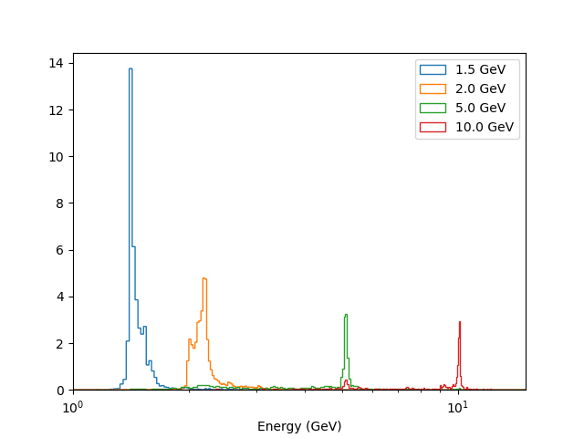
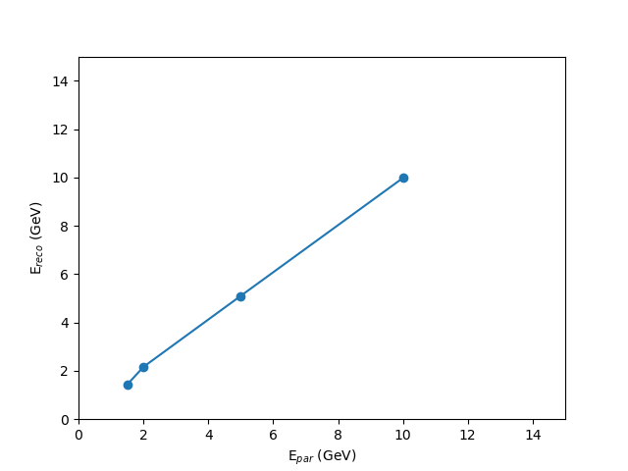
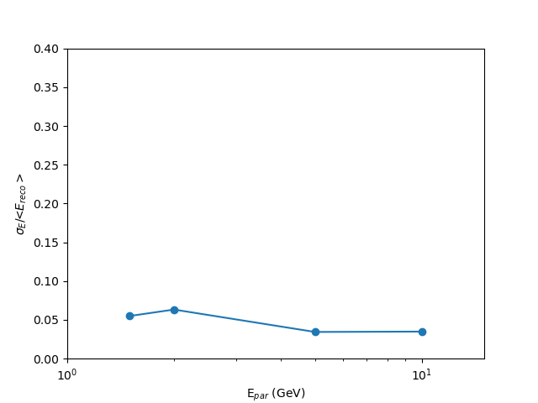
Refresher on Current Status
Used a custom PyTorch Multilayer Perceptron to try and do calibration for single particle neutrons
Resolutions were “unbelievably” small (with irregular distributions) – need a way to verify machine learning solution is trustworthy

Slide 3
How to check if we can trust the ML solution?
Train with a continuous energy distribution (from DIS simulation campaign) to provide a more realistic input that doesn’t allow the neural network to hone in on “classification problem” results
Perform a careful uncertainty analysis on the NN performance
Because I am in many ways still very inexperienced with BNL physics and the EIC simulation, took quite a lot of time to learn how to make appropriate training files for the first step…

Slide 4
Training File Generation
Thanks x1000 to Derek for a tremendous amount of help learning how he generated the old training files and figuring out a new way
Use DIS simulation campaign with appropriate Q2, eta, etc.
Loop through particle-cluster associations, identify clusters in BHCal, EMCal, ScFi, Imaging, and fill training tuple for each particle-cluster pairing

Slide 5
New Training Files
Network Inputs:
Mass
PDG
Kinetic Energy (“cheating on the test”)
BHCal: nClusters, Cluster energy, # hits, eta, phi, time
EMCal: nClusters, Cluster energy, # hits, eta, phi, time (for each layer)
ScFi: nClusters, Cluster energy, # hits, eta, phi, time (for each layer)
Image: nClusters, Cluster energy, # hits, eta, phi, time (for each layer)
Network Outputs:
Total Energy

Slide 6






Architecture Details
Hidden Layers
“Dense/Fully-connected” network
128-512 neurons in first of 3-6 hidden layers, “reverse pyramid” structure
Input
Layer
Output
Layer
E_{par}
H₁₁
$$w_{1}^{1}$$
I₁
$$w_{2}^{1}$$
H₂₁
$$w_{1}^{2}$$
H₁₂
E_{calib}
Huber Loss
$$w_{2}^{2}$$
I₂
$$w_{1}^{3}$$
H₂₂
$$w_{2}^{3}$$
H₁₃
Adam Optimizer

Slide 7
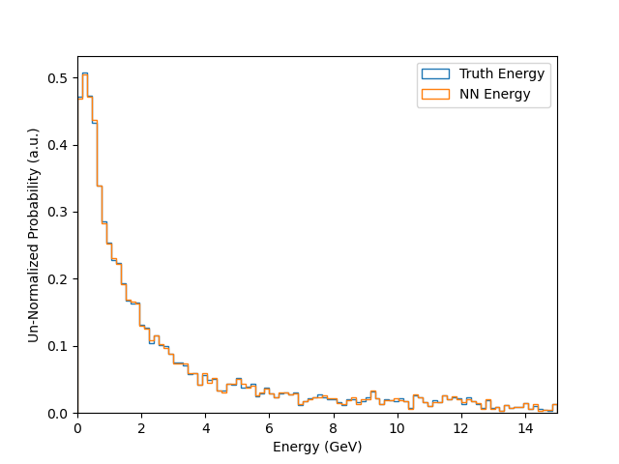
“Proof of Principle” Results
Does not reflect expected level of neural network performance
Just that we can now produce a (reasonable?) continuous energy spectra training file
And that the neural network can handle the input and perfectly produce the total energy when given the “cheat sheet” of the kinetic energy and mass
Performance without “cheat sheet” not worth showing yet but we can now make faster progress towards a meaningful result

Slide 8
Next Steps
Take off the training wheels and see how well the network reproduces the training data
Figure out a way to examine resolutions – train on continuous spectrum and then test with single particle energies?
Start on careful analysis of machine learning systematics

