Slide 1
Roadmaps Towards Early Science Results
Shyam Kumar, Rongrong Ma
Jets and HF PWG

Slide 2
Request for Physics Forum
Approval of Results for Jets and HF
DCA resolution for primary and secondary pions
Secondary vertex resolution
Invariant mass spectra w/o and wML
Projected statistical uncertainty for nuclear modification factor (R_{eAu})
Jet energy scale (JES)
Jet energy resolution (JER)
Statistical projection for (R_{eAu})
Jet reconstruction efficiency
We would like to request a Physics forum around 25 February 2026

Slide 3
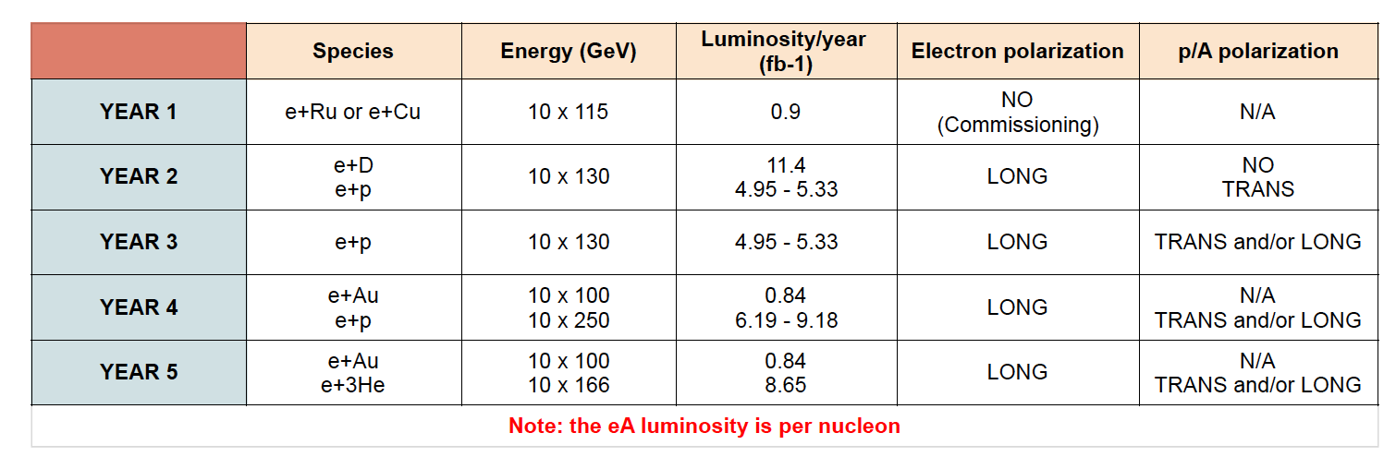
Running scenario
Plan to use:
ep @ 10x130: L ~ 10 fb⁻¹; 10x250: L ~ 5 fb⁻¹
eAu @ 10x100: L ~ 1 fb⁻¹
eRu/Cu @ 10x115: L ~ 1 fb⁻¹

Slide 4
Simulation samples
Hepmc file not produced yet
 |  | 10x100 | 10x130 | 10x250
ep | D0 | ✓✓ | Requested | Requested
 | Lc | ✓✓ |  | Requested
 | DIS | ✓✓ | ✓✓ | ✓✓
 |  | 10x100
eAu | D0 | ✓✓
 | Lc | ✓✓
 | DIS | ✓✓
 |  | 10x115
eRu/Cu | DIS | ✓✓

Slide 5

Preliminary deadlines
Start editing text since this week
Heavy-flavor and Jets

Slide 6

Early Science (Observables)
Focus on physics analyses rather than performance
Jet R_{eA}: nPDF effects + final-state energy loss in cold nuclear matter (Dener)
Jet R_{eA} ratio between different radii: final-state energy loss (Dener)
D⁰ R_{eA} vs. z_{proj}: nuclear absorption vs. energy loss (Gurtaj, Shyam, Rongrong)
Λ_{c}/D⁰ ratio in ep: charm quark hadronization (Shyam)
D⁰ jet Energy-energy Correlator (EEC) in ep: (Xuan)
Systematics
Request theorists for predictions
Hai Tao Li, Ze Long Liu, Ivan Vitevhttps://doi.org/10.1016/j.physletb.2021.136261

