Slide 1
Kyocera Anode Measured Spatial Variation
Mark Popecki
Incom
02-02-2026

Slide 2
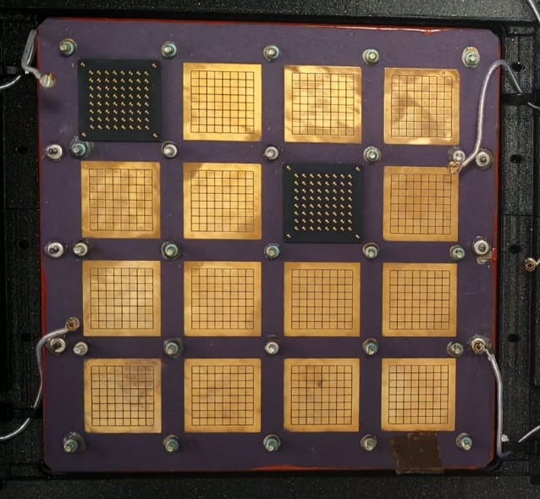
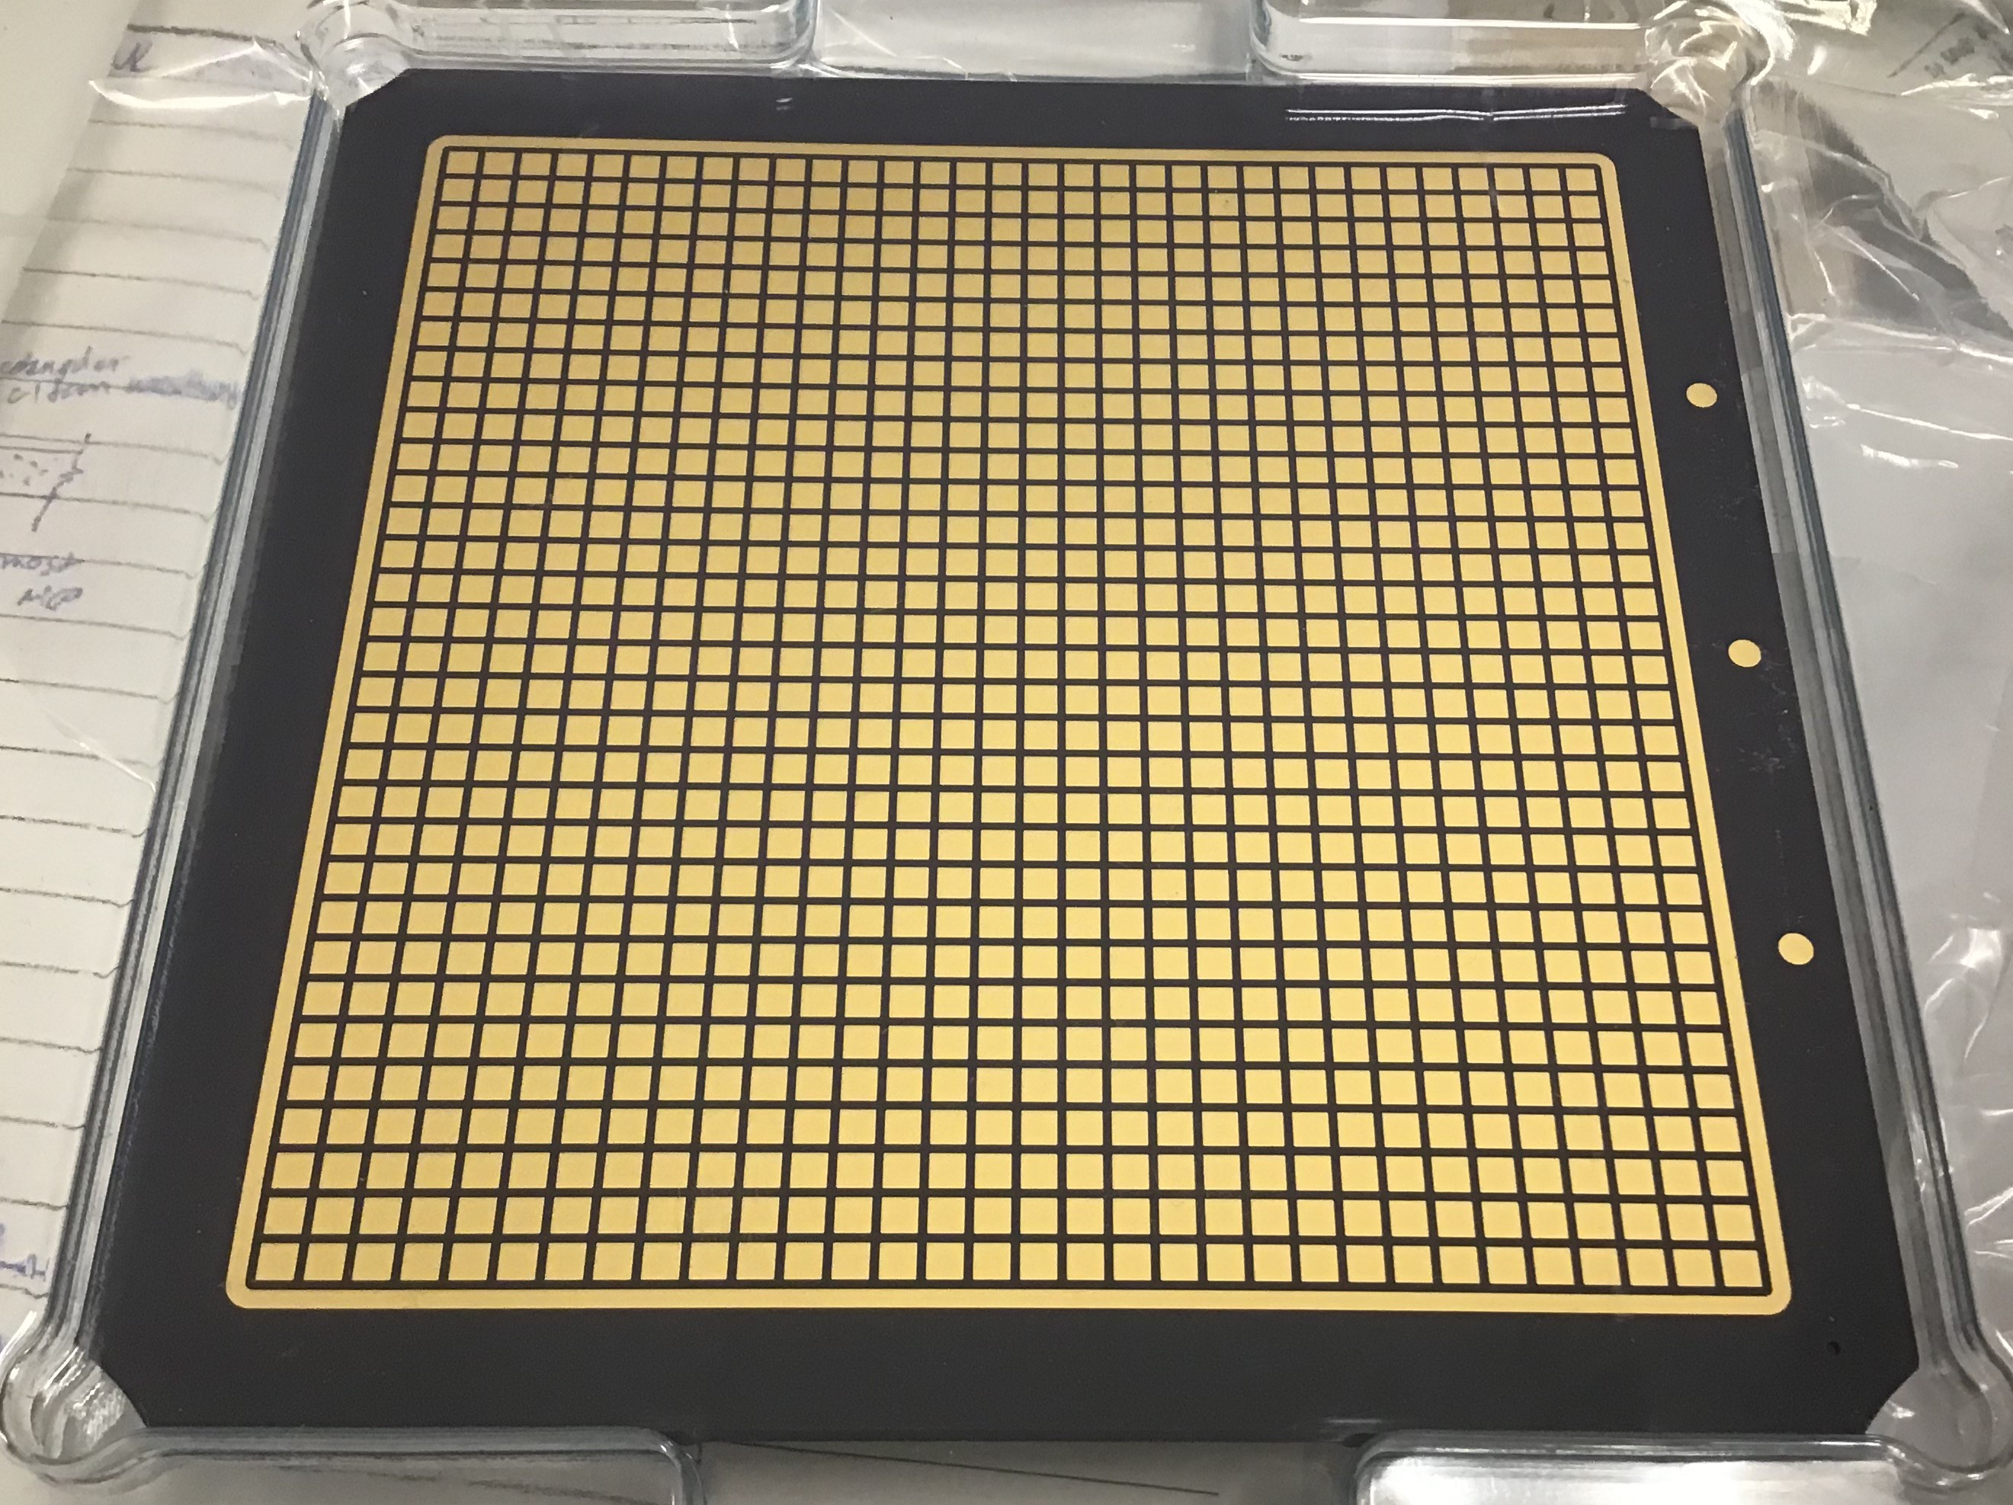
Position Scans, Two Anodes
Two anodes measured
A 32x32 straight through anode, with the same pattern on both sides
The EIC HRPPD anode, H27.
1
2
1
2
3
3
3
3
2
2
1
1
Kyocera Straight Through
EIC HRPPD 27

Slide 3
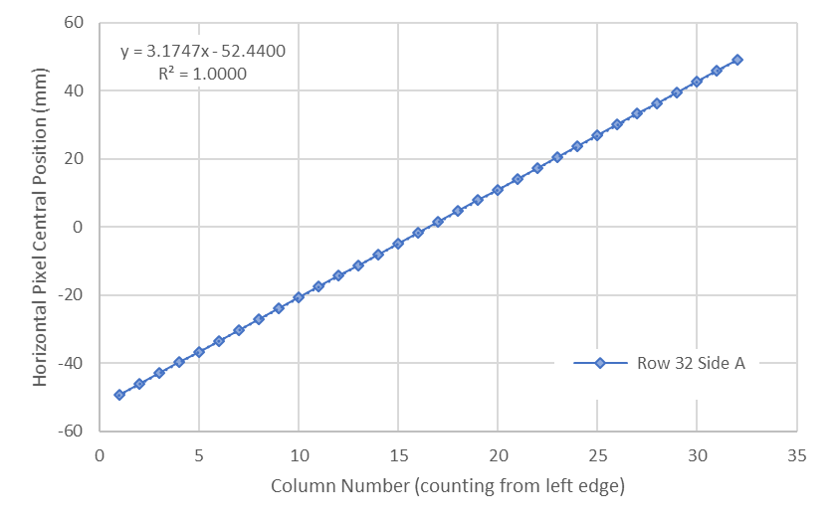
Kyocera Straight Through Anode
Scan along top row.
Good linear fit
Similar result for columns 1-16 only.
2
3
2

Slide 4
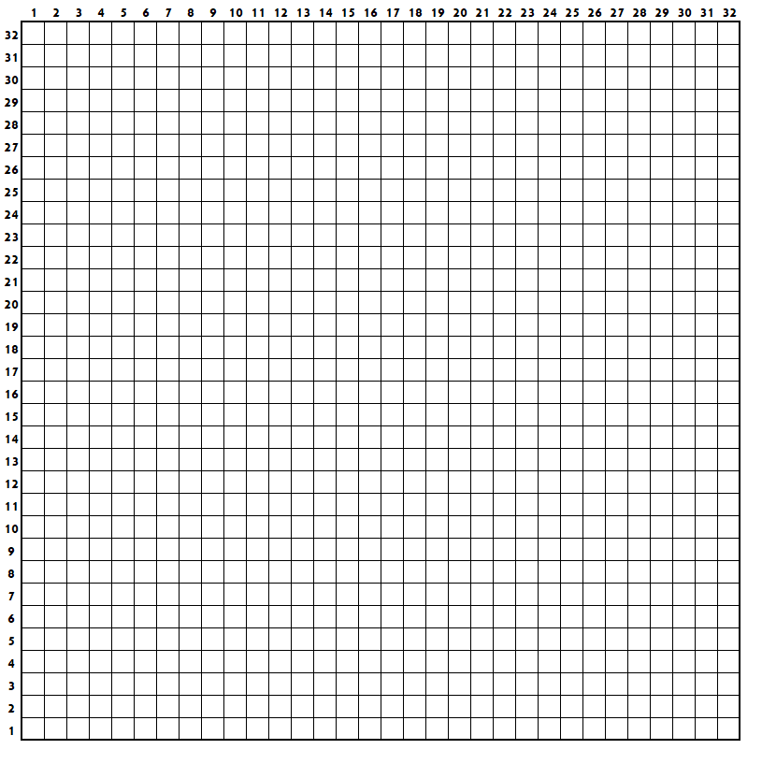
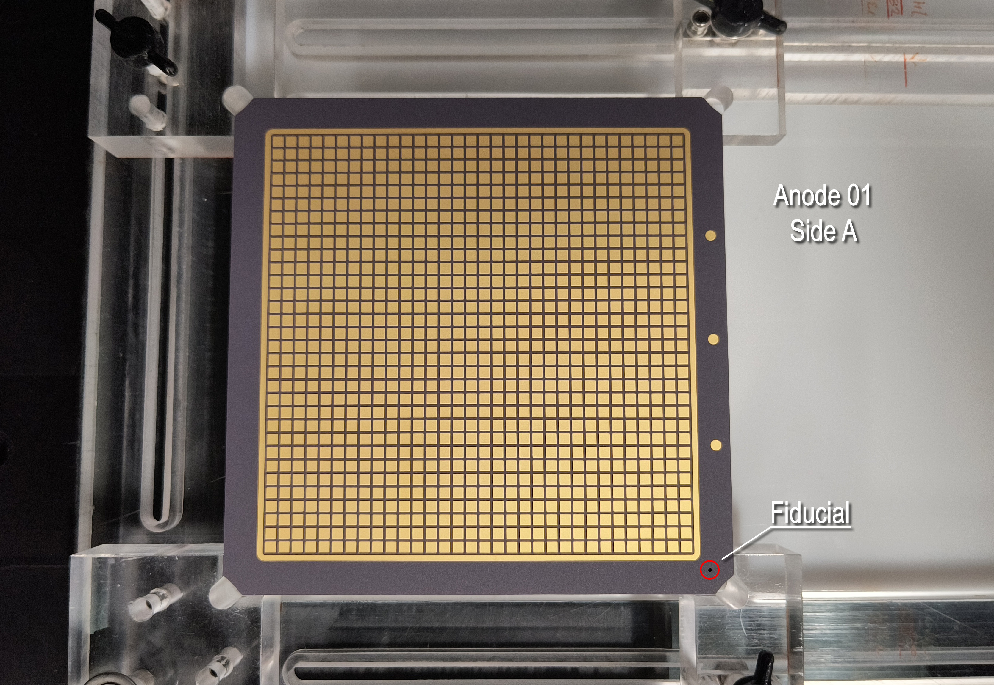
Part Arrangement and Pixel Numbering Convention

Slide 5
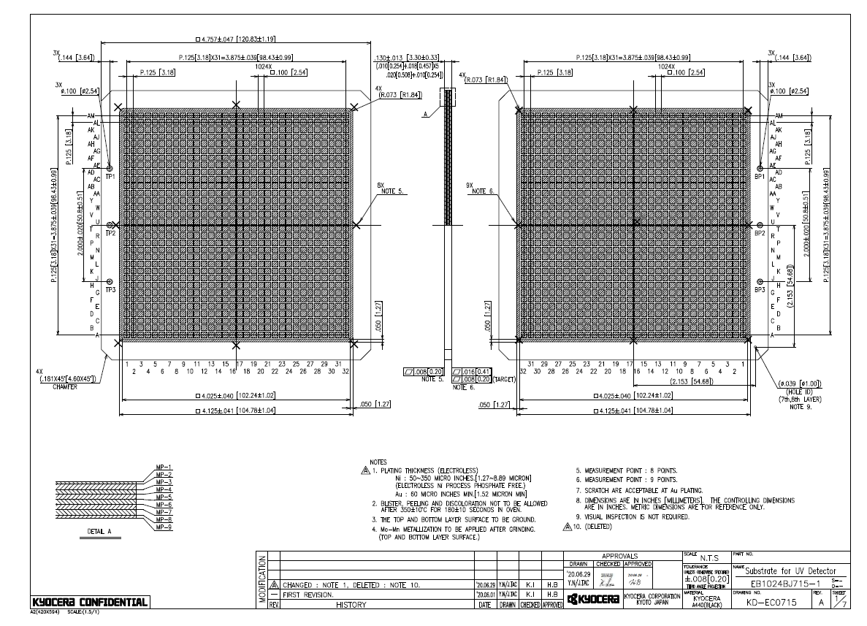
Kyocera Drawing: 32x32 Pattern, Same on Both Sides

Slide 6
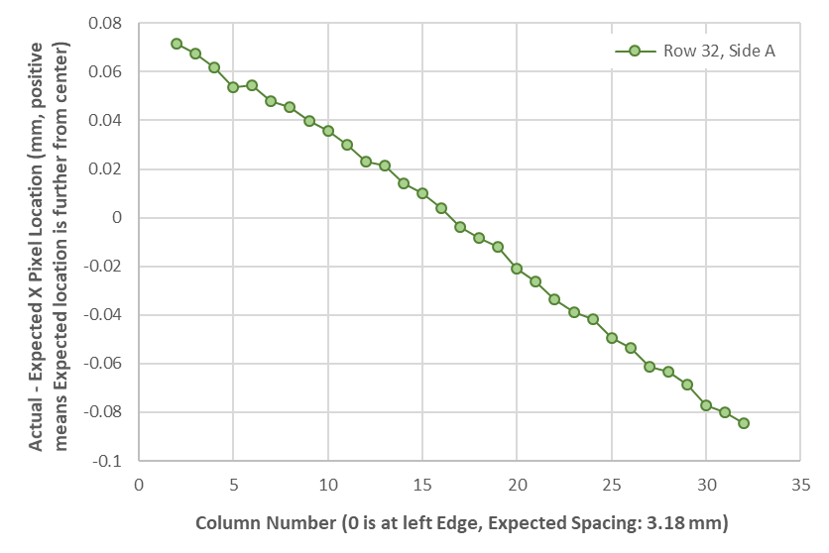
Variation Compared to Expected Pixel Location
3.18 mm spacing specified in drawing

Slide 7
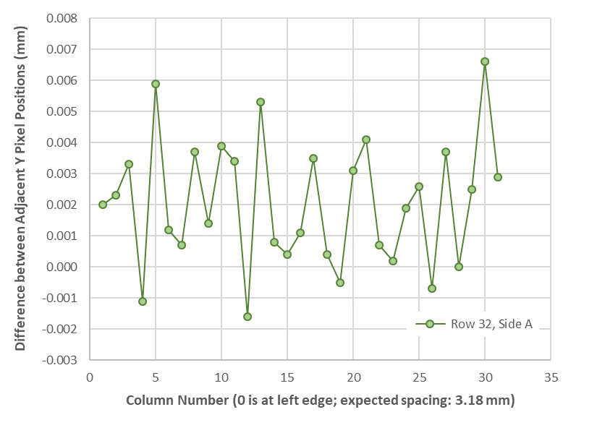
Vertical Spatial Variation on a Horizontal Scan
Adjacent pixel position differences on Y during a horizontal scan along X.
Position variations are ~2 to 7 um.

Slide 8
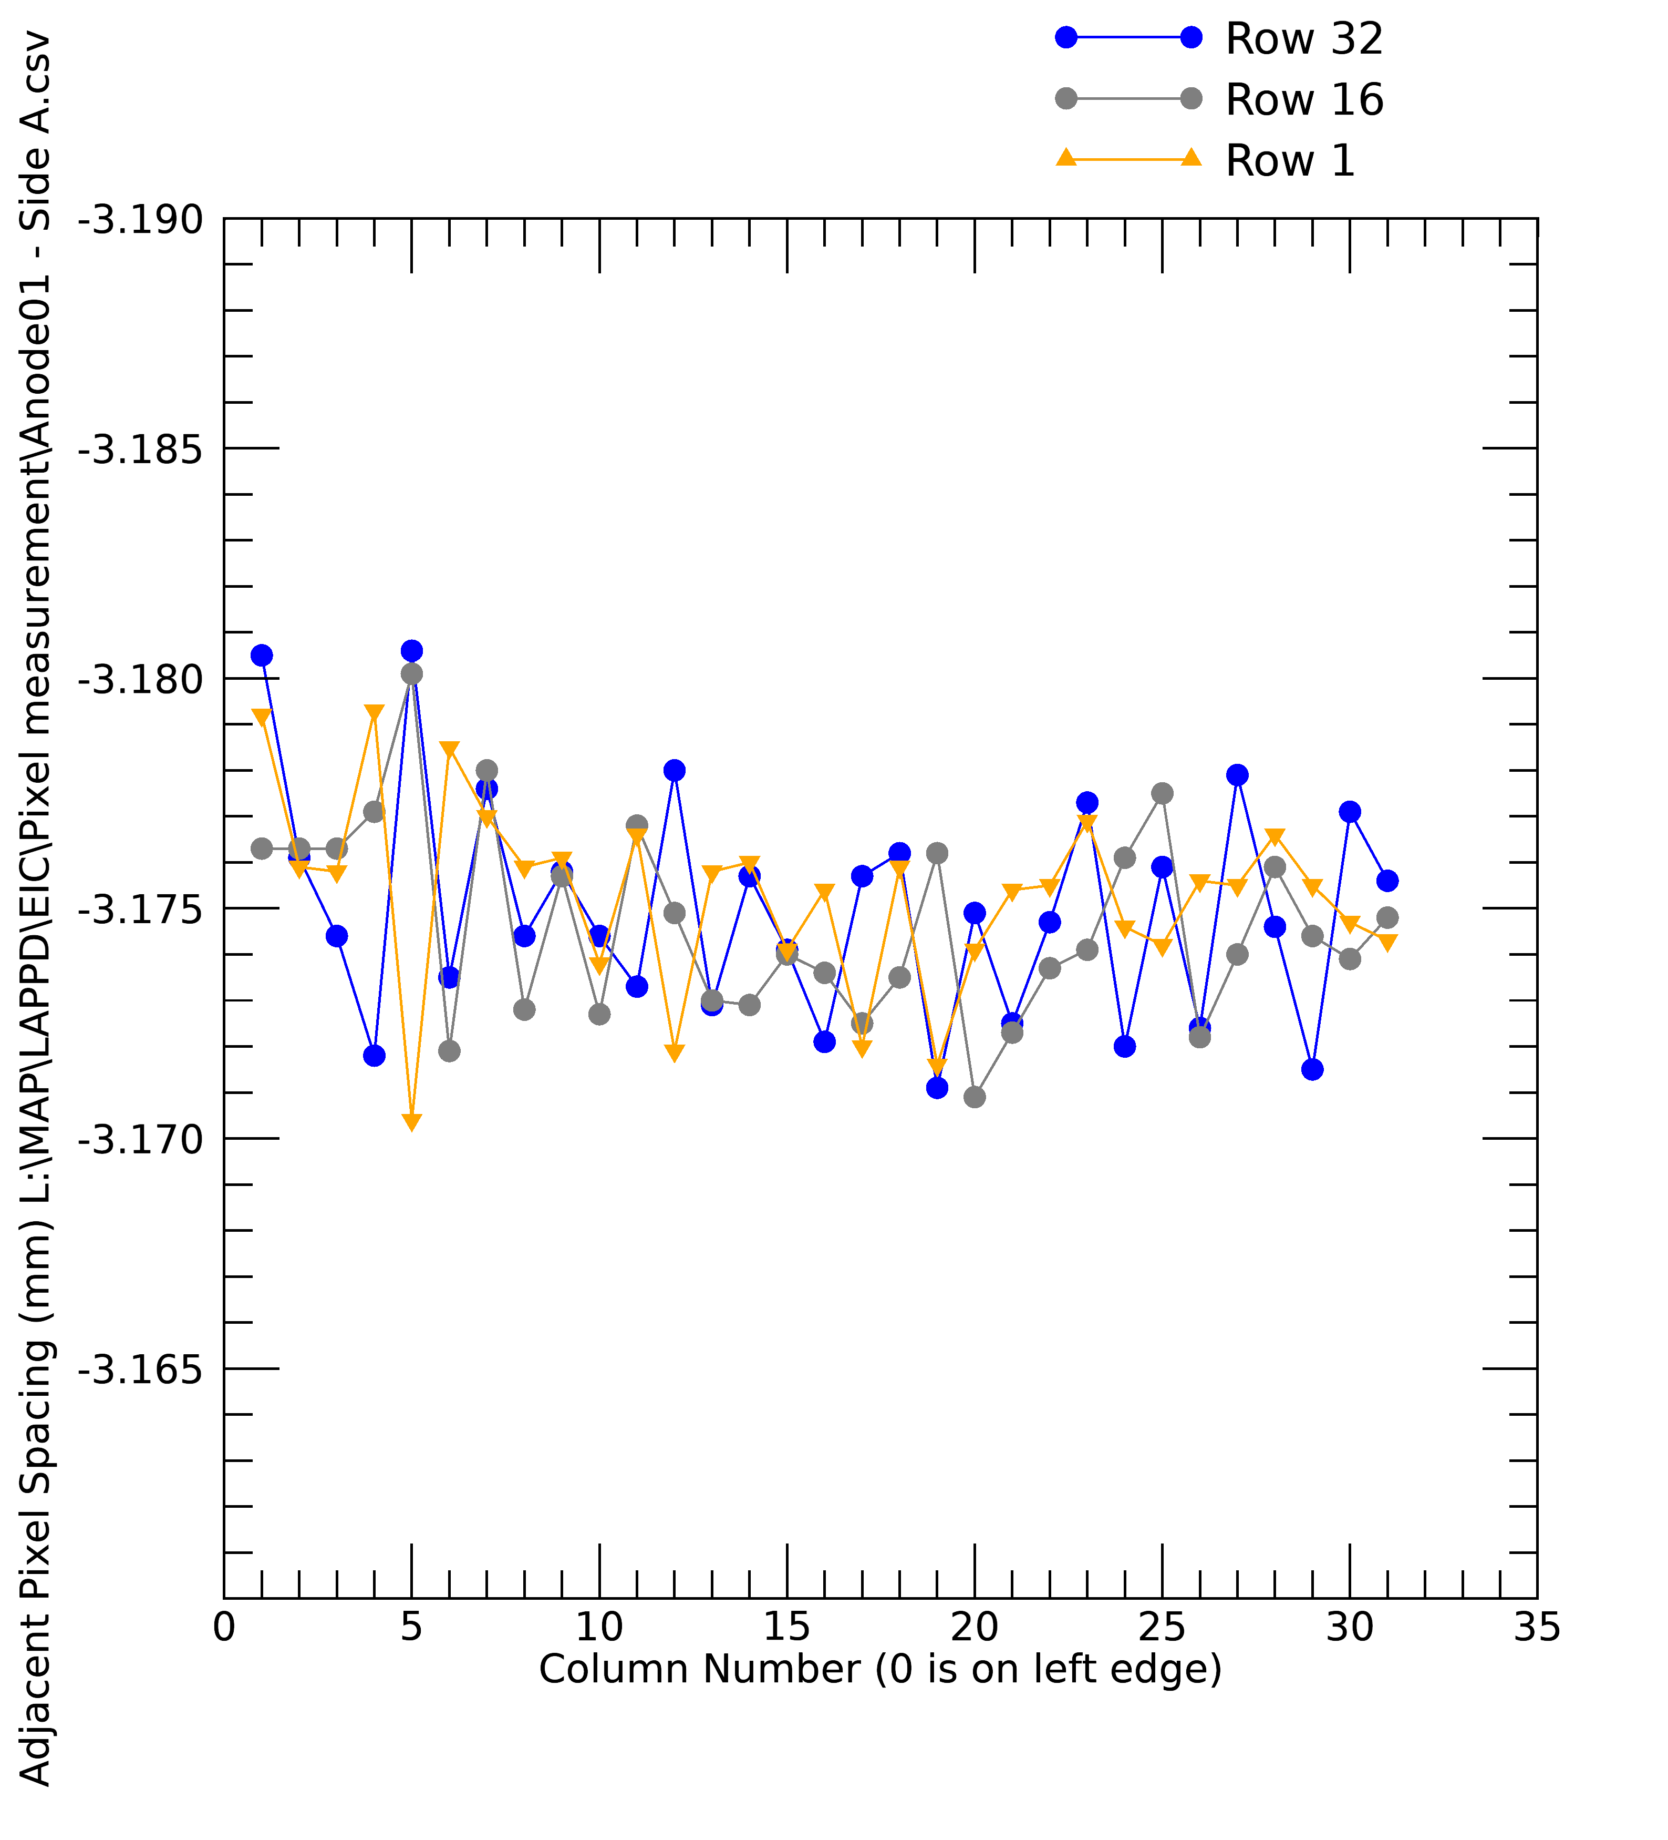
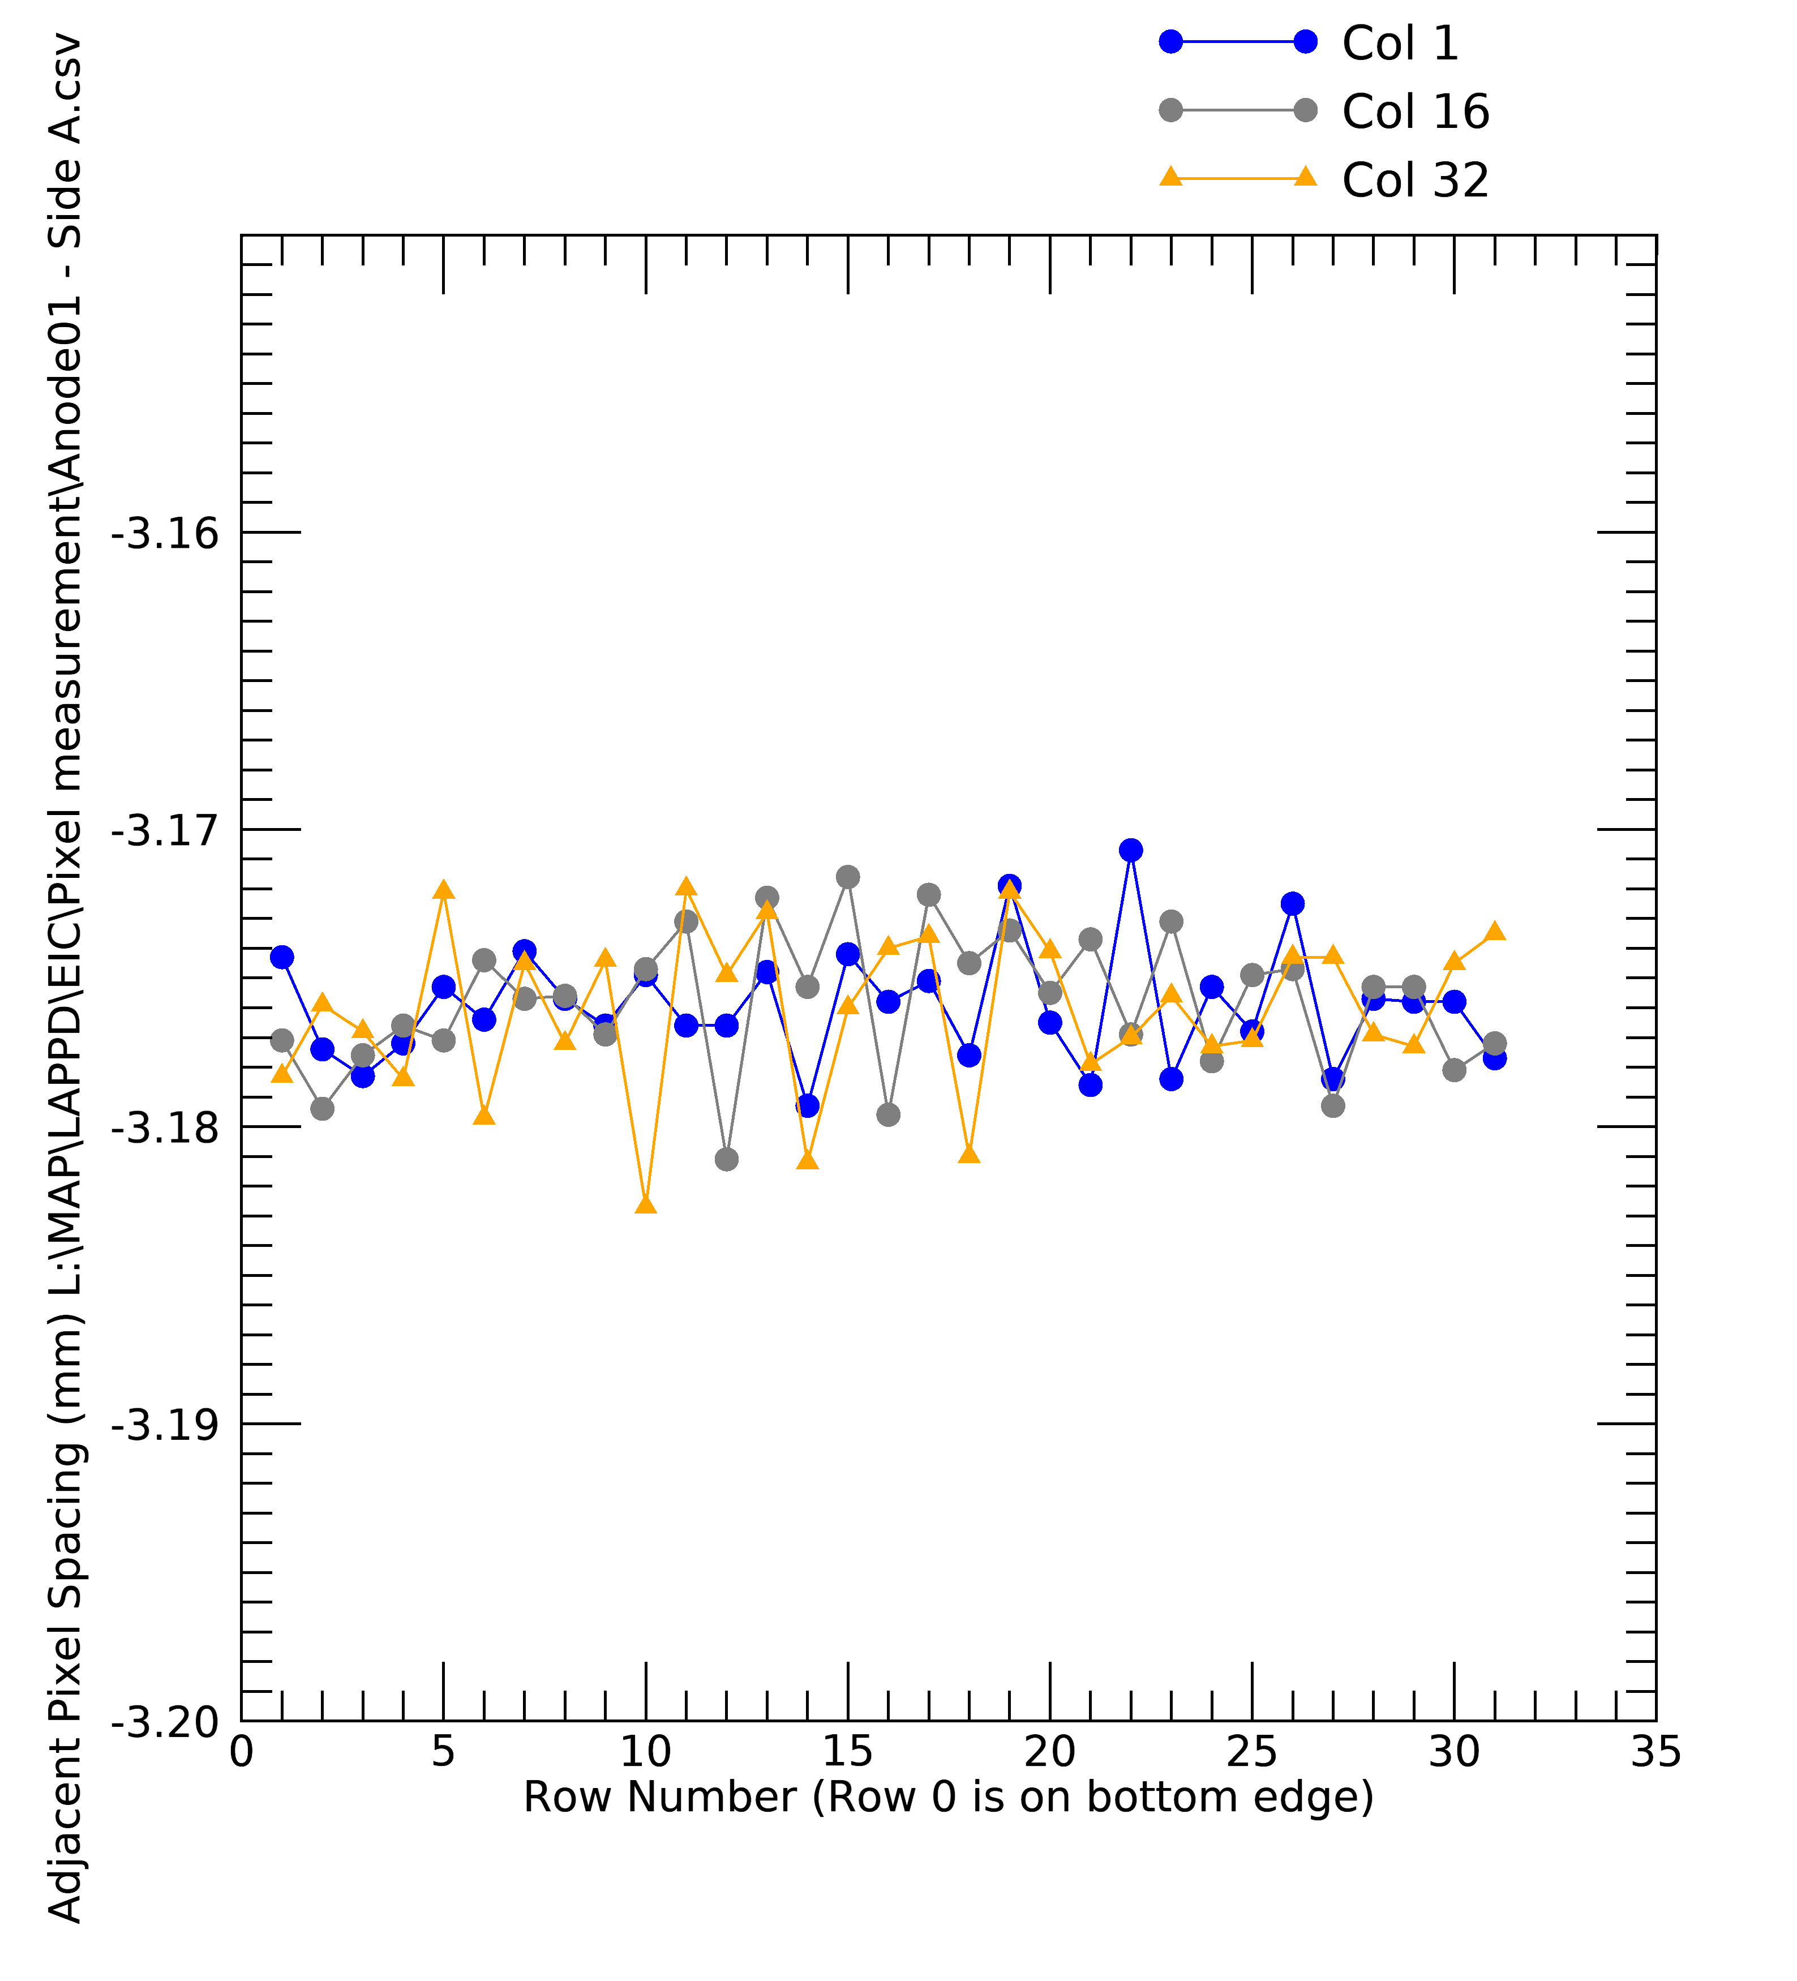
Side A: Adjacent Pixel Position Difference
Row 32
2
3
2
Row 16
Row 1
Col 1
Col 16
Col 32

Slide 9
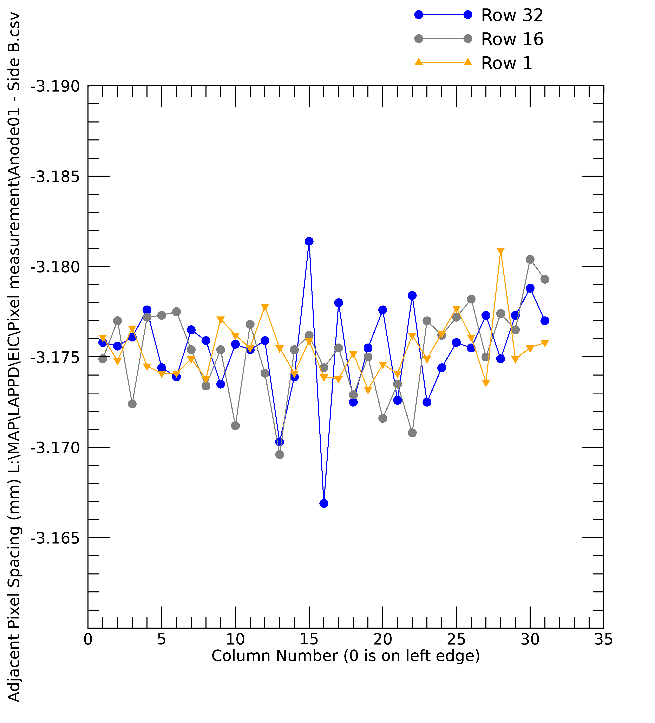
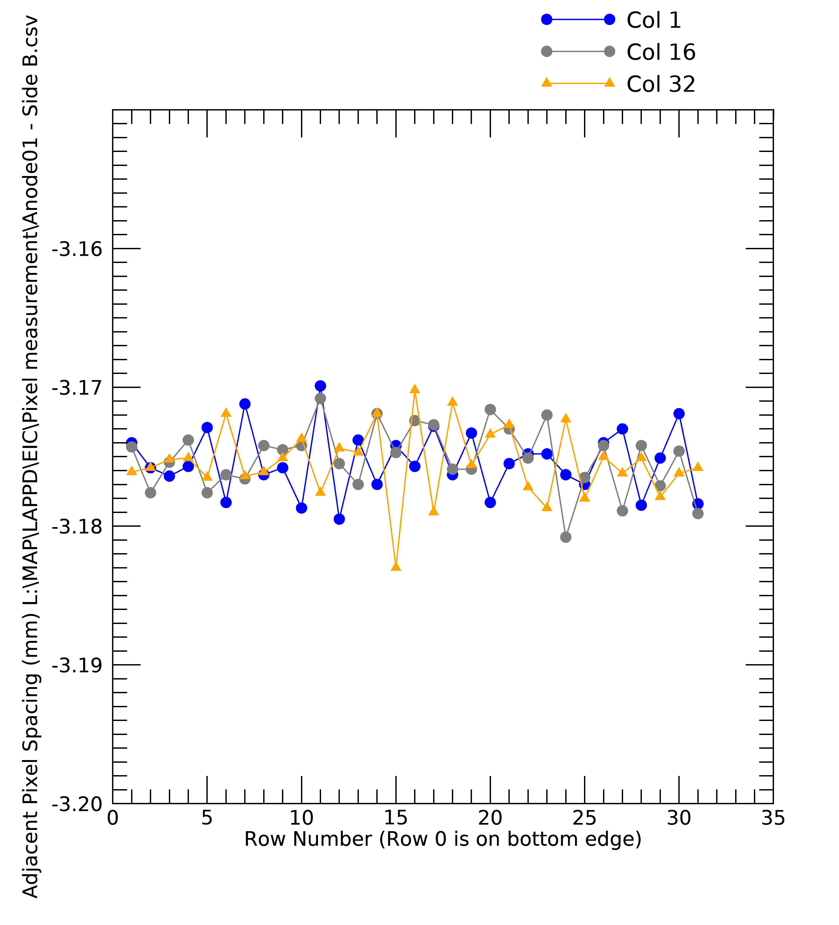
Side B: Adjacent Pixel Position Difference
Row 32
2
3
2
Row 16
Row 1
Col 1
Col 16
Col 32

Slide 10
sd

