Slide 1
RHIC R&R Project
David Chan
Division Head, Infrastructure & Technical Support, C-AD
RHIC to EIC Transition and Working Safely Meeting​
9 February 2026

Slide 2
Outline
Introduction – Raising the awareness of the RHIC R&R Project
Responsibilities Matrix
RHIC R&R Project
RHIC R&R - Scope Definition
Transition to RHIC R&R
First Steps to Start the RHIC R&R Project
Accelerator
STAR
sPHENIX
1008 Muon Steel
Project Schedule
Project Charges
Interface with EIC
Removals Preparation
Identification Flow Chart
Categories
Removals Identification Progress
Space Planning
External Project Engagement
Closing Remarks

Slide 3
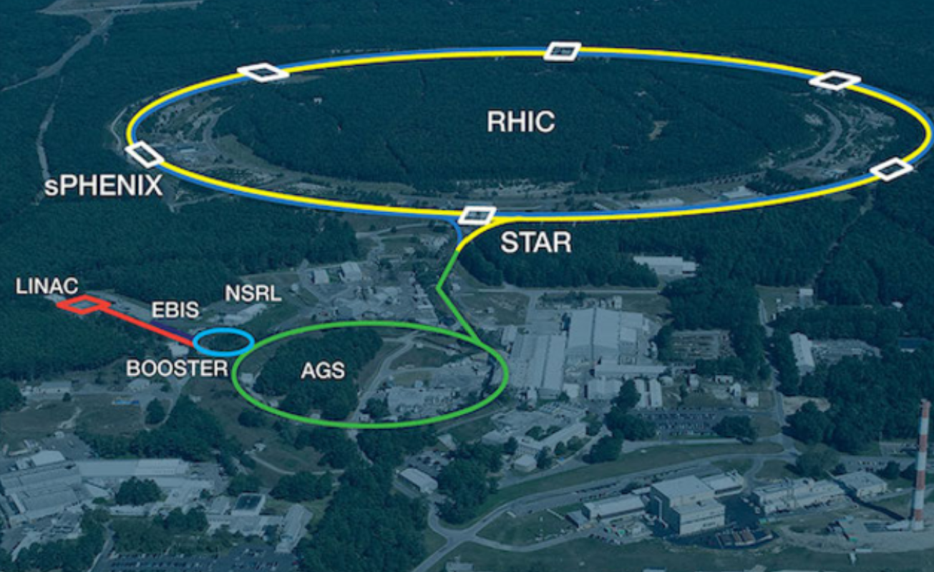
Introduction
Formal External Reviews
Status Review of RHIC Equipment Removals and Repurposing (R&R) - 30 May 2024
Director’s Review – 8 July 2025
DOE NP Review – 8 September 2025
Internal Presentations
Introduction to RHIC R&R – Presented to C-AD Project Lead Groups to determine path for developing project responsibilities – 14 January 2025
Space Concerns for Removals - Presented to C-AD Technical Supervisors and Group Leads – 9 April 2025 (Plus 5 working group meetings)
RHIC R&R – C-AD Expectations – Presented to all C-AD Technical Supervisors and Group Leaders – 4, 5, 6, 9 June 2025 (Total of 4 group meetings)
BNL ES&H Management – Presented to leadership within the ES&H Directorate – 16 October 2025
Presentation to F&O Management – 17 November 2025
Other Misc Presentations
Multiple EIC Reviews – Interface with EIC
BNL Project Oversight Board
Why the RHIC R&R is Important to the Laboratory
First step to the start of EIC within the existing facility. Our project goal is to fully support the EIC needs moving forward.

Slide 4
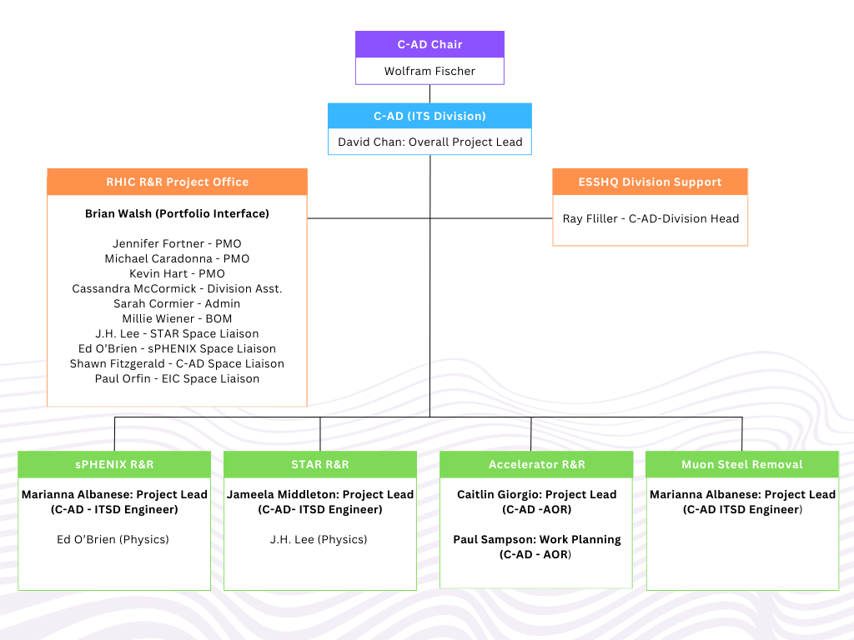
Responsibilities Matrix

Slide 5
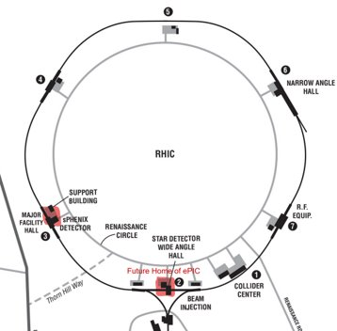
RHIC R&R – Scope Definition
Definitions
The first “R” is for REMOVALS within RHIC to allow for the installation of EIC (C-AD Responsibility)
The second “R” is for REPURPOSE by EIC and the responsibility of this project is to coordinate the labeling of components that EIC has identified as items they would like to keep and to turn over to EIC for repurposing (EIC Responsibility)
The RHIC R&R project includes a baseline cost estimate presented at the September 2025 DOE NP review. Path on how work will be performed will be dependent on the category of work tasks fall under:
C-AD Operations
C-AD Large Projects
RHIC R&R
EIC Project
EIC Portfolio – “EIC Off Project Dependencies”

Slide 6
Transition to the RHIC R&R
Completion of the RHIC Program and moving on to a new chapter to ensure C-AD provides a path to a successful EIC Project
A department training will be given to prepare for the change in work activities - Safety Presentation will provide more details)
All work planning for the RHIC R&R MUST be scheduled through the project leads and must be accompanied by a Job Hazard Analysis (JHA) - Safety Presentation will provide more details
Current Schedule:
Final Day of RHIC Run – 6 February 2026
C-AD Safety Stand down – 9 February 2026
Start of RHIC Decommissioning to Expire the RHIC ASE – Estimated Start on 11 or 12 February 2026
RHIC ASE Expires – 1 April 2026 (Current Estimation)
Start of RHIC R&R – 2 April 2026 (Current Estimation)

Slide 7
First Steps to Start the RHIC R&R Project
Work Planning, establishing work barriers, opening of shielding, preparation of work, housekeeping, etc.
Labeling of components that are removed and managing existing space/storage areas
Start of Accelerator Removals - IR08 to IR10 moving clockwise
STAR Detector Removals
Refurbishing of Lifting Fixtures
Prepare Detector Rollout
sPHENIX Detector Removals
Prepare Detector Rollout
Dismantle Platform and systems on platform
Turnover OHCAL to ePIC
As required for EIC as plans develop – careful coordination with Accelerator Rings (ASR) Subproject team, led by Charlie Folz

Slide 8
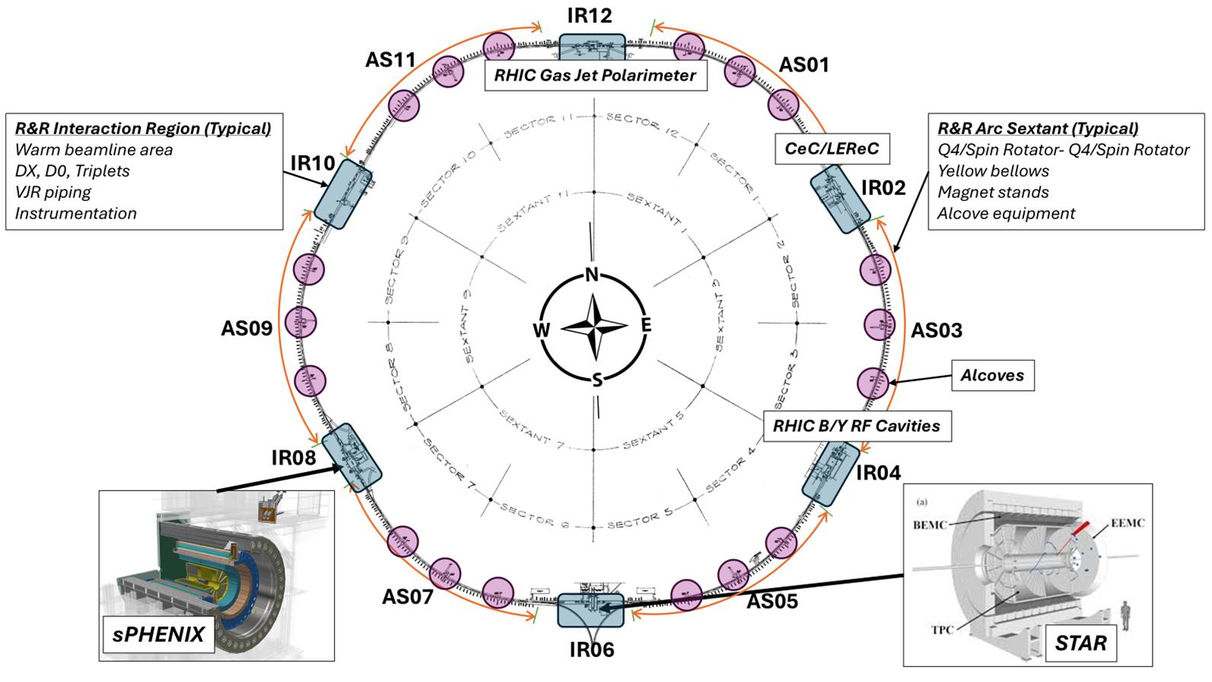
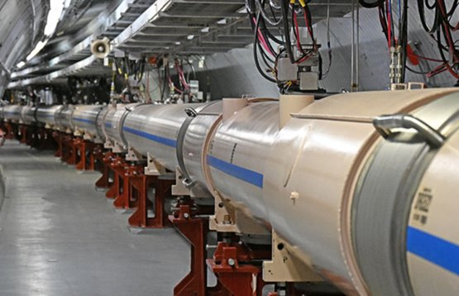
Accelerator
This project is broken up into twelve (12) areas within the RHIC Ring
Six (6) sections within the RHIC Ring (Arc Sector 01, 03, 05, 07, 09, 11)
Six (6) IR Regions within the RHIC Ring (1002, 1004, 1006, 1008, 1010, 1012)
RHIC Service Buildings
RHIC Alcoves (Total of 18)

Slide 9
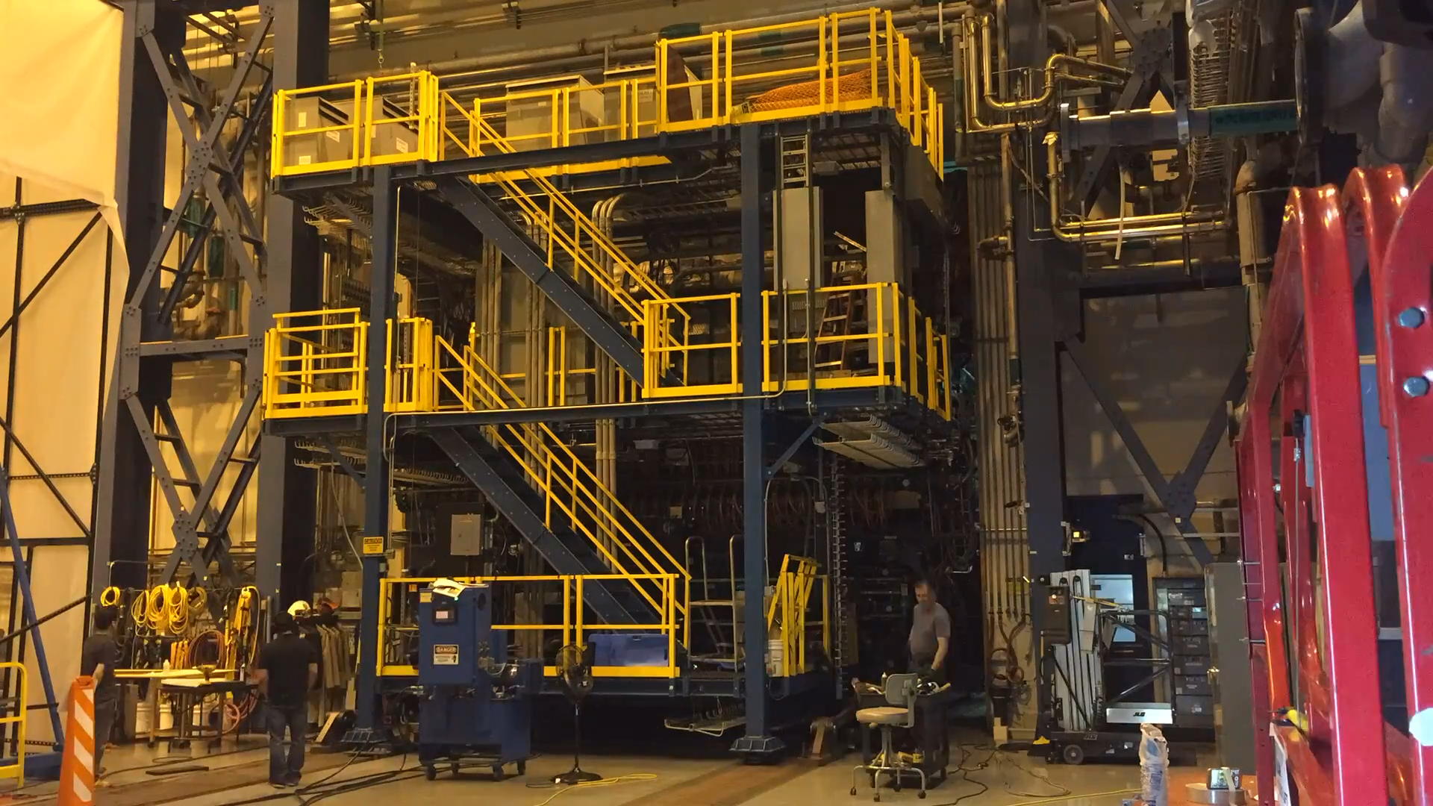
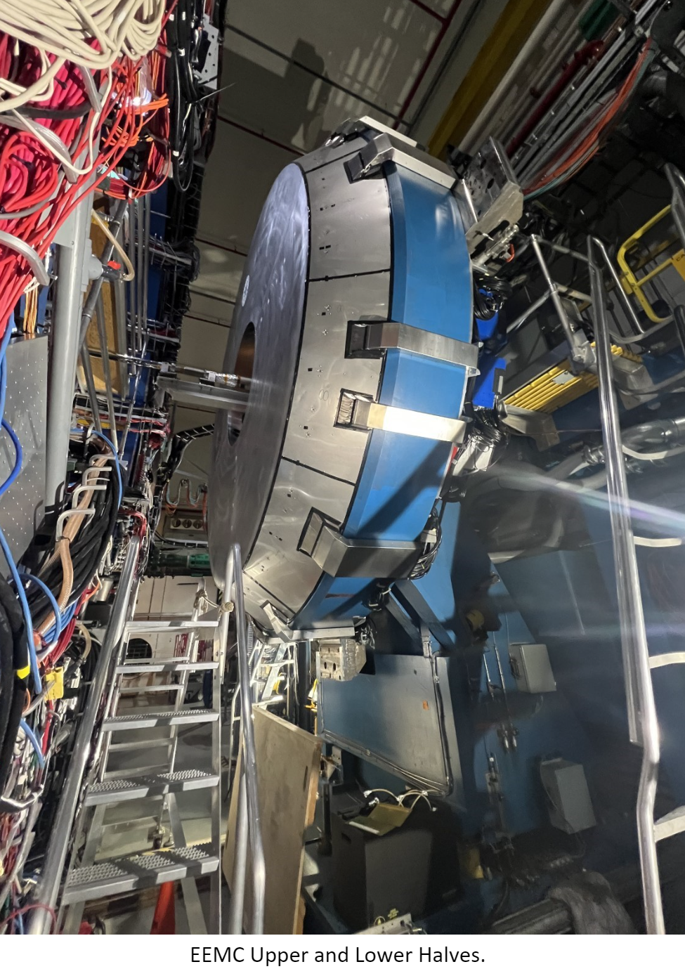
STAR
Open Poletips
Prepare and roll out STAR into Assembly Hall
Muon Telescope Detector (MTD) and PMT Boxes
EEMC – Endcap (2 Halves) on West Poletip inside face, PMT boxes on outside face
EEMC – (60) Modules, (60) PMT boxes (360⁰ Radially), Electronics
FCS – Forward Calorimeter System
Cone – Inside center of TPC, includes Beampipe, FGT, HFT, IST, PXL detectors
TPC- Major effort. Electronics, Gas & Laser Systems, Platforms
Magnet – Coils, Inner/Outer Rings, Backlegs, Cradles and Pistons
Bridge Removal
Project Management, ESH, Administration, Technical Support, etc.

Slide 10
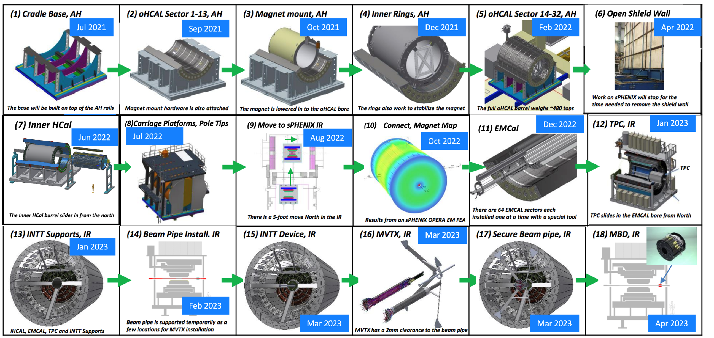
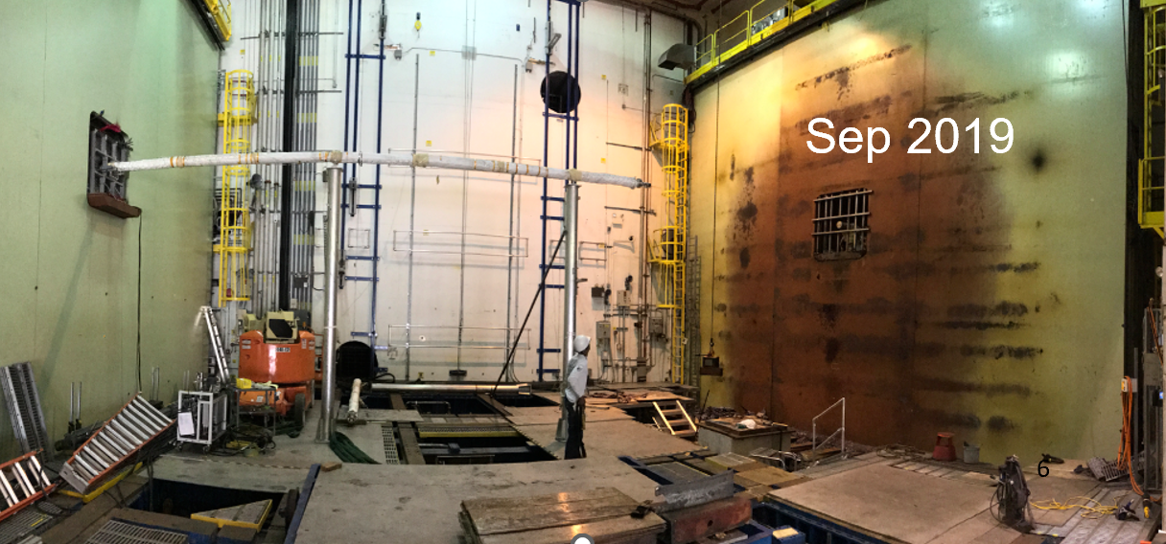
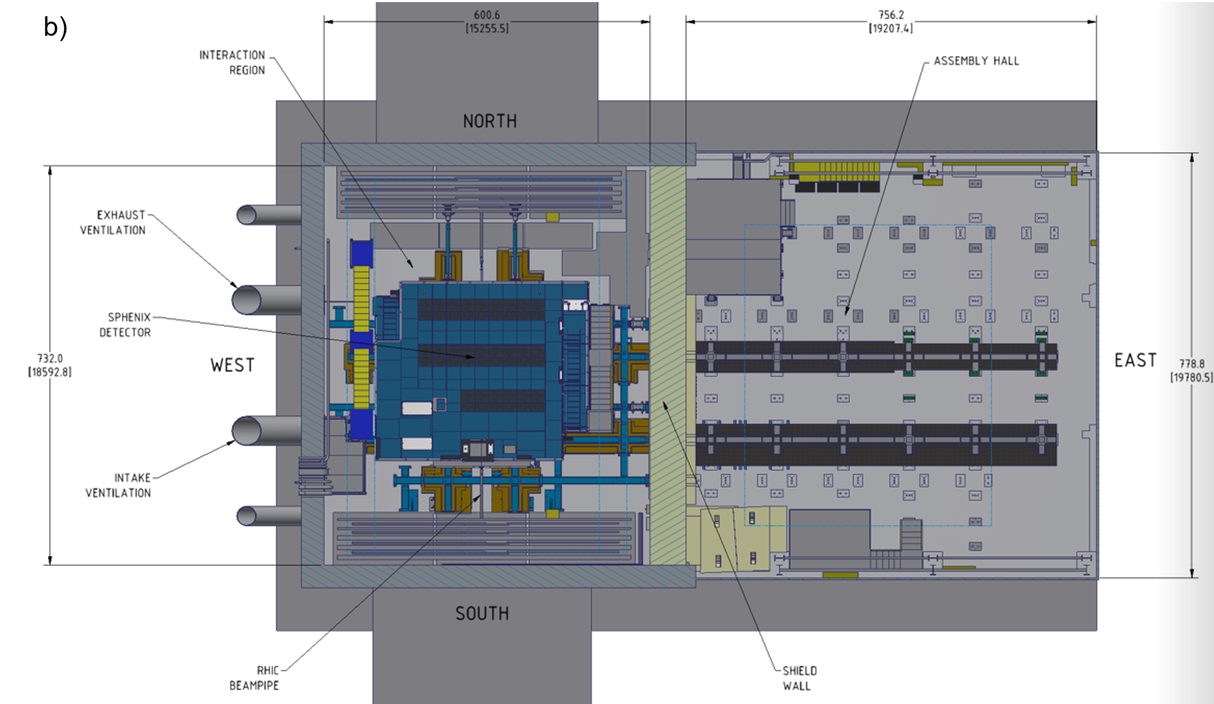
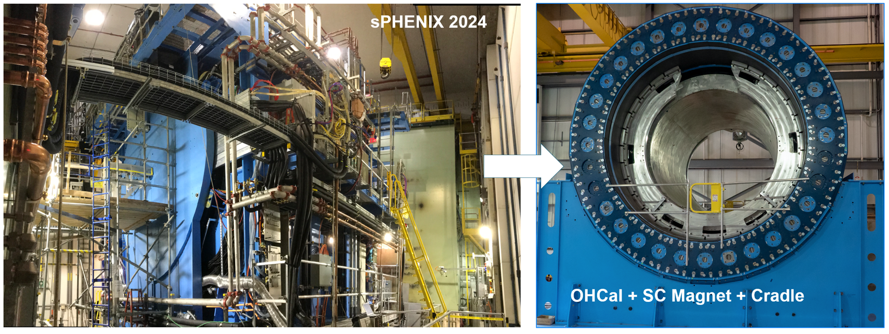
sPHENIX

Slide 11
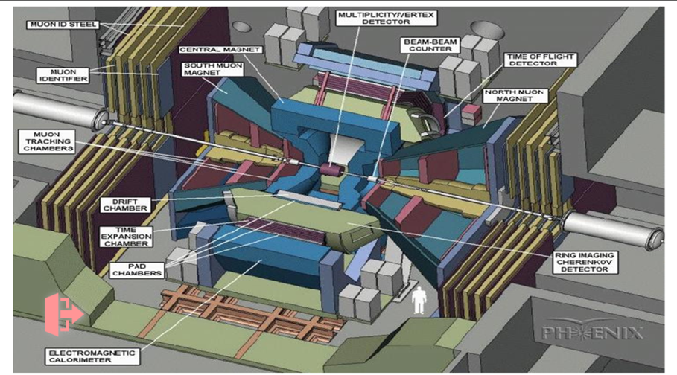
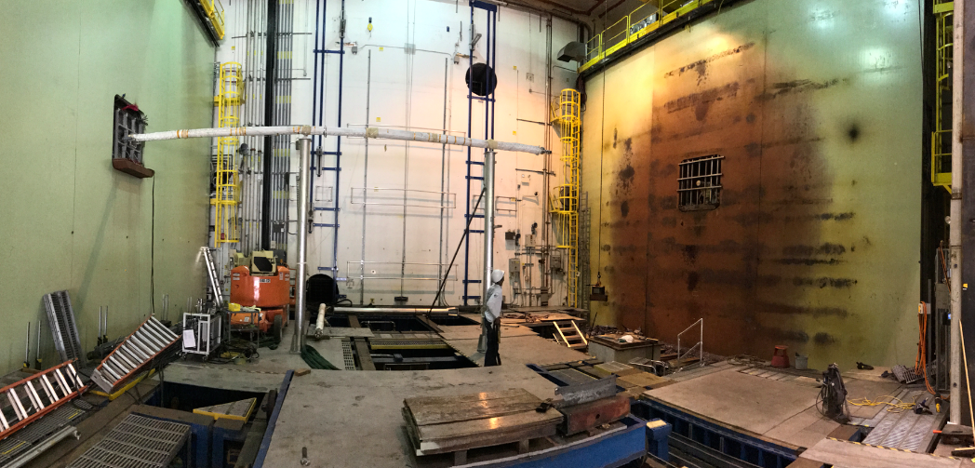
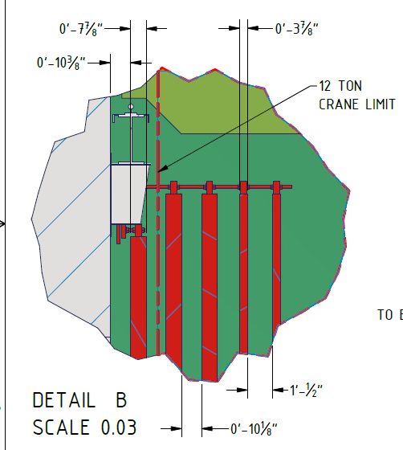
1008 Muon Steel
Sep 2019
Background: 30 steel plates from PHENIX experiment, installed ~30 years ago
Structure: Plates supported by tabs, pistons, locking set screws, and spacer blocks.
Current Status: Obsolete for current/future operations; obstruct tunnel access for RHIC/EIC magnet operations and potential future second EIC detector location.
Weight and Arrangement: 15 plates per side (north/south). Each side: 5 rows, 3 columns. 3 of the rows: ~8-inch thick solid steel, ~80 tons each.
2 of the rows: ~4-inch thick, ~40 tons each.

Slide 12
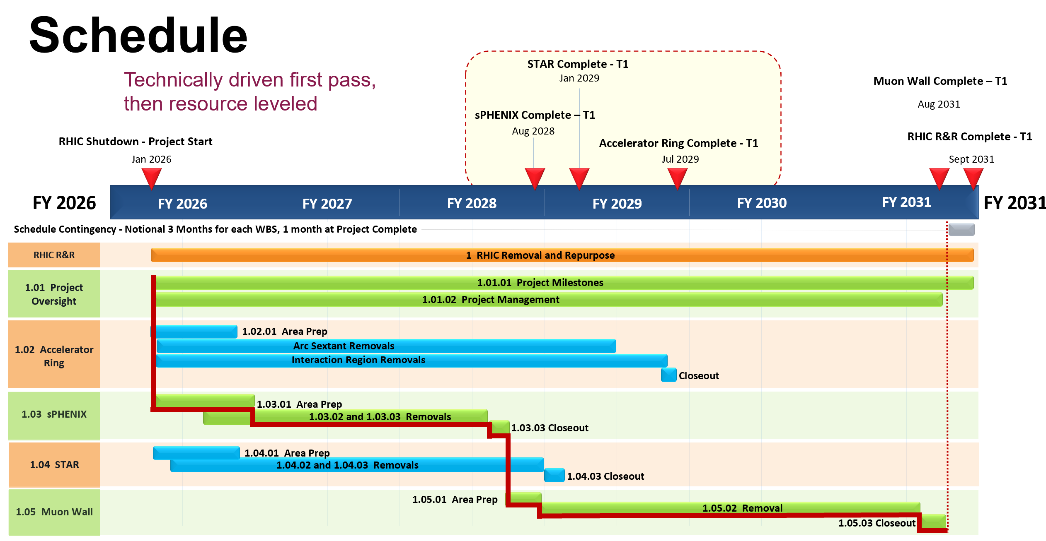

Slide 13
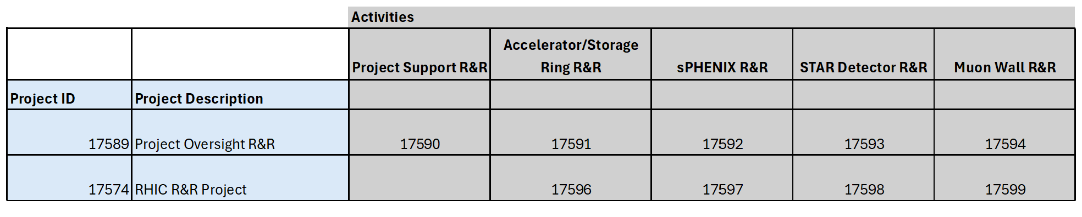
Project Charges
New Project/Activity accounts as follows:
It is important to charge time appropriately when performing work for the RHIC R&R Projects. Project Leads can provide details on what is included as part of the RHIC R&R Project.
Please ask Project Leads if you have questions related to the delineation of work to ensure you charge the project appropriately.
Accelerator R&R – Caitlin Giorgio
STAR R&R – Jameela Middleton
sPHENIX R&R – Marianna Albanese

Slide 14
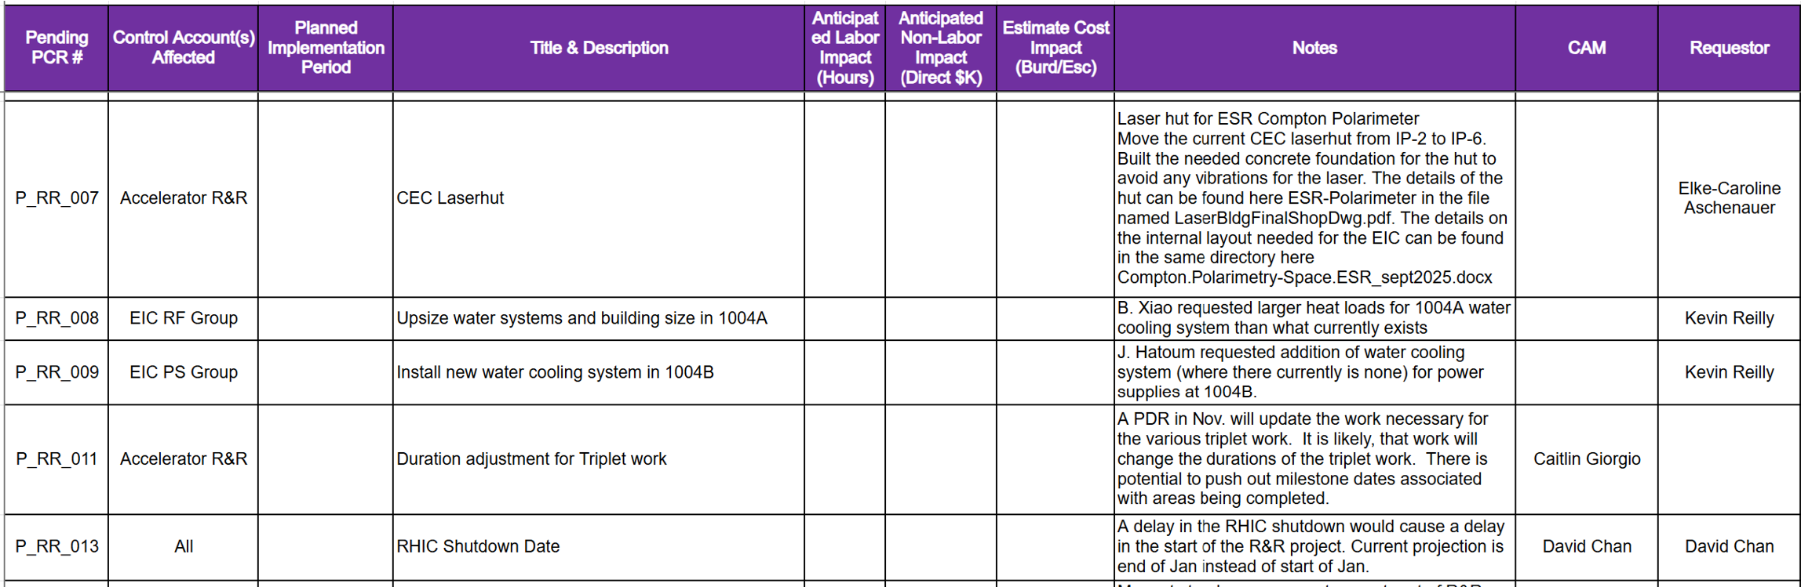
Interface of work in support of EIC
Engagement with EIC throughout the life of the project (Alignment with EIC Project Schedule)
Identify what is part of RHIC R&R and the EIC Project
Establish a means to entertain requests in support of the EIC Project needs
Project Change Request Log to determine the next level of supporting “off project dependencies”
Engage with the EIC Portfolio Team as needed or determining if work will be under operations or the EIC Project (Available Funding to Support)

Slide 15
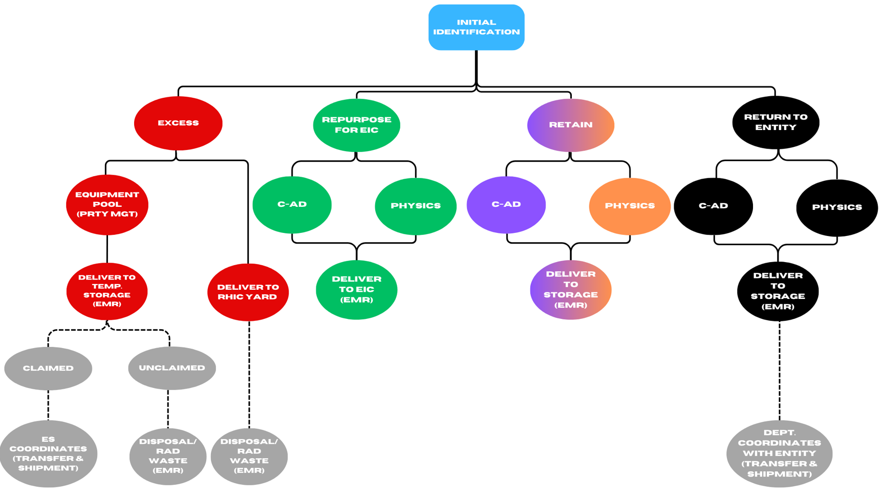
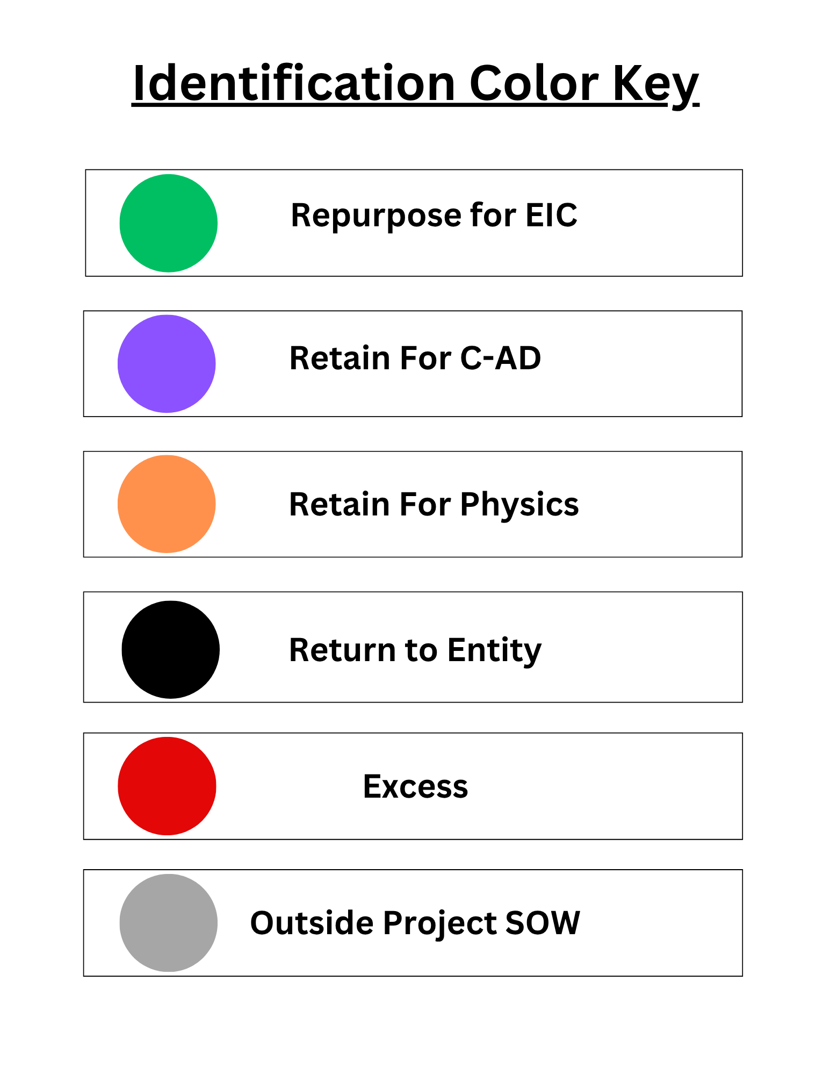
Identification Flow Chart
RHIC R&R Project
Operations – OBS 1.5.9

Slide 16
Categories
Excess - Government owned property under the control of BNL that is not in productive use in its present location and is excess to the requirements of the Departments/Divisions as defined in BNL Subject Area “Procurement & Property Management Group Standard Operation Procedures.
Repurpose (EIC Project Responsibility) - Equipment or components transferred from C-AD or Physics to EIC that will be repurposed for the EIC project.
Retain for C-AD or Physics - Equipment or components saved by a department for future use (example spare).
Return to Entity - Equipment or property owned by external entities that must be returned.
**The RHIC R&R Project is solely responsible for removing components within the RHIC Ring. Once components are removed, they will be assigned to the appropriate category listed above.

Slide 17
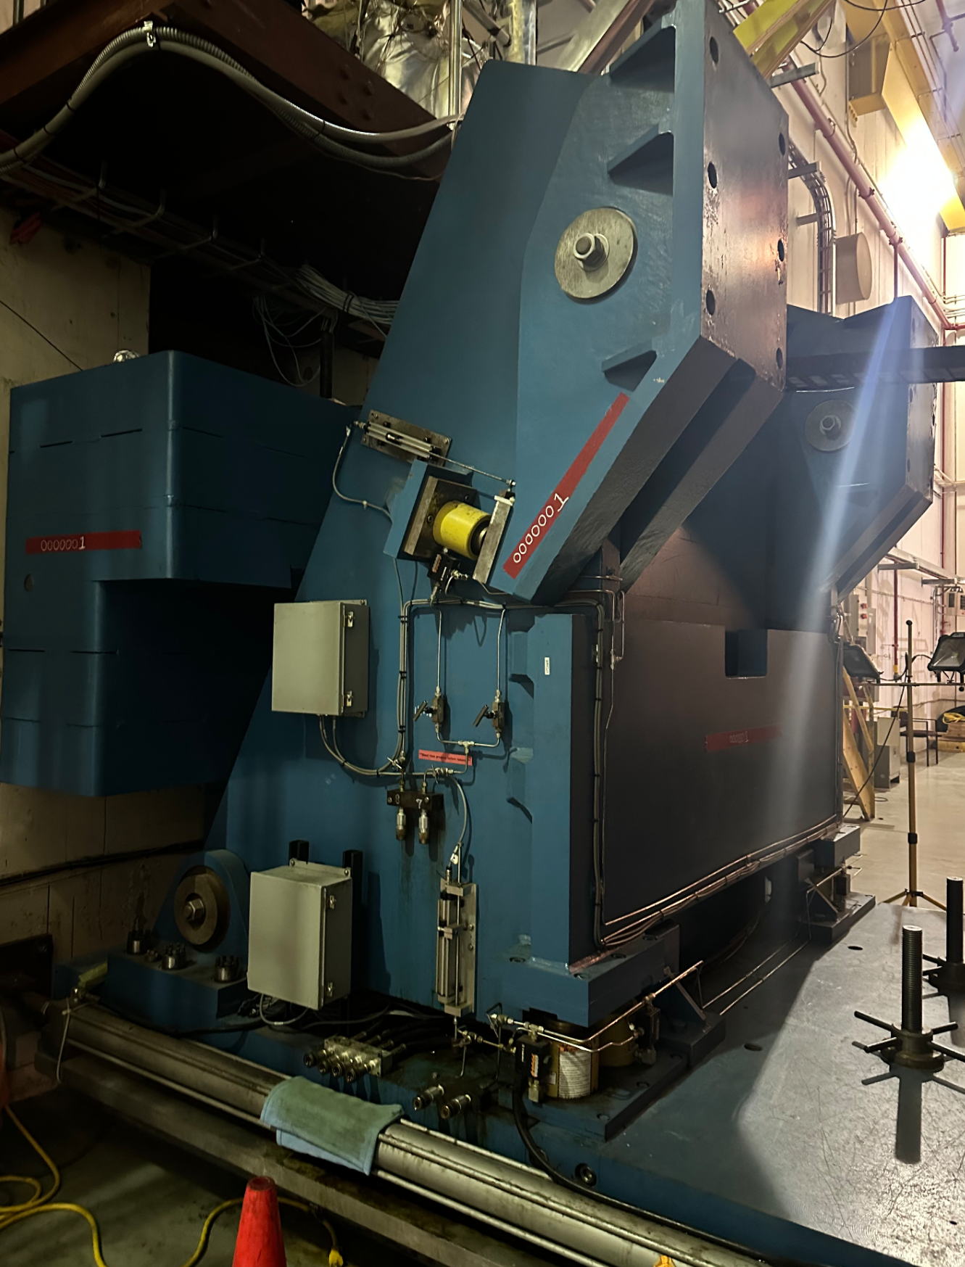
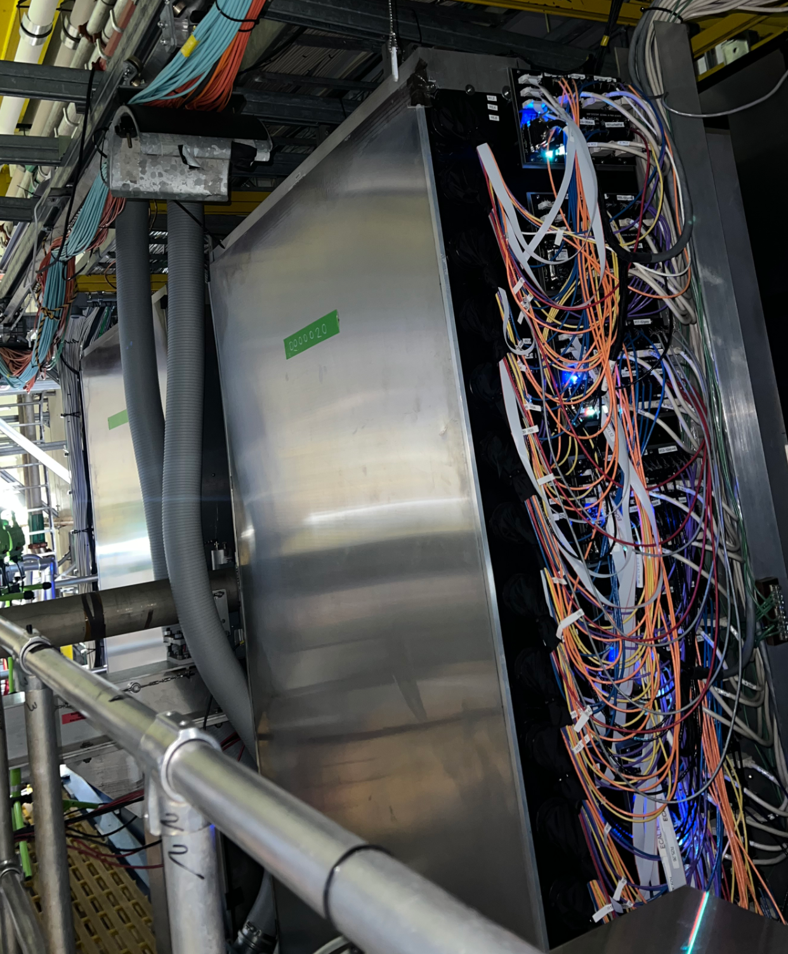
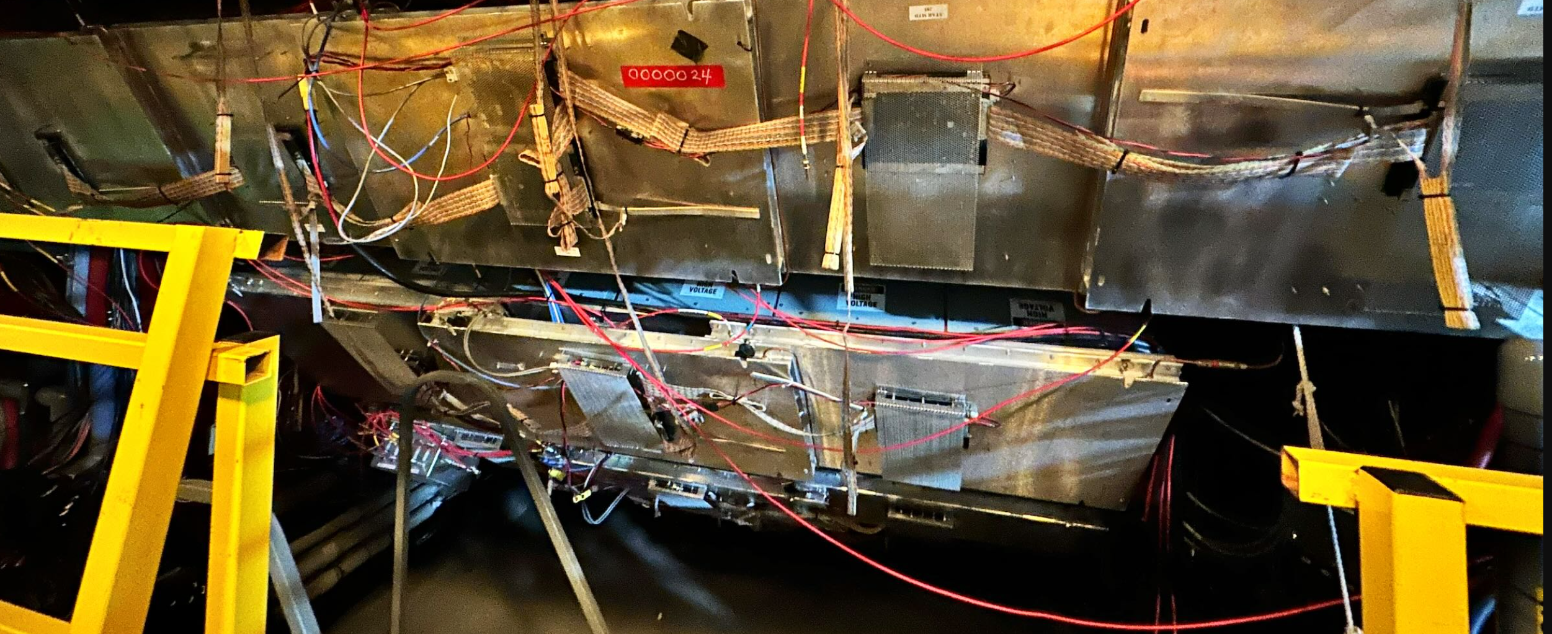
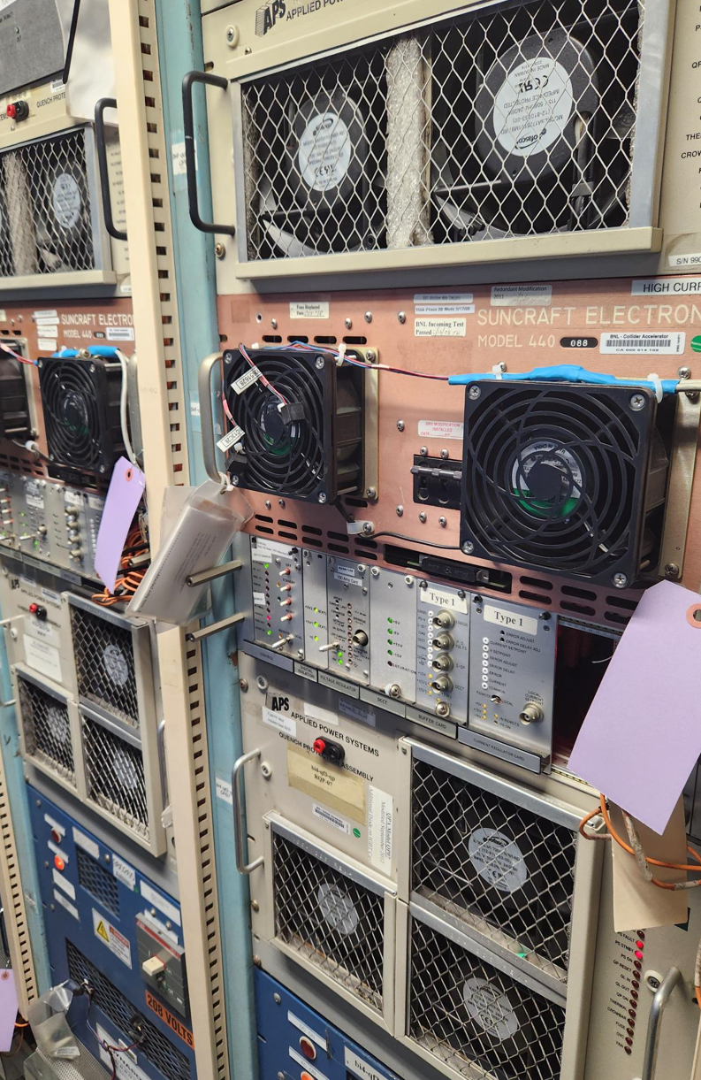
Removals Identification Progress
Below is the progress of identified components for the RHIC R&R to date:
Excess - 900
Repurpose - 1800
Retain for C-AD or Physics - 3700
Return to Entity - 30
TOTAL Components Identified – Approx. 6500
STAR Pole Tip
Forward Hcal
MTD Boxes
Power Supplies

Slide 18
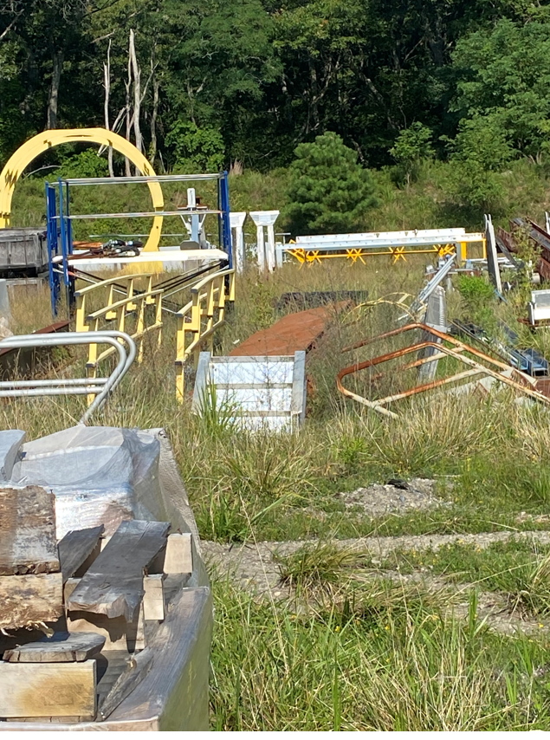
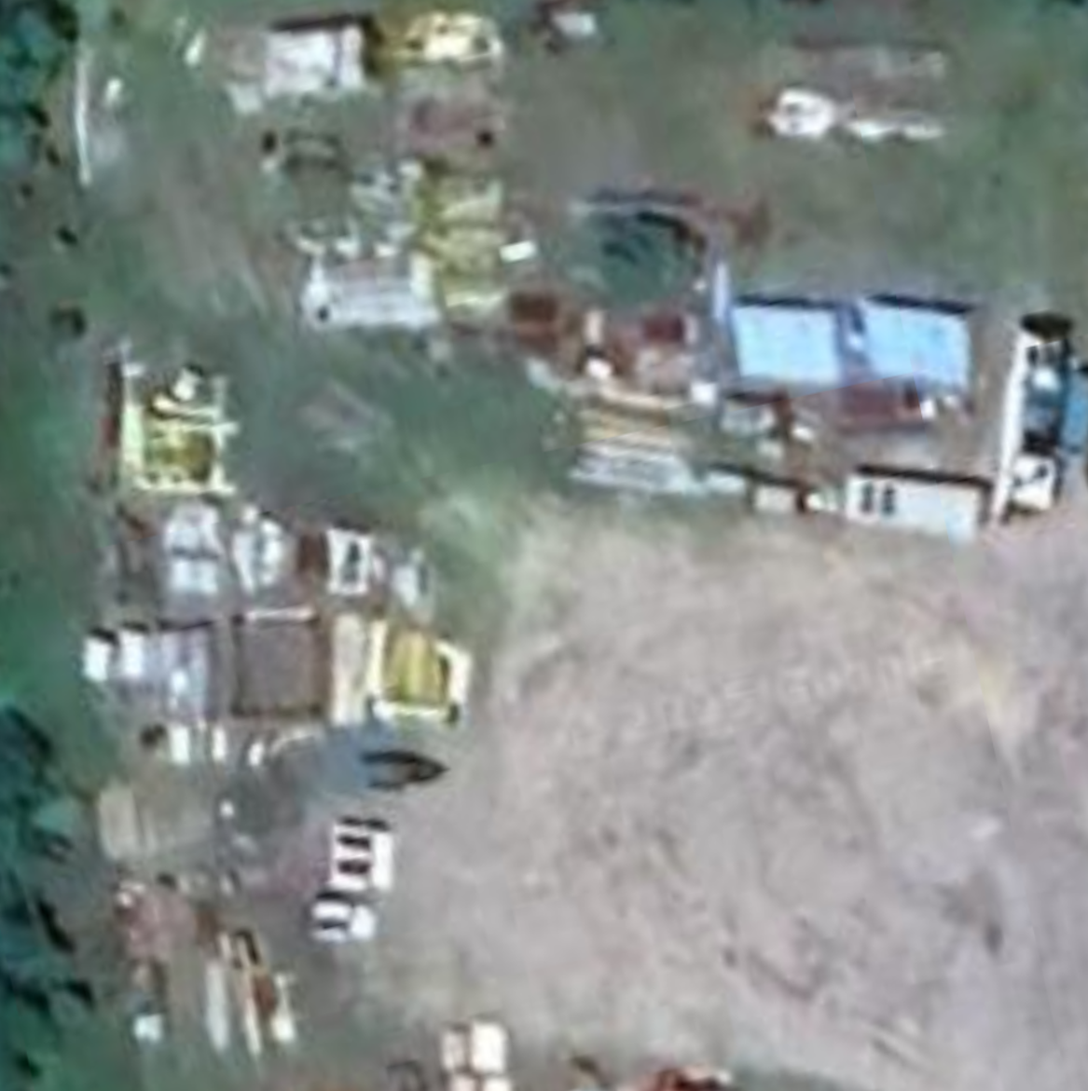
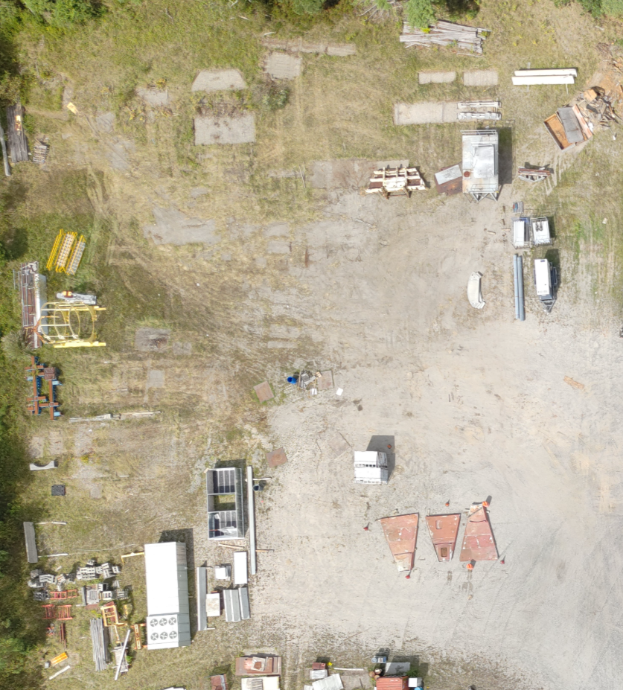
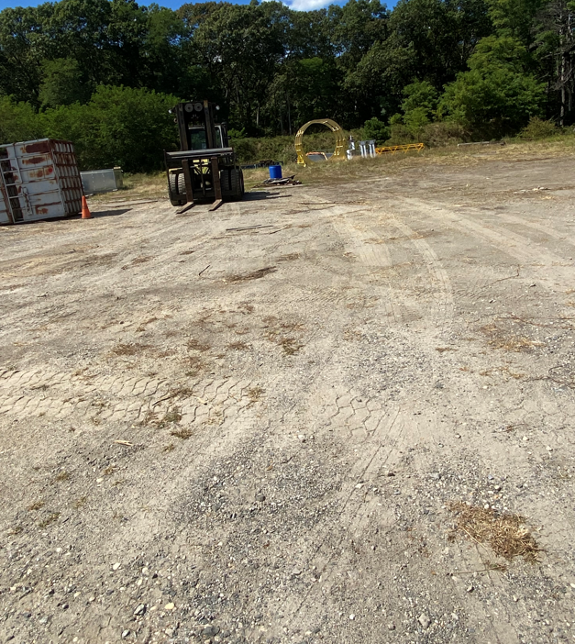
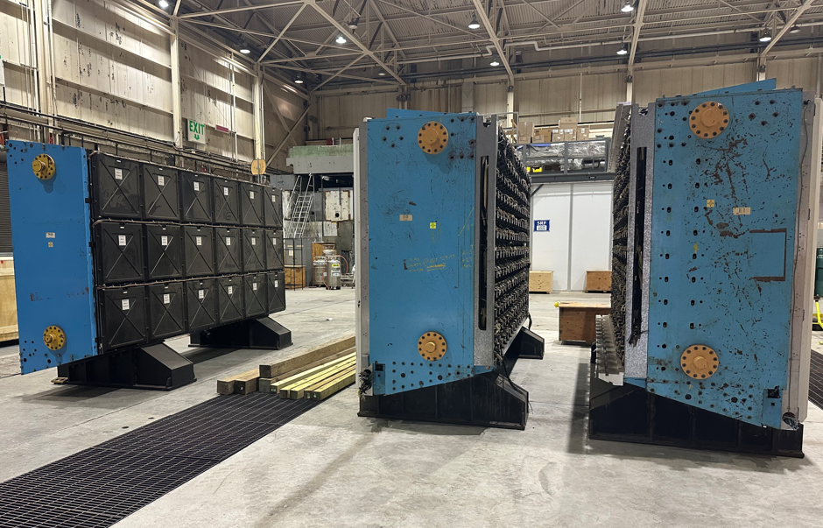
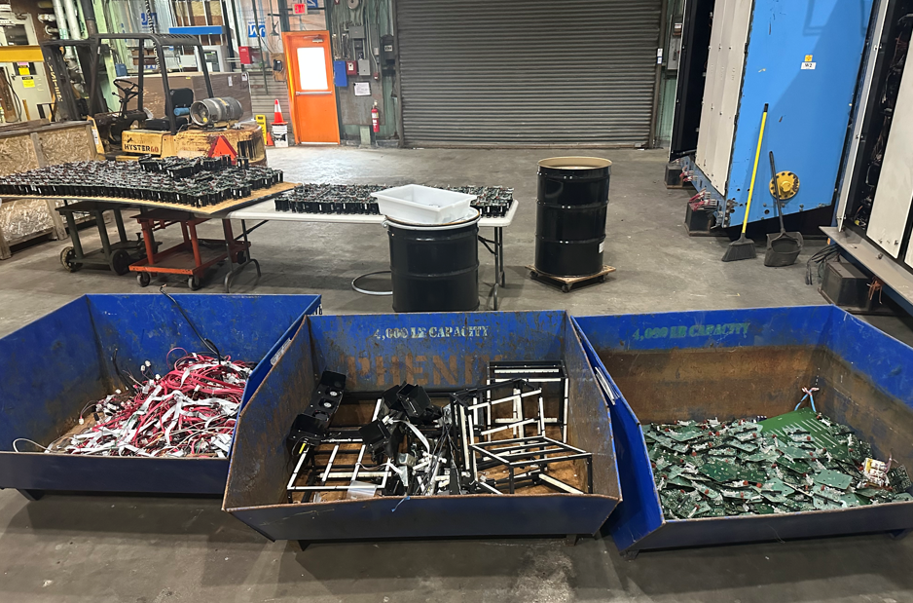
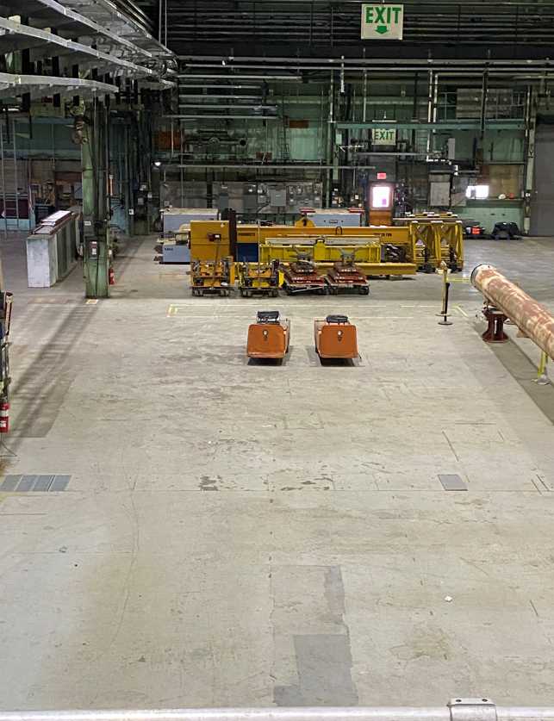
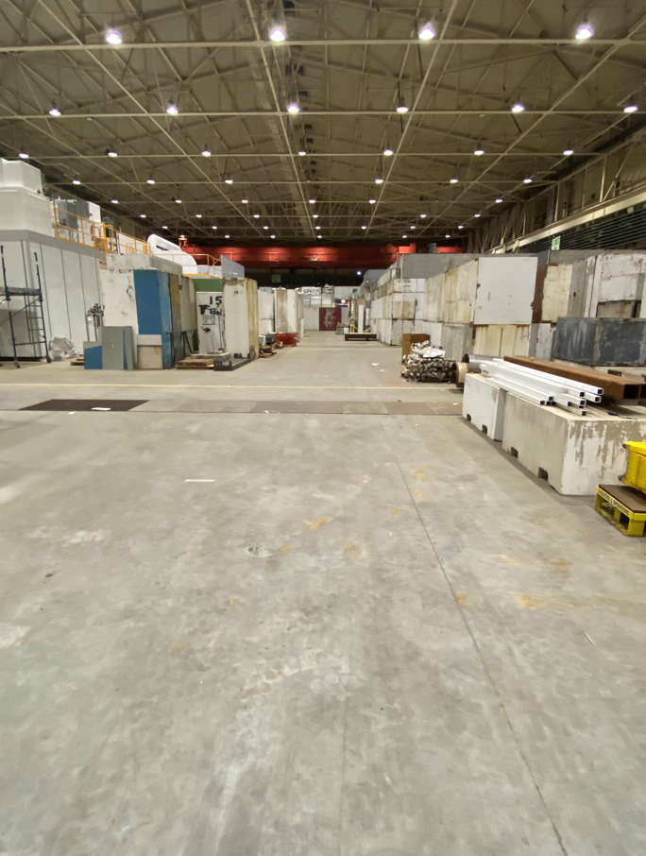
Space Planning (RHIC Yard and B912)
(Before & After Images)

Slide 19
External Project Engagement
Organizational Support Throughout BNL is needed to ensure that we have a successful EIC Project
Project Management Office
Environmental & Health Safety Representatives
Radiation Protection Operations for removals
Property Management Support (Excessing and transferring of components)
Export Controls
Business Office Management
Coordination of Space/Cleanup (Appointed Space Liaisons)
Subject Matter Experts – SMEs
EIC Portfolio and EIC Project Teams

Slide 20
Closing Remarks
RHIC R&R will start after Decommissioning and expiration of the RHIC ASE – Estimated to be around April 1, 2026
Duration of this project is approximately 3 years and is dependent on available funds, resources and the EIC project Schedule
All work MUST be coordinated daily through each RHIC R&R project lead or their designee.
Accelerator – Paul Sampson/Caitlin Giorgio
STAR – Jameela Middleton
sPHENIX – Marianna Albanese
High emphasis on the effort to clean up existing spaces and labeling of components for removals
The RHIC R&R project is one of the first steps to a successful EIC project and it is important that we focus on our goals to achieve a timely project completion. In doing so, we must remain focused on:
Working Safely
Budget
Schedule

