Slide 1
RHIC Decommissioning, Accelerator Safety, and New Risks
Ray Fliller III
ESSHQ Division Head
Collider-Accelerator Department
February 9, 2025

Slide 2
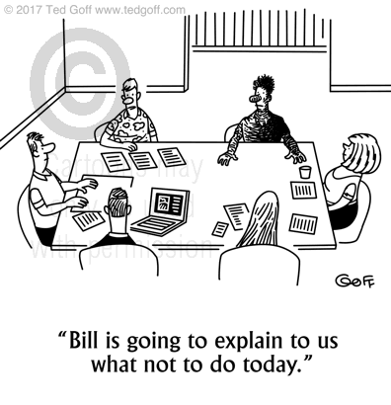
New Risks
RHIC decommissioning and the R&R Project will present new risks to work performed in the RHIC tunnel.
Certain hazards will go away.
Most hazards will remain.
Some remaining hazards may be handled differently than in the past.
Some hazards may increase.
We are going to need to adjust our work plans for this new environment

Slide 3
RHIC Decommissioning

Slide 4
Decommissioning
RHIC remains an accelerator until the decommissioning plan is completed and the RHIC ASE is retired.
The goal of the decommissioning plan is to permanently remove all of the accelerator specific hazards so that we can retire the RHIC ASE.
Even though RHIC will never see beam again, there are still accelerator hazards – for example ODH, X-Rays from RF systems.
All credited controls for RHIC must remain in place until decommissioning is complete and the ASE is retired.
NOTE: It is possible to have an ASE violation at RHIC until decommissioning is complete.

Slide 5
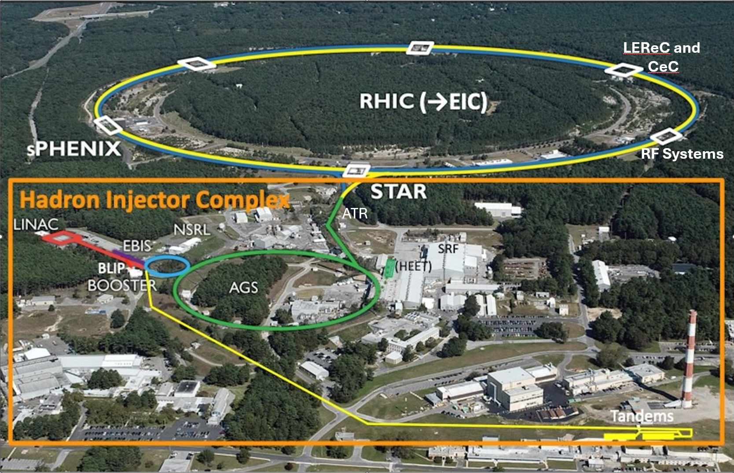
RHIC Decommissioning Scope
Facilities
RHIC
STAR
sPHENIX
LEReC
CeC
ATR line
Removal of Accelerator Specific Hazards
Prompt Radiation due to hadron and electron beams
X-Ray hazards from RF and High Voltage
Oxygen Deficiency Hazards
Flammable Gases at the STAR detector
The Decommissioning Plan does not remove other hazards or equipment from the facility.
In this sense it is a deactivation plan.

Slide 6
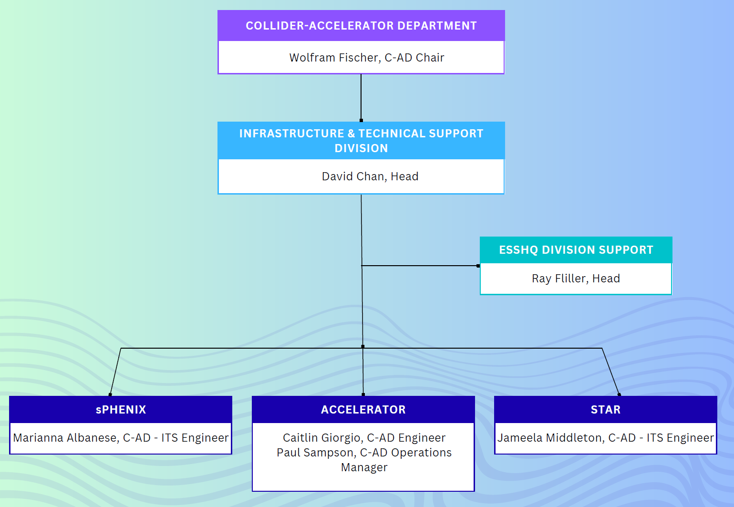
Organization
The start of work for RHIC decommissioning authorized by the C-AD Dept. Chair.
Responsibility for completing the decommissioning plan the Infrastructure and Technical Services Division Head
Sub-project leads are responsible for certain areas
Sub-project leads and ITS Division Head will coordinate tasks.
ESSHQ will provide safety and quality support through decommissioning.

Slide 7
RHIC Shutdown Activities
Certain operational tasks will take place at the end of the RHIC run to shutdown the facility. These include:
Power Supply tests
Removing Helium from the facility
sPHENIX calibration run (taking cosmic rays)
RF testing in building 1004
These are not part of the decommissioning plan and can be performed under the existing ASE. However decommissioning needs to be coordinated with these activities. Thus the decommissioning plan is broken into 3 modules to coordinate.
Tasks that are not already approved or normal shutdown tasks are not authorized during decommissioning.

Slide 8
Thirteen Controls
Air gap the W-line Switching Magnet (W-SWM) power supply at the beginning of the X and Y arcs.
Air gap the X and Y arc power supplies.
Operations Lockout of H10 septum.
Operations Lockout of UD1 and UD2 magnets.
LEReC laser beam block and Operations Lockout of beam block.
CeC laser beam block and Operations Lockout of beam block.
Remove RF feed from or air gap RF amplifiers of all RF cavities to air gap.
Disconnect the power inverter the high voltage multiplier to the LEReC gun to air gap.
Air gap Helium Tank Farm and prevent liquid helium production in refrigeration plant.
Apply Operations Lockout to the liquid nitrogen dewars at buildings 1005H and 1006B.
Air gap the liquid nitrogen dewar used to cool the sPHENIX magnet.
Remove compressed gas from sPHENIX. Cap off the gas lines. Remove compressed gas cylinders.
Remove the flammable gas from the STAR detector and purge with inert gas. Cap off the gas lines. Remove compressed gas cylinders.
Remove Beam Hazards
Remove X-ray Hazards
Remove Oxygen Deficiency Hazards
Remove Flammable Gas Hazards
These controls remove the hazards that are controlled by the RHIC ASE.
Implementing these actions does not impact the ASE controls and the ASE remains in effect through the decommissioning process.

Slide 9
Decommissioning Modules
Module I – tasks that have no impact on shutdown activities.
Module II – tasks that require the Helium to be removed and RHIC rings warmed.
Module III – tasks that require the sPHENIX calibration run to be completed or the RF testing in 1004 to be completed.
The modules are independent of each other.
All tasks in each module will be verified upon completion.

Slide 10
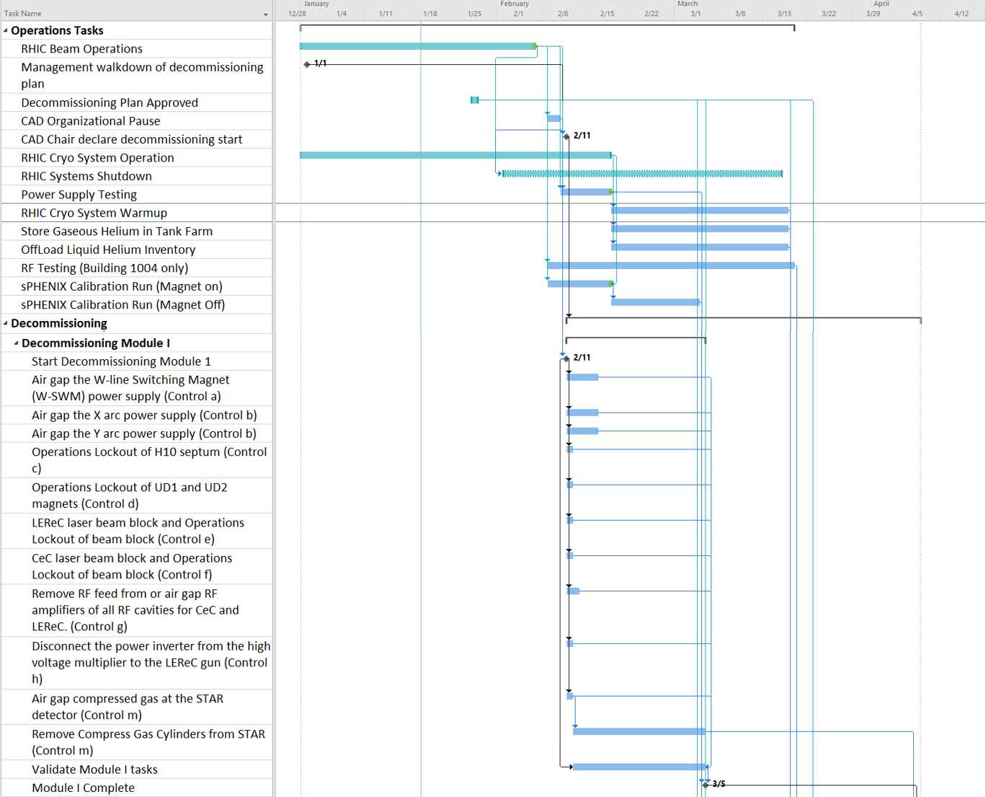
Module I
Beam Hazards are removed
Some X-Ray Hazards are removed (CeC and LEReC)
STAR flammable gas is removed.
This module can be started as soon as decommissioning is authorized
Tasks in this module are independent of each other.

Slide 11
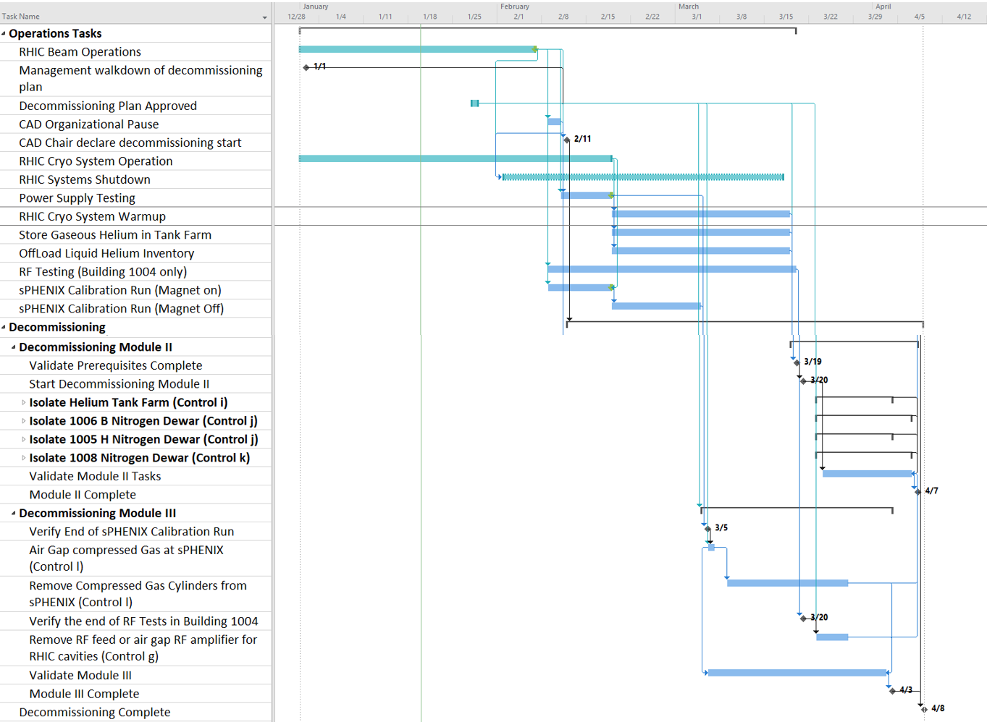
Modules II and III
Module II:
Requires cryogenics work to be complete
removes ODH hazards
Module III:
Requires sPHENIX calibration run to be over to remove compressed gasses.
Requires RF Tests in 1004 to be complete to air gap of RF systems to remove Xray hazards.

Slide 12
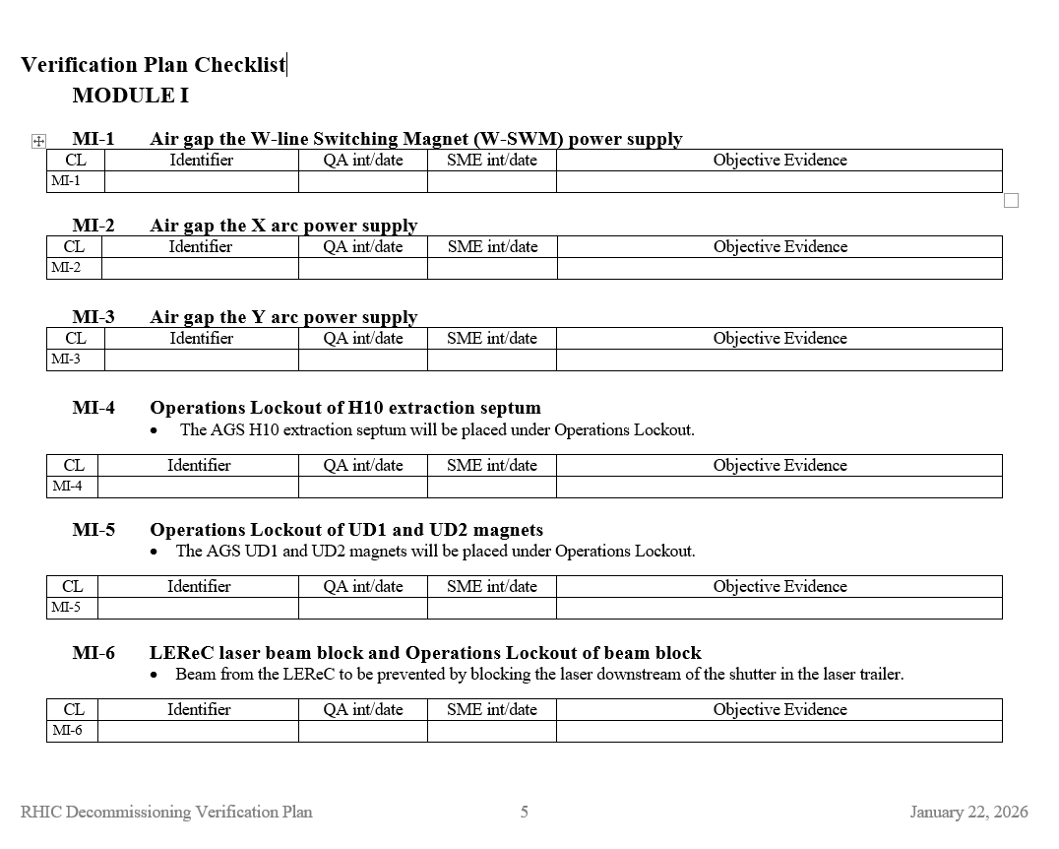
Verification
All tasks in the decommissioning plan will be validated by the C-AD QA Representative and the lab Accelerator Safety SME.
In most cases, before and after photos will be recorded to show the task was performed
A report will be generated to compile all of the evidence which will be reviewed by the ESSHQ Division Head and approved by the C-AD Chair

Slide 13


Verification
All decommissioning tasks will be verified by Jessica Paucar and Bryan Mason.
Jessica and Bryan will witness the decommissioning activity being performed.
Verification is important to show:
All the steps are completed
Hazards are removed as planned

Slide 14
Retiring the RHIC ASE
The verification report will be signed by Ray and Wolfram when complete and submitted to the ALD NPP and ALD ESH as proof that decommissioning is complete.
The RHIC ASE will be retired and the site office notified with a copy of the report.
R&R can be authorized after decommissioning is complete.

Slide 15
Operating our Accelerators Safely

Slide 16
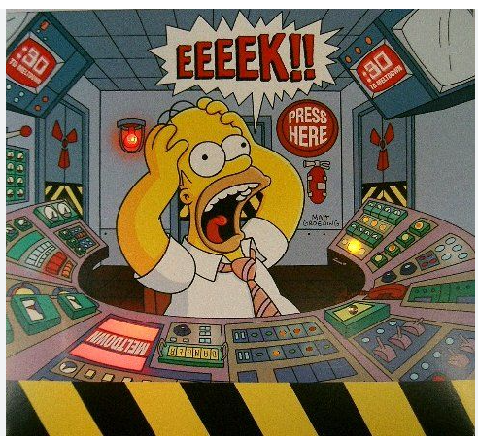
Accelerator Safety
Tandem, EBIS, Linac, Booster, NSRL, and AGS will continue to operate using the same procedures and safety requirements.
The ATR line to the W dump will be temporarily disabled as part of decommissioning.
The credited controls for these facilities still need to be respected as they do now. That includes ACS, ODH, chipmunks, shielding, MCR staffing requirements, etc.

Slide 17
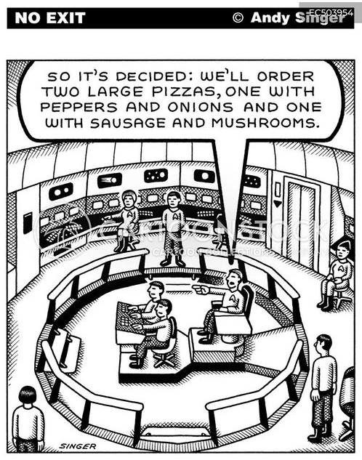
Updating the CAD SAD
We are still in the process of updating the SADs and ASEs for the Hadron injector complex.
SAD for EBIS, Linac, Booster, NSRL
Separate ASEs for EBIS and Linac, Booster, and NSRL
SAD and ASE for AGS and ATR to W dump
Linac and Booster are scheduled to have an ARR in July 2026.
AGS is scheduled for an ARR October 2027.
Performing these ARRs is part of our preparations for the EIC.

Slide 18
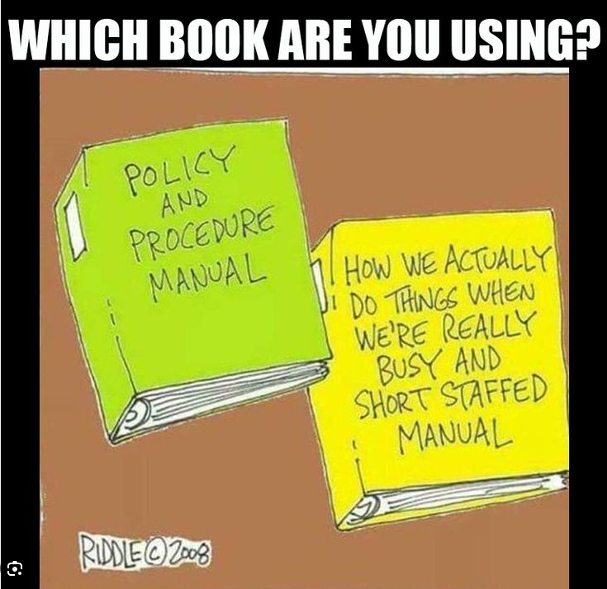
Procedures
The procedures project is close to the finish line.
The project is 92.3% complete on reformatting procedures.
There are a few dozen procedures that will be canceled in the next month or two as they are no longer needed.
We will move into a state of needing to maintain our procedures.
Procedures that are past the due date will become inactive after 30 days.
Procedures that are inactive for a year will be canceled.
Following our procedures is as important now, as it was in the past.

Slide 19
USI’s
USIs are still required for all work permits!
After RHIC decommissioning is complete, we will do a single USI for all R&R work.
Individual USI’s are still required for work permits in the Hadron Injector Complex.
Nothing changes.

Slide 20
Changes to Training and Access at RHIC

Slide 21
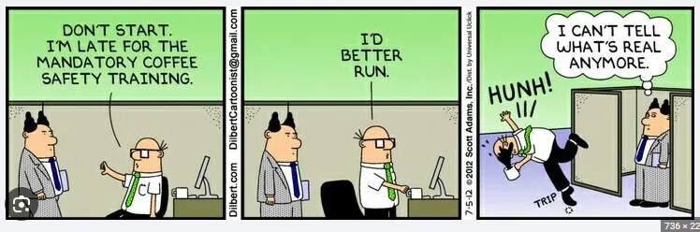
Changes to Training
The working environment at RHIC is changing and will continue to change.
The following changes to training are underway:
A new training will be issued at the beginning of March to those who need access to RHIC.
By the beginning of April, anyone who has not completed that training will have their access to RHIC restricted.
Collider User Training and Collider Access training will no longer be sufficient to access any RHIC facility.
All purple cards will be inactivated.
Blue will not allow RHIC access for those who do not complete the new training.
Collider Access will still be needed for all other CAD facilities.

Slide 22
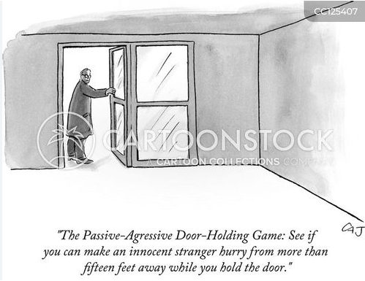
Changes to Access at RHIC
The access control system at RHIC is no longer a credited control but will still function as the main means of securing the facility and allowing access.
After decommissioning, the ODH system will be disabled.
The ACS group will phase out the blue cards at RHIC and the gates will be keyed.
Propping doors or tunnel gates open will not be tolerated.

Slide 23

Make sure your training is complete
If you have training that you don’t think you need let your supervisor know. We can certainly remove unnecessary training.
If you need additional training to perform a job, we can assist with that too.
Some of you may have noticed that if your training is expired for a while, you and your supervisor get invited to an in person meeting in my office.
At that meeting, you get to explain why you have not completed that training.
Your supervisor gets to explain why they did not ensure your training is completed and allowed you to keep working.
Nobody likes this meeting, so complete your training.
Top 5 courses that are incomplete:
Medical Surveillances (Noise, ladder, ODH)
LOTO JPM
LOTO OJT – this is literally a form.
CPR – required for all QEWs, no CPR, no electrical work
Fall Protection (we are getting more evaluators for this)

Slide 24
Work Planning and Hazards

Slide 25
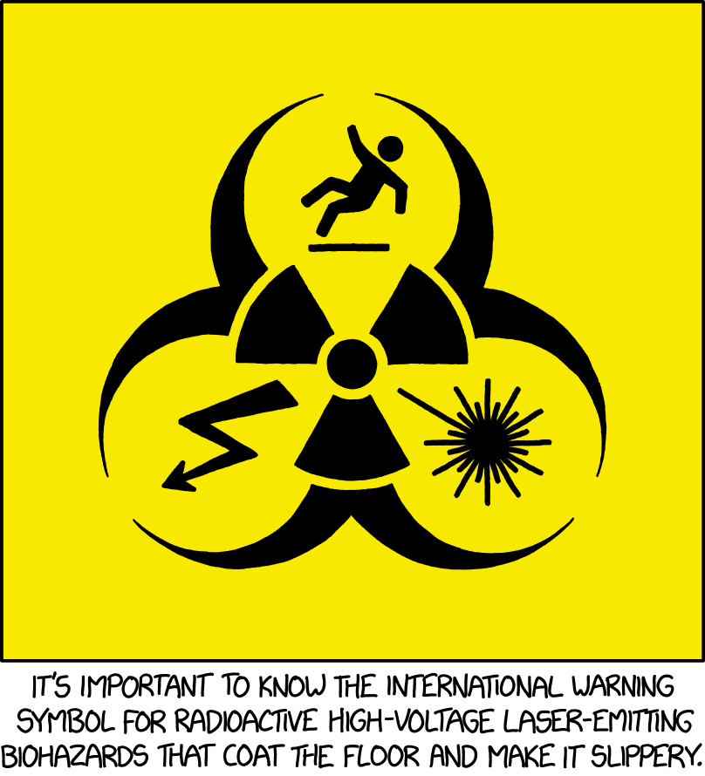
Changing Work and Hazards
The R&R project brings a new work profile to RHIC.
Even jobs that were done before need to be considered differently since the work environment is changing.
Methods of controlling certain hazards may change.
For example – there are no cryogens, air gapping may be used instead of LOTO.
The work occurring in RHIC is considered construction work by SBMS. This has additional requirements in work planning and execution.

Slide 26
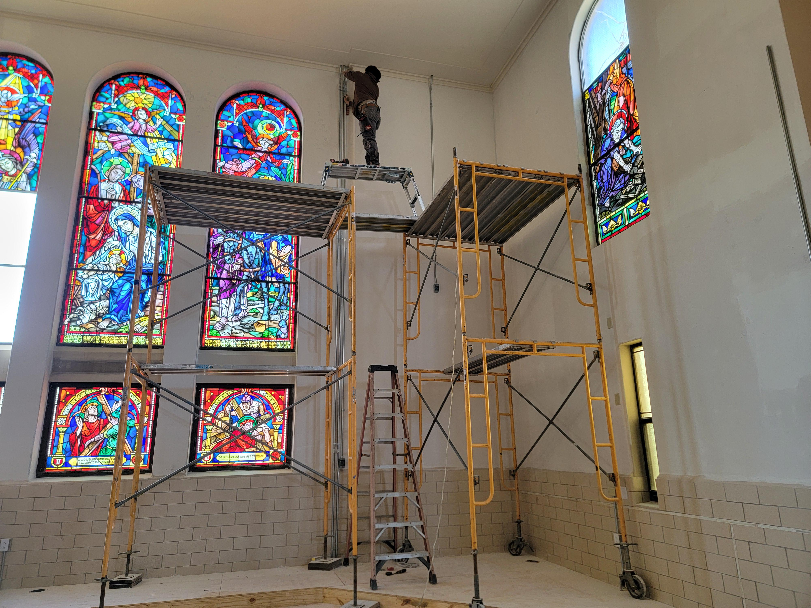
Work Planning - Construction
R&R Managed as Construction Work
Construction Managers / WCC: Sub-Project Leads
Job Hazard Analyses (JHAs) for all tasks
Safety Inspector (OSHA 30Hr, JTA: HP-70D) – ESH Reps
Site Boundaries: Construction Zone
PPE: Minimum Requirements (OSHA Rules)
Pre-Job Briefings: Daily (P.O.D.)
Planning & Scheduling: Daily / Weekly Coordination Meetings
Don’t do this.

Slide 27
WP&C…Same, but Different
Same…
OPM 2.28
Electrical JPB, >50V, IEWR
LOTO rules
Pre-Job Briefings
Work Boundaries
Work Plans
Work Permits
Different…
Construction Rules
Designated Project Lead
JHAs per task
Minimum PPE requirements
Postings will change
Multiple Groups working together
Coordination is imperative
Safety Inspector (OSHA 30Hr, JTA: HP-70D)
Shared Resources (HP, Rigging, Carp, Elec…)

Slide 28
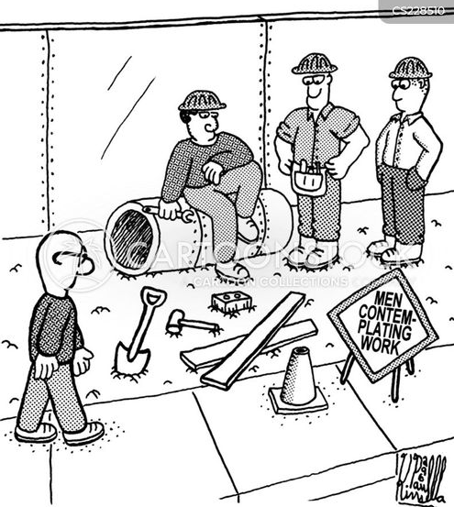
Pre-Job Briefs
Pre-Job Briefs are an important tool in safe operations
They are a short meeting prior to the start of a job to discuss the work at hand and address any concerns that participants may have.
This ensures that everyone understands the work and the risks involved.
This helps ensure that the work is done correctly and safely.
“ a strong prejob briefing process provides workers who face occupational hazards on the frontline a vehicle to express their concerns, receive validation for those concerns and achieve satisfactory resolution. That is an example of the value of worker participation and management commitment in a nutshell.”

Slide 29
What Makes a good Pre-Job Brief?
Ensure the work task is clear in scope
Make sure everyone knows what to do.
Make sure everyone knows what NOT to do.
Evaluate the work site.
Discuss aspects of the task that may change during the job.
Everyone involved in the job participates
All questions and concerns are addressed to the satisfaction of everyone.
“We can easily describe what a quality briefing looks like: Let’s picture in our minds a job briefing in action. Workers and management standing in a circle having a conversation. We see mutual respect. No one is afraid to speak up. There is a walk down of the job site to identify hazards and any risk from adjacent work. A job safety analysis is reviewed or completed. Each layer of protection, including controls for energy and work permits, are tested for effectiveness. Team members understand their authority to stop work the moment work planned no longer aligns with work performed.”

Slide 30
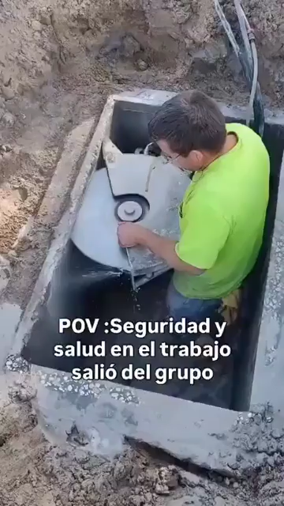
Hazards old and new
During the R&R project, the types of hazards present will be different than we are used to:
Activated Materials (including transport)
Beryllium (STAR, sPHENIX)
Effluent Discharge
Electrical Hazards
Elevated work
Ergonomics
Compressed gas
Hazards in areas may change day to day. This makes attention to postings, JHAs, work plans and pre-job briefings very important
Water systems
Welding,Grinding, Cutting
Moving heavy objects (material handling)
Noise
Silica
Rigging
Waste Generation

Slide 31

Changes to Signage
Expect changes to radiological and ODH signage at RHIC.
As work proceeds during the R&R signage is going to change.
Certain areas may have PPE requirements.
Be watchful of CAUTION and DANGER tape.
Use CAUTION and DANGER tape.
Be conscious of all signage and make sure you have the required training and permission to enter work areas.
If you see a sign that you think is no longer applicable, don’t ignore it, let us know. OBEY THE SIGN ANYWAY!

Slide 32
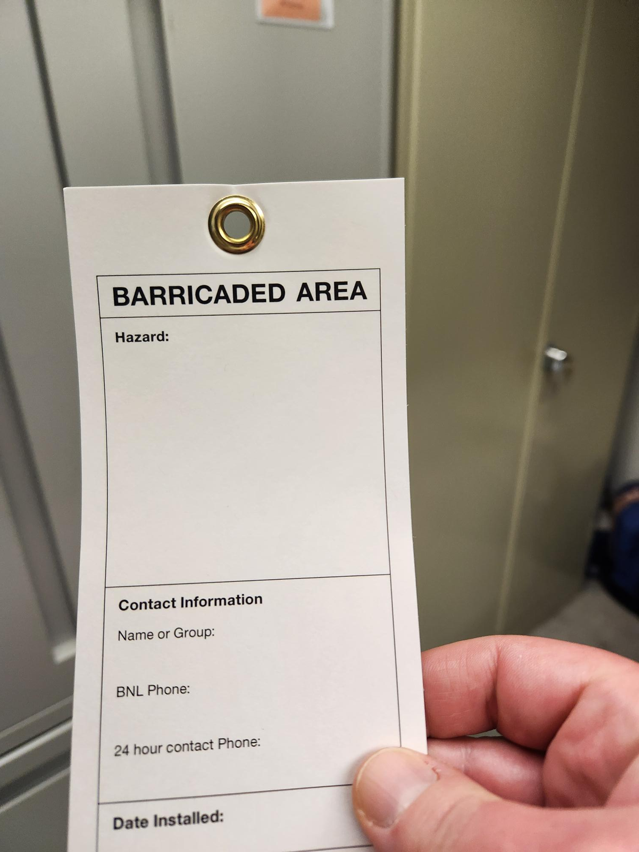
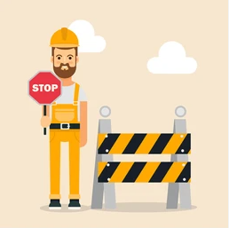
Barriers
Use CAUTION and DANGER tape and other temporary barriers to control your work area.
You cannot pass a barrier without contacting the person who’s name is on the barrier.
We have plenty of tags for use!
You cannot pass a barrier without being briefed.
If a LOTO is in place you must be on the LOTO.

Slide 33
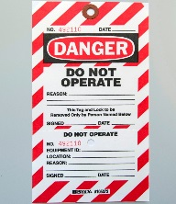

LOTO
LOTO: Process necessary for the protection of Personnel from the unexpected energization or startup of machinery and equipment, or the release of hazardous energy during installation, demolition, or service and maintenance activities. Hazardous energy includes mechanical (rotational, gravitational), electrical, chemical, pressure or vacuum (hydraulic, pneumatic), ionizing and non-ionizing radiation, thermal and other energies that may cause harm.
In addition to LOTO, many systems may be air gapped.
This is covered in the SBMS subject area on LOTO
Air gapping puts a physical separation between the source of hazardous energy and the system (e.g. removing the cables from a power supply to a magnet).
This can alleviate some of the needs for LOTO, and makes sense for R&R.
This of course is DOCUMENTED as part of the work plan.

Slide 34
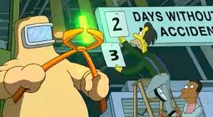
Activated Materials
The RHIC tunnel and detector halls will have the minimum posting of Radiological Material Areas (RMA)
Everything that has been exposed to beam MUST get an activation check before removal or be accompanied by an RCT to another RMA.
Need to assume that activated materials don’t get disposed of in the wrong waste stream.
When in doubt, ask an RCT or the RPO Rep.

Slide 35

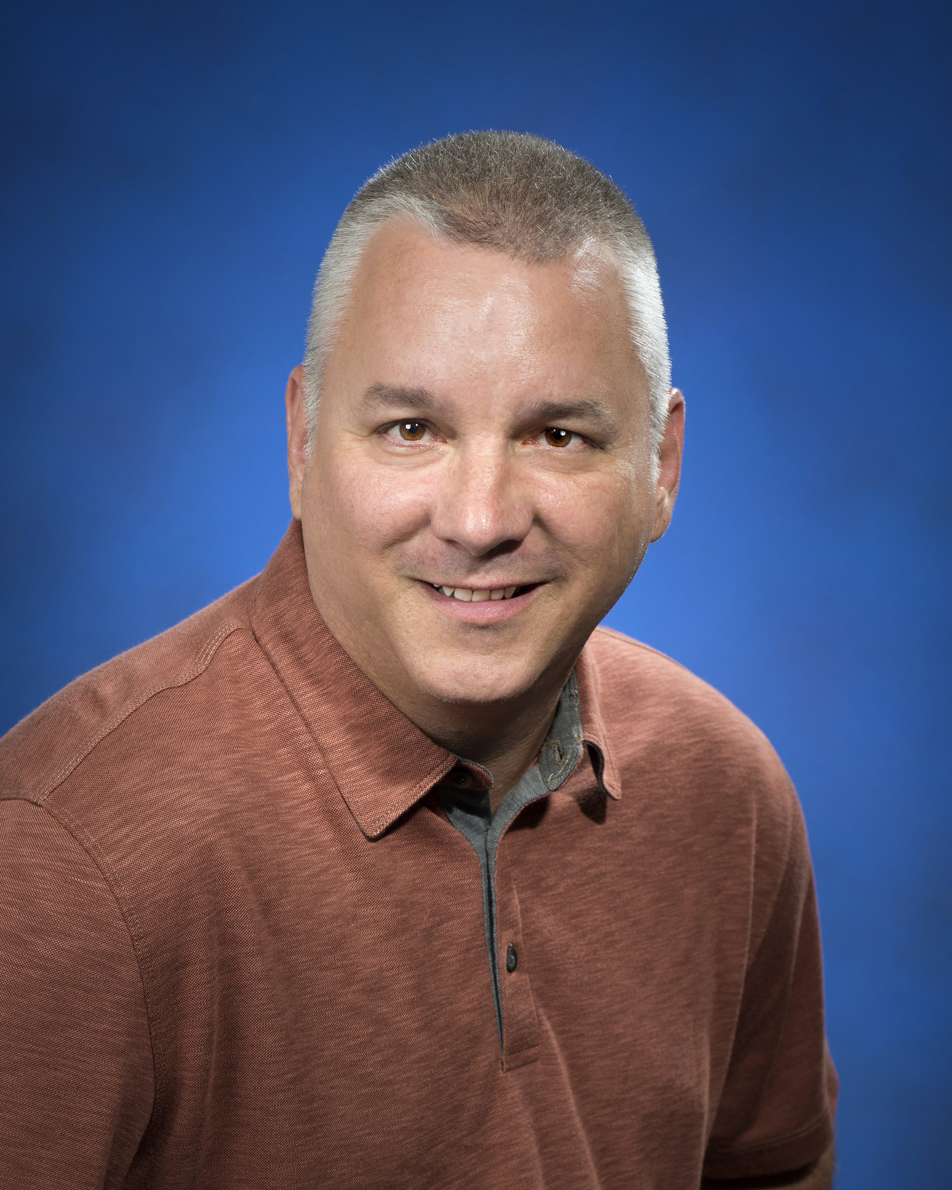

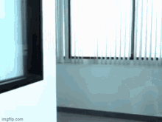
Expect to see safety around
ESSHQ is here to partner with you to plan and perform your work safely.
The ESR reps will be in the field performing daily safety walkthroughs. This is part of the requirements for Construction planned work. So expect to see them.
They are there to ensure that the job site is safe to work in and that safety rules are being followed. They are there to provide assistance if needed.
The ESH Group is a resource
Adrian Steinhauff
sPHENIX and STAR
Chris O’Shea
Accelerator
Chris Linkletter
Backup
The role of safety is not to try and catch you doing the wrong thing!
Terry Tate is not an ESH Rep

Slide 36

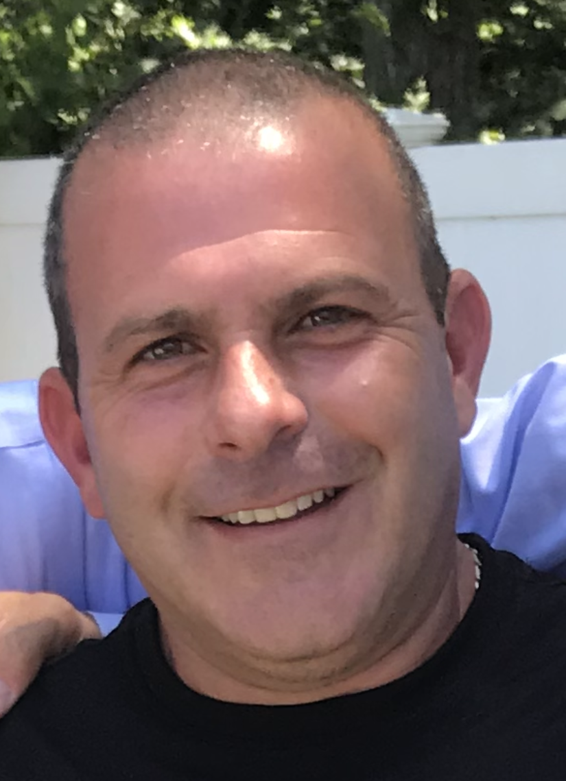

Waste Management Requirements
Rules apply at the point of generation
All waste must be characterized before disposal.
A Waste Management Rep, Environmental Compliance Rep, or ESH Manager must be involved in characterization decisions.
Only trained and qualified personnel may submit Waste Control forms.
For C-AD, coordinate with Lenny Campione.
Improper disposal can cause violations, fines, and cleanup costs.
Metal recycling allowed only if free of radioactivity and liquids.
C&D debris disposal is regulated.
SBMS Waste Subject Area defines BNL requirements

Slide 37
General Description of Common Waste Regulatory Categories
Hazardous Waste
Examples- Alcohols, Acids, lead-contaminated debris.
Universal Waste
Examples- NiCd batteries, lithium batteries, fluorescent lamps.
Radioactive Waste
Examples- Activated material waste
Industrial Waste (Non-Hazardous)-
Examples- Used Oils, non-hazardous chemicals, oils
Mixed Waste- waste that is both “Hazardous” and Radioactive
Examples – activated lead, activated mercury
Construction and Demolition Debris- Non-hazardous materials resulting from C&D activities.

Slide 38

Recycling
Recycling conserves resources, reduces costs, and is preferred over disposal.
Some items require pre-separation (e.g., refrigerants, oils, hazardous materials removed).
Examples- Scrap Metals, lead-acid batteries

Slide 39
Wrapping it up!

Slide 40
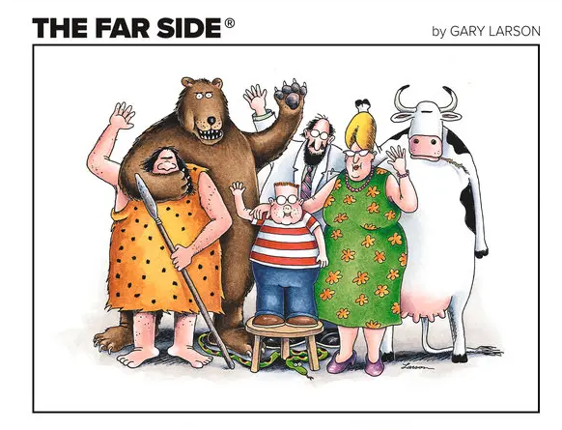
Conclusion
Decommissioning RHIC will retire the RHIC ASE.
The RHIC R&R program will start after decommissioning is complete.
There will be new training requirements to go to RHIC after decommissioning is complete.
Work Planning at RHIC will be planned as construction work.
There will be new hazards at RHIC was components are removed.
There will be changing conditions at RHIC as the R&R progresses.
Everything that was exposed to be needs to be checked for activation or accompanied by an RCT when removed from the tunnel.
Be careful about waste generation and disposal.
Expect an increased presence of the ESH group.
Our other accelerators will continue to operate with the same (or improved) standards we are used to
The credited controls for our other accelerators still need to be maintained as they have before.

