Slide 1




New AC-LGAD designs
Dr. Simone M. Mazza (SCIPP, UC Santa Cruz)

Slide 2
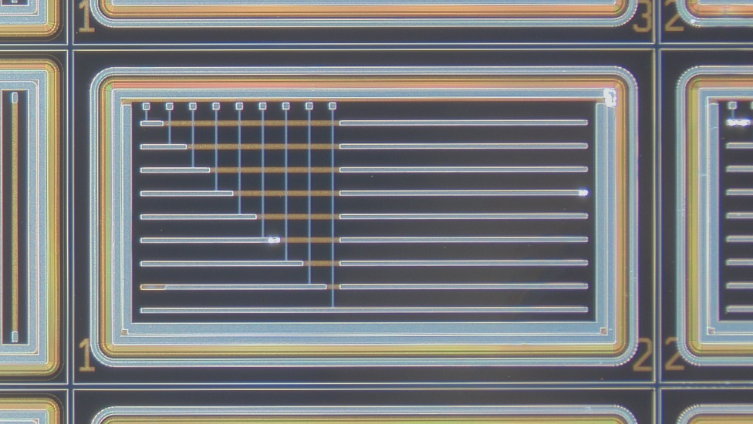
Improved AC-LGAD design
R&D can continue for EIC detector 2 or for a future ePIC upgrade
Collaboration of UCSC and BNL to push performance and better time resolution
Type 1: update of AC-LGAD design to improve production yield
Type 2: directly connect strips to reduce signal spread over multiple strips
Increase S/N (better charge collection), might allow for longer strips and pitch to reduce channel count
Type 3: lateral readout for strips with double metal layer
Simplified assembly for 100% coverage
Production 1: done with erd112 remaining funds: under test
Production 1 ½: a few test strip sensors on another sensor production, will start soon
Production 2: design ongoing, funded by EIC R&D funds
Misalignment issue
CHIP
Double metal layer
Credits to Satoshi
for suggesting it!

Slide 3
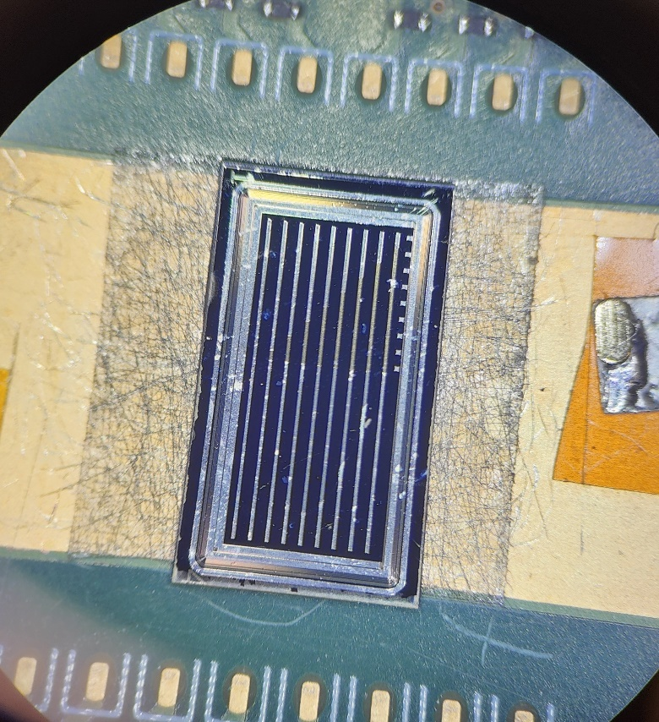
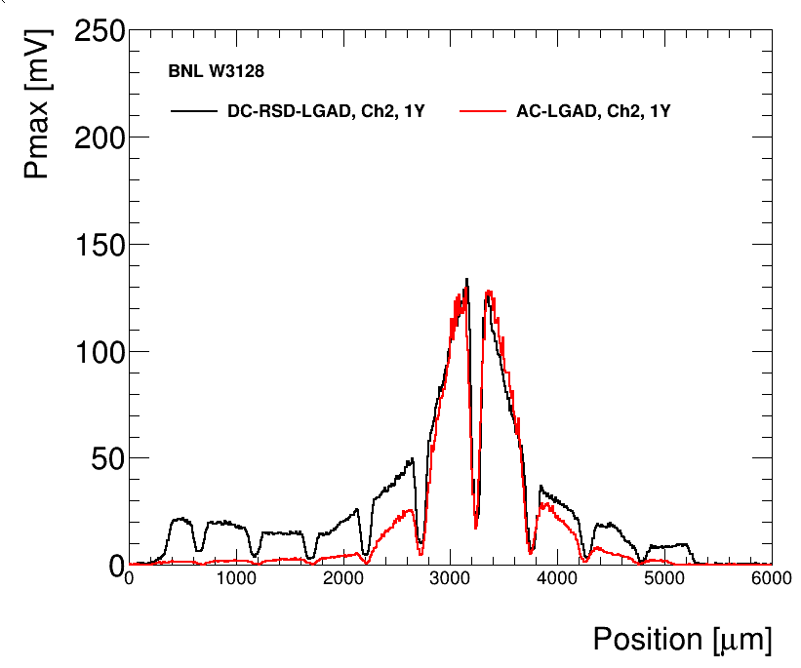
DC-RSD prototype vs AC-LGAD
First prototype of new type of AC-LGAD and DC-RSD produced at BNL
Waiting for double metal layer to finish
Testing two sensors with same geometry; 1cm long, 500um pitch, 100um wide strips
Laser TCT scan across the sensor shows worse performance for DC-RSD in terms of charge sharing (Ideal behavior is signal close to zero at first neighbor)
Timing proprieties (rise time, time of arrival) are the same
Still a lot to optimize, secured funding for the next production!

Slide 4
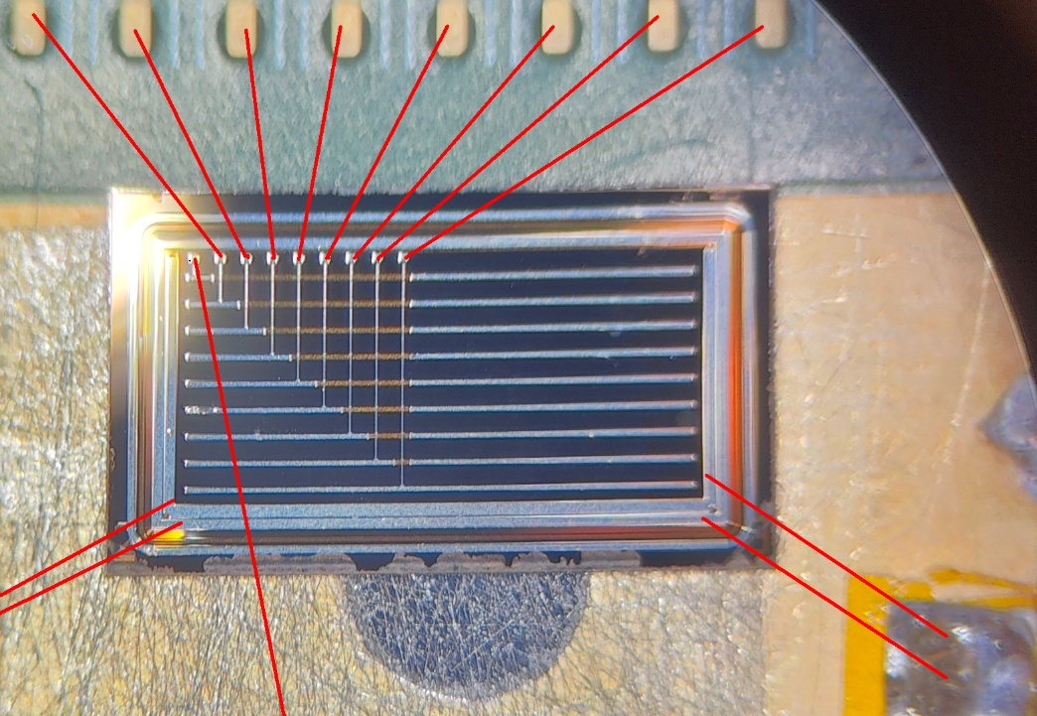
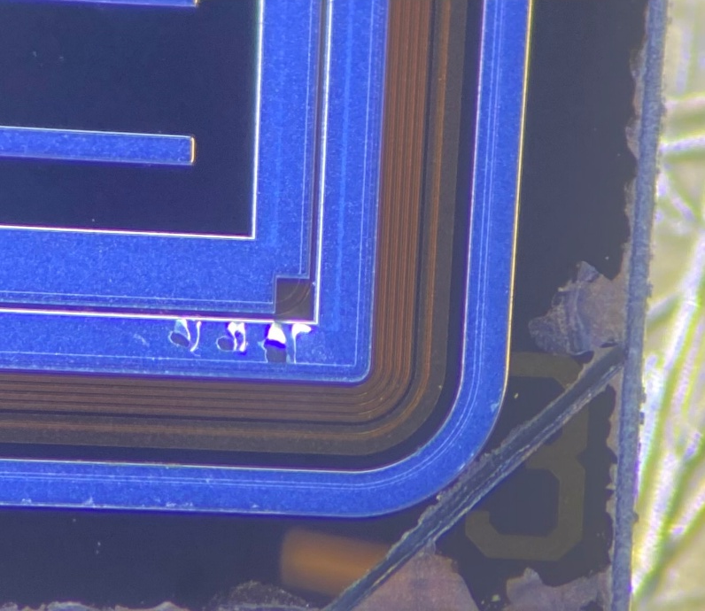
DML AC-LGADs
Double metal layer AC-LGAD, connected to usual FNAL 16ch board
Some issues during bonding, likely due to the double metal layer
Metal peeling off during bonding
Solved after changing parameters and bonding process
Bonds are extra fragile, one popped out during testing
Tested with laser TCT setup

Slide 5
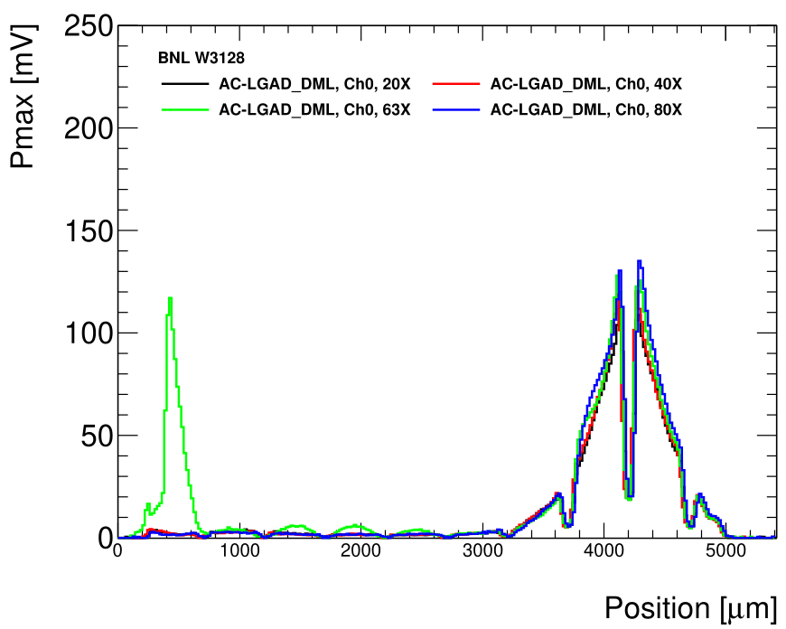
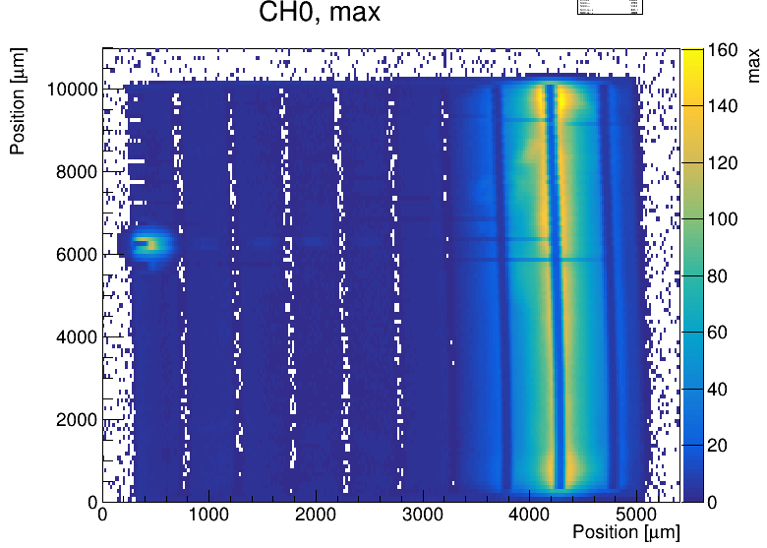
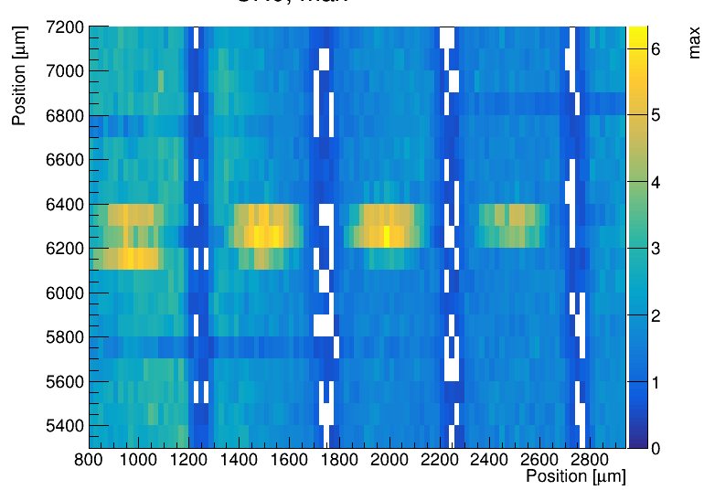
DML AC-LGADs
Proof of principle works! Behaves as standard AC-LGAD
Pickup of the cross strip is minimal, extra pickup at the bonding pad
Pickup on the line is ~4%
Cross talk with perpendicular strip hard to test with laser
Behavior across the strip is homogeneous
Both Pmax and rise time are ok
Crosstalk under metal?
Wirebond
Transmission line pickup

Slide 6
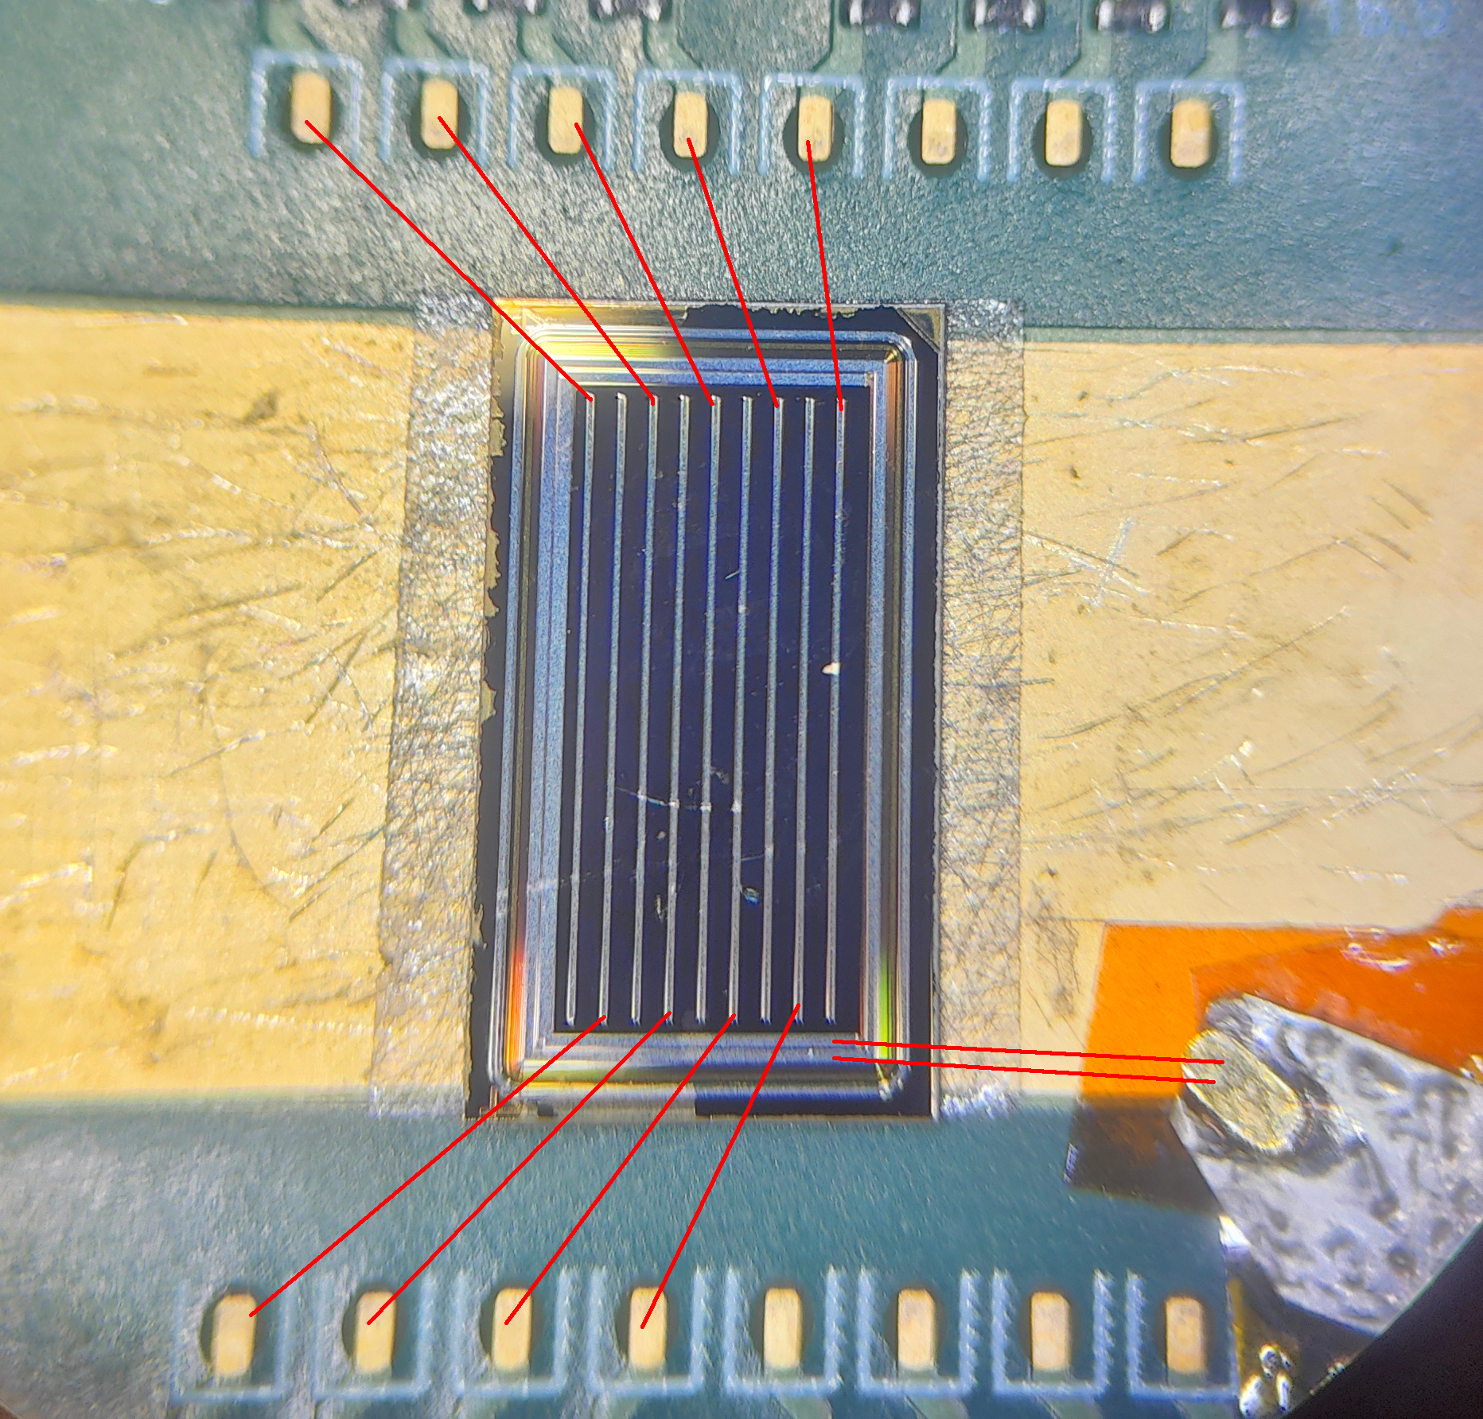
Delay correction in standard AC-LGAD (one side)
3
With strips we have to correct for signal propagation delays to maintain the time resolution
With standard connection (at the edge) it’s a constant (x,y) correction
X (1,2) perpendicular: slow propagation, small distance but good correction from strip precision
Y (3) parallel: fast propagation, large distance, correction from tracking of other detectors (1mm is enough)
3
1
2
Wirebond out

Slide 7

Delay correction in DM AC-LGAD
Correction is much more complicated, different strips have different delays vs (x,y)
Propagation in signal strip and transmission line could be different
Wirebond out
6
4
5
3
Completely different parameters
1
2

Slide 8
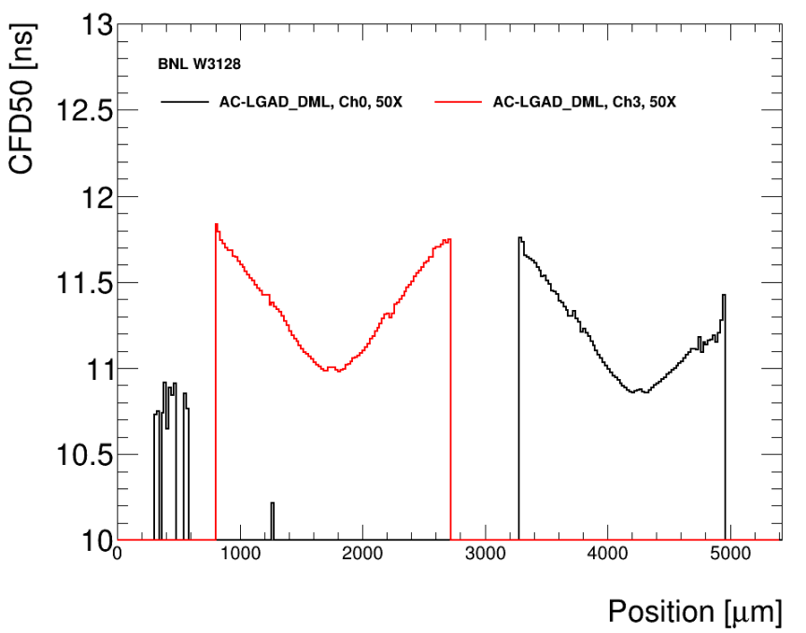
Delay correction in DM AC-LGAD
Time of arrival vs position for two strips, same Y
About ~100ps delay
Wirebond out

Slide 9
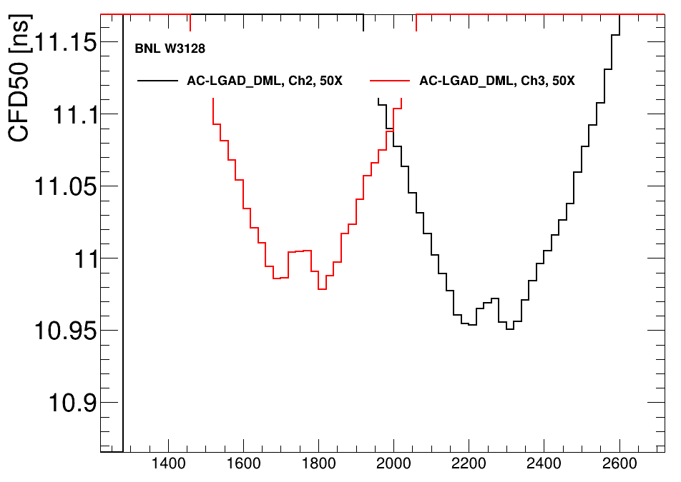
Delay correction in DM AC-LGAD
Time of arrival vs position for two nearby strips, same Y
Wirebond out
Delay of ~40ps over 500um section of the transmission line

Slide 10
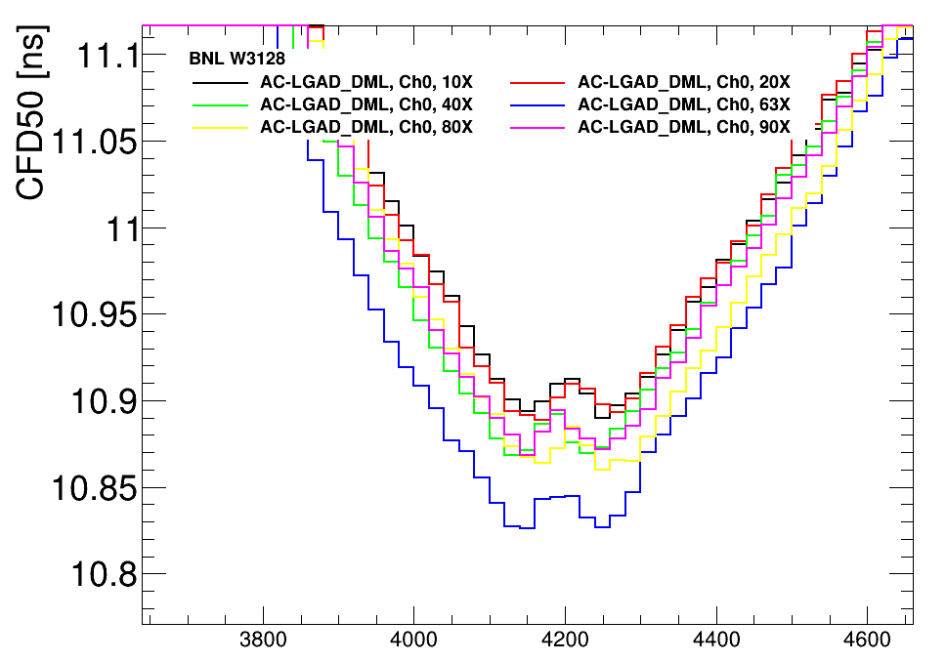
Delay correction in DM AC-LGAD
Propagation across strip is faster
Different impedance of the two, complicates things
Might be produced to match
Wirebond out
Delay of ~50ps over 3mm section of the strip

Slide 11
DML AC-LGADs
Pro:
Side ASIC connection, easier integration
Crosstalk and pickup seem ok
Cons:
More difficult time correction, need correction vs (x,y) of full sensor
Need to match propagation speed between strip and transmission line, or correction could be impossible
Awaiting HPK prototypes!

Slide 12
Backup

Slide 13
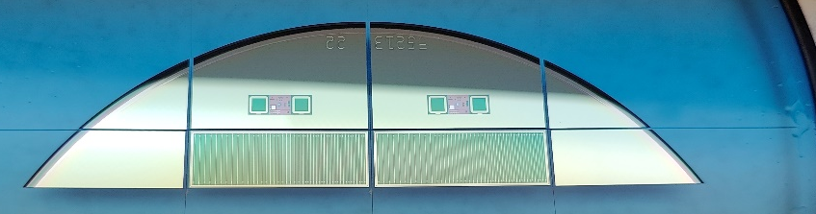
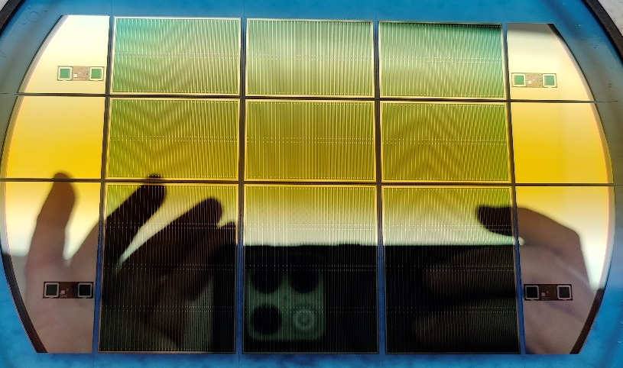
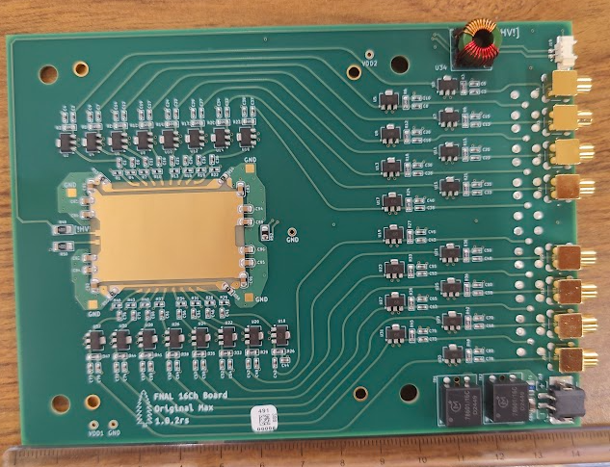
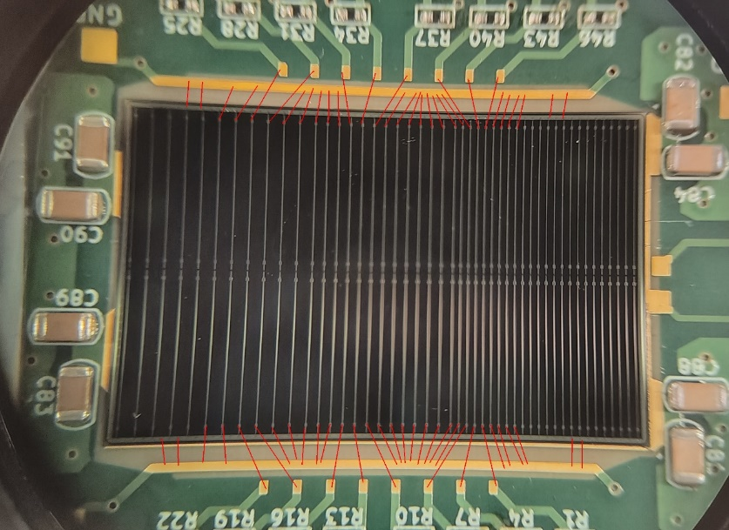
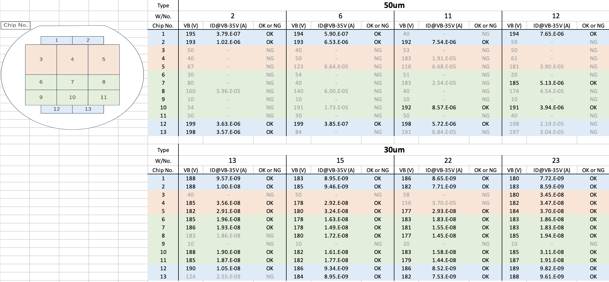
Strip production
Half sensors
ePIC full-size production of HPK strip AC-LGADs with devices as large as 3.2x4.2 cm → biggest AC-LGAD ever!
Nominal size 3.2x2.2 cm with 1cm strip ‘segments’
Strip width: 40-50um, strip pitch 500, 750, 1000 um
8 wafers in hand, four 50um thick and four 30um thick
Gain and N+ resistivity variation across wafers is <10%
Full sensors
Double sensors

Slide 14

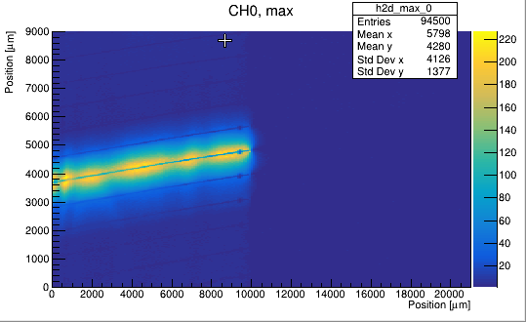
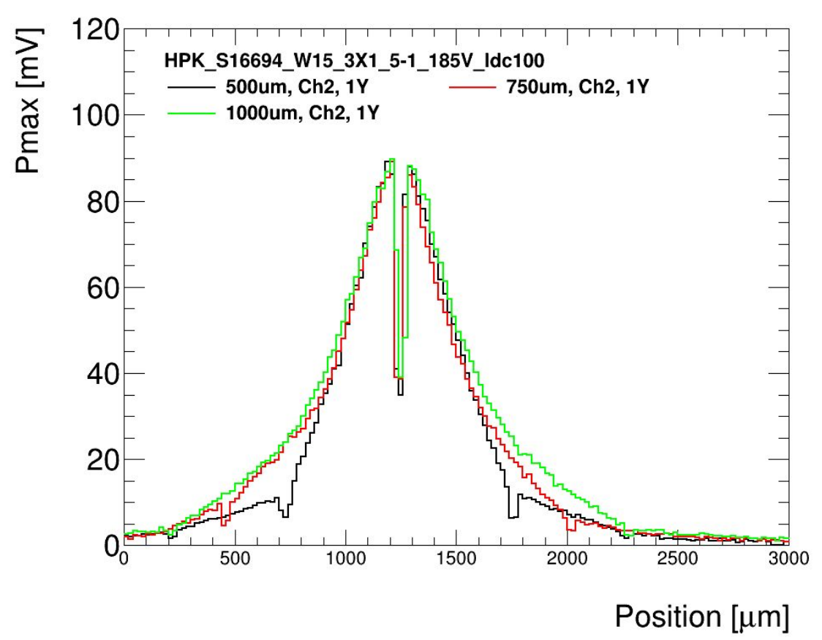
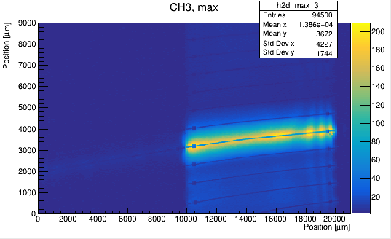
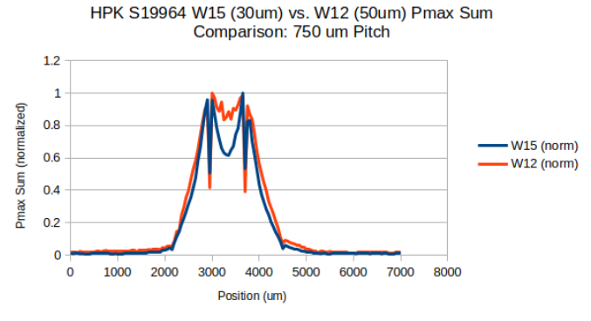
HPK production results - TCT
Strip response vs laser injection spot (x,y)
Full size sensors tested on a large board with laser TCT
Both 50um and 30um thicknesses, show similar performance
Pulse as expected with rise-time 600-700 ps for 50um and 400ps for 30um
Time of arrival variation delay ~2ps/um (250ps for 500um) perpendicular to the strip and ~0.01ps/um (<100ps for 1cm) parallel to the strip (metal propagation)
Profile response perpendicular to the strip for the three different pitches
Student: M. Davis, G. Stage, A. Borgijin

Slide 15
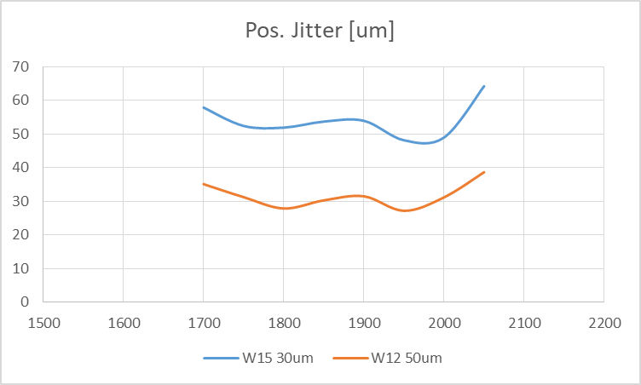
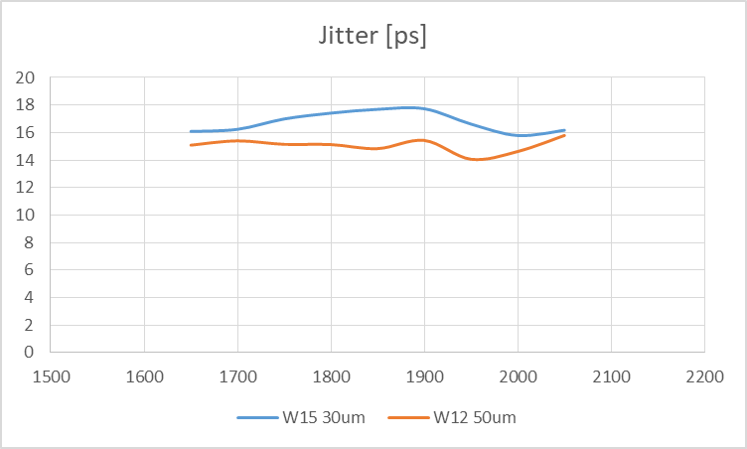
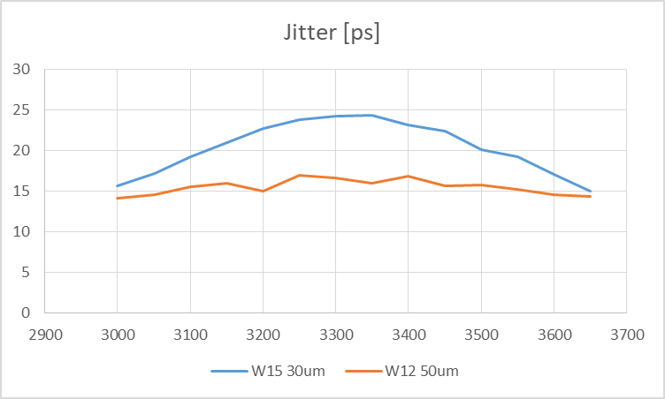
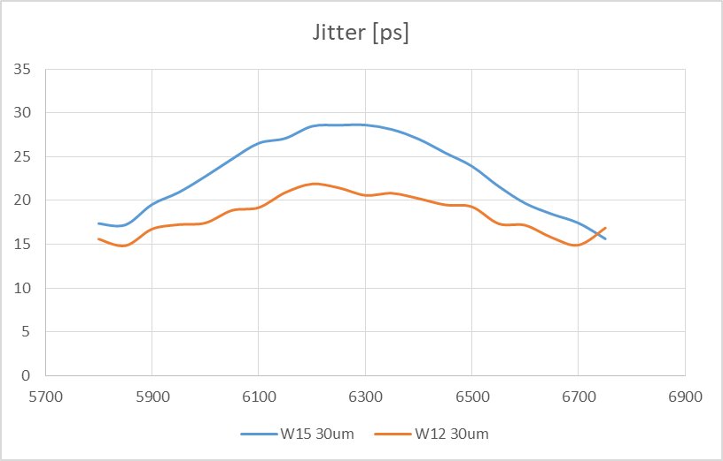
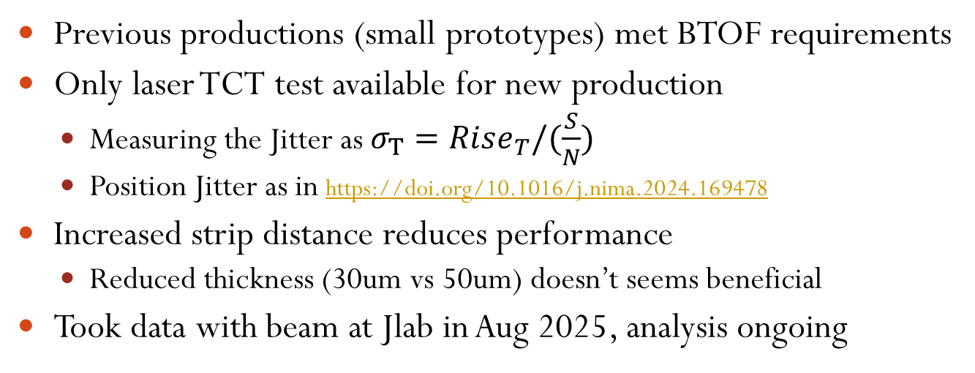
HPK production results - TCT
500um
Position resolution from laser TCT
Previous productions (small prototypes) met BTOF requirements
Only laser TCT test available for new production
Measuring the Jitter as $σ_{T}=Rise_{T}/(\frac{S}{N})$
Position Jitter as in https://doi.org/10.1016/j.nima.2024.169478
Increased strip distance reduces performance
Reduced thickness (30um vs 50um) doesn’t seems beneficial
Took data with beam at Jlab in Aug 2025, analysis ongoing
TOF requirement
500um
750um
1000um
Strips
More details in: https://indico.phy.ornl.gov/event/677/contributions/2683/

Slide 16
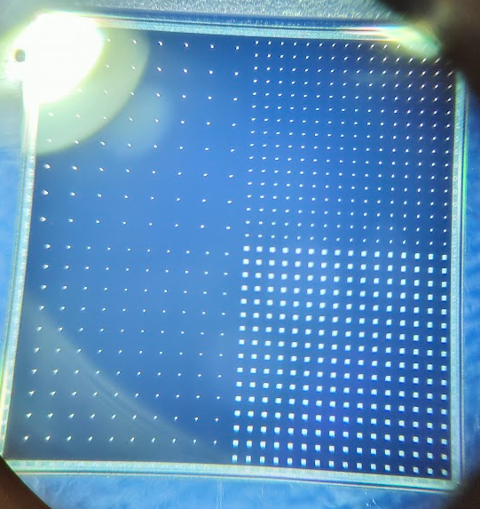
Pixel production
ePIC full-size production of pixel AC-LGADs from HPK with devices up to 1.6x1.6 cm
Pixel pitch and width: 50,100,150um, pitch 500, 750, 1000 um
4 wafers in hand, two 30um thick and two 20um thick
All devices tested with IV
Yield >80% for all wafers
Detector type | Thickness | Pitch-width 1 “Legacy” | Pitch-width 2 | Pitch-width 3 | Pitch-width 4
W3 pixBIG | 20um | 500-150 | 500-100 | 750-100 | 1000-100
W3 pixSmol | 20um | 500-150 | 500-50 | 750-50 | 1000-50
W7 pixBIG | 30um | 500-150 | 500-100 | 750-100 | 1000-100
W7 pixSmol | 30um | 500-150 | 500-50 | 750-50 | 1000-50
Students: N. Lynch, A. Drumm, Y. Spinos, O. Khandelwal

Slide 17
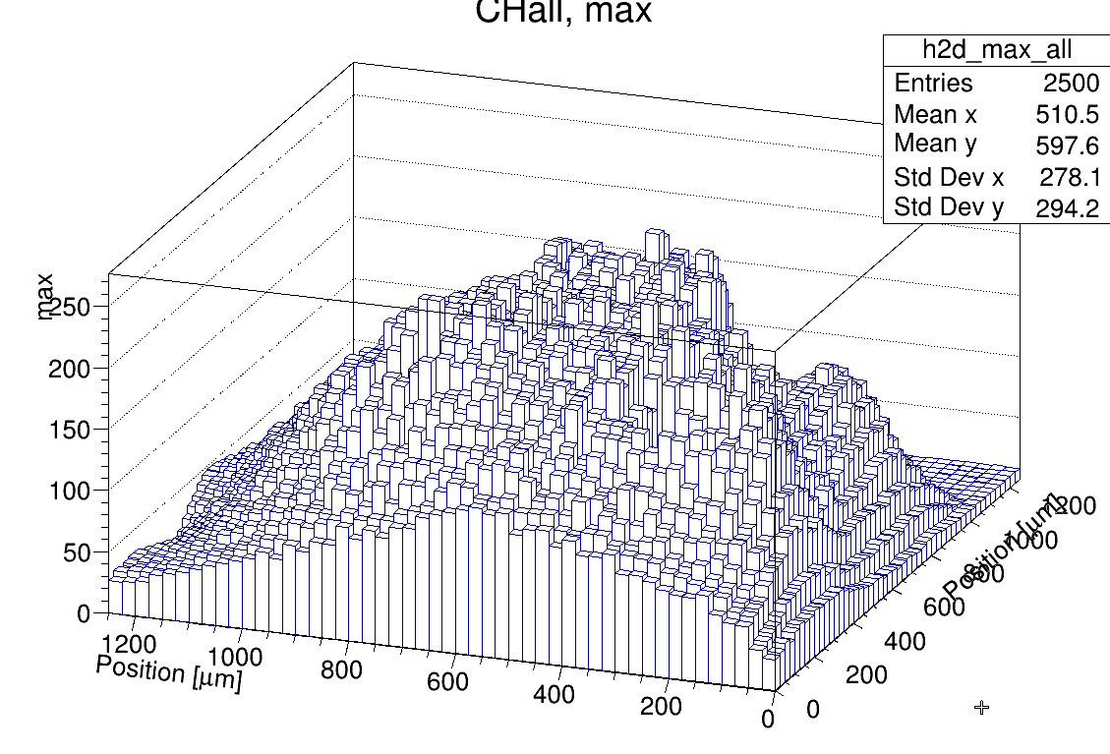
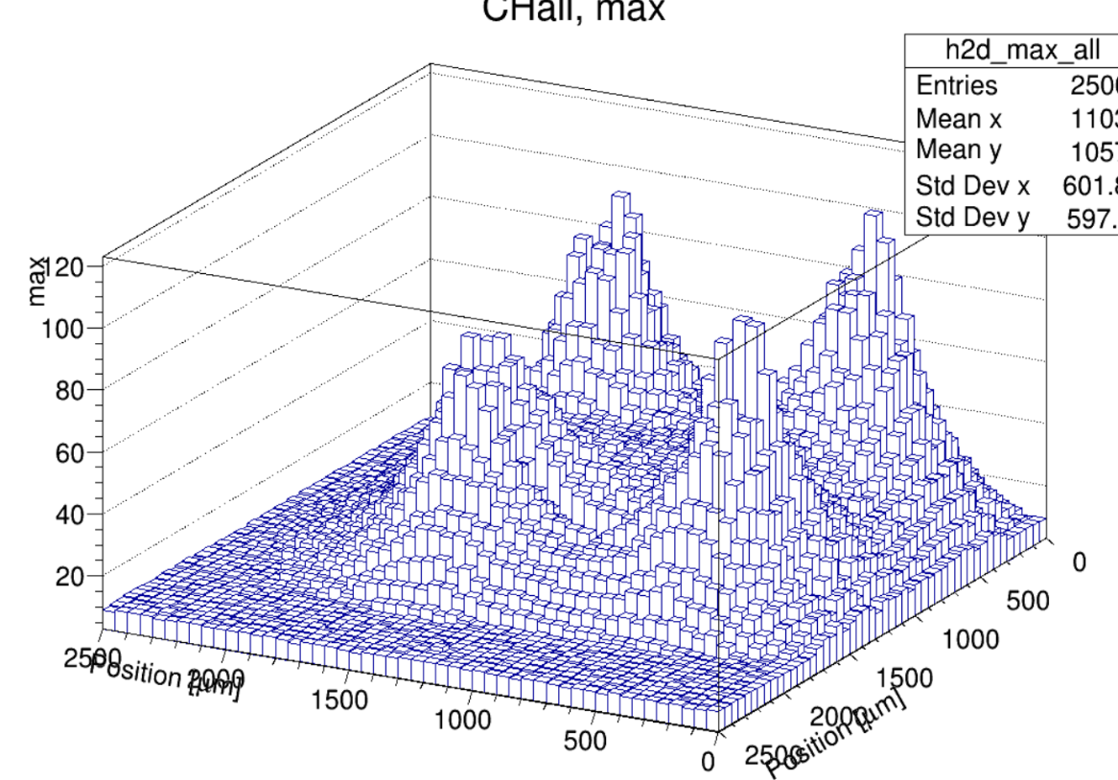
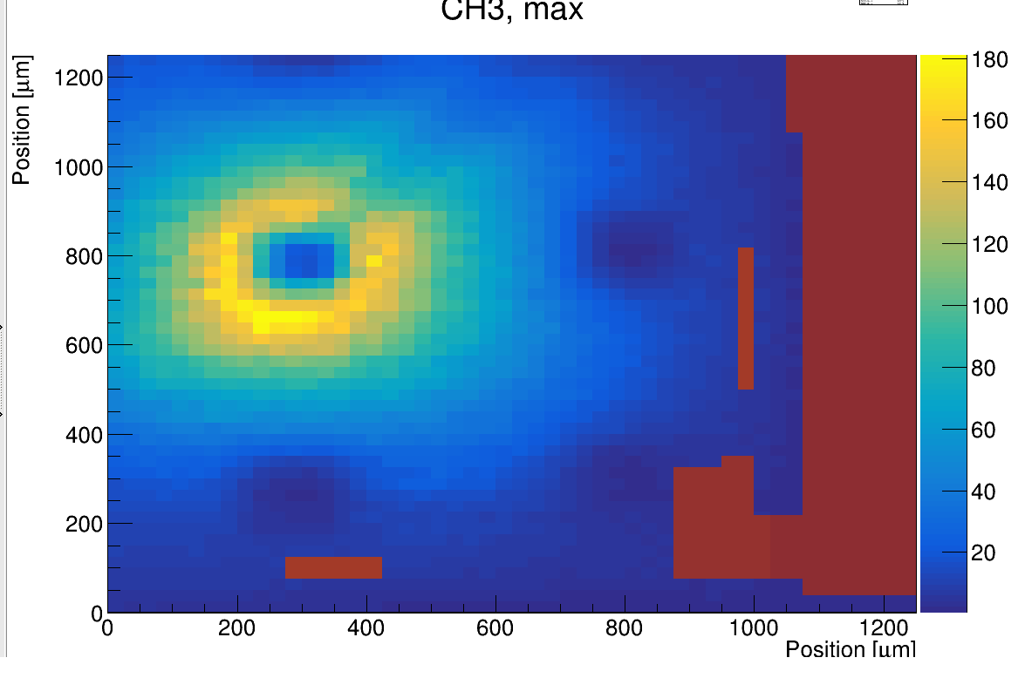
Pixel results - TCT
X-Y response of the sum of 4 pixels 500-150
Full size sensors tested on a large board with laser TCT
Sensor: W7 (30um) – big pixels
500-150 (“legacy”) vs 1000-100
Large loss of S/N if distance is increased and pixel size is decreased
Rise time ~300ps for both
Signal propagation time is similar for all geometries
X-Y response of a single pixel 500-150
X-Y response of the sum of 4 pixels 1000-100
Students: M. Davis, N. Lynch, O. Khandelwal

Slide 18
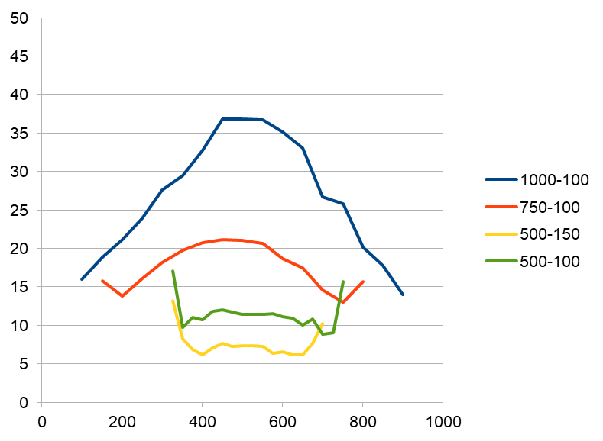
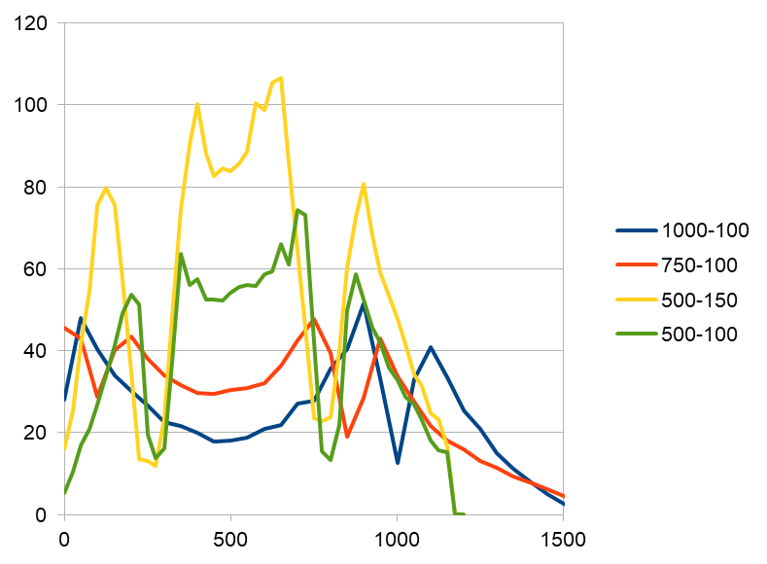
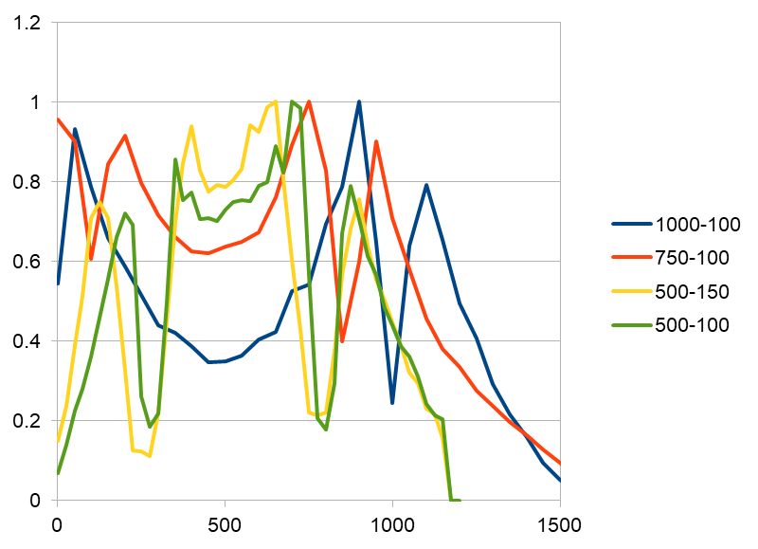
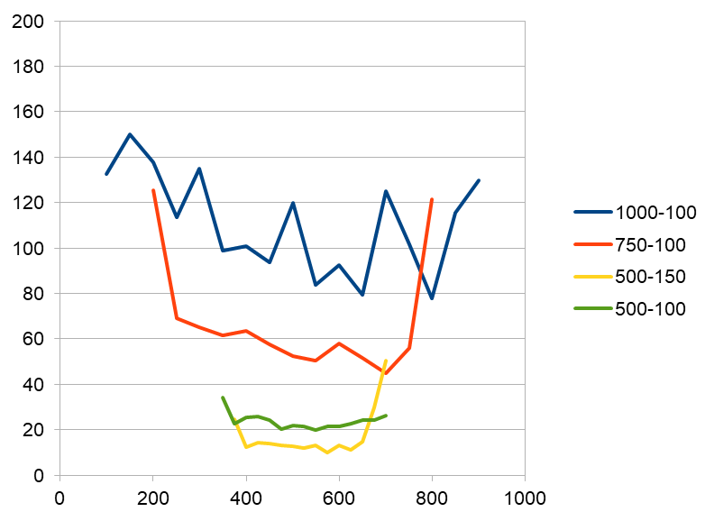
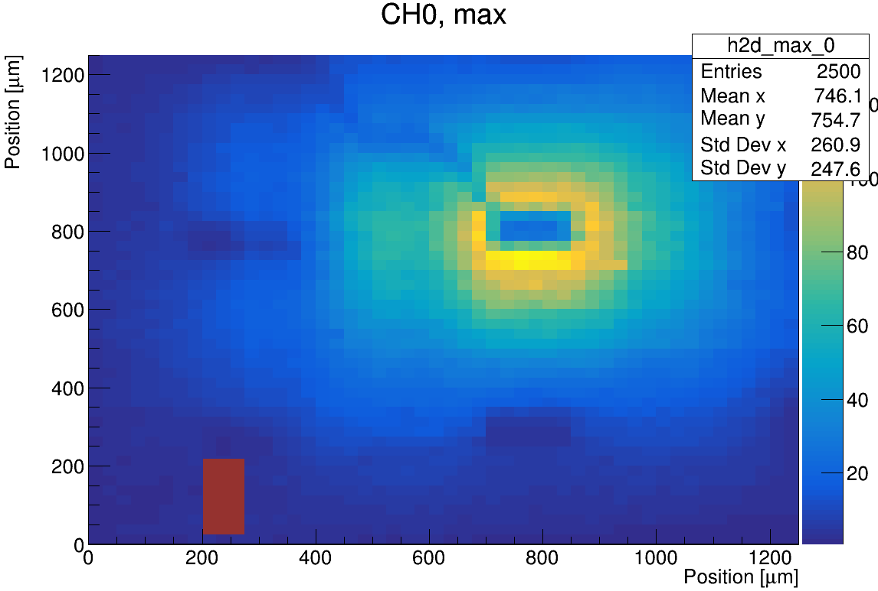
HPK pixel production results - TCT
Jitter [ps]
W7 (30um) with large pixels: measuring the Jitter and position Jitter as before in-between pixels
Assuming 100mV signal near pixel for 500-150um configuration
Performance of smaller (100um) pixels for 500um pitch is similar to “legacy” geometry, but up to 60% S/N loss for larger pitch
Pos. Jitter [um]
More details in: https://indico.phy.ornl.gov/event/677/contributions/2683/

