Slide 1

PID CC WG Workfest Summary
S. Tarafdar & B. Page
ePIC General Meeting
February , 2026

Slide 2
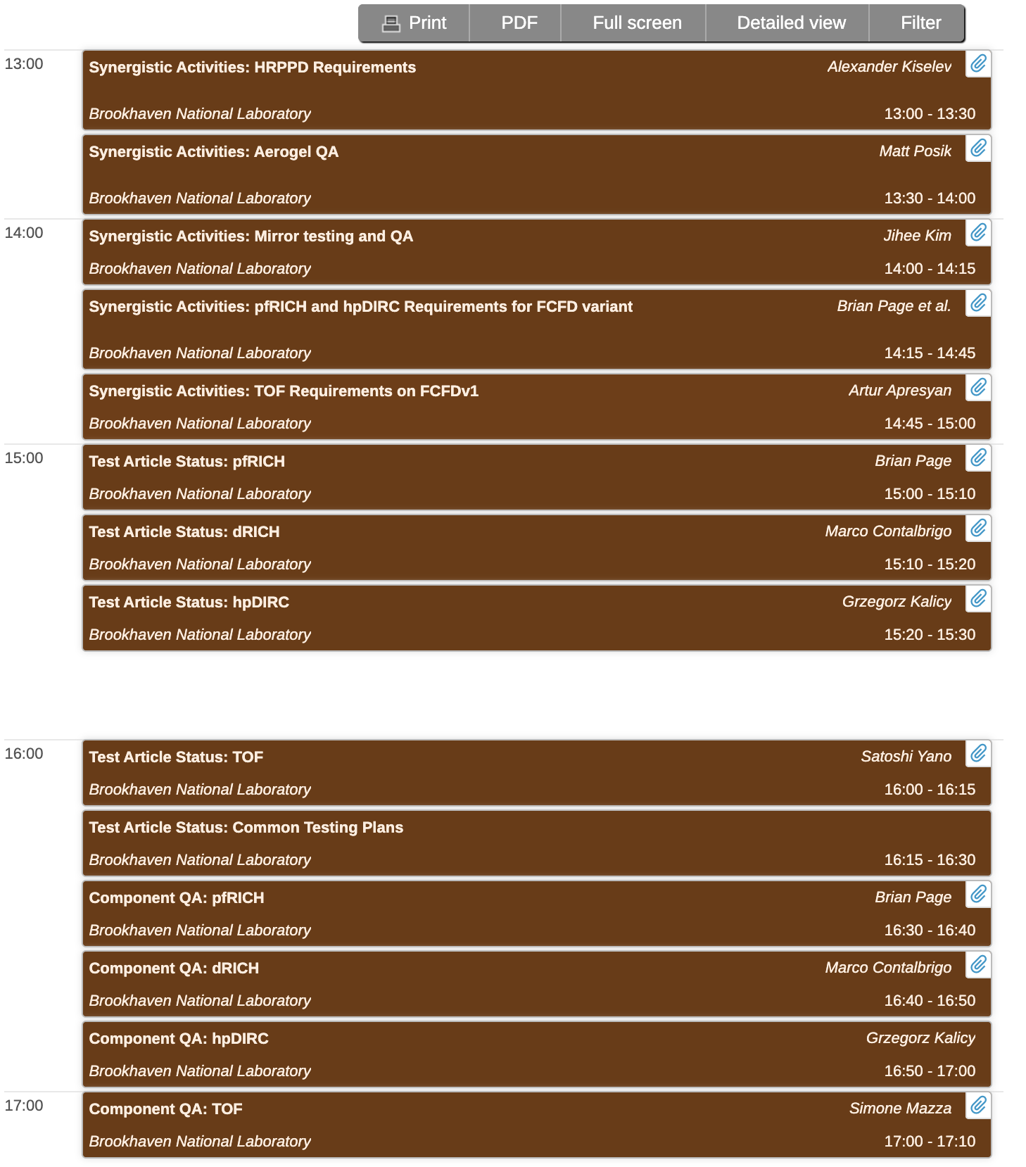
Wednesday, Jan 21
Focus on
Synergistic activities for subsystem components
  HRPPD (pfRICH and hpDIRC)
  Aerogel (pfRICH and dRICH)
  Mirror (pfRICH and dRICH)
  FCFD (BTOF and electronics)
  FCFD variant (pfRICH , hpDIRC and electronics)
Test article status of PID system
Component QA of PID system

Slide 3
Key takeaways on synergistic activities
HRPPD (pfRICH & hpDIRC)
  Need to optimize for hpDIRC
  PO already submitted to INCOM for new set of HRPPDs, explore method for higher PDE to satisfy hpDIRC requirement
  Strong possibility of similar QA protocols for HRPPD to be used in both pfRICH and hpDIRC.
Aerogel (pfRICH & dRICH)
  Test stand at TU capable of quantifying aerogel transmittance and index of refraction
  Need more input from dRICH group for possible upgrade on test stand to be used also for dRICH aerogel test stand. Benefit of test stand close to assembly site emphasized
Mirrors (pfRICH & dRICH)
  Extensive testing infrastructure at BNL for pfRICH
  Primary dRICH mirror QA at Duke/JLab with some existing INFN equipment
  Differing mirror dimensions likely preclude direct pfRICH/dRICH interoperability, but techniques and best practices can be shared

Slide 4
Key takeaways on synergistic activities
FCFD (BTOF, electronics)
  FCFD v1.1 already tested in test beam with sensors with 45 ps timing resolution.
  FCFD v1.2 design completed and will be available for testing in CY 2026.
  More coordination needed between ASIC development group and BTOF consortium
FCFD variant (pfRICH, hpDIRC, electronics)
  Well coordinated effort for development of ASIC between pfRICH and electronics group.
  Some confusion about requirement for hpDIRC but can be cleared with more coordination between hpDIRC and electronics group

Slide 5
Takeaways from test article status and QA plans
pfRICH
  Focus on testing individual components as outlined in Inspection and Test Plan document.
  First article vessel construction almost completed but test beam campaign will focus on HRPPD sensors and aerogel capability for PID.
dRICH
  Multiple test beam campaign to finalize PDU design and capability
  Has already proved working principle of dual radiator RICH with ALCOR electronics in test beam campaigns using small size prototypes.
  Real scale test article worth the size of one module will be constructed to test mechanical stability, gas tightness, temperature gradient, assembling scheme, inner component supports.
hpDIRC
  Focus on individual component validation.
  Facilities for testing individual components silica bars, lenses, sensors are fully functional.
TOF
  Multiple test beam campaigns to finalize sensor design.
  Focus will be on testing individual component and also assemble functional 1/4 stave (~0.6 m long) as engineering test article before CD3.

Slide 6
Summary
PID system components across multiple subsystems having synergy with each other has been identified.
Can be useful to have meetings once a month to bring experts in those detector components together to discuss progress and path forward.
Few components from PID systems can benefit from common test beam plan e.g. pfRICH and dRICH at CERN or hpDIRC bar box with full readout chain with pfRICH module etc.
Next collaboration meeting will focus more on selected components discussion.

