Slide 1





Combined PWG pTDR and ES Workfest Summary
Rachel Montgomery (Glasgow) & Salvatore Fazio (Calabria)
Rosi Reed (Lehigh)
ePIC General Meeting
Feb 13, 2026

Slide 2
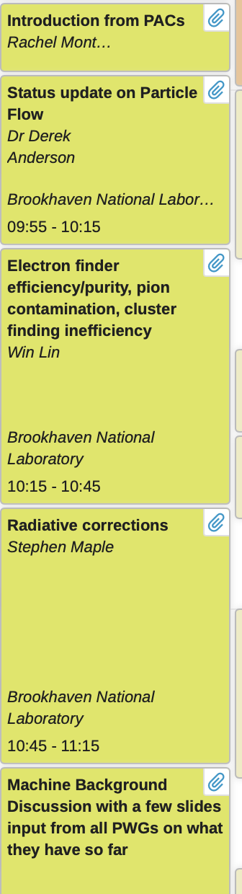
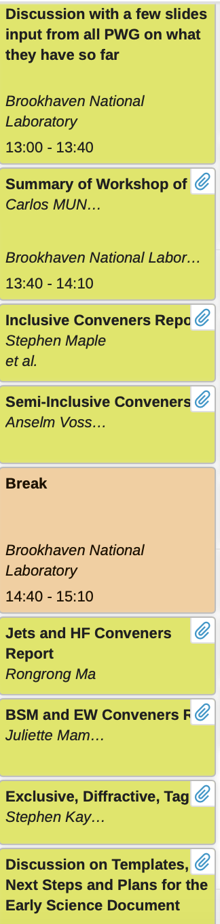
Workfest Outline, Links to Presentations and Notes
Link to workfest on indico (all slides are on indico)
Link to shared notes taken during discussions
Workfest spanned one whole day - it was packed!
Lot’s of activities reported from PWGs and very fruitful discussions
Focus on what was done for preTDR and status/plans for Early Science
Topics included:
reconstruction tools; radiative corrections; machine background and systematic uncertainties; PWG convenor reports; Summary of recent EIC-France Workshop; plans for Early Science

Slide 3
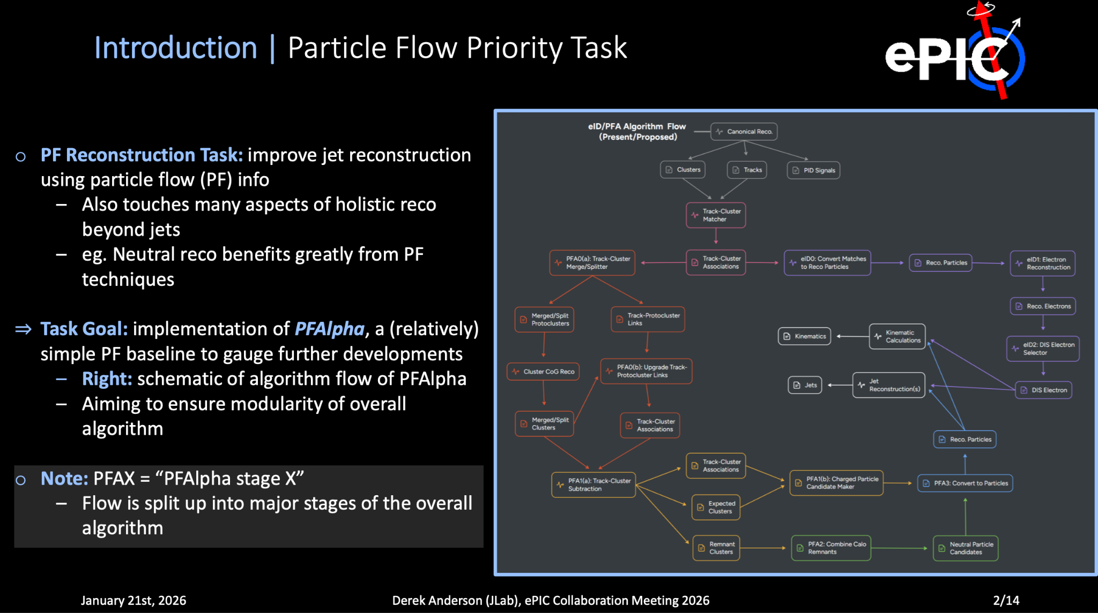
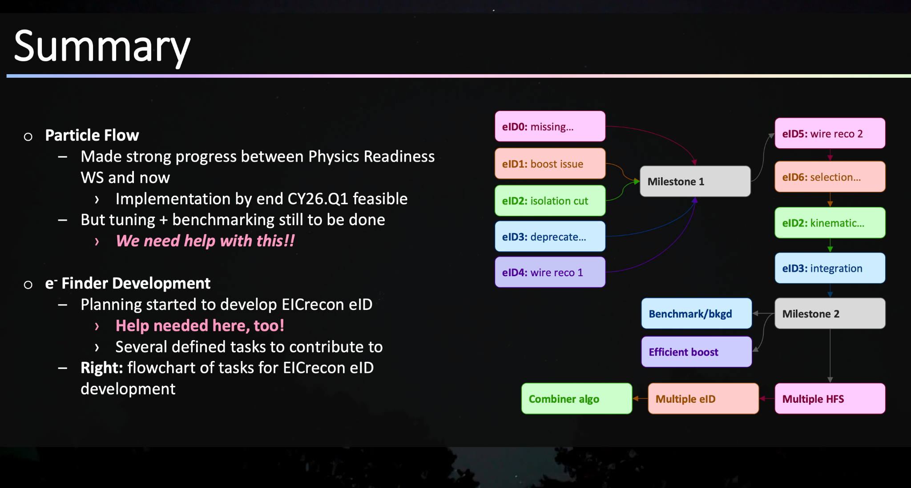
Particle Flow and Scattered Electron Identification
Slides: D. Anderson
Particle flow, Derek Anderson: lots of progress and roadmap for future shown
Improving jet reconstruction using particle flow info
Extremely important for developing more holistic reconstruction in future for physics analysis, beyond jets
Working with Win Lin towards development of eID for EICrecon
Lots of tasks where help is needed - would be great for student projects/PhD students/post-docs! Get in touch if interested

Slide 4
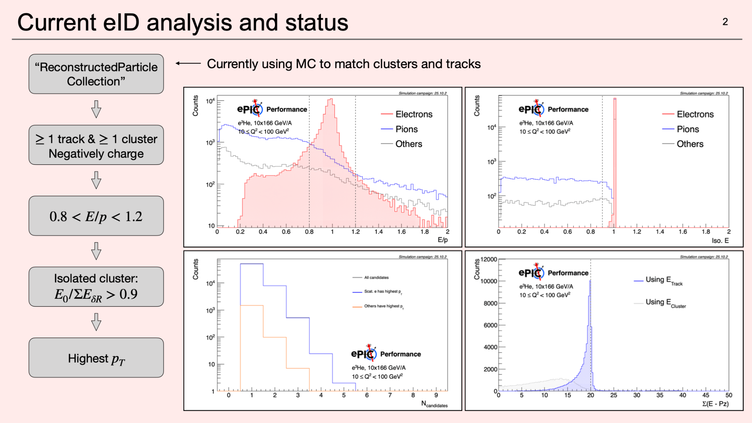
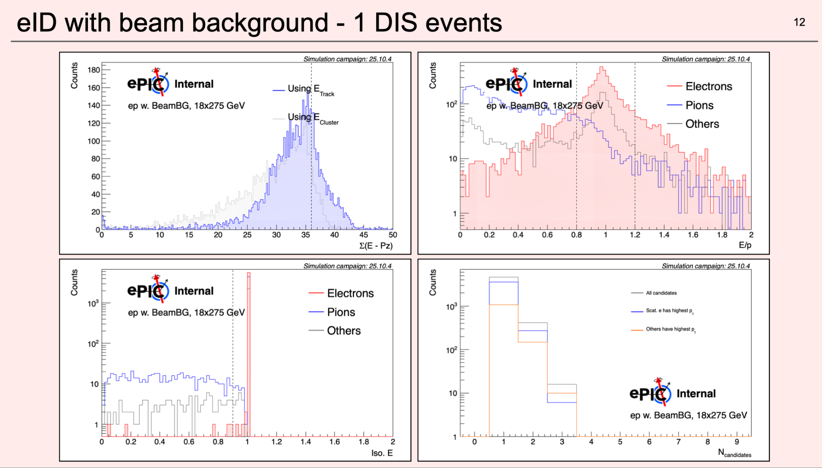
Particle Flow and Scattered Electron Identification
Slides: W. Lin
Win Lin: Scattered electron finder report
Lots of progress and studies reported: scattered electron finder efficiency/purity, pion contamination and cluster finding inefficiencies.
Initial photoproduction background studies and machine background studies also shown (including effect of number of track points used)
Discussed path forward and future developments, including need to further evaluate radiated photons and evaluate 10GeV machine background

Slide 5
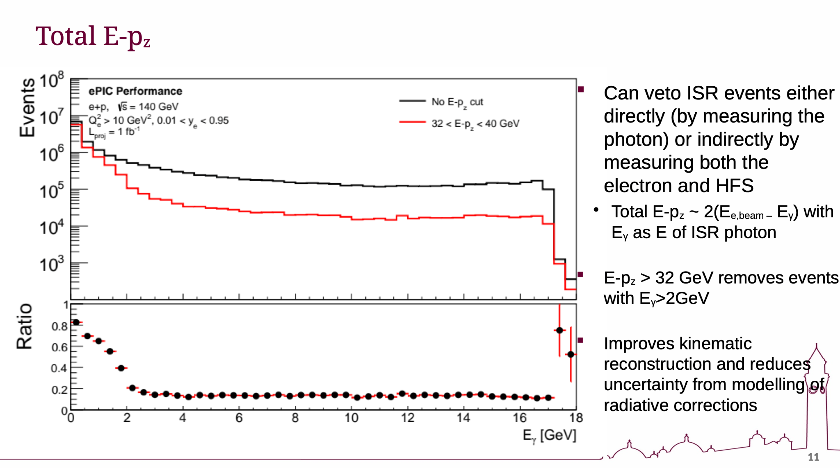
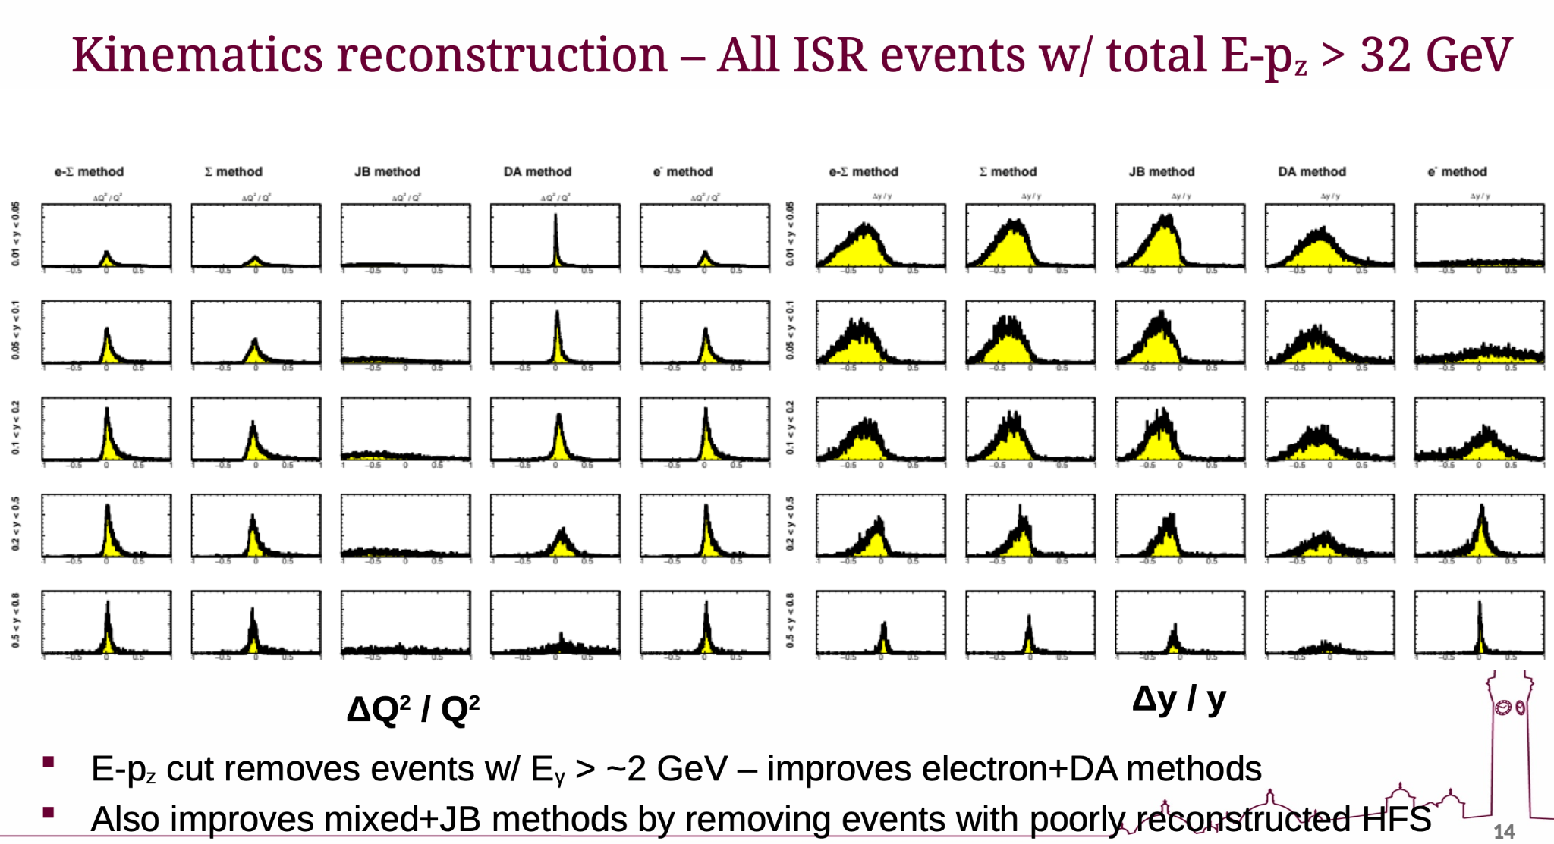
Radiative Corrections
Slides: S. Maple
Stephen Maple: Lots of progress in radiative corrections
Inclusive pythia8 sims from campaigns don’t include QED radiative effects; modelling of radiative effects incurs systematic uncertainty and different methods of kinematic reconstruction have different sensitivities to radiative effects.
With input from Barak Schmookler, solved issues with using Djangoh files with our software - now can use Djangoh event generator. Files available for others to use.
Showed kinematics not correctly reconstructed for ISR events, with degraded resolutions, but impact limited by E-pz cut
Next steps - more modern event generators, reaching out to theorists for more modern techniques for handling radiative effects

Slide 6
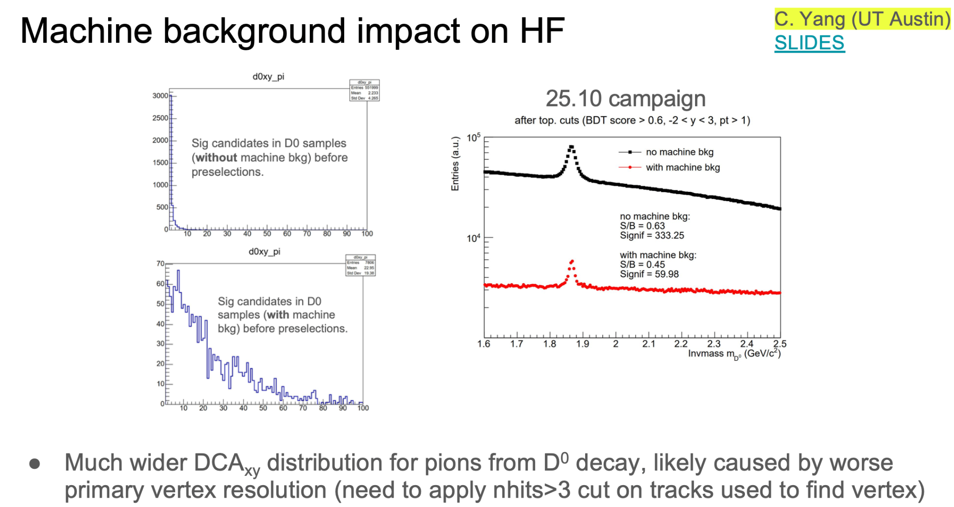
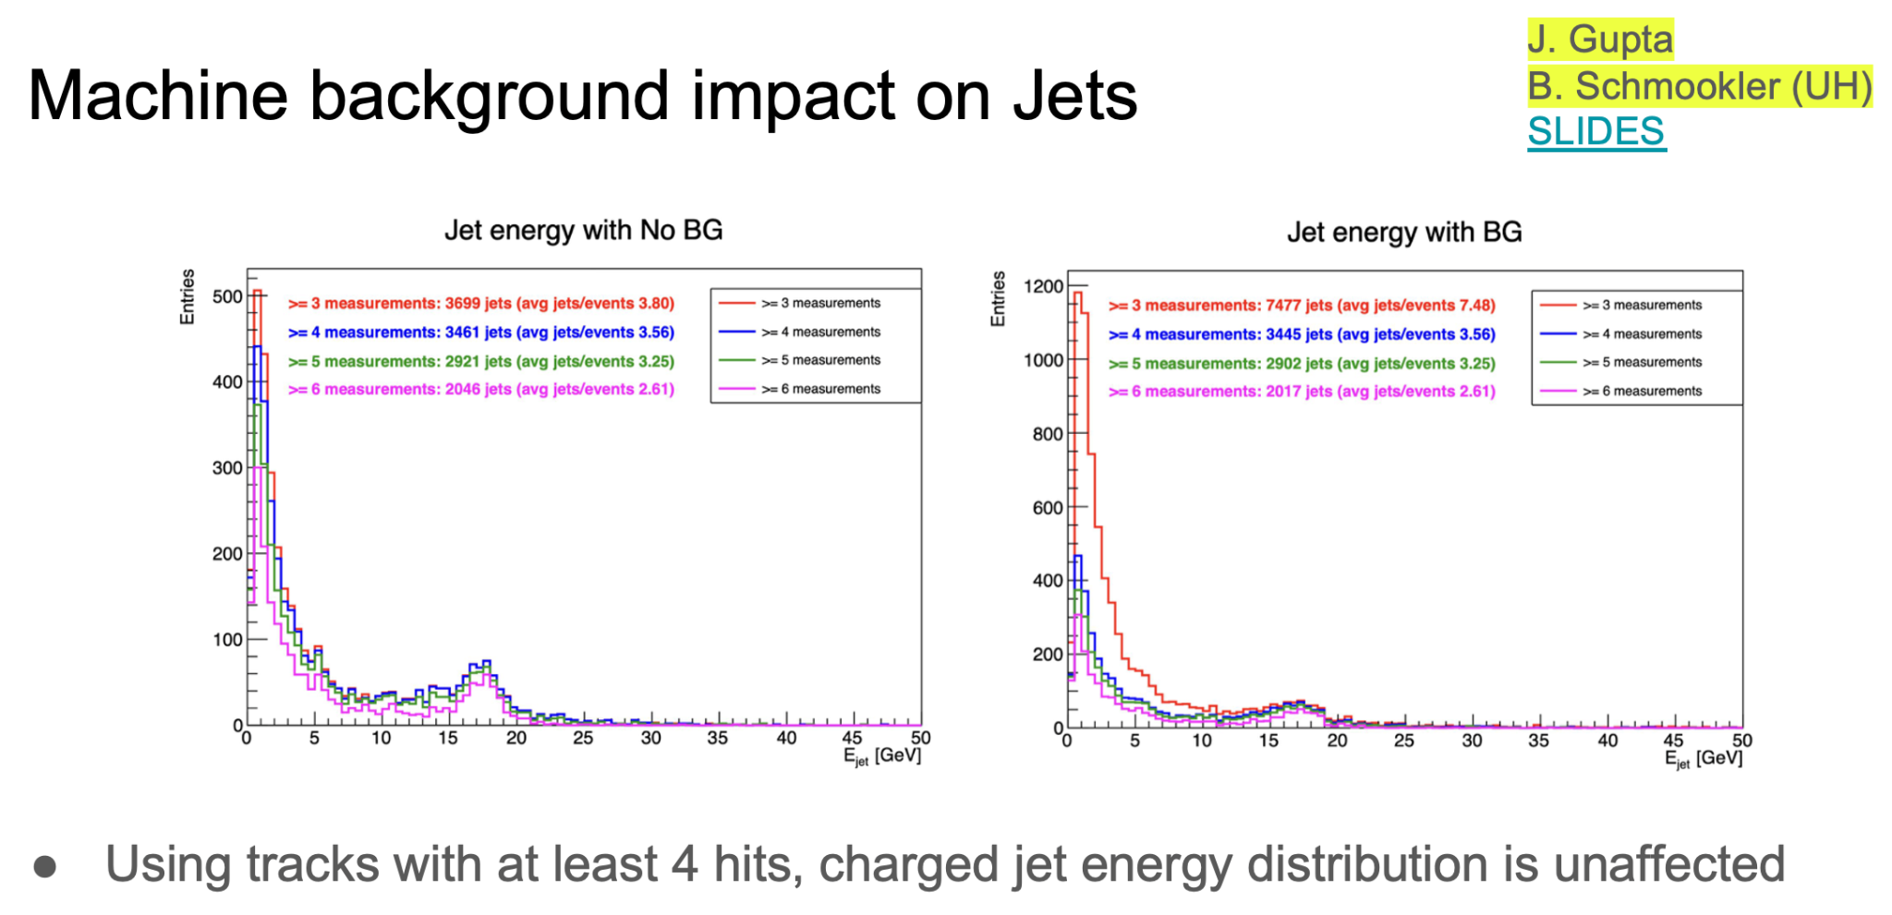
Machine Background and Systematic Uncertainties
PWG convenors provided discussions on machine background effects and plans for systematic uncertainty studies
Machine background examples:
SIDIS and exclusive, diffractive tagging (EDT) planning to look at effects, eg SIDIS will study effect on PID and tracking, EDT have DVCS, DVπ0P and DDVCS files already for 18x275 and starting to look into effects
Jets/HF: reported impact on D0 decay and Jet energy reconstruction
Inclusive: looking at effect on eID, so far have 18x275. Planning to look at impact on DIS kinematic reco
In general we discussed need to look at 10GeV next
Slides: R. Ma, S. Kumar

Slide 7
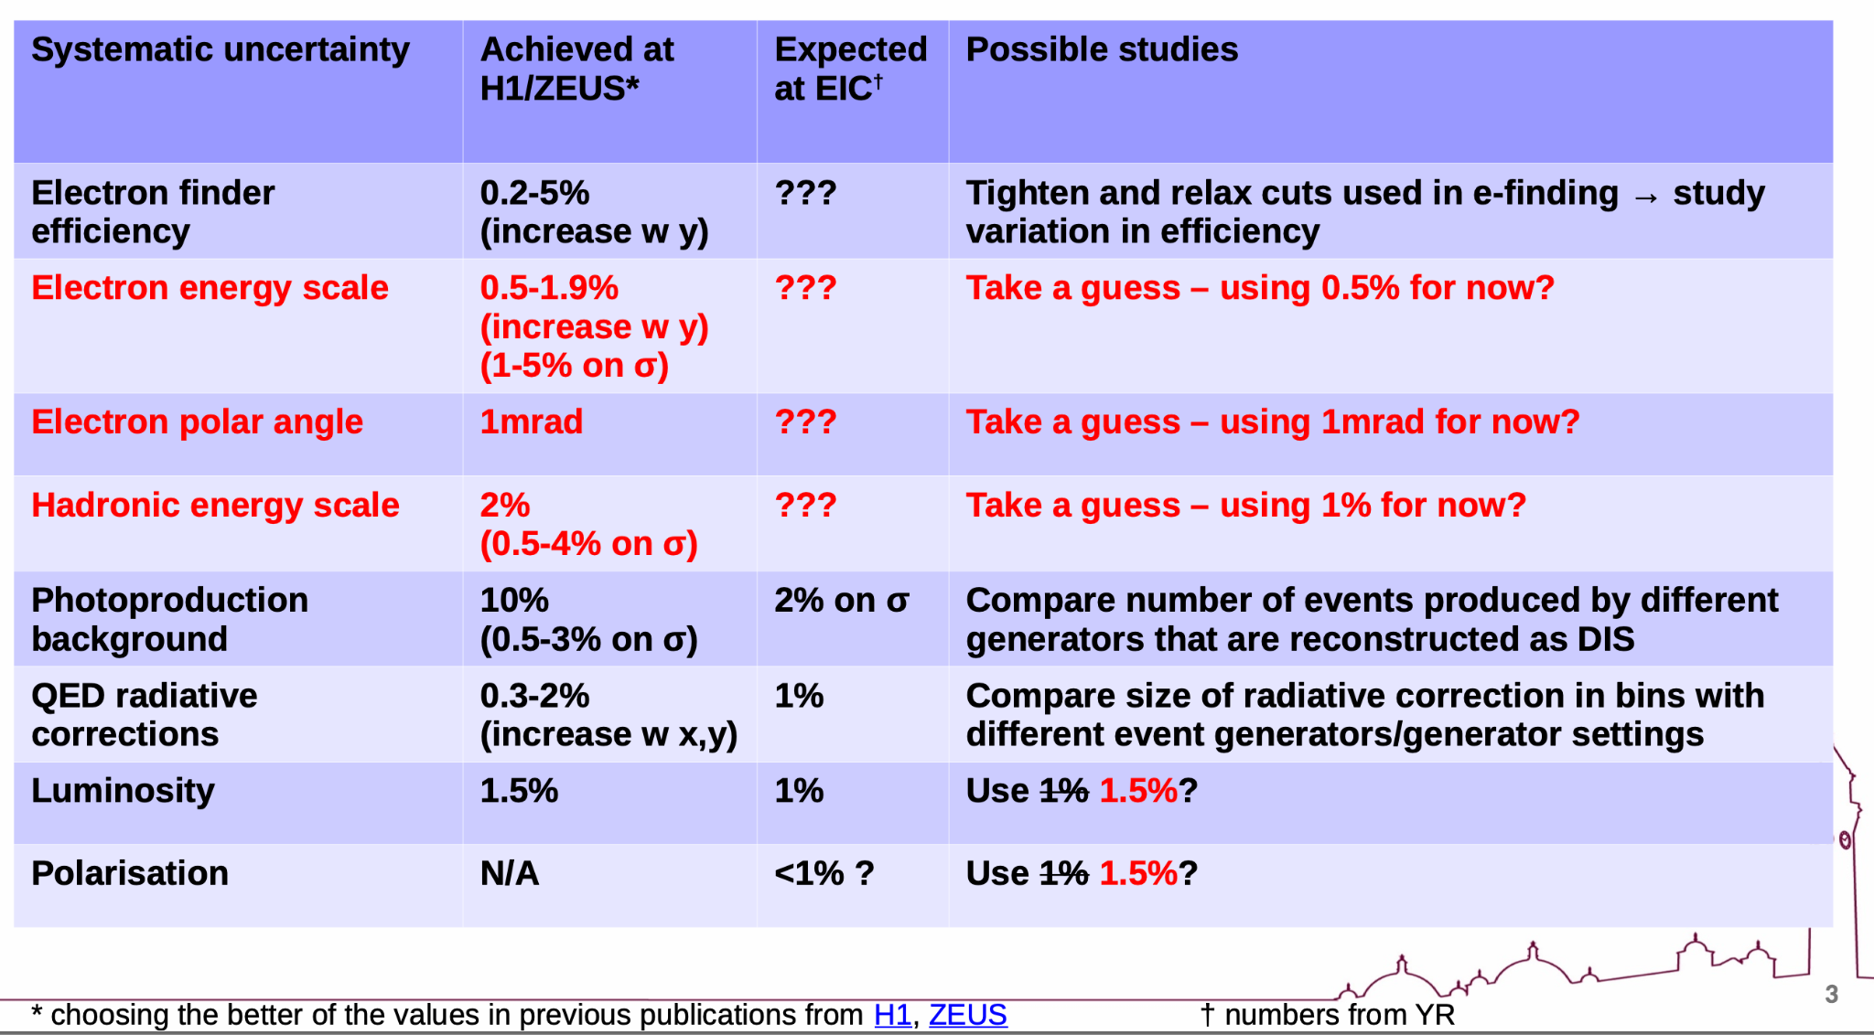
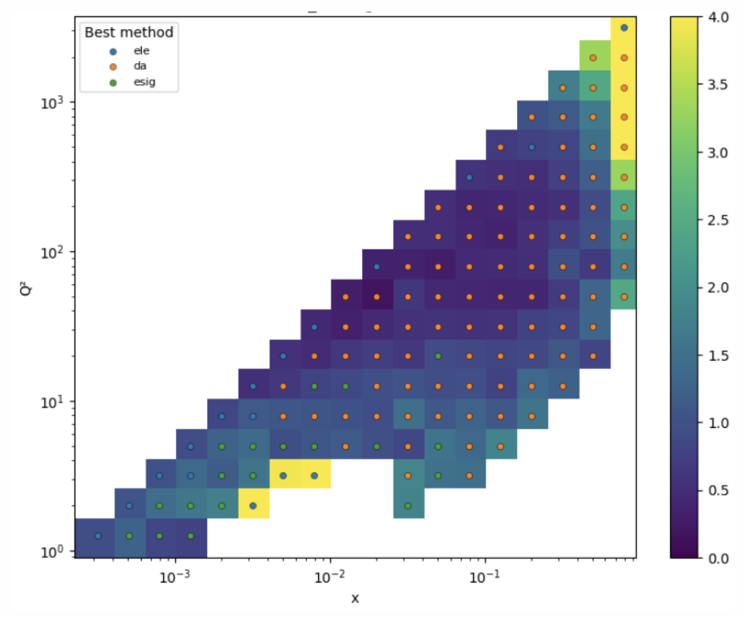
Machine Background and Systematic Uncertainties
Systematic Uncertainties examples:
Inclusive: planning studies in e-finding efficiency, electron energy, electron polar angle, hadronic energy scales, background modelling, radiative corrections.
Looked at A1(n,p) systematics inspired by YR/Athena - stats dominated
EDT: looking at dominant sources of uncertainty for each channel, more details in analysis notes from Dec 16th Physics Forum
SIDIS: Key sources will be PID, kinematics smearing unfolding, radiative corrections, efficiency corrections for cross-sections/unpolarised measurements, spectator proton efficiencies in neutron measurements with eD/eHe3, tracking/ecal reach for PW decomposition and lambda reco
SIDIS been collaborating with PID teams (dRICH, pfRICH and hpDIRC) on plans for systematics studies, eg LUT, availability of likelihoods and identifying sources from different subsystems.
All groups need input from DSCs to help with systematic uncertainties
Eg tracking, calorimetry, PID - we hope we can work together on this! It will benefit detector sections of TDR too
Stephen Maple
First studies:
total uncertainty for best electron reco method considering 1fb-1 stat plus avg sys from e-energy, hadron energy and electron polar angle scales

Slide 8
PWG Convenor Reports
Lots of fantastic progress: current activities in analyses and plans were reported by PWG convenors in their reports given on behalf of PWGs
Impressive to see the many activities summarised in overviews
Please check convenor reports - only some examples here
All PWGs worked hard to get material ready for December preTDR deadline
PWGs now focussed on ES activities for the May ESR deadline
PWGs would welcome more members!
Specific tasks in every PWG waiting for some keen analysers- great for student or post-doc projects - please get in touch or see reports for examples

Slide 9
PWG Convenor Reports
Examples of topics discussed
Inclusive (S. Maple, W. Lin): inclusive SF from ep and inclusive eHe3 with double tagging both released at Dec 16th Physics Forum; eID developments; systematics uncertainties; radiative corrections …
SIDIS (A. Vossen, R. Seidl): presentation of TMD sensitivities; 4D efficiencies/purities for kaons; backwards kaons A_LL; D0 reconstruction; plans for physics impact studies (eg di-hadron asymmetries, collins/sivers, TMD impact, nPDFs/nFFs) …
EDT (S. Kay, Z. Tu): preTDR and ES paper topics; DVCS; DVπ0P; eA VM; He3 double tagging; TCS; Sullivan process; Dec 16th Physics Forum Releases (eA VM, DVπ0p, He3 double tagging) and future releases (DEMP, DVCS, J/psi DVMP); future paper plans for the group
Jets/HF (R. Ma, S. Kumar): eic-smear fixes for secondary vertexing; secondary vertex finding software; jet energy scale and energy resolution; charged inclusive jet R_eAu; D0; dijets for gluon Sivers function; forward jets; inclusive jet EEC; HF jet EEC; Lambda_c reco …
BSM/EW (Z. Seyma Demrioglu, J. Mammei): muon identification performance; several studies for CLFV via leptoquarks; future BSM/EW studies from BNL and LANL teams

Slide 10
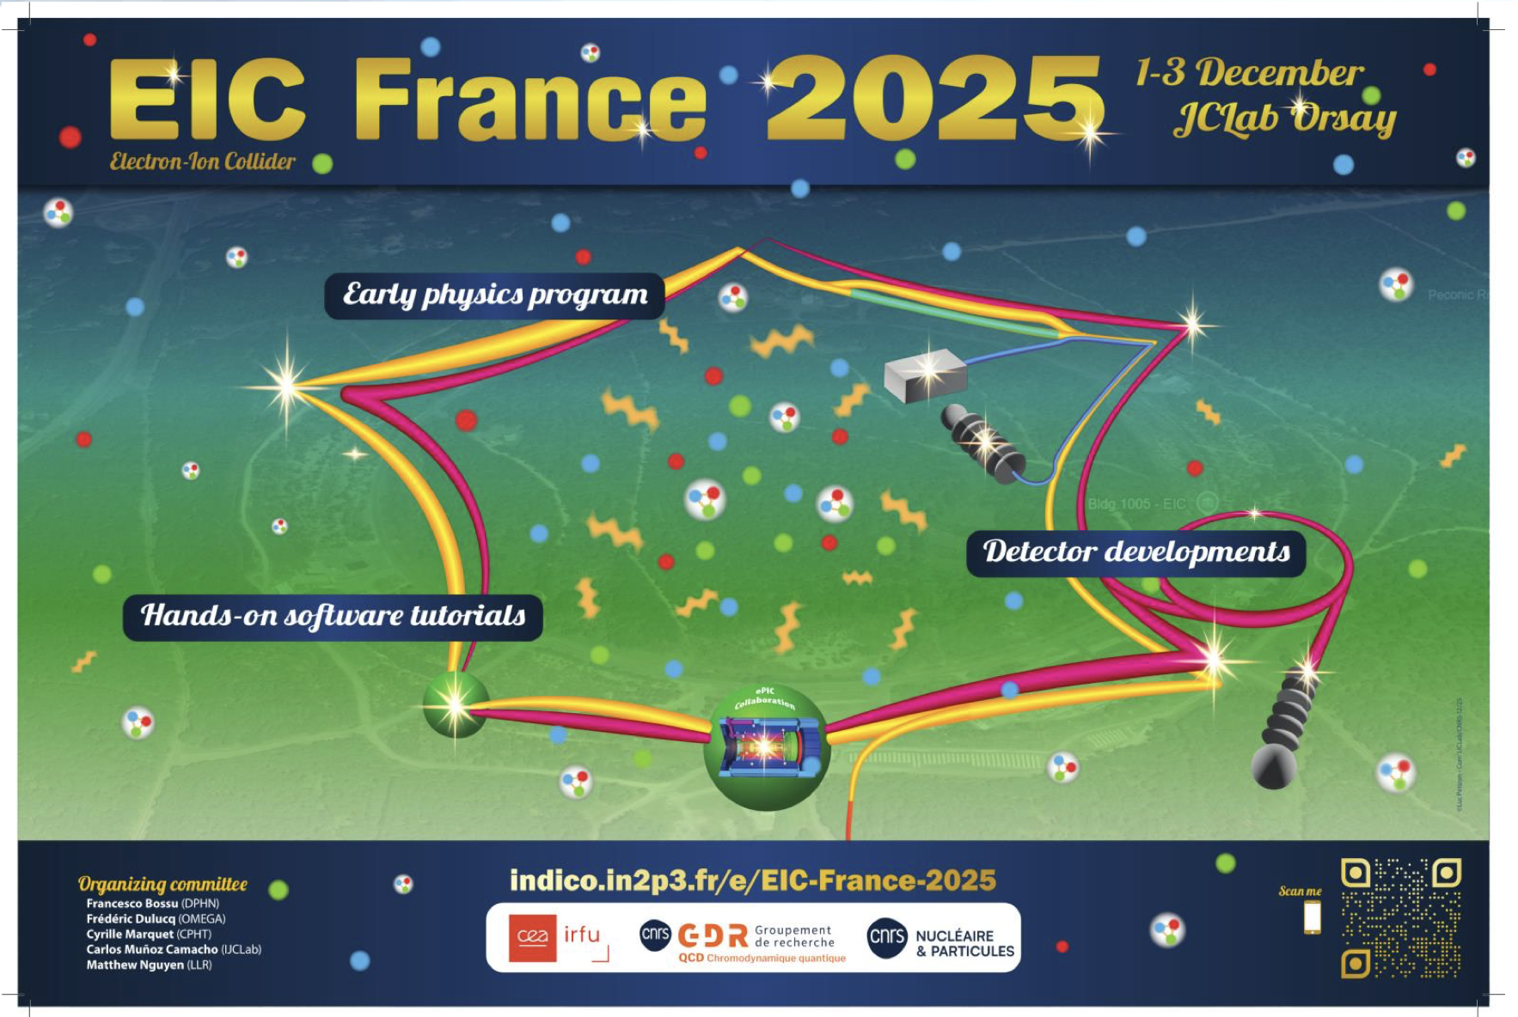
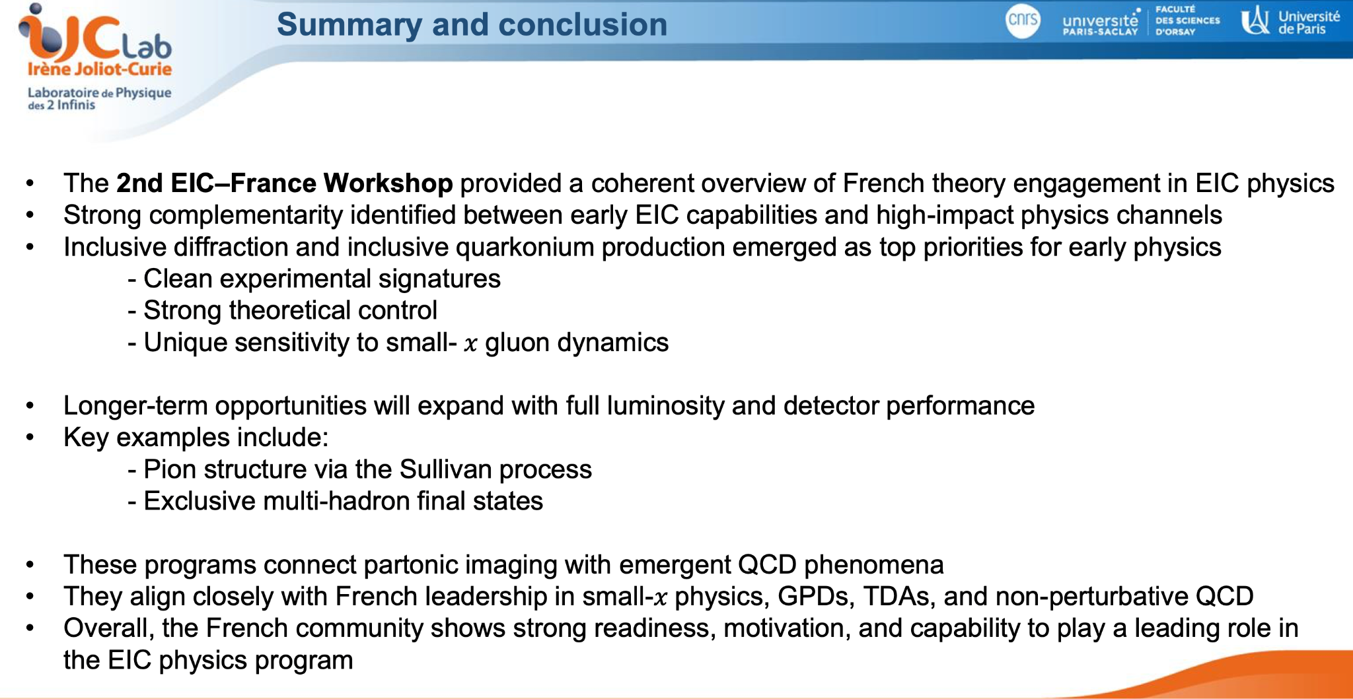
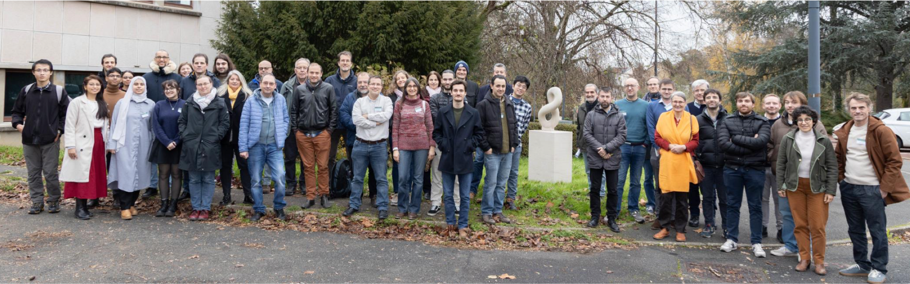
Report on EIC France 2025
C Muñoz gave very nice summary of EIC France 2025: activities, presentations, discussions, ePIC SW tutorial. See webpage for full agenda.
~70 participants: theorists; phenomenologists; detector experts
Very lively theory/physics sessions with much interest from theory and experimental community across France and expertise in many physics topics relevant for EIC
See slides for more info

Slide 11
Discussion on next steps for Early Science Report (ESR)
ESR Final Document Due May 1st
  Currently our top priority for upcoming 3 months
Discussed need for a simulation campaign for plots for ESR:
  Planned to coordinate with SCC for an ESR focused production campaign in March
Discussed timeline to ESR:
  Plan to have draft in place of ESR report by early March
  Send report to reviewers for feedback
  Physics Readiness Workshop – 17-19 March 2026, to discuss feedback and next draft
  After workshop will work on next draft - then circulate to reviewers and collaboration with time to implement feedback by May 1st
  Please join March workshop -it’s hybrid, register even if joining remotely in order to receive zoom link, communications and announcements

Slide 12
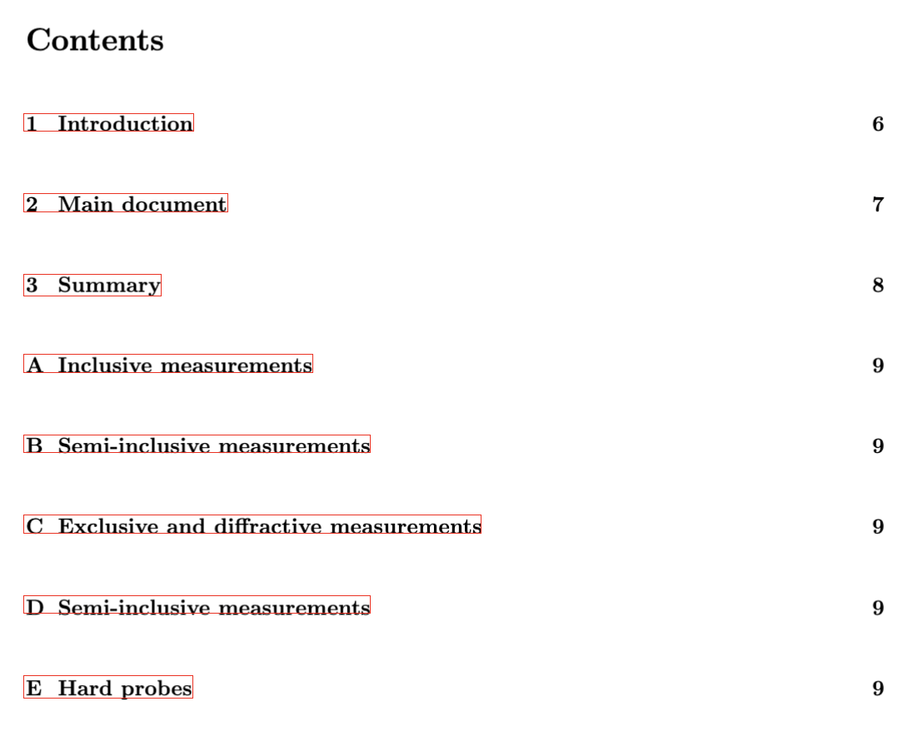
Discussion on next steps for Early Science Report (ESR)
We also discussed outline and strategy for structure of ESR and settled on format
PWGs currently working hard on generating and populating appendices

Slide 13
Summary
Really productive workfest
Workfest showcased how many activities and efforts are going on in PWGs
We are full steam ahead for ESR preparations - this will be primary focus for next 3 months
Workfest helped develop timeline and structure for document
Would be great to have more people to join our efforts - if you are interested please get in touch
Next physics forum 24th Feb, 11am ET, two releases – details at: https://indico.bnl.gov/event/31500/

