Slide 1
Hey John, start the recording….

Slide 2

ePIC General Meeting
J. Lajoie, S. Dalla Torre
February 13th, 2026
Limited time today due to APS DNP Town Hall Meeting
Update from the project on recent (and upcoming!) reviews
Short reports from January collaboration meeting workfests
Remainder in TIC meeting on Monday, February 16th

Slide 3

Consider submitting an ePIC/EIC-related workshop proposal!
To apply to host a workshop, please complete the short proposal template found at this link and send the completed proposals to Ramona Vogt (DNP Secretary/Treasurer, [rlvogt@lbl.gov]) and Bernd Surrow (LOC, [surrow@temple.edu]). The deadline for proposals is Monday, February 23, 2026. Any down selection will be completed by early March.

Slide 4
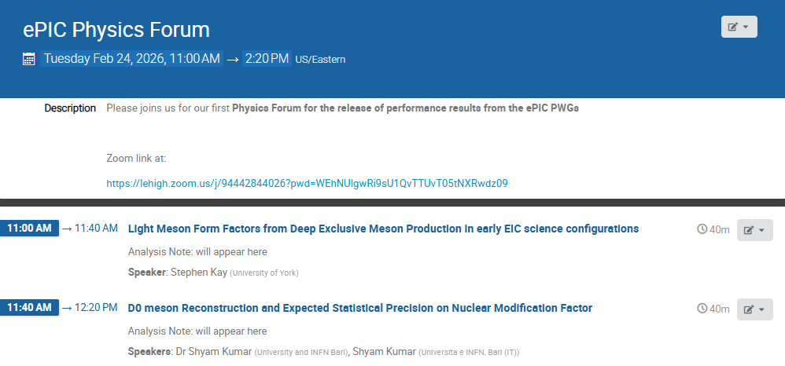
Second Physics Forum
Related Analysis Notes will be put on Zenodo and circulated to the Collaboration by February 17

Slide 5


Slide 6

ePIC Resources
Public Website - https://www.bnl.gov/eic/epic.php
Mailing Lists – https://lists.bnl.gov/mailman/listinfo
Indico Agenda - https://indico.bnl.gov/category/402/
ePIC Software and Computing: https://indico.bnl.gov/category/435/
Wiki - https://wiki.bnl.gov/EPIC
ePIC Software Training:
Landing Page: https://eic.github.io/documentation/landingpage.html
Tutorials: https://eic.github.io/documentation/tutorials.html
Mattermost: https://chat.epic-eic.org
ePIC Zenodo Community: https://zenodo.org/communities/epic

Slide 7


EICUG Membership
The EICUG is a vital organization to promote the interests of the EIC community!
Without the EICUG we would never have gotten far enough to form ePIC!
Please register your institution!
Check with your EICUG IB representative to get registered as a member
https://www.eicug.org/content/join.html

Slide 8
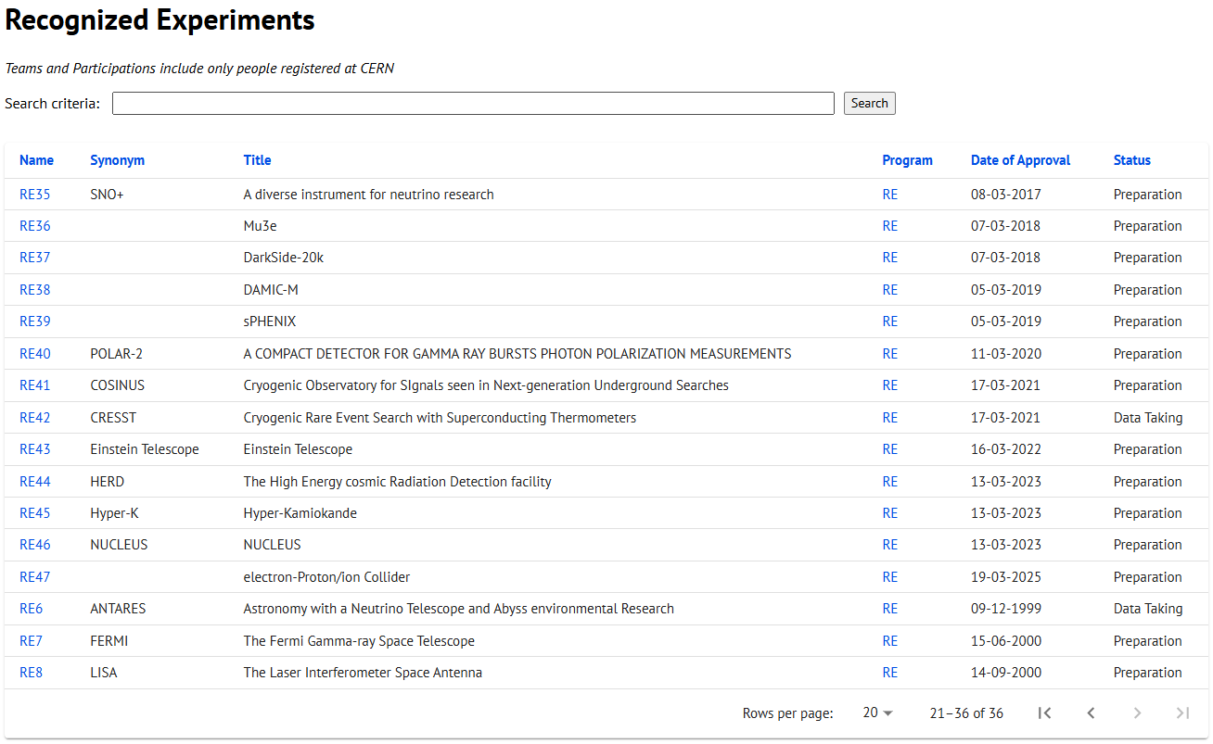
CERN Recognized Experiment Status: RE47
ePIC now appears in the CERN Grey Book database as RE47: https://greybook.cern.ch/experiment/recognized
Two steps to get ePIC Collaborators registered at CERN:
CC Representative needs to register as team leader with CERN Users Office:
https://usersoffice.web.cern.ch/
https://usersoffice.web.cern.ch/team-leaders-corner
Users.Office@cern.ch
CC member can then certify registrations of team members
Contact us if you run into problems!

