Slide 1

ePIC Collaboration News
J. Lajoie, S. Dalla Torre
March 5th, 2026

Slide 2
Hey John, start the recording….

Slide 3
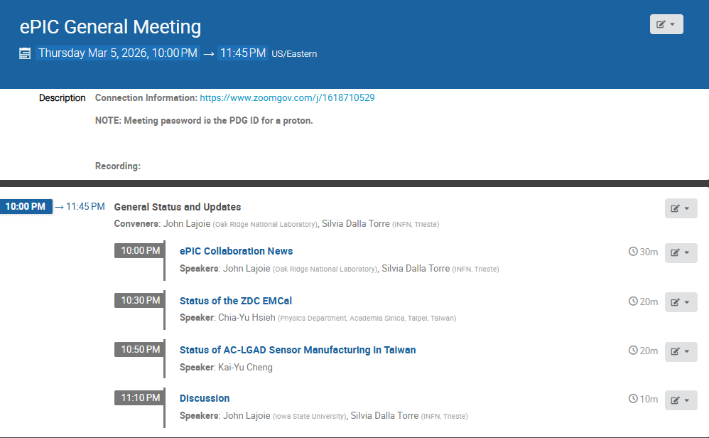
Agenda
Collaboration News
Reports from efforts in Taiwan

Slide 4


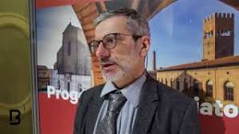
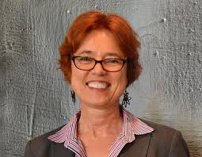
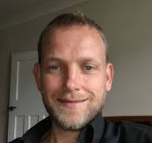
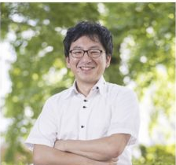
CC Elections
Francesco Bossu (Vice Chair of the Code of Conduct Committee)
Xin Dong (Vice Chair of the Publications Committee)
Pietro Antonioli, Barbara Jacak, and Paul Newman (Executive Board at-large members)
Many thanks to Taku Gunji for his service on the Executive Board

Slide 5
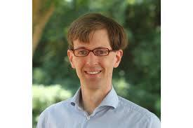
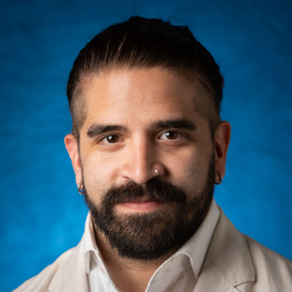
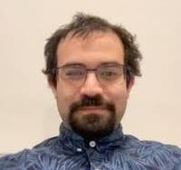

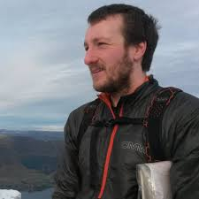
CC Endorsed Nominations
Members of the CTC: Wouter Deconinck (PC Liaison, Manitoba), Fernando Flor (ANL), Xuan Li (LANL), Charles Joseph Naim (Stony Brook), Sebouh Paul (FIU), Nicola Rubini (Bologna)
S&C Physics and Detector Simulation WG: Simon Gardner (Glasgow) as convener
S&C User Learning WG: Sasha Prozorov ( Czech Technical University) as convener

Slide 6


New Institutions
Chung-Ang University and Tokyo City University were endorsed as new ePIC members by the CC.

Slide 7
Collaboration Goals for the first half of 2026
Support the EIC project and ePIC Technical Design:
Close the design loop with ePIC simulations
Advance the pTDR in preparation for CD-2
Respond to review recommendations
Complete the Early Science whitepaper
Progress in developing a multi-year plan for ePIC Software and Computing
Begin submissions to the NIMA Special Issue
From the ePIC Jan 2026 Collaboration Meeting

Slide 8
Beam Background Challenges for the ePIC Subsystems Kick-off of these studies (TIC meeting, Feb. 23rd, 2026)
Motivations:
Background studies needed for pre TDR
Presently, Subsystem performance in preTDR are largely obtained from simulation studies w/o background
The project needs a feedback about the current scheme of collimation and shielding
HOW? By answering to 3 families of questions:
Impact on detector performance (DSC’s responsibility)
Impact on data flow, requested bandwidth and potential dead-time (el/r-o/DAQ CC WG’s responsibility);
radiation/fluence damages (DSC’s responsibility).
Using data from simulation campaigns; starting now using the February 2026 campaign
Using radiation maps, now made available, with DIS + background
Initial step:
Report on progress (short form: a couple of slides) at the end of March at the TIC meetings

Slide 9
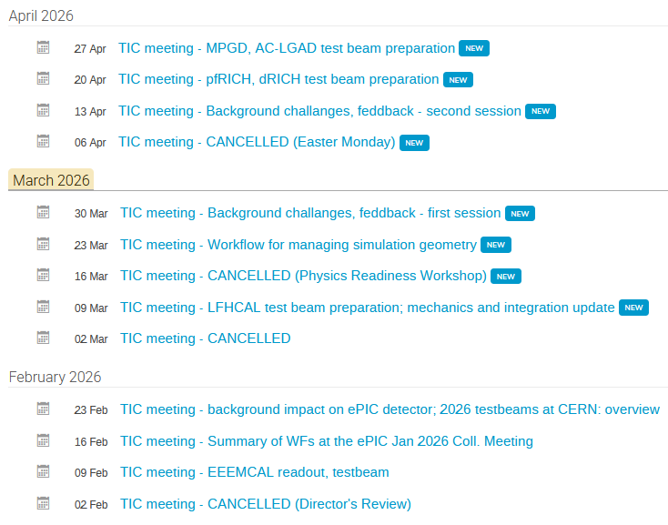
Activity overview via TIC meeting agendas
Coordinating testbeam activities
Background challenges effort
SCC/TC-Office cross-cutting efforts
MCP-PMT
HRPPD
Supporting technical challenges

Slide 10
Detector Technical Readiness for Baselining
Detector has been technically baselined since Spring 2024
Project Detector R&D has been completed
June 11-13, 2025: Comprehensive Design Review by DAC
All Subsystems have had PDRs: 4 final Preliminary (60%) Design Reviews remain
Subsystem | PDR Completed | PDR Scheduled | FDR Completed
Tracking | 40% & 60% Si, 40% & 60% MPGD
PID | 40% & 60% hpDIRC, pfRICH, dRICH ToF 40%, TOF Peer review | 60% TOF PDR: aim for April 2026 | DIRC Bar refurbishment
ECals | 60% bECal, BECal, fECal |  | SiPM & SciFi fECal, BEcal SiPM & PbW04 bECal
HCals | 40% & 60% BHCal & fHCal 40% & 50% bHCal |  | SiPM bHcal & fHcal Lead blocks fHCal
Solenoid | 60% PDR Cryogenics |  | Magnet, Conductor and Power Supply
Electronics | 40%, 50% & 60% |  | VTRX+ & lpGBT
DAQ | 40%, 50% & 60%
Integration- Installation - infrastructure | 60% Inner and outer Barrel support-structures |  | electron and hadron endcap support structures
Auxiliary Detectors | 40% & 50% RP, B0, ZDC, Low Q2-Tagger, Lumi. | 60% ZDC, Low Q2-Tagger, Lumi: aim for late March/early April 2026 60% B0, RP/OMD: aim for July 2026
Polarimetry | 40% RCS & ESR Compton Polarimeter & HSR Polarimeters | 60% RCS & ESR Compton Polarimeter & HSR Polarimeters PDR: February 18, 2026.

Slide 11
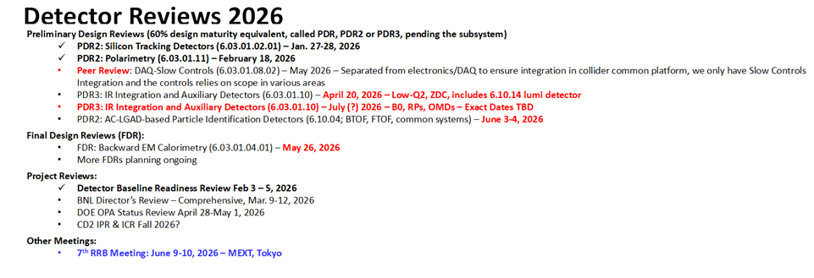
Update on Reviews – Path to Baselining CD-2
Next week!
Some details from the Detector Readiness Baseline Review and the Polarimetry PDR will follow.

Slide 12
EIC Line-Item Project Requirements
Project Requirements:
A single integrated line-item construction project.
Subprojects with well-defined deliverables, interfaces, and KPPs.
Plans consistent with DOE annual funding guidance and Total Project Cost (TPC) objectives.
EIC initial science program begins following the start of beam collisions.
Project scope provides the capability to achieve the performance required by the Mission Need.
EIC Line-Item Project Scope:
Accelerator Storage Rings (ASR)
Detector (DET)
Interaction Region (IR)
Electron Injector (EIN)
Project and Integrated Performance (IP)
Project scope required to start global commissioning and the EIC initial science program.

Slide 13
EIC Planning Dates
Milestone |  | Milestone
DOE Independent Project Review (IPR) | Jan 7-9, 2025 | Assessments of Baseline Readiness for SPs | Nov’ 25 – May ’26
Start Developing Scope of Subprojects | January 10, 2025 | Interaction Region | Nov 18-20, 2025
IR SC Magnet Steering Group Meetings - Monthly | January 17, 2025 | Accelerator Storage Rings | Jan 14-16, 2026
Project Advisory Committee Meeting | February 11, 2025 | Detector (Rescheduled from November 12-14) | Feb 3-5, 2026
Detector Advisory Committee Meeting | June 11-13, 2025 | Project and Integrated Performance (IP) | Mar 9-13, 2026
EIC Advisory Board Meeting | June 17, 2025 | Electron Injector (follow-up to Apr ‘25 Review) | May 2026
DOE IPR Focused Status Review | August 5-7, 2025 | DOE CD-3B ESAAB Approval Achieved | Jan 28, 2026
DOE RHIC R&R/Injector Operations Review | Sept 8-10, 2025 | RHIC Operations Concludes, R&R Starts | February 6, 2026
Machine Advisory Committee Meeting | Sept. 16-18, 2025 | BNL Director’s Review – Comprehensive | Mar 9-12, 2026
Infrastructure Construction Advisory Committee | October 1-2, 2025 | EIC Advisory Board Meeting | March 2025
EIC Advisory Board Meeting | October 10, 2025 | DOE IPR Comprehensive Review | Apr 28 – May 1
Resource Review Board Meeting (BNL) | Nov 4-5, 2025 | EIC Resource Review Board Meeting Tokyo | June 9-10, 2025
EIC Project Advisory Committee | Dec 2, 2025 | DOE Review of the ASR CD-2/3, DET CD-2 | October 2026
EIC Project Strategy Workshop - Stakeholders | Dec 4, 2025 | DOE CD-2/3 Approval for Accelerator Rings | ~End 2026
 |  | DOE CD-2 Approval for Detector | ~End of 2026
EIC received CD-3B Approval January 28, 2026!

Slide 14
Director's Review for the EIC Detector Subproject (ePIC) to Assess Baseline Readiness Closeout Report
Co-chairs - S. Nahn, FNAL, A. White UTA
SC 1: M. Begel, H. Chen, A. Macchiolo, E. Oliveri, A. Papanestis, K. Wyllie
SC 2: C. Polly, R. Poeschl, J. Strait, M. Trzebinski, T. Whitlatch
SC 3: A. Lung, R. Gutta, W. Hughes, J. Marx, P. McBride
Director's Review for the EIC Detector Subproject (ePIC) to Assess Baseline Readiness
February 5, 2026

Slide 15
Charge Questions
(a) Is the design of the EIC Detector (ePIC) Subproject technically sound, sufficiently mature and on a trajectory to support a CD-2 baseline in FY2026? (b) Will the DET subproject be ready for a DOE CD-2 review in the 4Q FY26?
(a) Is the Detector scope well defined, with clear responsibilities? (b) Does the baseline, including U.S. and international contributions, reflect full scope and requirements? (c) Is the scope integrated into the EIC subproject structure such that future design evolution of complementary scope in other subprojects will not cause excessive rework or costly redesigns? (d) Are interfaces clearly defined and controlled?
(a) Are the DET cost and schedule estimates sufficiently complete and reliable and on a trajectory to establish baseline on the projected timeline? (b) Do the estimates include adequate cost, schedule, and scope contingency to address the risks inherent in the remaining work and are the risks being properly managed?
(a) Is the DET subproject being properly managed (e.g., properly organized, adequately staffed) for its successful execution? (b) Does the baseline include the full scope, with mechanisms to manage international contributions?
(a) Are ES&H, Procurement, and Quality being properly addressed? (b) Is performance on CD-3A items related to DET scope satisfactory?
Has the project responded appropriately to recommendations from prior DOE/SC reviews?

Slide 16
Subcommittee 1
Electronics and DAQ, PID, Tracking
Michael Begel, Hucheng Chen, BNL
Eraldo Olivieri, Ken Wyllie, CERN
Antonis Papanestis, STFC
Anna Macchiolo, U. Zurich

Slide 17
Recommendations – SC1 Electronics and DAQ, PID, Tracking
By June 1, 2026, update the resource-loaded schedule to ensure integration activities with involvement by multiple WBS, have explicit links and resources in all relevant WBS to support these tasks.
By June 1, 2026, perform a bottoms-up assessment of the risk registry capturing the specific risks for each sub-detector. Ensure that cross-WBS risks, such as ASICs, are explicitly included and co-managed by all relevant WBS.
By June 1, 2026, update the baseline to accommodate for changes due to adjustments in UK scope.
Work with the agencies to ensure that the DOE-CERN agreement is completed as quickly as possible.

Slide 18
Subcommittee 2
Magnet, Calorimetry, Mechanical, Auxiliary, Polarimetry
C. Polly, FNAL
R. Poeschl, IJCLAB
J. Strait, LBNL retired
M. Trzebinski, IFJ PAN
T. Whitlatch, JLAB

Slide 19
Recommendations – SC2 Magnet, Calorimetry, Mechanical, Auxiliary, Polarimetry
(EMCAL) Prior to the CD-2 review, identify credible vendors for the AstroPix and add a risk for the procurement.
(HCAL) Prior to the CD-2 review, develop a plan for procurement of the HCAL tiles.
(Mech.) Before the CD-2 Director’s Review, estimate the amount of technical expert labor required from each detector system to support successful installation and integration of the full ePIC experiment, and include the cost of this labor either in the individual detector system budgets or add it to the I&I budget.
(Mech.) Before the CD-2 Director’s Review, clarify the responsibilities for installation and integration of the auxiliary detectors – is installation the responsibility of each of the remote subdetector teams, or the I^3 team or the accelerator IR team – and ensure that adequate resources are provided.
(Aux.) The B0 detector insertion is complicated, and the team should plan on testing the insertion with a full-scale mockup including cabling before final design is complete.

Slide 20
Subcommittee 3
Management, Cost and Schedule
Lung, JLAB
R. Gutta, BNL
W. Hughes, PNNL
J. Marx, Retired
P. McBride, FNAL

Slide 21
Recommendations – SC3 Management, Cost and Schedule
Prior to the DOE OPA IPR in April, identify an experienced, credible individual as Project Manager for the DET Subproject.
Prior to the DOE OPA IPR in April, develop and show the design maturity for each individual subsystem together with the projected maturity at the time of the DOE CD-2 Review.
Prior to the DOE OPA IPR in April, refine the Risk Register to separately capture individual detector elements that are assumed to be in-kind contributions and use this to update the quantitative need for cost and schedule contingency for the DET subproject.
Prior to the DOE OPA IPR in April, review the work breakdown structure and decompose them further.

Slide 22
Recommendations – SC3 Management, Cost and Schedule
By June 1, 2026, review, update and validate all cost estimates, including the latest vendor quotes that were received prior to June 2025.
By June 1, 2026, ensure all global risks (such as tariffs, inflation, exchange rates) are captured in the Risk Register for Detector subproject and associated with the corresponding activities. Perform a detailed risk analysis on the updated resource loaded schedule to determine the cost and schedule contingency needs.
By June 1, 2026, all DET subsystems should determine bottom-up risks specific to their scope and ensure they are reflected appropriately in the Risk Register.
By June 1, 2026, reach agreements with DOE on the KPPs and on the level of assurance for in-kind contributions that will be required for CD-2 approval.
By June 1, 2026, prepare a comprehensive scope contingency plan.
Develop and practice EVMS several months prior to the Director’s CD-2 baseline review to demonstrate CAMs are able to provide status, Cost Performance and other reports are being used to actively manage, and a rigorous change control process is in place.

Slide 23
Conclusion – SC3 Management, Cost and Schedule
The subcommittee believes that the project can be ready for a DOE CD-2 review in 1Q FY2027 if the following are completed before the Director’s CD-2 Review.
EIC Project secures a funding profile assumption from DOE and transmits the DET funding profile assumption with adequate time to finalize the baseline.
Risk register needs to be rethought and broken down.
A risk-based estimate of the DET Subproject cost and schedule contingency at 90% confidence level or higher is needed.
Design maturity for individual detector subsystems needs to be understood and justified as adequate for CD-2.
BOE need to be made credible and clear and shown to justify the cost estimate.
For in-kind contributions, develop a convincing argument that the DOE requirement for signed binding documentation for CD-2 can be modified so that the actual status of the binding documents is accepted for CD-2.
Train and rehearse CAMs so they can be credible, clear, and well-prepared for the DOE review.

Slide 24
Detector Baseline Readiness Assessment Review - Summary
The Detector Subproject Baseline Readiness Assessment review was held February 3-5. The review committee consisted of 18 subject matter experts from around the world, distributed in three subcommittees. The committees gave multiple valuable comments and recommendations towards Detector readiness. They concluded that the Detector is close, and project it to be fully ready for a CD-2 baseline review Q1/FY27 but not Q4/FY26. The SC-3 Management, Cost and Schedule subcommittee separated their recommendations in those to be completed before the OPA April 28-May 1 review and those to be completed before a CD-2 Director’s Review.
As follow up on this review, the project created an action list and discussed these activities with the Detector Control Account Managers and the Project Control Analysists. Many of these activities relate to some fixes to P6, to Basis of Estimate documentation, to ease of understanding scope (CD-3A, CD-3B, in-kind, or DOE costs) for reviewers, and further updates to the risk registry.

Slide 25


Slide 26
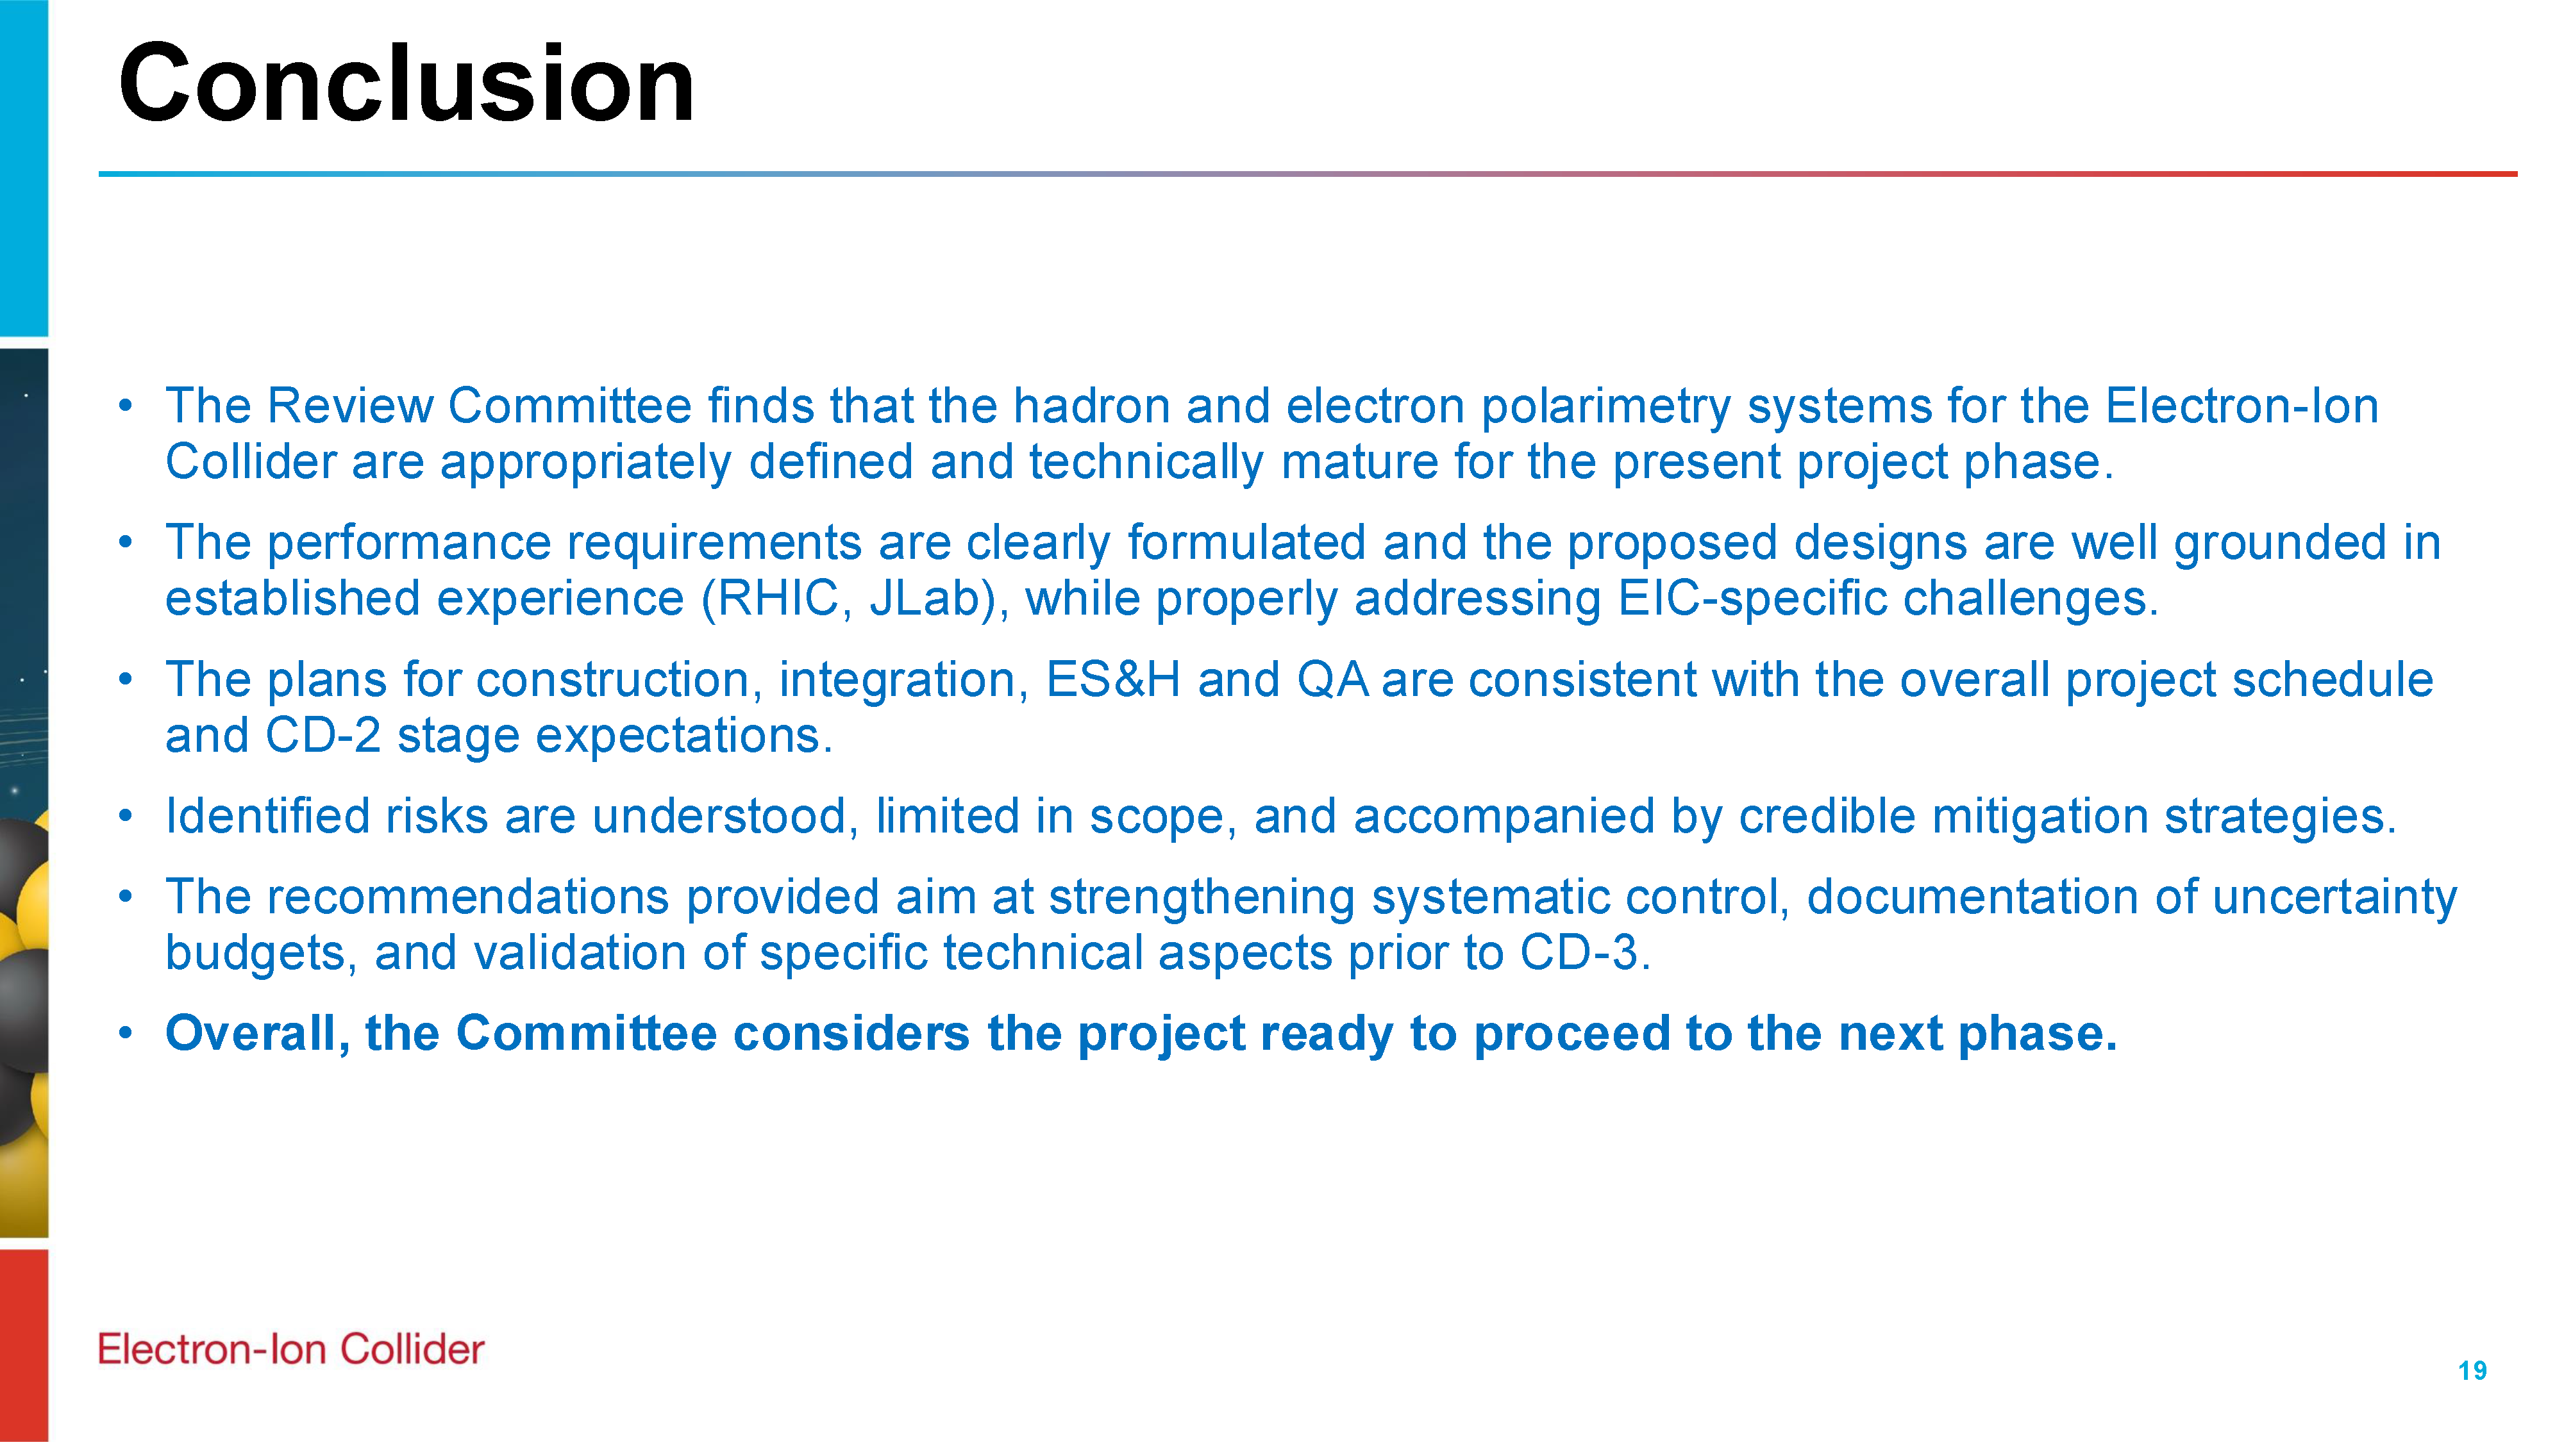

Slide 27
BNL Director’s Review – March 9-12th
DOE April IPR Charge:
Is the project team effectively executing the work, including long-lead procurements? Is the project positioned to complete long-lead procurements within the established schedule and cost baseline? Are technical issues across all subprojects appropriately and proactively addressed?
Is the project team on track to present performance baselines for the first two subprojects it has proposed, the Accelerator Storage Rings and Detector subprojects, by the end of 2026? Is the team making adequate progress developing the performance baseline for the other subprojects it has proposed? Is each subproject scope well and logically defined? Are the subprojects ordered and phased optimally? Are the schedules and cost estimates credible for the current stage of each subproject? Do plans include adequate scope, schedule, and cost contingency?
Are the key performance parameters and scope for each subproject well documented, traceable, reasonable, and justifiable? Does the roll-up of subproject scope unambiguously and progressively elaborate a complete and responsive Electron-Ion Collider facility in an asset-oriented hierarchy? Are subproject interfaces understood and clearly delineated at this stage of design? Would attainment of the key performance parameters of all subprojects indicate delivery of the mission need?
Are ES&H and QA properly addressed given the project’s current stage of development?
Is the project properly managed? Are risks being effectively managed? Is a management team in place to successfully execute the project including long-lead procurements? Are roles and responsibilities documented and understood?
Has the project team satisfactorily addressed recommendations from previous DOE SC reviews?
Focus on the whole EIC project and readiness for the April IPR review.

Slide 28
Final Design Reviews – Planning for CD-3
Final Design Reviews (FDR):
FDR: Backward EM Calorimetry – Mid February 2026 → Spring 2026
Planning for Final Design Reviews before CD-3: (dates given are what is in P6 for now)
FDR 6.03.01.02.01: MPGDs – January 2027 – perhaps safer to assume March 2027?
FDR 6.03.01.02.02: SVTs – August 2027
FDR: hpDIRC – August 2026 → combine with dRICH and pfRICH – late 2026?
FDR: dRICH – January 2027 → combine with hpDIRC and pfRICH – late 2026?
FDR: pfRICH – February 2027 → combine with hpDIRC and dRICH – late 2026?
FDR: TOF – June 2027
FDR: Barrel EM Calorimetry – September 2026
FDR: Forward EM Calorimetry – September 2026 → combine with Barrel HCAL and LFHCAL?
FDR: Barrel HCAL – October 2026 → combine with Forward EMCal and LFHCAL?
FDR: LFHCAL – September 2026 → combine with Forward EM Cal and Barrel HCAL?
FDR: Magnet Cryo – missing in P6, need to link to integral review with accelerator/cryo.
FDR 6.03.01.07: Electronics – September 2026
FDR 6.03.01.08: DAQ/Computing – July 2026
FDR: I3 Barrel Detector Structures – February 2027
FDR: I3 Detector Infrastructure and Utilities Integration – July 2027
Missing: FDR: Installation (includes also Magnet Installation)
FDR: Auxiliary Detectors, B0 – July 2027 → combine with other auxiliary
FDR: Auxiliary Detectors, RP/OMD – July 2027 → combine with other auxiliary
FDR: Auxiliary Detectors, ZDC – July 2027 → combine with other auxiliary (perhaps lumi & low-Q2)
FDR: Auxiliary Detectors, Low-Q2 – March 2027 → combine with lumi?
FDR: Auxiliary Detectors, Lumi Monitor – October 2026 → later and combine with low-Q2?
FDR 6.03.01.11.02: Hadron Polarimetry – March 2027 → combine with Electron Polarimetry
FDR 6.03.01.11.01: Electron Polarimetry – May 2027 → combine with Hadron Polarimetry
Missing: FDR (or perhaps rather a peer review): Commissioning
Assumption: DET CD-3 in Q1/FY28
→ DOE Review ~ October 2027
FDRs need completion ~ July 2027
BUT: There are subsystems that benefit from FDR this CY might there be a CD-3C. E.g., EM calorimetry, forward HCAL, gaseous-based PID detectors, and scope such as HRPPD, GEM foils, SiPM boards
DOE BNL/JLab PEMP deliverable - objective 2.1:
“Prepare a table of design reviews necessary to attain CD-2 and CD-3 for each subproject indicating what reviews have covered which scope and when, and when future reviews of specified scope will occur. Actively maintain this table. Indicate scope by citing work breakdown structure elements.”

Slide 29
Collaboration Goals for the first half of 2026
Support the EIC project and ePIC Technical Design:
Close the design loop with ePIC simulations
Advance the pTDR in preparation for CD-2
Respond to review recommendations
Complete the Early Science whitepaper
Progress in developing a multi-year plan for ePIC Software and Computing
Begin submissions to the NIMA Special Issue
From the ePIC Jan 2026 Collaboration Meeting

Slide 30
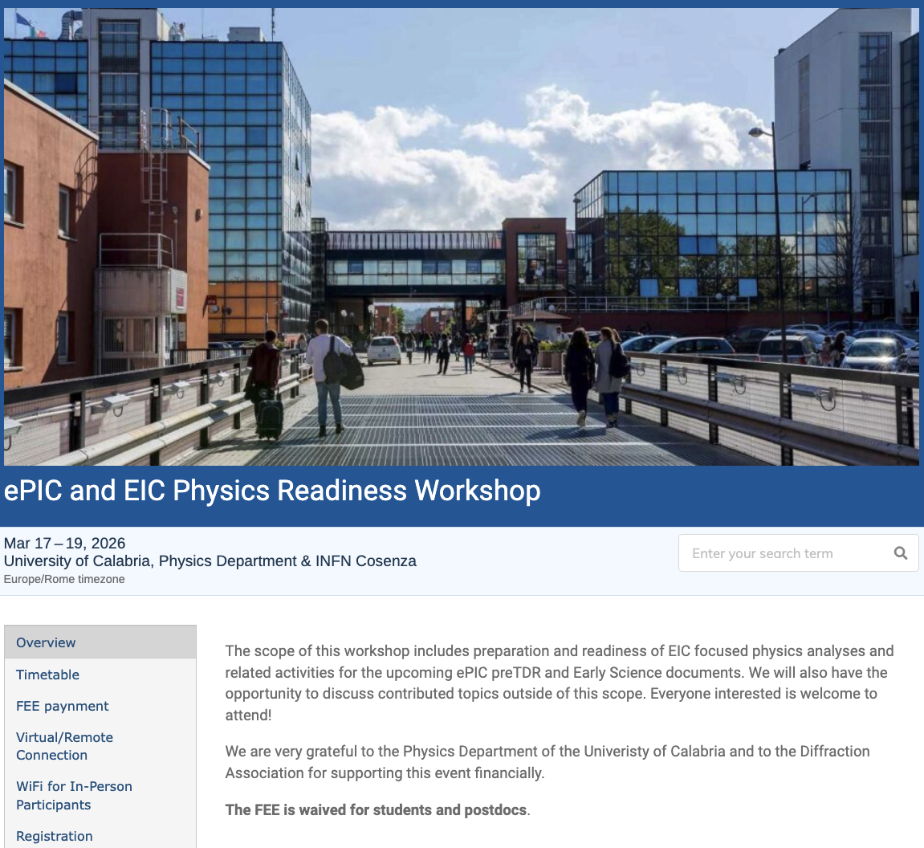
The discussion on performance continues!
Next Physics Readiness Workshop scheduled for March 17-19
Hosted by the University of Calabria & INFN Cosenza
Indico: https://indico.bnl.gov/event/30283/
Hybrid format - Please register even if attending online (select proper option)
The workshop will focus on the finalization of studies and text for the TDR and early science documents
Joint sessions with Software & Computing to discuss reconstruction and simulation priorities

Slide 31
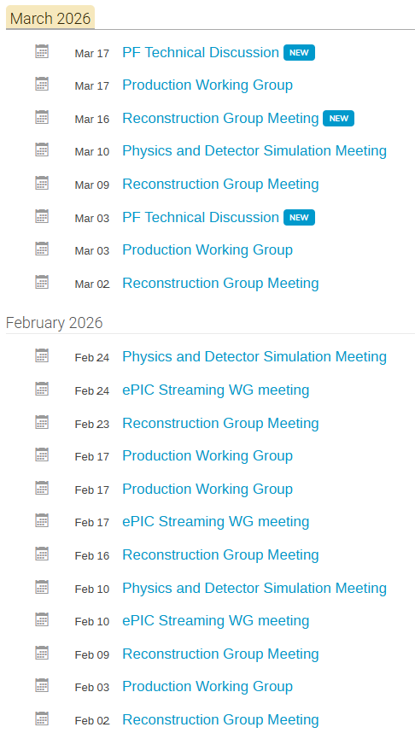
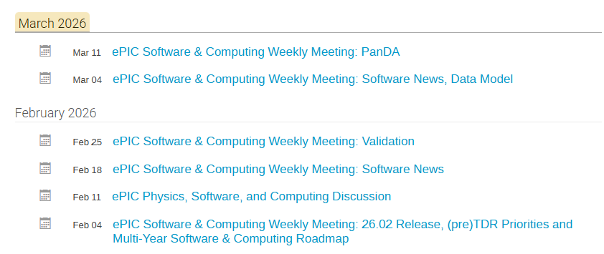
Software and Computing
Software and Computing is extremely active both supporting the simulation effort and planning for the future of S&C in ePIC. Will have a report at a General Meeting later this spring.

Slide 32
Discoverability and Reusability for the preTDR and Beyond
Announced March 2nd
We are excited to announce the upcoming online only ePIC Software & Computing Workshop on “Discoverability and Reusability for the preTDR and Beyond”. This workshop will take place Wednesday, April 29th with presentations on the current strategies for software discoverability and will be an open discussion with the community to gather feedback and refine priorities. We invite all in the ePIC Collaboration and EIC Community to join to learn about the current efforts and contribute to the discussions. Please find the agenda and registration on indico: https://indico.bnl.gov/event/31760/
We look forward to your participation,
Holly Szumila-Vance, Stephen Kay, and Sasha Prozorov on behalf of the ePIC User Learning WG

Slide 33
NIMA Special Issue
This Special Issue will be an important tool to communicate to the NP community the depth, breadth and excitement for EIC science.
Planning for submissions in ~July-September time frame
NIMA Special will open March 2026
Open through October 2026
Coordinators to act as Guest Editors
Goal of the issue is a comprehensive overview of ePIC
Contributions will undergo peer review
Plan to publish a super-set of the material prepared for the pTDR
Subsystem technical papers derived from pTDR
Physics performance paper spin-off from pTDR (full EIC)
BSM+EW Physics Paper (full EIC)
Early Science whitepaper
Expanded Physics Papers from Early Science appendices
Streaming Computing Model
Publications will be Open Access

Slide 34
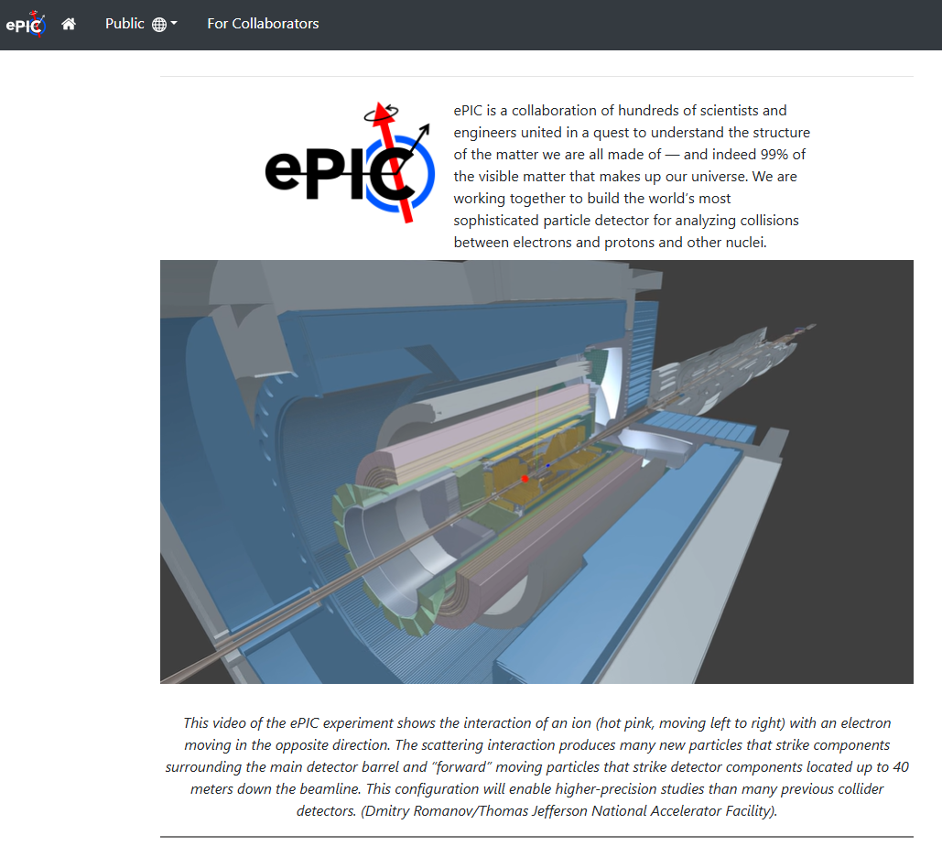
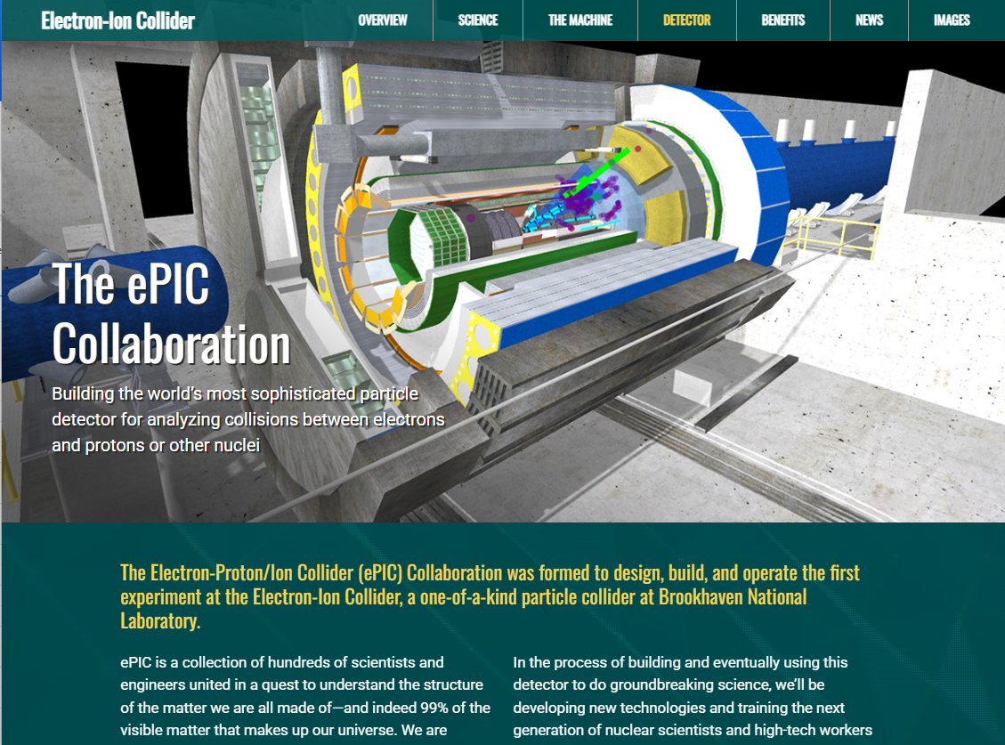
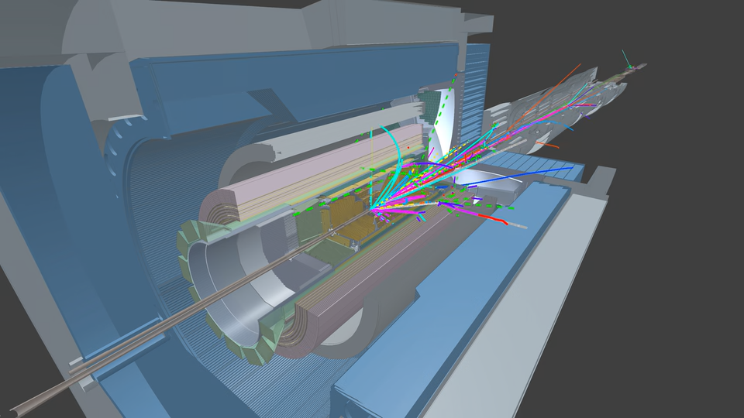
New Firebird Event Videos!
https://www.epic-eic.org/
https://www.bnl.gov/eic/epic.php
Awesome new Firebird event display videos from Dmitry Romanov (JLab) – integrated into ePIC and BNL web pages.
Firebird is the ePIC event display used for both outreach and reconstruction and analysis development:
https://eic.github.io/firebird/
Planning a variety of videos of different physics process to be incorporated into public portion of website.

Slide 35

7th RRB and EIC-Asia Meeting: June
The 7th EIC Resource Review Board Meeting will be held at MEXT headquarters in Tokyo, June 9-10th
This will be followed by an EIC-Asia meeting at the University of Tokyo, June 11-13th
Planned agenda topics:
Hardware updates from all detectors where Asian groups are involved, i.e. Barrel TOF AC-LGADs, ZDC, streaming readout, Astropix/BIC . Probably closely related, several student/early career talks on parts of the ongoing testbeam campaigns
Several physics related ePIC analysis talks + corresponding reconstruction, e.g. inclusive A1n with spectator tagging, nFFs, ML for ZDC reconstruction, etc.
Physics/theory talks: low-x physics, a more detailed talk on the EIC connections to the QCD mass generation, the interplay of jets and SIDIS for TMDs, etc.
More information coming soon!

Slide 36

Daylight Savings Time in the US
Daylight Savings Time in the US will begin this Sunday March 8th
This will shift ET one hour later than before, which will make meetings one hour earlier in time zones that have not changed to DST. Keep this in mind for ePIC meeting times!

Slide 37
Conclusions
The ongoing reviews are a process through which the EIC project to establish the project baseline.
Support for the review process by the collaboration has been tremendous!
The April OPA review will pave the way for a transition to a construction project
Planning for a CD-2 for the DET subproject in early FY27.
It is critically important that we work to communicate the importance of EIC science to the community!
The Early Science whitepaper and NIMA Special Issue are how we will do this
The hectic pace of the reviews can generate a lot of noise. We have to stay the course and stay focused on the EIC science mission. Achieving this will take time, patience, and fortitude.

Slide 38


Slide 39

ePIC Resources
Public Website - https://www.bnl.gov/eic/epic.php
Mailing Lists – https://lists.bnl.gov/mailman/listinfo
Indico Agenda - https://indico.bnl.gov/category/402/
ePIC Software and Computing: https://indico.bnl.gov/category/435/
Wiki - https://wiki.bnl.gov/EPIC
ePIC Software Training:
Landing Page: https://eic.github.io/documentation/landingpage.html
Tutorials: https://eic.github.io/documentation/tutorials.html
Mattermost: https://chat.epic-eic.org
ePIC Zenodo Community: https://zenodo.org/communities/epic

Slide 40
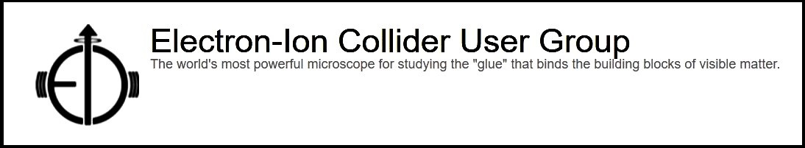

EICUG Membership
The EICUG is a vital organization to promote the interests of the EIC community!
Without the EICUG we would never have gotten far enough to form ePIC!
Please register your institution!
Check with your EICUG IB representative to get registered as a member
https://www.eicug.org/content/join.html

Slide 41
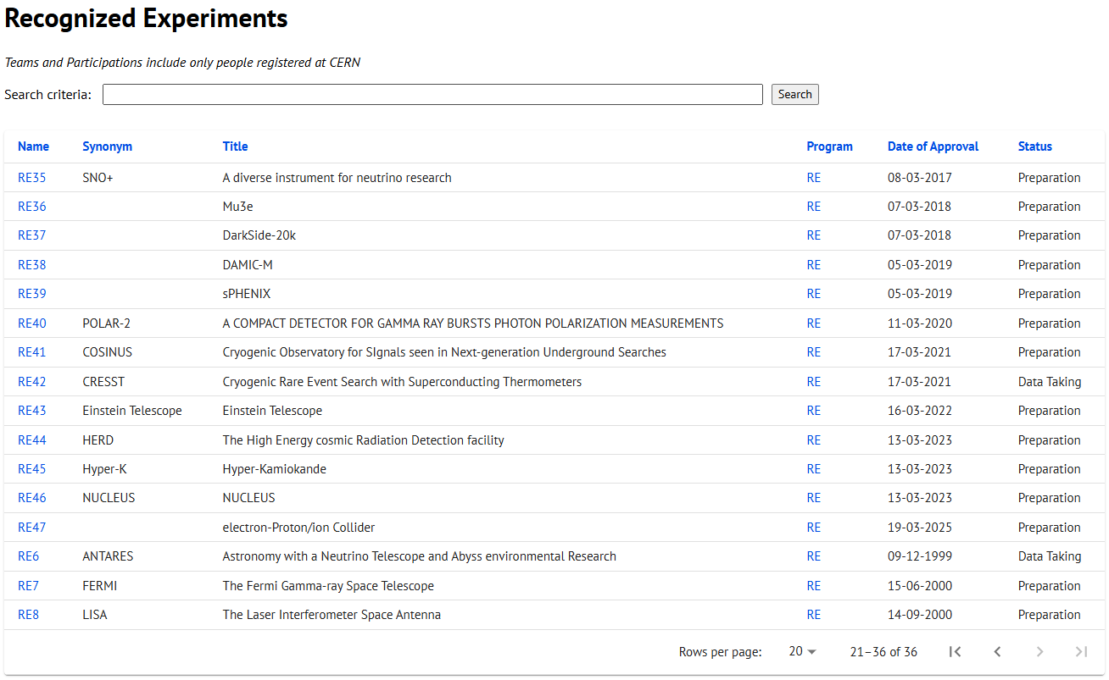
CERN Recognized Experiment Status: RE47
ePIC now appears in the CERN Grey Book database as RE47: https://greybook.cern.ch/experiment/recognized
Two steps to get ePIC Collaborators registered at CERN:
CC Representative needs to register as team leader with CERN Users Office:
https://usersoffice.web.cern.ch/
https://usersoffice.web.cern.ch/team-leaders-corner
Users.Office@cern.ch
CC member can then certify registrations of team members
Contact us if you run into problems!

Slide 42
Homework Questions – 1st Day
Jim Yeck, EIC Project Director & BNL ALD
Elke Aschenauer, DET Subproject Manager
Rolf Ent, DET Subproject Manager
Director's Review of the EIC Detector (ePIC) Subproject to Assess Baseline Readiness
February 3-5, 2026

Slide 43
1st Day HW Questions (21!)
Q1: Additional information is requested for ASICs being utilized by ePIC.
Provide a table of ASICs. For each ASIC, include the subsystem, fab, TRL (using the DOE definition https://www.directives.doe.gov/directives-documents/400-series/0413.3-EGuide-04/@@images/file), when you expect to reach TRL 7, and the need-by date for construction.
For each ASIC, what is your procurement and testing plan?
When do you expect to have completed a system test with pre-production articles for each subdetector (especially SVT & TOF).
Provide a list of engineering FTE and duration from US and non-US institutes contributing to the following designs:
MOSAIX ER2 (estimate from non-US institutes is OK)
MOSAIX ER3 (estimate from non-US institutes is OK)
LASv1
AncASICv1
FCFDv1.2
Q2: Provide a table of total labor & non-labor FTE and M&S for each subdetector. What assumptions have been made about contributions of uncosted labor to successfully complete each deliverable? How many postdocs and students are working on the Project whose subsistence comes from the DOE Research Program. Break this out by subdetector area.
Q3: Is there labor, scientific or technical, from international partners that the Project counts on for successful design and construction of ePIC that is not captured in the in-kind cost estimates. Please quantify in FTEs.
Q4: How will you develop the baseline scope in preparation for CD-2 — with and without UK resources — given recent actions by U.K. funding agencies. Describe the impact on physics/performance if the SVT outer layers need to be replaced by a non-silicon technology.
Q5: How much labor is needed to support the development of firmware to readout and integrate each subdetector. How is responsibility split amongst WBS (Detector, Electronics, DAQ) for this effort. In addition, Please tabulate the institutional responsibilities for front-end boards for all the subdetectors.
Q6: Please present a list of all Preliminary Design Reviews for the DET sub-project and indicate any that have not yet been completed or have outstanding recommendations.
Q7: Show us where alignment and metrology costs have been estimated. What is the total estimate for these labor resources?
Q8: Will the CERN and FNAL shutdowns (lack of test beam and irradiation) have an impact of the schedule via validation of detector components?
Q9: Is there a list of tasks or other mechanisms to encourage Institutes interested in participation?
Q10: What is the subproject TPC? (DOE Scope with contingency) (Excluding or including CD-3A and 3B; whichever you are comfortable with). Is this compatible with the target TPC (EAC and Contingency) for CD-2? Provide Estimate Uncertainty value by WBS (use the previous template if needed) as well as the methodology for establishing the estimate uncertainty. Provide Expected Monetary Value by WBS
Q11: Provide a simple schedule timeline of all required Detector Subproject tasks needed to fulfill the CD-2 Requirement checklist.
Q12: In-kind agreements – in the same template you provided, add columns for forecast dates for signing agreements
Q13: For the Project Coordinator position, specify what is the focus of the job, the responsibilities and authority.
Q14: What steps will be taken, when and by whom, to reach an agreement with DOE on the specific KPPs?
Q15: What steps will be taken, when and by whom, to reach an agreement with DOE on what DOE requires for the in-kind contributions to be considered realistic for CD2 baselining.
Q16: Please upload BOE for Management WBS
Q17: What are the possible impacts from the BNL EIC/NPP directorate re-org on the Detector Subproject?
Q18: WBS 6.03 vs 6.03.01 - these elements seem to be redundant, any specific reason?
Q19: Are there scaling/ benchmark from other detectors to gain confidence on the BOE. Can you provide some examples?
Q20: Confirm or update the table – the #s doesn’t tie out to P6/ presentations
Q21: Yes/No questions - Is there a draft Project Management Plan for subproject ready?
For reuse items – is the budget for any modifications necessary in order to repurpose items for DET ePIC included in the Detector subproject?

Slide 44
Homework Questions – 2nd Day
Jim Yeck, EIC Project Director & BNL ALD
Elke Aschenauer, DET Subproject Manager
Rolf Ent, DET Subproject Manager
Director's Review of the EIC Detector (ePIC) Subproject to Assess Baseline Readiness
February 3-5, 2026

Slide 45
SC3 – Project Management & Cost & Schedule
Q1: In the auxiliary detectors the staffing in years 2026-2028 looks low, on the level of 0.2-0.3 FTE, relative to the number of different detector subsystems and the complexity of the interfaces. Does it align with significant design work needed for these 5 subsystems? Please explain the basis of these estimates.
→ Yes, is low as assumed only for coordination of in-kind designs. May indeed look low. Note that AC-LGAD is in TOF, ASICs/readout development is in electronics.
Q2: Is shipping included in the cost estimates of all detector (sub)systems that will be built at other institutes before delivery to BNL.
→ Yes, as “pack ship items”
Q3: Is there a designated point (or points) of contact within DET to the accelerator to keep track of all of the DET-IR/ASR/EIN interfaces?
→ No, not one single designated point of contact but several (area, MDP, IR-DET, ..)
Q4: Please provide a P6 dump of all activities that have non-zero non-labor hours with $0 cost associated.
→ This amounts to 96812 student hours, was a mistake.
45

Slide 46
Comments – SC3 Management, Cost and Schedule
The detector scope is well-defined and well-matched to the science goals of the ePIC Collaboration. Responsibilities for the DOE-funded parts of the detector are well-defined. For the in-kind contributions, responsibilities are provisionally defined but will not be locked-in until legally binding documents are signed.
The leadership of the EIC Detector Project are to be commended for many significant accomplishments, (e.g. major progress on securing IKC, establishing robust engagement and aligned responsibilities with the ePIC collaboration, CD-3A scope work and defining CD-3B, begin transition to a Subproject structure), in a challenging environment with funding and schedule uncertainty.
In the post-CD2 phase of the project, having dual leadership roles for DET creates a risk of confusion and challenges in making difficult, timely decisions. This is especially the case when decisions are necessary based on limited information and other possible complexities and trade-offs. In addition, evolving the organizational structure to appropriately support the subproject and manage the IKC could open opportunities for succession planning.
The goal to achieve CD-2 Approval for the Detector Subproject by the end of the calendar year is appropriate and important to maintain momentum for the EIC Project and the international collaboration. This will require significant, prioritized effort at the Project and the Subproject level.

Slide 47
Response to Charge – SC3 Management, Cost and Schedule
Charge Question #1: Is the design of the EIC Detector (ePIC) Subproject technically sound, sufficiently mature and on a trajectory to support a CD-2 baseline in FY2026?
(b) Will the DET subproject be ready for a DOE CD-2 review in the 4Q FY26?
Response: No, the DET subproject would not be ready for a DOE CD-2 review during or before September 2026.
See later slide on actions we believe are necessary to be ready for a DOE CD-2 review by the end of the calendar year.

Slide 48
Response to Charge – SC3 Management, Cost and Schedule
Charge Question #2a: Is the Detector scope well defined, with clear responsibilities?
Response: Yes. Scope is well-defined and well-matched to the science goals of the ePIC Collaboration. Responsibilities for the DOE-funded scope are well-defined and the essential role of the owners for the in-kind contributions is clearly documented and already active. However, until legally binding documents are signed there is a risk that responsibility for some of the in-kind scope could change.

Slide 49
Response to Charge – SC3 Management, Cost and Schedule
Charge Question #3a: Are the DET cost and schedule estimates sufficiently complete and reliable and on a trajectory to establish baseline on the projected timeline?
Response: Yes, the Schedule appears to be built well for the current phase of the project, however some improvements are suggested. See comments.
No, the Cost estimates are not complete for CD-2 level maturity, they are likely not yet reliable. See comments and recommendations.
Charge Question #3b: Do the estimates include adequate cost, schedule, and scope contingency to address the risks inherent in the remaining work and are the risks being properly managed?
Response: Cannot answer, the contingency needs were not presented, the risk register at the sub-project level is incomplete and not mature and quantitative risk analysis has not been performed yet. See comments and recommendations.

Slide 50
Response to Charge – SC3 Management, Cost and Schedule
Charge Question #4a: Is the DET subproject being properly managed (e.g., properly organized, adequately staffed) for its successful execution?
Response: Yes, it is organized properly for the current stage of the detector project. However, a re-organization is recommended to be in place prior to CD-2 to support successful execution of the Subproject. Regarding staffing, it is not clear that adequate staffing from the Project Support areas are being deployed. In addition, some recent gaps in areas such as procurement and project controls have emerged.
Charge Question #4b: Does the baseline include the full scope, with mechanisms to manage international contributions?
Response: Yes. The baseline includes the full scope when the expected international in-kind contributions are included. These contributions will be tracked as other project scope is tracked. The mechanisms for management of these contributions include layers of reviews where technical decisions stay with the experts closest to the work and each decision is then reviewed at the level where it can be made most responsibly.

Slide 51
Response to Charge – SC3 Management, Cost and Schedule
Charge Question #5a: Are ES&H, Procurement, and Quality being properly addressed?
Response:
ES&H – YES
Brookhaven and JLab have well-established safety cultures and processes that cover the detector project activities. There are challenges presented for ePIC with work done at universities and international institutions as part of in-kind contributions for equipment that will be installed/operated at BNL. The project team is addressing these risks.
Procurement - MAYBE
Challenges continue to exist, predictability on cycle times is crucial for baseline integrity. The recent reorganization of procurement at JLab could create a significant challenge for the Detector Subproject. See comments.
Quality – YES
Brookhaven and JLab have robust QA/QC programs that are working well together to support the EIC Project and DET.
Charge Question #5b: Is performance on CD-3A items related to DET scope satisfactory?
Response: Yes, CD-3A performance related to DET scope is satisfactory.

Slide 52
Response to Charge – SC3 Management, Cost and Schedule
Charge Question #6:
Has the project responded appropriately to recommendations from prior DOE/SC reviews?
Response:
Cost and Schedule – MOSTLY YES, recommendations related to in-kind/risks (#932) and scope contingency (#933) are still in progress.
Management – YES
Recommendation from OPA Review (October 2021) to pursue formal commitments for in-kind contributions remains open. Project has made significant progress identifying IKC and documenting the commitments.
Recommendations from OPA Review (August 2025) to submit proposals to DOE/NP for Threshold and Objective KPPs remains open, pending next OPA Review, but the proposals have been submitted.

