Slide 1
10Gbs data decoding and general status
Martin
What’s new this week?
My not-working BNL KCU card is with Miklos (no news yet)
Both decoders (1G and 10G) are now “API-homogenized”
The API has changed, though (early enough I think)
I made a generic “barebones” pmonitor to get newcomers (such as the BIC folks) started
Our own monitoring/analysis also updated in gitea

Slide 2
Decoding/API is now like the sPHENIX TPC
$ dlist cosmics_ROC-00000295-0000.evt
Packet 12001 73004 -1 (ePIC Packet) 301 (IDH2GCROC3)
$ dlist cosmics_10G_ROC-00000324-0000.evt
Packet 12001 31422 -1 (ePIC Packet) 302 (IDH2GCROC3_10G)
Each “TimeFrame” (better term for SRO data) has multiple waveforms (think cosmics here) in it
For example, all non-streaming waveform samplers (DRS4, CAEN 1742, the sPHENIX calorimeters, etc etc) can use the following code that asks
Hey packet, how many channels do you have?
Hey channel, how many samples do you have?
Ok then, please give me sample s of channel c

Slide 3
Our Streamers have one more dimension
A SRO packet usually contains more than one waveform in a “TimeFrame”
Here you ask:
Hey packet, how many waveforms do you have?
Hey packet, how many channels do you have for waveform n?
Hey channel, how many samples do you have for waveform n ?
Ok then, please give me sample s of channel c of waveform n

Slide 4
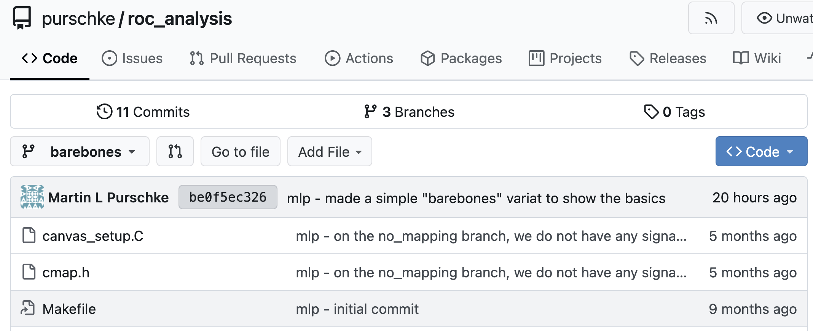
Reference pmonitor
https://git.racf.bnl.gov/gitea/purschke/roc_analysis
Check out the “barebones” branch

Slide 5
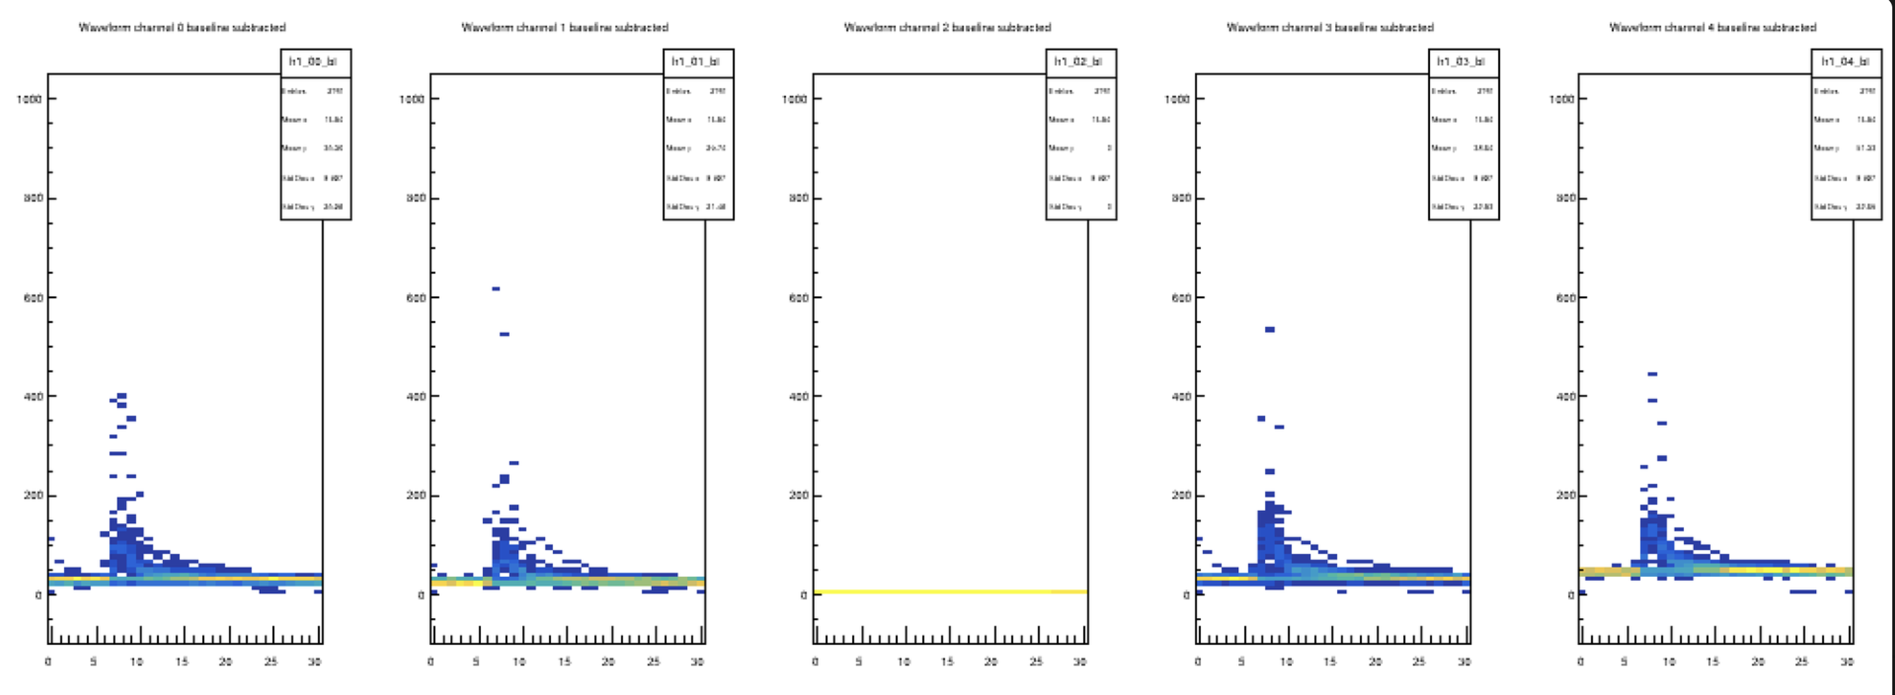
API
Now you have one more dimension
// how many channels do we have? (144)
int nr_channels = p->iValue(n,”CHANNELS");
// first we find out how many waveforms we have here
int nr_wf = p->iValue(0, "NR_WF");
// now we run through them
for ( int n = 0; n < nr_wf; n++)
{
// how many samples does this wf have?
int nr_samples = p->iValue(n,"SAMPLESIZE");
for ( int ch = 0; ch < nr_channels; ch++)
{
for ( int s = 0; s < nr_samples; s++)
{
double value = p->iValue(n,s,ch);
}
}
}

