Slide 1
BHCal: General Discussion
Stefan Bathe

Slide 2
Background studies
Request from TC office (TIC, Silvia) by email, referring to talk at TIC meeting on 2/23:
https://indico.bnl.gov/event/31599/contributions/120324/attachments/68421/117639/TIC_20260223.pdf
Based on Directors Review (3-5 Feb):“MPGDs ... Simulation studies (physics and background) remain an important element to further consolidate the evaluation of detector requirements and operating conditions.”
Presentation in TIC meeting requested on April 13
3 questions:
Impact on detector performance
Impact on data flow, requested bandwidth and potential dead-time
radiation/fluence damages (have)

Slide 3
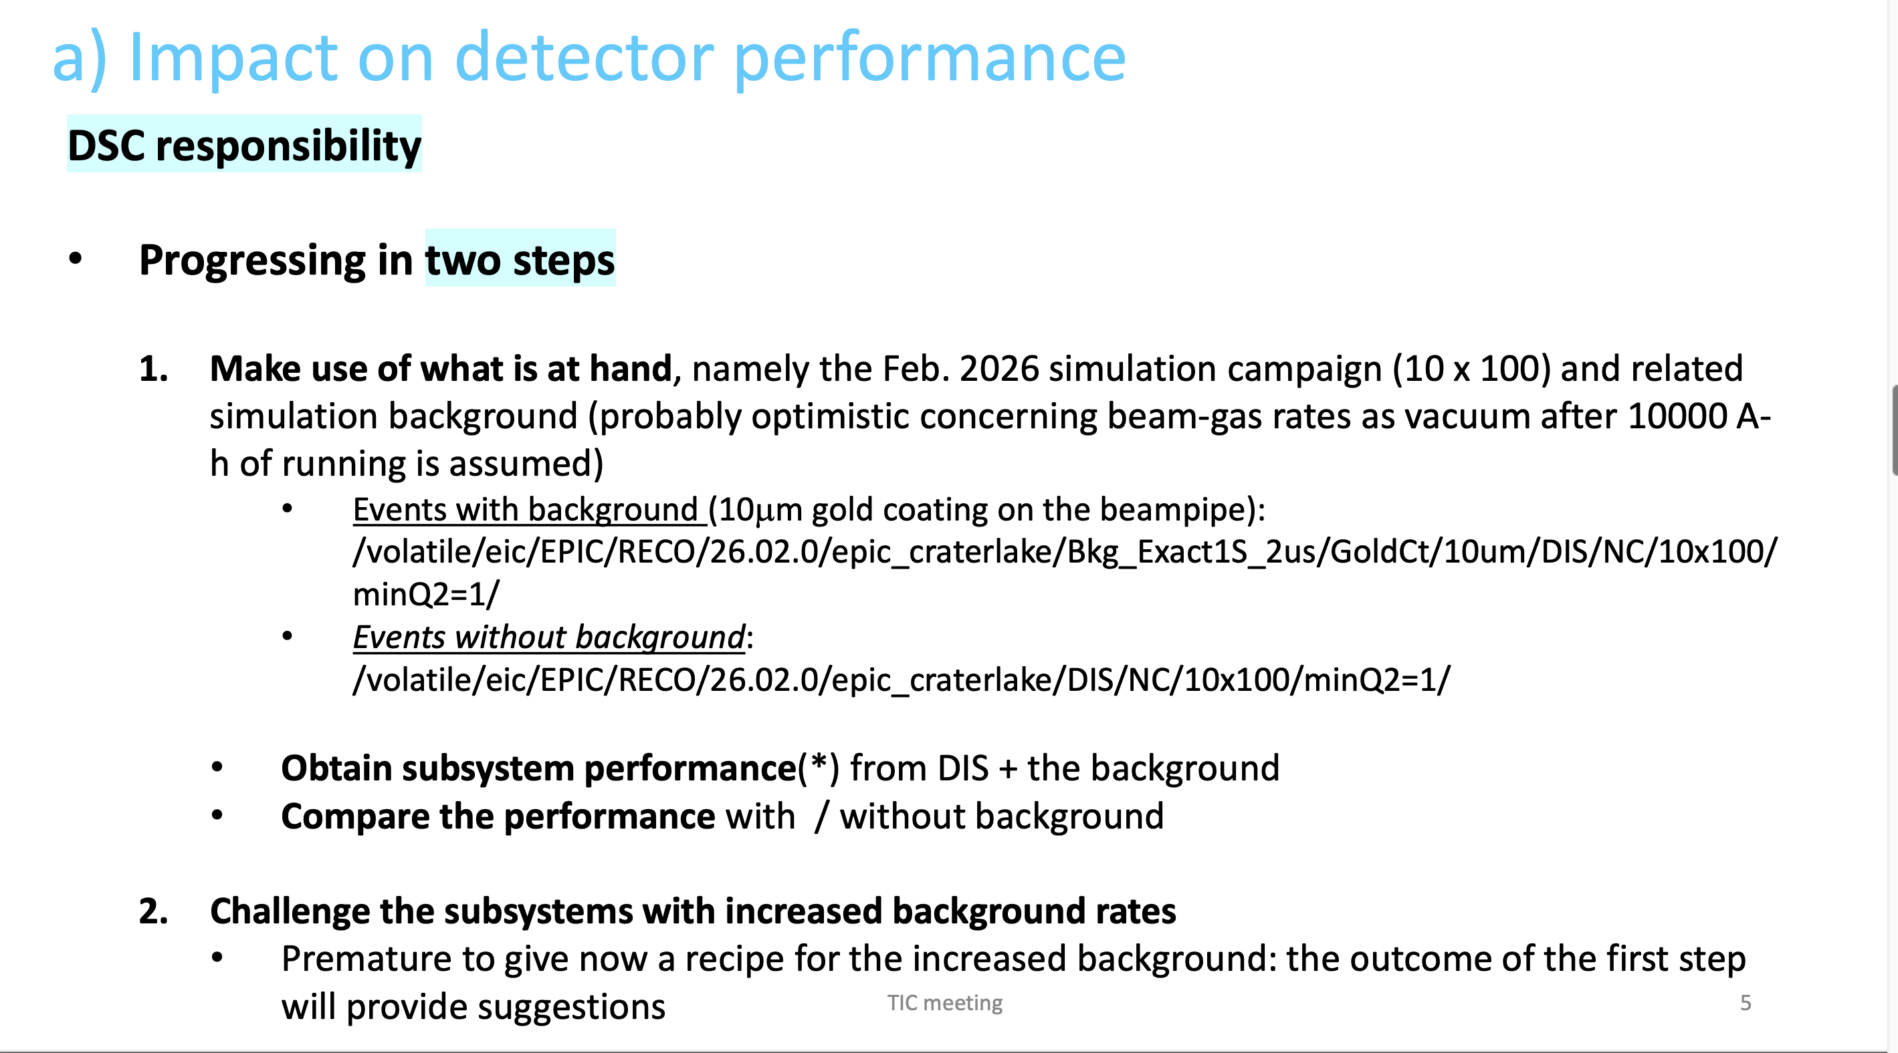
From Silvia’s talk on 2/23

Slide 4
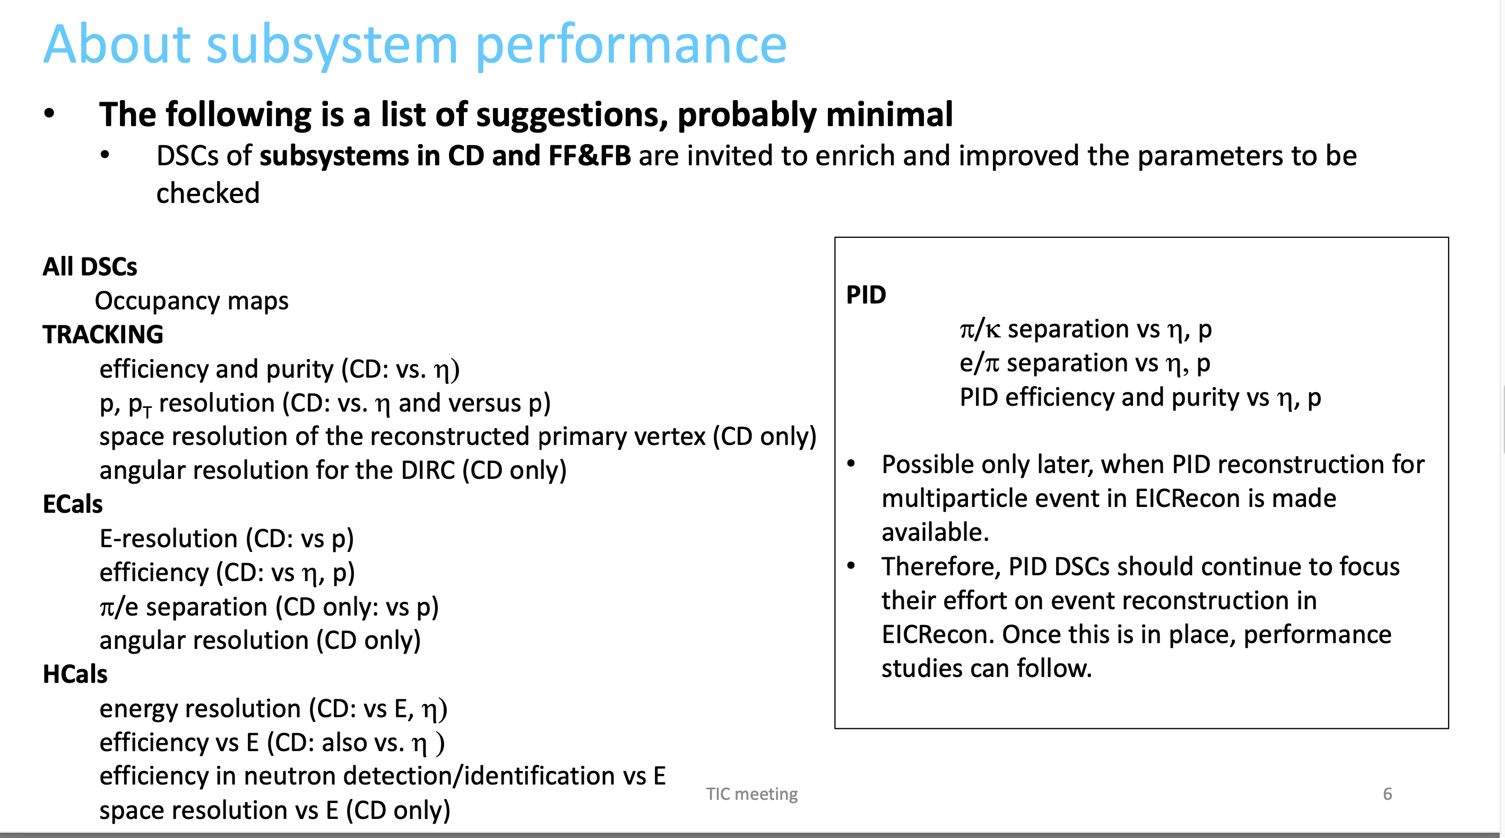
From Silvia’s talk on 2/23

Slide 5
Monday (March 30) TIC meeting: presentation my Jeff Landgraf on CALOROC capabilities
Need to show that our detector with background is within those limits

