Slide 1
bHCAL Meeting – Neutron Calibration Update
Jan Vanek
University of New Hampshire
04/10/2026

Slide 2
Overview
Updated bHCAL geometry
Removed chimney tiles from current geometry
Background studies status

Slide 3
Chimney sector geometry

Slide 4
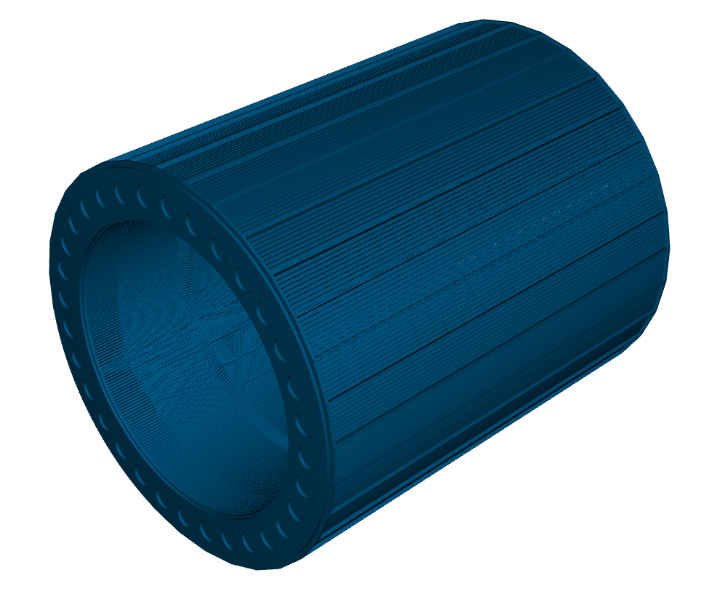
Full bHCAL geomeytry
Full bHCAL geometry
No changes to the sectors yet
New gdlm files for new chimney sectores should be available soon

Slide 5

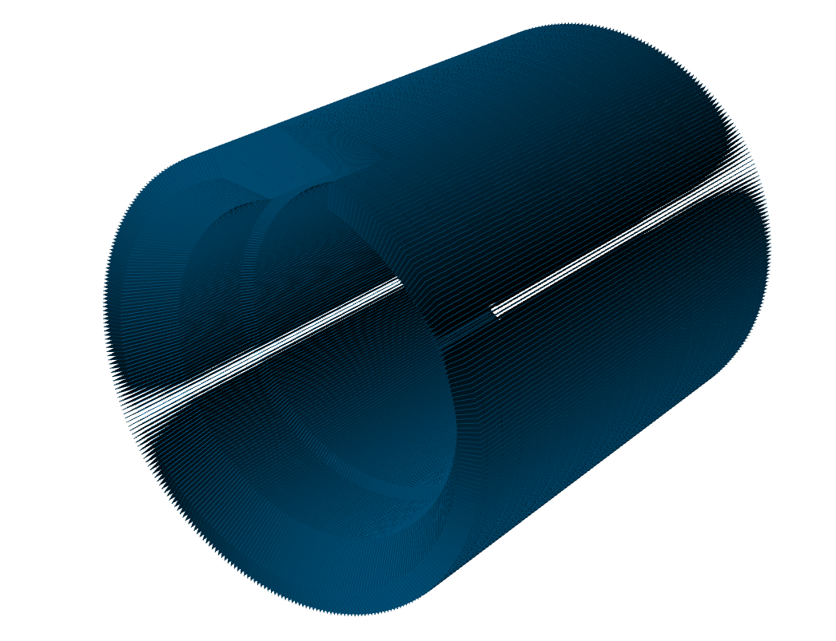
Chimney tiles
Four outer tile rings
All bHCAL tiles

Slide 6
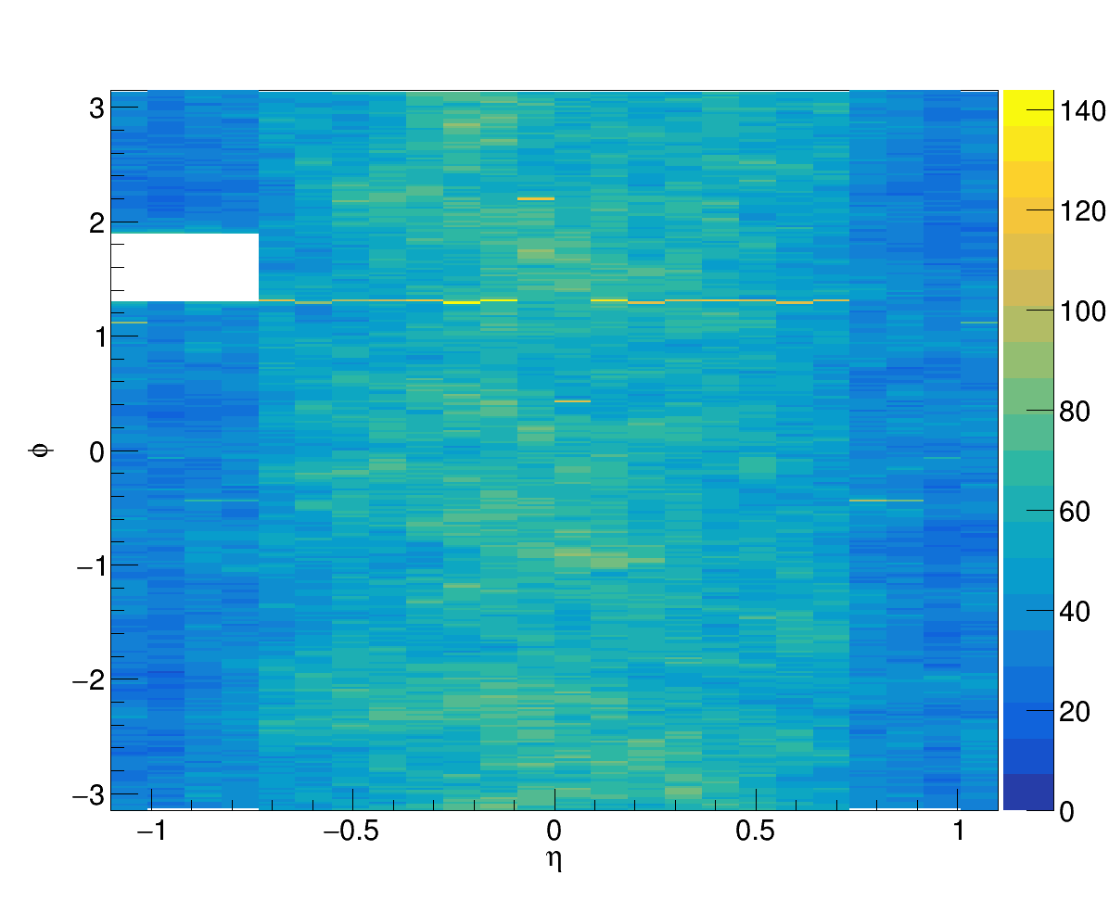
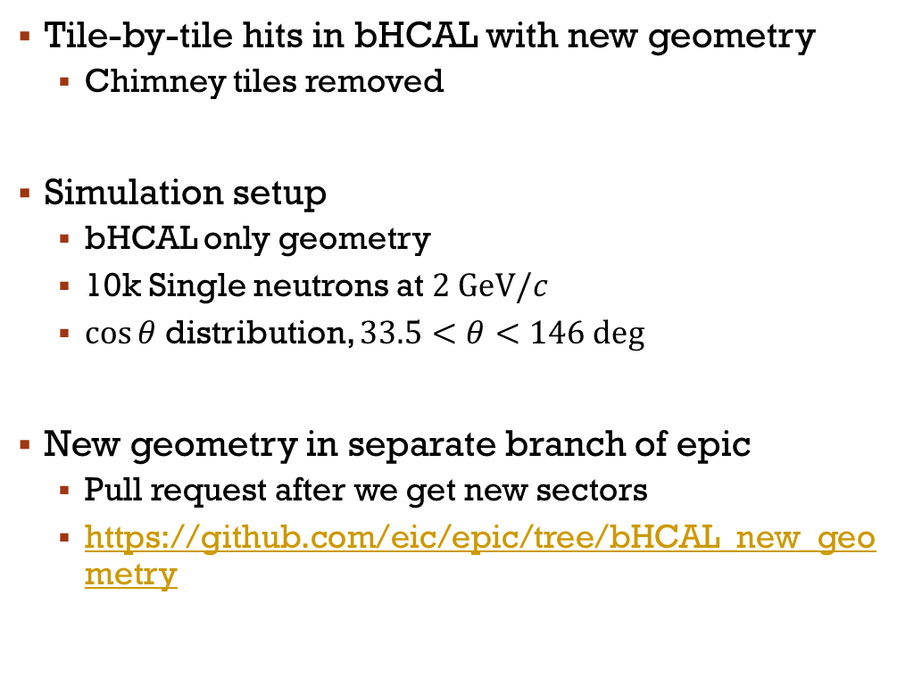
New $η$ vs. $φ$ map
Tile-by-tile hits in bHCAL with new geometry
Chimney tiles removed
Simulation setup
bHCAL only geometry
10k Single neutrons at $2 GeV/c$
$\cos{θ}$ distribution, $33.5<θ<146 deg$
New geometry in separate branch of epic
Pull request after we get new sectors
https://github.com/eic/epic/tree/bHCAL_new_geometry

Slide 7
Background study

Slide 8
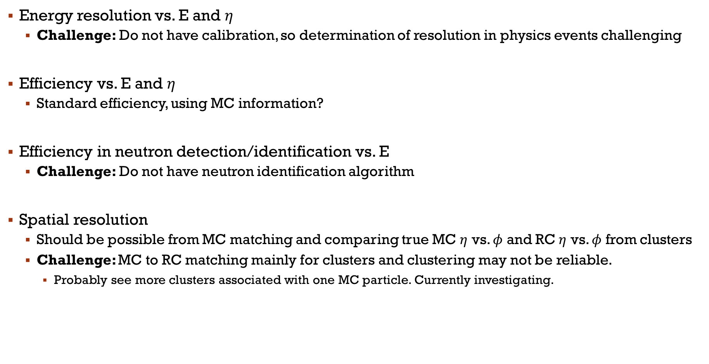
Background overview
Energy resolution vs. E and $η$
Challenge: Do not have calibration, so determination of resolution in physics events challenging
Efficiency vs. E and $η$
Standard efficiency, using MC information?
Efficiency in neutron detection/identification vs. E
Challenge: Do not have neutron identification algorithm
Spatial resolution
Should be possible from MC matching and comparing true MC $η$ vs. $φ$ and RC $η$ vs. $φ$ from clusters
Challenge: MC to RC matching mainly for clusters and clustering may not be reliable.
Probably see more clusters associated with one MC particle. Currently investigating.

Slide 9
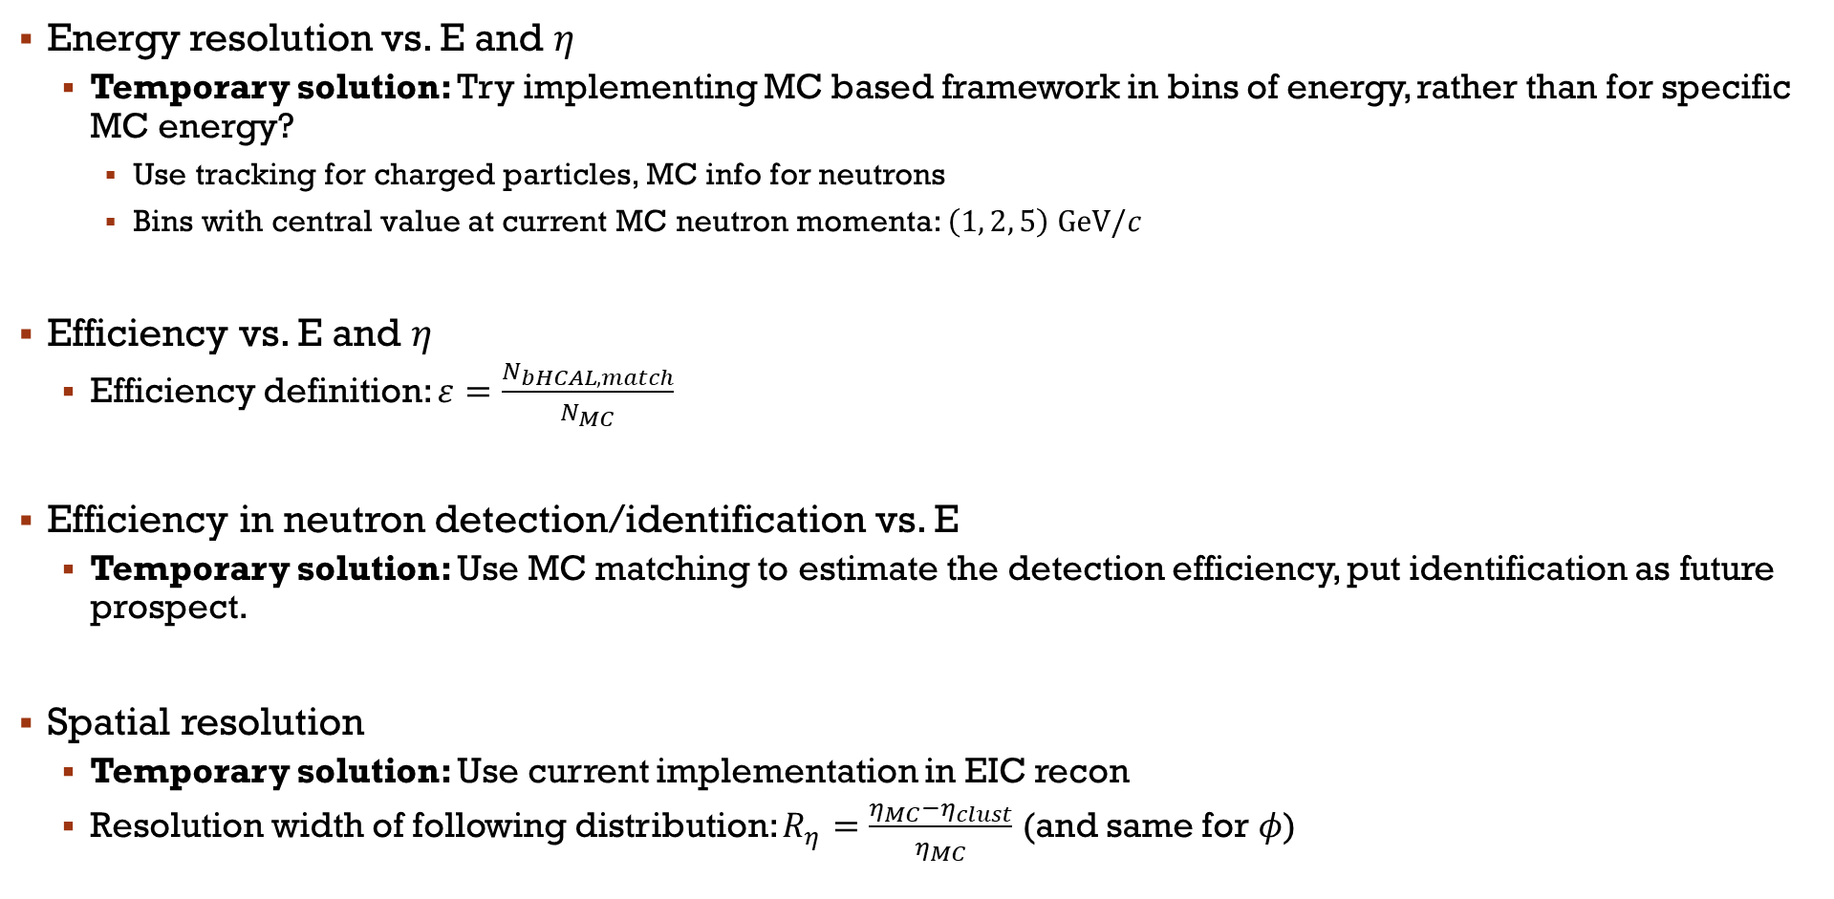
Background Outlook
Energy resolution vs. E and $η$
Temporary solution: Try implementing MC based framework in bins of energy, rather than for specific MC energy?
Use tracking for charged particles, MC info for neutrons
Bins with central value at current MC neutron momenta: $\left(1, 2, 5\right) GeV/c$
Efficiency vs. E and $η$
Efficiency definition: $ε=\frac{N_{bHCAL,match}}{N_{MC}}$
Efficiency in neutron detection/identification vs. E
Temporary solution: Use MC matching to estimate the detection efficiency, put identification as future prospect.
Spatial resolution
Temporary solution: Use current implementation in EIC recon
Resolution width of following distribution: $R_{η}=\frac{η_{MC}−η_{clust}}{η_{MC}}$ (and same for $φ$)

Slide 10
summary
Updated bHCAL geometry
Removed chimney tiles
Waiting for new chimney sector gdml files
Pull request after we get new sectors
Current version available at github:
https://github.com/eic/epic/tree/bHCAL_new_geometry
Working on background studies using central DIS files with and without background

Slide 11
Thank you for attention

Slide 12
Backup

Slide 13
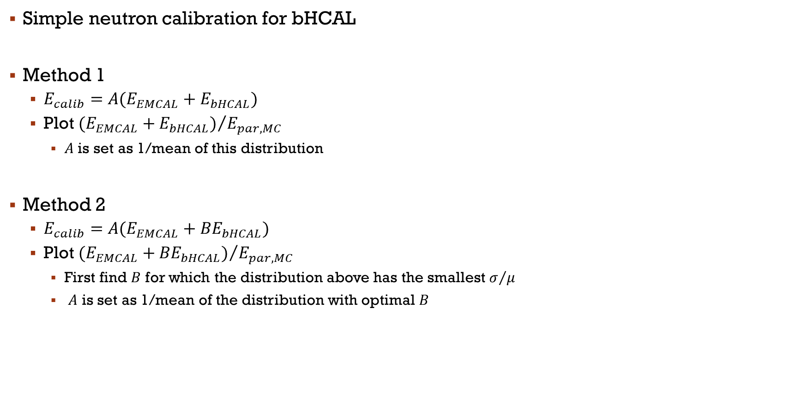
Manual calibration methods
Simple neutron calibration for bHCAL
Method 1
$E_{calib}=A(E_{EMCAL}+E_{bHCAL})$
Plot ${(E_{EMCAL}+E_{bHCAL})}/{E_{par,MC}}$
$A$ is set as 1/mean of this distribution
Method 2
$E_{calib}=A(E_{EMCAL}+{BE}_{bHCAL})$
Plot ${(E_{EMCAL}+{BE}_{bHCAL})}/{E_{par,MC}}$
First find $B$ for which the distribution above has the smallest $σ/μ$
$A$ is set as 1/mean of the distribution with optimal $B$

Slide 14

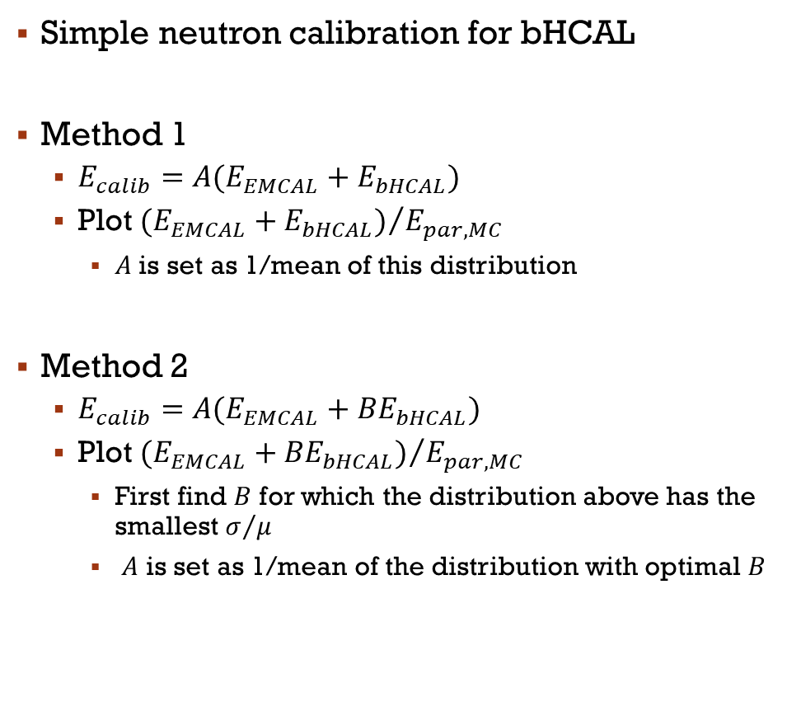
Manual calibration methods
Simple neutron calibration for bHCAL
Method 1
$E_{calib}=A(E_{EMCAL}+E_{bHCAL})$
Plot ${(E_{EMCAL}+E_{bHCAL})}/{E_{par,MC}}$
$A$ is set as 1/mean of this distribution
Method 2
$E_{calib}=A(E_{EMCAL}+{BE}_{bHCAL})$
Plot ${(E_{EMCAL}+{BE}_{bHCAL})}/{E_{par,MC}}$
First find $B$ for which the distribution above has the smallest $σ/μ$
$A$ is set as 1/mean of the distribution with optimal $B$
Method 3:
$χ^{2}$ method
Simultaneously determine $A$ and $B$ parameters from method 2 by minimizing:
$\sum_{events}{{{\left(E_{calib}−E_{par}\right)}^{2}}/{E_{par}^{2}}}$
Requires custom minimizer e.g. using Tminuit class

