Slide 1
Fermilab Test beam results
Henry Klest

Slide 2
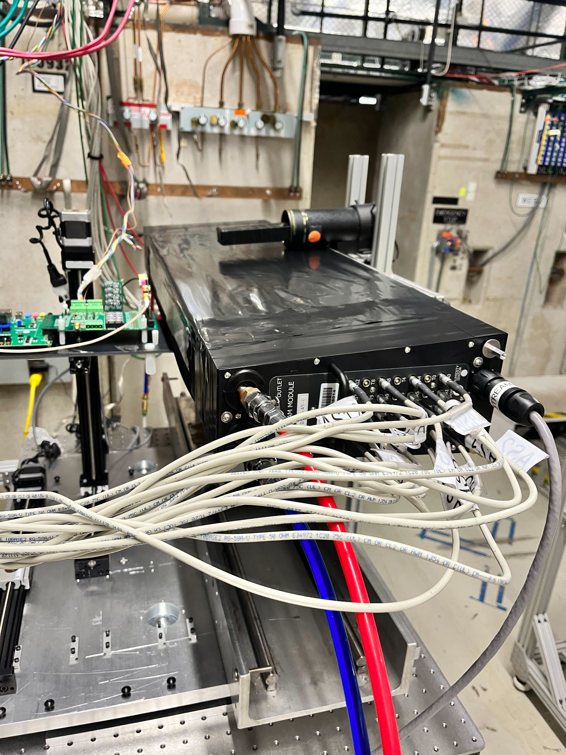
goals
Use the Baby BCAL as a proxy of the BIC SciFi
Matrix design is mechanically identical
Kuraray double-clad fibers
Older generation SiPMs
Verify simulated performance of BIC
Particularly hadronic showers, which are often not well simulated
Extract energy resolution of Baby BCAL
Measure electron/pion separation capabilities

Slide 3
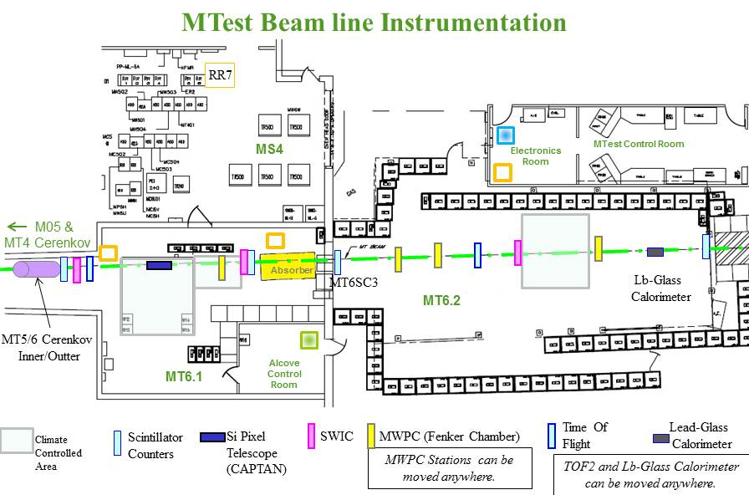
Fermilab test beam facility
Nominal beam is 120 GeV protons from main injector
Secondary hadron/electron beam from sending 120 GeV protons on a 30 cm thick aluminum target
Scintillators provided by FTBF along beamline for trigger
Two Cherenkovs for PID
BIC

Slide 5
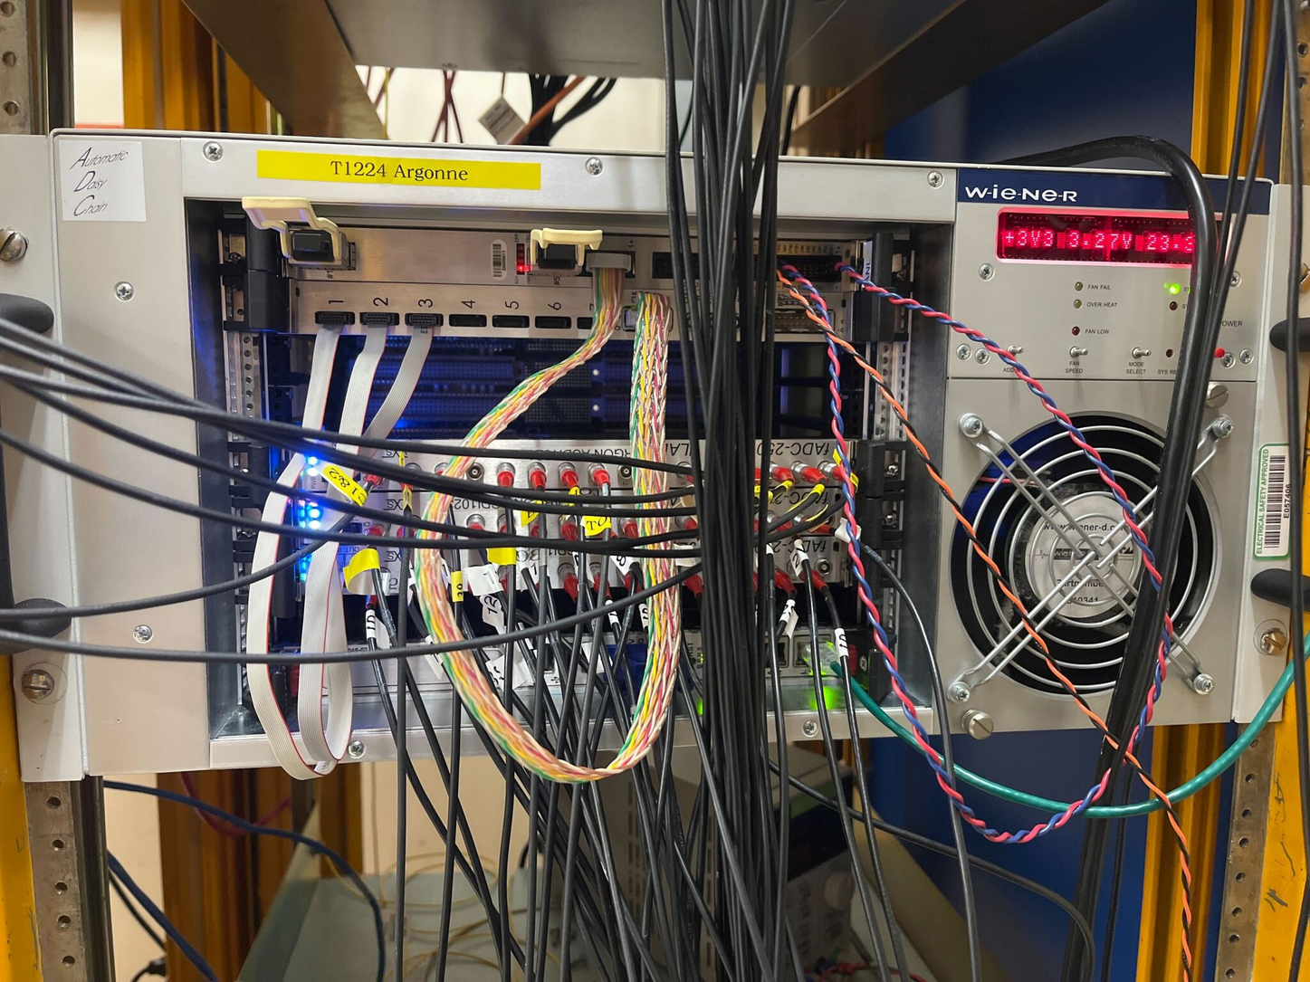
daq
Used 3x 16 channel JLab 250 MHz fADCs in full waveform readout mode
Sent analog signals from the “north” and “south” sets of 16 baby BCal channels into two blades of fADC, remaining blade used for FTBF detectors, cosmic ray paddles, AstroPix analog signal

Slide 6
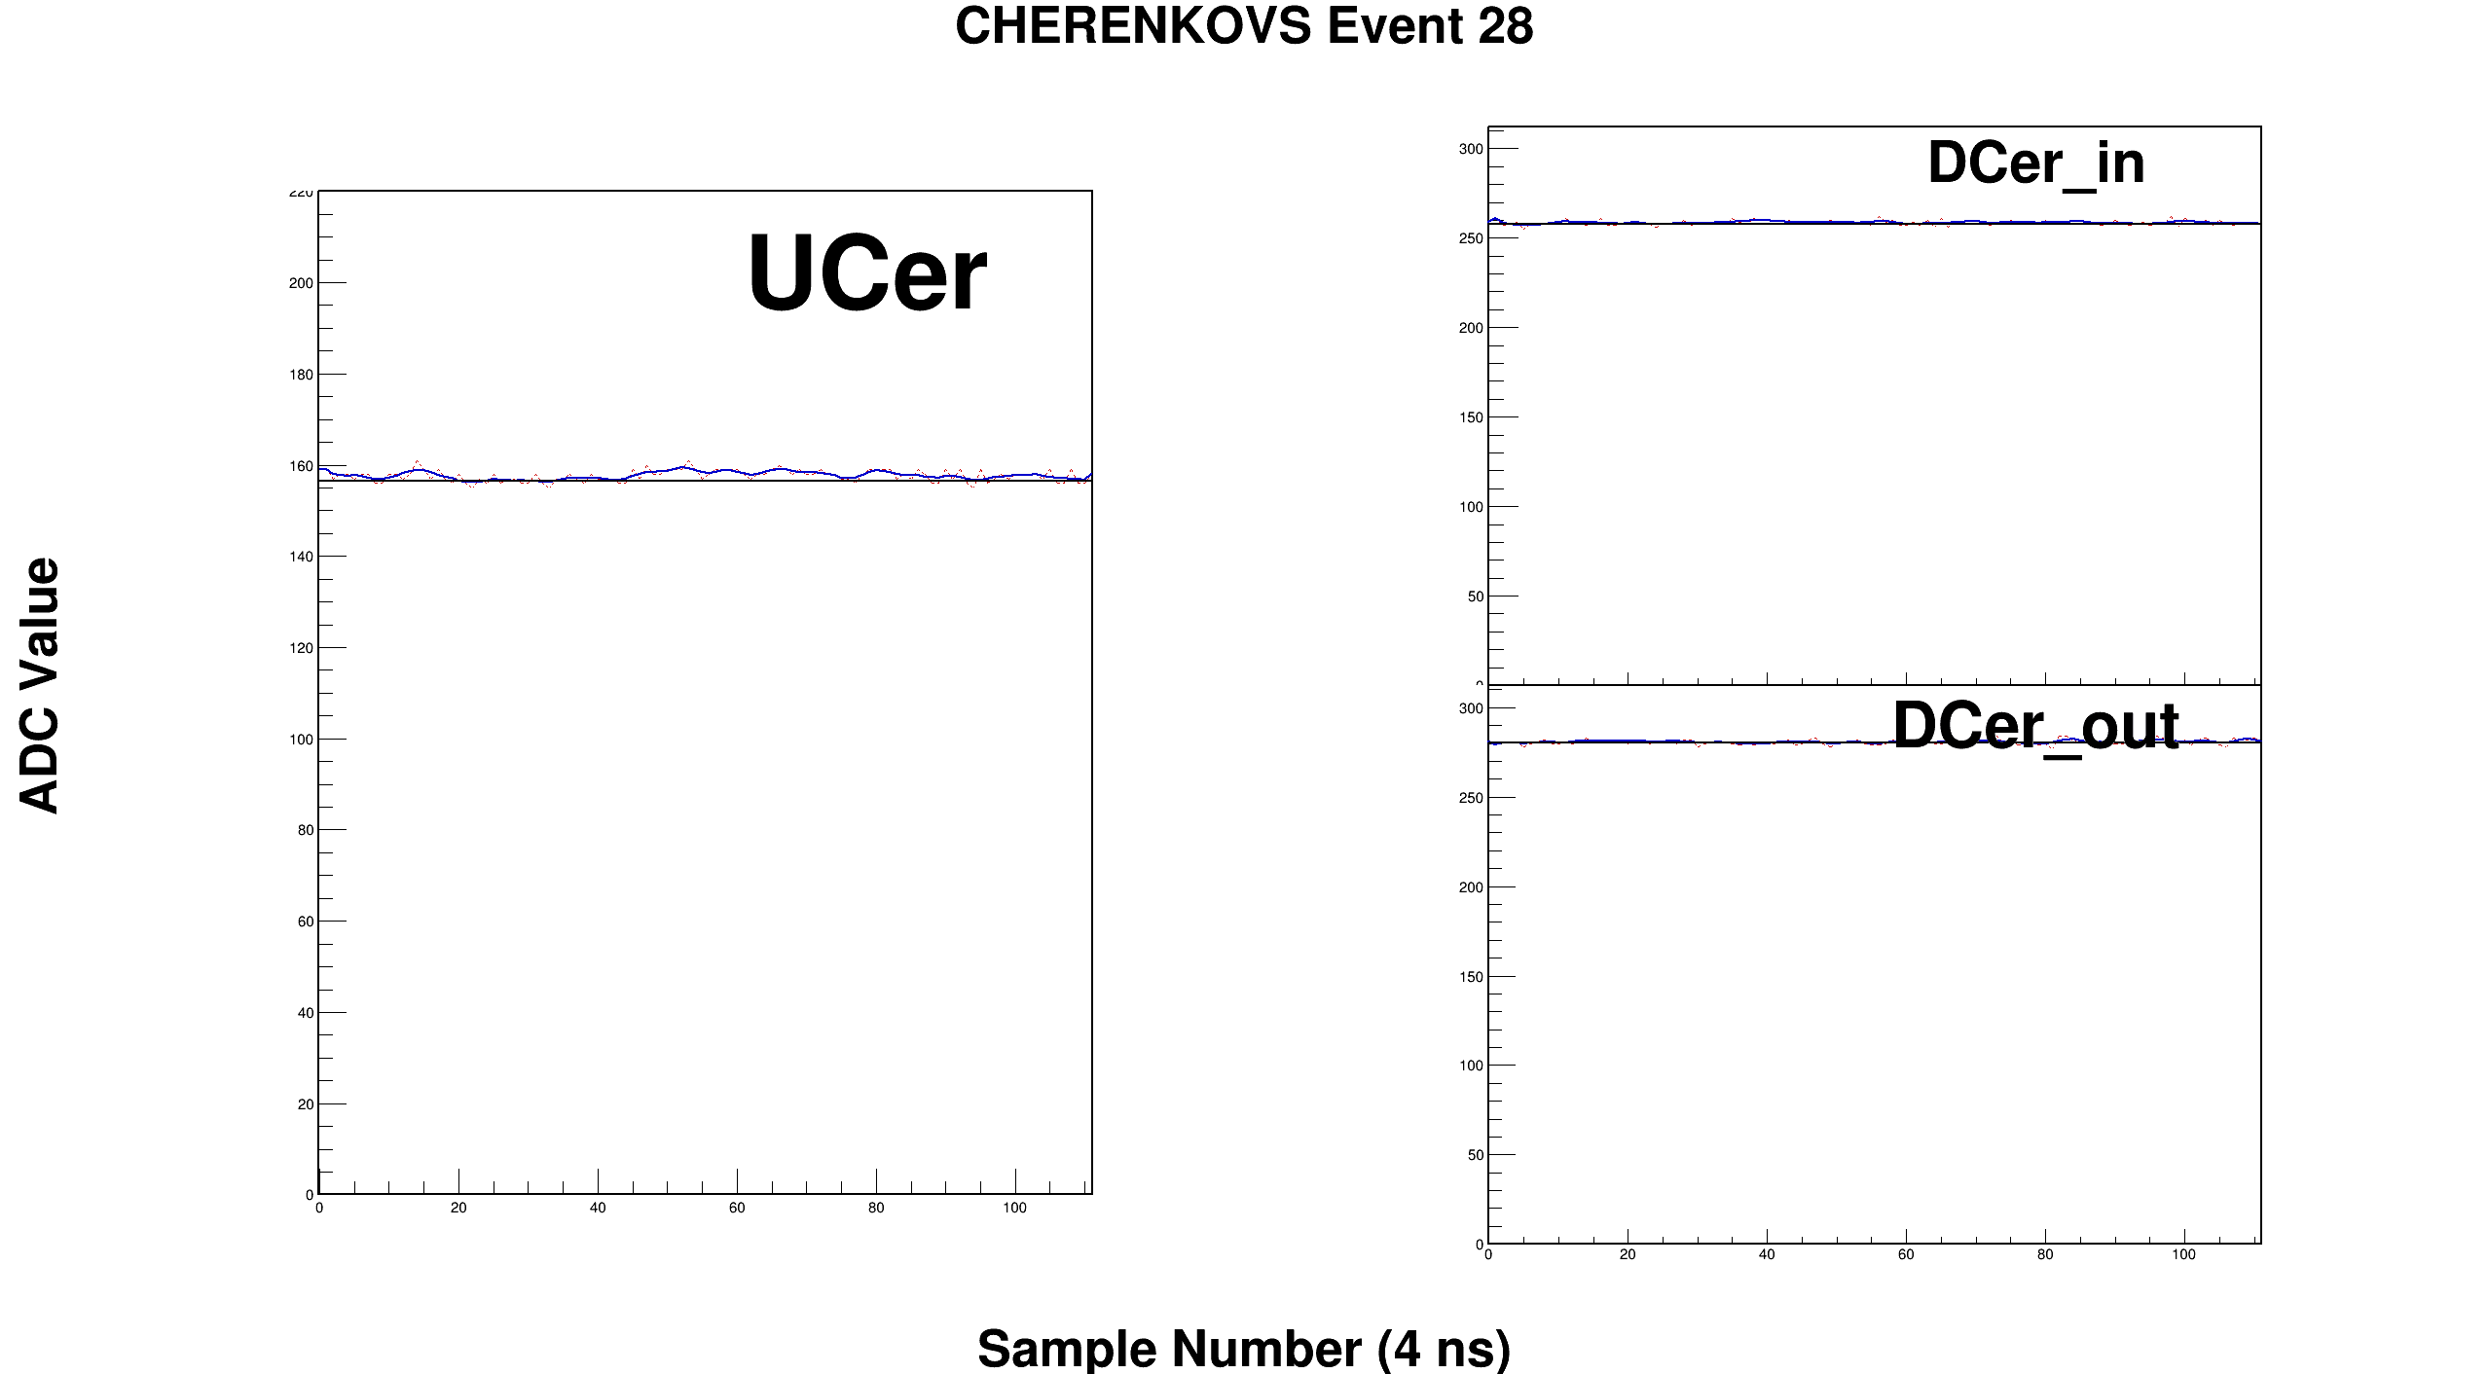

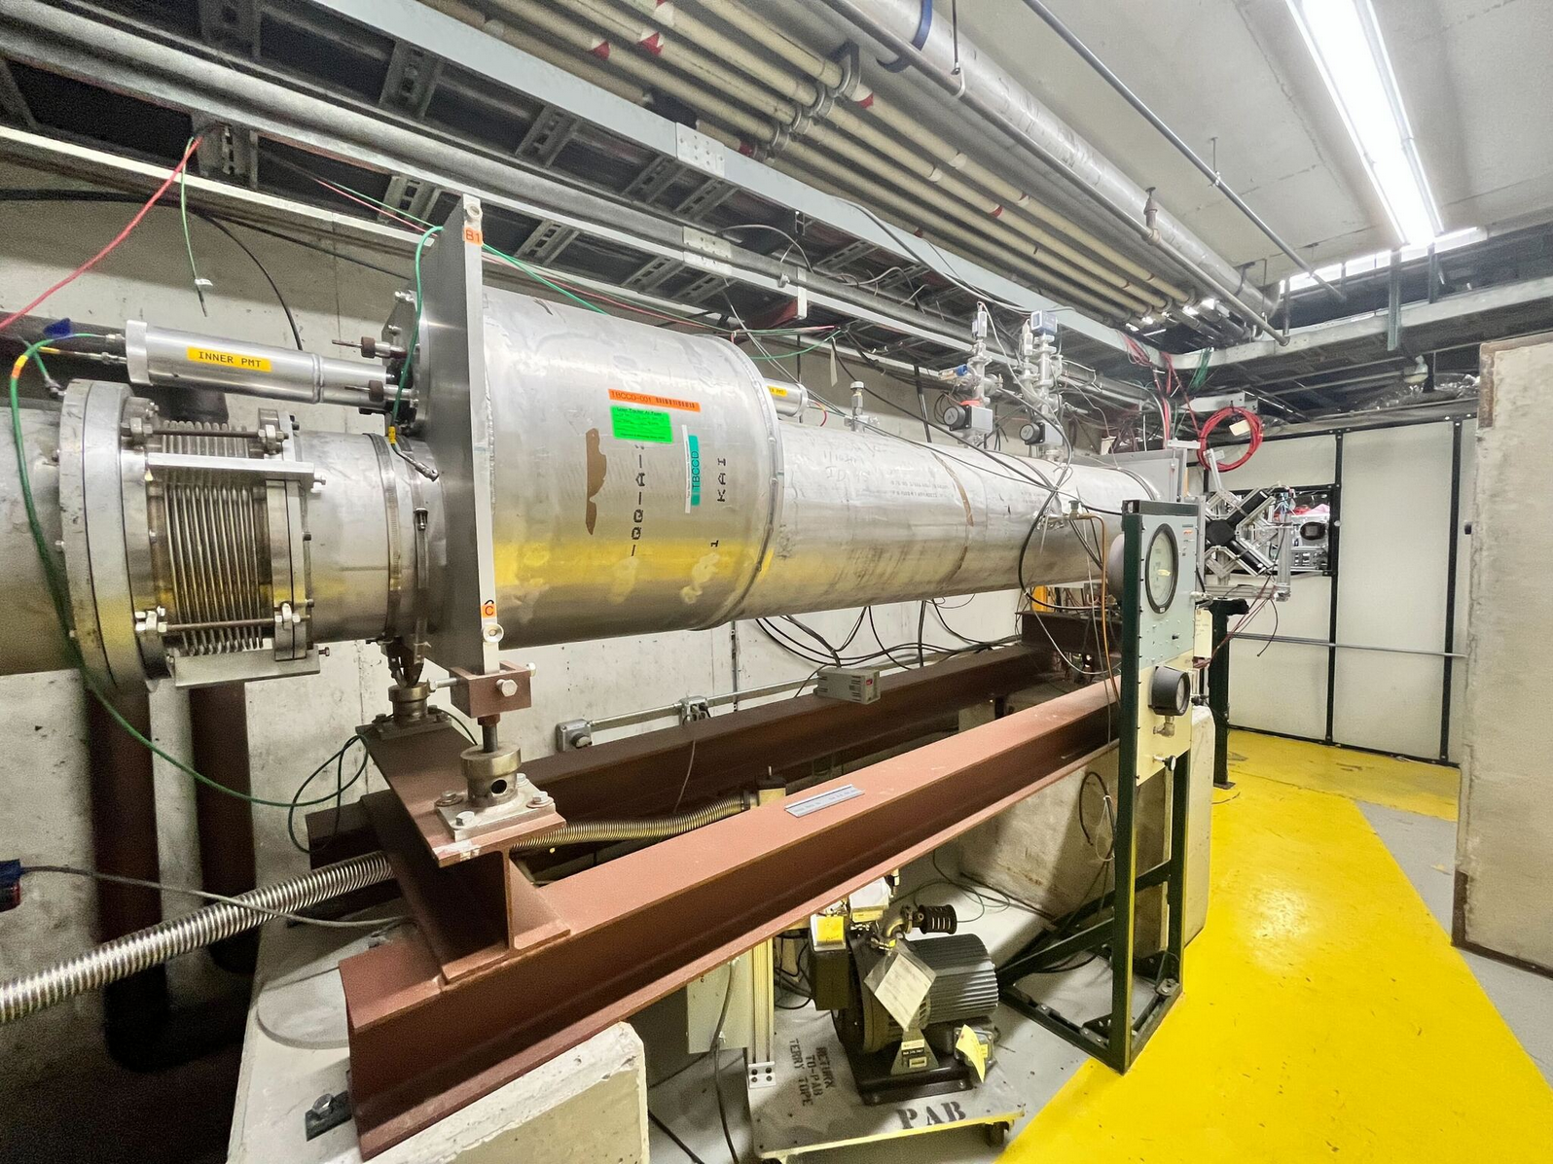
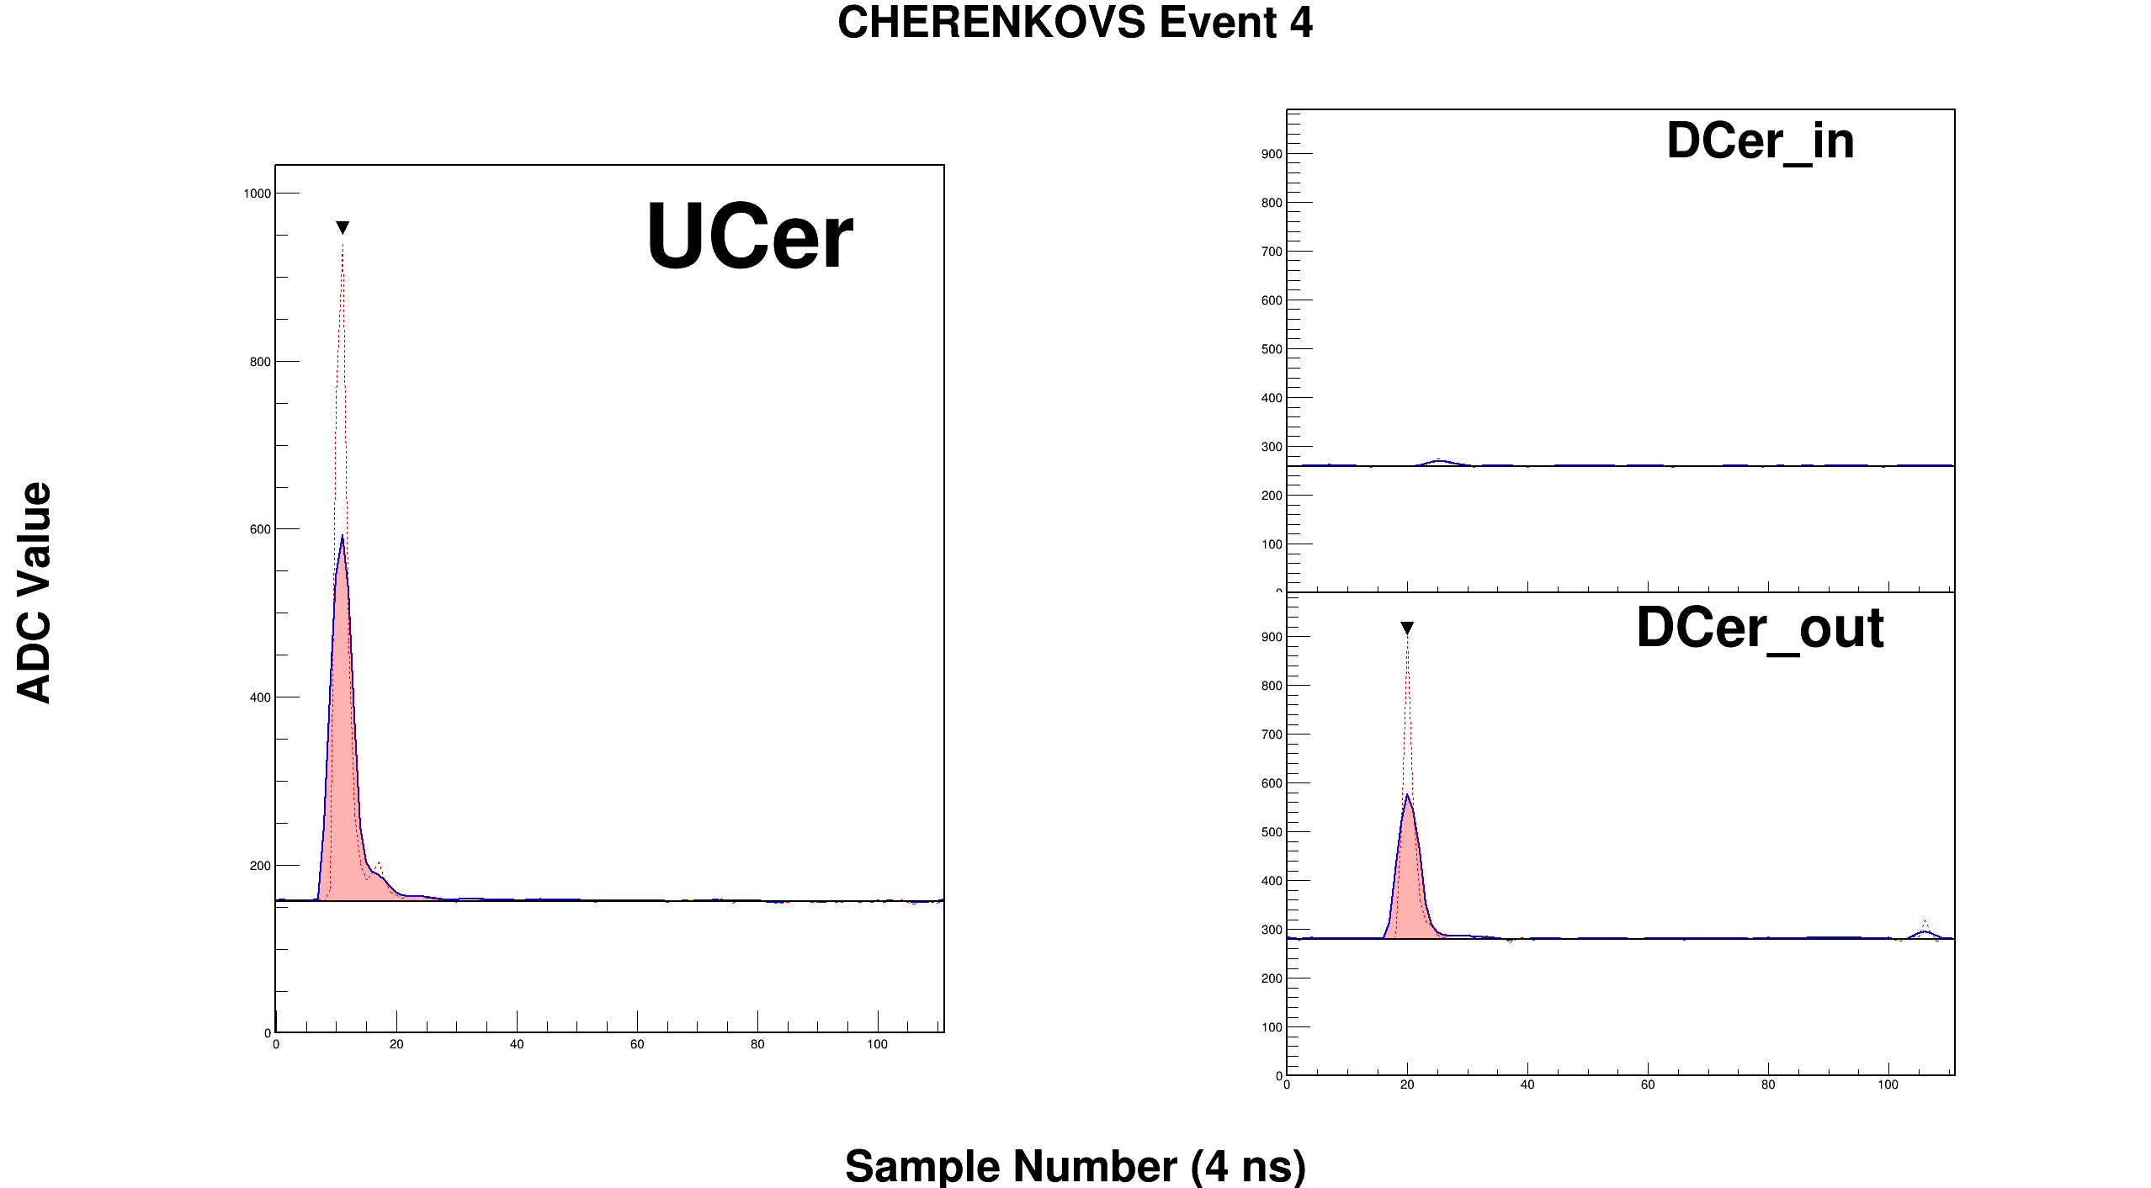
Cherenkov Detectors
Pion event
Downstream Cherenkov
Inner PMT
Upstream Cherenkov
Downstream Cherenkov
Outer PMT
Downstream Cherenkov
Electron event
Downstream Cherenkov
Inner PMT
Upstream Cherenkov
Downstream Cherenkov
Outer PMT

Slide 7
datasets
Due to heat issues at FNAL, only ran for ~30% of our allotted week
DAQ was limited to ~7 kHz due to full waveform readout
120 GeV protons
Mostly parasitic overnight
Large dataset, few million events
10 GeV e/pi
Also large dataset, but mostly taken with FADC jumpers set in the wrong positions, so gain is 2x higher than it should be
10 GeV mu/pi
Taken with a lead sheet in the beam to absorb electrons
Provides a large MIP calibration dataset
Energy scan e/pi
4 GeV (1.4M), 6 GeV (440K), and 8 GeV (320K)
Took a larger 4 GeV because pions are rarer at low energies

Slide 8
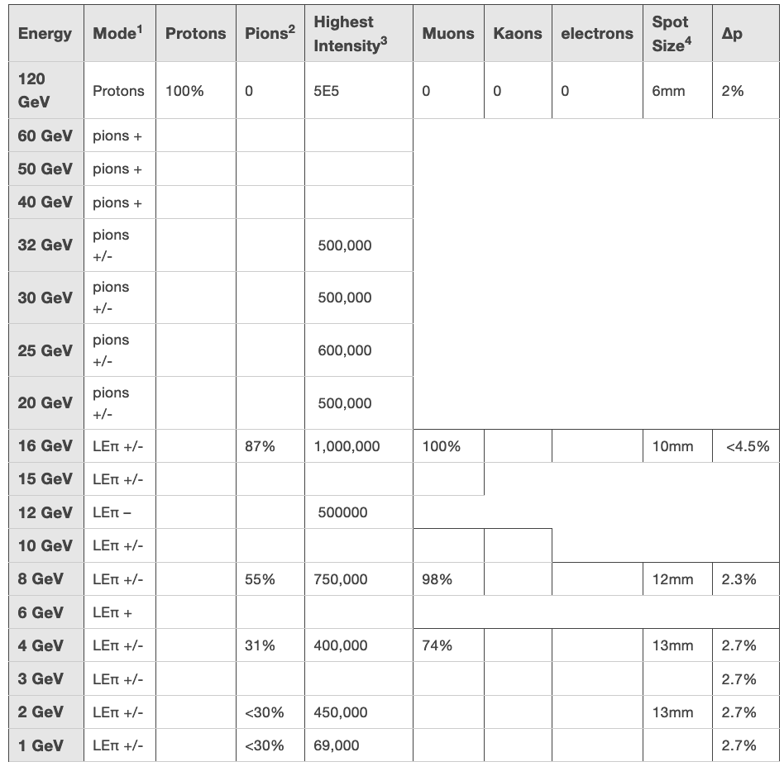
Beam Δp
An important factor in understanding the energy response is the beam momentum spread
This term enters as a constant term on the energy resolution
Quoted beam spread is 2.7% at low energies, improving to 2% at 120 GeV
However, statement from Joe at FTBF: ”Every calo group is telling me it looks like the momentum spread is higher than the website indicates it should be.” – does this tell us something about the beam or the “optimism” of calorimeter experts?
This number depends on beam tune, which can vary from run to run
We see the 4 GeV beam is physically wider, which suggests it also has a larger momentum spread

Slide 9
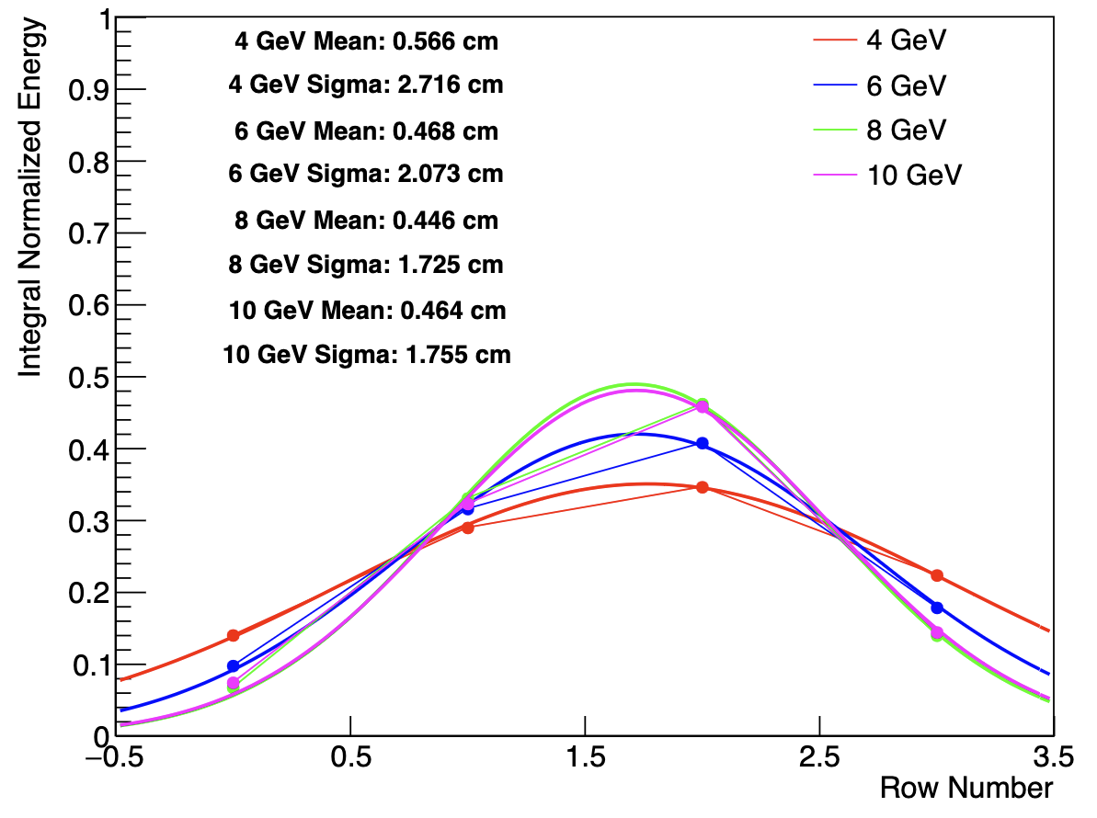
Beam profile
For calo analysis, want to know the profile of the beam in the vertical direction
Determines amount of leakage
Not much info from FTBF detectors
MWPCs were out of gas
SWICs showed poor performance for secondary beams
Have AstroPix & Calo information
Thanks to Bobae and Manoj for taking nice AstroPix data for us ☺
Both detectors agree beam widens at lower energy, both agree the beam center is vertically below the center of the calorimeter
Vertically down
Vertically up
Vertically up
Vertically down

Slide 10
Calibration
Employ two complementary calibration techniques
MIP technique – use MIP peak to align all channels
Pro: Each channel has an independent calibration constant, one single solution
Con: MIP sampling fraction is different from electrons! Needs an additional sampling fraction correction.
Electron technique – minimize difference of sum of all channels with respect to a known input electron energy
Pro: Better energy resolution achievable
Con: No unique solution, 16 (or 32) unknowns and one known, different combinations of calibration constants can give the same result

Slide 11
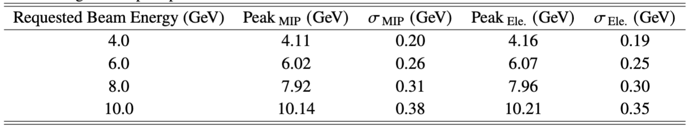
Electron energy
MIP & Electron give very similar results!

Slide 12
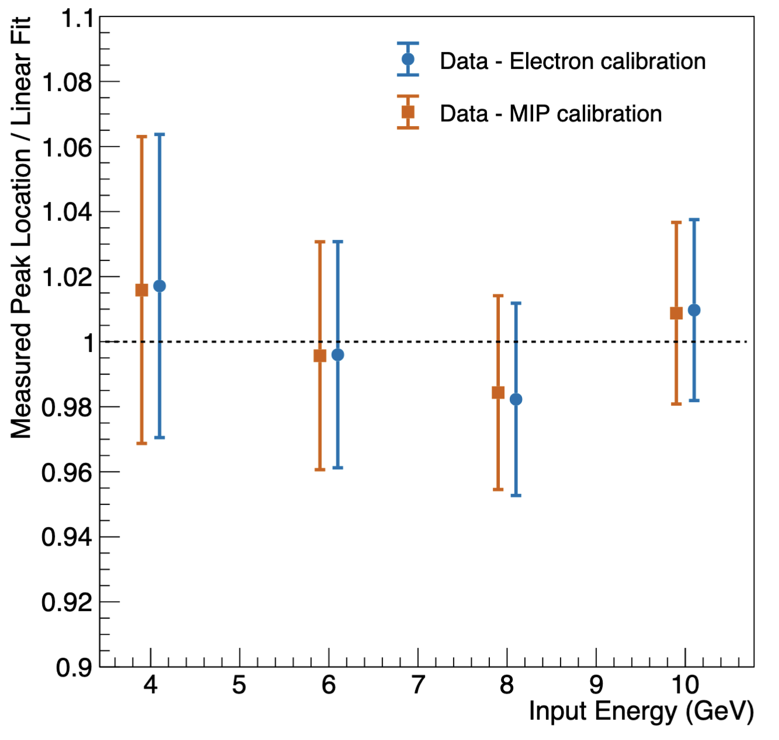
Linearity

Slide 13
Comparison to simulation
Simulation using FTBF cited beam momentum smearing
Peaks are narrower than data
Shapes of distributions are similar
Tail in data is well-reproduced by simulation

Slide 15
Pion data
Compare data to simulation
Observed offset in beam energy, attempt to include in simulation
Data and simulation agree for 6 GeV pions
4 GeV pions in data deposit more energy than simulation, 8 GeV pions in data deposit less than simulation

Slide 16
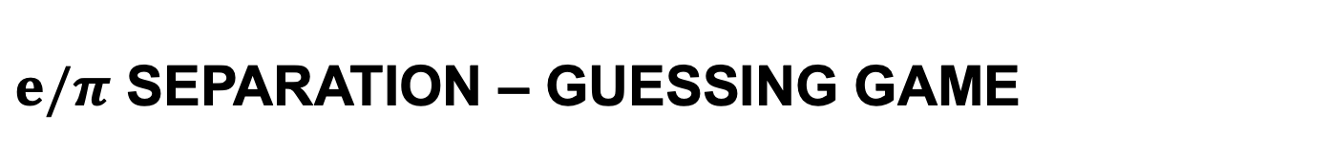
$e/π$ separation – guessing game
One of these events is an electron
One is a MIP
One is a showering pion

Slide 17
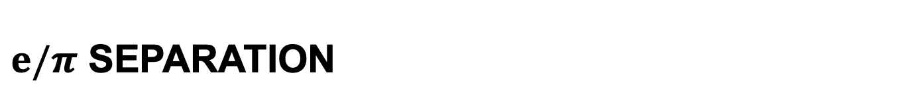
$e/π$ separation
Measured energy distributions of events with Cherenkovs firing (electrons, orange) and Cherenkovs not firing (pions, blue)
Electrons and pions well separated, but both have tails
Electron tail – showers upstream, horizontal leakage
Pion tail – electron misID, pileup

Slide 18
$e/π$ separation
The tail of the electron distribution is an artifact of the measurement setup
Predict the true performance by fitting crystal ball or gaussian to the electron peak

Slide 19
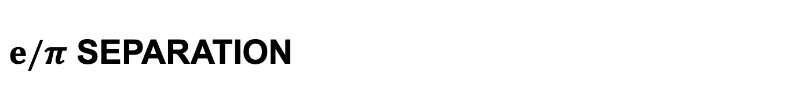
$e/π$ separatioN
All things considered, separating electrons and pions is pretty easy in this detector! (even with beam momentum spread & some leakage)

Slide 20


conclusion
Detector is good!
Impressive performance despite complications from beam uncertainty
Honestly didn’t expect to be able to get all of these results from such a short beam time
Thanks to everyone who made our test beam campaign successful!

