Slide 1
OKState – AstroLinx Design Status
By Greg Shildt
Contributors: Blake Beauchamp, Steven Welch, Evan Van de Wall

Slide 2
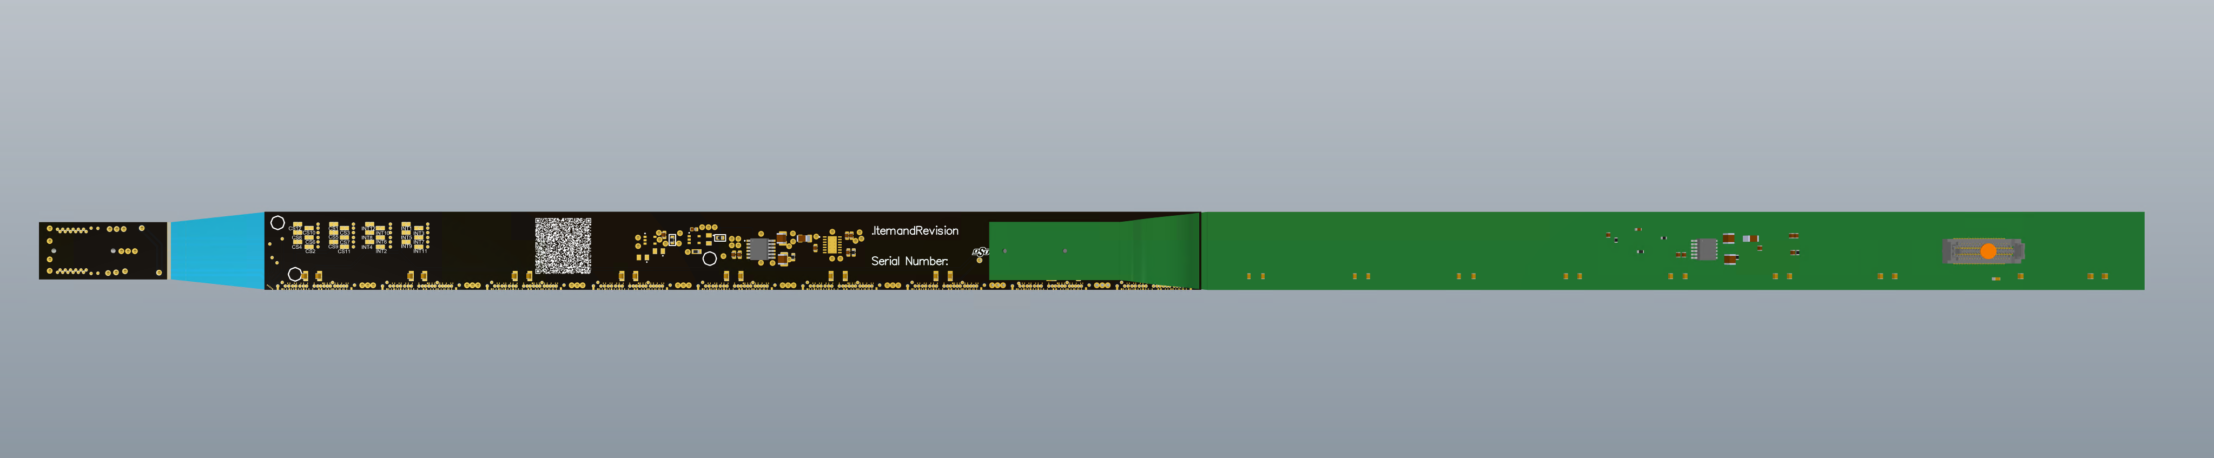
Design Overview
ePIC Astropix v3 chips
9 chips in a module
12 modules in a tray
Connects all the chips with data and power

Slide 3
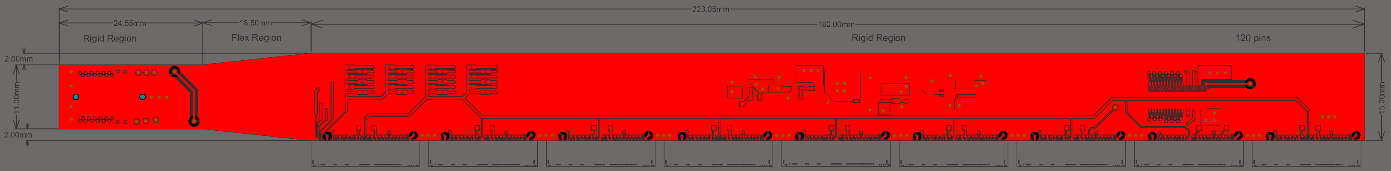
Status
Prototype is in review stage
Layers 1, 3, 8

Slide 4
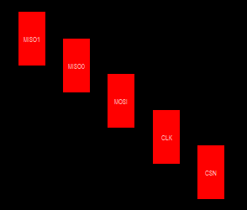

Wirebond Footprint
SPI pads (left)
AstroPix chip pads (below)

Slide 5
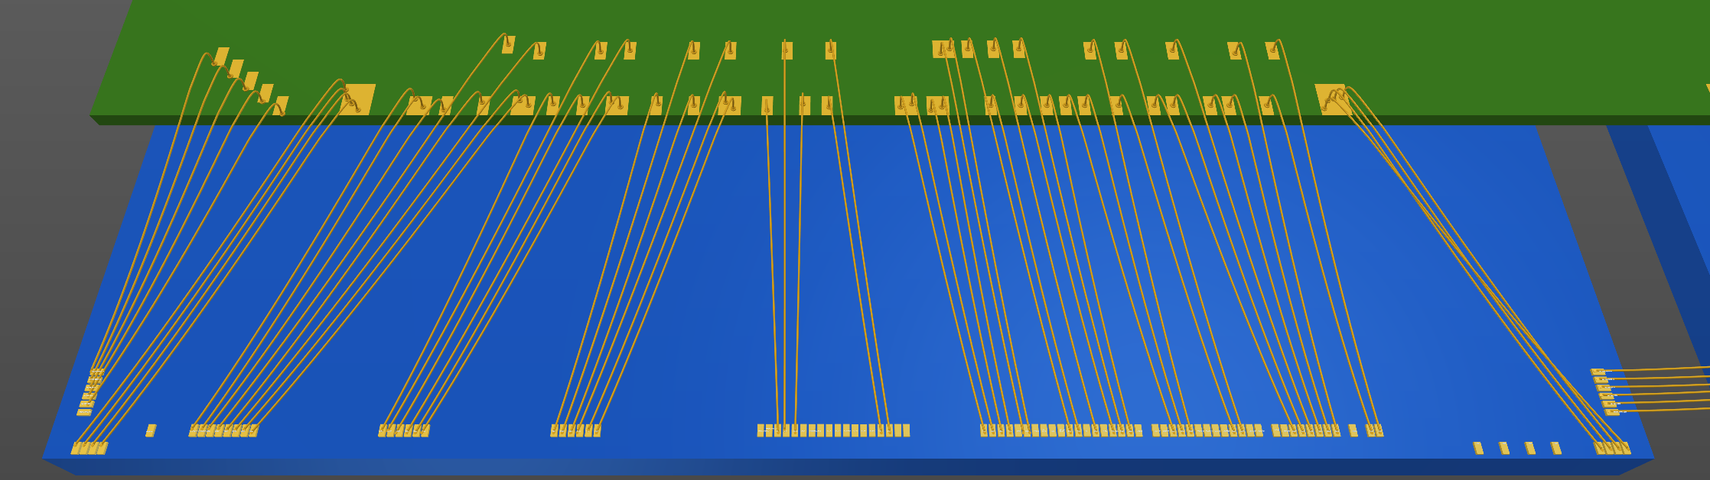
Wirebond
~1mm left and 0.3mm right – collision tolerance for pad shifting
AstroLinx Prototype​
Astropix V3​

Slide 6
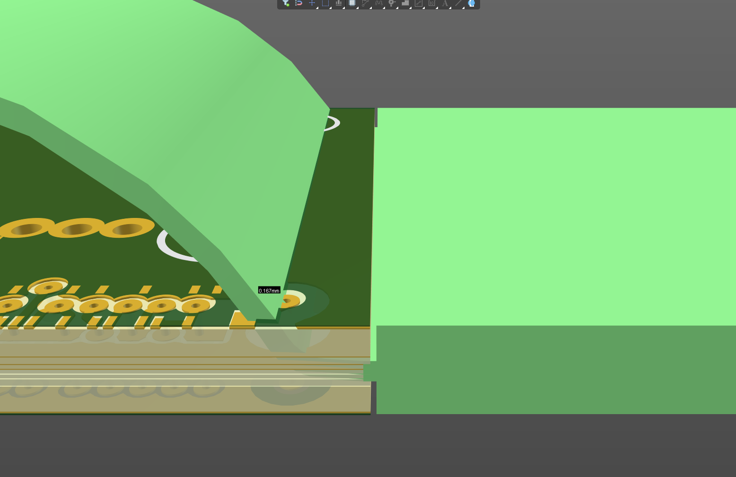
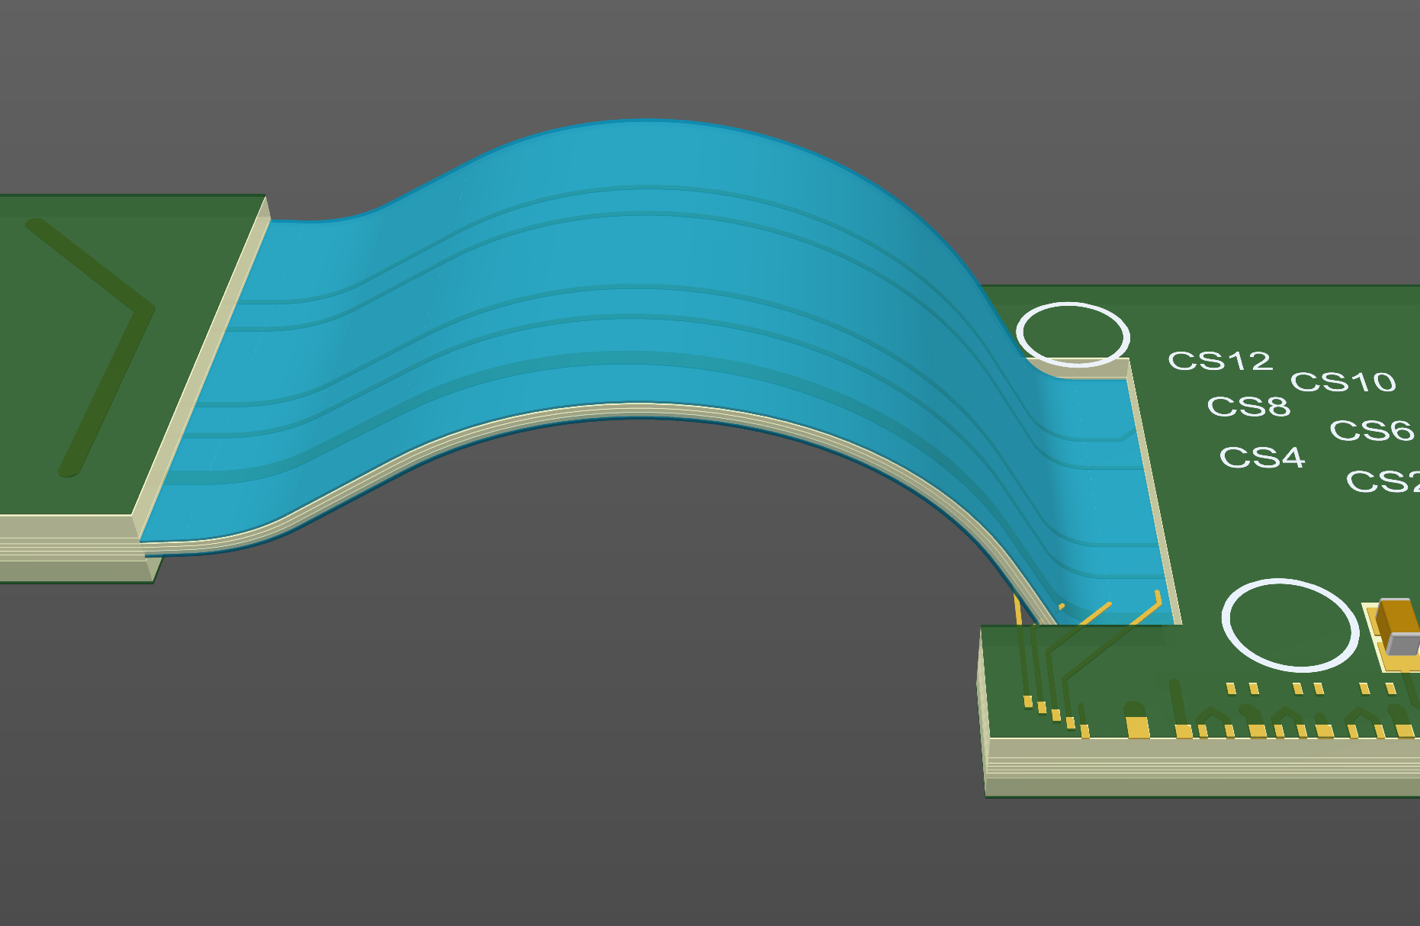
Challenge
Due to the space the pads take, the board is too long and would collide if chips (first of right module and last of left module) are too close
Planning to tighten the wire-bond pads to shorten the board.

Slide 7
Next Steps
Design is not final
Changes needed, post board review
Update design
Validate wire-bond map with collaborators
Secondary board review
Community board review in bi-weekly design meeting

Slide 8
Questions?

Slide 9
Layers 2, 4, 5, 6, and 7

Slide 10
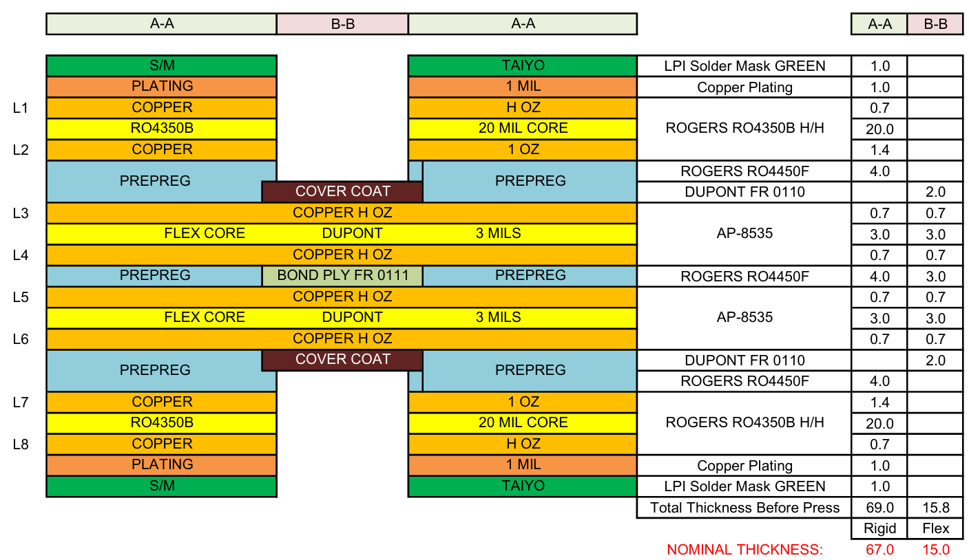
Stackup

Slide 11
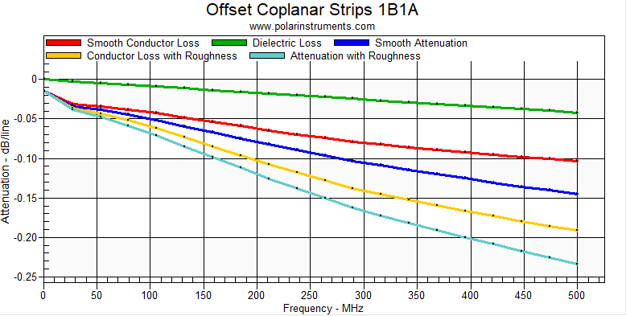
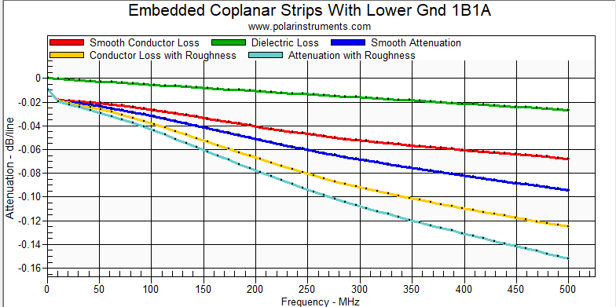
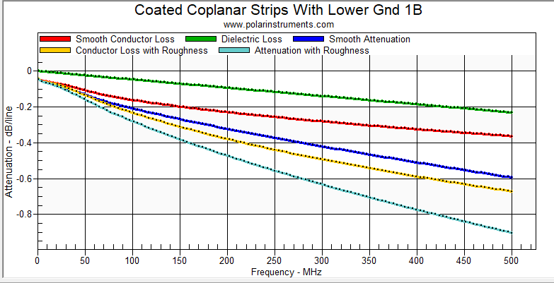
Stack-up Losses (Single Board)
Upstream (24.55mm)
Flex (18.5mm)
Downstream (180mm)
Total dB losses @ 20MHz
Upstream -0.015 dB/-0.033 dB
First is layer 1 profile, second is layer 3 (most routing)
Flex -0.020 dB
Downstream -0.0775 dB/ -0.240 dB

Slide 12
Flex 3D

