Slide 1
Overview of AstroPix Performance
Daniel Violette
4th BIC Workshop, Argonne National Lab

Slide 2
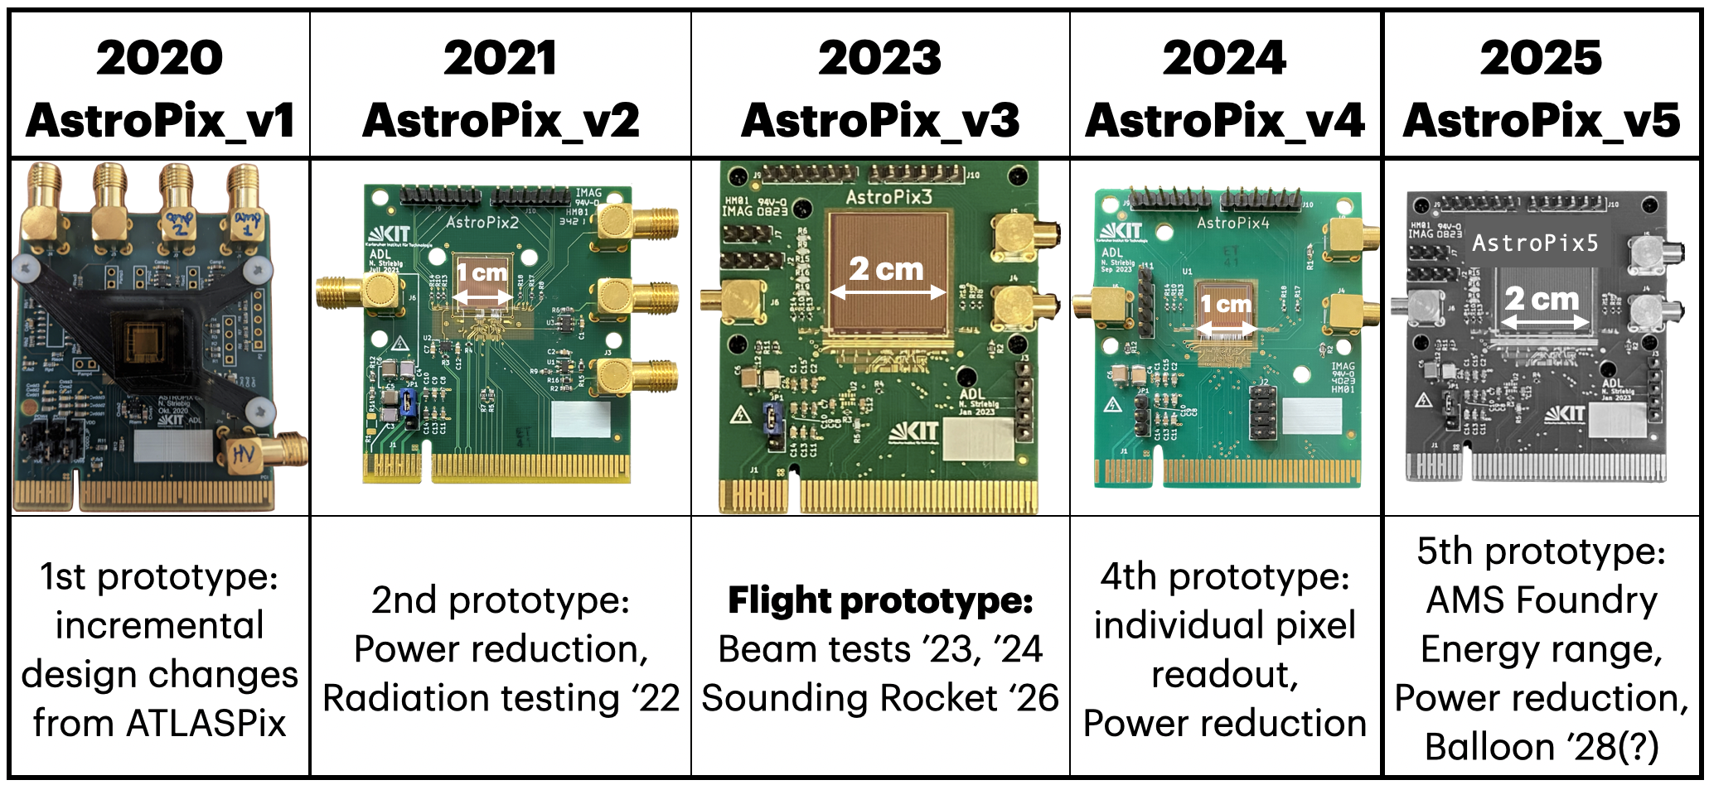
Overview
Discussion Topics:
AstroPix Version 3
AstroPix Version 4
SW/FW Development

Slide 3
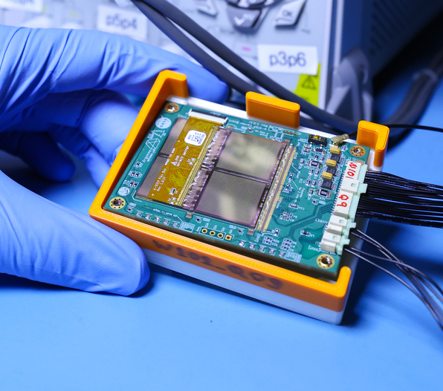
AstroPix Version 3 : Overview
AstroPix v3 is the first 2x2 cm² chip implemented.
Last version with OR’d Row/Column Hit Buffers
First version of AstroPix tested in “quad-chip” design.
Testing with AstroPix v3 is still providing lots of important feedback on how to operate the AstroPix daisy-chain readout.
AstroPix v3 Quad Chip Test Board

Slide 4
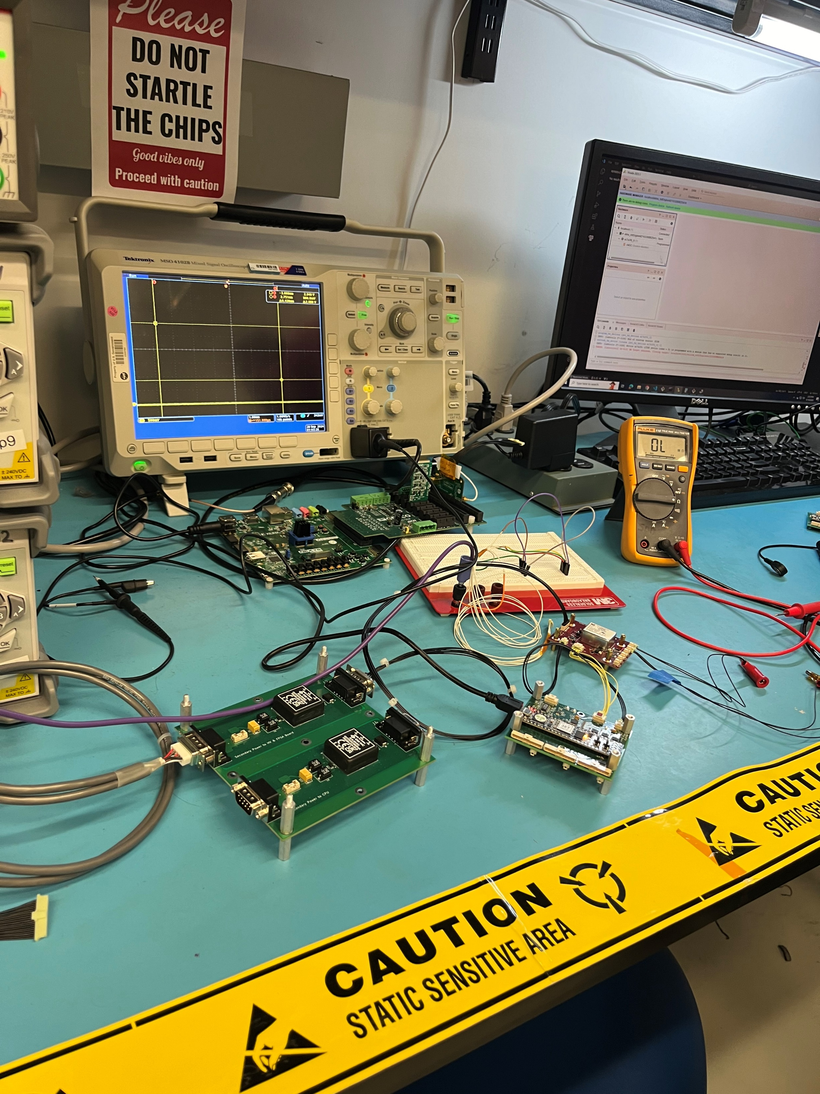
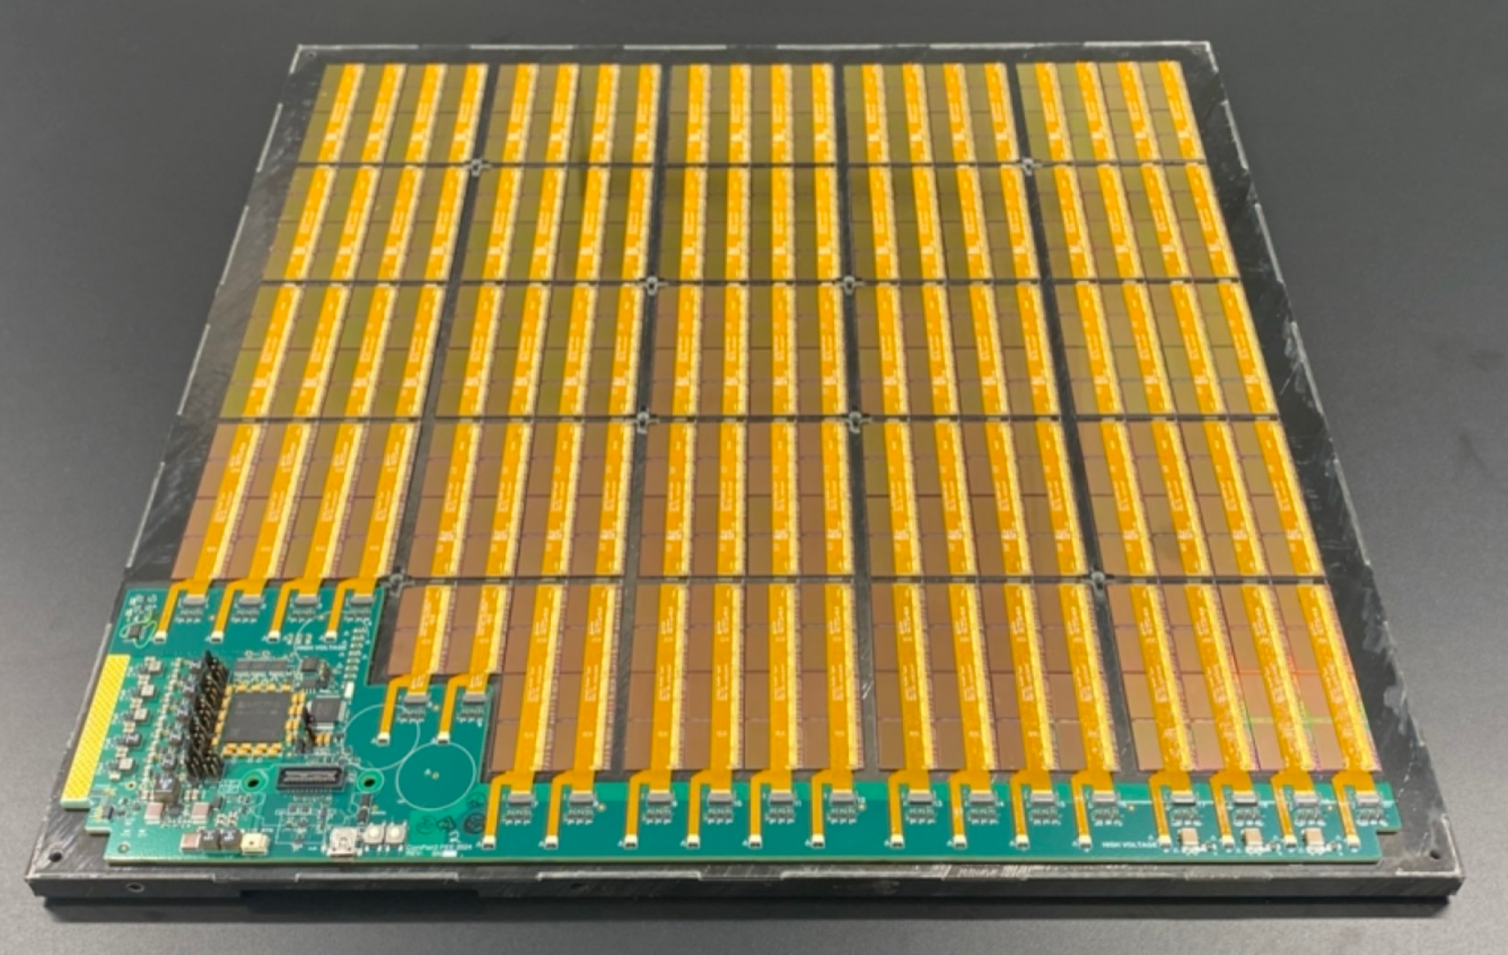
AstroPix Version 3 : Overview
New hardware has been developed to interface with AstroPix v3, moving away from the Nexys Video + GECCO board readout.
AstroPix Sounding Rocket Technology Demonstration Payload (A-STEP)
Compton-Pair (ComPair-2) Segment

Slide 5
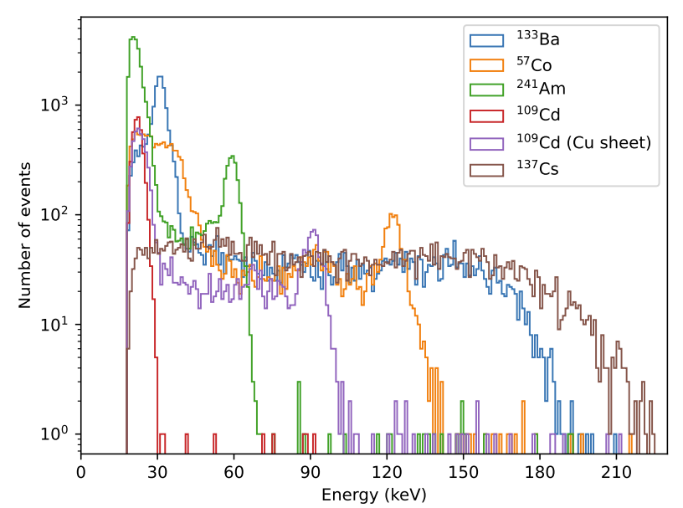
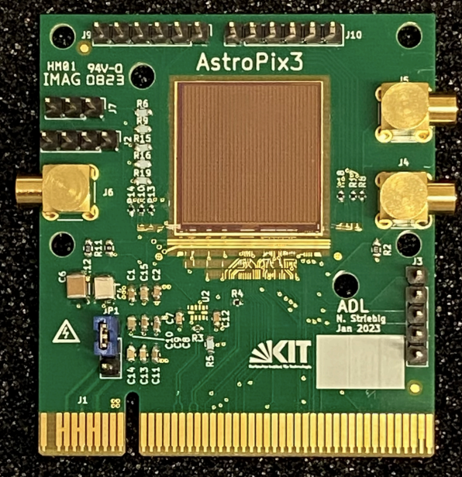
AstroPix Version 3 : Single Chip Performance
AstroPix v3 detector testing: mean 6.4 keV FWMH at 59.5 keV.
44% of pixel meet target (<10% FWHM at 60 keV)
Single Pixel Source Spectra
31 keV
22 keV
60 keV
122 keV
88 keV
Credit: Yusuke Suda, Hiroshima U. (https://arxiv.org/abs/2408.12891)

Slide 6
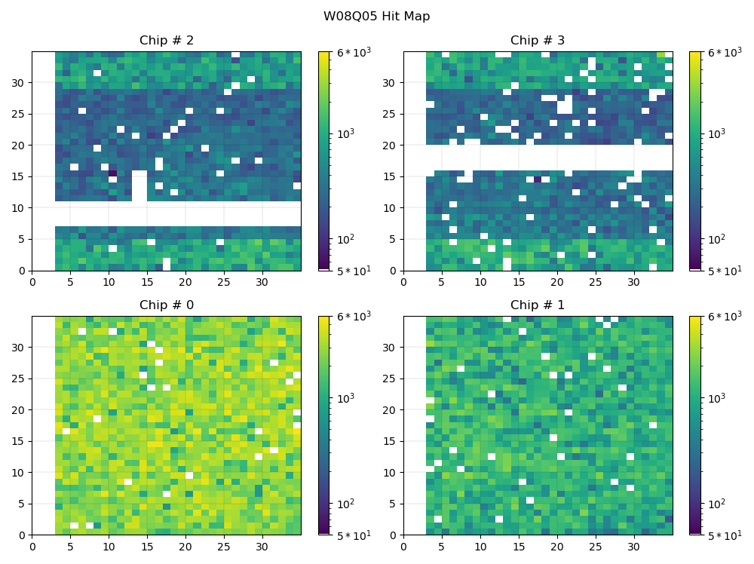
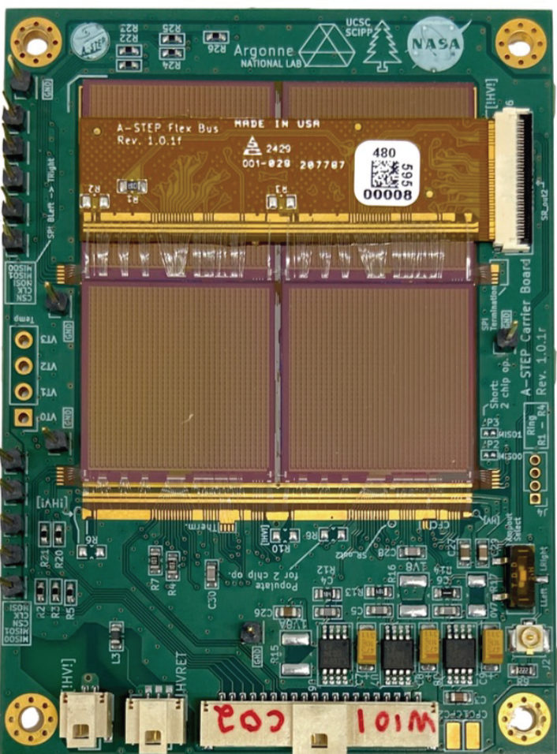
AstroPix Version 3 : Quad Chip Performance
Am-241 source
2
3
0
1
Hit-map of four AstroPix chips on one SPI bus
Recorded 580 events/s after row/col hit matching
Credit: Kavic Kumar, UMD College Park, Adrien Laviron NASA\GSFC

Slide 7
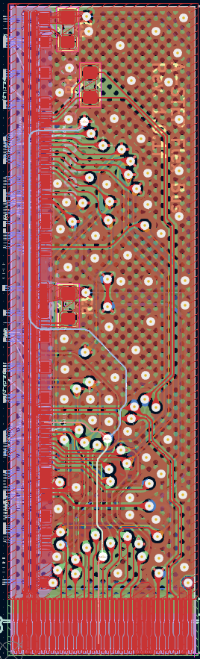
AstroPix Version 3 : Quad Chip Performance
Bus bar photon attenuation
Interrupt Line
?
PMOS comparator test columns disabled

Slide 8
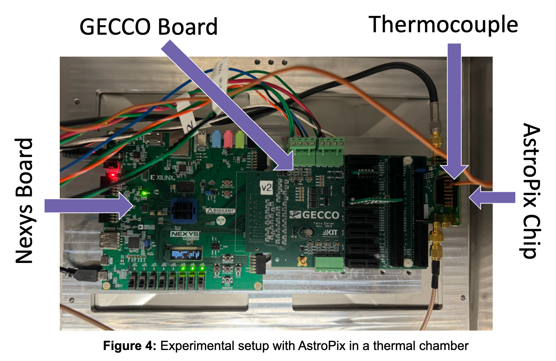
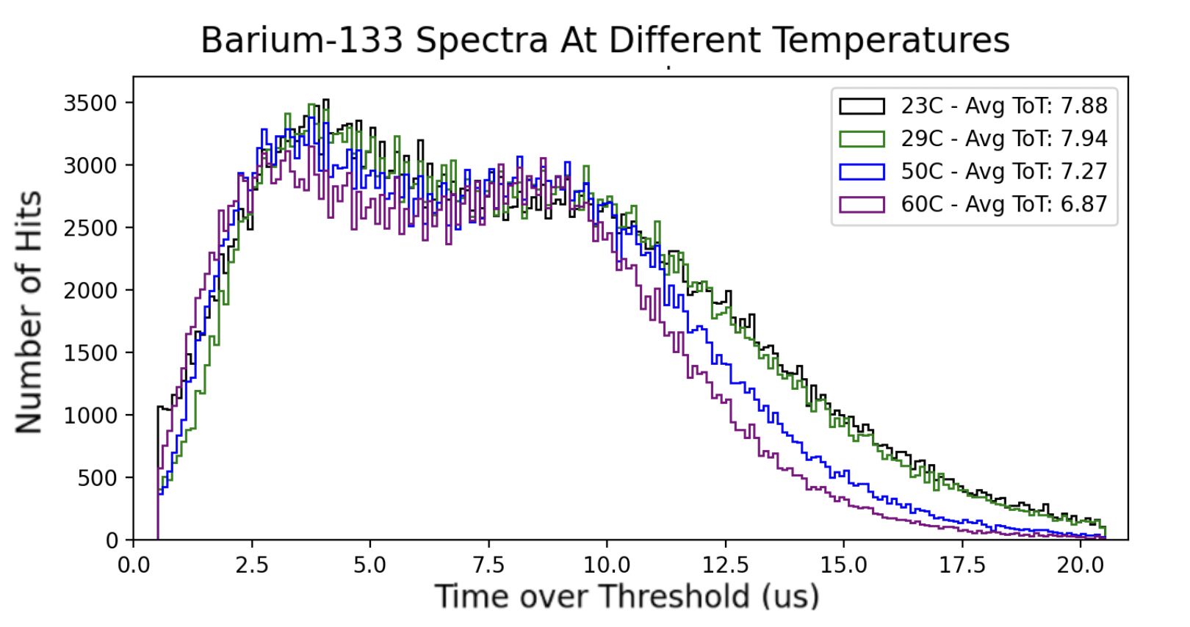
AstroPix Version 3 : Thermal Testing
Credit: Carolyn Chinatti, Carleton College

Slide 9
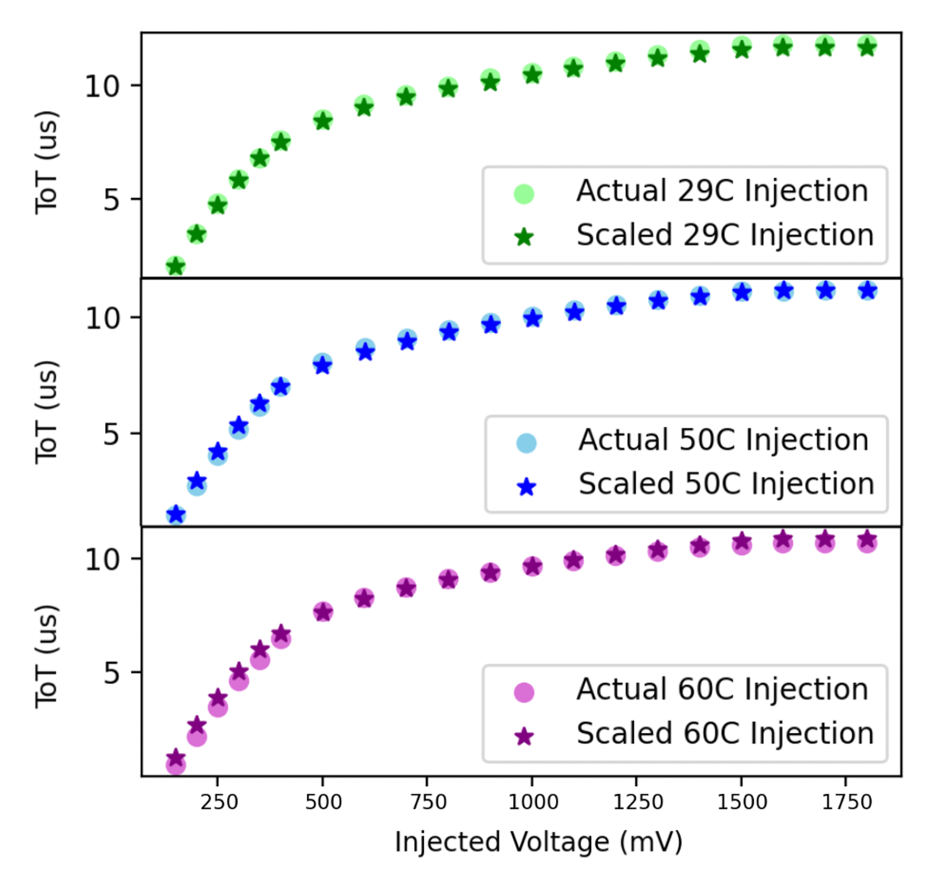
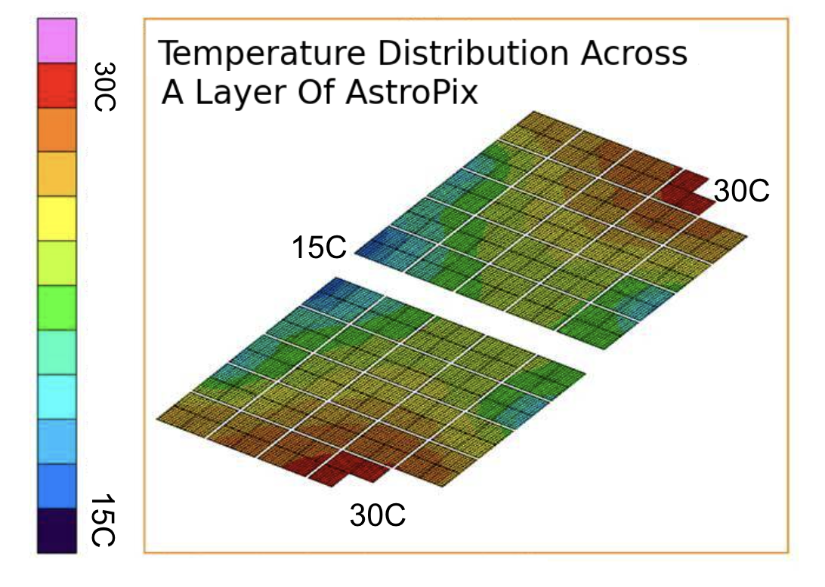
AstroPix Version 3 : Thermal Testing
Attempted a linear scaling of the shifted ToT spectrum as a function of temperature.
Some noted energy dependent shifts remain, bimodality of the amplifier, other effects?
Credit: Carolyn Chinatti, Carleton College

Slide 10
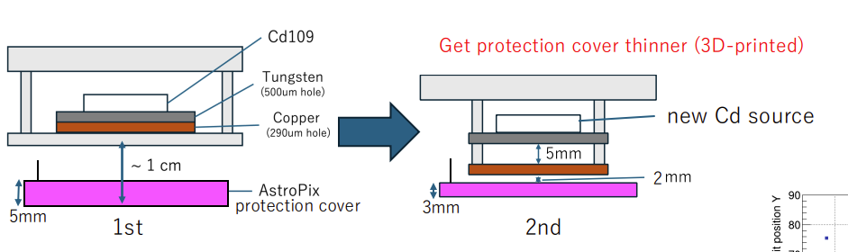
AstroPix Version 3 : Sub-Pixel Scans
We want to understand AstroPix’s subpixel detection efficiency.
Is depletion uniform? What does charge collection look like at pixel boundaries?
Norito Nakano designed experiment to collimate x-rays for a 2-D scan using Cd-109.
Best spot size: ~220 um
Credit: Norito Nakano, Hiroshima U.

Slide 11
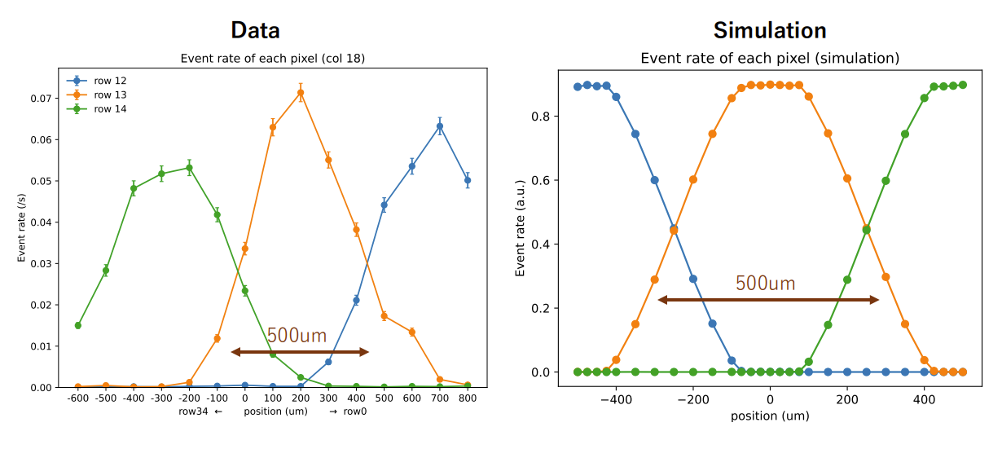
AstroPix Version 3 : Sub-Pixel Scans
Showed change-over in count rate from one pixel row to the next while scanning across a column. Compared simulations.
Credit: Norito Nakano, Hiroshima U.

Slide 12
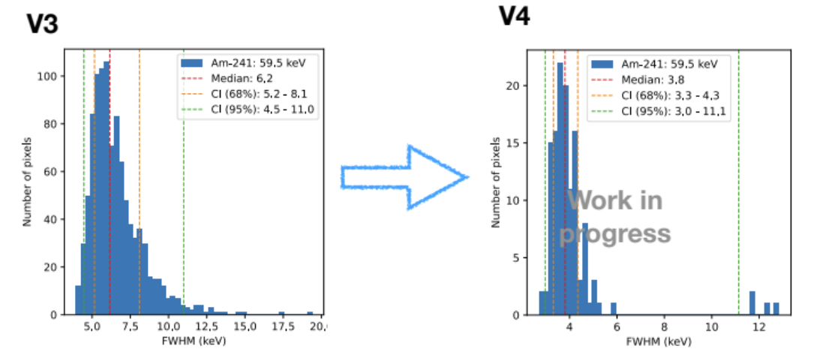
AstroPix Version 4
Reduction in pixel capacitance!
Credit: Yusuke Suda, Hiroshima U

Slide 13
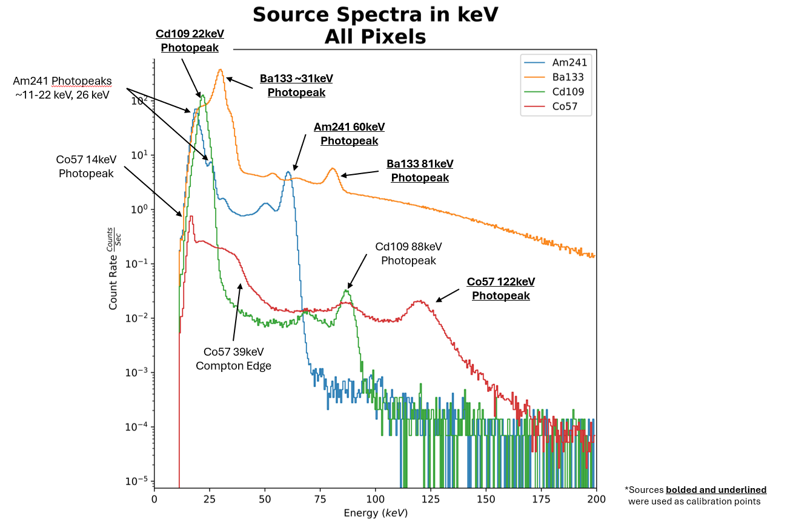
AstroPix Version 4: Performance
Credit: Grant Sommer, GW University.

Slide 14
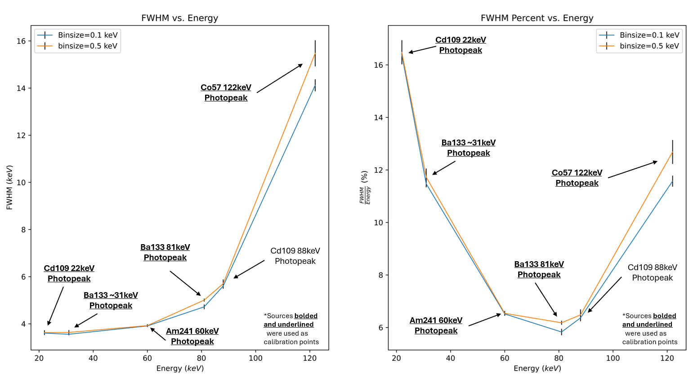
AstroPix Version 4: Performance
Slightly above goal 10% FWHM at 122 keV!
Credit: Grant Sommer, GW University.
Credit: Grant Sommer, GW University.

Slide 15
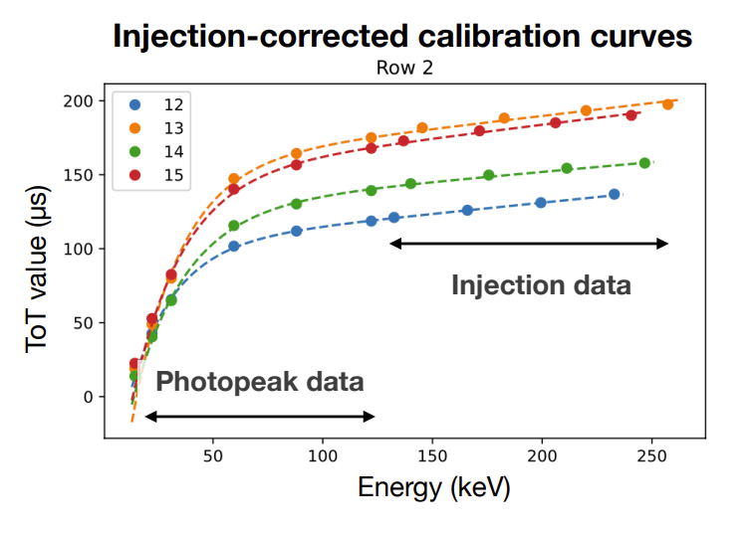
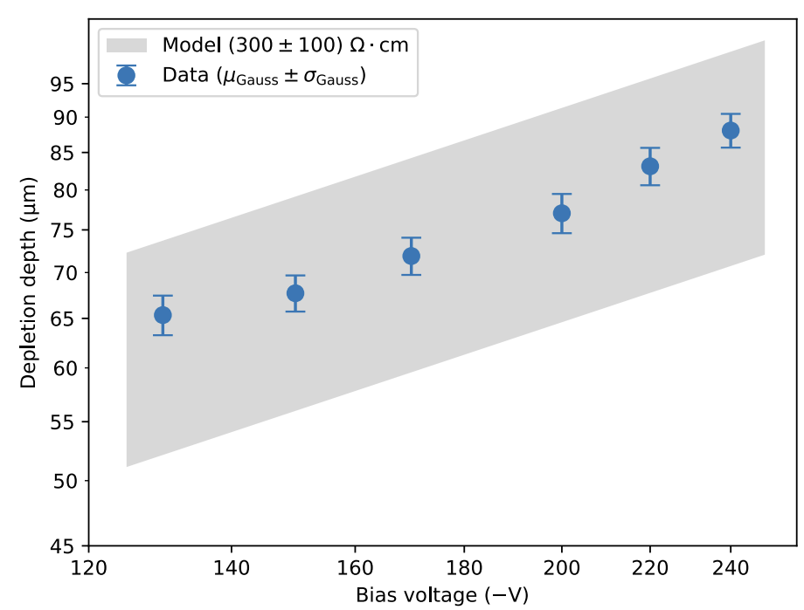
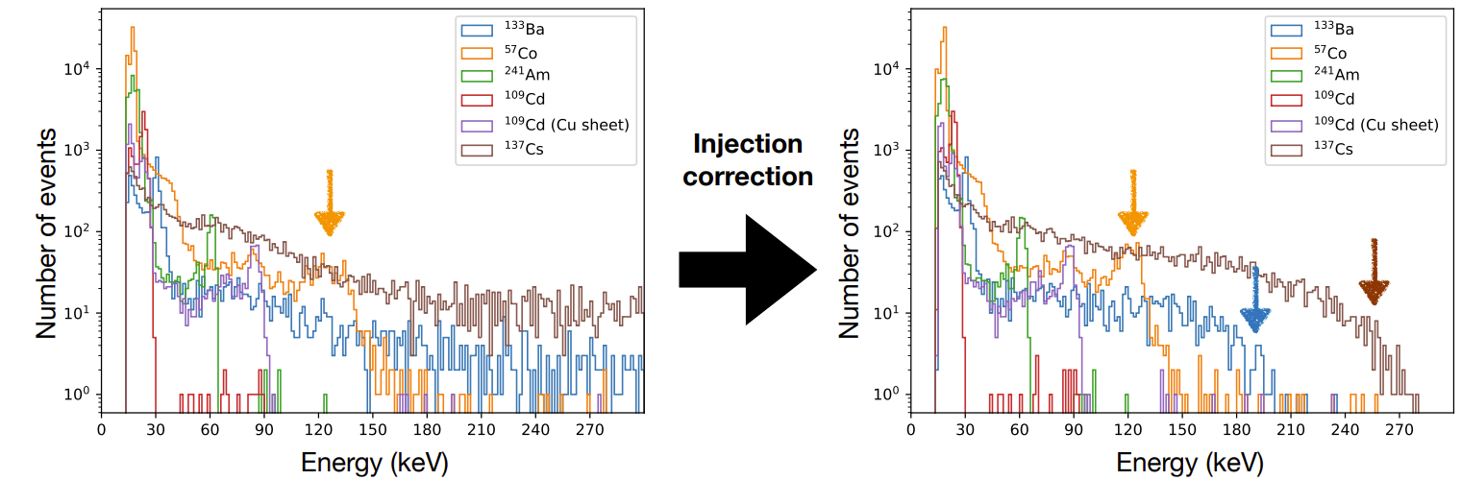
AstroPix Version 4: Injection Calibration + Depletion
Work in Progress!
Credit Yusuke Suda, Hiroshima U.
Methods: https://www.sciencedirect.com/science/article/pii/S0168900224006880?via%3Dihub

Slide 16
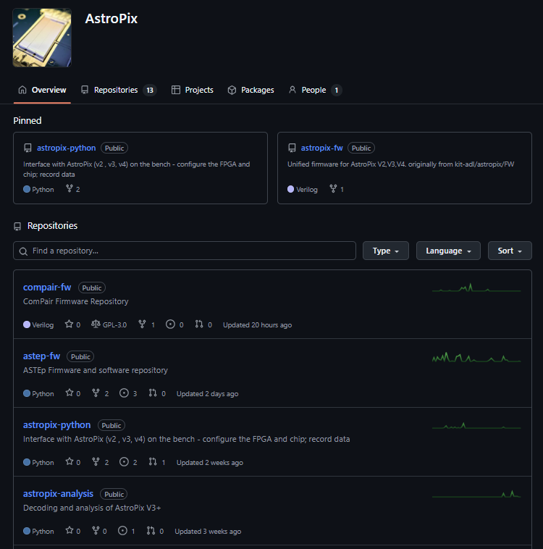

Software Development
As the AstroPix user group grows we are attempting to adjust from an R&D mindset.
Looking for feedback!
https://github.com/AstroPix

Slide 17
Software Development
How HW agnostic can this be?
ComPair Segment Running (380 Detectors)!
Quad Chip (v3) Running, Daisy Chain Readout
Single-Chip (v3,v4) Running
AstroPix v3, Quad-Chip, v4 Decoding

Slide 18
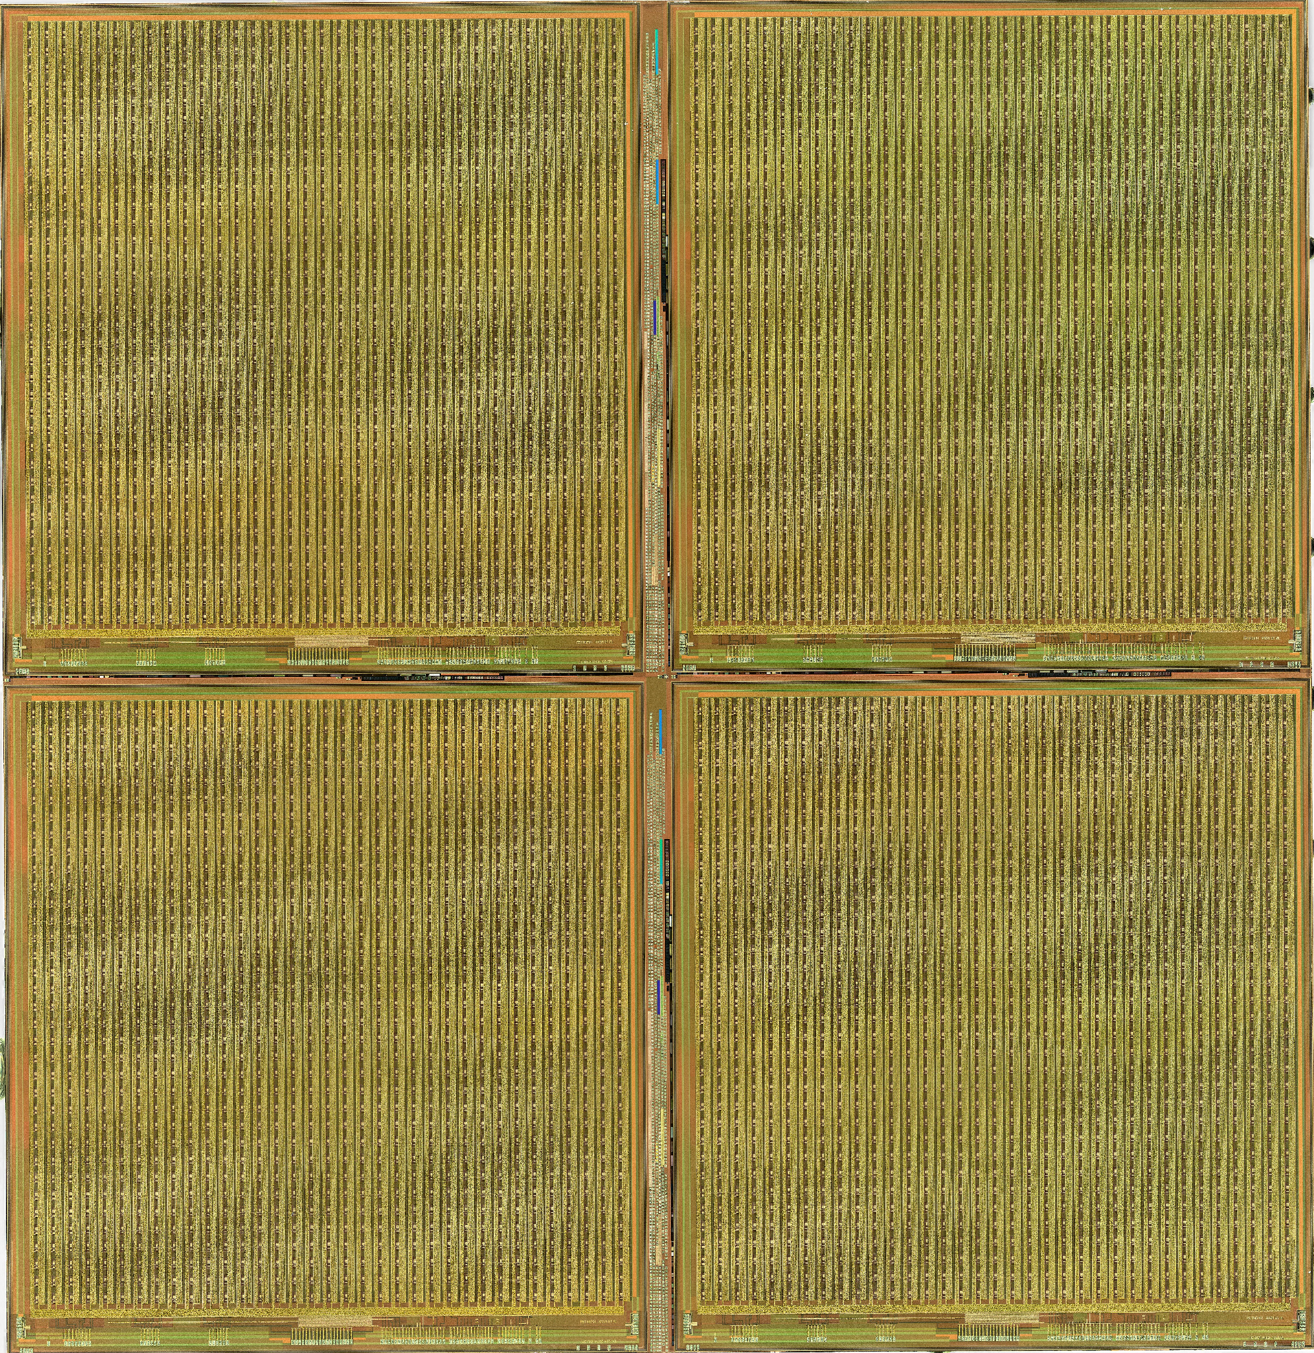
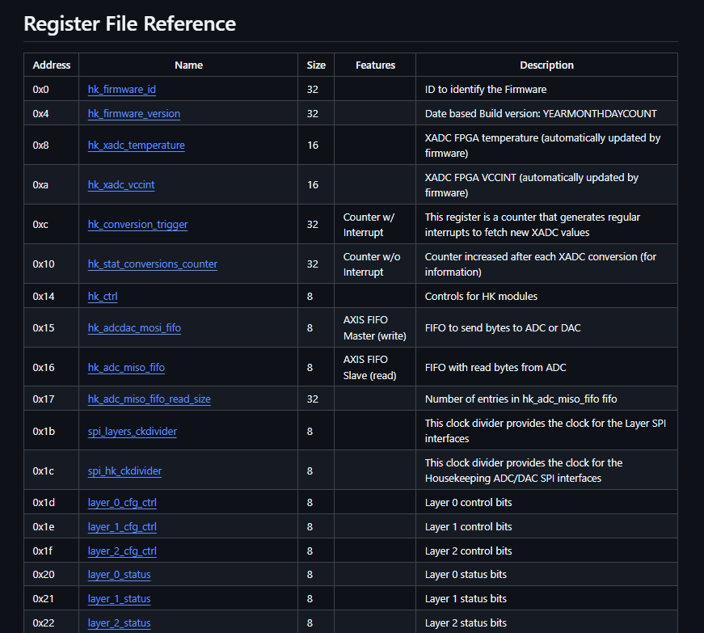
Software Development
Mostly design agnostic? HW change, # daisy chains just update Register File Map references
Software
low-level firmware
Register File Map
Use-specific firmware/logic
*Adjustable # of AstroPix daisy-chains

Slide 19

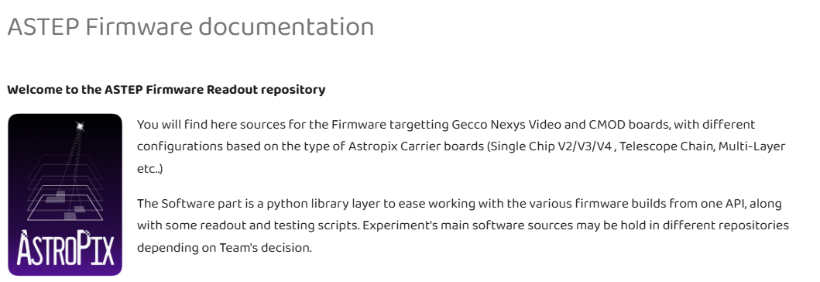
Software Development
Great firmware/software documentation by Richard Leys
https://astropix.github.io/astep-fw/

Slide 20
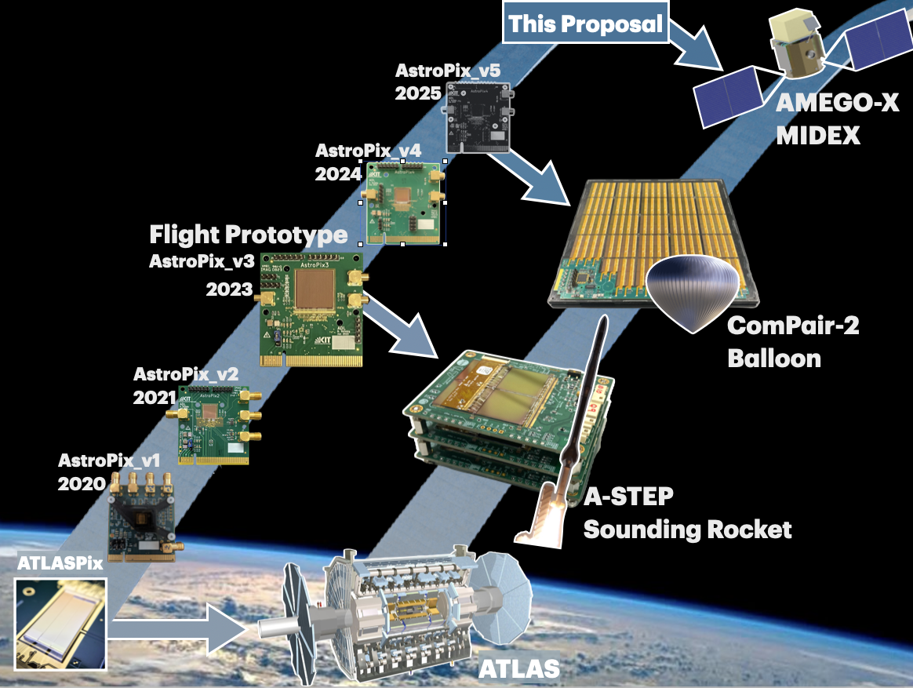
Thank You!

