Slide 1
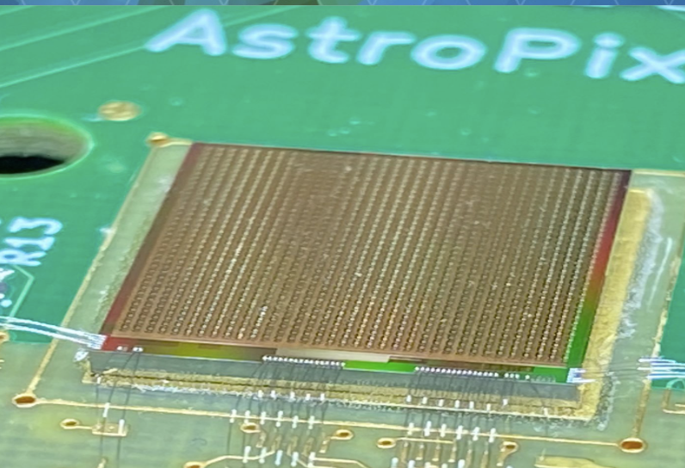
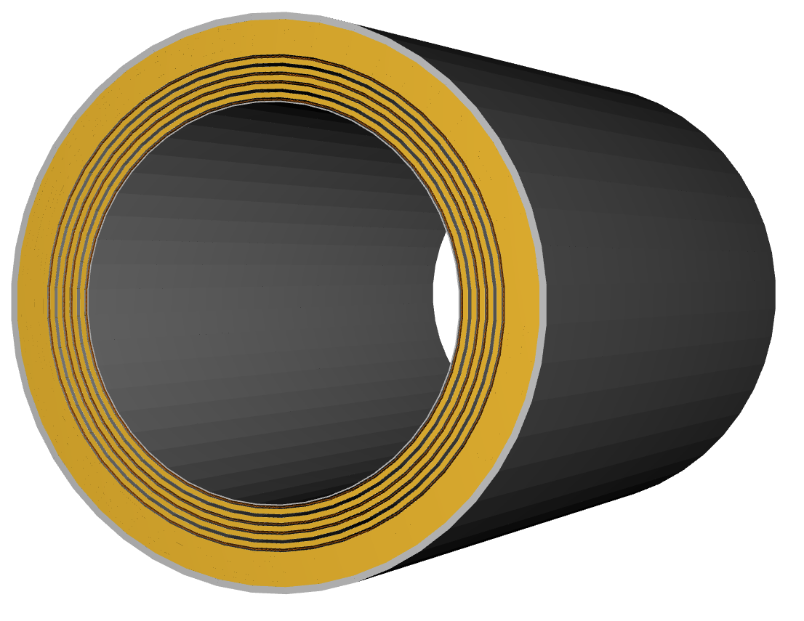
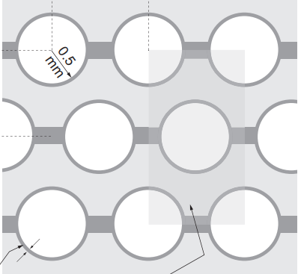
WELCOME!!
The ePIC Barrel Imaging Calorimeter
Jessica Metcalfe
BIC Workshop
Argonne National Laboratory
June 16, 2026

Slide 2
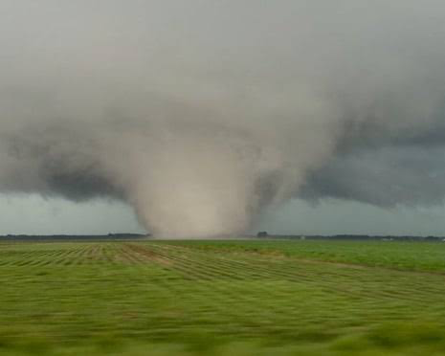
Safety @ ANL
Tornado Watch: Means a storm is coming that may be capable of producing a tornado
Tornado Warning: Means there is a possible tornado in the area and you should seek shelter immediately → outside sirens
Shelter Areas:
Tornado (Outside Sirens)→ Basement by the vending machines (stairs down the hallway with the bathrooms)
Fire (Inside Alarm w/ flashing lights) → Go outside to the meeting point at the cafeteria parking lot

Slide 3
BIC Workshop Goals
Workshop Goals:
Prepare for FDR in ~September → will have to focus on Sectors
Prepare as much as possible for FDR for tracker layers
Working session on QC documents → required by project for CD2
Not the focus, but some discussion: major production planning issues

Slide 4
BIC Organization Chart
New and reorganized GTL Deputies
Thank you!

Slide 5
BIC Project Phases
BIC Project Phases
PED: Preliminary Design
PED: Final Design
Preproduction
Production
Preliminary Design Review
Sept 2025
Final Design Review
Late 2026
Need CD3 approval to start production articles
2027/2028 Production Readiness Review
Ready for installation
~Dec 2031
Final Design Review, 90% design completion
AstroPix v5
BabyBCal & Lanky BCal
Final-ish prototype of each component demonstrating all major technical design challenges are met
AstroPix v5
One full sector
Production style procedures
AstroPix v6 validation tests
AstroPix v6
48 sectors

Slide 6
Project funding
Project funding for BIC for FY26 was reduced compared to the request
  →was due to the uncertain budget situation when the request for funding distribution was made
  Request was based on a technically driven schedule (doing work as fast as reasonably possible)
  Received 33% of request for FY26 from EIC project → work proceeding more slowly
  Working with project to get next allotment for FY27
  In-kind contributions:
  Canada is making in-kind contributions to the ESB → already incorporated into planning
  Korea is receiving funds for a major contribution to BIC → still need to work out the details
  Produced ‘Objectives Planning’ document (attached to agenda) a.k.a Bubble charts

Slide 7
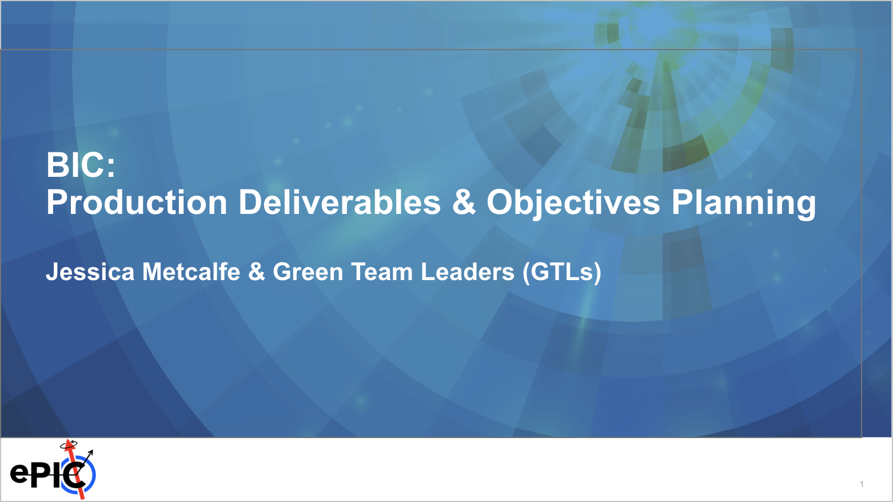
Organizational Planning aka Bubble Charts
Purpose: To allow BIC collaborators to pick up responsibilities in areas that will benefit the project
→Avoid putting effort into things that won’t benefit the project. There is plenty to do!
Some areas already have responsible institutes/people (but there could still be room to contribute)
Contact GTL (Green Team Leader: Manoj, Sylvester, Zisis, Maria) to discuss your potential contribution

Slide 8

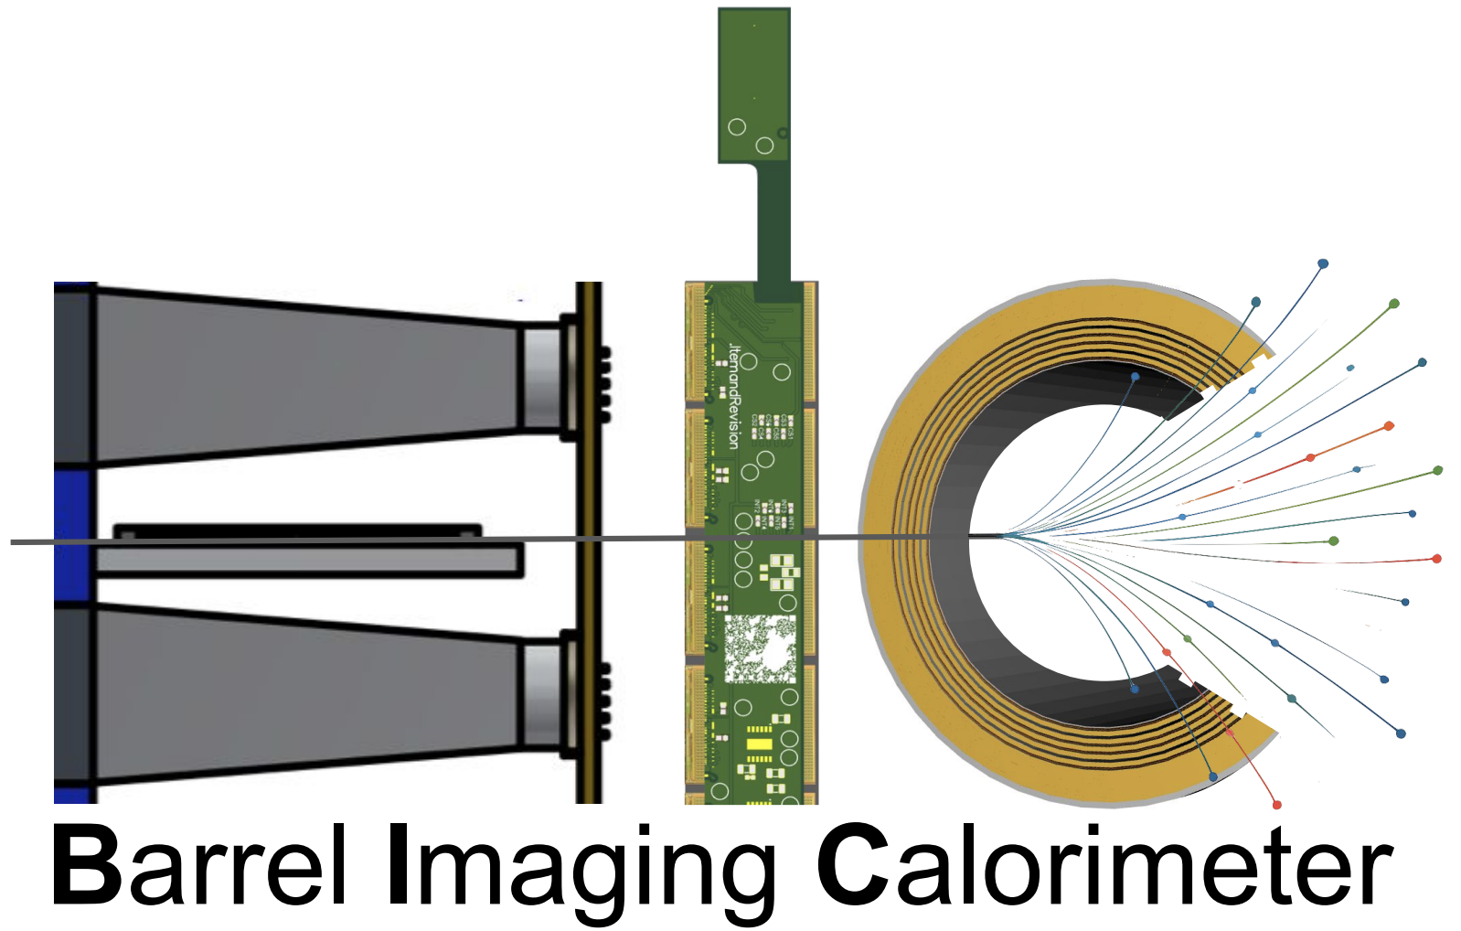

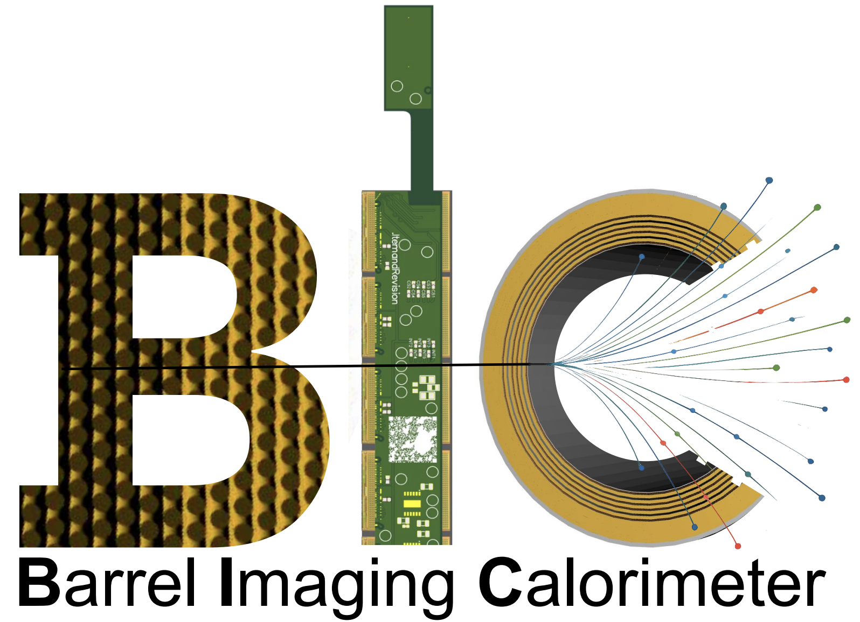
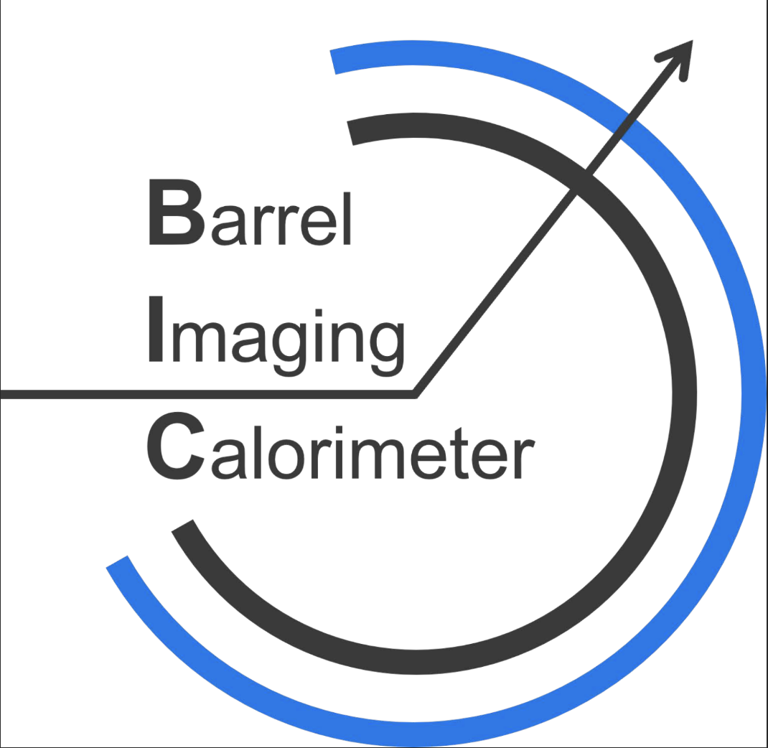
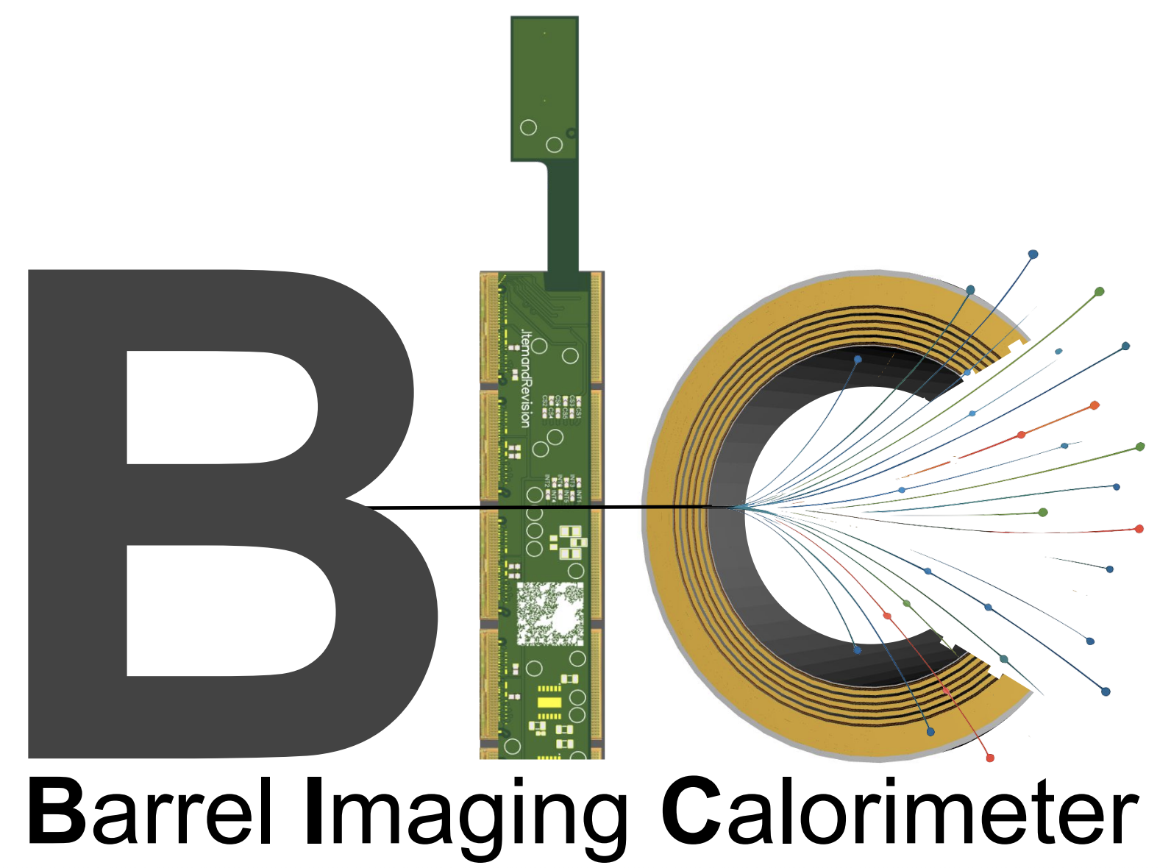
BIC Logo Contest
Pick your favorite—voting link sent after meeting

Slide 9
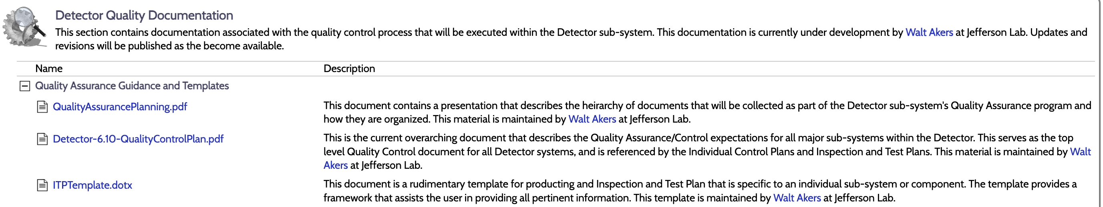
QC Documents
Requested by the project for CD2 → not everything will be final, but we should fill out what we do know
Fibers –Zisis, Sylvester
Wafer QC -Sanghoon
Module/Tray QC -Manoj
AstroLinx -Oklahoma-Blake (TBC)
Trays/Module bases –Korea (TBC)
Tracker mechanics/sectors -Sylvester
Light Monitoring System -Shinhyung
SiPM’s -Zisis
ESB mechanical -Aram
CaloRoc -Norbert
ETC-Regina
Link to QC docs: https://eic.jlab.org/Detector/

Slide 10
Dinner
Tuesday Evening: Pizza & Games at the Argonne Park
(or Skeleton Key if the weather is bad)
Wednesday Evening: Mago’s in Bolingbrook
Raise of hands for attendees?

Slide 11
Backup

Slide 12
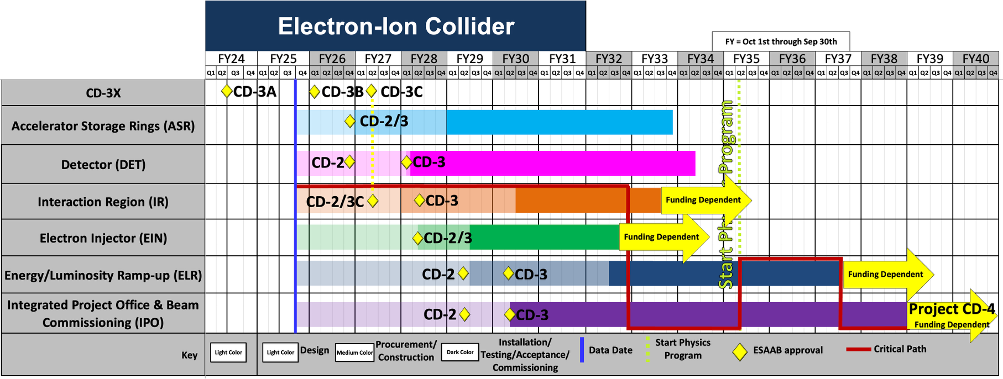
EIC Project Schedule
A Director’s Review or Intermediate Project Review (IPR) will happen in September that will decide if/when to go to CD2. CD3c is planned during the IPR in September 2026.

Slide 13
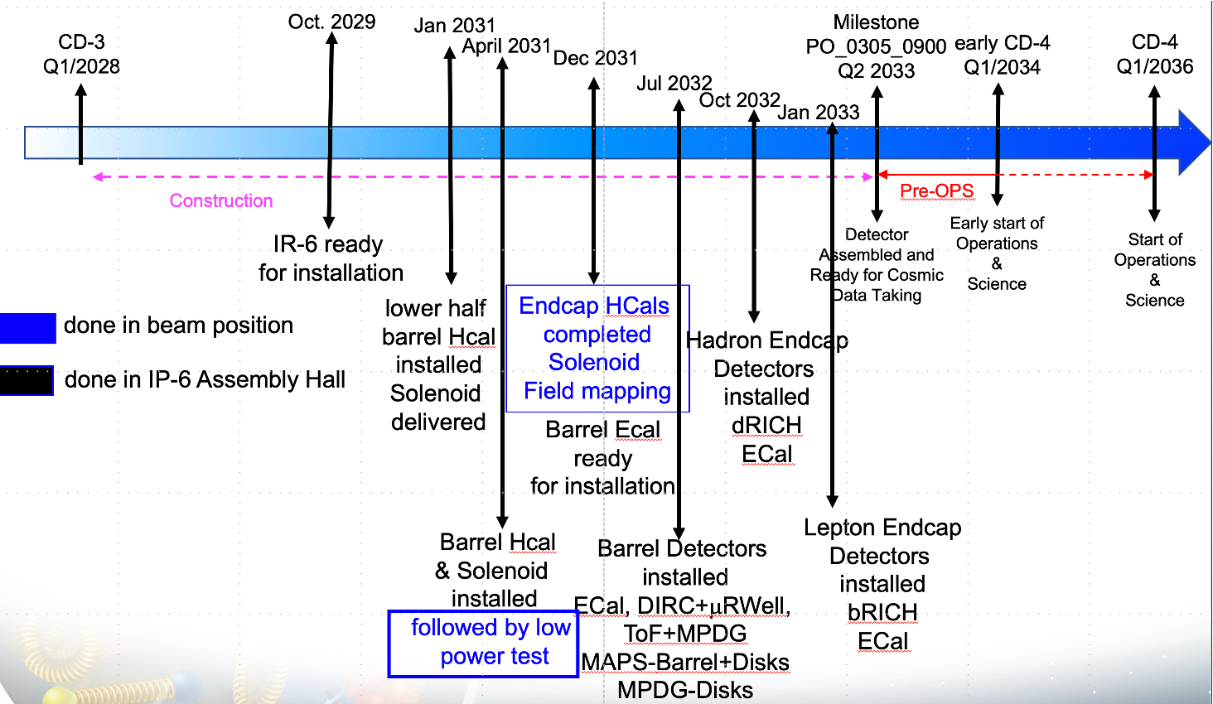

ePIC Schedule

Slide 14
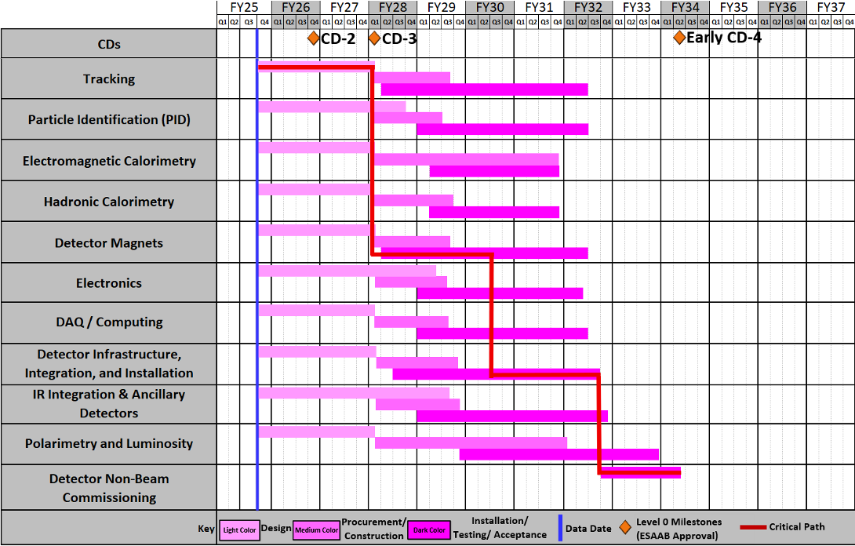
EIC Project Dates

Slide 15
BIC Organization

Slide 16
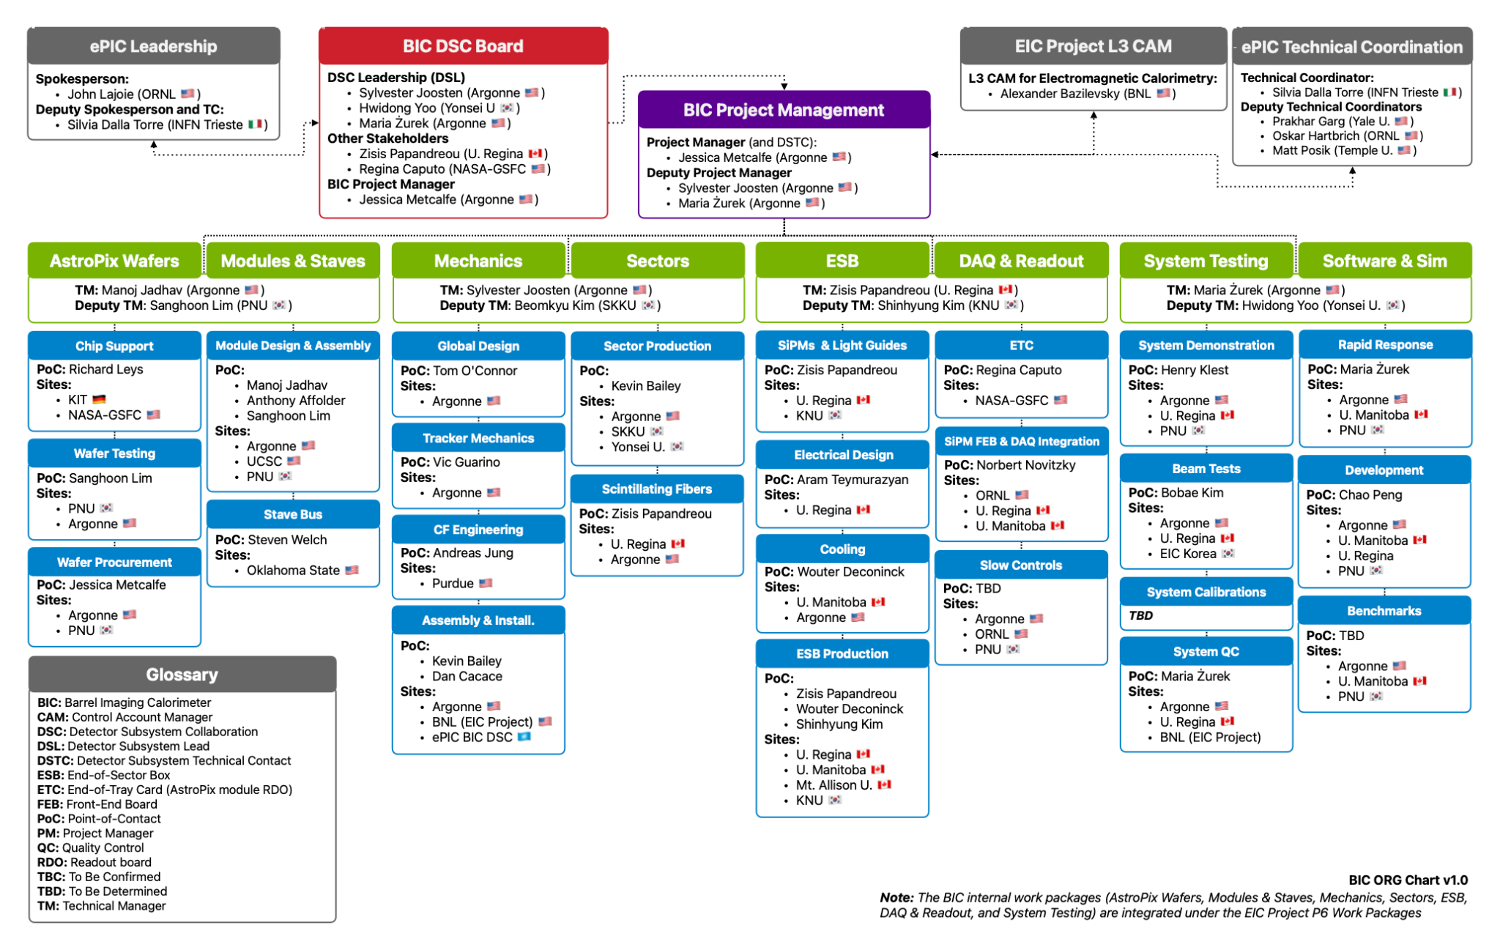
BIC Organization Chart
ePIC Collaboration:
international user organization
responsible for community needs, physics performance
Detector Subsystem Collaboration → Red Team
  DSL’s Detector Subsystem Leads
  provide oversight to the BIC collaboration
Detector Subsystem Technical Contact
  also BIC project manager

Slide 17
BIC Organization Chart
EIC Project:
DOE funded project
  accelerator & detector
  responsible for building/delivering
  US funds for the project are controlled by the Project
BIC reports to the EM Calorimeter Control Account Manager (CAM)
  Institutes receive funds via a contract with Statement of Work (SOW)

Slide 18
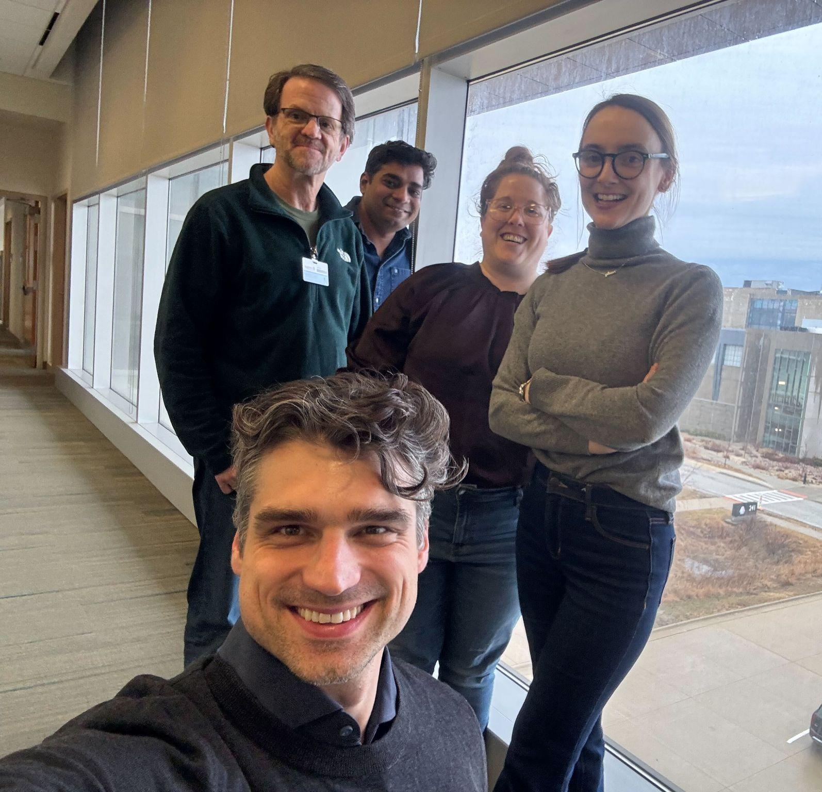
BIC Project Management Team
BIC Project Management Team
Purple Team:
manage and support the BIC community
deliver the BIC detector
Green Team Leaders:
manage a major technical area
contact for the BIC community in that technical area
meet key deliverables and milestones within their area
BIC Management Roles & Responsibilities

Slide 19
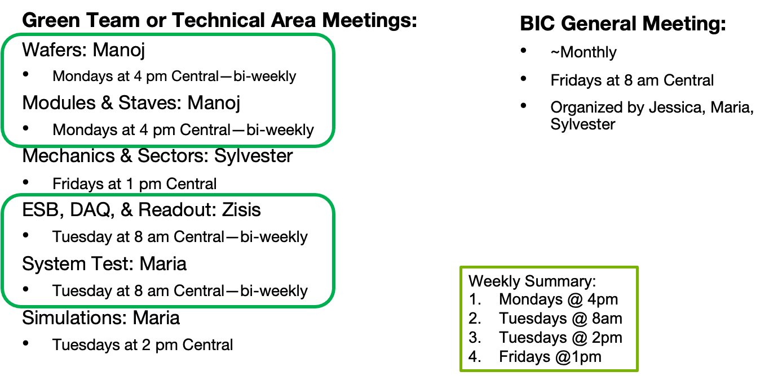
Meeting Schedule

Slide 20
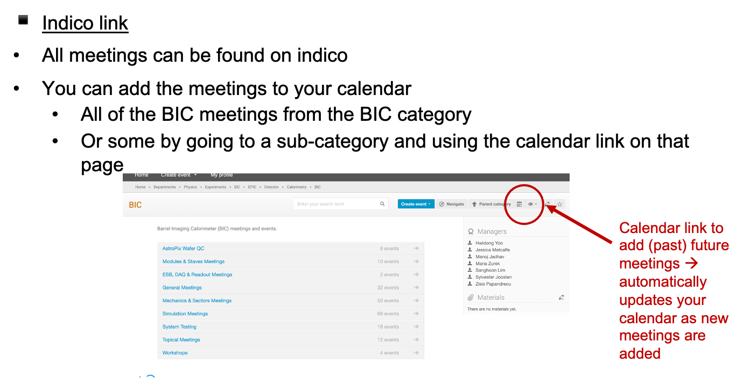
BIC Meeting Indico Calendar

Slide 21
Documents
Zenodo
BOX
Google Drive
-ePIC endorsed file management system hosted by CERN
-version controlled
-share with collaboration
-searchable by keywords
-critical to get correct keywords
-epic-eic & bic
-BOX folder for sharing technical drawings
-Argonne hosted
-request access permissions to anyone in the Purple Team
-collaborative documents → shared editing
-presentations for reviews
-reference documents
-photos

Slide 22
Design Document Review/Approval
Review key designs before fabrication
Review/Approval Log
1) Make the design available on the google drive and fill in description, links, and deadline in the log. Define required approvers.
2) Present at a relevant meeting that is announced 1 week in advance (prefer if documents ready in advance, but not required)
3) Email BIC list and required approvers with request to review by deadline (minimum 1 week after presentation). Provide links to documents, presentation, comment collection document
4) Respond to comments
5) Final approval is logged

Slide 23
Presentation/Paper Review Process
For ALL BIC (or ePIC/EIC) related presentations or paper that will be shared outside the collaboration:
review process to ensure the quality and consistency of results
Instructions:
  submit document via zenodo
  request approval in zenodo and send an email notification
  approvers for BIC should include Green Team Leader and/or Purple Team
Want to be inclusive in the author list → paper drafts should be circulated to the BIC collaboration list and ask for anyone that feels they should be included on the author list can ‘opt in’
If the paper involves AstroPix, the AstroPix mailing list should also be notified with a request for potential authors to opt in

Slide 24
Reference Documents
BIC Management Roles & Responsibilities
Interface Document
Organization Chart
Risk Register/RAID log
Presentation/Paper Approval Instructions
Design Review/Approval Log

