Slide 1
Astrolinx
5th BIC In-person Workshop
6/17/2026

Slide 2
Outline
Overview
Images
Procurement
Power Needs
Data Transmission

Slide 3
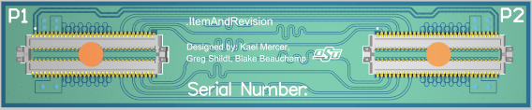
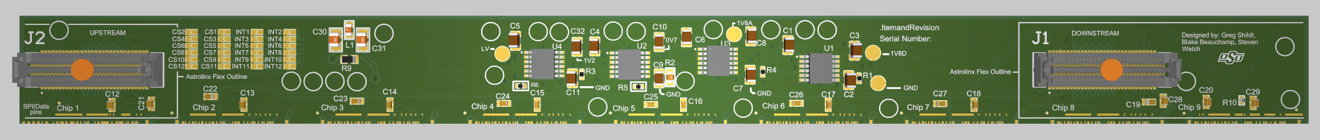

AstroLinx Overview
AstroLinx Flex (bottom view)
AstroLinx Flex (bottom view)
AstroLinx (1 module)
ETC
Adheres atop 9 AstroPix
...12 modules daisy chained
Edge view

Slide 4
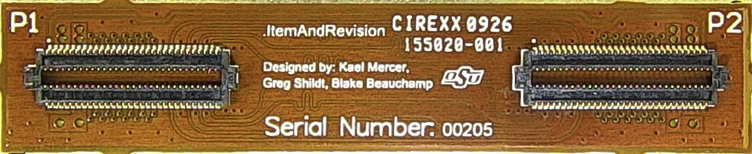
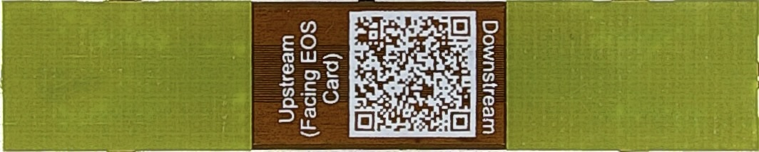
PCB Images
Bottom View
AstroLinx Flex
  Jumper between modules
  Jumper from AstroLinx to ETC
Top View

Slide 5

AstroLinx Module PCB
Adheres to chips and wire-bond to chips
Ordering blocked by contract issues
Will push order of AstroLinx for AstroPix v3 when funding available
AstroLinx
Wire-bond pads

Slide 6
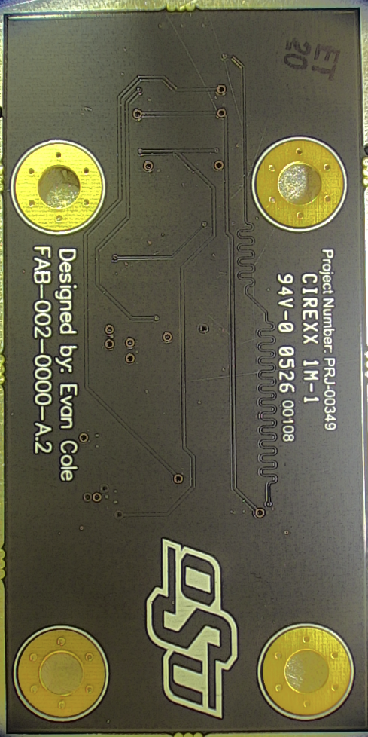
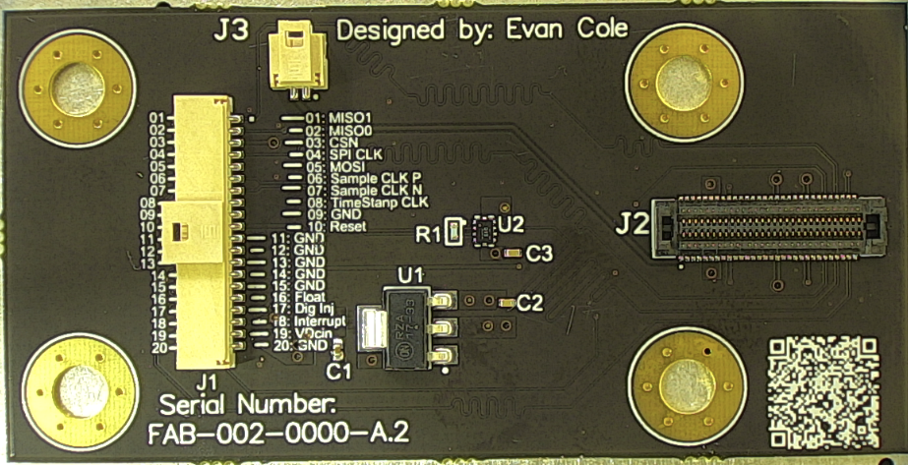
PCB Images
Bottom View
AStep Interface Board
  Allows interfacing between Astrolinx and FPGA
Top View

Slide 7
Power Needs
LV provides power to the Chips
Based on 3V minimum at the last module for regulators to maintain voltage
9V input
Voltage drop per AstroLinx 5mV – actual LV voltage at last regulator ~8.25V
Total power consumption per AstroLinx: 0.544mW, per stave: 6.52mW
1HV
Supply | Voltage per chip (V) | Current per chip (mA) | Power per Module (mW) | Power per stave (mW)
VDDA | 1.8 | 1.47 | 23.85 | 286.2
VSSA | 1.2 | 1.33 | 14.4 | 172.8
VDDD | 1.8 | 6.88 | 110.16 | 1321.92
Given power consumption for AstroPix

Slide 8
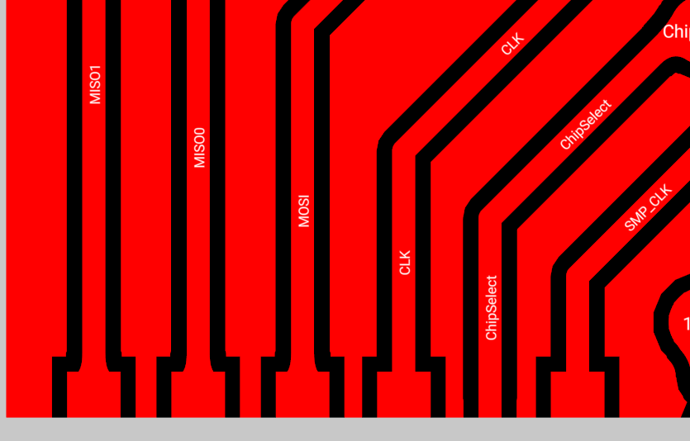
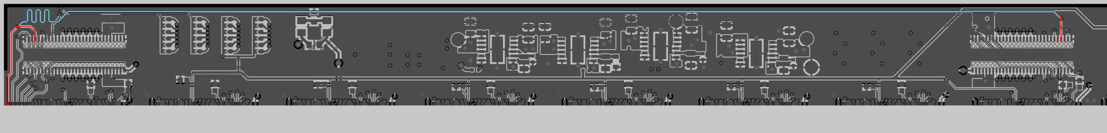
Data Transmission
Each AstroLinx passes data to/from first chip in each module
Multidrop to the next module downstream
50 Ohm Single-Ended Data Lines
5 Data Lines per tray (MISO0,1,MOSI,CLK,SMP_CLK)
Data Bond Pads to AstroPix

Slide 9
Questions?

Slide 10
Backup

Slide 11
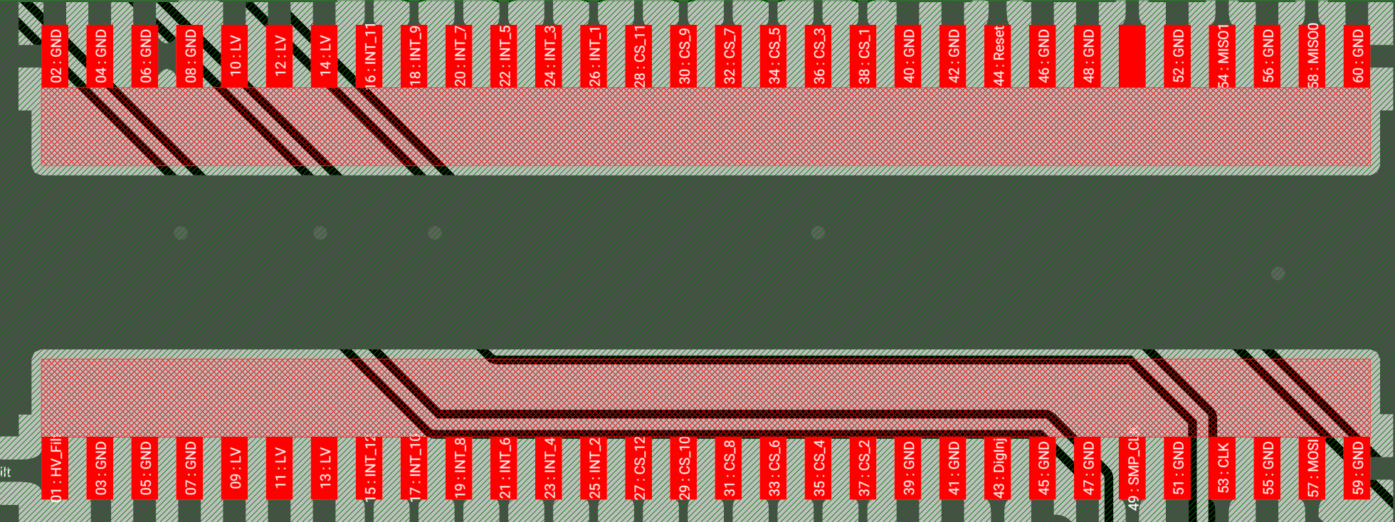
Interface – ETC pinout and orientation

Slide 12
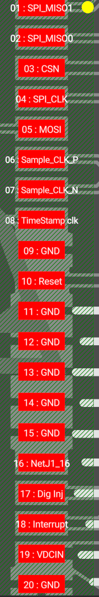
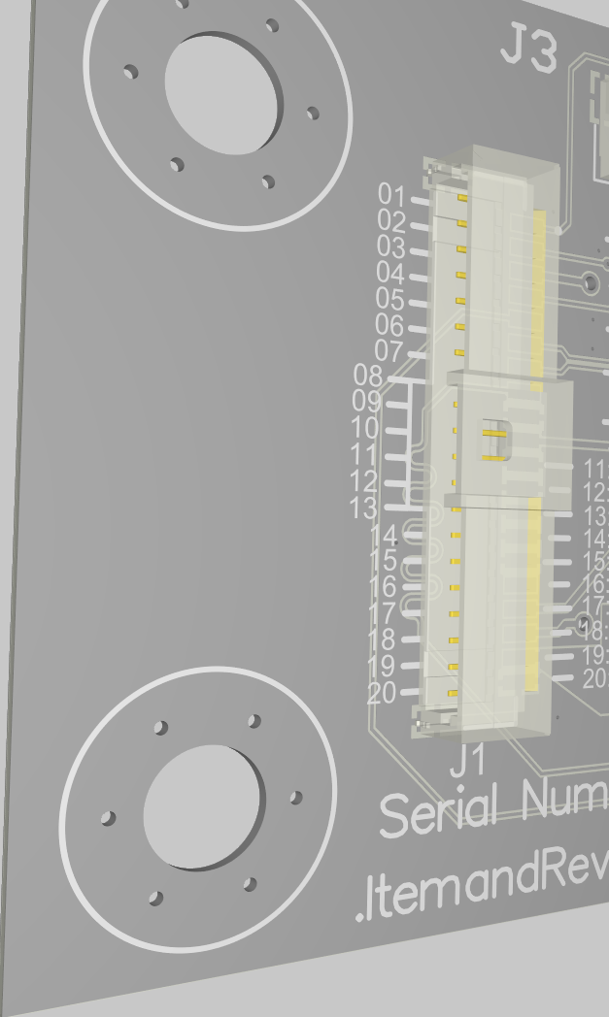
Interface – AstroLinx to AStep Adapter pinout
Connect from left
AstroLinx Flex
FPGA
Port

Slide 13
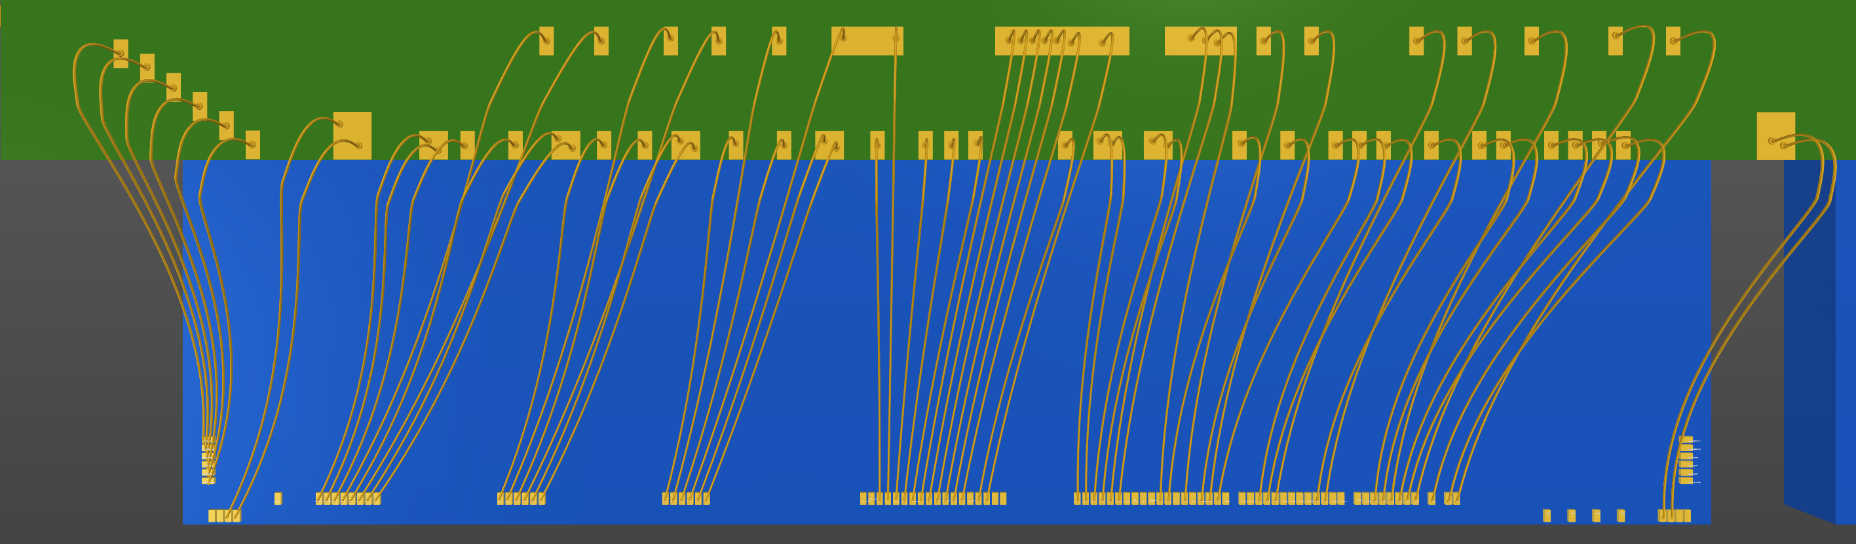
Wire-bonds Simulation (1st Chip)
Not updated with new straight pads on left

Slide 14
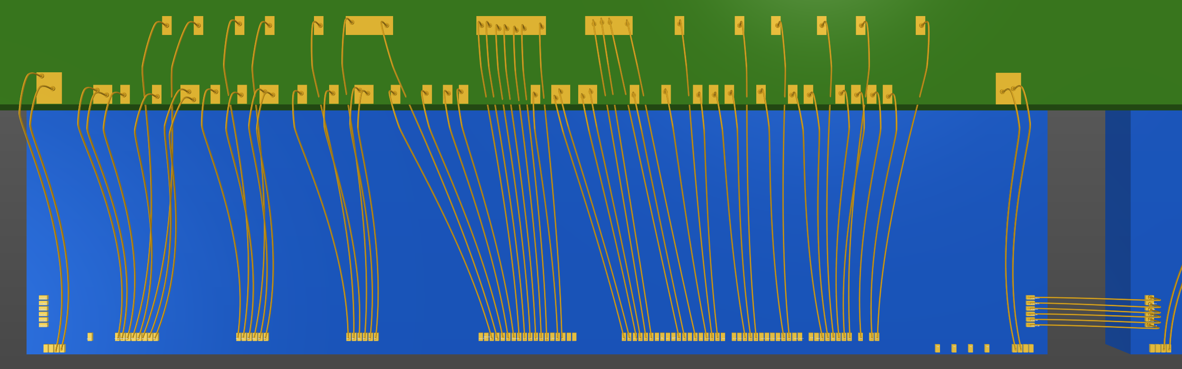
Wire-bonds Simulation (2nd-5th Chip)

Slide 15
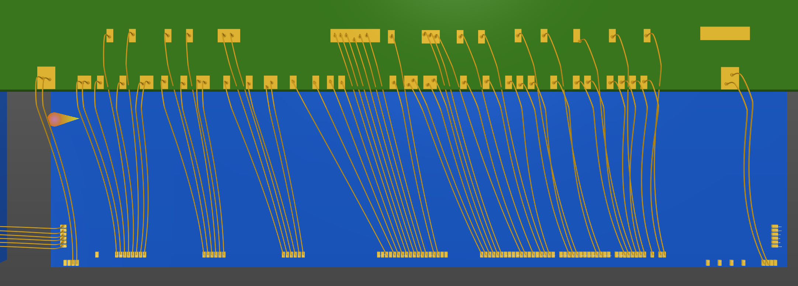
Wire-bonds Simulation (6th Chip)

