Slide 1
RDO Interfaces (ETC interface to Astropix)
ePIC Electronics and DAQ WG Conveners
Fernando Barbosa (JLab), Jeff Landgraf (BNL)
WBS 6.10.08 Electronics
Fernando Barbosa (JLab)
WBS 6.10.09 DAQ
David Abbott (JLab), Jeff Landgraf (BNL)

Slide 2
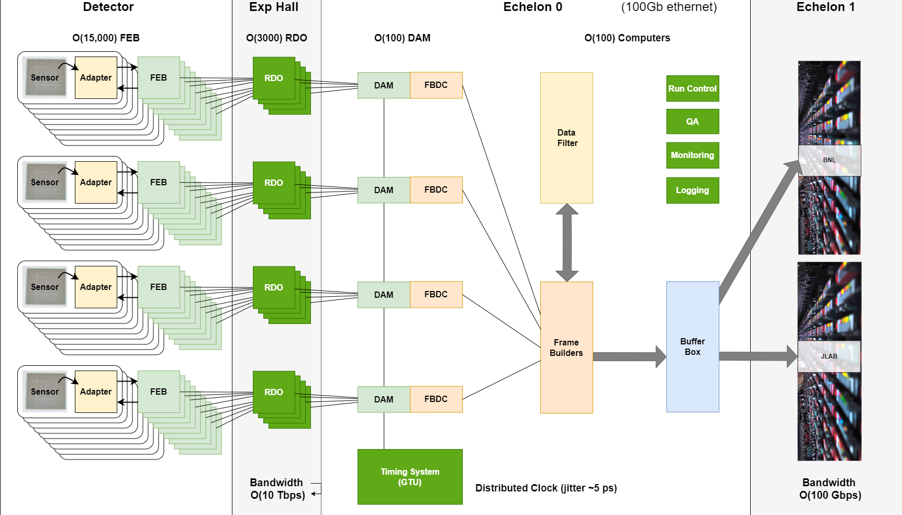
ePIC Streaming DAQ/Computing Architecture
(Online Computing)
EIC Specs
Bunch Crossing
~10.2 ns (98.5 MHz)
Interaction Rate
~ 2 us (500 kHz)
(one interaction per ~200
bunch crossings)
High Luminosity
-- up to 10³⁴ cm⁻²s⁻¹
-- Low occupancy
physics signal
-- Background and noise
significant for some
sub-systems
Frame Builder
Data Concentrator
(FBDC Server)
Controls

Slide 3
ePIC Streaming DAQ/Computing Architecture
(Online Computing)
EIC Specs
Bunch Crossing
~10.2 ns (98.5 MHz)
Interaction Rate
~ 2 us (500 kHz)
(one interaction per ~200
bunch crossings)
High Luminosity
-- up to 10³⁴ cm⁻²s⁻¹
-- Low occupancy
physics signal
-- Background and noise
significant for some
sub-systems
Frame Builder
Data Concentrator
(FBDC Server)
Controls
Astropix:
Wafers / Modules / Staves
ETC
(End of Tray Card)

Slide 4
ePIC Streaming DAQ/Computing Architecture
(Online Computing)
EIC Specs
Bunch Crossing
~10.2 ns (98.5 MHz)
Interaction Rate
~ 2 us (500 kHz)
(one interaction per ~200
bunch crossings)
High Luminosity
-- up to 10³⁴ cm⁻²s⁻¹
-- Low occupancy
physics signal
-- Background and noise
significant for some
sub-systems
Frame Builder
Data Concentrator
(FBDC Server)
Controls
Astropix:
Wafers / Modules / Staves
ESB
Todays Discussion

Slide 5
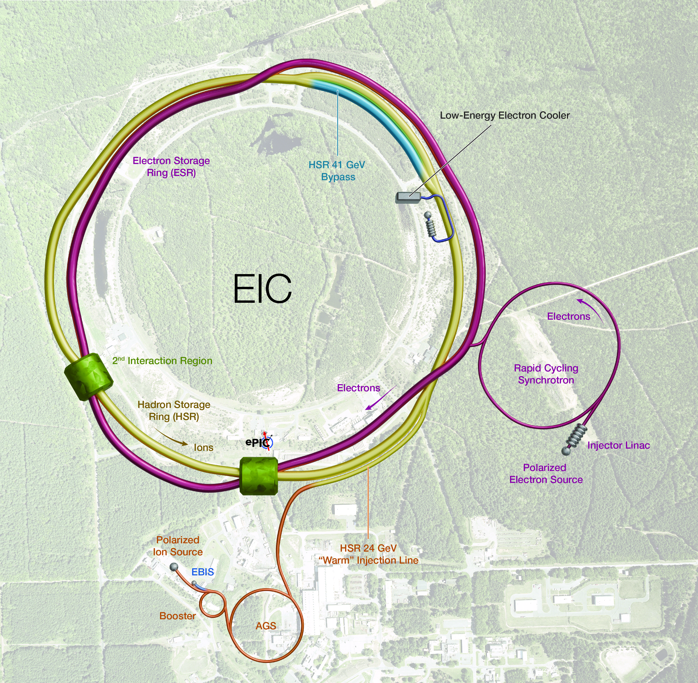
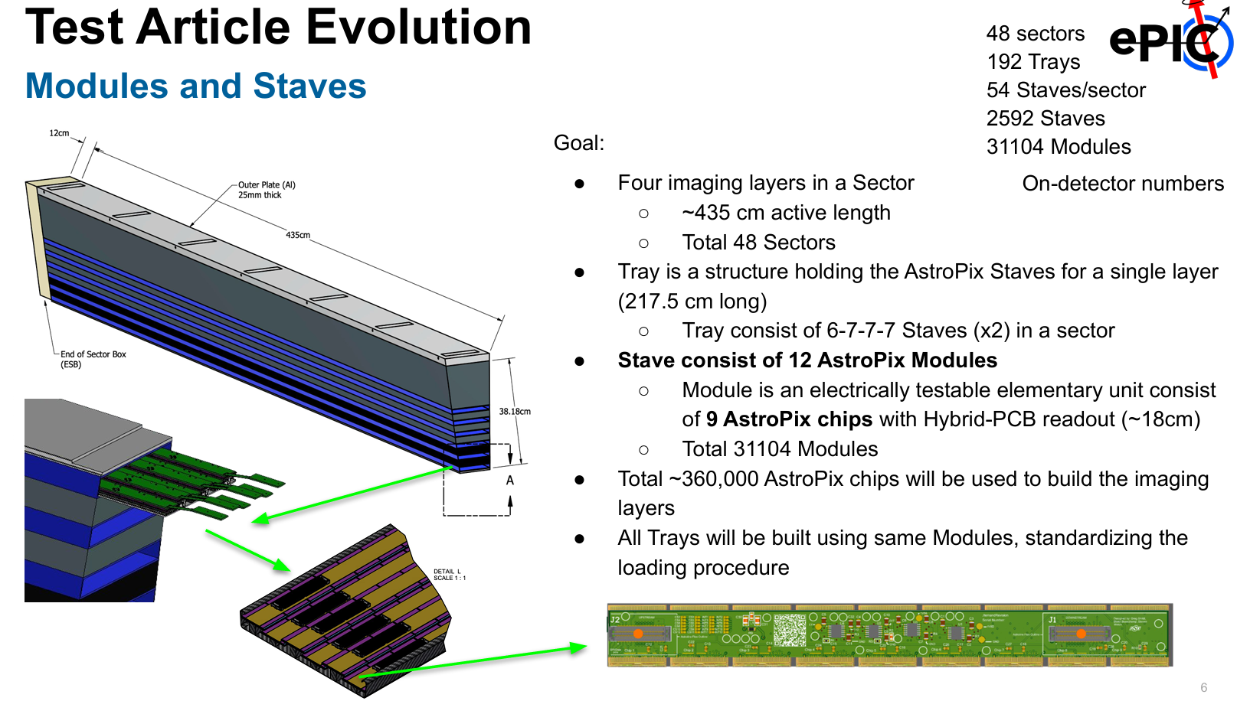
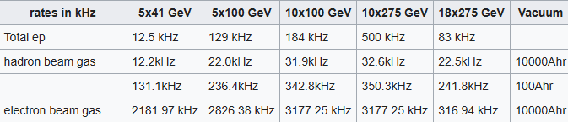
Basics… just to make sure we are on same page…
Detector Basics:
Assume Ecal uses CALOROC as per other calorimeters
Assume SiFi/Pb Cal boards (FEBs/RDOs) independent from astropix layers and using generic RDO …at least wrtr DAQ fibers / interfaces.
Numbers:
  SciFi/Pb: 5,760 channels → 96 FEBs → 24 RDOs → 1 FLX
  Astropix: 500M pixels → 192 ETCs → 5 FLX
    48 sectors / 192 trays / 2592 staves / 31104 modules…
Astropix Readout Capabilities?
  What maximum rate / sensor &/or ESB?
  What data size / pixel hit
  How many pixels hit per incident particle?
  (Daq needs to know rate / reducability. But we also summarize chain for collab)
Streaming
  The meaning of streaming: → no external trigger
  ESB gets two fibers:
    Downlink fiber (DAQ→ESB)
      Reconstruct clock (either 98.5 MHz or 39.4 MHz words)
      Synchronised commands
      Configuration Commands
    Uplink fiber (ESB → DAQ)
      Data
      Slow controls information (If applicable)
  Hits are pushed from ESB to FLX when they arrive
Manoj’s Slide

Slide 6
Basics…
Collider Parameters
1260 Bunches arriving at 98.5Mhz (10.15ns bunch separation)
1.015us abort gaps (100 bunches)
Each bunch can have different polarization states
  DAQ must tag event data to specific bunch crossings
  Need to track luminosity for each bunch crossing
  ASTROPIX: What is time resolution of the Astropix hits?
    (Assuming << 10ns)
    Assuming each Hit has its own independent time info
Synchronized events from DAQ (Rev-Tic, software triggers, start runs, etc…) will always arrive on BX divisable by 5 because of need to synchronize detectors running at 98.5 and 39.4 MHz
Time data must be converted to EIC bunch crossings at later stages (presumably using helper functions for each detector)
Physics Performance
Maximum DIS rate ~500kHz
Astropix Data Requirements?
  Backgrounds/Noise could dominate rates!
  What is likely noise rate?
  What is expected data rate
    ePICdataVolumeSummary.xlsx

Slide 7
Readout Chains
Detector System | Digitization Clock | FEB-RDO Protocol | RDO | RDO-DAM Protocol | Configuration
EICROC: (AC-LGAD pixels) | 39.4 MHz | lpGBT | Direct to FLX | lpGBT | Fast Configuration mode
FCFD/variant: (AC-LGAD strips, DIRC, pfRICH) | 39.4 MHz | lpGBT | Direct to FLX | lpGBT | I2C
SAMPA (Endcaps MPGs) | 39.4 MHz | lpGBT | Direct to FLX | lpGBT | I2C
SAMPA (Cymbal/Outer Barrel) | 39.4 MHz | lpGBT | 4 → 1 GenericRDO (or Direct to FLX) | Aggregated*** (e.g. Aurora 64B/66B) | I2C
CALOROC: Calorimeters | 39.4 MHz | lpGBT | 4 → 1 GenericRDO | Aggregated (e.g. Aurora 64B/66B) | I2C / Fast Config Mode
Discrete: Various Calorimeters | 98.5 MHz | Internal | 16 → 1 GenericRDO | Aggregated (e.g. Aurora 64B/66B) | User config mode
ITS3 / LAS (SVT) | 39.4 MHz (2-8 us time) | lpGBT | Fiber Aggregator GenericRDO | Aggregated (e.g. Aurora 64B/66B) | User Config mode (lpGBT protocol interpreted by Ancillary ASIC)
TimePix: (Low Q Tagger) | 98.5 MHz | Internal | SPIDR4 Variant (NIKEF) | ? | ?
ALCOR: (dRICH) | 39.4 MHz | Internal | FPGA/VTRX+ (INFN) | lpGBT? | I2C
Imaging Calorimeter (Astropix): | 98.5 MHz | Astropix Internal | End of Stave Card (NASA) | ? | ?
ePIC DAQ must be flexible wrt underlying protocols between RDO-DAM from various detectors!
We expect for lpGBT that 10.24 Gb/s FEC5 is suitable
Not yet specified and Some detectors might require other choices (e.g. for CERN compatibility)

Slide 8
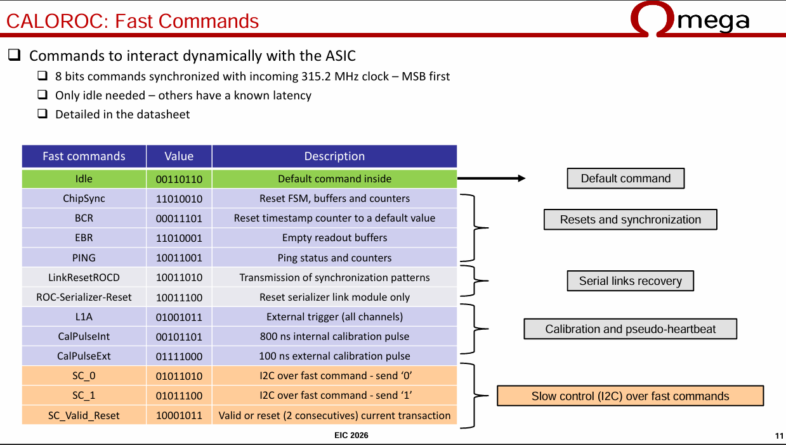
Control Commands
DAQ will provide Synchronized commands generated by GTU (FAST COMMANDS)
  Latency must be deterimistic through chain, DAM to store appropriate delays to synchronize each detector
  Synchronized commands must arrive on multiple of 5, 10.15ns time buckets due to need to synchronize 40 MHz and 100 MHz systems
  Minimal Supported Fast Commands:
    REVTIC – This is the first bunch of each of 1260 time buckets (Arrives every 12.79 us)
    SYNC – Similar to REVTIC but can be programmed for a different specified interval for each detector for ASICs with a natural frame significantly different from 1260 time buckets
    TRIGGER – Software trigger forcing a readout on a deterministic bunch.
      This readout should include the current Bunch counter, but may include other information depending on the ASIC
      Can be incorporated in REVTIC or SYNC commands if required by the ASIC
      Goal is to give DAQ mechanism to ensure detector-wide synchronization
    ASSERT_BUSY – stop sending data (i.e. busy) This can be handled at RDO rather than ASIC/Sensor if needed
    Other detector specific commands can be provided if needed.

Slide 9
Control Commands
Configuration Commands and High Level Control Commands are more flexible
  To be implemented with detector/ASIC specific sequences, and setups defined in files organized by code in readout computers
  These sequences will be initiated by GTU (e.g.)
  Can be extended depending upon detector needs…
User Level | RDO interface
Config For Start | Series of actions (Control given to Readout Computer: actions orchestrated by RO computer / FLX)
Config Done | Control Returned to GTU
Start | Synchronous Command (deterministic delay, defined by detector)
Stop | Synchronous Command
Conf for Stop | Series of actions (Control given to Readout Computers: actions orchestrated by RO computer / FLX)
Stop Done | Control returned to GTU
Assert Busy | Pause readout (RDO can handle this)
Reset | Control given to Readout Computers
Ready | Control returned to GTU

Slide 10
Slow Controls Interface
The only signal connections to the FEBs are through the
  Downlink Fiber (Fast Commands, Configuration/Slow Controls, Firmware Management, Clock)
    lpGBT protocol
  Uplink Fiber (Hit data & Slow Controls Data)
The slow controls system will interact via soft IOC
Detector data formats must indicate hit data vs Slow Controls data to be separated by DAM
Detector data formats must sense & indicate overflow conditions leading to dropped data.
RDO
DAM
SC Data
EPICs IOC
Detector
Specific
GTU
Synchronized

Slide 11
Questions / Comments?

Slide 12
Backup

Slide 13
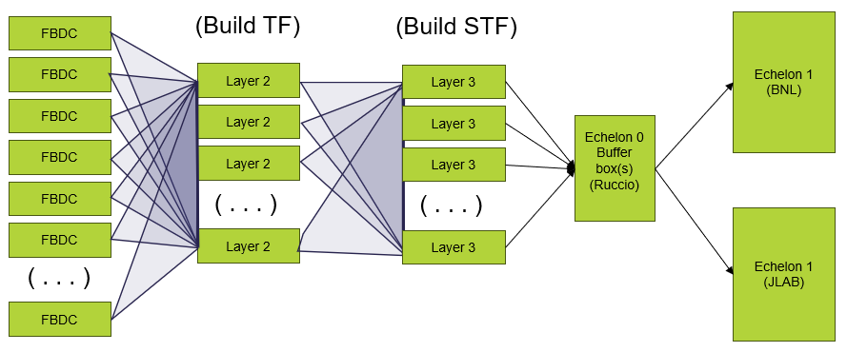
TF / STF and interface to Orchestration
Time Frames (TF) are buffers containing the multiplexed data from the entire detector corresponding to 0.6 ms time periods
Super Time Frames (STF) are ordered, contiguous sets of O(1000) time frames corresponding to roughly 0.6 seconds of detector data
Likely to have independent DAQ Systems
  Polarimetry
  Luminosity Detectors
  Independent STFs for each
On Start/Stop Run
  Notifies Orchestration of detector/collider status via message
On production of STF DAQ:
  Writes file to Buffer Box
  Notifies Orchestration of data availability via message

Slide 14
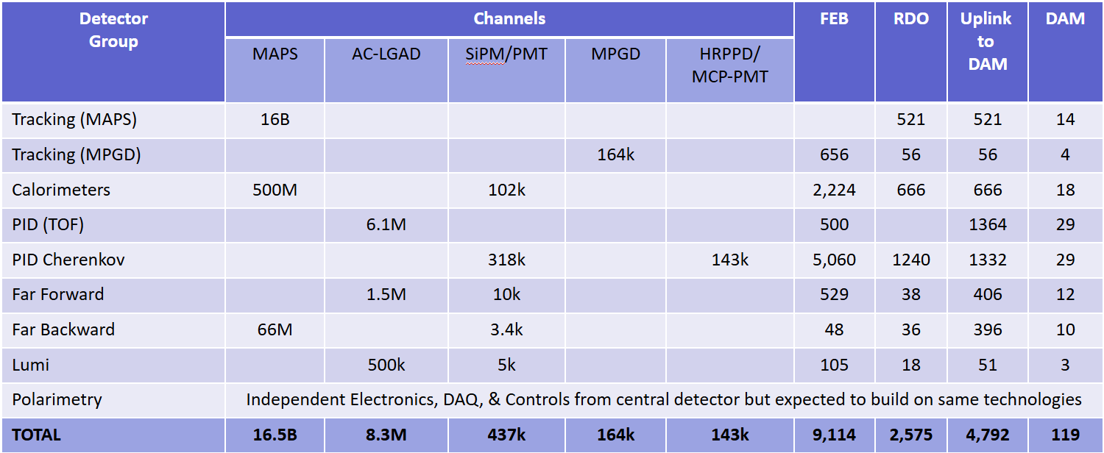
Summary of Channel Counts and Data Flow
Scale of the system:
Electronics
  ~ 25 detectors
  ~ 5 Sensor Technologies
  ~ 2500 RDOs (on detector/in racks)
  ~ 120 DAM boards (DAQ room)
  GTU (with interface boards)
Detailed simulations of DIS events, Proton and Electron beam gas lead to maximum Data Volume
  ~ 2 Tb/sec digitized
  ~ 100Gb/sec recorded
Dark current rates high for dRICH (SiPM sensitive to single photons) after radiation damage. Need High-Level Filter (ML algorithms under study)
Synchrotron Radiation Simulations still in flux. Rates at 18GeV with currently simulated beam-line dominate physics rates. Scaling to lower energies is not trivial, and optimized beam line being simulated.
Summary of Data Flow
PCI/Eth
Eth
Detector
FEB
Copper
RDO
Fiber
DAM
Readout Computer
Aggregate | 2.0 Tb/sec
Noise | 1.6 Tb /sec
Signal from Physics + Background | 400 Gb / sec
Aggregate | 109 Gb/sec
Collision Signal | 62 Gb/sec
Synchrotron Rad | Under design
Electron Beam | 4.5 Gb/sec
Hadron Beam | 1.0 Gb/sec
Noise | 41 Gb/sec
Aggregate | 2.0 Tb/sec
Per RDO (Avg) | 0.7 Gb/sec

Slide 15
Readout Chains
Detector System | Sensor | ASIC / Digitization | Digitization Clock | FEB | FEB-RDO Protocol | RDO Type | RDO Location | Notes
Si Tracking --- (ITS3 / LAS): (IB, OB, EE, HE) | ITS3/LAS | Integrated /w sensor | 39.4 MHz (2-8 us time) | Integrated (Schambach) | GBT | Fiber Aggregator GenericRDO | South Platform | J. Schambach Presentation
MPGD tracking: (SAMPA): (IB, OB, EE, HE) | urWELL / uMegas | SALSA | 39.4 MHz | lpGBT / VTRX+ | GBT | 4 → 1 GenericRDO | South Platform | RDO – N. Novitzki Presentation FEB – F. Barbosa Presentation
Calorimeters (CALOROC): BarrelHCAL, Backward HCAL, Barrel ECAL, Backward ECAL, Backward HCAL | SiPM | CALOROC | 39.4 MHz | lpGBT / SFP+ | GBT | 4 → 1 GenericRDO | South Platform | N. Novitzki Presentation
Calorimeters (CALOROC): LFHCAL, HCAL Insert | SiPM | CALOROC | 39.4 MHz | lpGBT / SFP+ | GPT | 4 → 1 GenericRDO | East HCAL Platform | N. Novitzki Presentation
Calorimeters (Discrete): FwdEcal | SiPM | Discrete | 98.5 MHz | FPGA / SFP+ / Cu | Internal | 16 → 1 GenericRDO | South Platform | G. Visser Presentation Planned RDO similar to existing designs
Far Forward (AC-LGAD / EICROC): B0 tracking, Roman Pots, Off Momentum | AC-LGAD | EICROC | 39.4 MHz | lpGBT / VTRX+ | GBT | Direct to FELIX | N/A | Same as per Endcap TOF
Far Backward: (AC-LGAD / FCFD): Lumi photon spectrometer tracker | AC-LGAD | FCFD | 39.4 MHz | lpGBT / VTRX+ | GBT | Direct to FELIX | N/A | Same as per Barrel TOF
Central Detector (AC-LGAD / EICROC): Endcap TOF | AC-LGAD | EICROC | 39.4 MHz | lpGBT / VTRX+ | GBT | Direct to FELIX | N/A | F. Barbosa Presentation
Central Detector (FCFD): Barrel TOF, pfRICH, DIRC | HRPPD / MCPMT | FCFD | 39.4 MHz | lpGBT / VTRX+ | GBT | Direct to FELIX | N/A | F. Barbosa Presentation
Far Forward/Backward (CALOROC / Discrete): B0 Crystal Calorimeter, ZDC Crystal Calorimeter, ZDC HCAL, Lumi Photon Spectrometer Calorimeter | SiPM | Discrete | 39.4 MHz (or) 98.5 MHz | FPGA / SFP+ / Cu (or) lpGBT / SFP+ | Internal GBT | 16 → gRDO (or) 4 → 1 gRDO | East/West Tunnel Near Detectors | Small channel count detectors Expect to copy either CALOROC or Discrete
Far Backward: (Discrete): Direct Photon Lumi Calorimeter* | SiPM | Flash-250 | 197 MHz | FADC 250 | Streaming ADCs | (N/A) | West Tunnel | Special FELIX processing to histogram / Sum bunch by bunch luminosity data
Far Backward: (TimePix): Low Q Tagger | TimePix | Integrated / w sensor | 98.5 MHz | Integrated / w sensor | Internal | SPIDR4 Variant (NIKEF) | West Tunnel Under Detector | K. Livingston Presentation Planned RDO similar to existing designs
Imaging Calorimeter (Astropix): | AstroPix | Integrated / w sensor | 98.5 MHz | Integrated / w Sensor | Astropix Internal | End of Stave Card (NASA) | On Detector | J. Metcalfe Presentation Planned RDO similar to existing designs
Central Detector (ALCOR): dRICH | SiPM | ALCOR | 39.4 MHz | FPGA / Cu | Internal | FPGA / VTRX+ | On Detector in PDU | Pietro Antonioli Presentation
Electronics design pending
Planned variants of GenericRDO
Scope of outside Electronics/DAQ

Slide 16
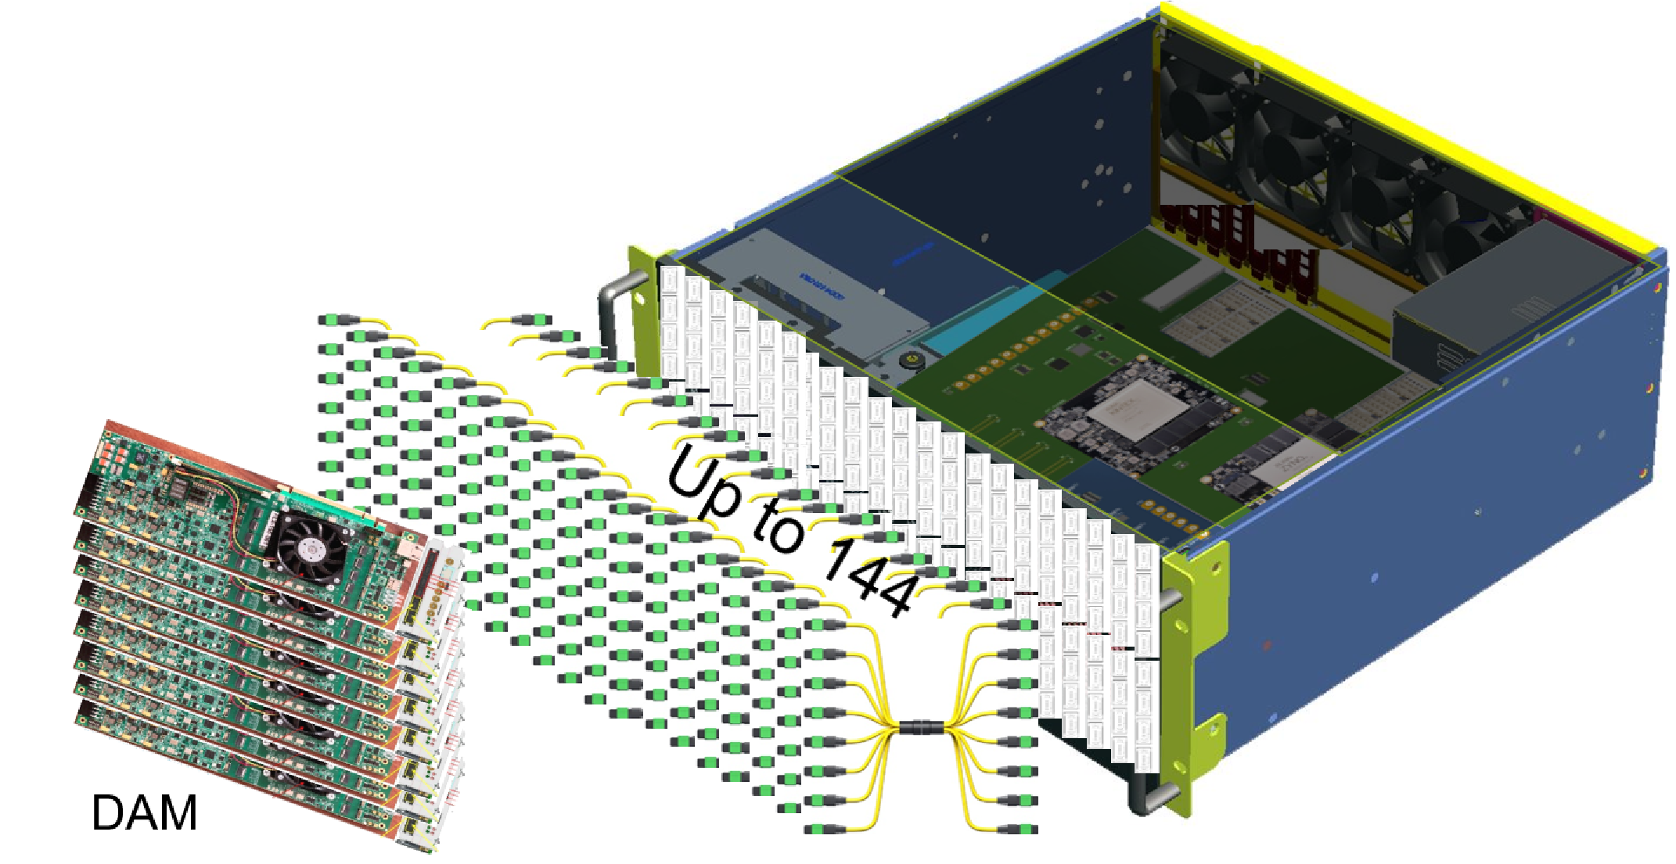
Overview of the GTU
The Global Timing Unit Consists of a 4u, 19” rack mounted, air-cooled box containing
  GTU base board
  Optic transceiver adaptor boards
  Clock monitor board
Boards in advanced design
  Internal Review for PCB fabrication on 11/5/25
  Expect articles early 2026

Slide 17
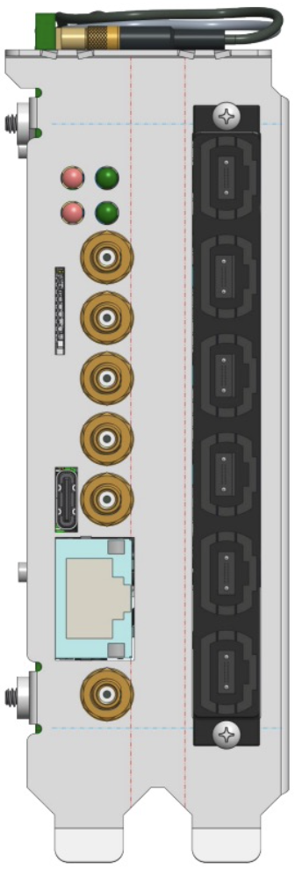
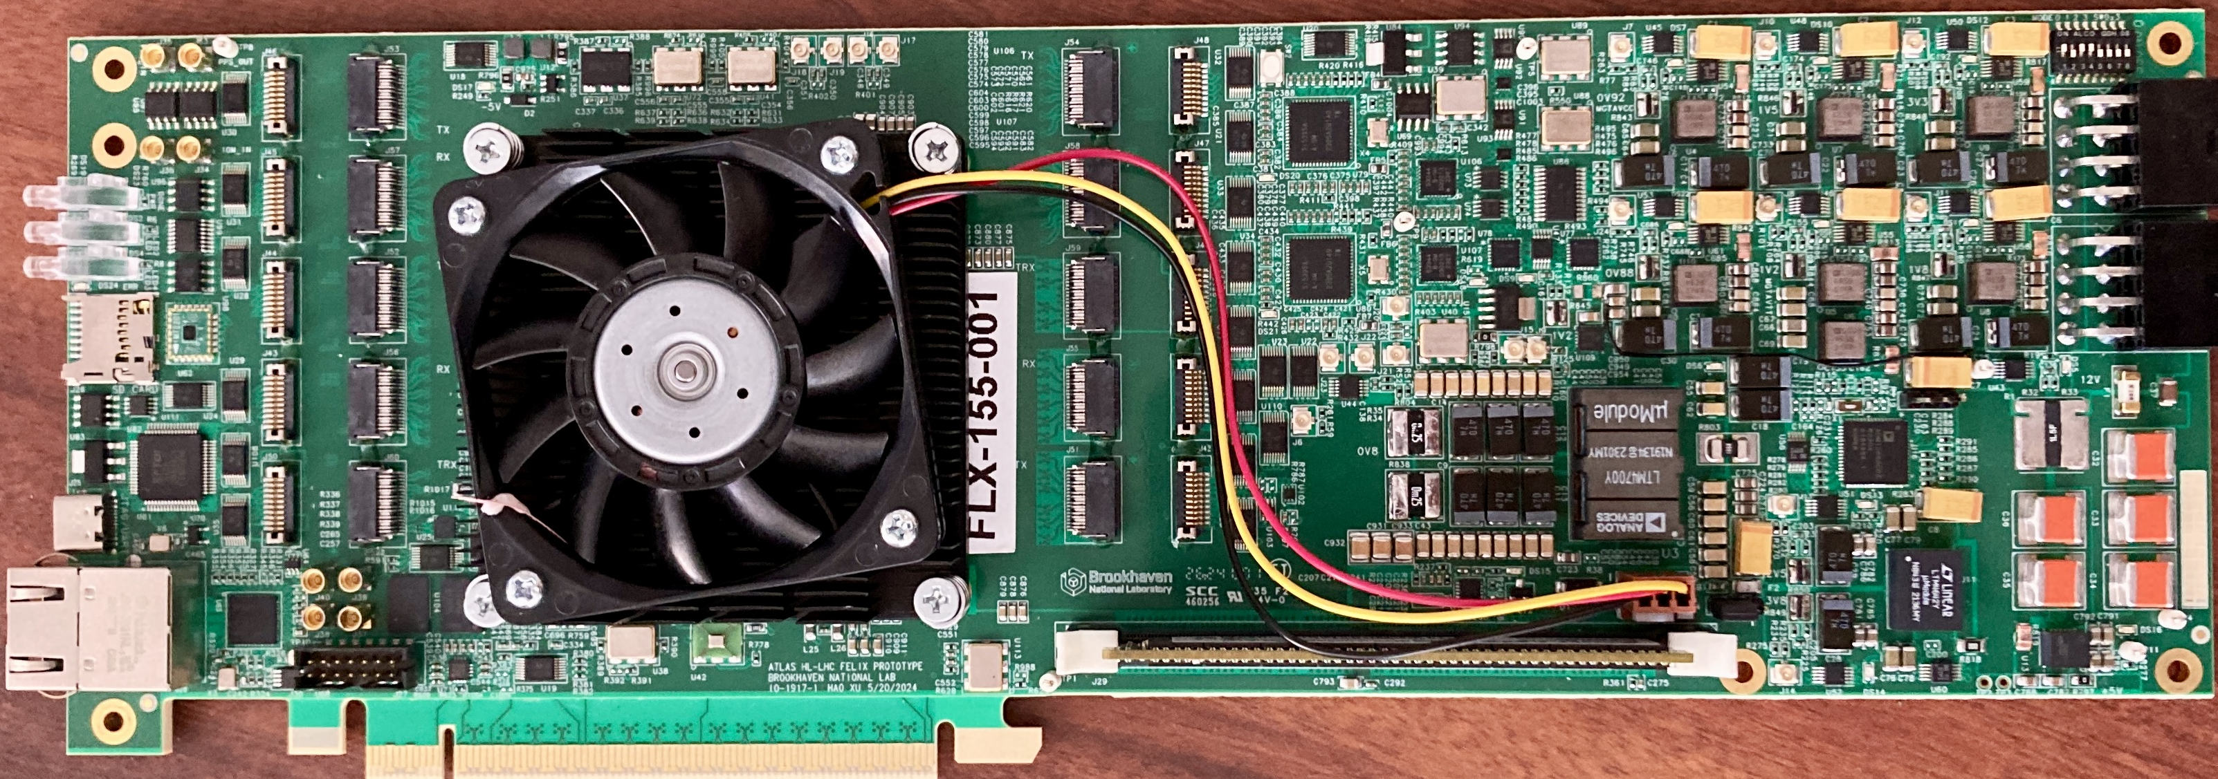
FELIX Updates – FLX-155 – DAM Status
Front-End Link eXchange
Versal Ultrascale+ FPGA/SoC
Linux OS, Clock Distribution, Stream Frame Builder, Optional fixed latency processing
( data output via Ethernet and/or PCIe)
GTU interface
100Gb
Ethernet
External
Power
(<175Watts)
48 bi-directional links to RDO/FEBs
FELIX hardware for future ATLAS experiments at HL-LHC is being developed at BNL (Omega Group)
  ePIC is collaborating with Omega to use this design as our DAM board.
Initial engineering articles were tested in early 2025. Updated PCB design sent out for fabrication/population
  Final design board will be tested this Fall (2025).
We expect to produce at ~4 boards for ePIC use after testing. Availability anticipated in early 2026
  Currently we have two 24-port versions (FELIX 182) being used for development

Slide 18
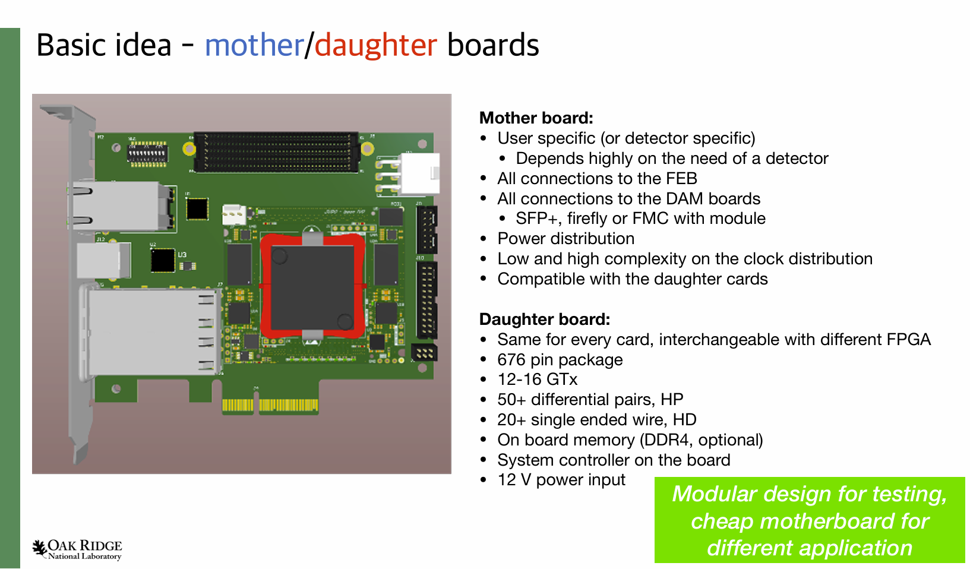
Generic RDO

Slide 19
Front End Boards and RDOs
Front End Boards:
Organized By ASIC/Sensor
MAPS
Timepix
Astropix
CALOROC
EICROC
SAMPA
FCFD
Fwd/Back
Ecal
ALCOR
Direct Photon
RDO Electronics have several
Flavors
4 → 1 Generic RDO
16 → 1 Generic RDO
Fiber Aggregator
ALCOR RDO
ASTROPIX End of
Stave Card
Spyder Variant
Integrated and managed
under detector groups
as part of sensor development
Generic RDO supporting multiple potentially varied ASIC choices
(Norbert Novitzky’s Presentation)
General electronics design
planned by technology but will
split into specific form factors for
individual detectors depending
on integration needs
Electronic Design is waiting
on ASIC completion but
PCBs exist and used for testing
of proceeding ASIC variants
e.g. ETROC / HGCROC2 / SALSA
Planned RDO for forward ECAL – the only functional difference larger aggregation will likely merge with 4 → 1 Generic RDO
Specific RDO for MAPS to reduce O(6000) fibers to manageable number. Cost & FPGA capability being analyzed. May merge with 4→1 RDO
dRICH physical / data rate needs. Articles existing under testing
Discrete design in advanced form. Development for Forward ECAL but expected for other small calorimeters
Designs planned but not yet begun. Development by groups with prior experience developing similar boards for similar technologies
Design in advanced form for dRICH
Unique System in ePIC. Streaming ADCs with no zero-suppression..

