Slide 1
Electronics & DAQ WG
Fernando Barbosa (JLab)
12 February 2026

Slide 2
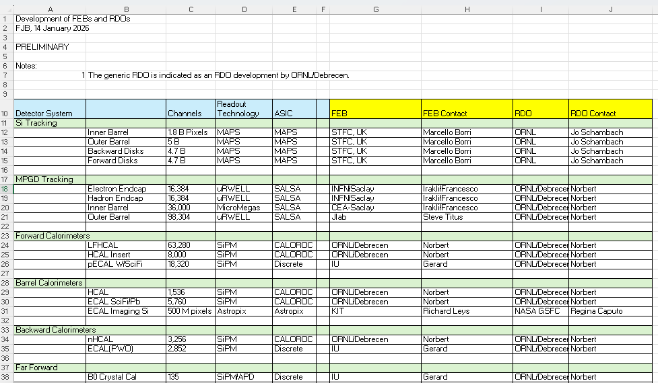
Agenda
Today: ASIC & Electronics Status Updates
Internal assessment reviews of each ASIC/Discrete to be scheduled starting in Q1 2026
March - May 2026 – Discrete + 6 ASICs. Preferences?
FEBs/RDOs Responsibilities: Review Excel file in the meeting link. Provide feedback.

