Slide 1
02/10/26 update
Tianhao Jin (OSU)

Slide 2
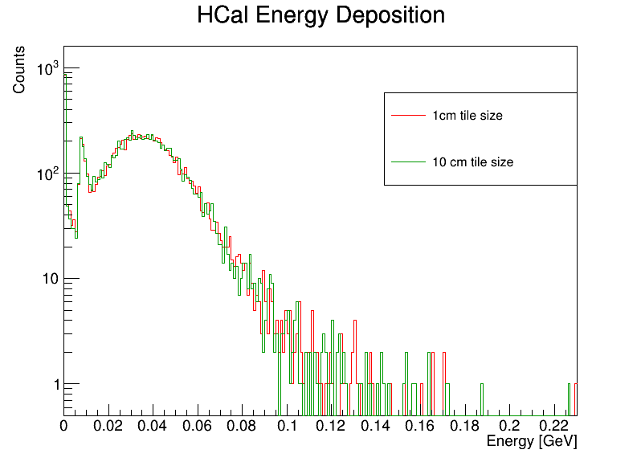
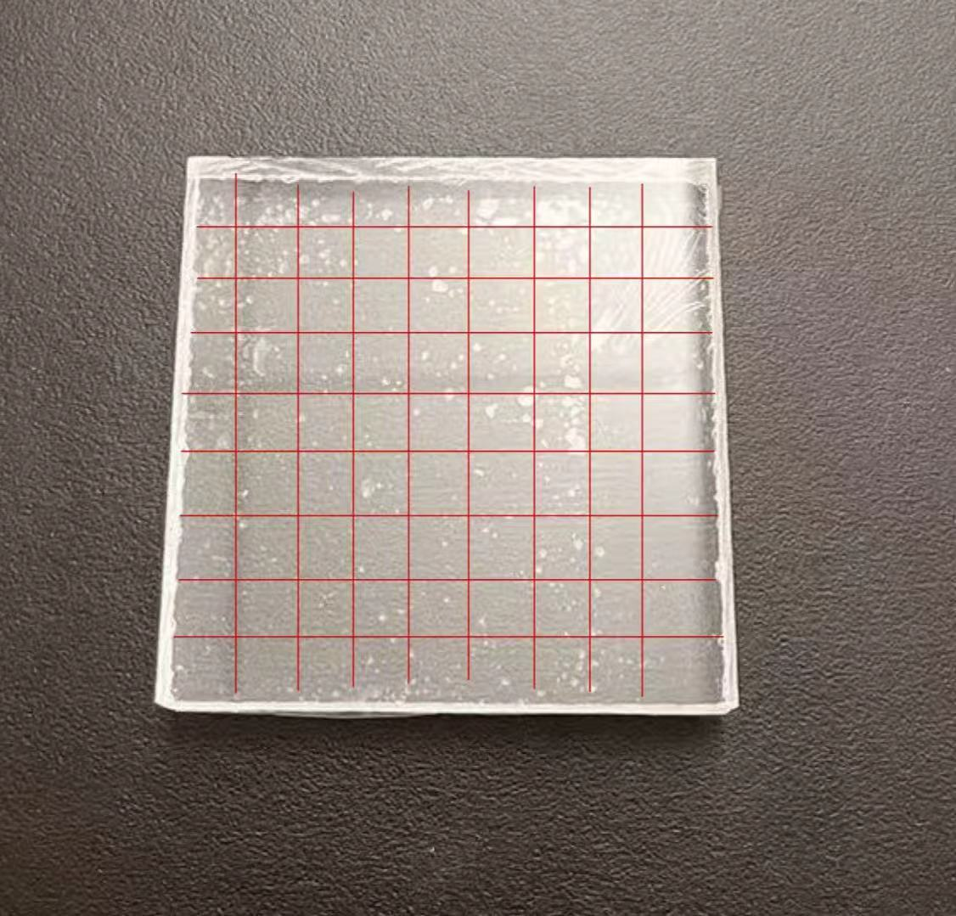
Smaller tiles
Divided the scintillator to 100 smaller tiles.

Slide 3
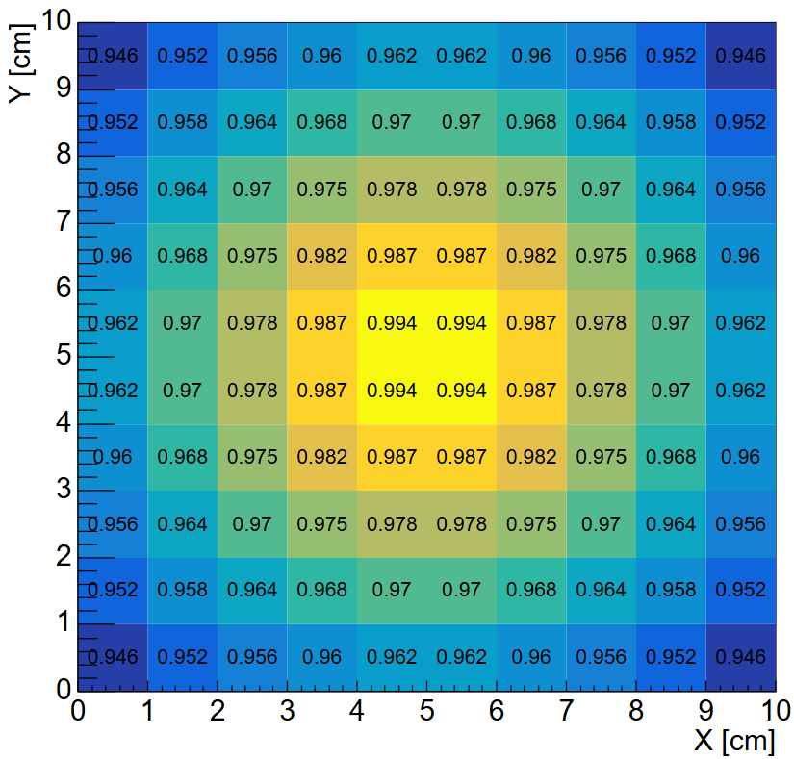
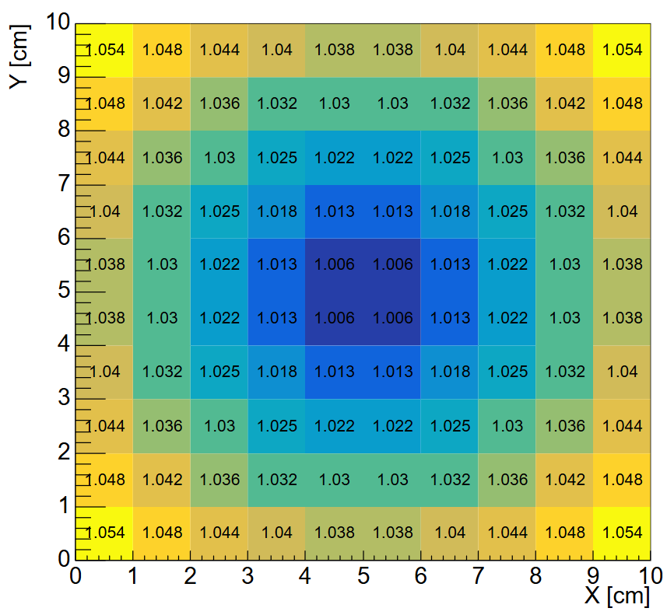


Weight map for different non-uniformity setup

Slide 4
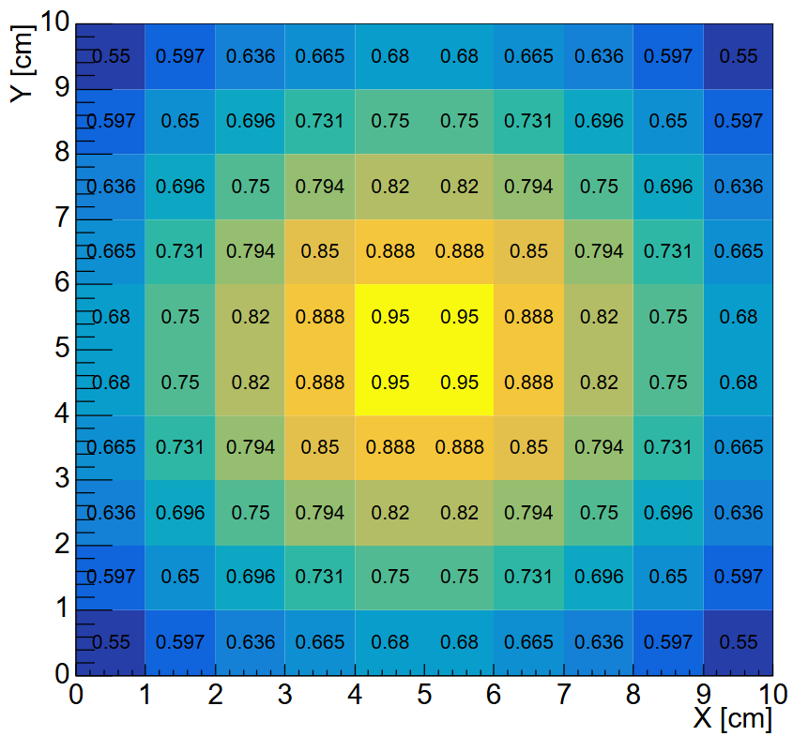
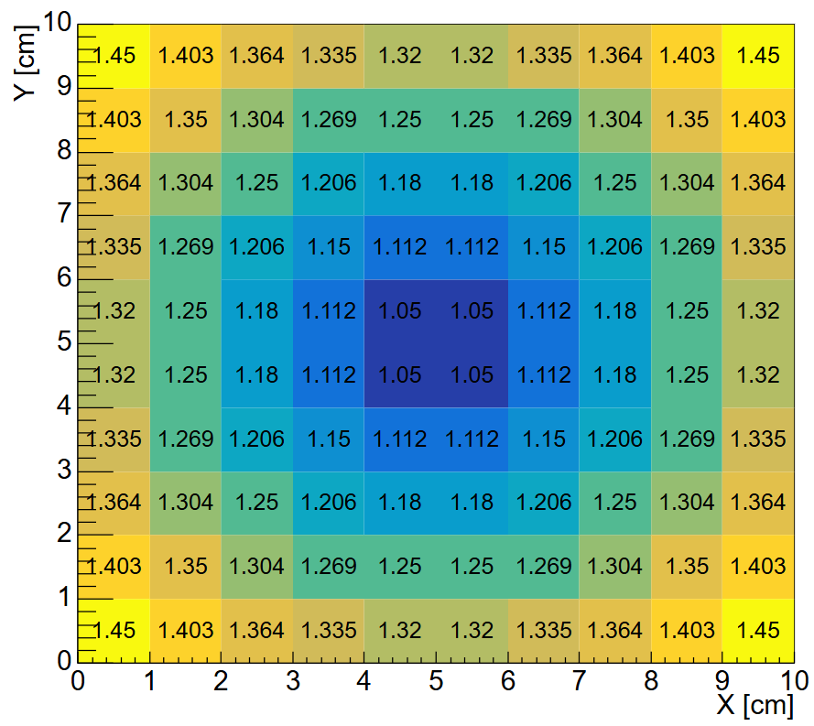



Weight map for a larger non-uniformity

Slide 5
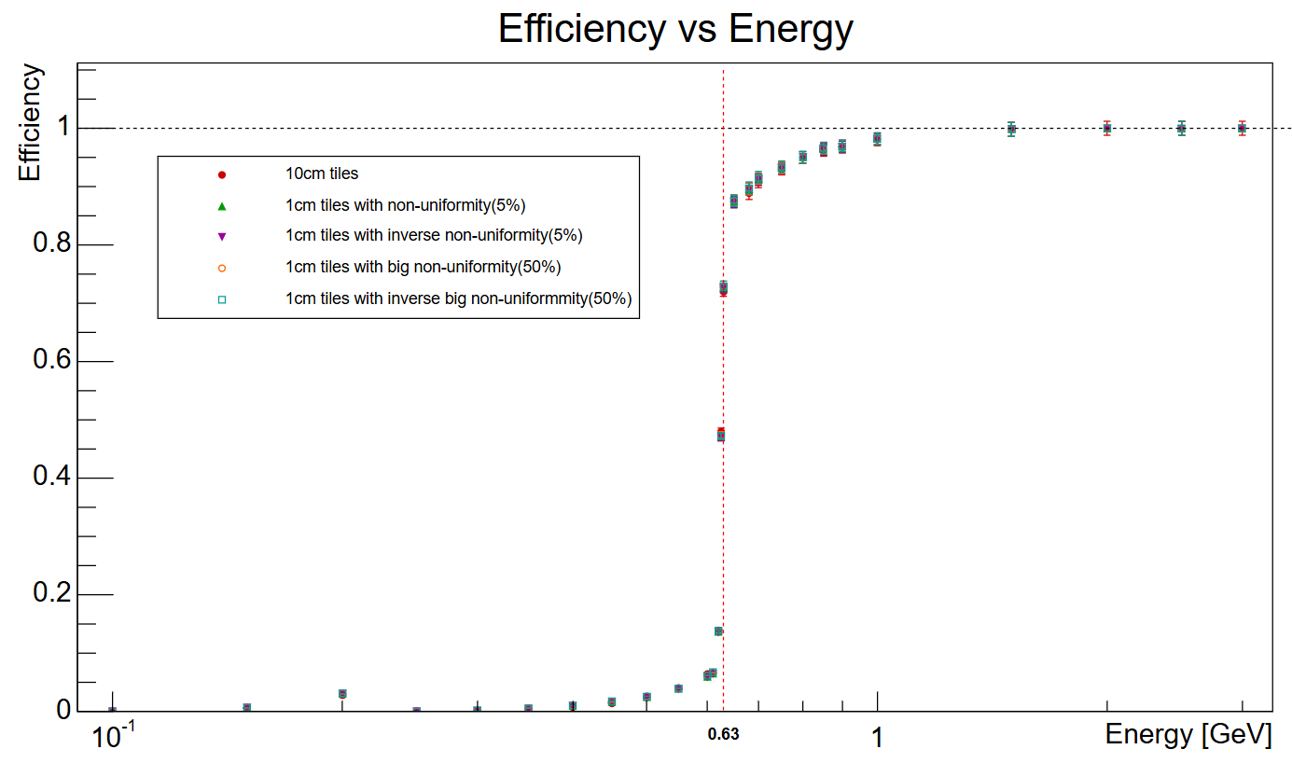
Efficiency of proton of different non-uniformity

Slide 6
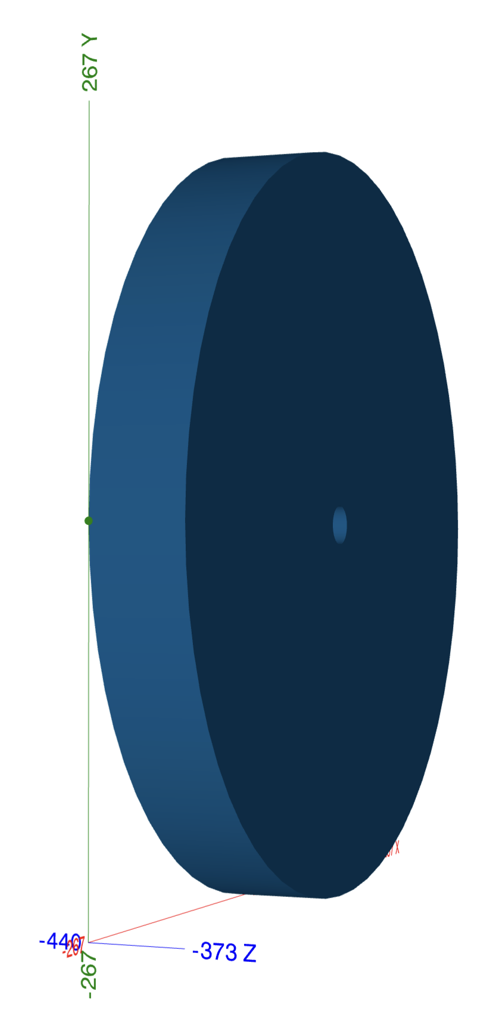
Up to date geometry
11 layers of Polystyrene (2.4cm)
10 layers of StainlessSteelSAE304 (4.0cm)

Slide 7
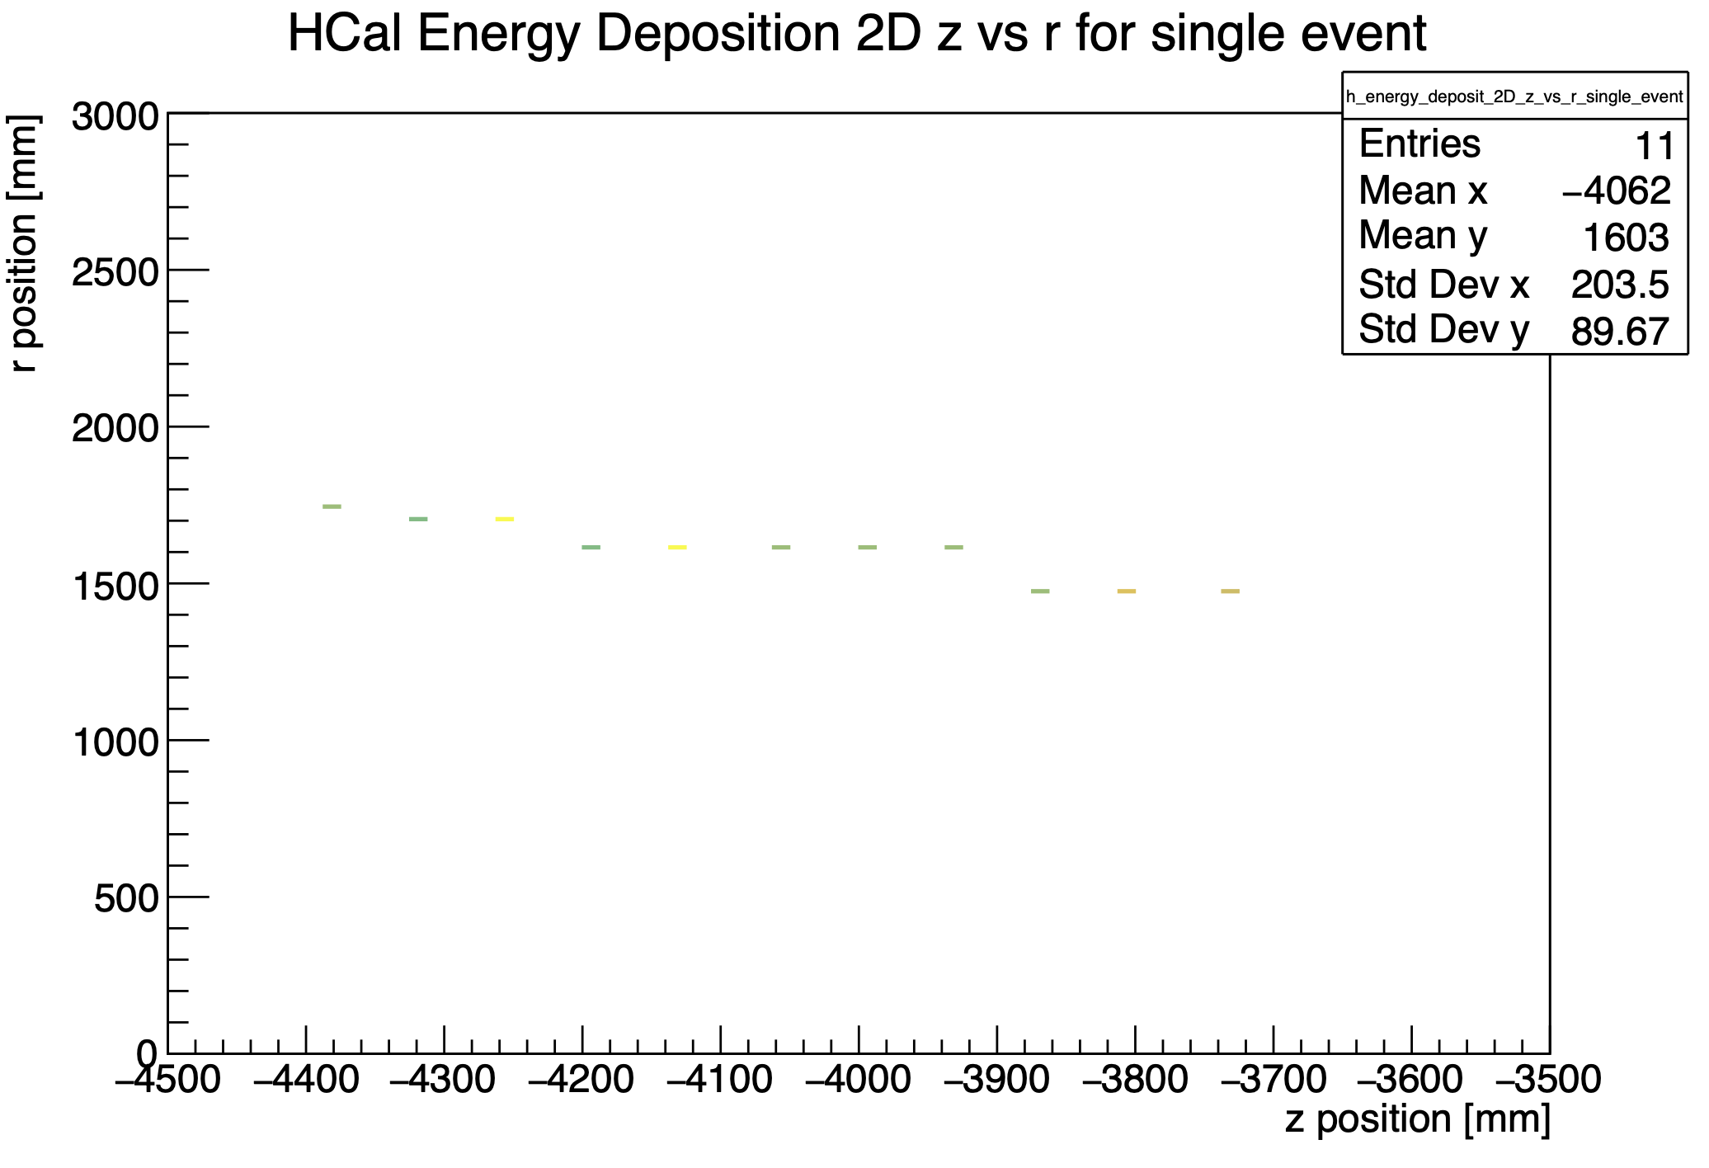
Goal
Find muon
Test how the non-uniformity will change the muon detection efficiency.

