Slide 1
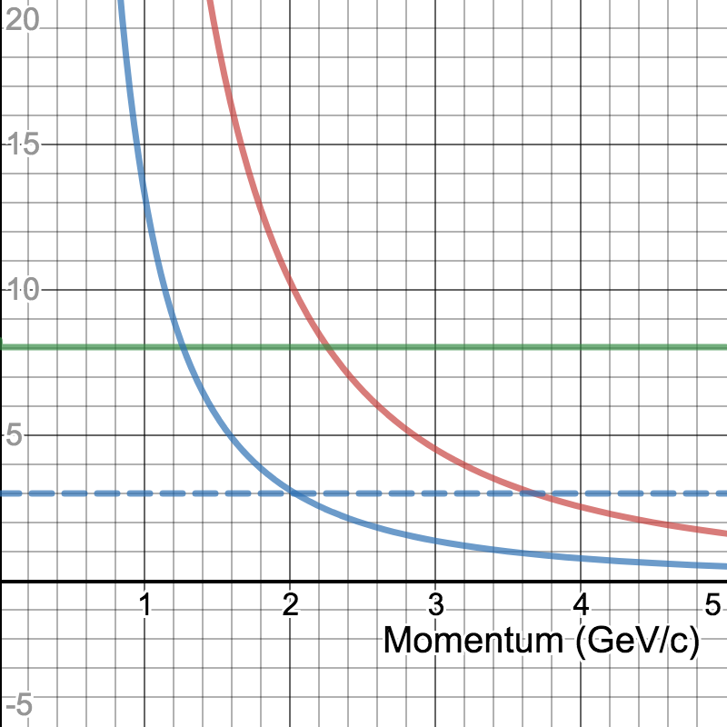
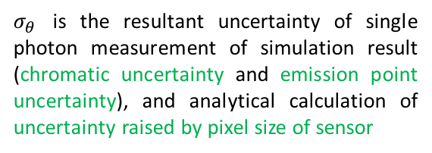
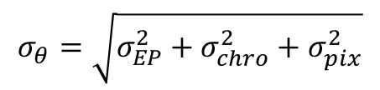
Estimation of e/pi Separation Power
Δθ (mrad)
Δθ (mrad)
Num. of Sigma
$$σ_{θ}=\sqrt{σ_{EP}^{2}+σ_{chro}^{2}+σ_{pix}^{2}}$$
Num. of Sigma
σ_{θ} (mrad)
$σ_{θ}$ is the resultant uncertainty of single photon measurement of simulation result (chromatic uncertainty and emission point uncertainty), and analytical calculation of uncertainty raised by pixel size of sensor
σ_{θ} (mrad)
3-sigma
3-sigma
(2.04 GeV/c, 3σ)
(2.04 GeV/c, 3σ)
Refractive index of aerogel = 1.03
Focal length of Fresnel lens = 6”
Pixel size of photon sensor = 3mm x 3mm
Number of photons (per event) on ring (from beam test result) =5.9

