Slide 1
Electronics and DAQ WG Meeting (2/26/2026) - Polarimetry
Announcements, Schedule, News
Polarimetry
Overview of Electronics / DAQ plans (Me)
Polarimetry Group
Electron Polarimeters (Dave Gaskell)
RCS
IP6
Hadron Polarimeters (Frank Rathmann)
IP4
IR6
Discussion…

Slide 2
Schedule
CD-3B approval (Feb 6th)
Detector Baseline Review: February 3-5, 2026
E & DAQ Meetings:
2/25 E & DAQ WG: Polarimetry
3/5 E & DAQ WG: SVT Slow Controls Links
3/12 – No E & DAQ Meeting due to Director’s EIC Review
3/19 – E & DAQ WG: ASICs and Electronics Monthly Meeting
3/26 – E & DAQ WG: Felix Test Development / Test Stands
Echelon 1 / ESNET
At collaboration meeting discussed with SCDF. Planning to add network, and 1 rack at SCDF by end of calender 2026. Can be used with testbeds being developed by SRO for “orchestration”, data transfer, and calibration workflow tests
Today – SCDF / ESNET workshop. Discussing EIC needs this afternoon.
Reviews
Director’s EIC Review: March 9-12, 2026
DOE Independent Project Review of the EIC Project Status: 4/28-5/1, 2026
DOE CD-2 Review for DET subproject (Goal is by end of 2026)
PDR → Peer Review for Slow Controls (~June 2026)
2025: Slow Controls Scope Workshop with EIC Controls (13 November 2025) · Indico
Need more complete scope definition
Distinction between controls (EPICs control of detector)
Safety Systems (PLC based interlocks and safety controls)
Overlap between EIC Controls and ePIC’s controls.
Overlap between scope in Detector Control Accounts vs Slow Controls Integration Control Account.
Test stand setup
Needs to be defined and will need change control request procedure
Goal for CD-3 is by end of 2027 – need to start planning FDR’s and expect similar review schedule in 2027 aimed towards CD-3

Slide 3
Other Activities
Last TIC Meeting:
There is a global collaboration effort to get better understanding / control of backgrounds and data rates.
Effects on Physics
Physical Effects on Detectors
Effects on Data Volumes
Our part in this:
Develop a summary document:
Table of Maximum Rates per ASIC / FEB
Table of Maximum Rates per RDO / Fiber / FELIX where these funnel less potential data than maximum front end rates
Failure modes of each if higher rates are present
Some of you will be working with detectors:
Understand mapping of detector simulations hits to channel data in ASICs / FEBs
Compare rates between detector simulations and DAQ/Electronics capabilities & define safety margins
Project effort to understand heat load in detector
Mechanical and Electrical Engineers from each detector to be invited to project electronics engineering meeting over next months
Need good info about all sources of board heat generation (ie. Questions about bpol48 heat generation?)
Need good info about distribution of heat sources. (Can start with parametric description of location and density of heat sources, but moving towards specification detailed locations of electronics)
Reminder on priorities for 2026 discussed January
Needed software support: contact us for packages used / needed.
Should include need for source code version control
Git for software
Firmware?

Slide 4
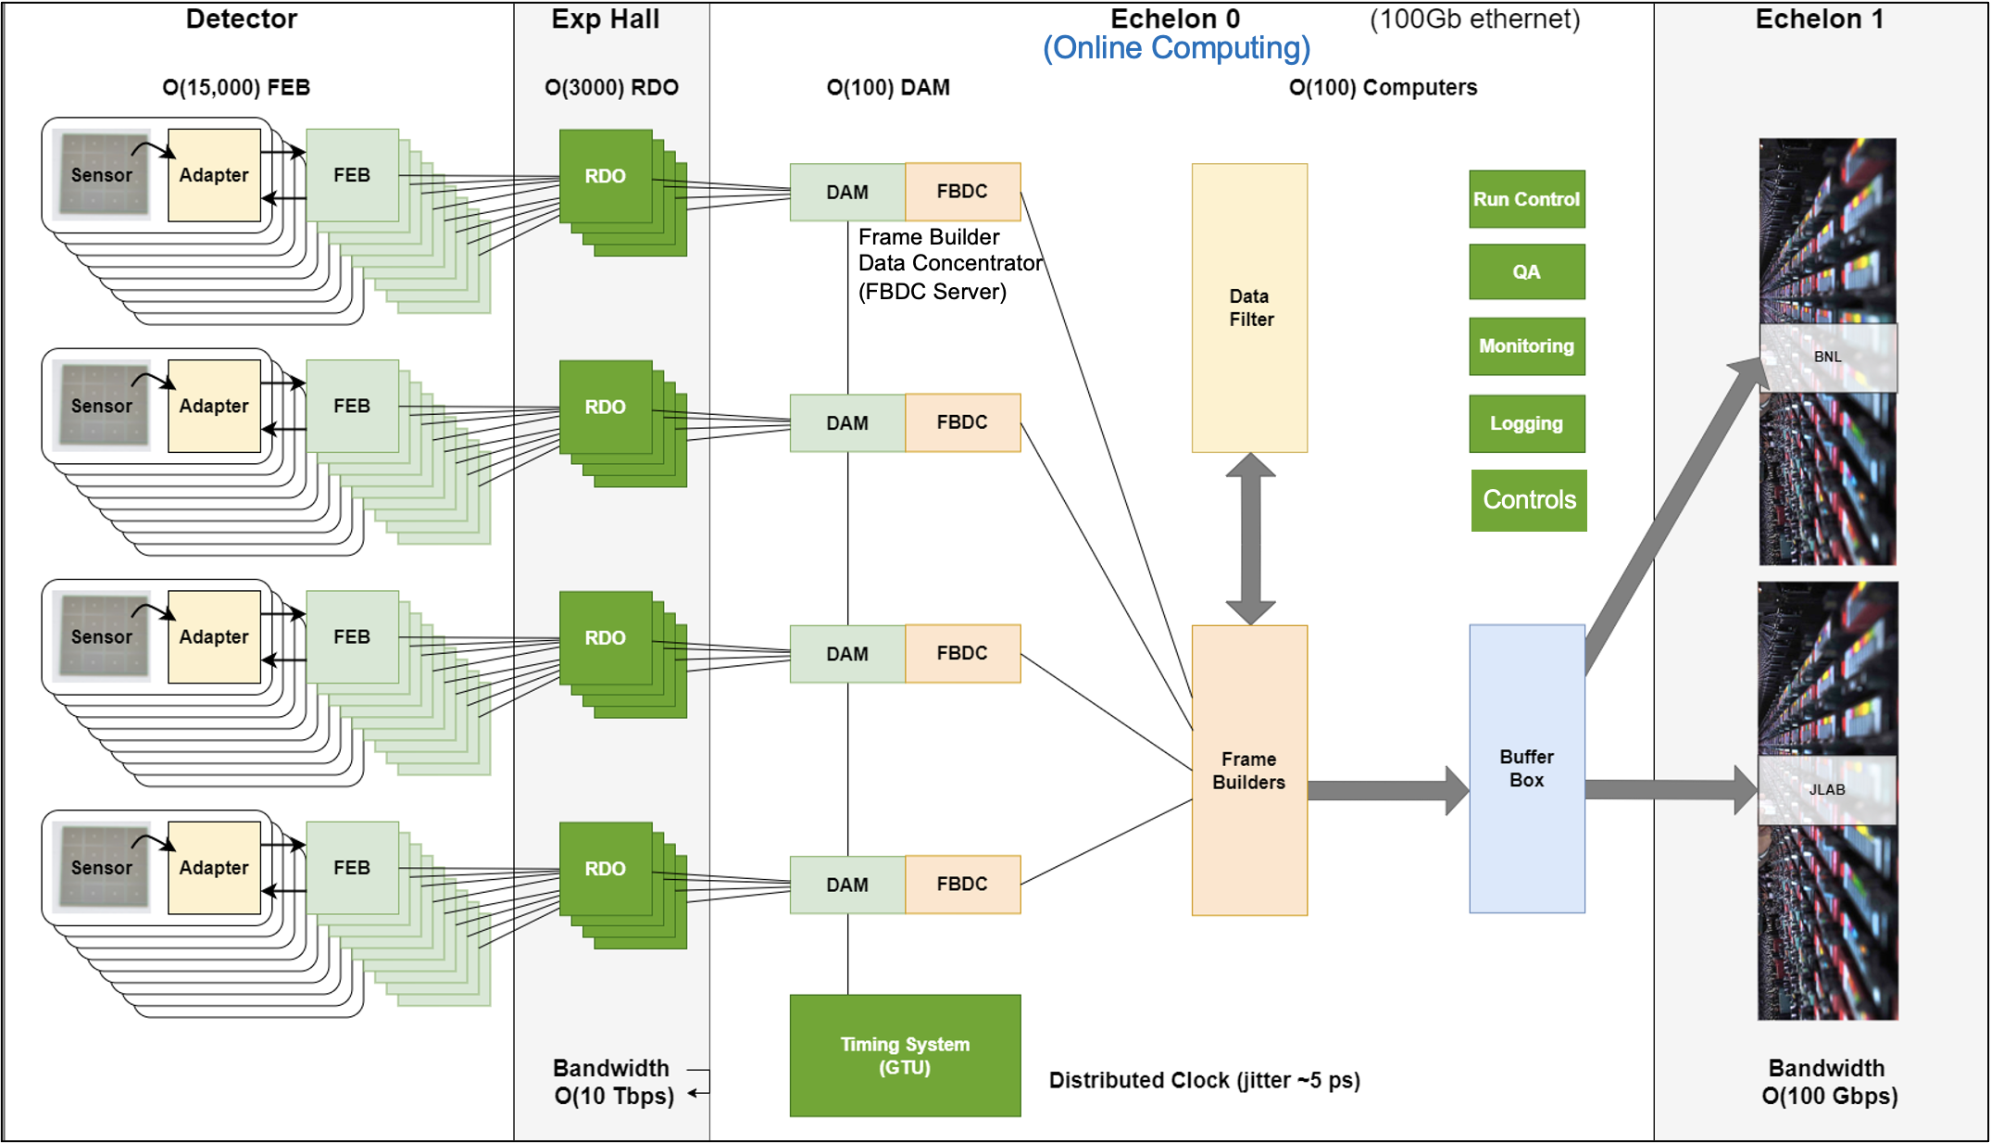
Polarimetry – DAQ Perspective

Slide 5
Polarimetry – DAQ Perspective
The current understanding is very sketchy but we do have some global plans:
Slow controls components and readout electronics are costed as part of the polarimetery control accounts
Digitization to be organized with potential help from Electronics CAM, but specific relationship not defined yet.
Storage scheme to go through DAQ, including streaming concept, GTU, FELIX, and long term storage interfaces. There doesn’t seem to be a lot of value to unify polarimetry data with the main ePIC DAQ stream, but this is still potentially an open issue.
3 physical locations for polarimeters (RCS, IP4 & IP6), and at least IP4/RCS need independent systems.
Operational Mode is likely to be different from standard DAQ operation and is possibly different for different polarimeter components. In RHIC operations:
Global polarimetery:
Each polarimeter has different needs (runs for different lengths of time, etc…)
fully separated from the detector data analysis. It was operated in the context of the collider
It was managed by a mixed group of STAR/PHENIX & Collider people
It produced polarimetry values which were the result of analyzed data for relatively large time periods (Fills, or at least hours within a fill)
Other data / data analysis was outside the domain of the detectors
Local polarimetry was done as analysis on detectors that were part of the physics program through the standard data stream
I don’t know how this will be appropriately translated for the EIC
The operational responsibility may be shared with EIC main control room?
Whether the data is analyzed as part of the ePIC streaming reconstruction or not also needs to be understood and resolved. Part of this depends on whether polarization will be organized by the collaboration or by the collider.

