Slide 1
ESR and RCS Compton DAQ
Dave Gaskell
2/26/2026

Slide 2
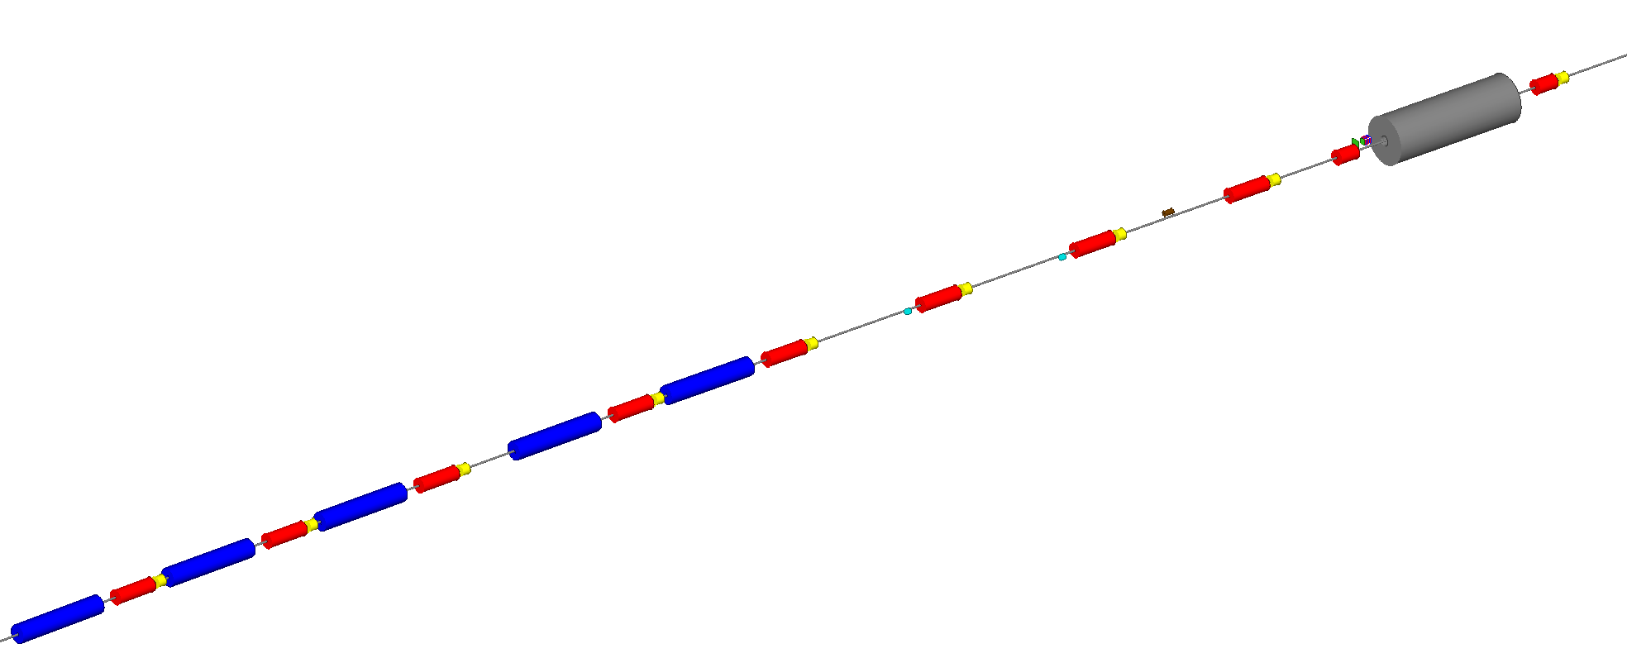
ESR Compton Layout
Three key interfaces with electron ring:
Laser-electron beam interaction region
Backscattered photon exit and transport to detector
Electron detector
Photon Detector
(30 m from Laser IP)
Crab cavity
Electron Detector
D2EF
Q3EF
Q4EF
D3EF
θ_{B}=13 mr
Q5EF
D4EF
θ_{B}=1.5 mr
Q6EF
D5EF
θ_{B}=1.5 mr
Q7EF
*
Q8EF
D6EF
θ_{B}=12 mr
Q9EF
Q10EF
Key requirement: bunch-by-bunch measurement:
Implies 100 MHz “readout” at 5 and 10 GeV
25 MHz at 18 GeV
Laser IP​
74 m upstream of IP-6

Slide 3
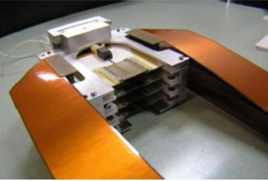
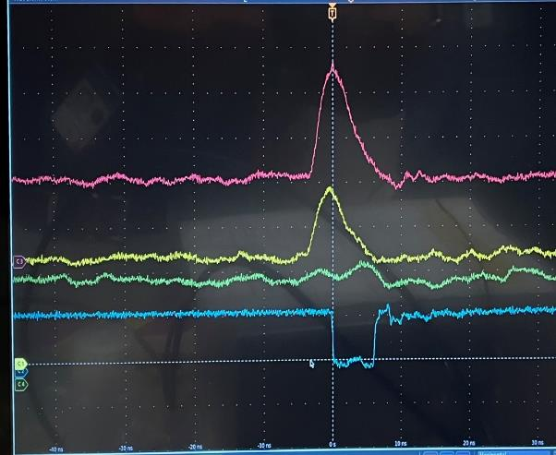
Electron Detector
10 ns
Hall C diamond strip detector
Signals from CALYPSO/FLAT32 prototype
Will use 4 planes of diamond strips to detect scattered electrons
Active area = 6 cm, segmentation = 0.4 mm → 150 channels per plane
Total number of channels = 600

Slide 4
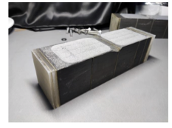
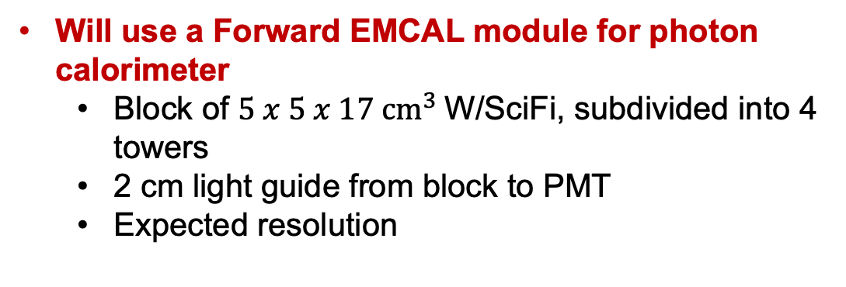
Photon Detector
Will use a Forward EMCAL module for photon calorimeter
Block of $5 x 5 x 17 {cm}^{3}$W/SciFi, subdivided into 4 towers
2 cm light guide from block to PMT
Expected resolution
Would like to read out in threshold-less, energy integrating mode → this is easiest with a single PMT
→ Some subset of full waveforms also desireable
Will use also need to use diamond strips for transverse polarization measurement
Size = 5 cm, segmentation = 0.1 mm → 500 channels per plane
2 planes → 1000 total channels

Slide 5
ESR Compton Readout summary
Detectors
1600 channels for diamond strip detectors → LVDS pulses, < 10 ns wide
LVDS repeater will likely be required to propagate signals to DAQ
1 channel for photon calorimeter → FADC
Other signals
BPM from laser IP (for each bunch)
Beam intensity measurement (for each bunch)
Laser signals (photodiodes, power, position measurements) → slow ok
Laser helicity
Various slow signals from epics

Slide 6
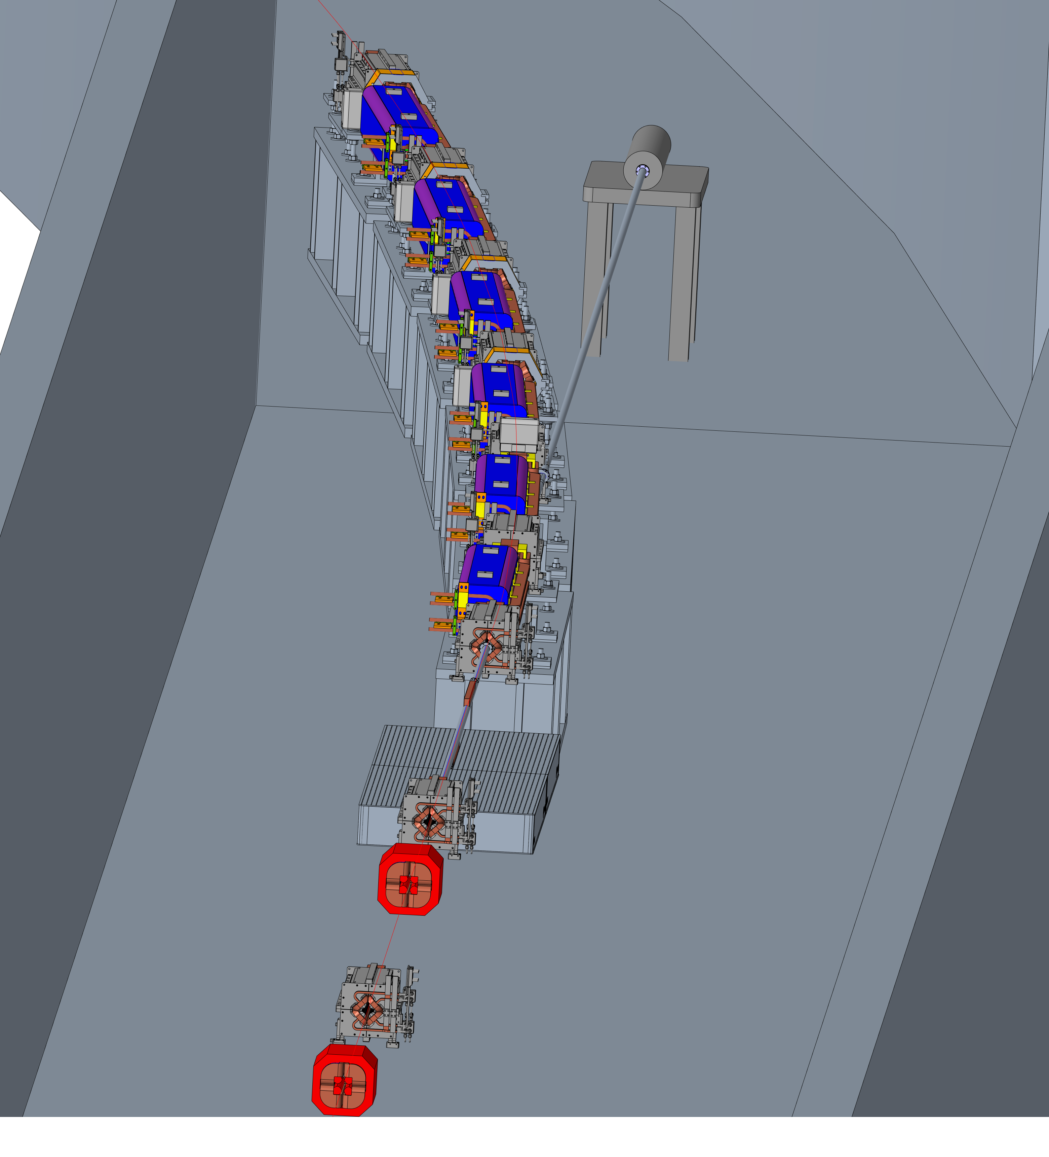
RCS Compton Polarimeter
RCS polarimeter similar to ESR Compton
No electron detector
Will use same detectors for photon detector
Calorimeter
Diamond strips

Slide 7
RCS Operation Mode
RCS must accelerate electrons from 0.75 to nominal ESR beam energy → 5, 10 , 18 GeV
Racetrack design: 2 accelerating linacs with recirculating arcs
Designed to maintain (vertical) polarization through acceleration
Ramp time < 500 ms at 10 GeV
ESR fill time @10 GeV 19.33 minutes
1160 buckets at 1 Hz
RCS properties
Property | Value
Injection energy | 0.75 GeV
Bunch train repetition rate | 1 Hz
Charge per bunch | Up to 28 nC
Max. current | 5.9 mA
Circumference | 1421.26 m
RCS Compton will operate in “multi-photon” mode
thousands of backscattered photons per collision
average over several bunches at a given energy

Slide 8
RCS Readout Summary
Detectors
1000 channels for diamond strip detectors → analog pulses (not LVDS)
1 channel for photon calorimeter → FADC
Other signals
BPM from laser IP (for each bunch)
Beam intensity measurement (for each bunch)
Laser signals (photodiodes, power, position measurements) → slow ok
Laser helicity
Various slow signals from epics

