Slide 1
Detector readout for HJET polarimeter
E. Shulga for Polarimetry Effort

Slide 2
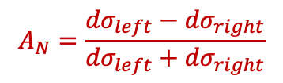

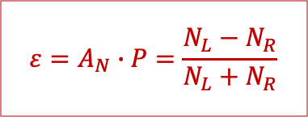
Measurement
Interference between electromagnetic (Coulomb) and strong (nuclear) forces at small scattering angles creates a spin-dependent asymmetry.
Measurement of recoils in one direction versus the other, can determine the beam polarization using the known analyzing power of the reaction.
CNI region (0.001<-t<0.03 (GeV/c)²) has a large, calculable analyzing power (A_{N}), the beam polarization (P) is directly proportional to this asymmetry (𝜀)
Detectors are registering recoil target particles (p, C) and provide direct 𝜀 measurement
Left detector
proton/Carbon
Target
proton Beam
Right detector
$$σ_{P}=σ_{0}(1+A_{N}P_{y}\cos{φ})$$
$$A_{N}=\frac{{dσ}_{left}−{dσ}_{right}}{{dσ}_{left}+{dσ}_{right}}$$
$$ε=A_{N}∙P=\frac{N_{L}−N_{R}}{N_{L}+N_{R}}$$

Slide 3
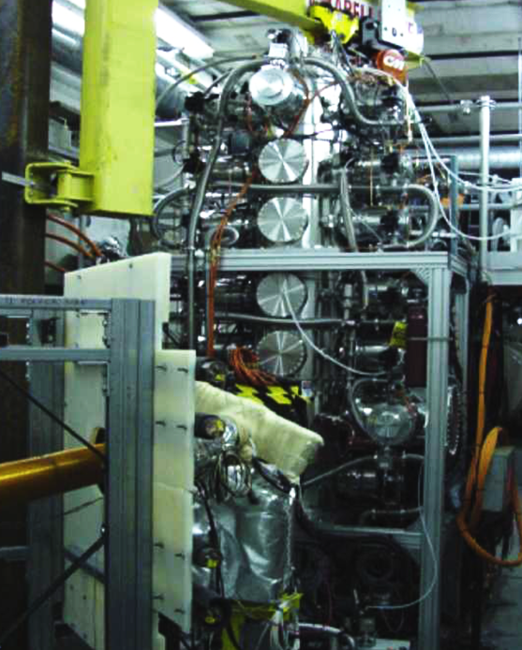
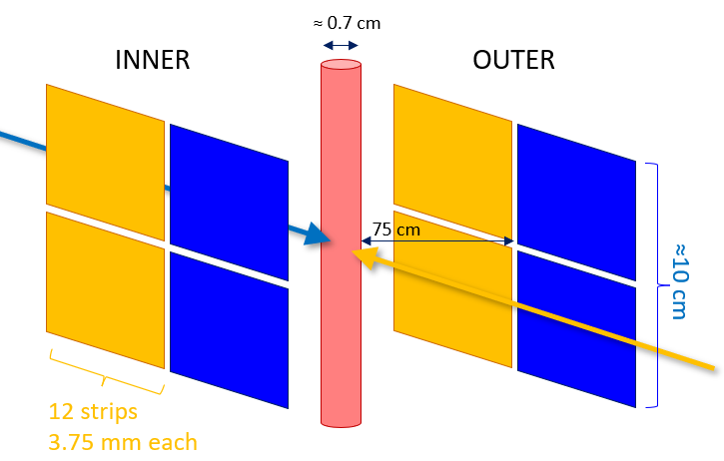
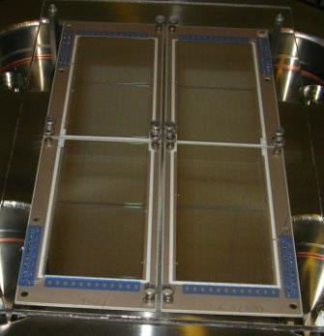
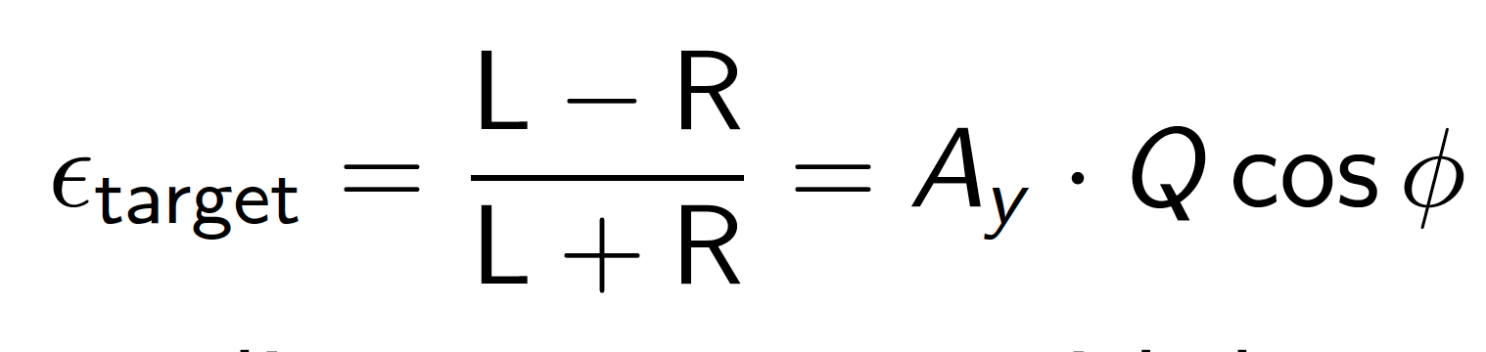
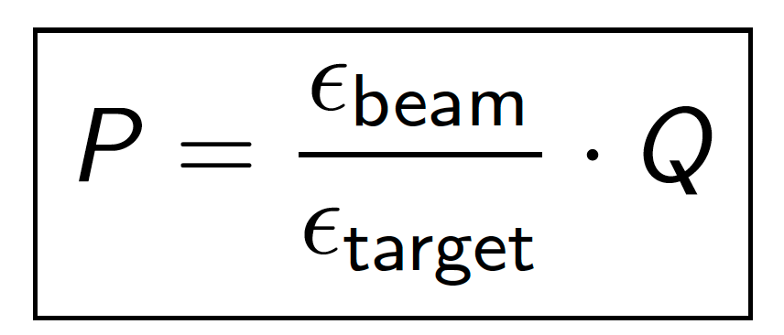

HJET polarimeter detectors: Current setup
R/L
L/R
8 Si-strip detectors:
12 vertical strips
3.75mm pitch
500 μm thickness
Proton beam passes through target of polarized H atoms of known polarization Q
Beam
Present setup: L-R detectors and guide field B_{y}
Only vertical component P_{y} measurable near $θ=\frac{π}{2}$

Slide 4
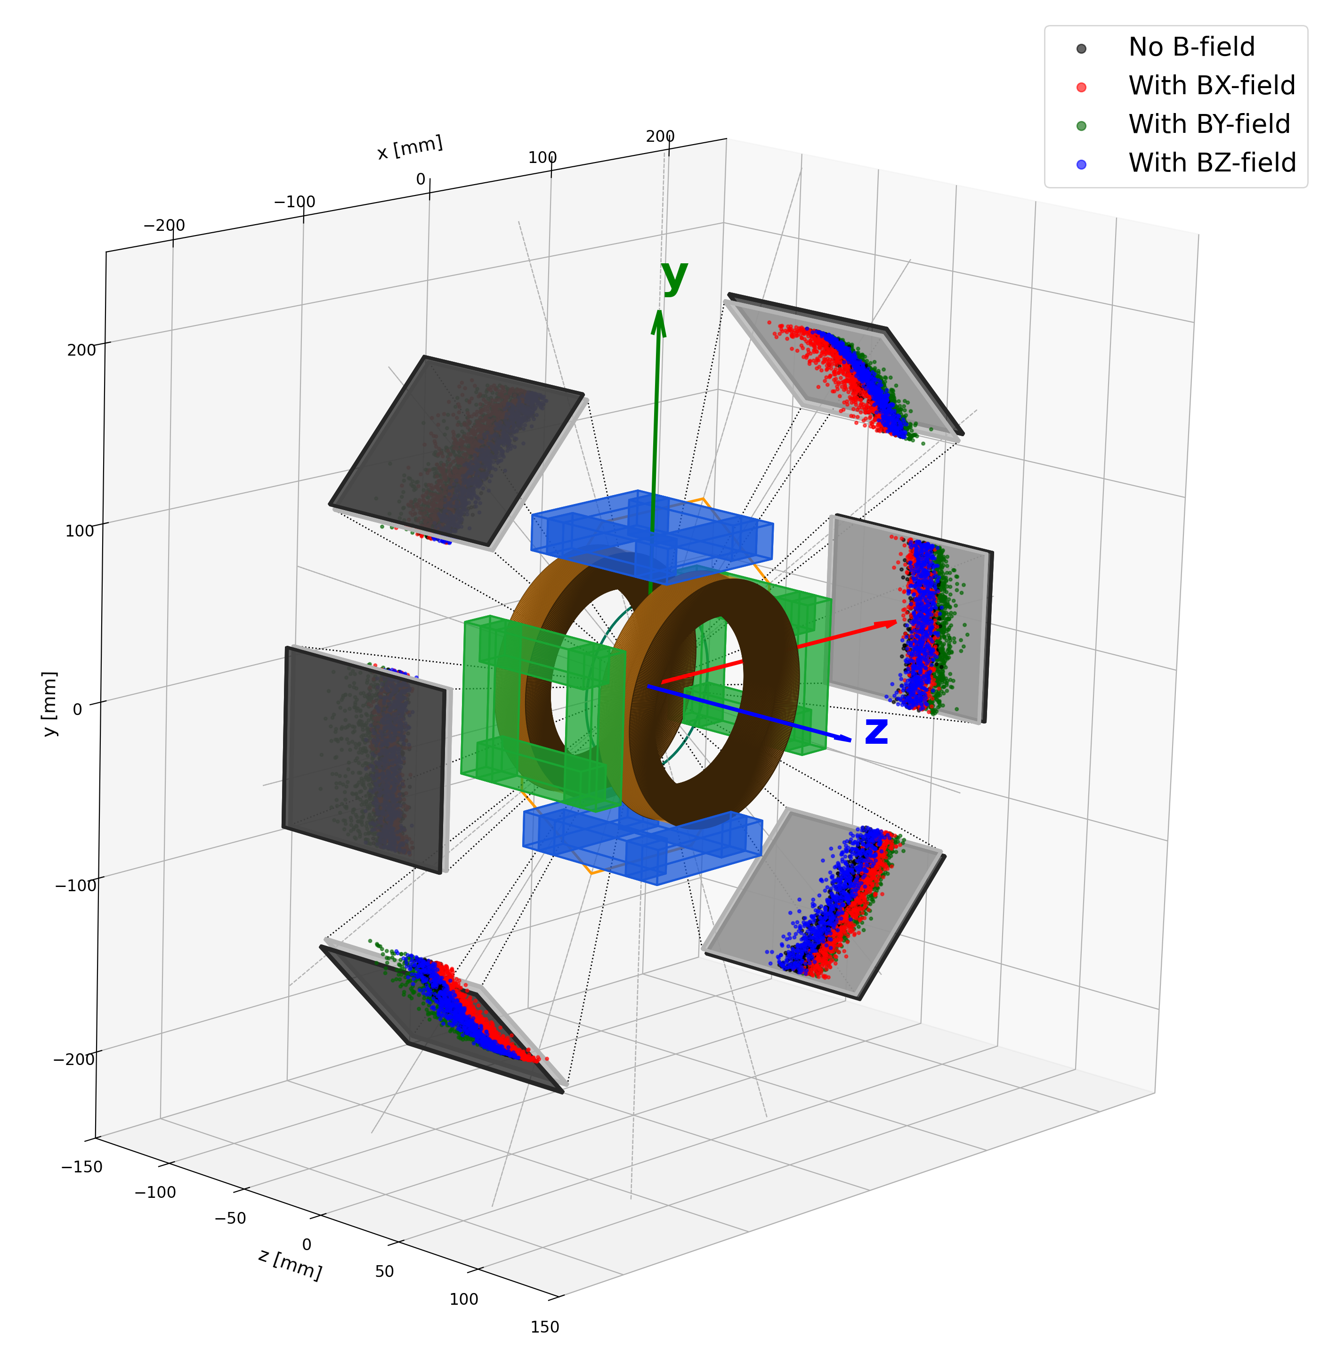
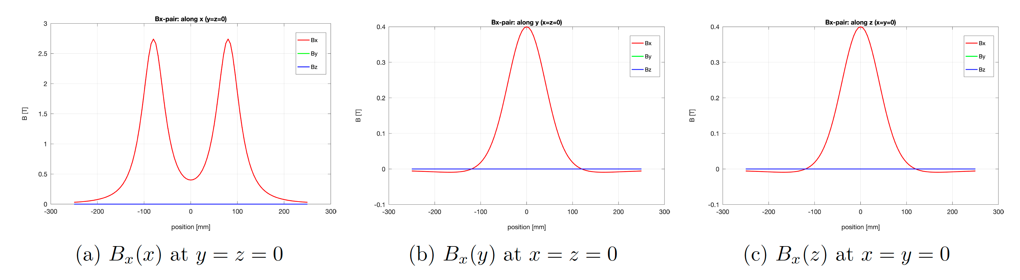
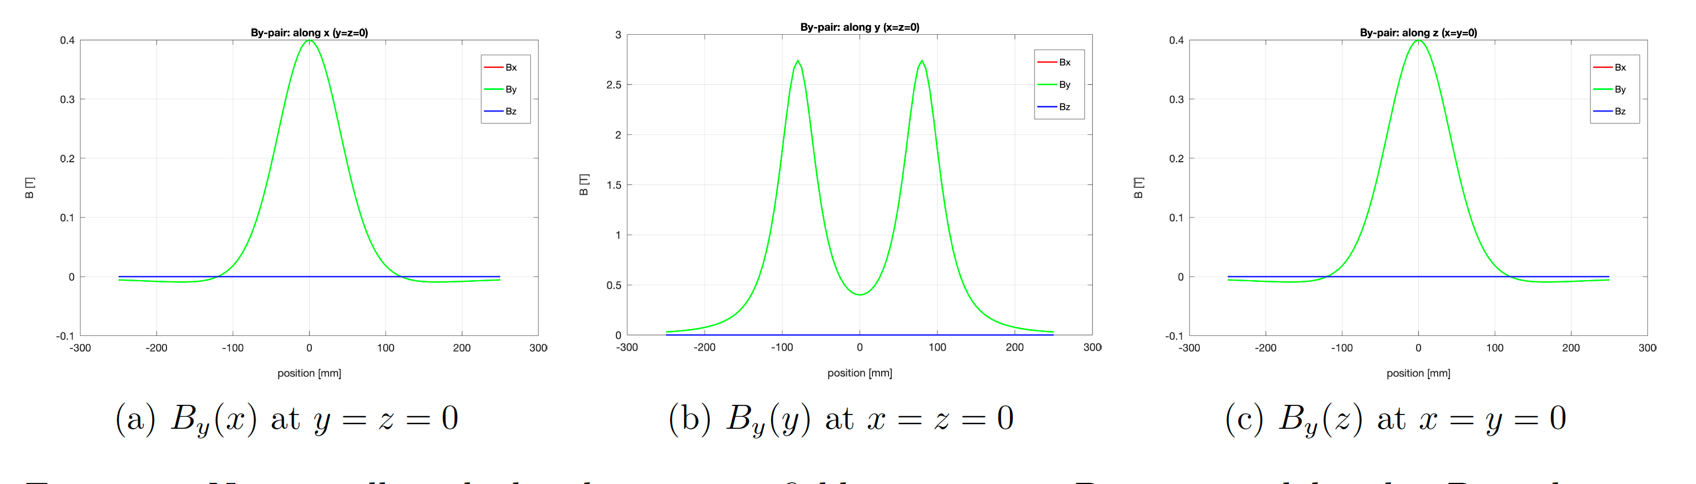
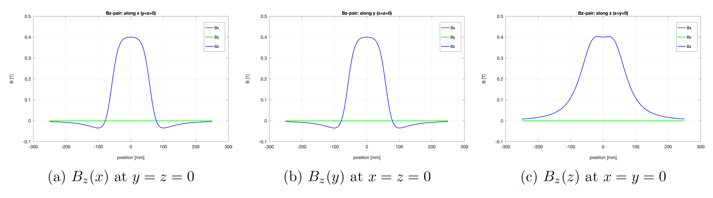
HJET polarimeter detectors: Holding field effects
Charges #1, 3
Strong transverse holding field required to suppress beam-induced depolarization Bx, B_{y}, B_{z}
Toy MC recoil p results for HJET:
Work in progress
Colored points represent endpoints of recoil protons

Slide 5
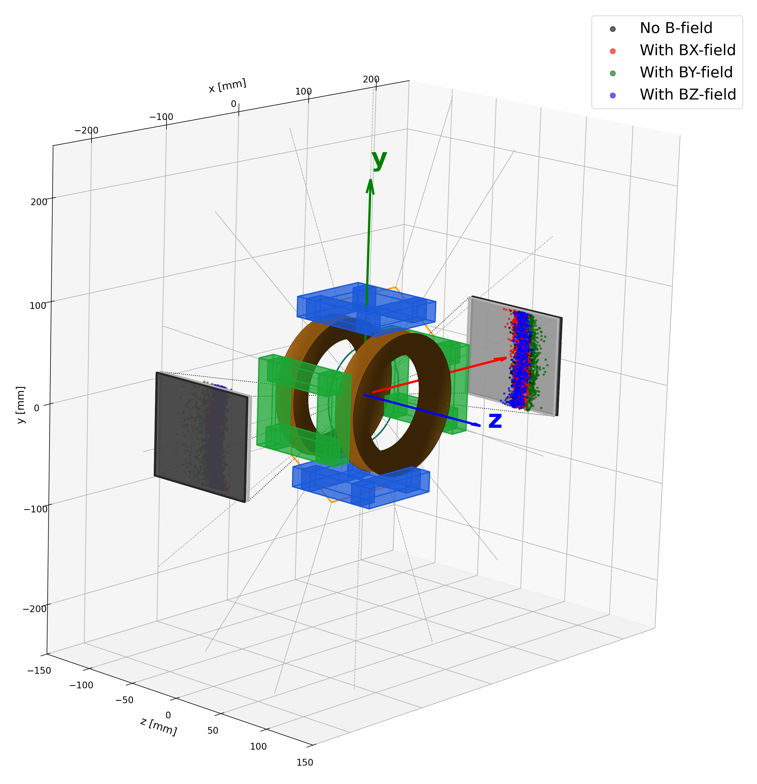
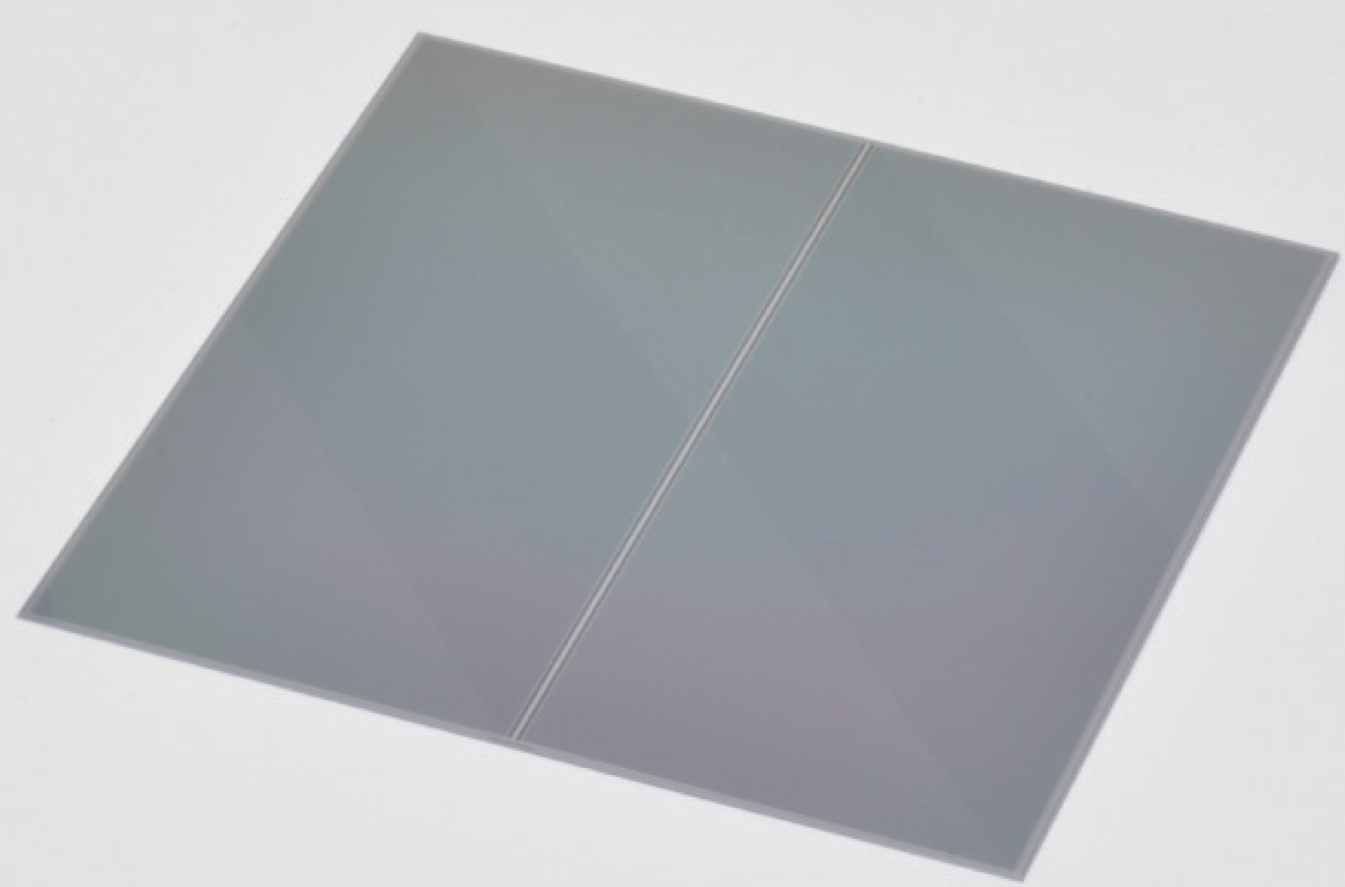
HJET polarimeter detectors: Possible upgrade
Charges #1, 3
Requirements:
Time resolution < 2ns to separate 10 ns
Large 𝞿 coverage for Px, Py, Pz
Punch-throughs selection for background rejection (no material between layers)
Detector Solution S13804:
Hamamatsu 1024-strip 300 um thick SSD
97mm by 97 mm
2 detectors, 2 layers each @ 22 cm
Readout:
Combine 8 strips ➔ 256 per detector
Exploring ePIC ECAL analog readout
mini-DAQ system to be synchronized with EPIC data stream and accelerator cycle
× 2
97 mm
97 mm
512 ch
Work in progress
512 ch

Slide 6
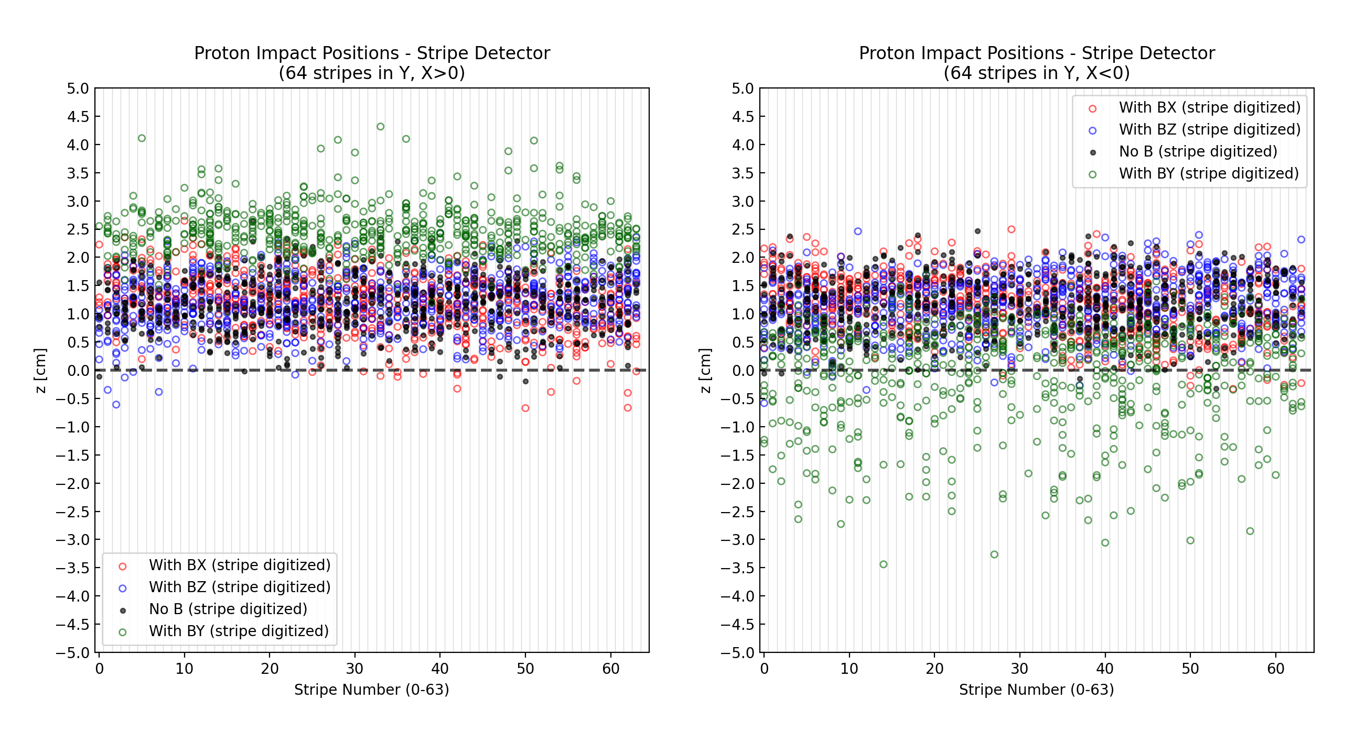
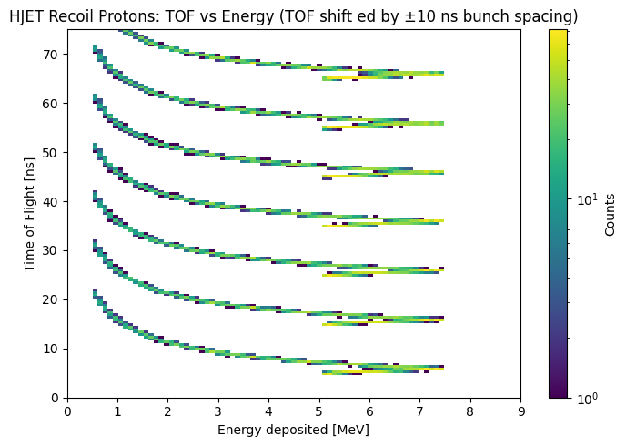
HJET polarimeter detectors: Simulation results
Hits in the detectors with 8 strips interconnected:
Energy deposition in 2 layers
L
R
10 ns
Requirements:
Time resolution < 2ns to separate 10 ns
Large 𝞿 coverage for P_{x}, P_{y}, P_{z}
Punch-throughs selection for background rejection (no material between layers)
Charges #1, 3

Slide 7
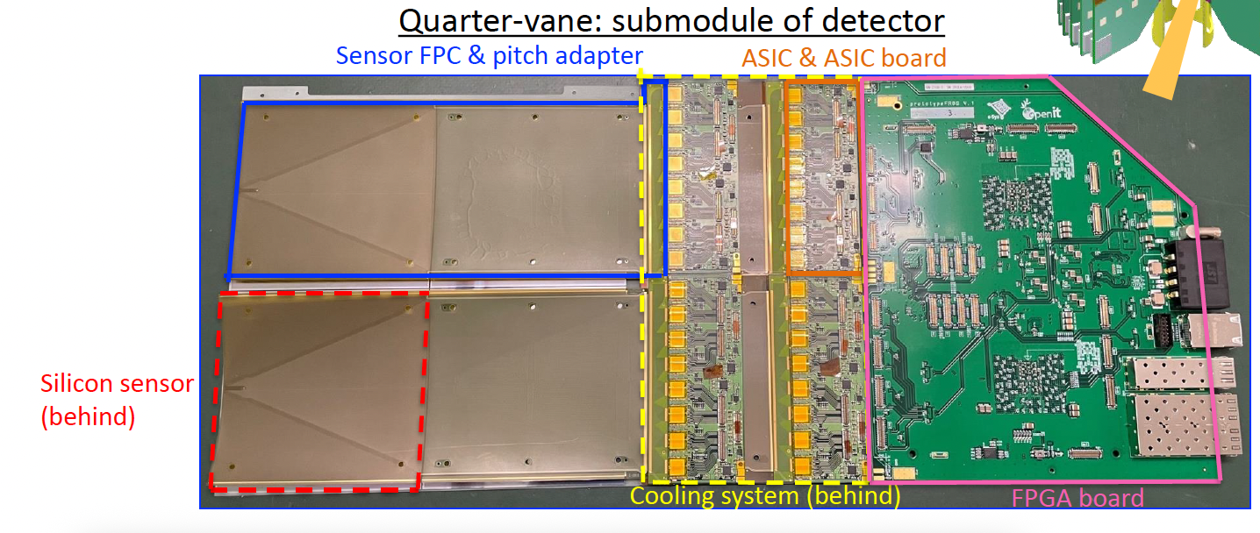
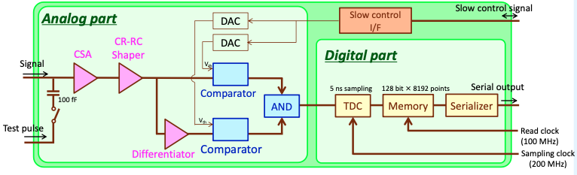
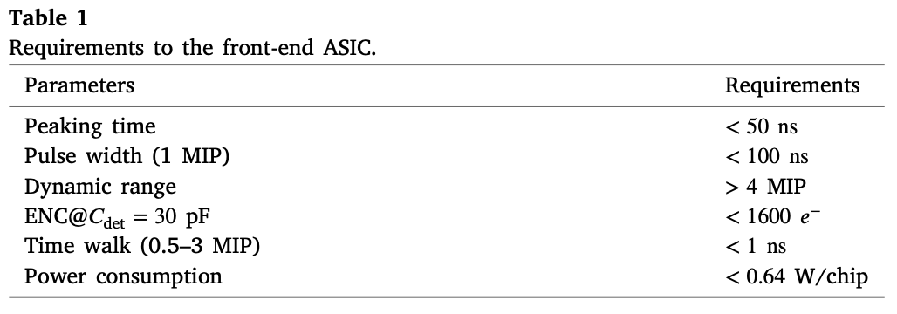
HJET polarimeter detectors: Readout
Original Muon g-2 / EDM readout design with Slit128D
SilTerra 180 nm CMOS technology

Slide 8
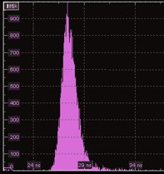
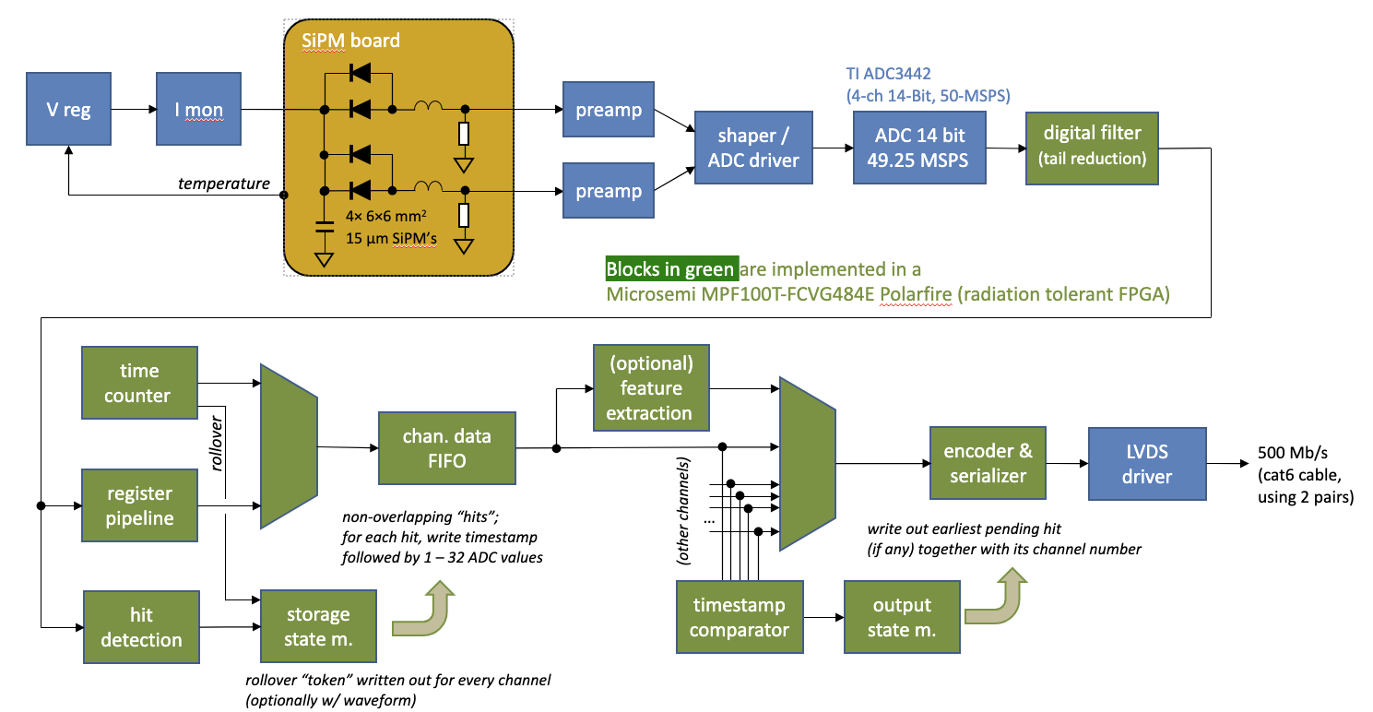
HJET polarimeter detectors: Readout
Forward and Backward ECALs (suggested by Elke)
LED pulser 1.8 ns
FWHM optical pulse
Seams to be suitable for our needs
Needs upgrade for 256 channels per detector

Slide 9
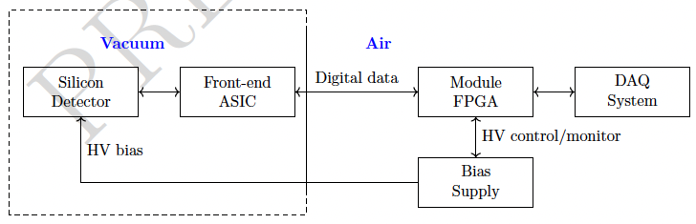
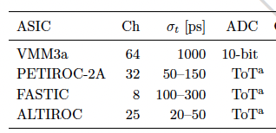
HJET polarimeter detectors: Readout
Current thoughts
ASICs to consider
Detector capacitance (1 layer) | ~17 [pF]
Charge deposit (MIP) | ~12 [fC]
Charge collection | 5-10 [ns]
Time resolution | <1 [ns]
Max. channels per detector | 260
Max. Data rate | 15 [Mbit/s]
What is your experience with this ASICs ?
Suggestions are very welcome

Slide 10
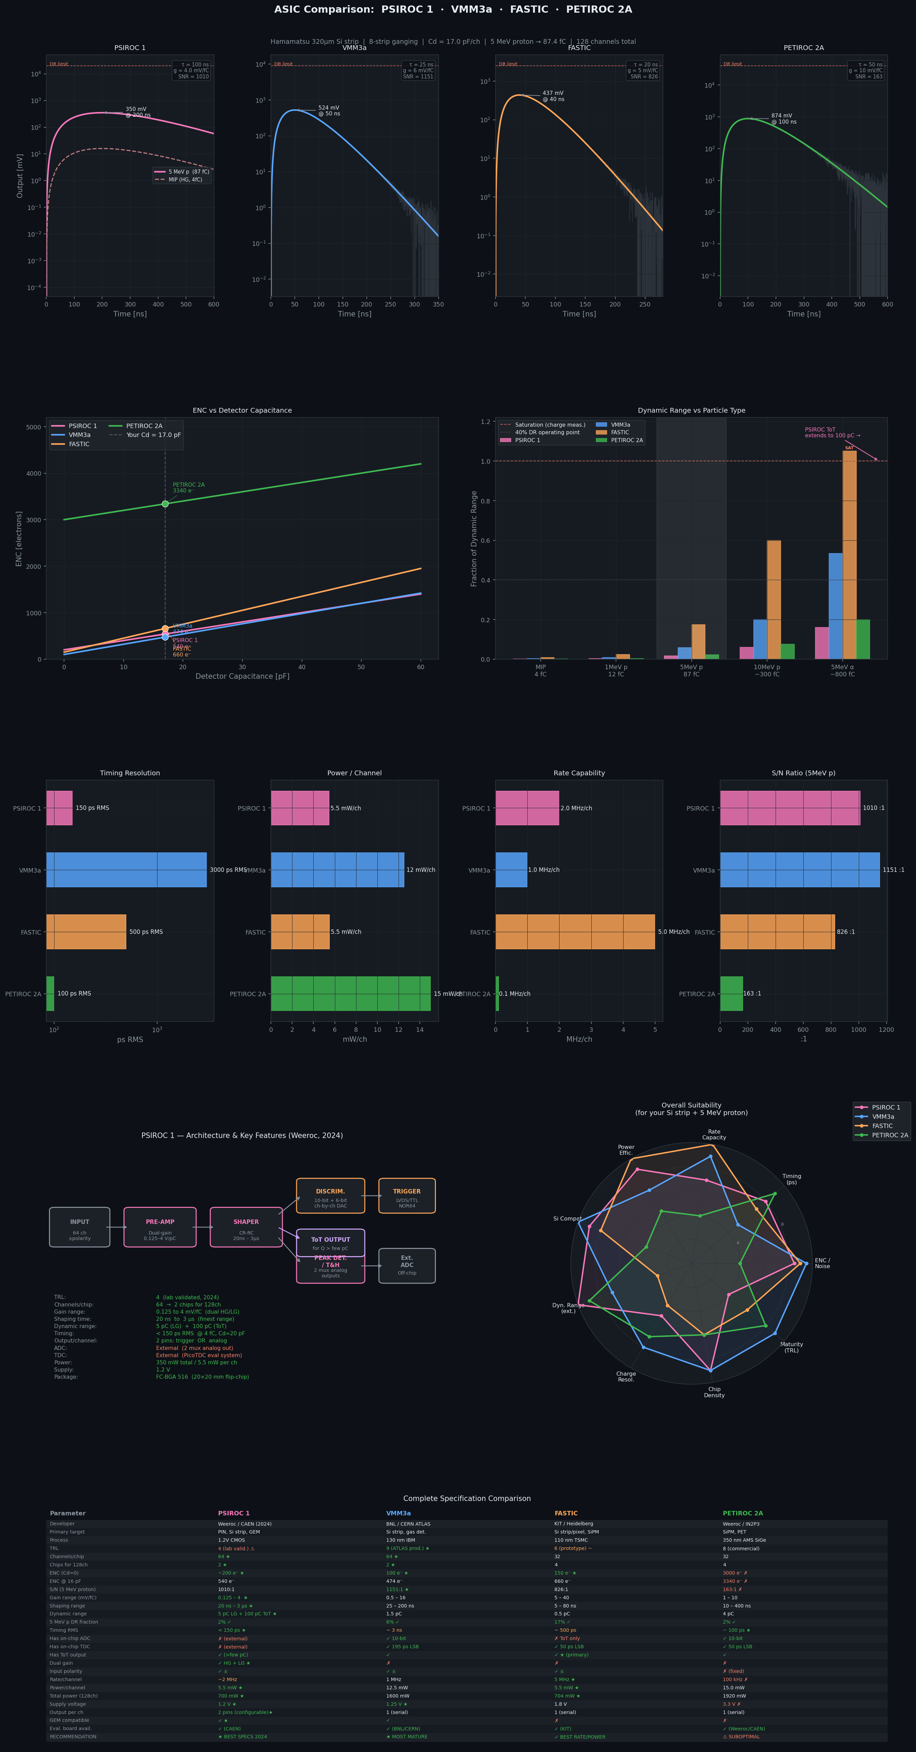
HJET polarimeter detectors: Readout (Claude)
Claude thoughts (must be thoroughly checked)

Slide 11
HJET polarimeter detectors: Readout (Claude)
Claude thoughts (must be thoroughly checked)

Slide 12
HJET polarimeter detectors: Readout (Claude)
Claude thoughts (must be thoroughly checked)

Slide 13
HJET polarimeter detectors: Readout (Claude)
Claude thoughts (must be thoroughly checked)

Slide 14
Summary
We need fast (<1 ns) Silicon Strip detector readout
Detailed simulation is required
Various ASICs available, need additional work and studies
Can we utilize ePIC readout?

Slide 15


Slide 16


Slide 17

HJET polarimeter detectors: S13804

Slide 18

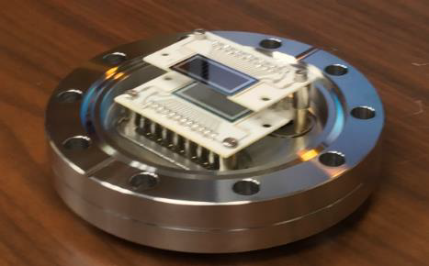
HJET polarimeter detectors: S4114-35Q

Slide 19
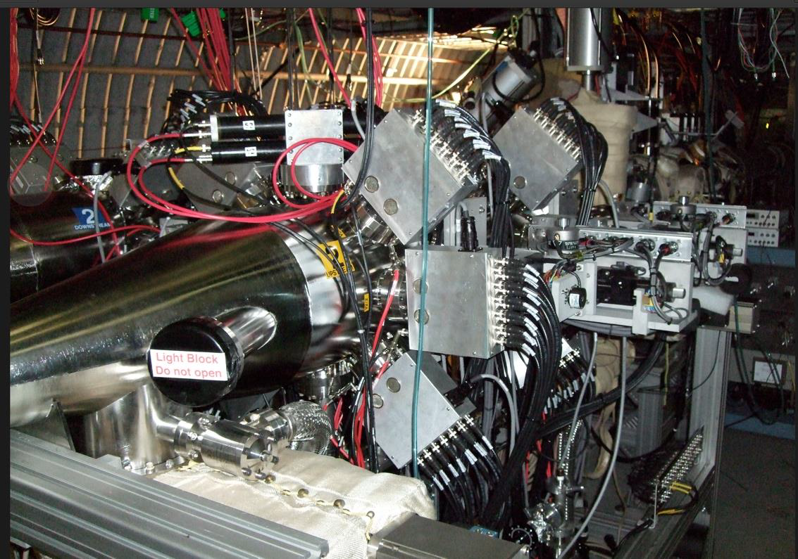
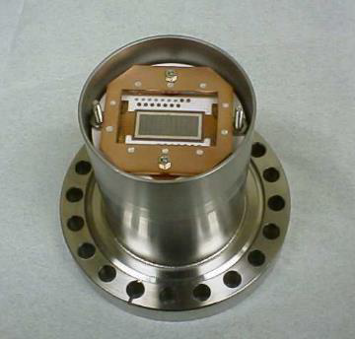
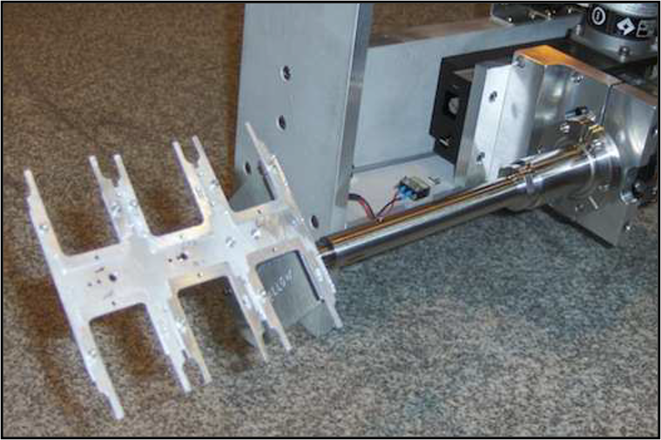
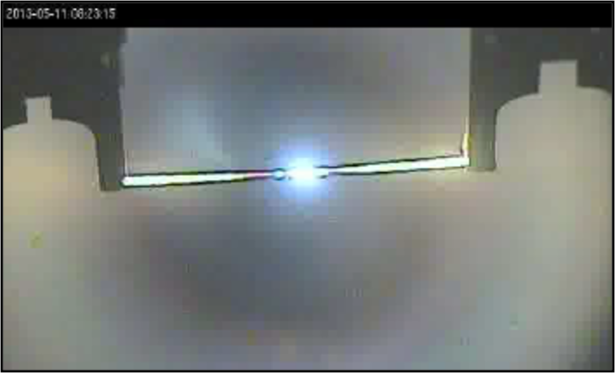
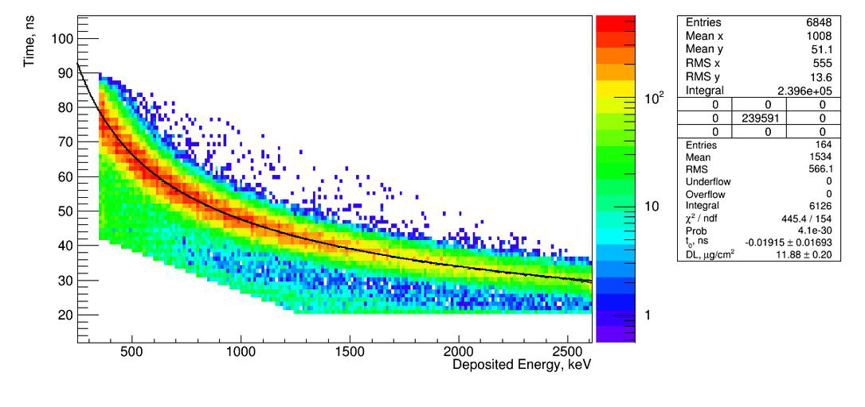
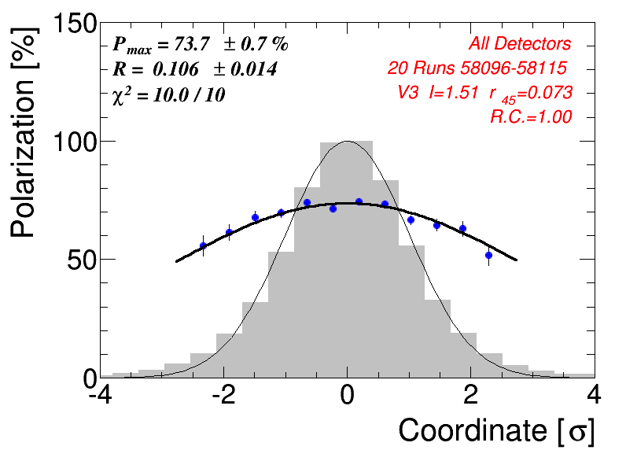
pC polarimeter detectors: Current setup
6 Si strip detectors
C-target holder
6
1
18cm
5
2
4
3
Ultra-thin ribbon targets: ≈ 10 μm × 50 nm
Target holder inside beam pipe
Provides fast monitoring for Depolarization and Polarization profiles
In sweep mode, a polarization of ±2% measurement can be done by p-Carbon polarimeter in about 30sec.
H. Huang Existing spin manipulators at RHIC 2024
Provide fast measurements and depolarization evolution and scan polarization structure in the beam

Slide 20
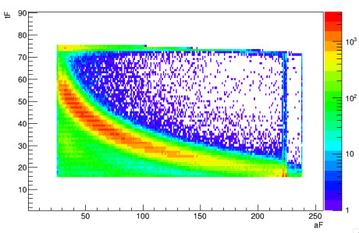
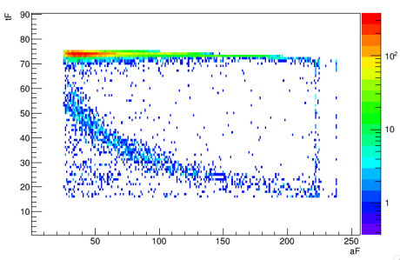
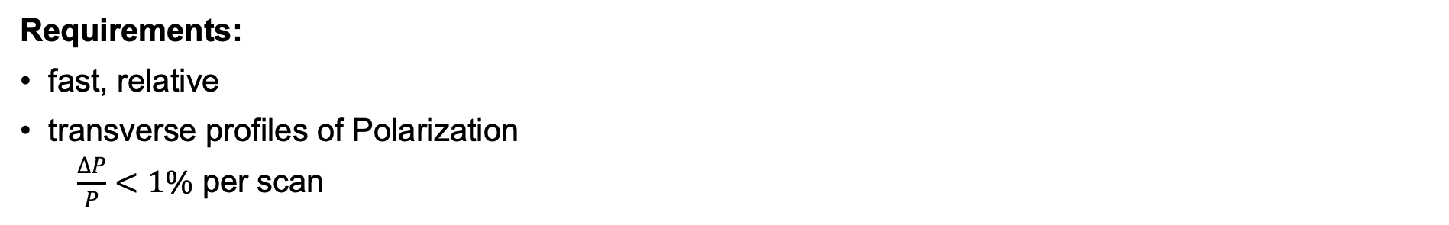
pC polarimeter detectors: Possible upgrade
Charges #1, 3
Requirements:
fast, relative
transverse profiles of Polarization
$\frac{ΔP}{P}<1\%$ per scan
Second detector layer installed in pC polarimeter
Included in DAQ since start of Run22 operations
Data from RHIC Run 22
TOF vs. 𝐸_{𝑘𝑖𝑛} in layer 1
Detector Solution for upgrade S12858:
Hamamatsu 16-strip 200 um thick Si
6 detectors, 2 layers each
Readout:
32 channels per detector
The same ePIC ECAL analog readout should be suitable
with a match in second layer
H. Huang Existing spin manipulators at RHIC 2024

Slide 21
ESH and Quality Assurance
Charge #7
Hadron Polarimeters:
ESH and QA-related issues:
After 20 years of operating experience at RHIC, ESH and QA-related issues for the pC and HJET polarimeters are well established.
Components requiring quality control:
Upgraded 2-layer Si-detector systems
Electronics readout with preferred <2 ns time resolution
Described in Quality Control Plan: → https://eic.jlab.org/Documents/DET/Quality/References/Detector-6.10-QualityControlPlan.pdf

Slide 22
Summary
HJET Polarimeter:
Current L-R detector setup measures only vertical polarization component (Py)
Strong holding field effects require detector geometry optimization
Two detectors with dual layers will enable full 3D polarization measurement (Px, Py, Pz)
Time resolution <2ns meets requirement for 10ns bunch separation
pC Polarimeter:
Current 6-detector system provides fast polarization monitoring (~30s for ±2%)
Second layer successfully commissioned in Run22 for improved background rejection
Proposed upgrade: Hamamatsu S12858 detectors (16-strip, 300 μm)
Dual-layer configuration (6 detectors, 2 layers) enhances measurement precision
Target: ΔP/P < 1% per scan for transverse polarization profiles
Readout: 100s of channels per system, exploring using ePIC ECAL analog electronics
Overall Status:
Overall concept is based on current system, needs to be upgraded to EIC conditions
Both systems address critical EIC polarimetry requirements
Integration with ePIC electronics provides unified readout approach
Ready to proceed to next project phase

