Slide 1

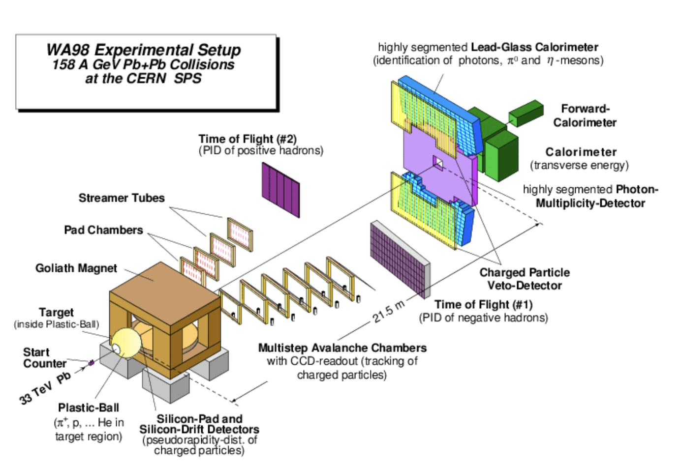
The RCDAC Data Acquisition System
Martin L. Purschke
DAQ manager of sPHENIX
Previous DAQ/Electronics WG co-convener for what is now ePIC
I have been a DAQ (and notably, a calorimeter) guy since my early days at CERN (1985-1996)
Why do I have a soft spot for calorimeters? I helped design and build the original lead glass “SAPHIR” SF5 lead glass calo for WA80… played a big role in building the WA98 calos

Slide 2
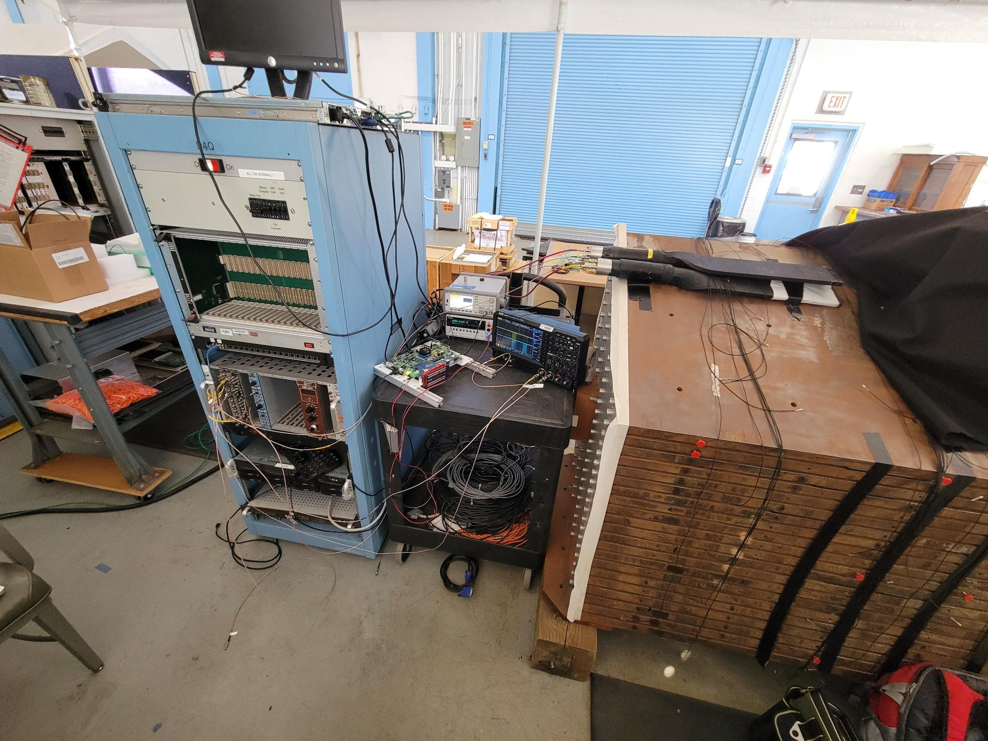
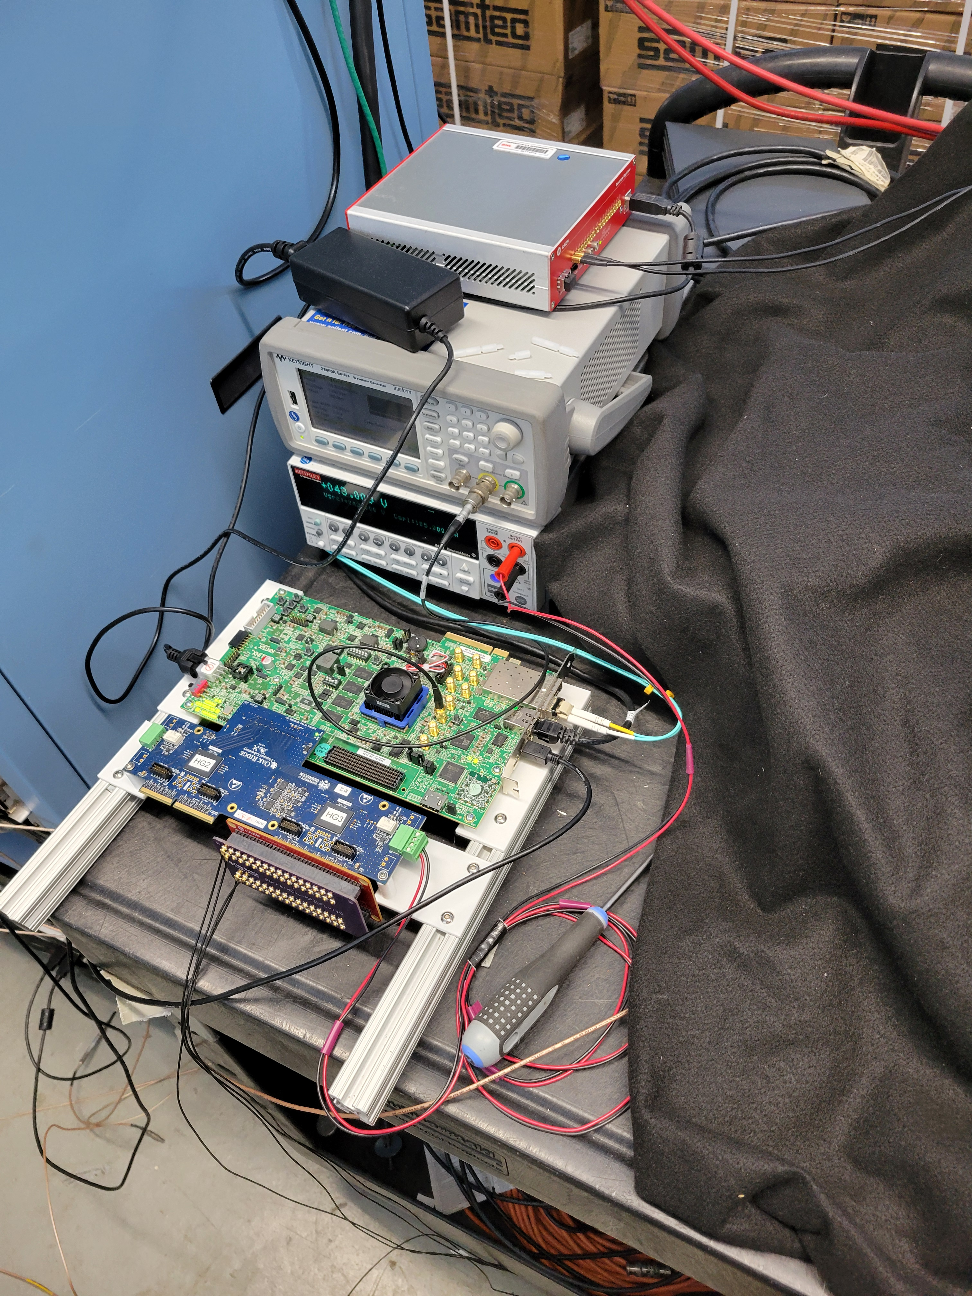
What I’ll be talking about today
First, a more generic overview of RCDAQ / monitoring / analysis
Then, some demo targeted towards what we will do
Please interrupt me any time for questions. A lot of it is an actual live demo.
Pic from Friday
The Barrel HCal prototype setup

Slide 3
RCDAQ
RCDAQ is DAQ system that has been around since about 2012
It started out as your swiss army knife-type DAQ system to quickly read out whatever you need for your R&D project
It was used in pretty much all R&D campaigns for sPHENIX, but already much earlier in several EIC-themed test beams and other measurements, typically at the Fermilab Test Beam Facility
To the best of my knowledge (some I know, some I learn about when I get questions), it is in use in about 25-30 places around the world
I have step-by-step manuals with examples that seem to work for groups that set up completely autonomously. Just the other day I got a question from an outside group that I didn’t know about. They had been using RCDAQ for years and finally had a question.
RCDAQ was chosen to be the main DAQ system of sPHENIX
We achieved a sustained data rate of a bit more than 42 Gbyte/s (330GBit/s), about 3x what ePIC intends to do. We ended up taking 293PB of data with sPHENIX and RCDAQ.
And most of it in streaming mode.
Go to https://www.phenix.bnl.gov/~purschke/rcdaq for the manuals and sample data files etc

Slide 4
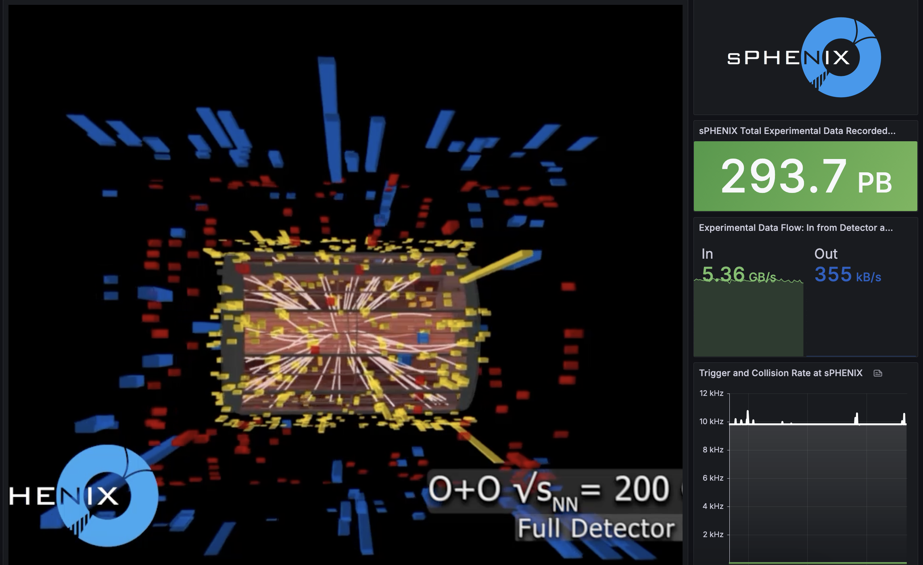
A lot of data
Can’t stop myself showing this -

Slide 5
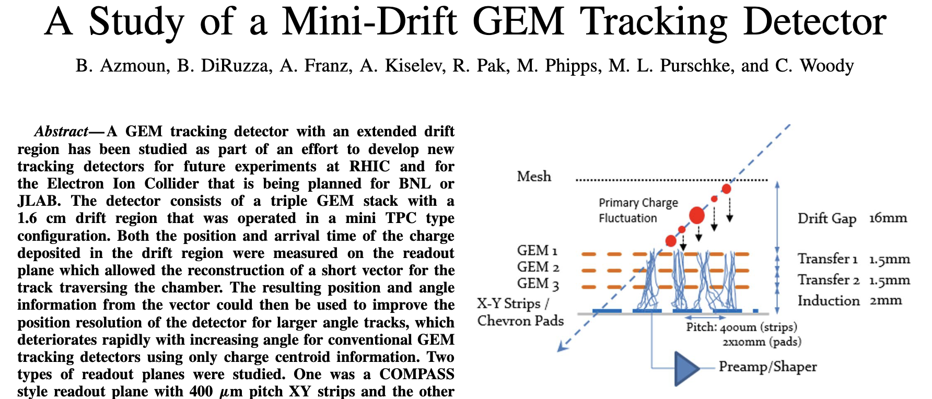
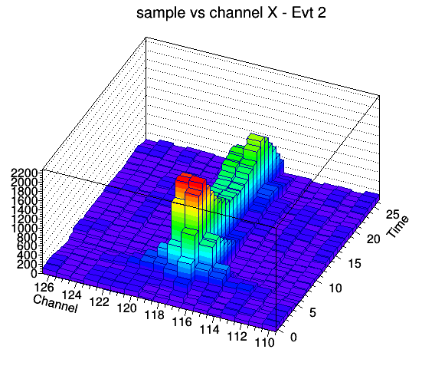
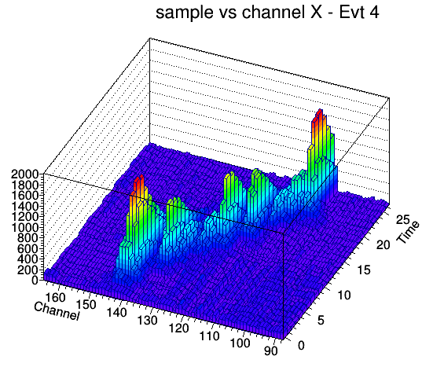
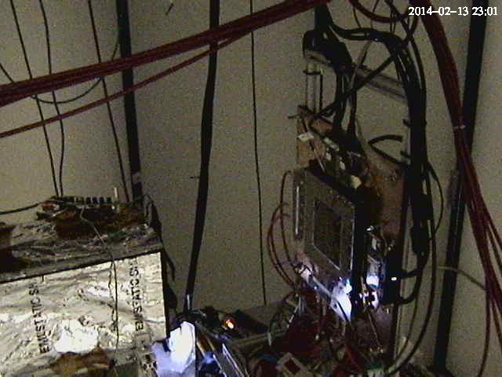
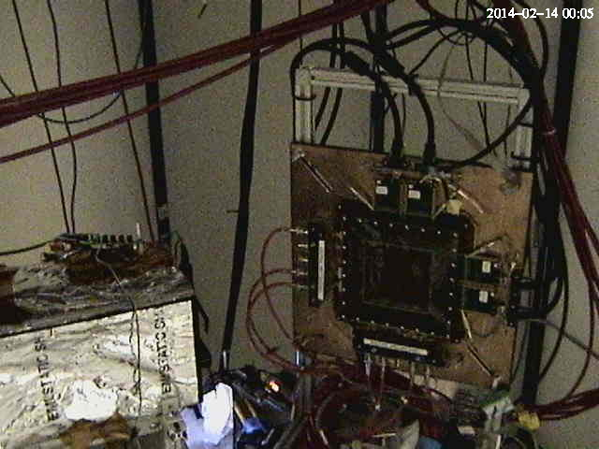
One of the early EIC test beam campaigns with RCDAQ - The Minidrift GEM tracking detector (2014)
IEEE Transactions on Nuclear Science, vol. 63, no. 3, pp. 1768-1776, June 2016
12 years ago!

Slide 6
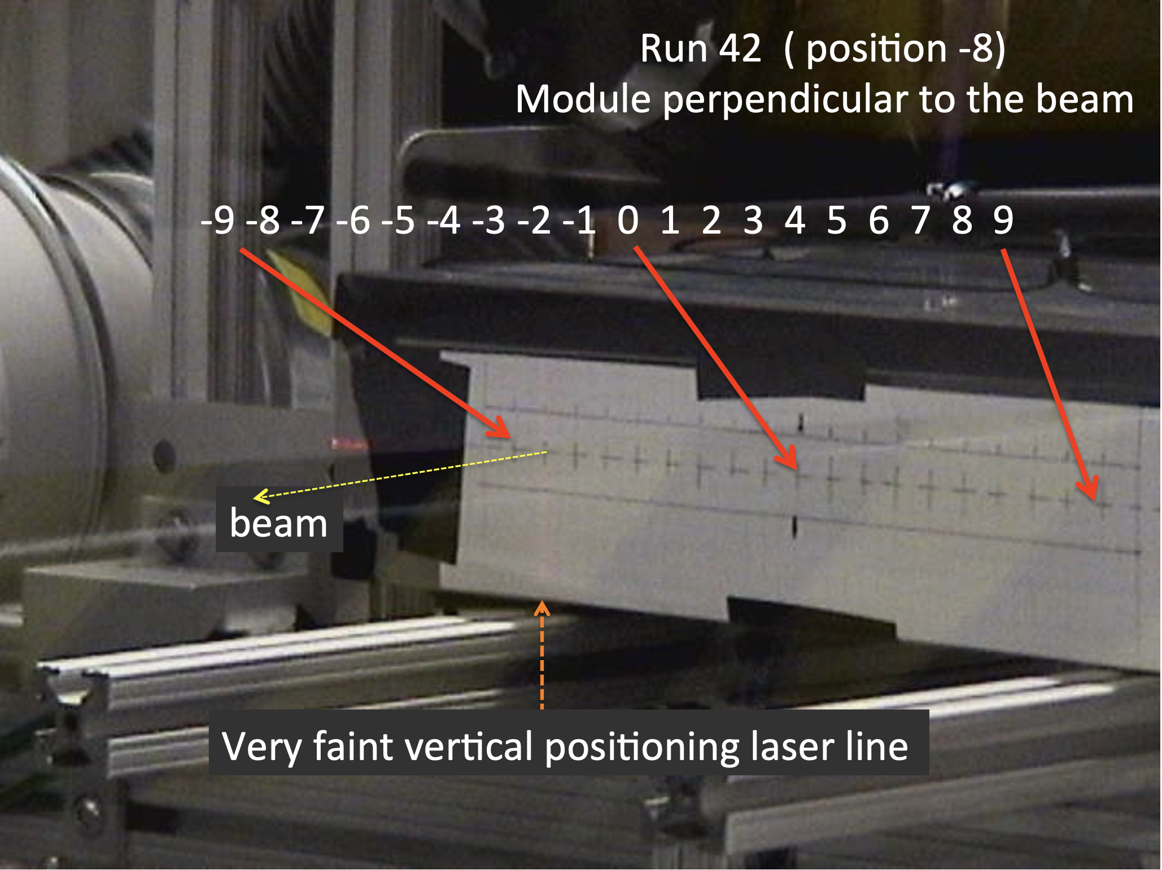
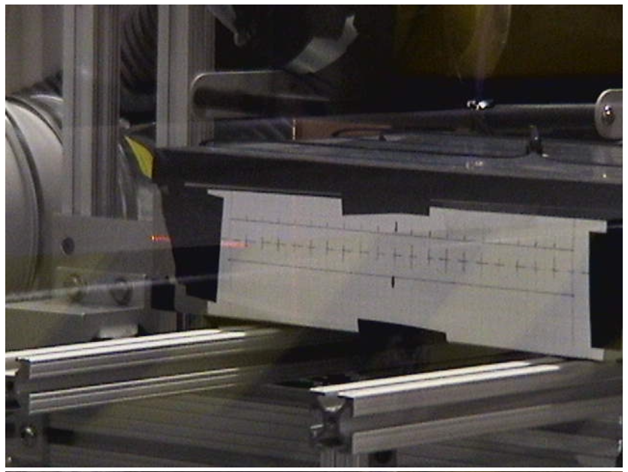
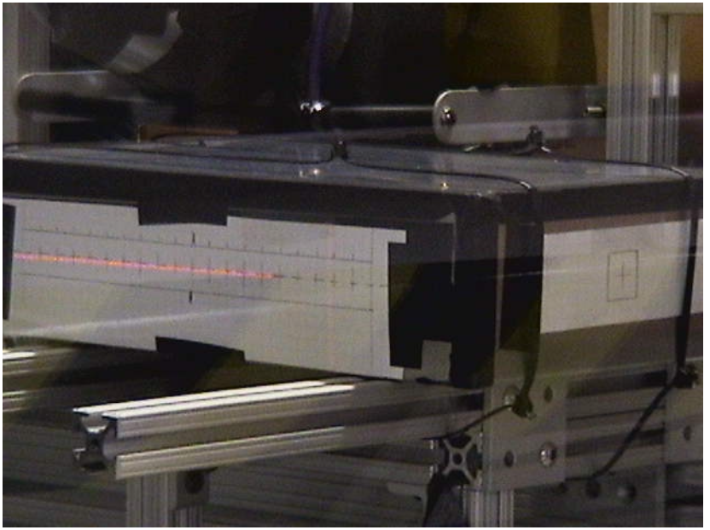
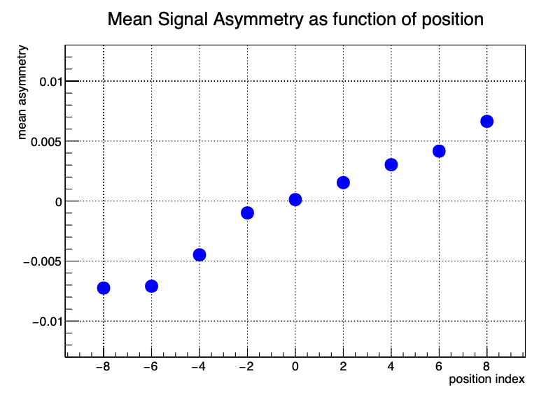
Another one from the EIC calo orbit – Oleg, Craig, myself
”Can we get more calorimeter position information by adding a dual readout and measure time?”
Moving the calorimeter in the beam for “more left” or “more right” incidence
In the end we found that it’s too small an effect to pursue, but it was worth checking!

Slide 7
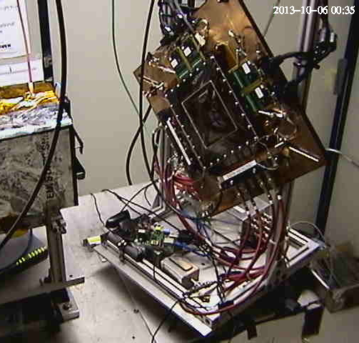
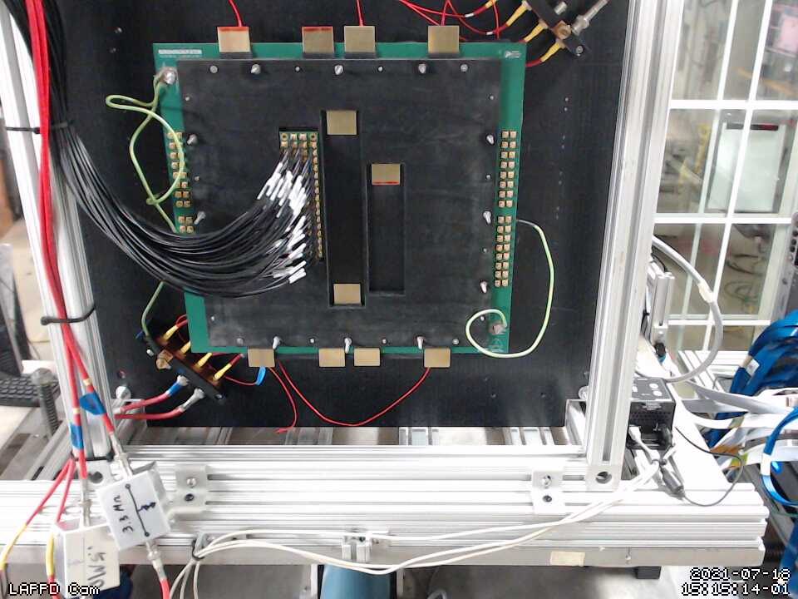
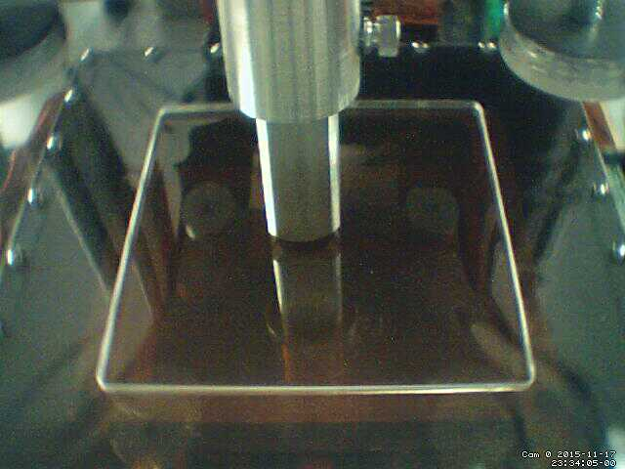
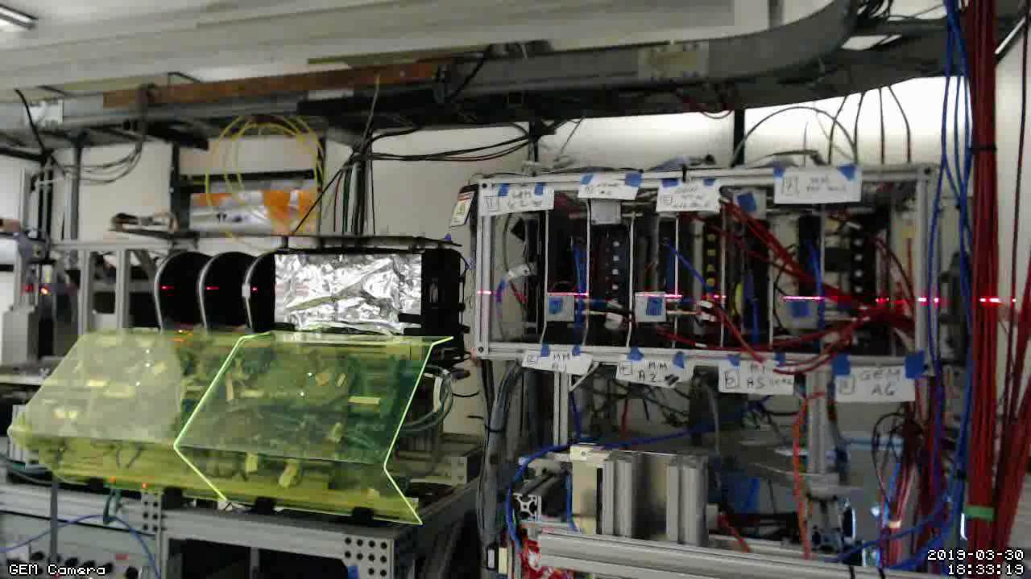
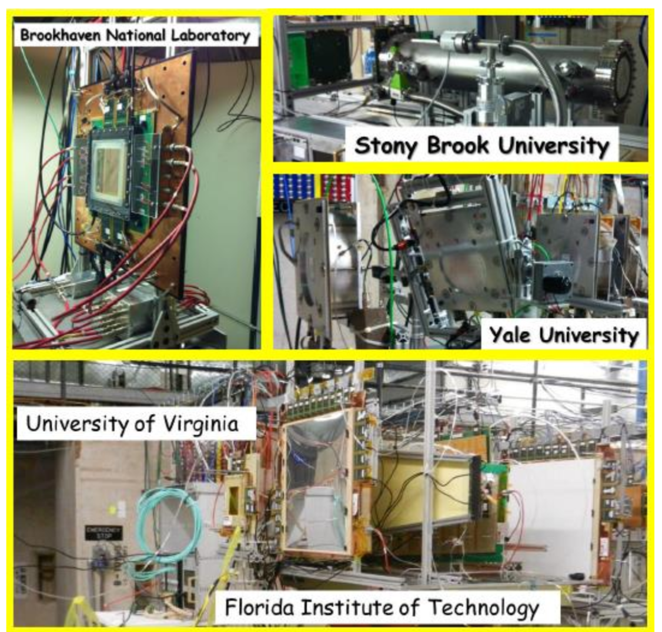

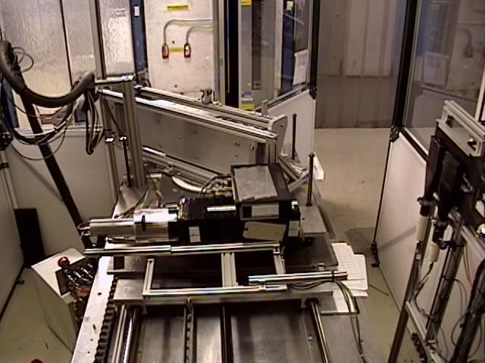
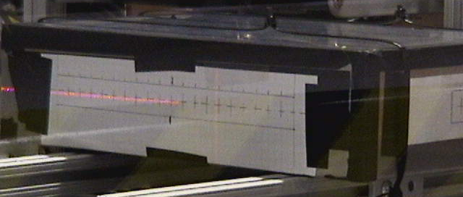
Long History of EIC-themed test beams with RCDAQ
The RCDAQ system has been a pillar of EIC-themed data taking for R&D, test beams etc since 2013 – eRD1, eRD6, LDRDs, …
Many active RCDAQ installations in the ePIC orbit + ~30 elsewhere
Usual entry by ease-of-use for standard devices (DRS, SRS, CAEN, …) and support for fully automated measurement campaigns
Manuals and “application notes” at https://www.phenix.bnl.gov/~purschke/rcdaq
MPGD-LDRD (2019)
LAPPD / Kiselev
(2022)
Minidrift TPC (2013)
ZigZag Readout (2016)
PWO prototype (2018)
Dual-sided PWO readout (2017)
FLYSUB consortium (2014)
Thanks to Jin Huang for this collection

Slide 8
What does one need?
Pretty much any Linux machine and distro will do. (I do lots of development on a Linux VM on my M2 Mac here)
I’m striving to be distro-agnostic:
RedHat and derivatives (RHEL, Fedora, Alma… all good)
Debian and similar (Ubuntu, Mint, …)
Arch Linux
And yes, it does run on a Raspberry Pi – sometimes you want to take a few weeks worth of cosmics with some detector module without tying up a more expensive PC
The main platforms currently at work in sPHENIX are 96-core AMD EPYC PCs.
For practicing/going through the manuals, you can run everything without any actual readout hardware – RCDAQ provides “pretend-devices” that behave like an ADC, for you to be able to kick the tires…

Slide 9
Data Formats in general…
One of the trickiest parts when developing a new application is defining a data format
It can take up easily half of the overall effort – think of Microsoft dreaming up the format to store this very PowerPoint presentation you are seeing in a file. We used to have ppt, now we have pptx – mostly due to limitations in the original format design
A good data format takes design skills, experience, but also the test of time
The tested format usually comes with an already existing toolset to deal with data in the format, and examples – nothing is better than a working example
Case in point: We could easily accommodate the sPHENIX Streaming Readout data in this format, even though no one had ever heard the term when I designed this

Slide 10

Modularity and Extensibility
No one can foresee and predict requirements of a data format 20 years into the future.
Must be able to grow, and be extensible
The way I like to look at this:
FedEx (and UPS) cannot possibly know how to ship every possible item under the sun
But they know how to ship a limited set of box formats and types, and assorted weight parameters and limits
Whatever fits into those boxes can be shipped
During transport, they only look at the label on the box, not at what’s inside
We will see a surprisingly large number of similarities with that approach in a minute
“packets”

Slide 11
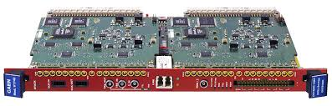
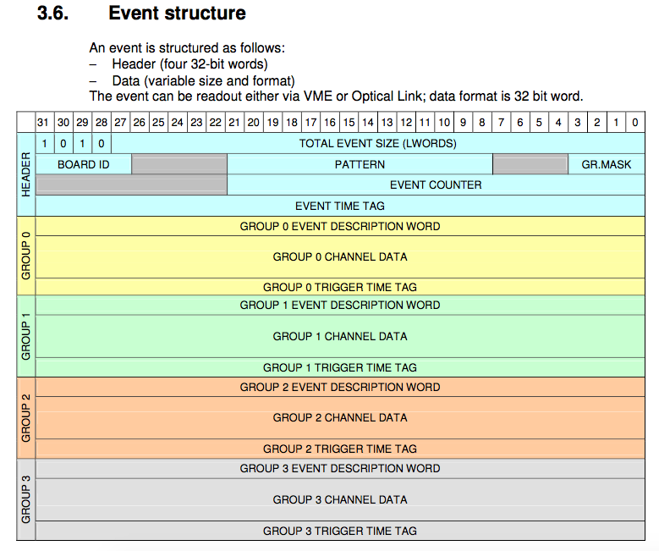
Example: CAEN’s V1742/DT5743 format
We just take that blob of memory, “put it in a box”, done.
The analysis software takes care of the unpacking and interpretation later
Just grab it. Don’t waste time here.
This is really all I’m looking at for the readout

Slide 12
RCDAQ - The High Points
Each interaction with RCDAQ is a shell command. There is no such thing as “starting an application and issuing internal commands” (think of your interaction with, say, root)
RCDAQ out of the box doesn’t know about any particular hardware. All knowledge how to read out something, say, a FELIX card, comes by way of a plugin that teaches RCDAQ how to do that.
That makes RCDAQ highly portable and also distributable – some sPHENIX FEMs use commercial drivers for the readout; I cannot re-distribute CAEN software, etc etc
RCDAQ has no proprietary-format configuration files. (huh? In a minute).
Support for different event types
Built-in support for standard online monitoring
Built-in support for electronic logbooks (Stefan Ritt’s Elog)
Network-transparent control interfaces

Slide 13
Everything is a shell command…
One of the most important features. Any command is no different from “ls –l“ or “cat”
Everything is inherently scriptable
You have the full use of the shell’s capabilities for if-then constructs, error handling, loops, automation, cron scheduling, and a myriad of other ways to interact with the system
In that sense, there are no proprietary configuration files – only configuration scripts.
This is quite different from “my DAQ supports scripts”!
I do not want to be trapped within the limited command set of any application!
With shell commands, the DAQ is fully integrated into your existing work environment
(And yes there are GUIs – many GUIs. They usually just trigger the appropriate command)

Slide 14
On Autopilot - Scripts at work
Very often – especially in your R&D days – you want to step through a range of values of a configuration parameter and see what your detector prototype has to say
Bias voltage scans (we characterized gazillions of SiPMs)
Position scans
Temperature scans
And on and on
Such a measurement is best done in a script that reads predetermined positions / voltage settings / what have you and performs the measurement
I picked an example: What is the response uniformity of a calorimeter module when a shower develops in different places? (We were very worried about this)
We were simulating different shower positions by “writing light with a light fiber” on the module front face

Slide 15
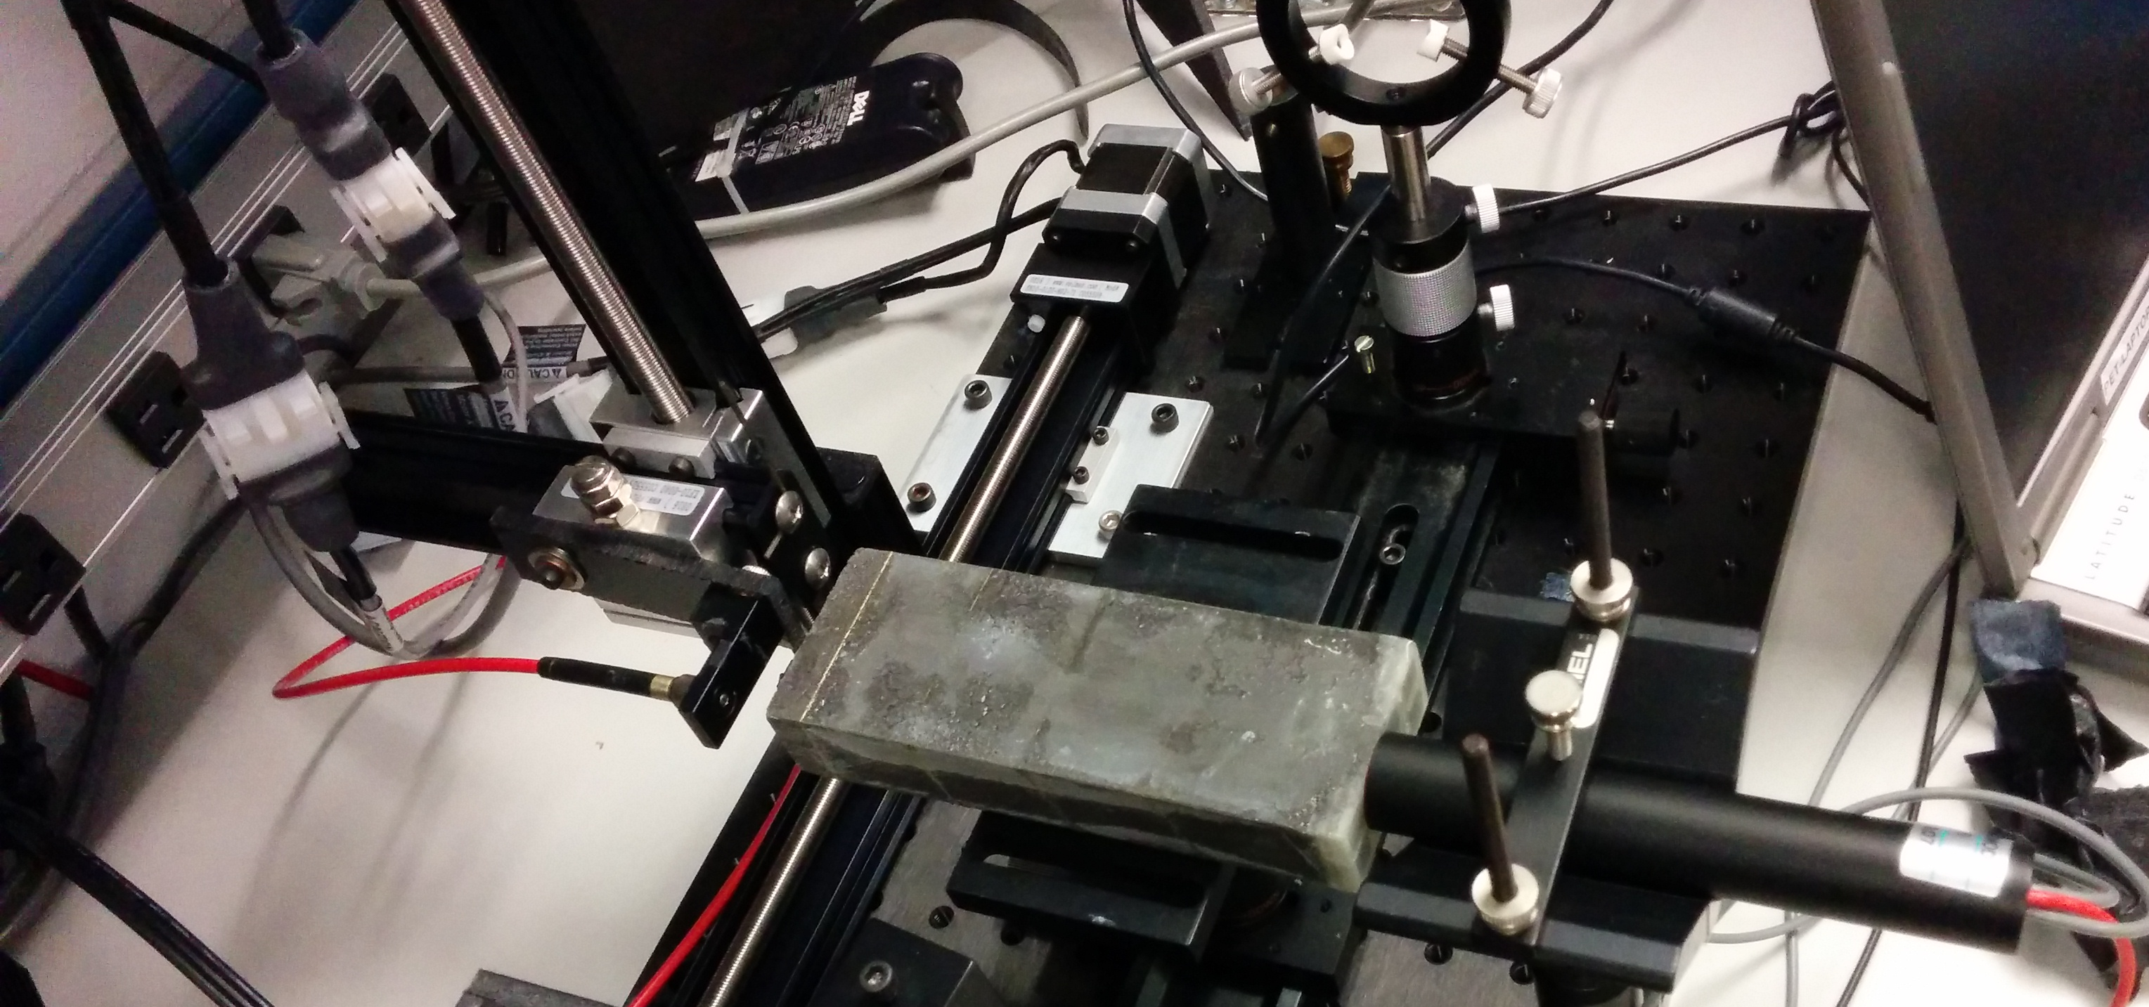
Measurements on autopilot through scripting
Simulate shower incidence positions by moving a light fiber in x and y
take a run for each position w/ 4000 events = 4000 LED pulses
50 x 25 = 1250 positions (later we had 70x70, you really want to automate that)
Let it run overnight, come back in the morning, look at the data
This early picture shows a photomultiplier. We switched to actual sPHENIX blocks and SiPMs soon after
X-Y step motor
Calorimeter Module
Light Fiber
PMT
(later SiPM)

Slide 16
The Script
#! /bin/sh
STARTPOSX=0
STARTPOSY=9900
INCREMENTX=200
INCREMENTY=-200
CURRENTPOSY=$STARTPOSY
for posy in $(seq 25) ; do
quickmove.sh $CURRENTPOSY 2
sleep 5
CURRENTPOSY=$( expr $CURRENTPOSY + $INCREMENTY)
CURRENTPOSX=$STARTPOSX
for posx in $(seq 50) ; do
echo "moving to $CURRENTPOSX"
quickmove.sh $CURRENTPOSX 1
sleep 5
CURRENTPOSX=$( expr $CURRENTPOSX + $INCREMENTX)
done
done
The DAQ operation becomes an integral part of your shell environment
25 positions in y
move the Y motor
50 positions in x
move the x motor
next x
next y
Automatic end after 4000 events
start the DAQ
rcdaq_client daq_set_maxevents 4000
rcdaq_client daq_begin
wait_for_run_end.sh

Slide 17
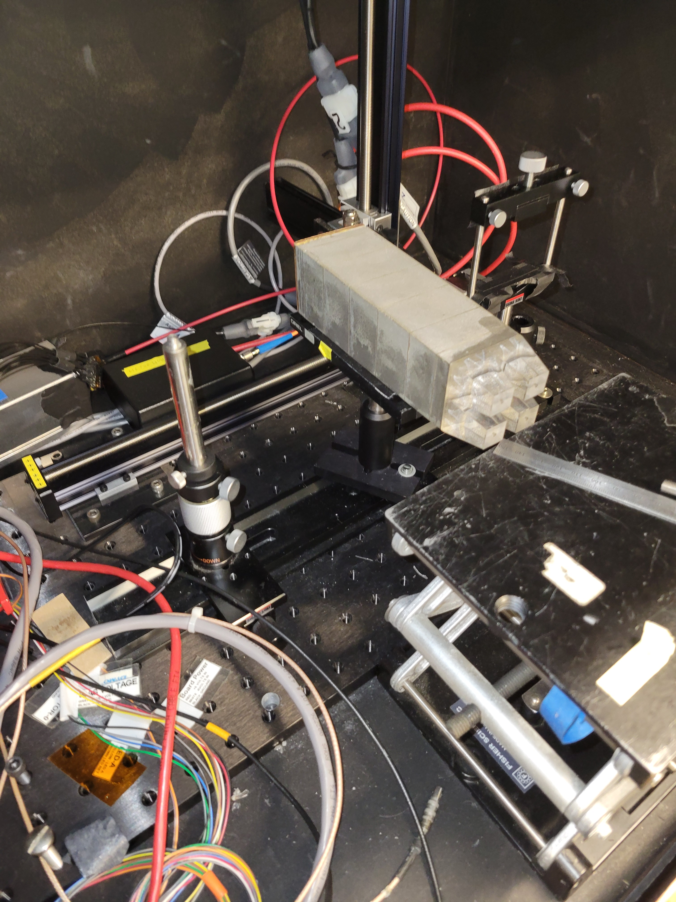
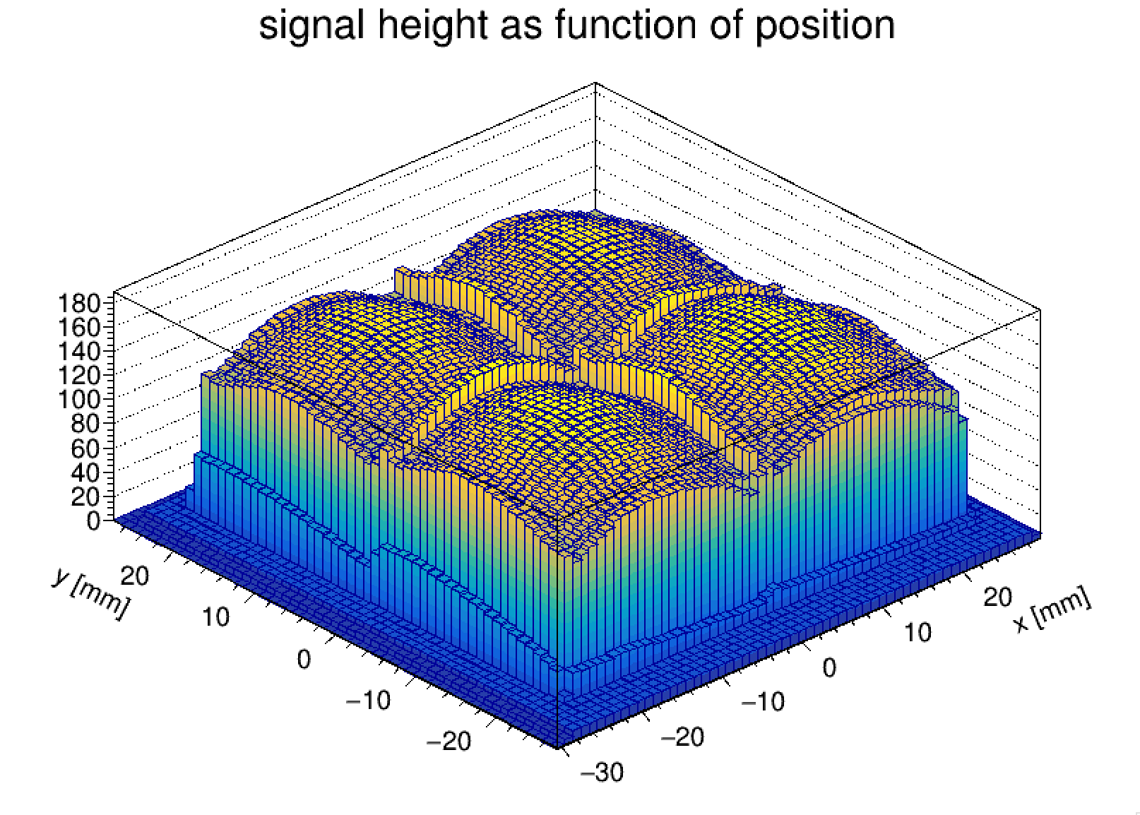
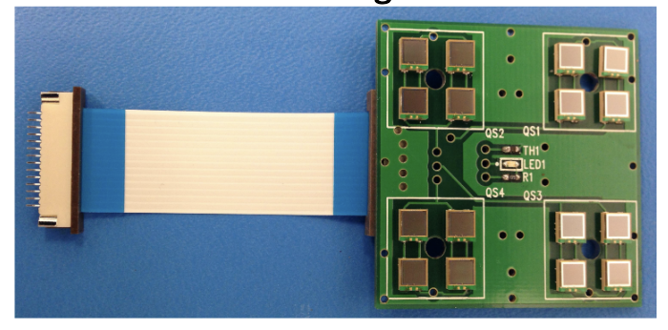
There’s a lot more to this…
We also added more things to this RCDAQ setup to make the next-day analysis super-easy.
I first need to explain a few things; we get back to this later.
This is the outcome of a later 70x70 position scan of a “real” calorimeter module
4x4 SiPMs

Slide 18
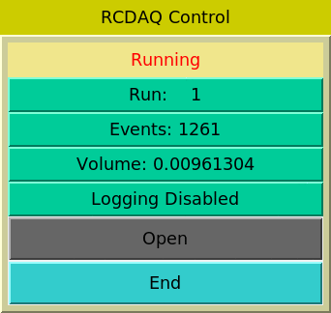

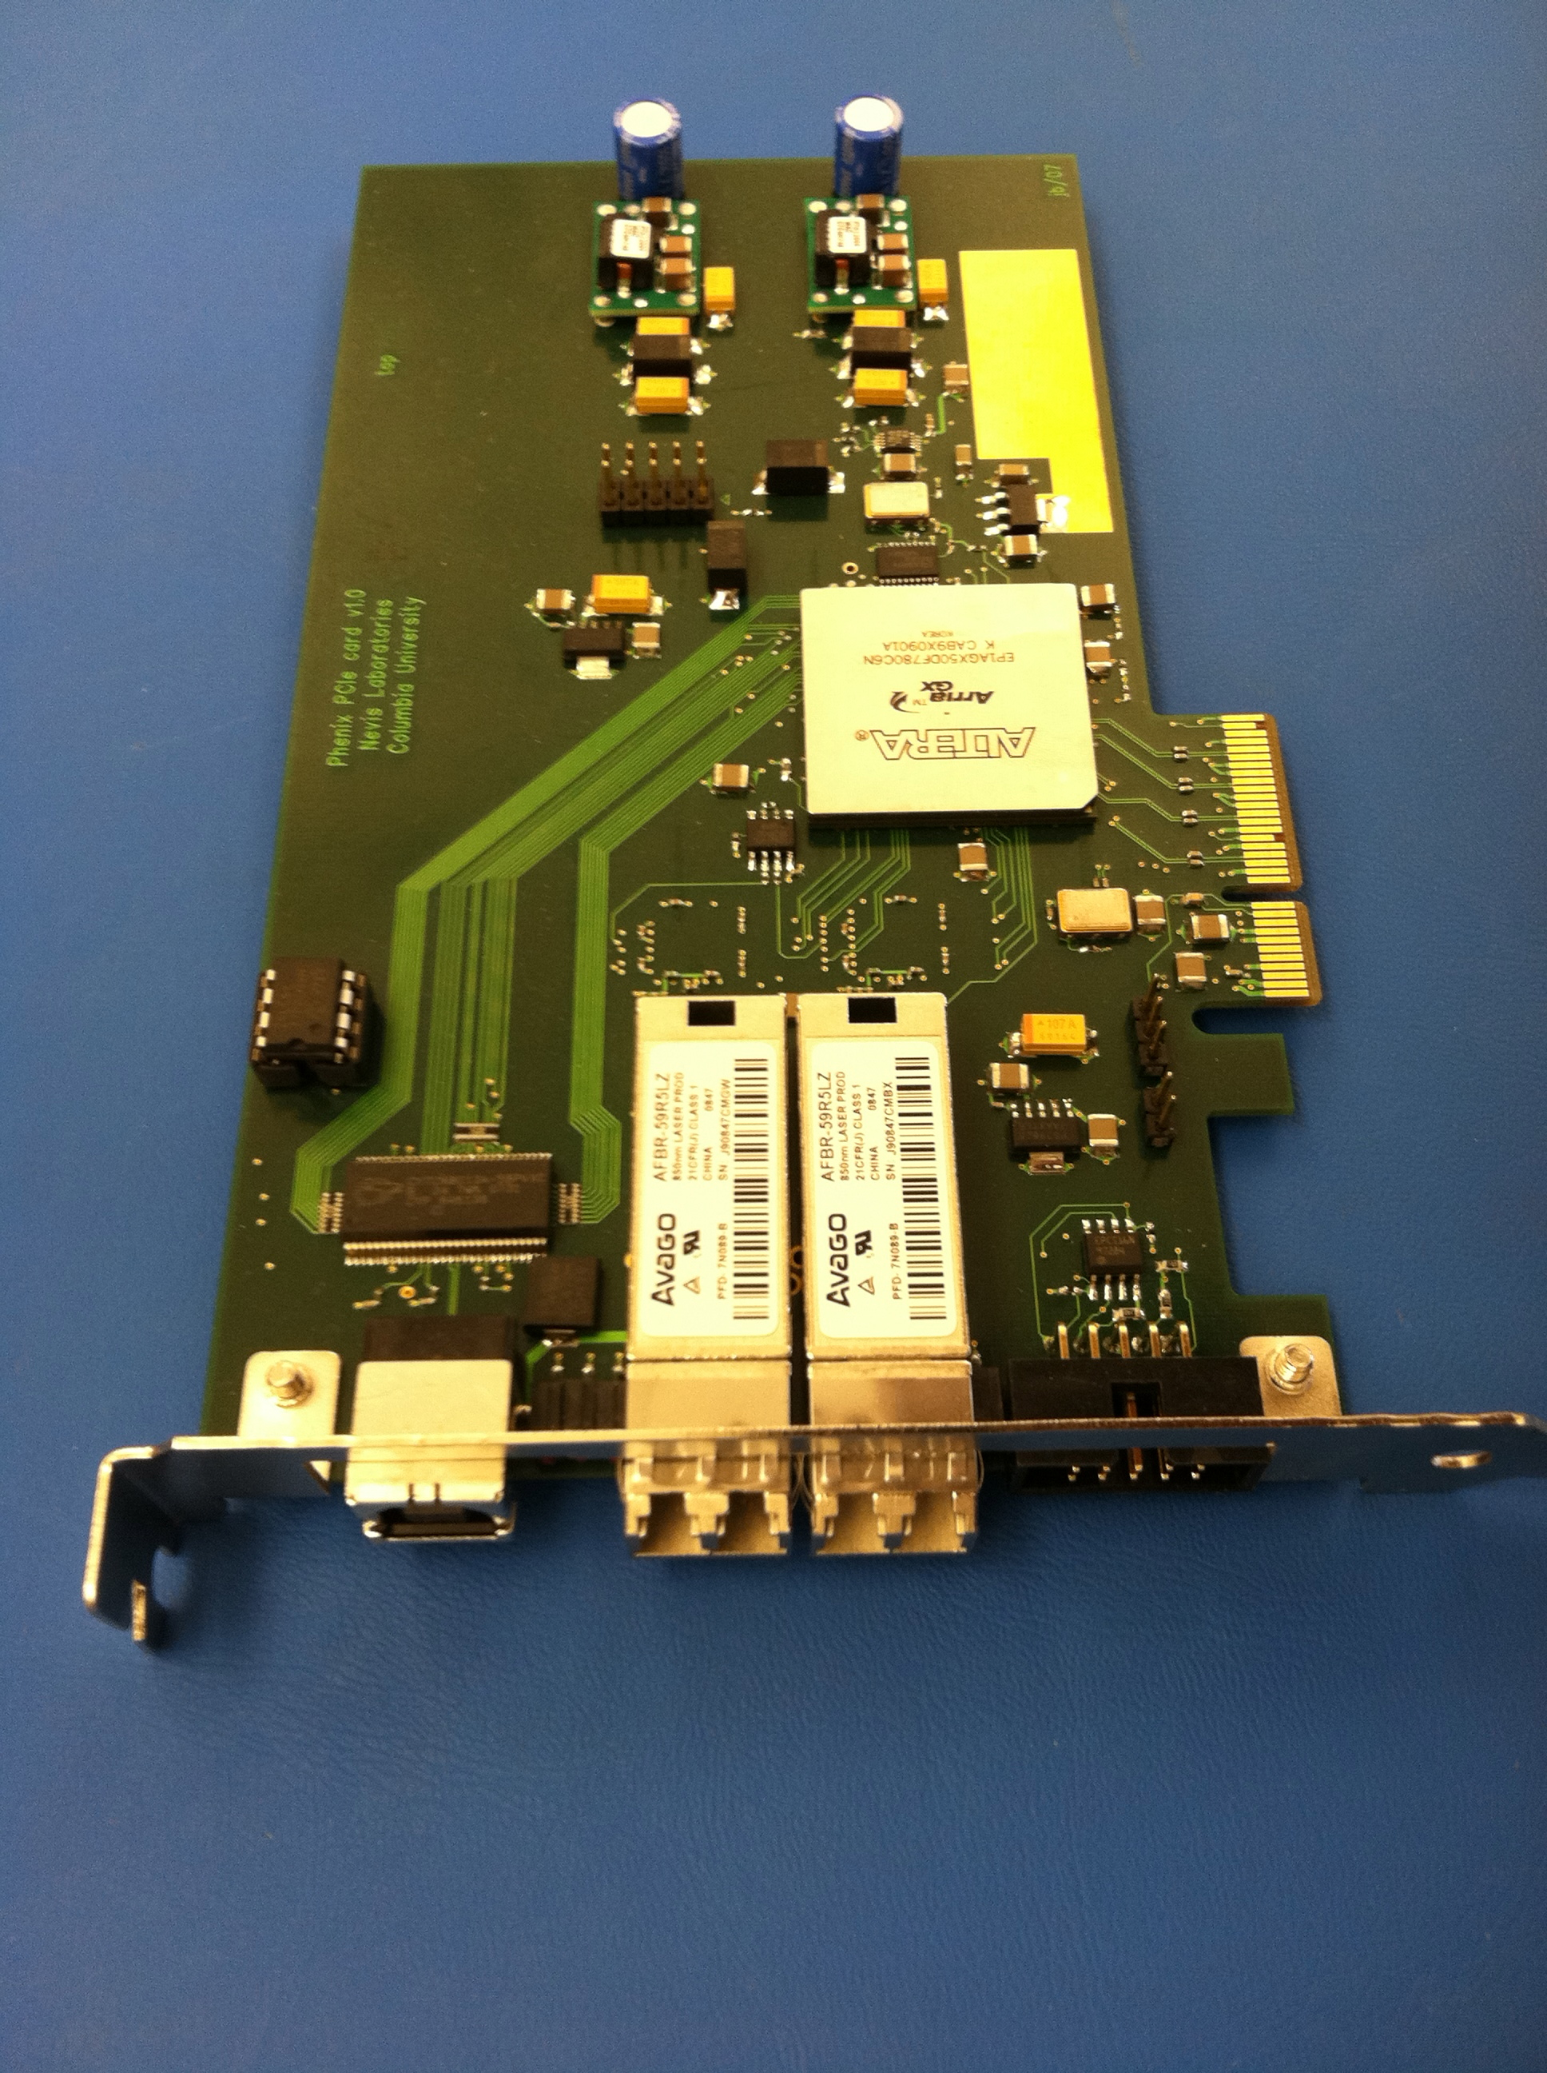

The RCDAQ client-server concept
RCDAQ Client
RCDAQ Client
scripts
Command line
RPC Protocol
RCDAQ Client
Command line
RCDAQ server
This allows an arbitrary number of processes to interact with RCDAQ concurrently
PCIe Network USB
Hardware
Hardware
Hardware
These are the 3 fundamental ways for data to get into a PC –
PCIExpress
Network
USB

Slide 19
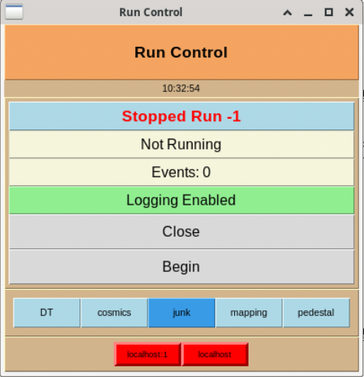
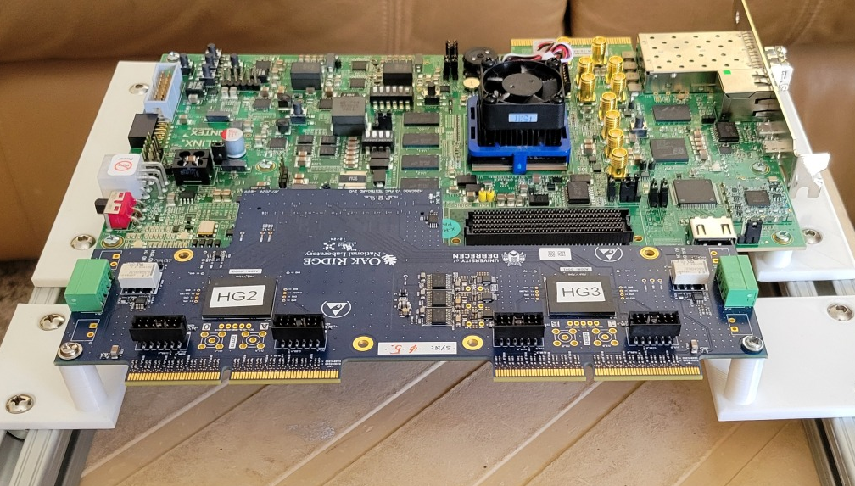
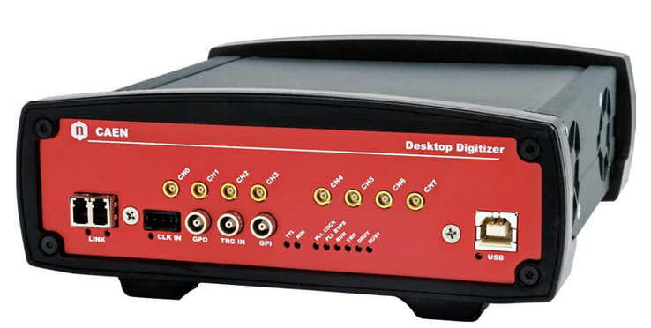
Multiple RCDAQs – almost always with streaming readout
Here you have multiple RCDAQ Servers, each of them reading out their part of your streaming detector(s)
Instead of individually controlling one RCDAQ instance, we have “Run Control” that controls your “cohort” of rcdaq servers.
Here I’m showing 2 RCDAQ instances from the BHCal setup
One is reading out the H2GCROC
One is reading a CAEN DT5743 waveform sampler (which we will use at Jlab – yes?)
RCDAQ server
RCDAQ server

Slide 20
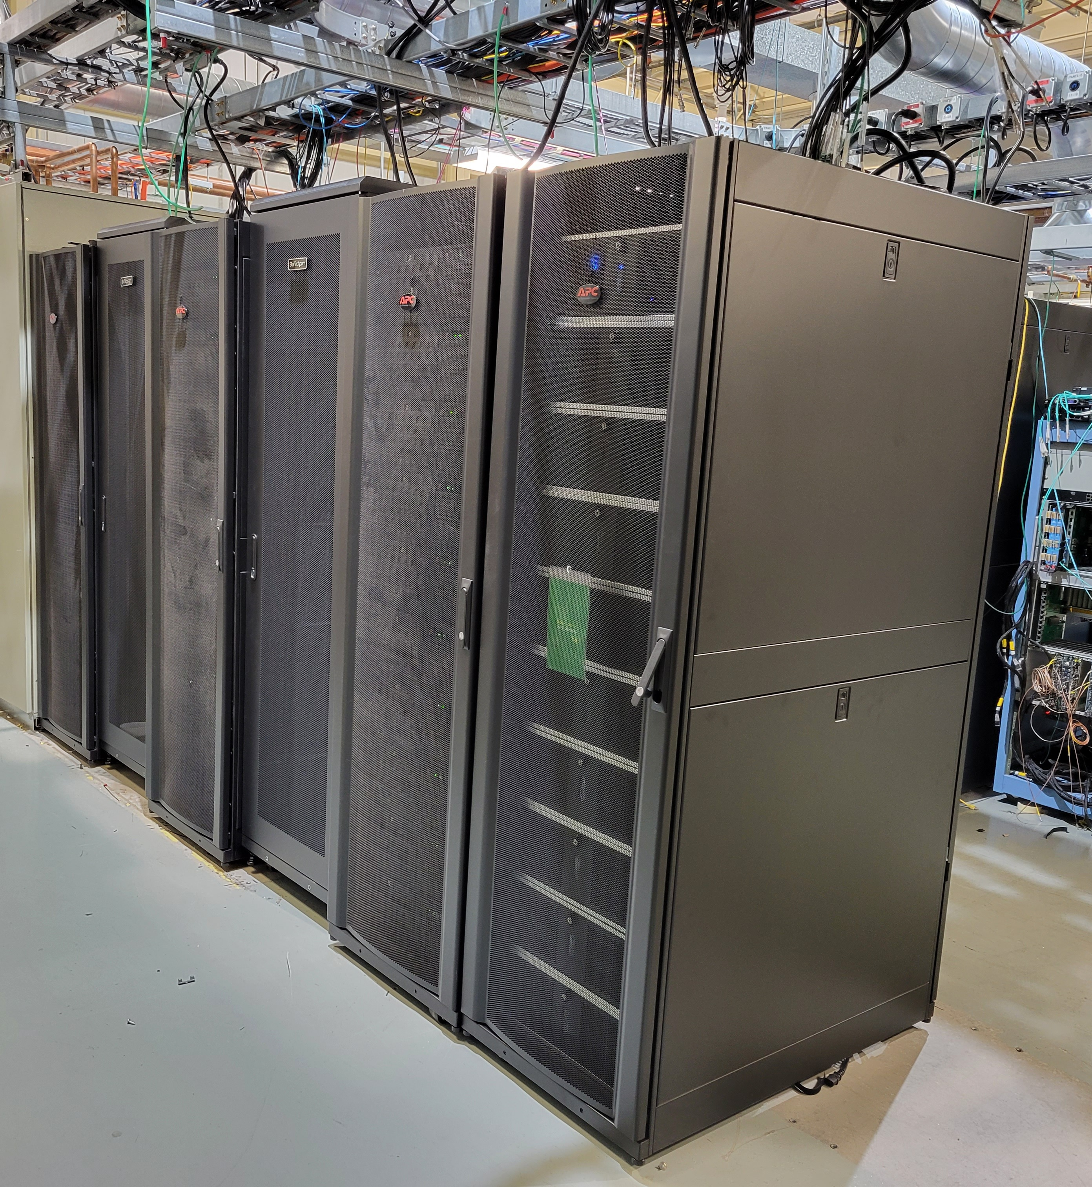
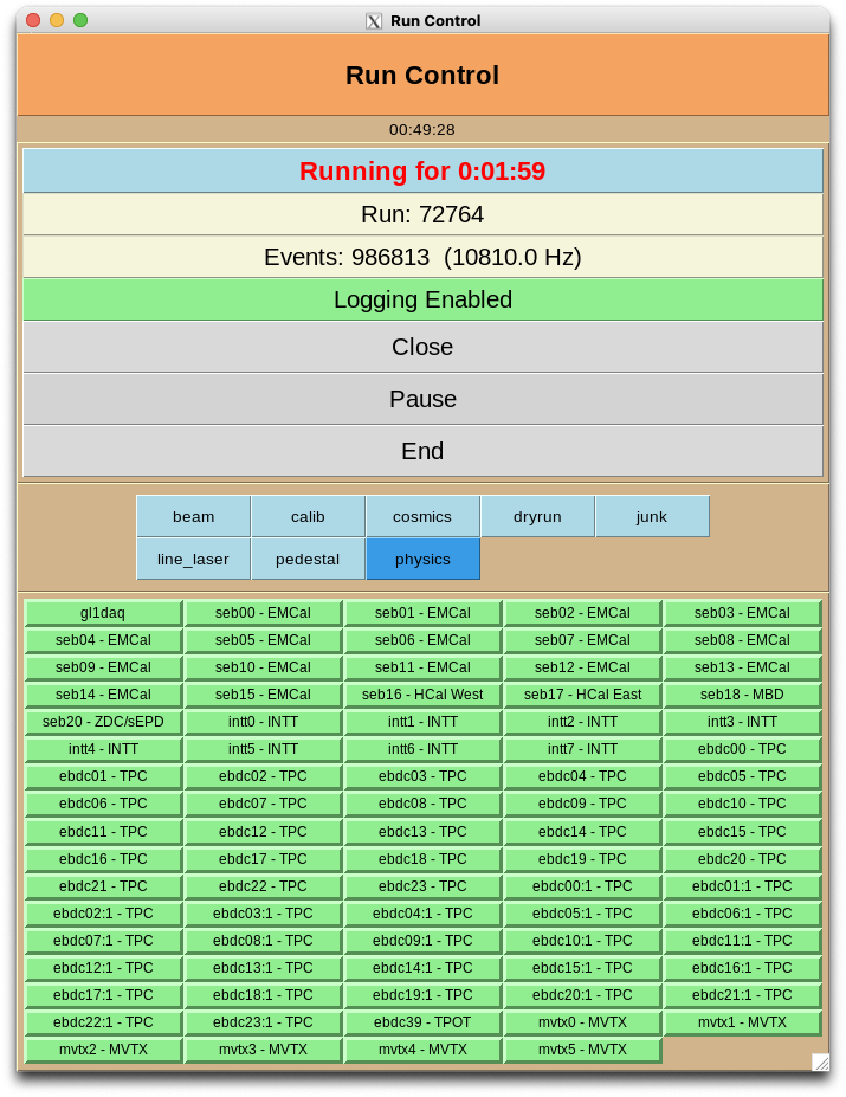
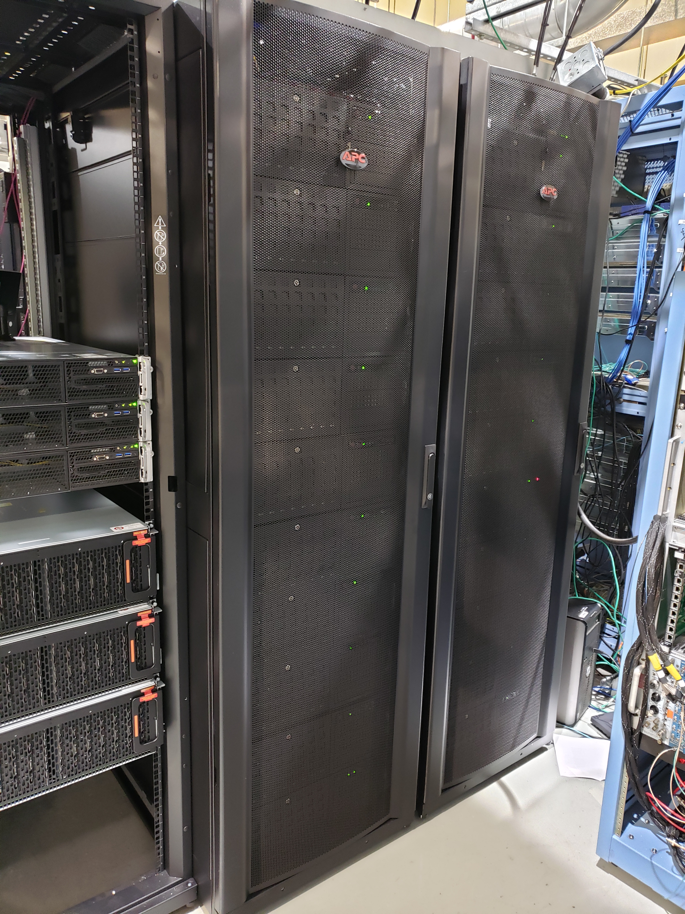
Here is the sPHENIX setup
FEM
FEE
FEE
DCM
DCM2
DCM
DCM
DCM
DCM
DCM
FELIX
EBDC
DCM
DCM
DCM
DCM
DCM
FELIX
EBDC
FEM
DCM
SEB
FEE
FEE
DCM
DCM
DCM
DCM
DCM2
DCM
FELIX
EBDC
DCM
FELIX
EBDC
DCM
DCM
DCM
DCM
DCM
FEM
DCM
SEB
FEE
DCM
DCM
FEE
DCM
DCM
FELIX
EBDC
DCM
DCM
DCM2
DCM
DCM
FELIX
EBDC
DCM
SEB
DCM
DCM
DCM
FEE
FEE
DCM
DCM
DCM
FELIX
EBDC
DCM
FEM
DCM
DCM
FELIX
EBDC
DCM
DCM2
DCM
DCM
FEE
FEE
DCM
DCM
DCM
DCM
DCM
SEB
DCM
FELIX
EBDC
DCM
FELIX
EBDC
FEM
DCM
DCM
DCM
DCM
DCM2
FEE
DCM
DCM
DCM
FEE
DCM
DCM
FELIX
EBDC
DCM
FEM
DCM
SEB
DCM
DCM
FELIX
EBDC
DCM
DCM
DCM
DCM
DCM2
FEE
FEE
DCM
SEB
DCM
DCM
DCM
DCM
FELIX
EBDC
DAQ machines
DCM
DCM
DCM
FELIX
EBDC
FEE
DCM
FEM
DCM
FEE
DCM
DCM
FELIX
EBDC
DCM
DCM
DCM2
DCM
DCM
FELIX
EBDC
DCM
DCM
DCM
DCM
DCM
SEB
FEE
FEE
FEM
DCM
FELIX
EBDC
DCM
DCM
DCM
DCM
FELIX
EBDC
DCM
DCM2
DCM
DCM
DCM
DCM
DCM
FEM
DCM
SEB
FEE
FEE
DCM
DCM
DCM
DCM
DCM
FELIX
EBDC
DCM
DCM
DCM2
DCM
DCM
FELIX
EBDC
DCM
SEB
DCM
DCM
FEE
FEE
DCM
DCM
DCM
FELIX
EBDC
DCM
FELIX
EBDC
FEM
DCM
DCM
DCM
DCM2
FEE
FEE
DCM
DCM
DCM
DCM
DCM
DCM
DCM
FELIX
EBDC
DCM
FELIX
EBDC
FEM
DCM
SEB
DCM
DCM
DCM
DCM
DCM2
FEE
DCM
DCM
DCM
FEE
DCM
DCM
FELIX
EBDC
DCM
FEM
DCM
SEB
DCM
DCM
FELIX
EBDC
DCM
DCM
DCM
FEE
DCM
DCM2
DCM
FEE
DCM
SEB
DCM
FELIX
EBDC
DCM
DCM
DCM
DCM
FELIX
EBDC
DCM
FEE
DCM
DCM
FEE
FEM
DCM
FELIX
EBDC
DCM
FELIX
EBDC
DCM
DCM
DCM
DCM
DCM2
DCM
DCM
DCM
DCM
DCM
SEB
FEE
FEE
FEM
DCM
DCM
DCM
DCM
FELIX
EBDC
DCM
DCM
DCM2
DCM
DCM
FELIX
EBDC
DCM
DCM
DCM
FEE
FEM
DCM
SEB
DCM
FEE
DCM
DCM
FELIX
EBDC
DCM
DCM
DCM
DCM
FELIX
EBDC
DCM
DCM2
DCM
DCM
SEB
FEE
DCM
DCM
FEE
DCM
DCM
FELIX
EBDC
DCM
FELIX
EBDC
DCM
DCM
FEM
FEE
DCM
DCM
DCM2
DCM
FEE
DCM
DCM
DCM
DCM
DCM
DCM
DCM
FELIX
EBDC
DCM
FELIX
EBDC
FEM
DCM
SEB
DCM
DCM
FEE
DCM
DCM2
DCM
FEE
DCM
DCM
DCM
FELIX
EBDC
DCM
DCM
DCM
DCM
FELIX
EBDC
FEM
DCM
SEB
DCM
DAQ Machines
DCM
FEE
DCM
DCM
FEE
DCM
DCM2
DCM
FELIX
EBDC
DCM
FELIX
EBDC
DCM
DCM
DCM
DCM
SEB
DCM
DCM
FEE
FEE
84 RCDAQs
DCM
DCM
DCM
FELIX
EBDC
DCM
FEM
DCM
DCM
FELIX
EBDC
DCM
DCM2
DCM
DCM
DCM
DCM
FEE
FEE
DCM
SEB
DCM
DCM
FEM
DCM
FELIX
EBDC
DCM
FELIX
EBDC
DCM
DCM
DCM
DCM
DCM2
DCM
DCM
FEE
DCM
DCM
FEE
FEM
DCM
SEB
DCM
FELIX
EBDC
DCM
FELIX
EBDC
DCM
DCM
DCM
DCM
DCM
DCM
DCM2
DCM
SEB
DCM
DCM
It uses a synchronized “cohort” of 84 individual RCDAQ instances, each reading a particular part of the detector
Held together by “Run Control”, like a conductor keeping everyone in line

Slide 21
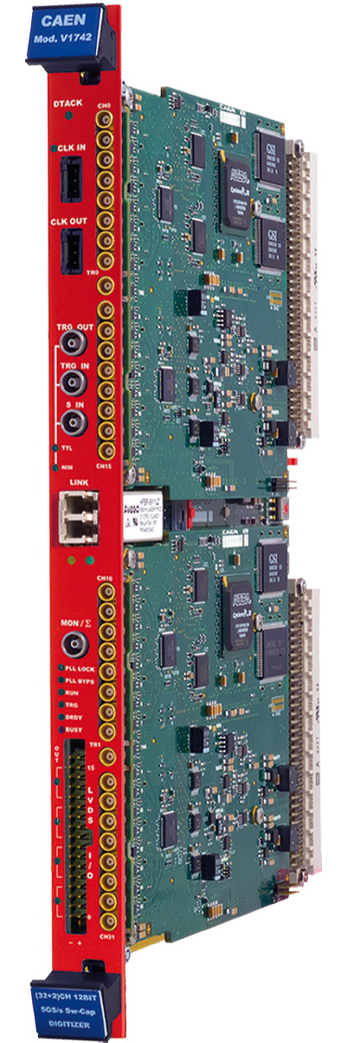
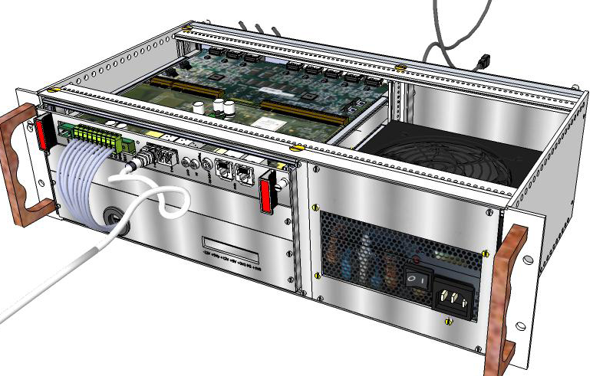
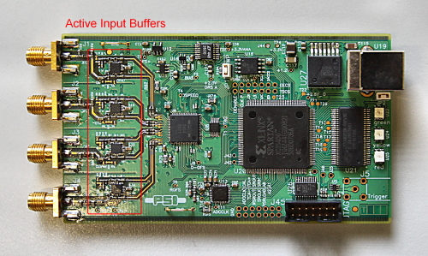
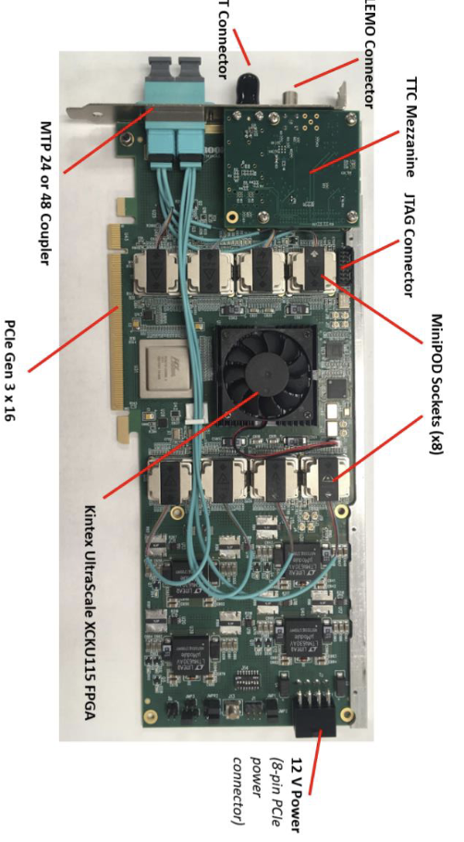
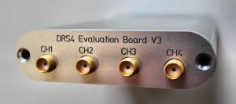
Some workhorse devices implemented in RCDAQ
RCDAQ
PCIe
PCIe
The CERN RD51 SRS System
H2GCROC readout
DRS4 Eval board
“USB Oscilloscope”
The CAEN V1742 waveform digitizer
FELIX Card
There are many more not shown (all told, there are plugins for about 60)
Many devices that you can often find in your institute already, or in the CAEN catalog

Slide 22
Setting up and reading out a DRS4 Eval board
Do you remember me saying that each RCDAQ interaction is a shell command?
$ rcdaq_client load librcdaqplugin_drs.so
$ rcdaq_client create_device device_drs -- 1 1001 0x21 -150 negative 120 3
$ daq_open
$ daq_begin
# wait a while…
$ daq_end
BTW, this double-dash is shell standard for “stop processing command line options”
Else the later “-150” would be interpreted as -1 -5 -0 options like “ls –ltr”.
Try to delete a file named “-I”…
This is a super-simple device, so all the setup can be done on the “create” command line
Not normally the case. In short: we are reding out a data event (1) with the DRS going to packet 1001, triggering (like a scope) on ch 1, -150 threshold, negative slope, move the pulse on the x-axis by 120 samples “right”, and setup 5GS/s

Slide 23
What’s the significance of that “1001”?
It is literally just a packet ID number that you are free to pick.
As a convention (nothing more) we pick numbers above 1000
Here we are just playing around, so 1001 is as good as any
That packet number identifies a particular readout unit (say, a FELIX card/ ROC card, what have you) and so it identifies a particular piece of real estate of your detector
Once assigned, one should never change that assignment
They are still just numbers… in both PHENIX and sPHENIX we imposed a numbering scheme where each detector system was enumerated (MBD 1, MVTX 2, INTT 3, TPC 4, …. and so on… outer HCal = 8)
sPHENIX has o(250) packets in total

Slide 24
PacketID assignment Example (BHCal)
Each detector then can assign packet IDs in the detector_nr * 1000 +1 …. d_nr * 1000 +999 range
8001… 8999 for the Hcal (the “even 1000” is reserved). Much more than we need
So we have 8001, 8002, 8007 and 8008 on the west side.
8003, 8004, 8005, 8006 on the east side
All 8 together constitute the data of the entire outer HCal
8003
8002
E
8004
8001
W
8005
8008
8006
8007
$ dlist /bbox/bbox6/W/HCal/cosmics/cosmics_seb16-064906-0000.prdf
Packet 8001 788 0 (Unformatted) 172 (IDDIGITIZERV3_12S)
Packet 8002 676 0 (Unformatted) 172 (IDDIGITIZERV3_12S)
Packet 8007 753 0 (Unformatted) 172 (IDDIGITIZERV3_12S)
Packet 8008 753 0 (Unformatted) 172 (IDDIGITIZERV3_12S)
The channel mapping for one device /packet repeats for each packet – super-easy to deal with
$ dlist /bbox/bbox7/W/HCal/cosmics/cosmics_seb17-064906-0000.prdf
Packet 8003 746 0 (Unformatted) 172 (IDDIGITIZERV3_12S)
Packet 8004 732 0 (Unformatted) 172 (IDDIGITIZERV3_12S)
Packet 8005 662 0 (Unformatted) 172 (IDDIGITIZERV3_12S)
Packet 8006 690 0 (Unformatted) 172 (IDDIGITIZERV3_12S))

Slide 25
Meta Data Capturing
In the “real” experiment that’s running for a few years (think sPHENIX, ATLAS, what have you) you are embedded in an environment that supports all sorts of record keeping
At a test beam or you in your lab needs a different kind of “record keeping support”
What was the temperature? Was the light on? What was the HV? What was the position of that X-Y positioning table?
We capture this information in the raw data file itself and the data cannot get lost
I often add a webcam picture to the data so we have a visual confirmation that the detector is in the right place, or something
A picture captures everything…
Let me show you how we always capture the RCDAQ setup itself
For that I need to introduce “Event Types”…

Slide 26
Reading different things with different Event Types
You would think of the DAQ as “reading your detector”
Almost always, it is necessary to read different things at different times.
Let’s go to the CERN-SPS (or the Fermilab Test Beam) for an example:
Let’s recap here:
The red lines are events that you would expect (read your detector)
The blue and yellow lines are events that read something else
acceleration
SPS or FTBF
extraction
“spill”
Begin-run event
End-run event
Spill-On event
Read and clear scalers
Flush buffers
Data Events
Read your detector channels, ADCs, TDCs...
Spill-Off event
Read and clear scalers
(allows spill intensity-based corrections)
26
In addition to your data, you need information about the spill itself – each one is different
You need to make intensity-dependent corrections on a spill-by-spill basis
So you put some signals on scalers and get an idea about the intensity, dead times, microstructures, etc

Slide 27
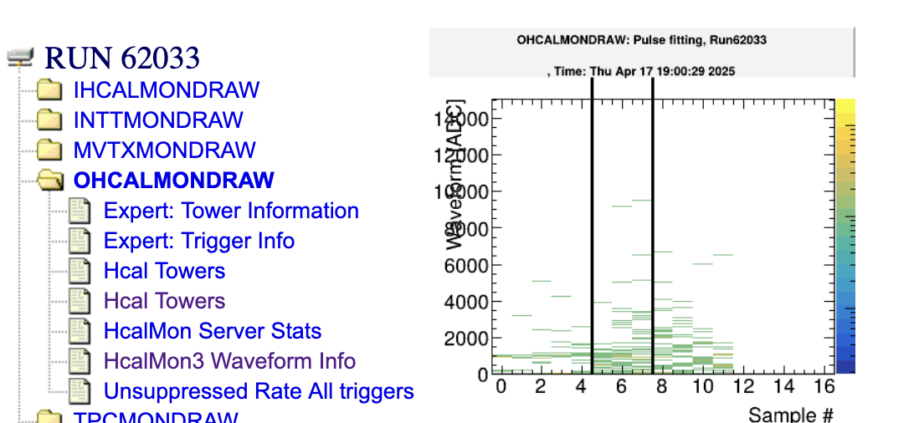
Why are begin- and endrun events so important?
In each run, they are generated exactly once
This is the place where you can keep information that is needed/valid for the entire run
Like the position information of the x/y motors that you saw before - they would get stored in the begin run.
Ditto for configuration information – we always make it so that we store it in the begin-run.
RCDAQ guarantees that the begin-run is the first, and the end-run is the last event in that run
If nothing else, if you treat your data as a stream (think online monitoring – doesn’t stop, sees many runs), these serve as convenient markers that a new run has begun, or a run has ended.
On receipt of the begin-run event, you typically clear all your monitoring histograms
On receipt of the end-run event, you save your histograms to a file
This is actually how all this online monitoring history is generated!

Slide 28
Let’s capture meta-data now!
This was our typed-in example from before
$ rcdaq_client load librcdaqplugin_drs.so
$ rcdaq_client create_device device_drs -- 1 1001 0x21 -150 negative 120 3
Now you put this into a script so you always get the same setup:
#! /bin/sh
rcdaq_client load librcdaqplugin_drs.so
rcdaq_client create_device device_drs -- 1 1001 0x21 -150 negative 120 3

Slide 29
Capturing the setup script itself for posterity
We add this very setup script file into our begin-run event for posterity
This “device” captures a file as text into a packet
This “9” is the event type of the beg-run
And this refers to the name of the file itself
#! /bin/sh
rcdaq_client create_device device_file 9 900 ”$0”
rcdaq_client load librcdaqplugin_drs.so
rcdaq_client create_device device_drs -- 1 1001 0x21 -150 negative 120 3
So this gets added as packet with id 900 in the begin-run
It’s not quite right yet - $0 is usually just “setup.sh”, so the server may not be able to find it.
Let me show the “end product”:

Slide 30
A typical RCDAQ Setup Script
#! /bin/sh
# this sets up the DRS4 readout with 5GS/s, a negative
# slope trigger in channel 1 with a delay of 140
if ! rcdaq_client daq_status > /dev/null 2>&1 ; then
echo "No rcdaq_server running, starting..."
rcdaq_server > $HOME/rcdaq.log 2>&1 &
sleep 2
fi
MYSELF=$(readlink -f $0)
rcdaq_client daq_clear_readlist
rcdaq_client create_device device_file 9 900 "$MYSELF”
rcdaq_client load librcdaqplugin_drs.so
rcdaq_client create_device device_drs -- 1 1001 0x21 -150 negative 120 3
We comment a lot as a way of documentation
If no server is running, we start one here.
We convert the script filename into a full path
We clear all existing definitions
We load the plugin(s) and define the device(s)

Slide 31
Output file management
The output file names are governed by what is called a “file rule”
It acts as the format portion of a c-program “printf” statement
The startup default is “rcdaq-%08d-%04d.evt” – called with 2 int parameters, one the run number, and one a “file sequence number” if we roll over files
You can try this even on the command line ( I added the \n to have it by itself on a line)
The %08d and %04d parts make an 8- or 4-digit number with leading zeroes – we want to avoid spaces in filenames.
We usually give a file rule with a full and complete path, such as
/data/phnxrc/BHCal/cosmics/cosmics_ROC-%08d-%04d.evt
You can have “Run Types” that quickly switch between different pre-made file rules for beam/cosmics/calibration/pedestal/junk etc
$ printf "rcdaq-%08d-%04d.evt\n" 100 0
rcdaq-00000100-0000.evt

Slide 32
Here is the actual setup script for our H2GCROC readout
In 2 parts, and still a bit abridged…
#! /bin/sh
MYSELF=$(readlink -f $0)
if ! rcdaq_client daq_status > /dev/null 2>&1 ; then
echo "No rcdaq_server running, starting... log goes to $HOME/rcdaq.log"
rcdaq_server > $HOME/rcdaq.log 2>&1 &
sleep 2
# see if we have an elog command (ok, this is a weak test but
# at least it tells us that elog is installed.)
ELOG=$(which elog 2>/dev/null)
[ -n "$ELOG" ] && rcdaq_client elog localhost 666 RCDAQLog
fi
rcdaq_client daq_setrunnumberfile $HOME/.rcdaq_run
Here we set up our elog, so RCDAQ can make automated entries
We make run numbers persistent across restarts

Slide 33
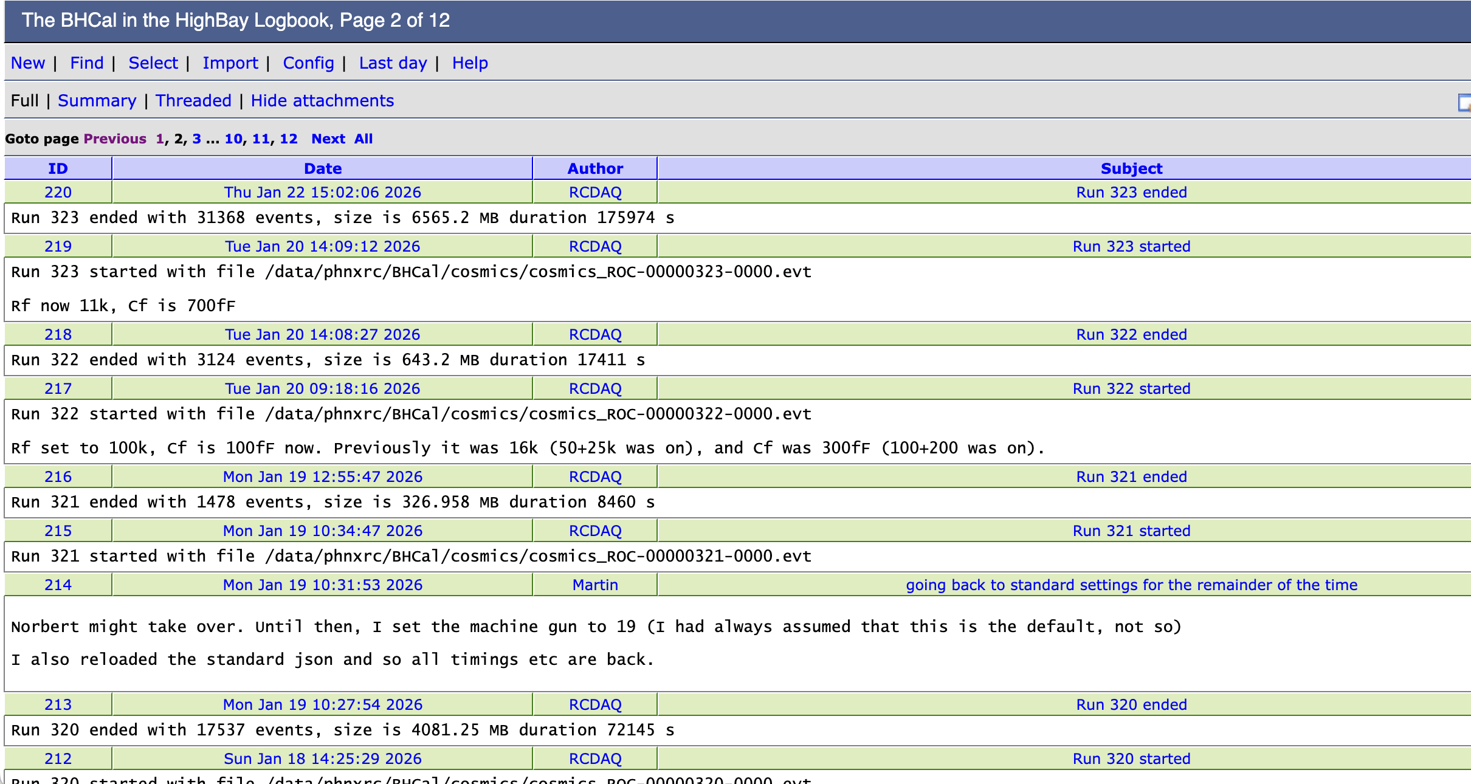
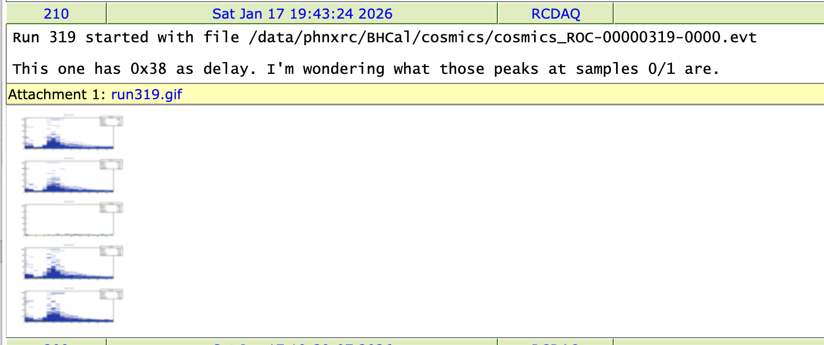
Automated Elog Entries
RCDAQ can make automated entries in your Elog
Of course you can make your own entries, document stuff, edit entries, add plots…
Gives a nice timeline and log
Notes:
----- Meeting Notes (1/27/16 16:27) -----

Slide 34
Actual setup script for our H2GCROC readout, part 2
2nd part…
STEM=/data/phnxrc/BHCal
rcdaq_client daq_define_runtype junk $STEM/junk/junk_ROC-%08d-%04d.evt
rcdaq_client daq_define_runtype mapping $STEM/mapping/mapping_ROC-%08d-%04d.evt
rcdaq_client daq_define_runtype cosmics $STEM/cosmics/cosmics_ROC-%08d-%04d.evt
rcdaq_client daq_define_runtype pedestal $STEM/pedestal/pdestal_ROC-%08d-%04d.evt
rcdaq_client daq_set_runtype junk
rcdaq_client daq_clear_readlist
# we add this script itself to the begin-run event
rcdaq_client create_device device_file 9 900 "$MYSELF"
rcdaq_client load librcdaqplugin_h2gcroc3.so
rcdaq_client create_device device_h2gcroc3 1 12001 10.1.2.208 1 200
rcdaq_client daq_open
We pre-make 5 run types to switch quickly (file rules)
And this is the business end of this entire setup…

Slide 35
More about capturing your environment
Sometimes you add meta-info to make the analysis easier, especially in the aforementioned “scanning something” setups - example later
Many times you capture things only “just in case”
I usually add a camera picture to the begin-run, especially when the detector moves in the beam for some position scan
You don’t routinely look at them in your analysis, but it’s good to have that info
If you have some inexplicable feature, you can use the meta-data to do “forensics”
Find out what, if anything, went wrong
The more data you capture, the better this gets
Think of it as “black box” on a plane…

Slide 36
Forensics (FermiLab test beam for the future ePIC HCal)
“It appears that the distributions change for Cherenkov1 at 1,8,12,and 16 GeV compared to the other energies. It seems that the Cherenkov pressures are changed. […] Any help on understanding this would be appreciated.”
Martin: “Look at the info in the data files:”
Among many other things, we capture the most relevant beamline parameters
$ ddump -t 9 -p 923 beam_00002298-0000.prdf
S:MTNRG = -1 GeV
F:MT6SC1 = 5790 Cnts
F:MT6SC2 = 3533 Cnts
F:MT6SC3 = 1780 Cnts
F:MT6SC4 = 0 Cnts
F:MT6SC5 = 73316 Cnts
E:2CH = 1058 mm
E:2CV = 133.1 mm
E:2CMT6T = 73.84 F
E:2CMT6H = 32.86 %Hum
F:MT5CP2 = .4589 Psia
F:MT6CP2 = .6794 Psia
$ ddump -t 9 -p 923 beam_00002268-0000.prdf
S:MTNRG = -2 GeV
F:MT6SC1 = 11846 Cnts
F:MT6SC2 = 7069 Cnts
F:MT6SC3 = 3883 Cnts
F:MT6SC4 = 0 Cnts
F:MT6SC5 = 283048 Cnts
E:2CH = 1058 mm
E:2CV = 133 mm
E:2CMT6T = 74.13 F
E:2CMT6H = 37.26 %Hum
F:MT5CP2 = 12.95 Psia
F:MT6CP2 = 14.03 Psia

Slide 37
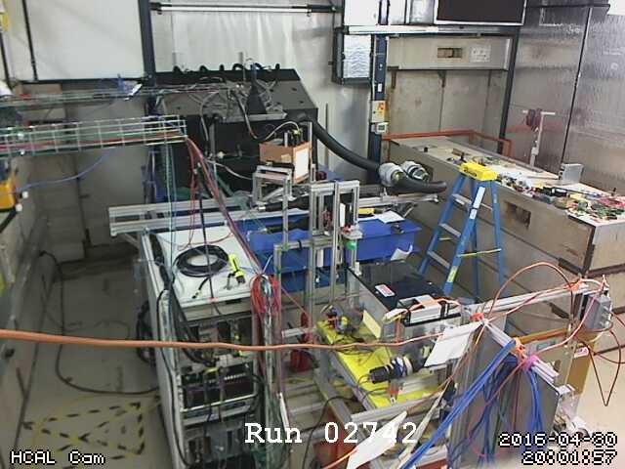
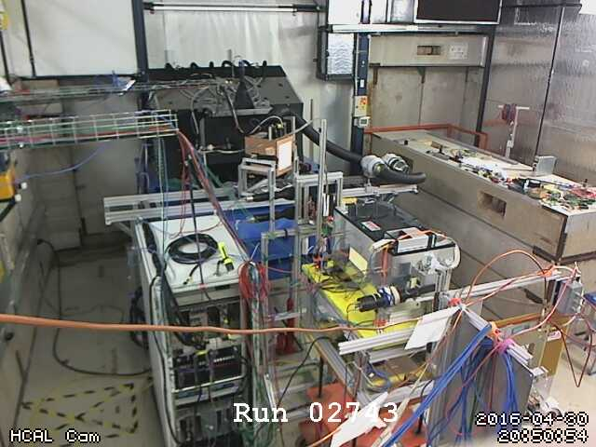
More Forensics (HCal at the Fermilab test beam again…)
“There is a strange effect starting in run 2743. There is a higher fraction of showering than before. I cannot see anything changed in the elog.”
Look at the cam pictures we automatically captured for each run:
$ ddump -t 9 -p 940 beam_00002742-0000.prdf > 2742.jpg
$ ddump -t 9 -p 940 beam_00002743-0000.prdf > 2743.jpg

Slide 38
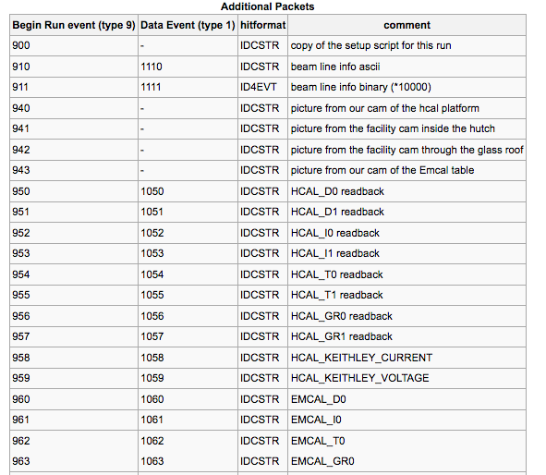
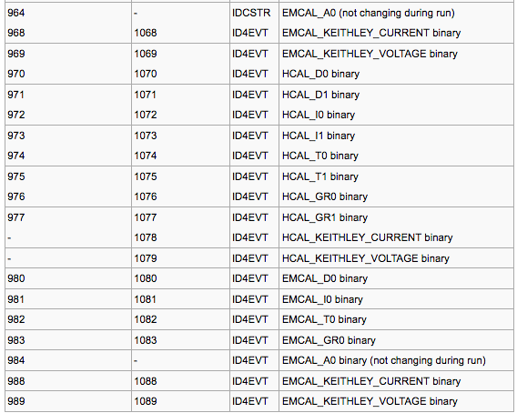
“Meta Data” Packet list from that test beam
More than 72 environment-capturing packets (accelerator params, voltages, currents, temperatures, pictures, …)
Captured at begin-run
Captured again at spill-off

Slide 39
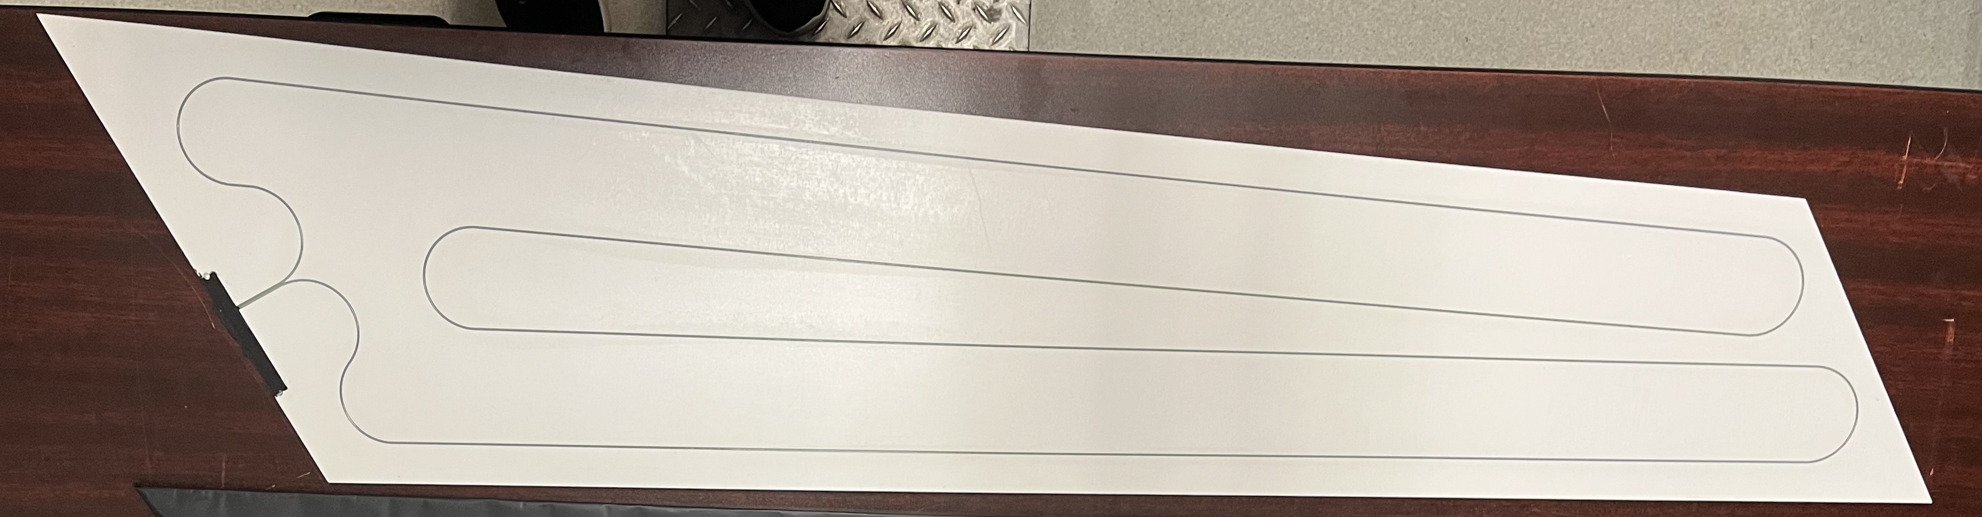
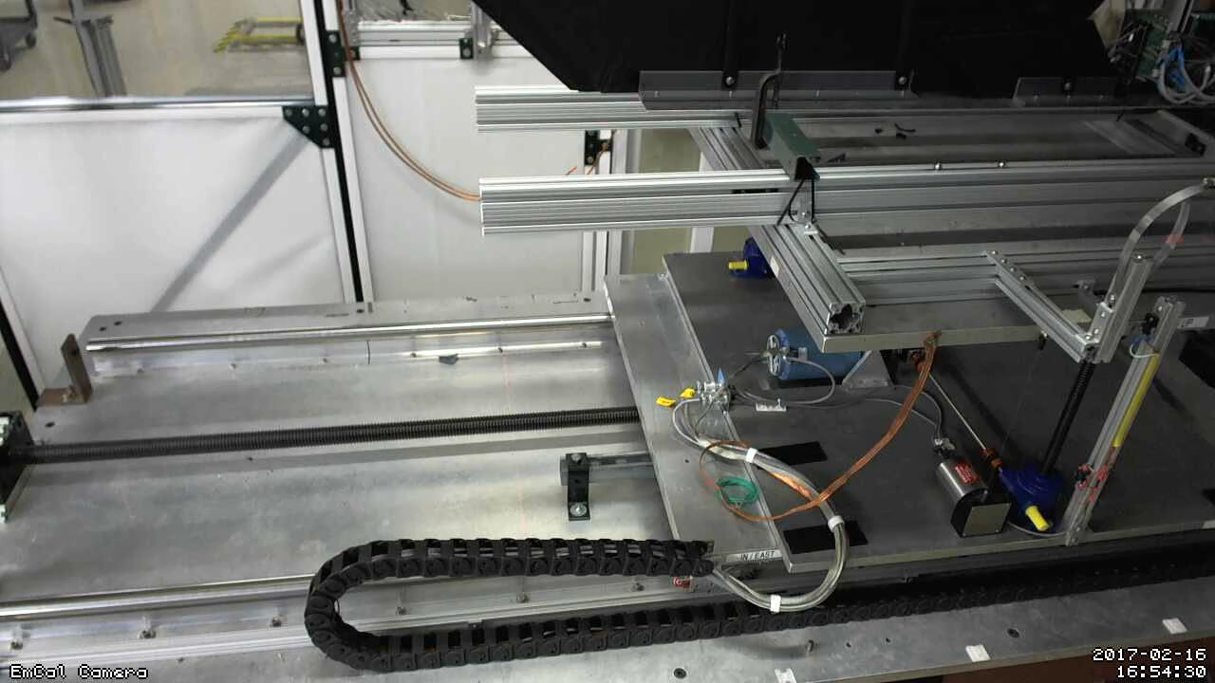
Moving Detector Example: “HCal Tile Mapping” at the Fermi Test Beam Facility
“Tile mapping” refers to mapping the position-dependent response of a hadronic calorimeter tile. We were moving a stack of Hcal tiles so the beam hits particular positions (In the picture, beam is coming at you)
About 200 individual positions of the tile relative to the beam – you’d go nuts doing all that manually, and you are bound to make mistakes
And all on camera for ach run for feel-good value – does that thing move right when we think it should?
This setup exercises many of the aforementioned features: scripting and reacting to the FTBF spill, network transparency (we cannot access the table positioning from our DAQ machine, but a FTBF-owned machine can control our DAQ)

Slide 40
Wait a minute – how to I get “fresh” begin-run information??
I have shown you how you swallow an existing file (like you setup file) into the begin-run event
But this was different – for each run we got a “fresh” picture from the cam… how?
Throw in the ”daq_device_command”
It doesn’t read out anything – just when the event is triggered, it executes the assorted command
The subsequent commands grab the just-made jpg files and delete them after
So it is impossible to store stale info in case the picture-grabbing from the cam fails for some reason
# get the cameras
rcdaq_client create_device device_command 9 0 "$HOME/mlp/cam_capture.sh"
rcdaq_client create_device device_file_delete 9 940 "$HOME/mlp/hcals.jpg" 110
rcdaq_client create_device device_file_delete 9 941 "$HOME/mlp/ftbf_hut.jpg" 70
rcdaq_client create_device device_file_delete 9 942 "$HOME/mlp/ftbf_hut_birdseye.jpg" 70
rcdaq_client create_device device_file_delete 9 943 "$HOME/mlp/emcal.jpg" 110
rcdaq_client create_device device_file_delete 9 944 "$HOME/mlp/ftbf_moving_cam.jpg" 70

Slide 41
Meta-data:I had called our H2GCROC setup script “abridged” – two more lines
# we add this script itself to the begin-run event
rcdaq_client create_device device_file 9 900 "$MYSELF”
rcdaq_client create_device device_command 9 0 "RequestScript.py > /tmp/roc_setup.json"
rcdaq_client create_device device_file_delete 9 910 /tmp/roc_setup.json
rcdaq_client load librcdaqplugin_h2gcroc3.so
rcdaq_client create_device device_h2gcroc3 1 12001 10.1.2.208 1 200
rcdaq_client daq_open
Analogous to what I showed you with the cameras before, the first command asks the KCU to dump every configuration setting into that /tmp/roc_setup.json file
The 2nd command absorbs the file into packet 910. So for each data file, you will be able to figure out how the setup was configured.

Slide 42
Config capture
$ ddump -t 9 -p 910 /data/phnxrc/BHCal/cosmics/cosmics_ROC-00000299-0000.evt | more
['0xa0', '0x0', '0x10', '0x0', '0x0', '0x95', '0x5', '0xa0', '0x0', '0x0', '0x0', '0x0', '0x0', '0x0', '0x0', '0x0', '0x0', '0x0', '0x0', '0x0', '0x0', '0x0', '0x0', '0x0', '0x0', '0x0', '0x0', '0x0', '0x0', '0x0', '0x0', '0x0', '0x0', '0x0', '0x0', '0x0', '0x0', '0x0', '0x0', '0x0']
ASIC0 Register Top: 0xa0 0x00 0x10 0x00 0x00 0x95 0x05 0xb4 0x0b 0x0f 0x40 0x7f 0x00 0x07 0x85 0x00 0xff 0x00 0xff 0x00 0xff 0x00 0x7f 0x00 0x22 0x02 0x04 0x00 0x00 0x00 0x00 0x00 0x00 0x00 0x00 0x00 0x00 0x00 0x00 0x00
['0xa0', '0x0', '0x10', '0x0', '0x0', '0x8f', '0x0', '0x0', '0x0', '0x0', '0x0', '0x0', '0x0', '0x0', '0x0', '0x0', '0x0', '0x0', '0x0', '0x0', '0x0', '0x0', '0x0', '0x0', '0x0', '0x0', '0x0', '0x0', '0x0', '0x0', '0x0', '0x0', '0x0', '0x0', '0x0', '0x0', '0x0', '0x0', '0x0', '0x0’]
. . . And on and on…

Slide 43
Online monitoring in 3 slides
In an offline analysis, you run through a dataset. At the end, you write out or look at {histograms, ntuples, what have you}
No good for online monitoring!
You want to look at (and more generally manipulate, such as fit, reset, …) at any time while the data are coming in
What I see from other packages often is a root loop that refreshes some pre-made displays periodically. I call this “billboard monitoring”, and it has its applications.
However: I want total interactivity! Bottom line: I want my root prompt “active” at all times to be able to do stuff while the data are flowing!
And yes, I sometimes also do billboard monitoring where appropriate (like on a completely passive X display mounted on the wall).
But the interactivity is great when you are tuning things.
My package is called “pmonitor”. It works by pushing the processing to a background thread, so you always have the root prompt
You have the option not to use this feature – then you have a swiss-army-knife type offline analysis.

Slide 44
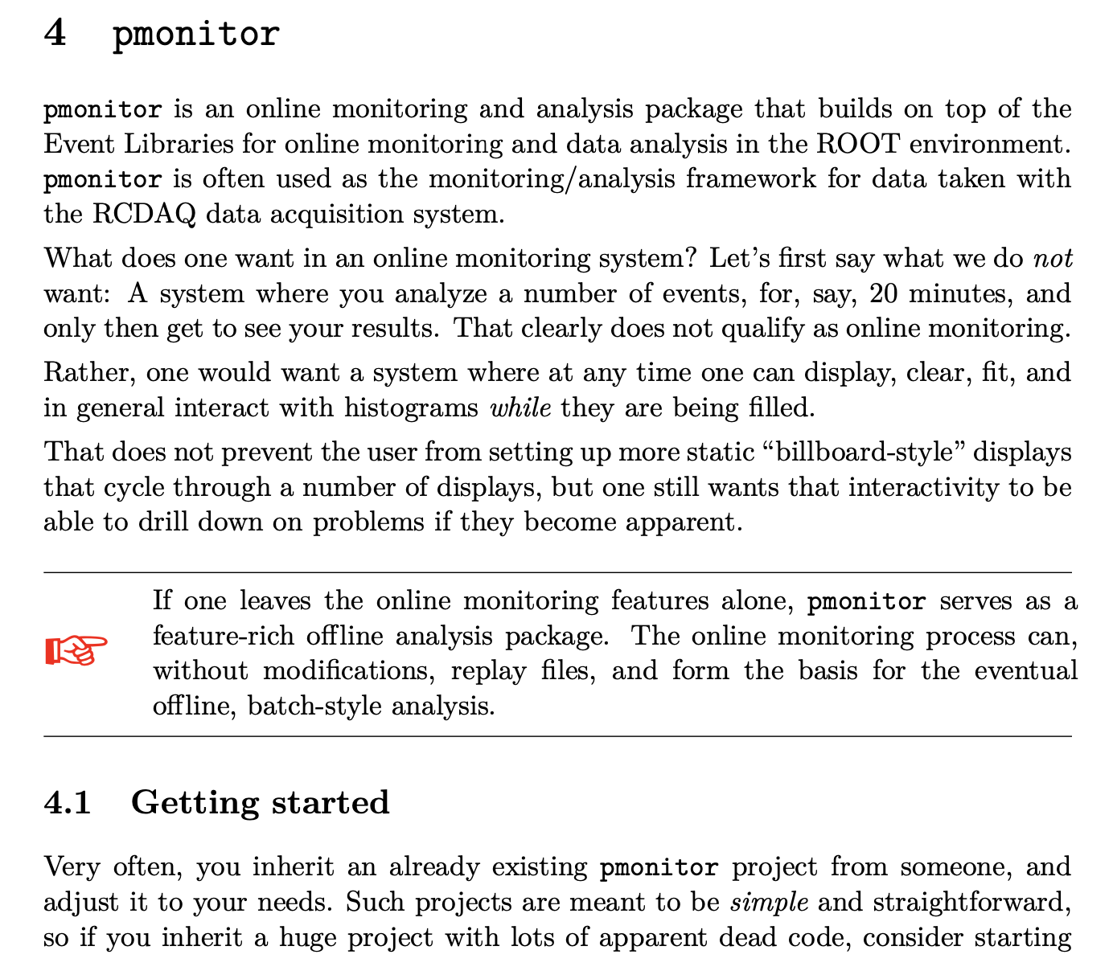
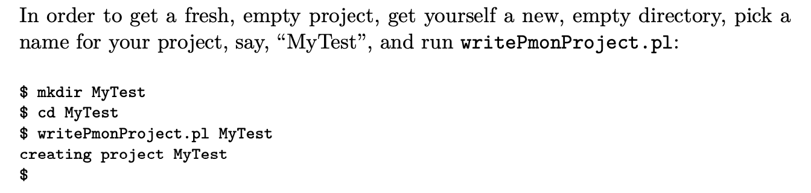

Let me show you the example from the manual:
In an offline analysis, you run through a dataset. At the end, you write out or look at {histograms, ntuples, what have you}
I have all theROC monitoring done, but this is how it started! Straight from the manual:

Slide 45


This is our online monitoring:
It makes many monitoring histograms, and has some configurable Canvas setups it can generate
What you see here are the persistency plots that plot many waveforms on top of each other (gleaned from a digital scope “persistency mode” where the same happens)
We see that one of our scintillators has a weak signal…
This is a crude waveform analysis to get a signal, histogrammed here

Slide 46


And for our eventual trigger setup:
I added the CAEN DT5743 waveform sampler to the setup.
In order to have something to show, I added out trigger scintillators’ last-dynode output to ch 0 and 1
Here shown on a scopeshot and from onl. monitoring

Slide 47

This is our VNC “Control Station”
We run our entire show in a VNC desktop (the machine itself is headless, what’s the point…)
You may have used NoMachine – VNC is similar but way better
It allows us to share the same desktop among different people. So experts can intervene in the same environment/Desktop (”let me quickly show you…”)

Slide 48
Using RCDAC features to streamline your analysis
Going back to the “calo module mapping” for a moment
You are ending up with several thousand individual data files, one per position
In each begin-run event we capture additional information, especially the x/y position where this data point is from
RCDAQ has a “command device” that doesn’t read out anything but executes a command when the event is triggered – here we execute “getmotorpositions.sh” at each begin-run
This script reaches out to the positioning system and writes a file “positions.txt” with the two numbers
We then absorb the file into the begin-run event
And we can retrieve this in the analysis (here shown with a command-line utility):
# we add a command to capture the positions to a file
rcdaq_client create_device device_command 9 0 "$HOME/getmotorpositions.sh"
rcdaq_client create_device device_file 9 920 "$HOME/positions.txt"
rcdaq_client create_device device_filenumbers_delete 9 921 "$HOME/positions.txt"
$ ddump -t 9 -p 920 scan10_0000201800-0000.evt
4600
-4400

Slide 49


Using RCDAC features to streamline your analysis
Then we make a list of all files that belong to this scan, and throw them all at the at the analysis process
We get the begin-run event and extract and remember the x-y positions
We then histogram the signal with the actual data events
Eventually we hit end end-run event, know that this position is done. Get the mean from the histogram, and fill it in the map at the right position
Run through all files in the set, have a coffee, and see the results:
In this way you can run the analysis without burdensome additional bookkeeping
All you need to analyze the data in one fell swoop is contained in the data themselves
Notes:
/phenix/u/purschke/sipm

Slide 50
Some code snippets
Here I’m extracting the x and y position from packet 921:
if ( e->getEvtType() == BEGINRUN )
{
reset_histograms();
old_runnr = e->getRunNumber();
Packet *p921 = e->getPacket(921);
if ( p921)
{
xpos = p921->iValue(0);
ypos = p921->iValue(1);
cout << "Postions " << xpos << " " << ypos << endl;
delete p921;
}
return 0;
}
Notes:
/phenix/u/purschke/sipm

Slide 51
Some code snippets
Here I recognize the end-run event and analyze the signal distribution for this run:
if ( e->getEvtType() == 12 ) // end run
{
h2_gainmap->Fill( (xpos+400)/200., (ypos-10000)/-200., h_signal->GetMean() );
if (open_flag)
{
xlsfile << xpos << " " << ypos << " " << h_signal->GetMean() << endl;
}
return 0;
}
Notes:
/phenix/u/purschke/sipm

Slide 52
Internal data format changes
We have transitioned from the old KCU firmware to the new 10G-capable one, which brought some internal format changes
Q: Do I have to re-write/modify all my analysis/monitoring/user code now?
A: Nope. The user code never accesses the raw data directly, but uses APIs to get at the information it needs
The APIs deliver the data in the same way, independent of internal format
This is done with the (historically named) “hitformat”
Some sPHENIX readout units (like the calorimeters) have seen 5,6,7 format changes, mostly to improve the “density” of the data storage
Like instead of first storing 2x10bits in a 32bit field, now store 3x10bits in same
No changes to any of the user/monitoring/reconstruction code!
$ dlist cosmics_ROC-00000295-0000.evt
Packet 12001 73004 -1 (ePIC Packet) 301 (IDH2GCROC3)
$ dlist cosmics_10G_ROC-00000324-0000.evt
Packet 12001 31422 -1 (ePIC Packet) 302 (IDH2GCROC3_10G)
Notes:
/phenix/u/purschke/sipm

Slide 53

A word about APIs
The packets provide their info via a number of APIs (about 10 different ones)
You need to know what kind of questions to ask
you need to know, in this example, that you are dealing with a waveform sampler (as opposed to, say, a pixel detector)
The APIs then hand you theit information in a generic way.
For example, all non-streaming waveform samplers (DRS4, CAEN 1742, the sPHENIX calorimeters, etc etc) can use the following code that asks
Hey packet, how many channels do you have?
Hey channel, how many samples do you have?
Ok then, please give me sample s of channel c
for ( int c = 0; c < p->iValue(0,"CHANNELS"); c++) // the channels
{
for ( int s = 0; s < p->iValue(c,"SAMPLES"); s++) // the samples
{
h2->Fill(s, c, p->iValue(s,c) );
}
}

Slide 54


Our Streamers have one more dimension
A SRO packet usually contains more than one waveform in a “TimeFrame”
Here you ask:
Hey packet, how many waveforms do you have?
Hey packet, how many channels do you have for waveform n?
Hey channel, how many samples do you have for waveform n ?
Ok then, please give me sample s of channel c of waveform n

Slide 55

This is the end…
Let me end this with a bit of eye-candy

Slide 56




GUIs
On my phone
GUIs must not be stateful!
Statelessness allows to have multiple GUIs at the same time
And allows to mix GUIs with commands (think scripts)
(all state information is kept in the rcdaq server)
My GUI approach is to have perl-TK issue standard commands, parse the output
Slowly transitioning to Web-based controls (web sockets + Javascript)
Perl-TK
Web Browser

Slide 57


Shell integration
The Speaking DAQ

