Slide 1

EICUG Report
EICUG Chairline
Anselm Vossen (Duke)
Douglas Higinbotham (Jlab)
Or Hen (MIT)

Slide 2
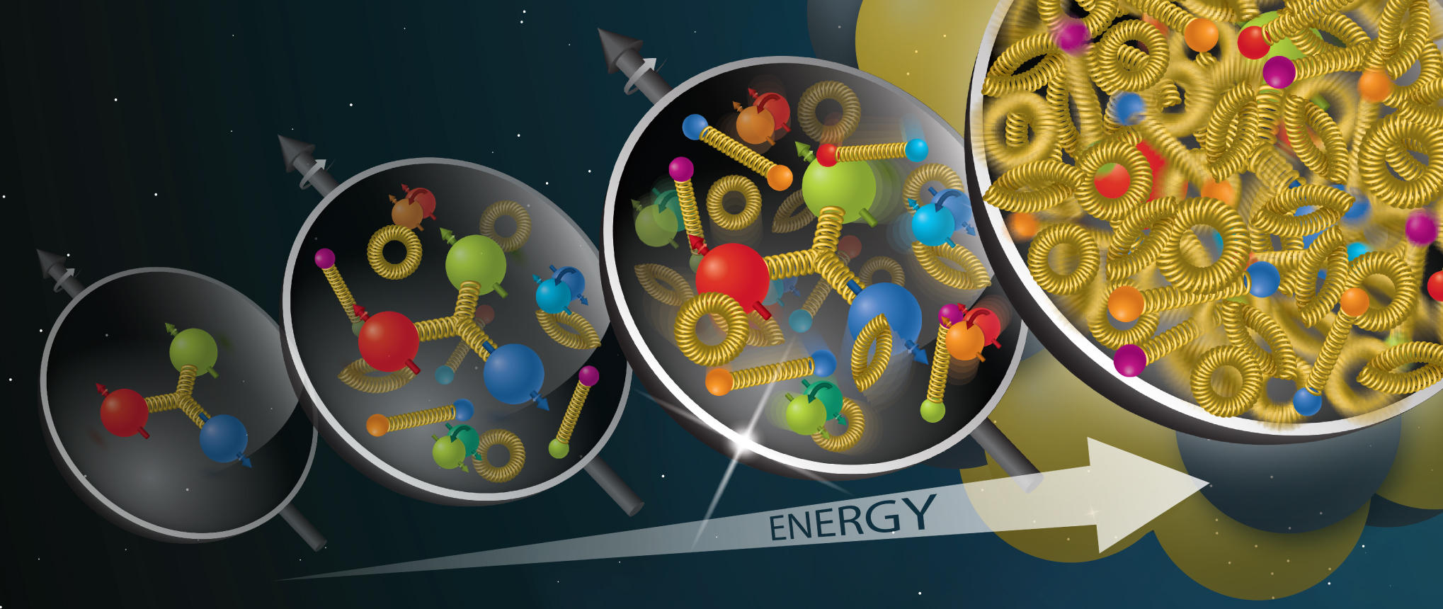
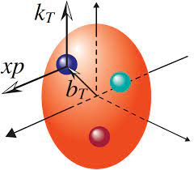
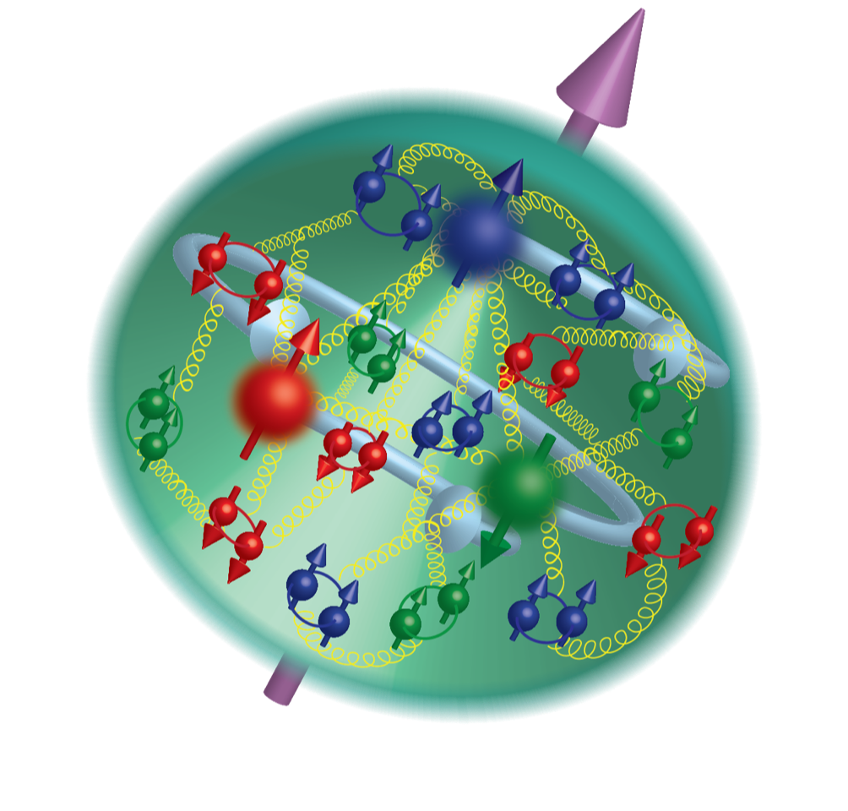

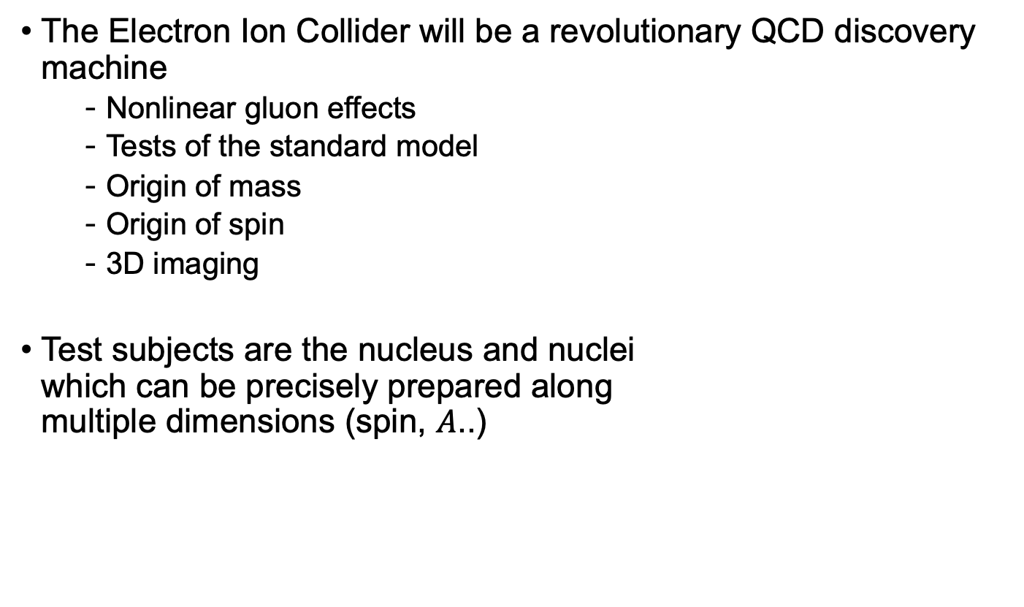
The role of the User’s group:
A great machine needs a great UG
The Electron Ion Collider will be a revolutionary QCD discovery machine
  Nonlinear gluon effects
  Tests of the standard model
  Origin of mass
  Origin of spin
  3D imaging
Test subjects are the nucleus and nuclei
which can be precisely prepared along
multiple dimensions (spin, $A$..)

Slide 3
The role of the User’s Group
Every facility needs a User’s group….
ePIC collaboration is laser focused on the realization of the ePIC detector
The EICUG is the natural home for all EIC User
  EICUG represents a natural discussion forum for members with diverse expertise (accelerators, theory, experiments)….The EICUG will foster and support collaborative discussion of initiatives that aim to enhance the EIC scientific program. [charter]
  Represent the interests of EIC users to the laboratories
  Represent the broader EIC Users community in discussions of scientific priorities and tradeoffs that may be imposed by budget realities [charter]

Slide 4
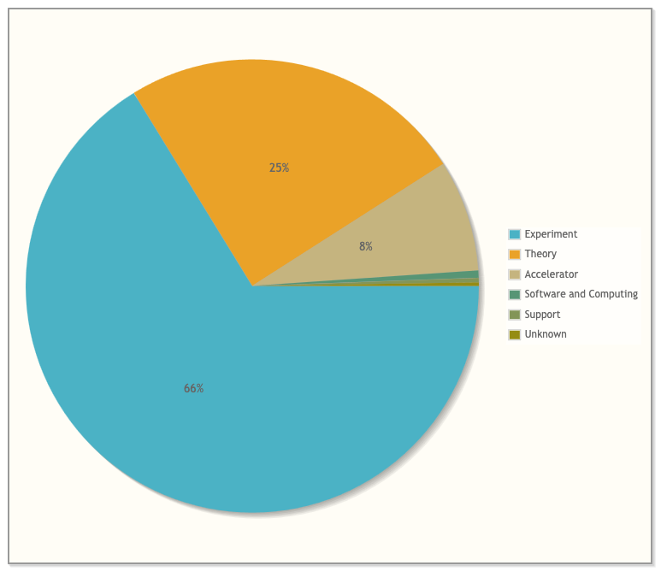
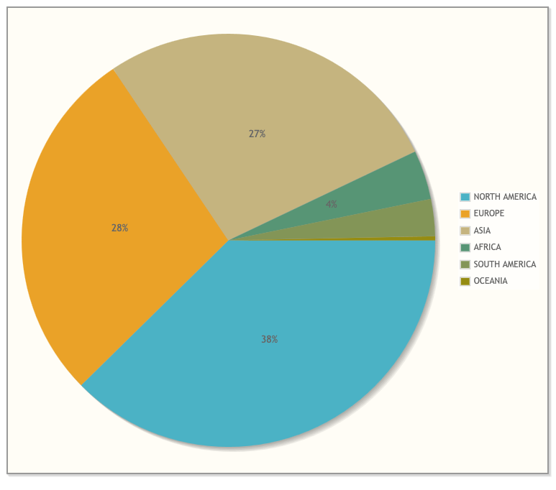
Organization and Structure
1547 members. (-9)
311 institutions (+4)
41 countries (6 world regions)
  Experiment Scientists: 1024 (-7),
  Theory Scientists: 383,
  Accelerator Scientists: 124 (+1) ,
  Computer Scientists: 8. (-1), Support: 5, Other: 3

Slide 5
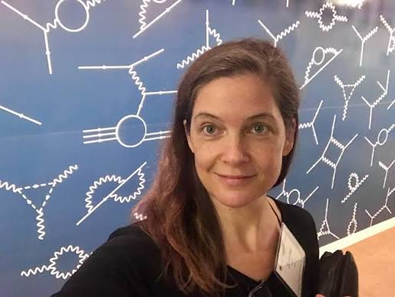

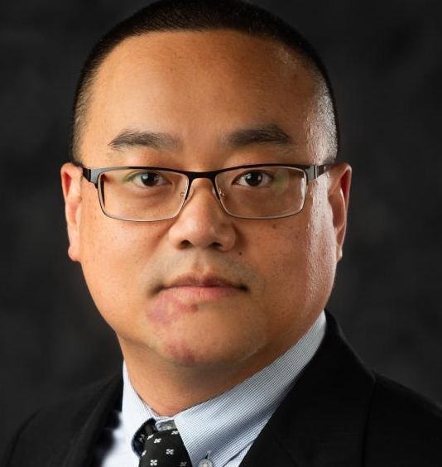

Thanks to the Organizers of the EC Workshop
Jennifer Rittenhouse West
Wenliang (Bill) Li (MSU)
Derek Anderson (Jlab)
Gary Penman (Glasgow)
Akshaya Vijay (Manitoba)

Slide 6
Organization of the EICUG Steering Committee
Chair Line
Douglas Higinbotham (Jlab)
Or Hen (past chair)
Anselm Vossen (chair elect)
Regular Members
Charlotte Van Hulse (University of Alcalà, Madrid, Spain), term August 2024 - August 2027
Henry Klest (Argonne National Laboratory, USA), term August 2024 - August 2027
Martha Constantinou (Temple University, USA), term August 2023 - August 2026
Alex Jentsch (Brookhaven National Laboratory, USA), term August 2023 - August 2026
Early Career
Derek Anderson August 2025- August 2027
International Representatives
William A. Horowitz (Cape Town, South Africa), term August 2025 - August 2028
Carlos Muñoz Camacho (IJCLab, Orsay, France), term August 2024 - August 2027
Lab/EIC Project Representatives:
Rolf Ent (Jlab), Peter Steinberg (BNL)
ePIC Representative
John Lajoie (ORNL)

Slide 7
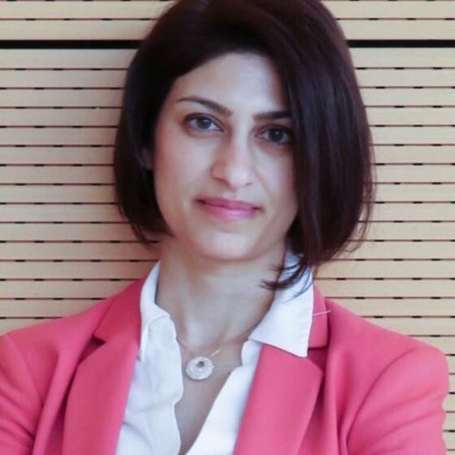

Upcoming EICUG Steering Committee elections
Martha Constantinou and Alex Jentsch will finish their terms as members
Or Hen will finish his term as past chair
Election for one new member and one member of the chair line will be announced shortly
Chair line candidates:
  Todd Satogata (Jlab)
  Holger Witte (MIT)
Member:
  Hyon-Suk Jo (Kyungpook National University, Korea)
  Vasily Morozov (ORNL)

Slide 8
EICUG Working Groups
From the charter: “Ad hoc Working Groups have been created with conveners appointed by the EICUG Steering Committee; currently, there are the Theory, Software, Computing Coordination, and 2nd Detector Working Groups, but others could be added if needed”
Theoretical Physics
  Wim Cosyn (FIU) Anna Stasto (PSU) , Alessandro Bacchetta (Uni & INFN Pavia) - Felix Ringer (SBU)
Detector-2/IP8
  Anselm Vossen (Duke U), Björn Schenke (BNL), Charles Hyde (ODU), Charlotte van Hulse (Vrije Universiteit), Pawel Nadel-Turonski (U of SC), Simonetta Liuti (UVA), Vasiliy Morozov (ORNL), Wenliang “Bill” Li (MS State U), Physics Co-Conveners: Bjoern Schenke (BNL), Charles Hyde (ODU), Detector: Vasily Morozov (ORNL)
  → Report by Pawel Nadel-Turonski on Tuesday and Talk by Cheuk-Ping Wong today
Monte Carlo Event Generators (MCEG)
  Frank Krauss (Durham University, UK), Ilkka Helenius (University of Jyväskylä, Finland)
  →Talks by Frank Krauss and Andy Buckley on Tuesday
  →MC4EIC Workshop in Zurich August 26-28
Artificial Intelligence (AI4EIC)
  Tanja Horn (CUA), Cristiano Fanelli (William & Mary)
  →Report on Tuesday
  →AI4EIC Workshop Dec 15-18 at Duke University
This is not a fixed structure….

Slide 9

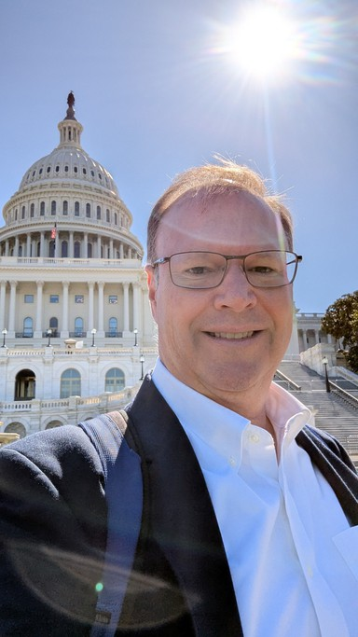
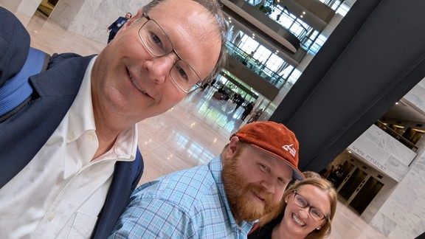
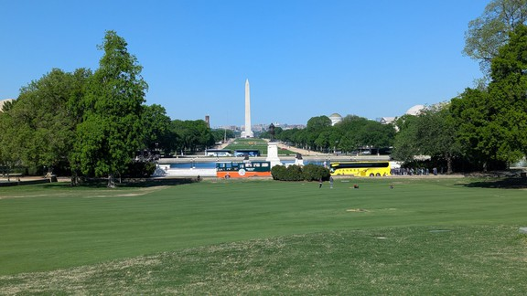
SC Focus over the last yearS
This has been an eventful year….
Core mission of supporting the EIC science
Strong focus on general and specific advocacy for the EIC e.g.
  Congress →Day on the hill
  Laboratories →Meeting and coordination with lab directors
  Funding agencies → Input and advocacy to SC Facilities Report
  …
Resurrection of the EIC Newsletter…
NP Day on the Hill April 21st
participated in coordinated
advocacy meetings organized
with Battelle’s Government
Relations team.

Slide 10
Focus in the future
Big Picture:
  EICUG SC will continue its advocacy for EIC science
  Support the EIC project
    Theory community & “General” tools
    ePIC
    Accelerator
    Advocacy
    Recognize user contributions
  Push for the future
    Generic R&D
    Detector II
    New initiatives to take advantage of recent developments and align with priorities by funding agencies e.g. Quantum
Some book-keeping issues
  Keep website up to date, refresh WGs, update the charter…
As users become more active onsite, we will reach out to RHIC/AGS User’s group to coordinate

Slide 11
Summary/Conclusion
YOU are the EICUG, please reach out to us with suggestions, criticism, material for the newsletter etc.
Contact entry points to the EICUG and the working groups can be found on the website: https://www.eicug.org/
Have a great meeting!

Slide 13
Election

Slide 14
User engagement?
YOU are the EICUG, let us know what you need..

Slide 15
EICUG represents a natural discussion forum for members with diverse expertise (accelerators, theory, experiments). Ad hoc Working Groups have been created with conveners appointed by the EICUG Steering Committee; currently, there are the Theory, Software, Computing Coordination, and 2nd Detector Working Groups, but others could be added if needed. The EICUG will also promote and facilitate the formation of experimental collaborations around a specific EIC detector project. Realization of the full scientific potential of the EIC will require multiple experiments. The EICUG will foster and support collaborative discussion of initiatives that aim to enhance the EIC scientific program. The EICUG will also provide opportunities for communication and collaboration beyond the boundaries of a single EIC Detector collaboration. The EICUG will work to
Provide a forum to further develop the EIC scientific program and user community, particularly by fostering exchange of ideas between experimenters and theorists using diversified communicating tools (web site, mailing lists, wiki pages, GitHub pages, Zenodo document repository, etc..)
• Provide a forum for discussion and promote collaboration with the accelerator community to optimize design and realization of the EIC experiments
• Organize and host annual meetings of the entire EIC Users community, along with regular online periodic meetings. The EICUG will strive to hold meetings in locations where none of the members are discriminated against or endangered by laws or policies.
• Represent the interests of EIC users to the laboratories
• Represent the broader EIC Users community in discussions of scientific priorities and tradeoffs that may be imposed by budget realities; e.g. articulate the scientific need for a second experiment.
• Select appropriate official speakers and coordinate their participation with the detector collaborations in EIC-related seminars, colloquia, workshops, conferences, through the Conference and Talks Committee, whose members are appointed for a one-year term by the EICUG Steering Committee, and elect a Chair and a Vice-Chair
• Organize outreach to physicists, scientists, policy makers and the general public about the EIC project
• Establish connections with other communities of potentially interested physicists, in order to become a contact point for scientists willing to join the EIC project.

Slide 16
