Slide 1
EIC Project Status
Jim Yeck
Associate Lab Director & EIC Project Director
July 2026 ePIC/EICUG Meeting
July 13, 2026

Slide 2
Outline
Project Outlook and Current Activities
Director’s Review in March 2026
Preparation for DOE IPR
Project Organization
Project Scope and Schedule
Science Potential During Initial Operations
EIC Portfolio and Funding Plans
Conclusion

Slide 3
Project Outlook
  The EIC will be a unique, world-leading collider facility and the only collider operating in the United States in the next decades. Established a sound technical design.
    CD-1 Approved June 2021, CD-3A - March 2024 ($90M), CD-3B - January 2026 ($67M).
    New York State EIC Buildings - Approved Feb 2024 ($100M).
    RHIC Equipment Removal and Repurposing – Started April 2026.
    Strong user interest and international engagement.
  Successful project delivery requires additional DOE Critical Decision approvals and start of EIC infrastructure construction in 1QFY27.
    DOE IPR planned for September 15-18, 2026.
    Proposing LLP CD-3C (<$100M), Infrastructure CD-2/3 (<$100M).
  EIC project team working to align requirements, scope, and cost with the Total Project Cost (TPC) target of $3B and DOE annual funding profiles.
3

Slide 4
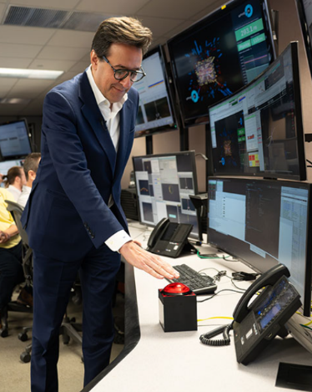
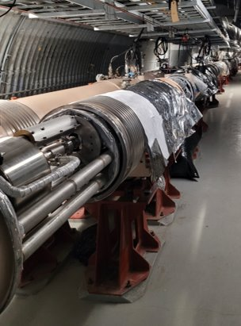
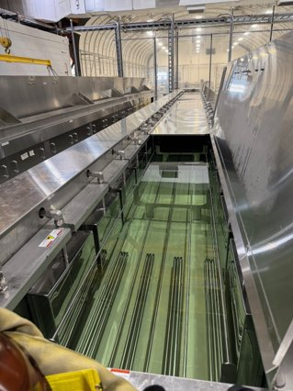
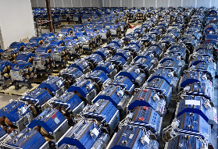
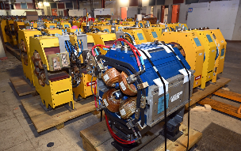
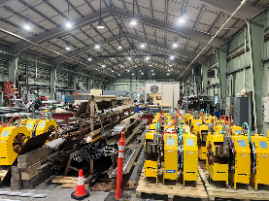
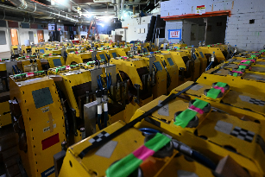
Current Activities
BNL using a “portfolio” strategy to plan all the activities required to ensure the EIC’s long-term success. Key activities planned for FY26–FY27 include:
    Removal and repurpose RHIC equipment for EIC
    New York State financed EIC buildings and infrastructure
    Initiate EIC construction
DOE Under Secretary D. Gil –
End of RHIC and Start of EIC
Blue Ring Removal –
April 2026
Ultrasonic Tank –
Clean Room Assembly
Arrival of ANL APS &
MIT Bates Magnets
4
4

Slide 5
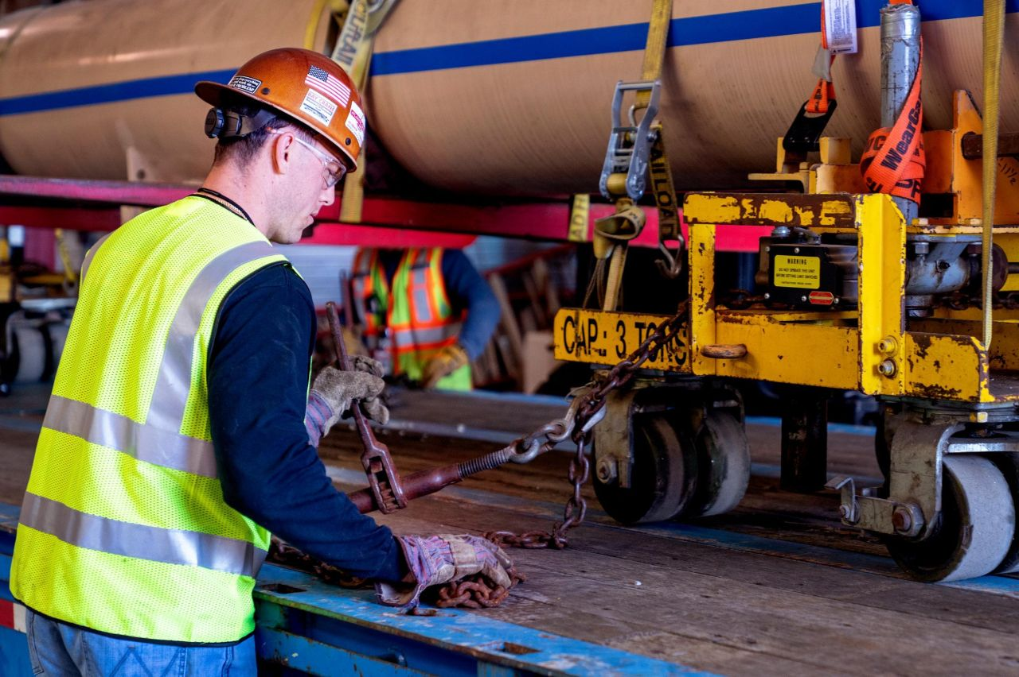
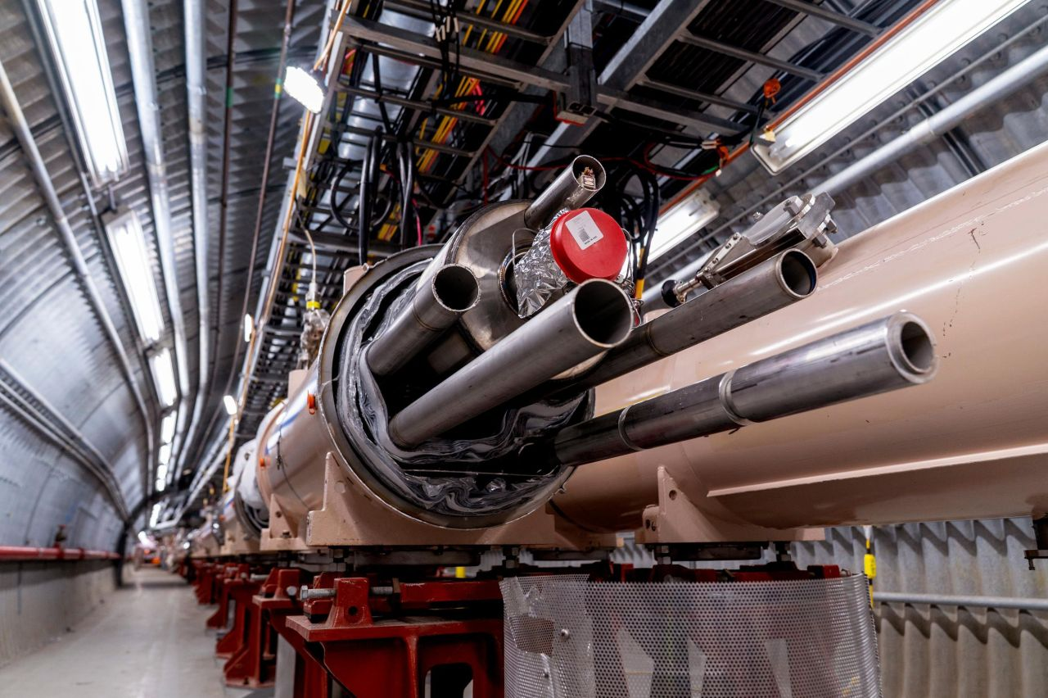
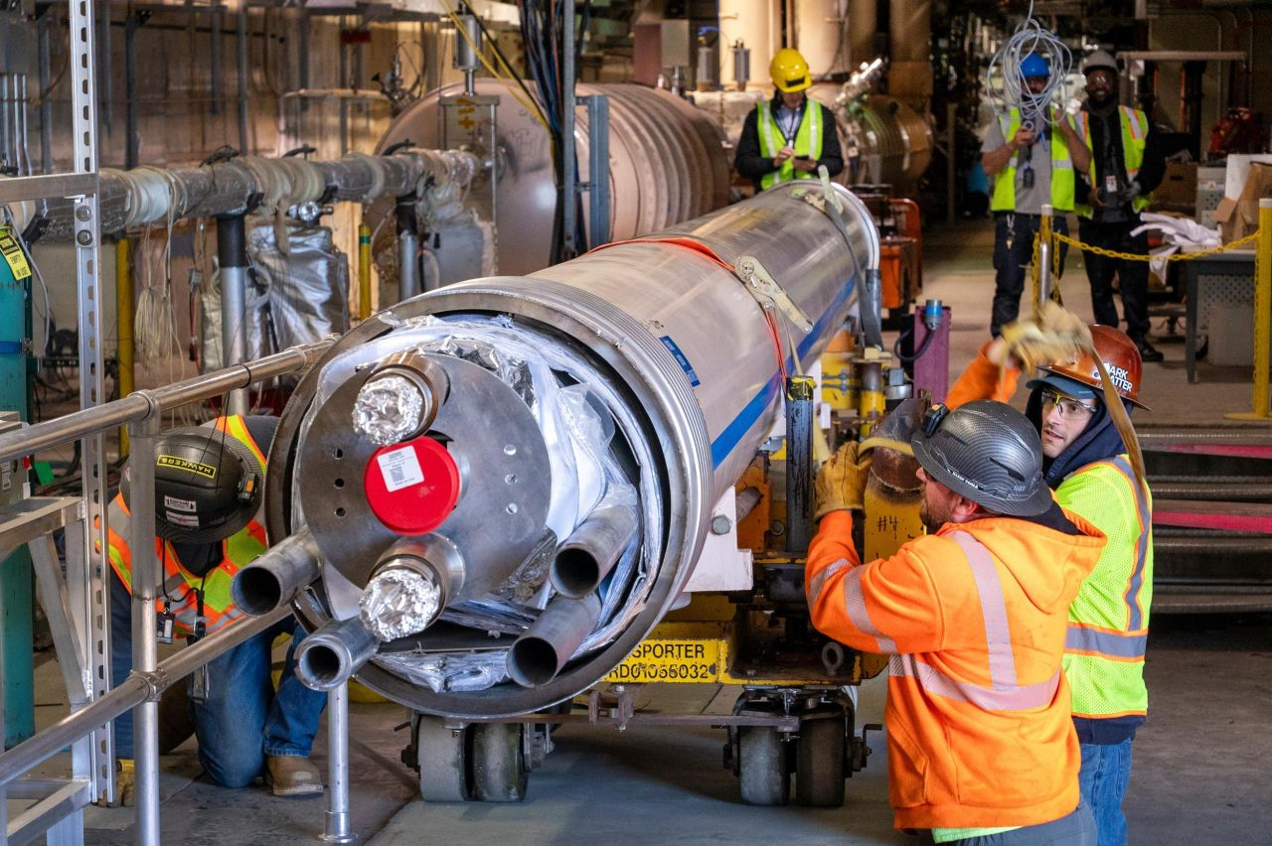
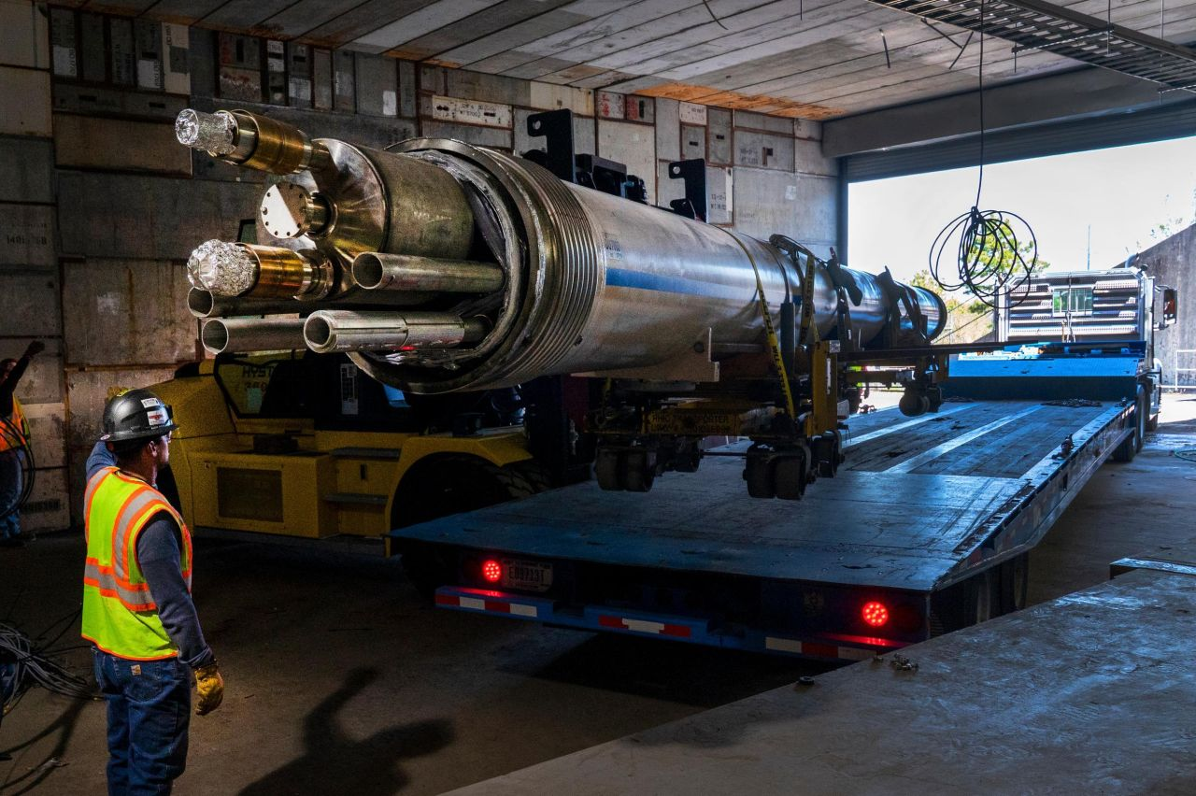
First EIC Cryostat Move on May 12
On May 12th, we reached a major milestone in starting to transform the Relativistic Heavy Ion Collider (RHIC) into the Electron-Ion Collider (EIC): moving the first cryostat.
A cryostat was relocated from its original location in the RHIC tunnel to a new position along the ring, where it will become part of a “bypass” in the EIC.
5

Slide 6
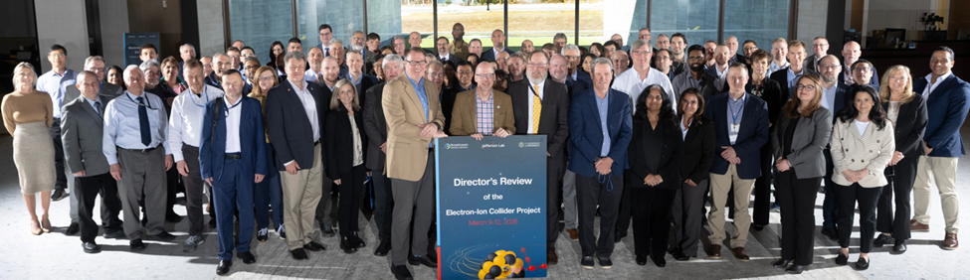
Director’s Review of the EIC Project
Brookhaven National Laboratory on March 9-12, 2026
Co-Chairs: Thomas Glasmacher, MSU-FRIB & Mark Reichanadter, SLAC-retired
SC1 Electron Injection | SC2 Storage Rings / Interaction Region | SC3 Global Systems | SC4 Detector | SC5 Infrastructure | SC6 Cost & Schedule | SC7 Project Management
*Timur Shaftan, BNL | *John Seeman, SLAC | *Sang-Ho Kim, ORNL | *Vivian O’Dell, UW | *Damian Dockery, FNAL | *Kathy Bailey, ORNL | *John Galambos, ORNL Ret.
John Schmerge, SLAC | Vladimir Shiltsev, NIU | Allan Rowe, FNAL | Juan Estrada, BNL | Marty Fallier, BNL (Retired) | Trushar Patel, ANL | Stefania Trovati, LBNL
 | Jim Strait, FNAL (Retired) | Andy Benwell, SLAC | Glenn Young, BNL Retired |  |  | Elmie Peoples-Evans, LBNL
6

Slide 7
Director’s Review March 2026 – Key Messages
Strong technical progress across all subprojects – Designs are maturing and long-lead procurements are generally proceeding well, indicating solid advancement toward project goals.
The project cost estimate exceeds the $3B cost cap – The absence of a complete, resource-loaded schedule limits confidence in cost, schedule, and execution credibility.
Completion of an integrated, resource-loaded preliminary baseline is the top priority – This preliminary baseline is essential to support cost reduction efforts, validate schedule feasibility within annual funding constraints, assess risks, and support future Critical Decision approvals.
Cost reductions must be systematically evaluated against impacts to Key Performance Parameters (KPPs) and mission need – Cost, schedule, scope, and performance are tightly coupled and require disciplined trade-offs.
Affordability depends in part on funding priorities following the conclusion of RHIC operations – A combined operations and project funding plan.
7

Slide 8
DOE Independent Project Review (IPR)
Originally April 2026, the review is now scheduled for September 15–18, 2026 to allow time to address the results of the Director’s Review.
The IPR will assess:
  Execution of long-lead procurements (CD-3A and CD-3B)
  Development of a preliminary baseline
  Justification for a long-lead procurement Critical Decision (CD-3C)
  Readiness for CD-2/3 approval for conventional facilities infrastructure funded by New York State
  Assess progress towards a future Critical Decisions including CD-2 for the ePIC detector
EIC Project Advisory Committee "Director's Review" August 18-19, 2026.

Slide 9
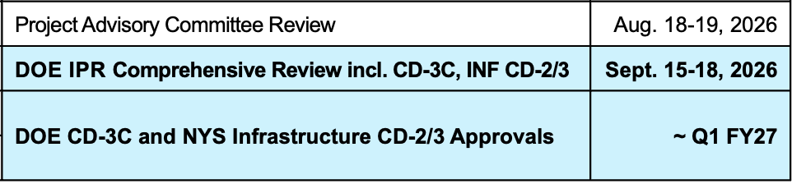
EIC Planning Dates
Milestone |  | Milestone
DOE Independent Project Review (IPR) | Jan 7-9, 2025 | EIC Project Advisory Committee | Dec. 2, 2025
Start Developing Scope of Subprojects | January 10, 2025 | EIC Project Strategy Workshop - Stakeholders | Dec. 4, 2025
IR SC Magnet Steering Group Meetings - Monthly | January 17, 2025 | (ASR) Assessment of Baseline Readiness | Jan. 14-16, 2026
Project Advisory Committee Meeting | February 11, 2025 | (DET) Assessment of Baseline Readiness | Feb. 3-5, 2026
Resource Review Board Meeting (Prague) | June 5-6, 2025 | RHIC Operations Concludes, R&R Starts | February 6, 2026
Detector Advisory Committee Meeting | June 11-13, 2025 | BNL Director’s Review – Comprehensive | Mar. 9-12, 2026
EIC Advisory Board Meeting | June 17, 2025 | (IP) Assessment of Baseline Readiness | Mar. 9-12, 2026
DOE CD-3B ESAAB Approval | January 28, 2026 | EIC Advisory Board Meeting | May 28, 2026
DOE IPR Focused Status Review | August 5-7, 2025 | Electron Injector Review (Previous Review April 2025) | June 3-5, 2026
DOE RHIC R&R/Injector Operations Review | Sept 8-10, 2025 | Resource Review Board Meeting (Japan) | June 9-10, 2026
Machine Advisory Committee Meeting | Sept. 16-18, 2025 | Infrastructure Construction Advisory Committee | June 10-11, 2026
Infrastructure Construction Advisory Committee | October 1-2, 2025 | Project Advisory Committee Review | Aug. 18-19, 2026
EIC Advisory Board Meeting | October 10, 2025 | DOE IPR Comprehensive Review incl. CD-3C, INF CD-2/3 | Sept. 15-18, 2026
Resource Review Board Meeting (BNL) | Nov 4-5, 2025 | DOE CD-3C and NYS Infrastructure CD-2/3 Approvals | ~ Q1 FY27
(IR) Assessment of Baseline Readiness | Nov. 18-20, 2025

Slide 10
EIC Project Org Chart
*Interim
Boards & Committees
Advisory Board J. Dilling
Resource Review Board A. Deshpande, D. Dean & Franck Sabatié
Project Advisory Committee T. Glasmacher
Brookhaven National Laboratory
J. Hill
Laboratory Director
M. Schoonen* A. Emrick
Deputy Director S&T Deputy Director Operations
EIC Portfolio Coordination
EIC Portfolio Coordinator B. Wahl
International Governance Bodies
BNL Off-Project Scope
Electron-Ion Collider Project
J. Yeck
Project Director
S. Nagaitsev C. Folz*
Technical Director Project Manager
Deputy Project Director-JLAB K. Wilson
Co- Associate Director for the Experimental Program-JLAB R. Ent
Co- Associate Director for the Experimental Program-BNL E. Aschenauer
Associate Director for Strategic Partnerships L. Lari
Associate Director for Infrastructure P. Caradonna*
Deputy Technical Director OPEN
ES&H Manager C. Schaefer
Chief of Staff A. Petrone
Executive Administration C. Hoffman
Science & Technology Collaborations
Science Director A. Deshpande
User Group Steering Committee D. Higinbotham & O. Hen
ePIC Collaboration J. Lajoie & S. Dalla Torre
Accelerator Collaboration T. Pieloni & W. Fischer
Advisory Committees & Steering Group
Machine Advisory Committee T. Raubenheimer (SLAC), Chair
Detector Advisory Committee A. White (U. of Texas), Chair
Infrastructure Construction Advisory Committee M. Fallier (BNL Retired), Chair
IR Superconducting Magnets Steering Group G. Apollinari, (FNAL), Chair
Collaboration
Technical Advice
Project Advisors
C. Lavelle
D. Lissauer
F. Willke
Technical Integration Support Office
S. Nagaitsev
Director
ESR/Collider Performance Lead C. Montag
HSR Performance Lead V. Ptitsyn
RCS Performance Lead V. Ranjbar
Pre-operations Lead A. Blednykh
Chief Project Engineer J. Tuozzolo
Project Engineer K. Wilson
Chief Systems Engineer T. Russo
Project Management Support Office
C. Folz*
Director
Procurement Manager K. Kirkendall
Planning & Reporting Manager J. Fortner*
Risk Manager I. Sourikova
Financial Manager H. Turbush
Project Controls Manager A. Miske
Quality Manager C. Porretto
In-Kind Contributions Engineer P. Berrutti
Collider
Accelerator Storage Rings
Charlie Folz
Project Manager
Interaction Region (IR)
S. Nagaitsev*
Project Manager
C. Lavelle
Deputy Project Manager
Electron Injector
Q. Wu
Project Manager
Detector
E. Aschenauer* & R. Ent*
Project Managers
Infrastructure
P. Caradonna*
Project Manager
10

Slide 11
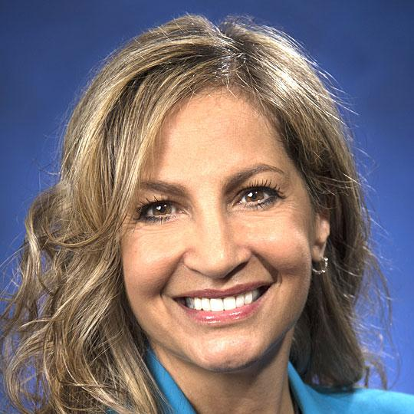

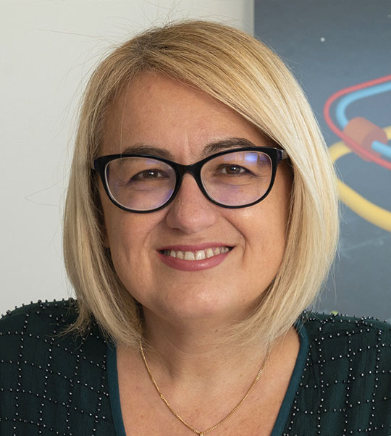


Recent EIC Organizational Changes
Peggy Caradonna – Interim Associate Director for Infrastructure. Leads the infrastructure subprojects.
Charlie Folz – Interim EIC Project Manager. Responsible for preliminary project baseline and integration of scope, schedule, and cost; and advancing infrastructure subproject.
Luisella Lari – Associate Director for Strategic Partnerships and Senior Scientist. Leads the development of technical partnerships, expands collaborations, and pursues additional opportunities for in-kind contributions.
Alyssa Petrone – Interim Project Management Division Director (BNL); oversees Project Controls, Business Operations, and Procurement.
Jim Yeck – Supporting the transition to a new Project Director, Allen Weeks. Allen will join meetings and participate in decisions on key personnel. September 28 start date.
11

Slide 12
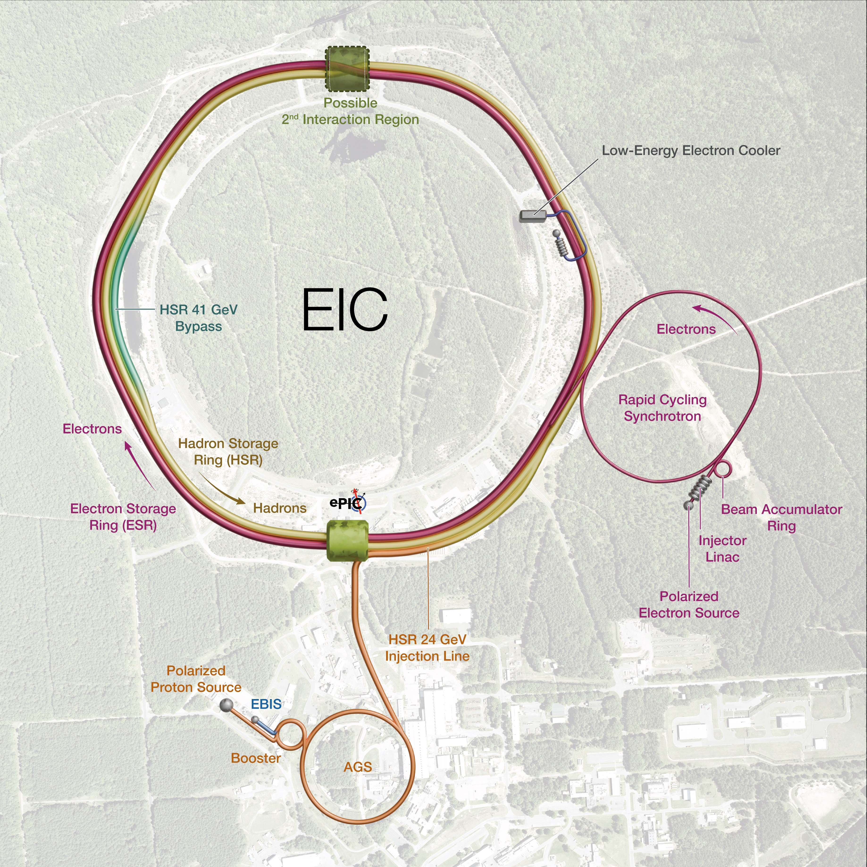
EIC Scope
EIC Scope
A single integrated line-item construction project.
Scope includes well-defined deliverables, interfaces, and draft KPPs.
EIC Line-Item Project Scope:
Infrastructure (subprojects, INF-1, …)
Collider - Accelerator Storage Rings and Interaction Region (subprojects)
Electron Injector (subproject)
Detector (subproject)
EIC Portfolio (Off-Project Scope)
NP Operations scope, including initial EIC Ops
Host Laboratory Infrastructure
12

Slide 13
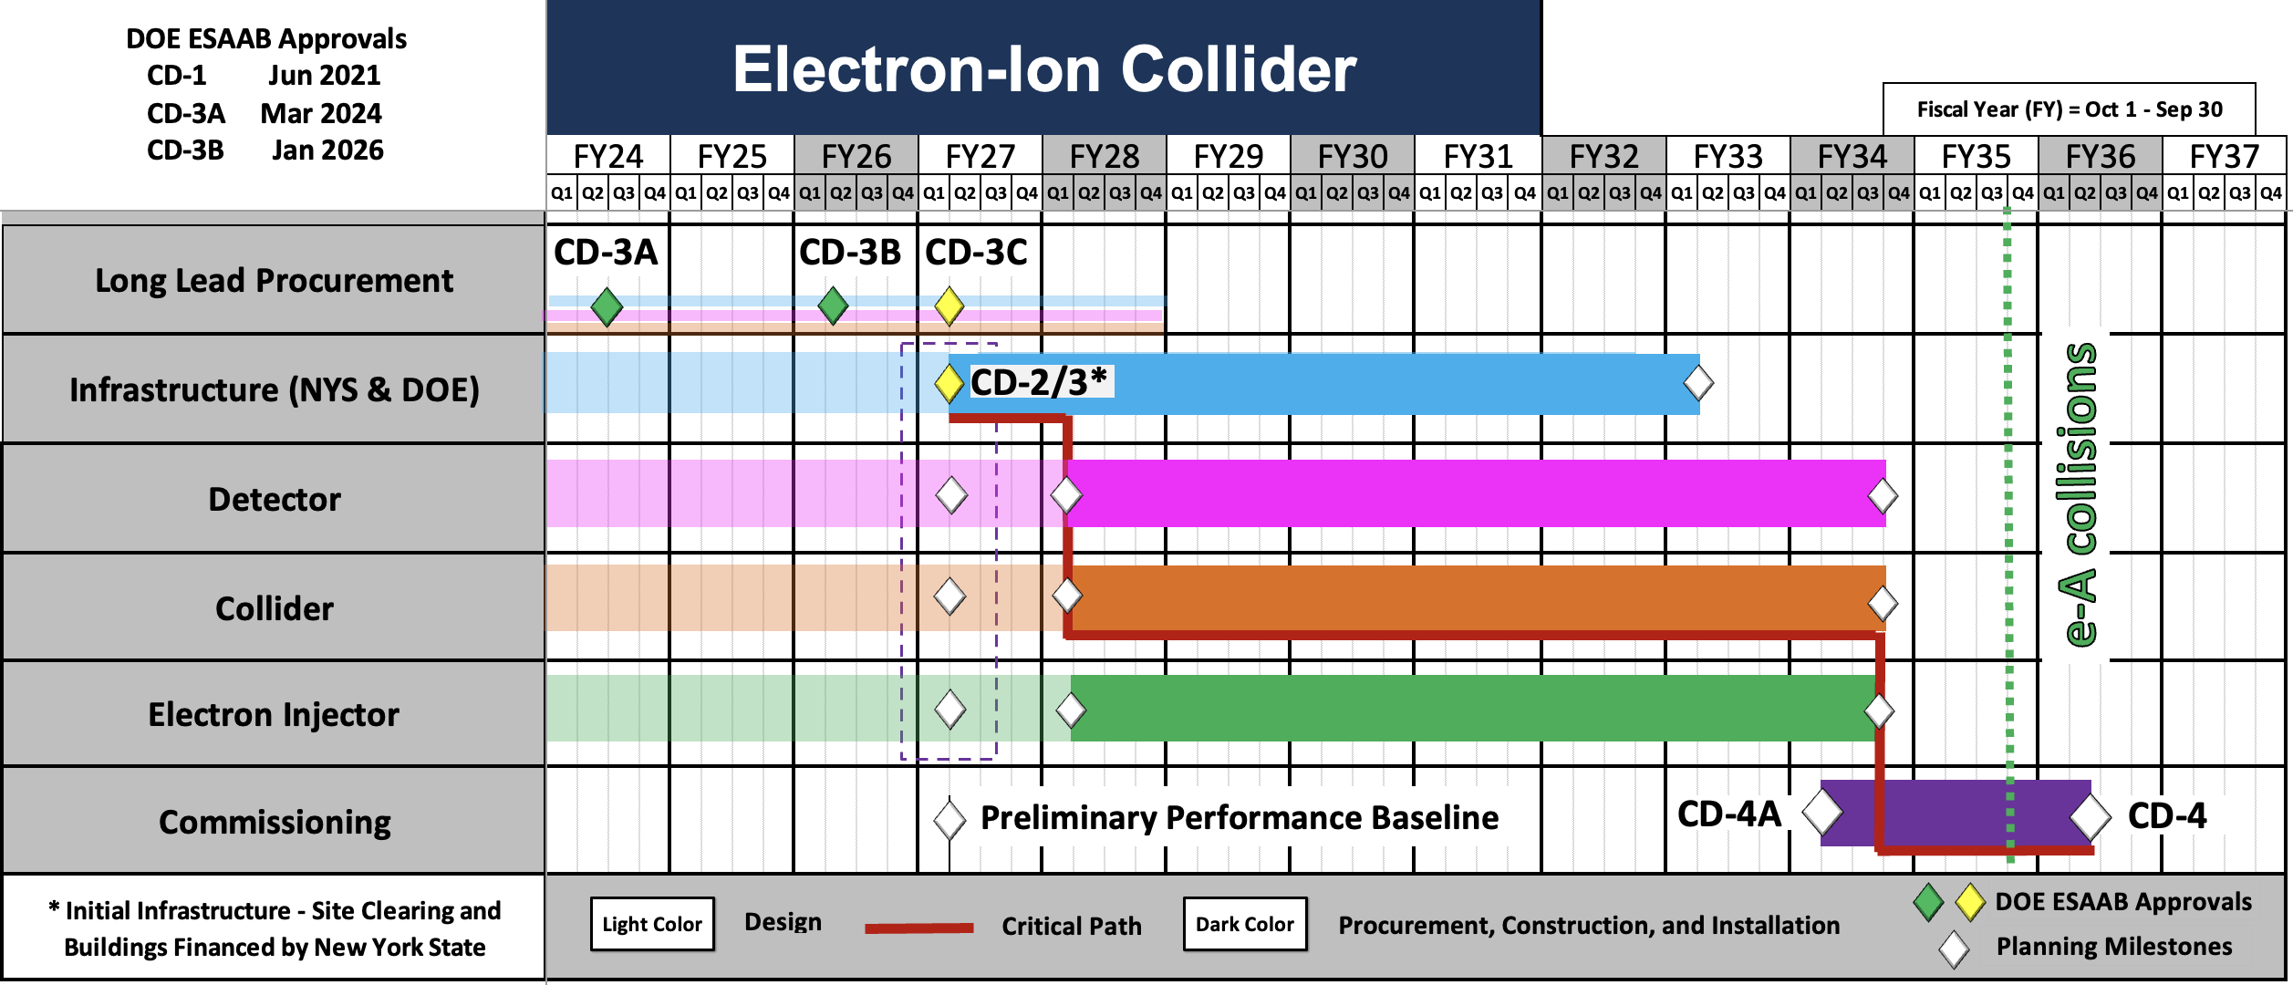
EIC Technically Driven Schedule
13

Slide 14
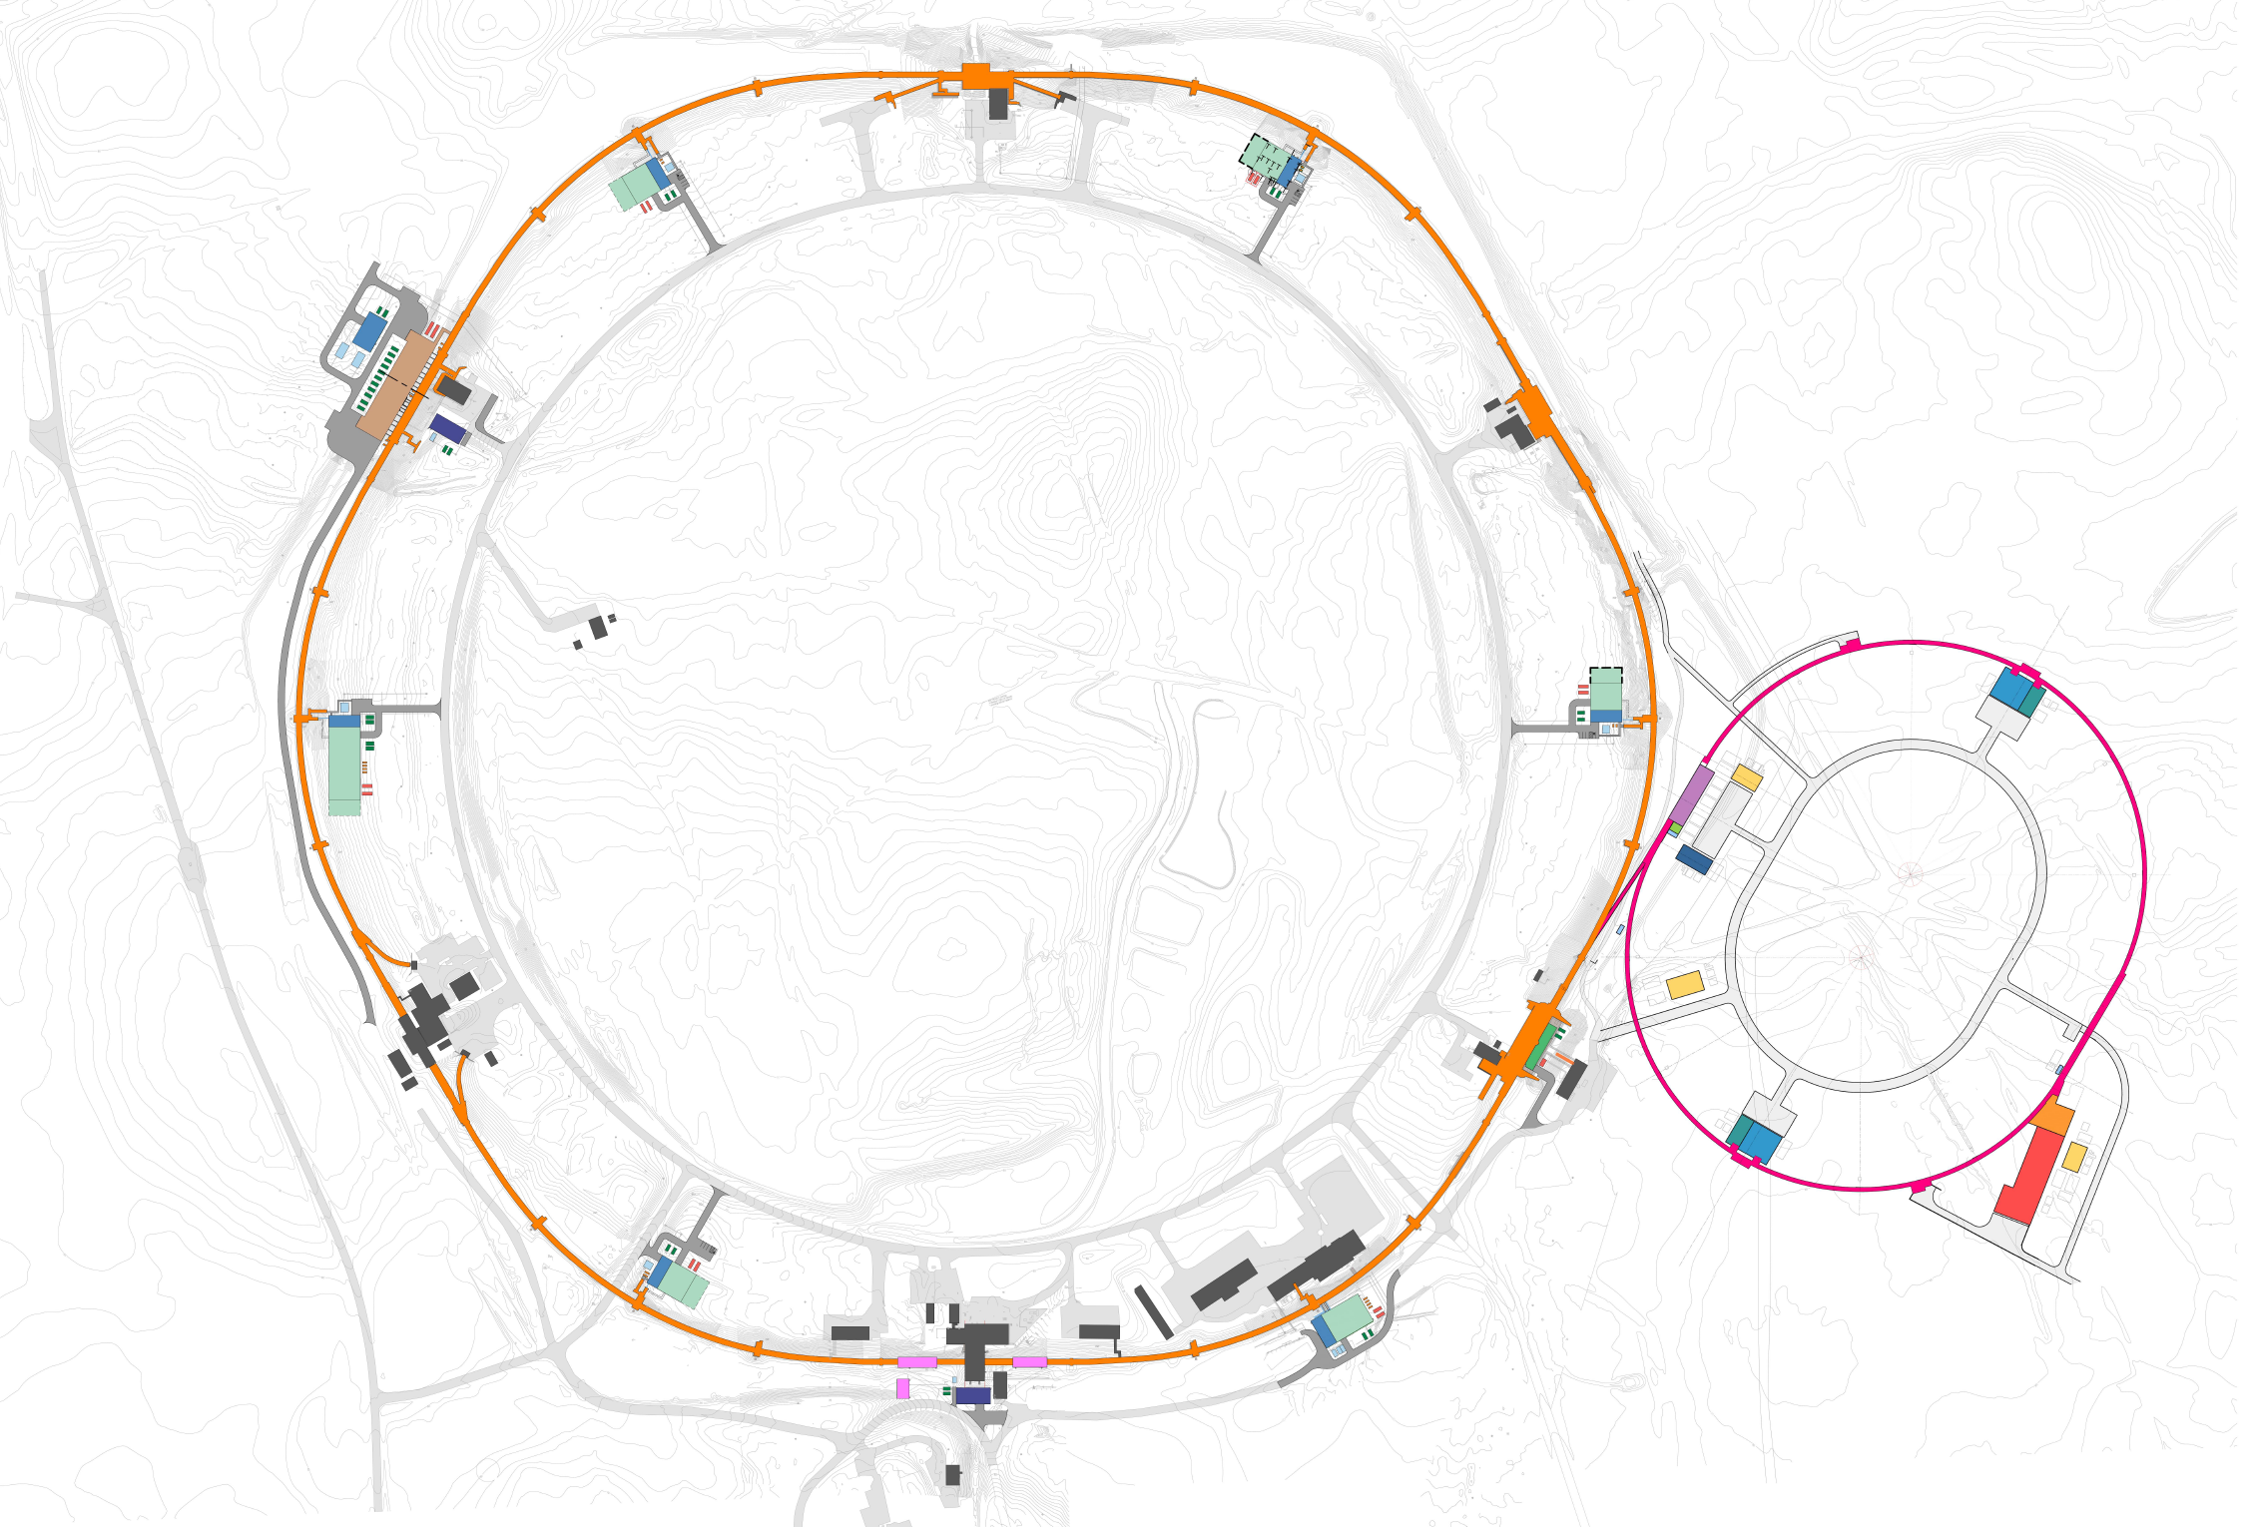
EIC Infrastructure Summary - P. Caradonna
34 New Buildings
366,000 Square Feet
70 MVA Peak Demand
42 Electrical Unit Substations
6 Miles 13.8kV Lines
60 MW Heat Rejection
15 Cooling Towers
5 Miles Cooling Piping
28 Chiller Units
RHIC to EIC
1,180m
3,870 ft.
EIN
DOE: $575.2M
NYS: $86.5M
3:20’ Animation Flyover Video
14

Slide 15
Preliminary Internal Baseline Prep – C. Folz
Internal baseline readiness timeline presented at the March review was accelerated by 2 months.
The new timeline supports building the full resource loaded schedule within the revised WBS structure and the implementation of cost reduction actions.
All scope elements included in the resource loaded schedule for internal management and visibility. Planning packages will be utilized where appropriate with substantiated estimates and logically linked networks.
Resource limitations will be identified and funding realities incorporated.
15

Slide 16
EIC Science Program During Initial Operations
Year - 1 |  | Year - 2 |  | Year - 3 |  | Year - 4 |  | Year - 5
Start with Phase 1 EIC
New Capability:
Commission electron polarization in parallel
Run:
9 GeV electrons on 115 GeV/u heavy ion beams (Ag, Nb, Cu, Ru)
Physics:
Dense Gluon Systems QCD in Nuclei
Phase 1 EIC + long. electron polarization
New Capability:
Commission proton polarization in parallel
Run:
9 GeV long. polarized electrons on 130 GeV/u Deuterium
Physics:
QCD in Nuclei Flavor structure of nucleons and nuclei
Run:
Last weeks: 10 GeV long. polarized electrons and 130 GeV polarized protons
Physics:
Flavor structure of nucleons and nuclei
Phase 1 EIC + long. electron polarization + proton polarization
New Capability:
Commission running with hadron spin rotators
Run:
9 GeV long. polarized electrons on 130 GeV transverse polarized protons
Physics:
Flavor structure of nucleons and nuclei
Run:
Last weeks switch to longitudinal proton polarization
Physics:
Spin
Phase 1 EIC + long. electron polarization + proton polarization + spin rotators
New Capability:
Commission hadron accelerator to operate with not centered orbits
Run:
9 GeV long. polarized electrons on 110 GeV Au
Physics:
Dense Gluon Systems QCD in Nuclei
Run:
10 GeV long. polarized electrons on 275 GeV transverse and longitudinal polarized protons
Physics:
Spin
Phase 1 EIC + long. electron polarization + proton polarization + operation of hadron spin rotators
Run:
9 GeV long. polarized electrons on 110 GeV Au
Physics:
Dense Gluon Systems QCD in Nuclei
Run:
10 GeV long. polarized electrons on 166 GeV transverse and longitudinal polarized He-3
Physics:
Spin
Unique science questions addressed as performance ramps-up.
16

Slide 17
Notional Funding Assumptions
EIC Total Project Cost Objective = ~$3B (working on preliminary internal baseline). Current point estimate is higher and further cost management needed.
FY27 appropriations process is underway:
  The President’s Request includes $200M for EIC construction, a $42M increase from FY26. DOE Office of Nuclear Physics (NP) = $791 M (-9%)
  Total BNL NP Ops and EIC Project FY26 to FY27 Request flat at $340M.
  House Mark in agreement on EIC = $200M. NP = $887M!
  Senate Mark?
NP Operations funding supports the accelerator complex operations and modernization including removal and repurposing of RHIC equipment and related improvements.

Slide 18
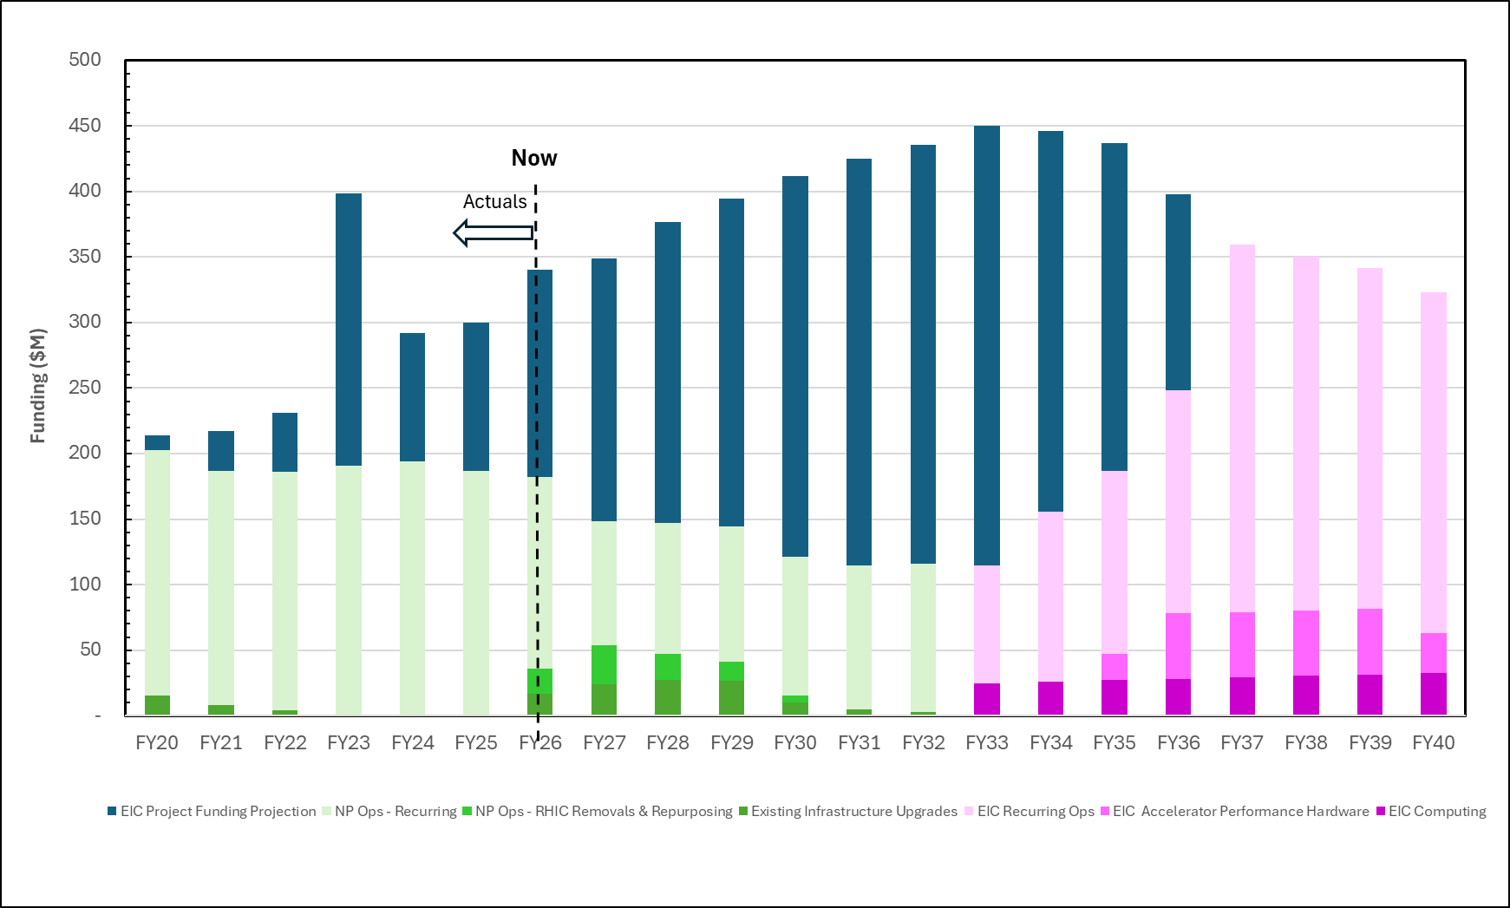
EIC Notional Funding Profile
Project
NP-Ops & Computing
Equipment Removal
Accelerator Complex Modernization Projects
EIC Ops
EIC AIPs
EIC Computing
18

Slide 19
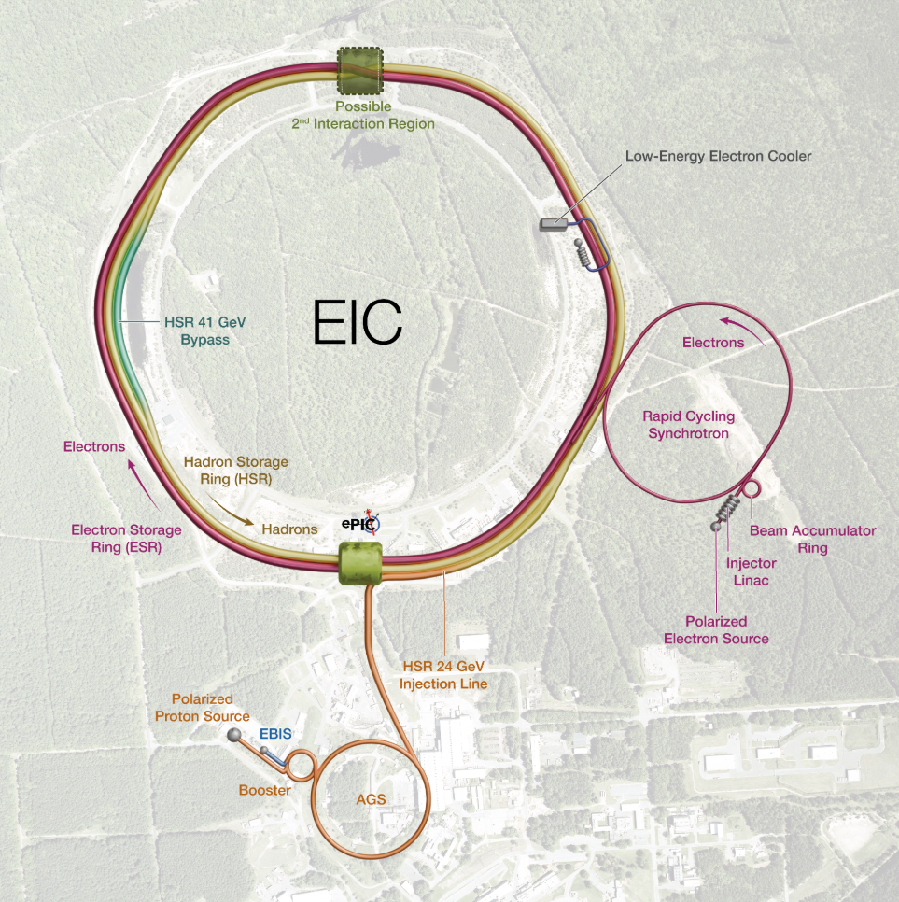
EIC Portfolio – B. Wahl
The EIC Portfolio aligns the project, DOE programs, and Host-Laboratory capabilities to deliver the infrastructure, scope, and readiness needed for the Electron-Ion Collider.
The Portfolio Office connects the work that must be defined, funded, delivered, and monitored across the enterprise.
EIC Line-Item
Project
SC Program
Engagements
SC Host Lab
Engagements
Design, construction, and commissioning of the Electron-Ion Collider using a sub-project methodology including:
Infrastructure
Collider
Electron Injector
Detector
Capabilities, infrastructure, and operational readiness provided by way of DOE-SC HENP funding
RHIC Removal & Repurposing
Hardon maintenance & infrastructure
AGS Cooling modernization
SRF Test Facility
Cryo Plant reliability improvements
Infrastructure and services provided by
way of SC Host Laboratory funding opportunities.
Electrical power
Fire protection
Potable water
Storm & Sanitary Drain
Additional scope opportunities under consideration
The Portfolio Office aligns scope, funding, and schedules so the right work is delivered by the right organization at the right time.
19

Slide 20
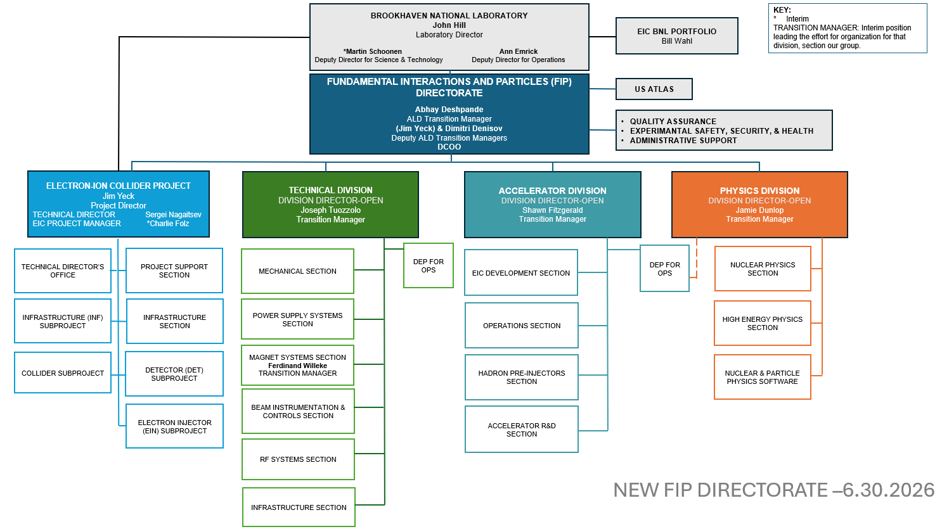
RHIC Ops Concluded Feb 2026
BNL Organizing for the EIC
Fundamental Interactions and Particles Directorate
Current Draft Organization - 6.30.26
Planned Implementation - 10.01.26
Nuclear Physics Section organized into two groups: ePIC and RHIC analysis.

Slide 21
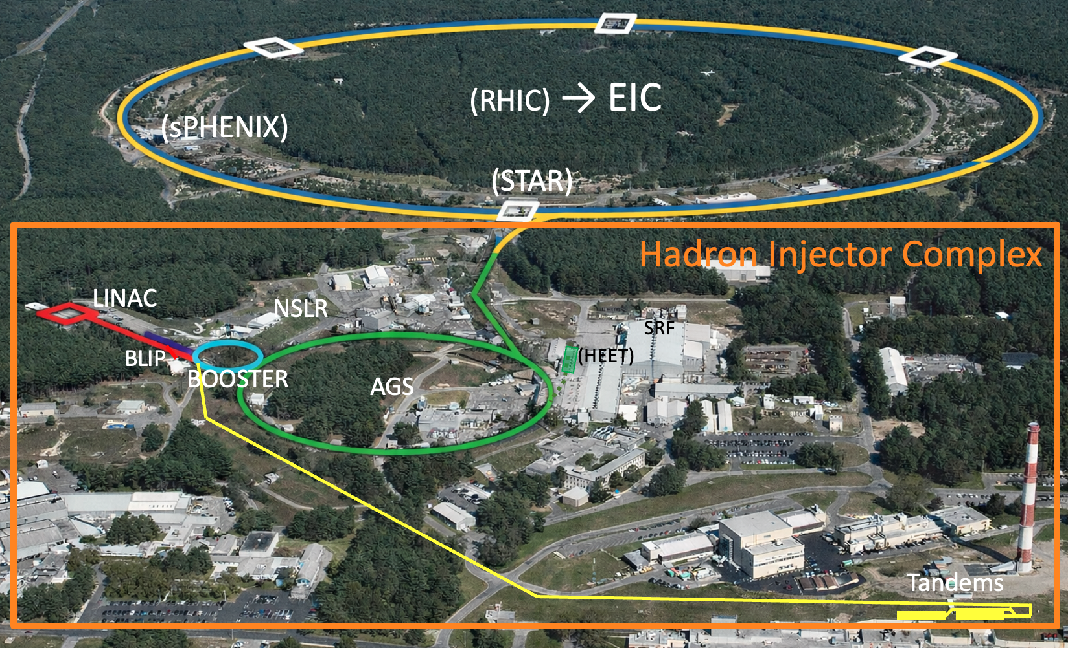
EIC Portfolio NP Operations – W. Fischer
Accelerator Complex Operations
  Hadron Injector Complex => Maintain in ready state
  Technical Infrastructure => space and shops (~100 buildings)
Accelerator Complex Modernization
  RHIC Removals and Repurposing (R&R)
    Blue Ring, STAR, and PHENIX Removals
    Yellow Hadron Ring Repurposing
  Cryoplant Reliability Improvements
  SRF Test Facility Capabilities
  AGS Cable and Cable Tray Replacement
  AGS Cooling Water System Replacement
21

Slide 22
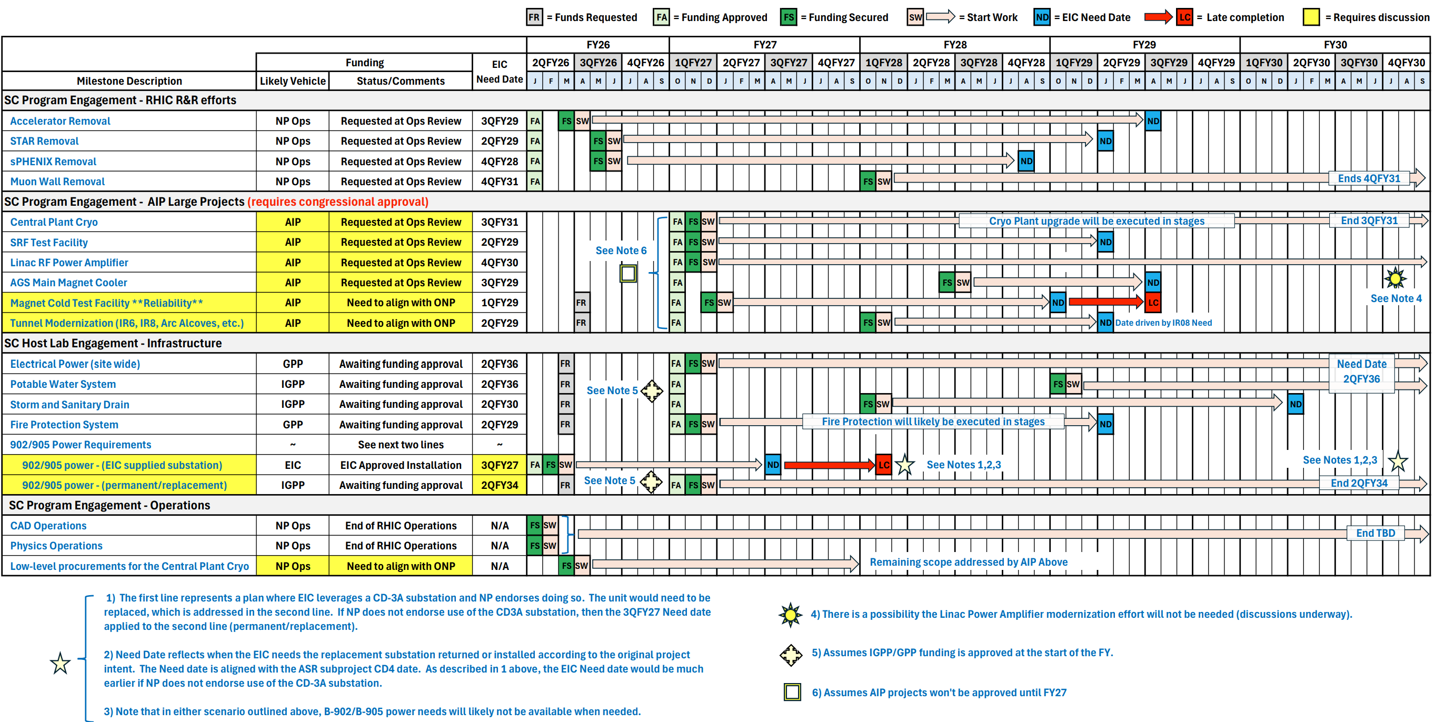
EIC Portfolio Delivery – Illustrative Schedule
NP Operations - R&R and accelerator complex modernization projects.
BNL Host Laboratory - electrical power to site, potable water, storm water, etc.
NP Operations – Accelerator complex/hadron injector operations.
22

Slide 23
Opportunities
Capitalize on the transition from RHIC operations to EIC construction to align workforce and organizational priorities.
Leverage growing international interest to expand strategic partnerships and in-kind contributions.
Use construction start to reinforce performance discipline and partner delivery schedules.
Enhance execution through stable leadership, disciplined baseline management, and reliable annual performance.
Together, these opportunities position the project to deliver a world-leading Electron-Ion Collider through strong partnerships, disciplined execution, and a shared commitment to success.

Slide 24
Conclusion
Exciting time for EIC as we move into construction!
Momentum building with significant technical progress in the tunnel.
Good progress preparing the preliminary internal baseline, cost remains a major focus, and we have the tools to manage cost.
Preparing for a DOE comprehensive Independent Project Review (IPR) in September and a civil construction start.

Slide 25
BACK-UP

