Slide 1
The AI Revolution and Nuclear Physics
David Lawrence, JLab
July 13, 2026

Slide 2
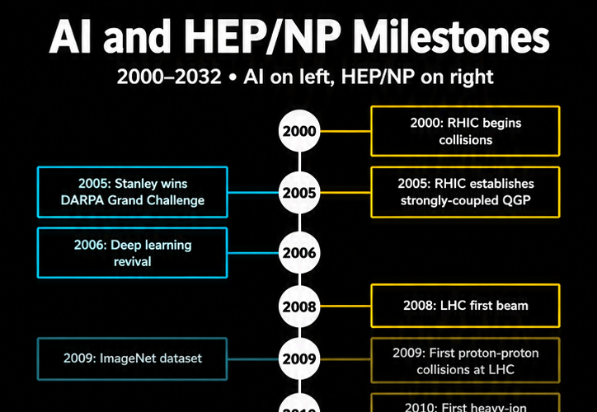
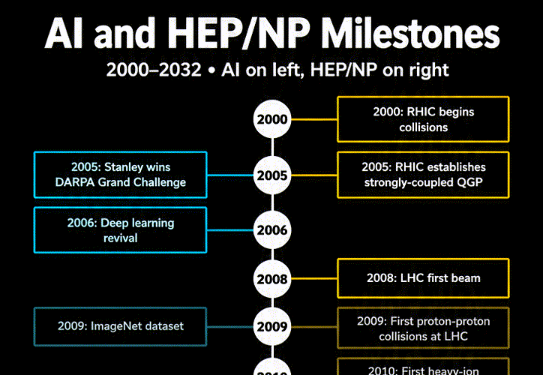
Milestones in AI and HENP
AI
HENP
HENP has generally been good at adopting new technologies*.
AI is no exception. (See the last 3-4 CHEP conferences).
This technology is outpacing construction of the EIC.
*cernlib and Fortran users excused

Slide 3
We design and execute experiments to meet measurement goals.
AI will allow dynamic adjustment of experiments to achieve the physics goals while minimizing resource usage.
Automated, holistic calibrations of interdependent systems will enable experiment pipelines*
The revolution is a workflow revolution
The opportunity is not “use a model”; it is to redesign the scientific loop.
Today
Tomorrow
Sequential pipeline
Acquire
Acquire
Calibrate
Control
Calibrate
Closed-loop experiment
Reconstruct
AI links real-time measurements, simulation, intent, and operations.
Analyze
Analyze
Simulation/
Digital Twin
Document/Preserve
Preserve
*ePIC already incorporates much of this type of workflow in its design.
Sources:
CHEP Track 6: AI/LLM tools
CHEP Track 8: analysis + open data
CHEP Track 1: FAIR data
Draft deck — replace placeholders with final collaboration details
Notes:
The first content slide frames the narrative. Older computing models were pipelines: data taking, calibration, reconstruction, analysis, preservation. The emerging model is a closed loop in which AI has access to live data, simulation, knowledge bases, monitoring, and control surfaces. For ePIC, the key preparation is not merely training a few models. It is ensuring that every major system exposes reliable, documented, permissioned interfaces and machine-readable provenance so automated reasoning can be connected safely.

Slide 4
Coding with AI

Slide 5
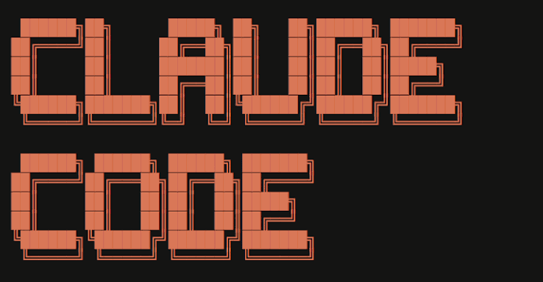

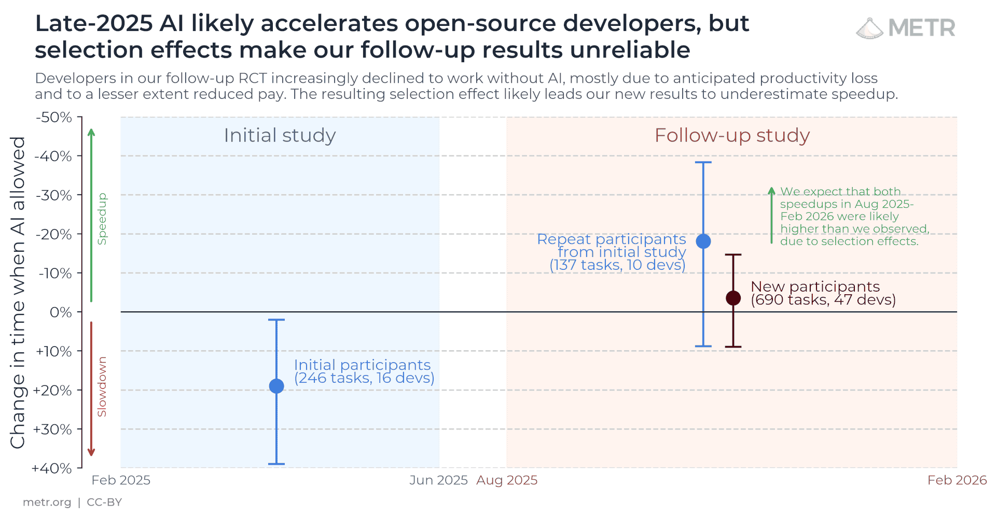


AI is changing the way we code and will likely continue ..
Vibe Coding: "I describe the vibe of what I want, the AI hands me a complete app, and I pray it works."
Agentic Coding: "I give an autonomous AI agent a high-level goal, and it manages its own step-by-step execution, testing, and debugging loop."
https://metr.org/blog/2026-02-24-uplift-update/
Studies of improved development time are very mixed but tend to say 25%-50% more FTEs when using AI for coding.
Experienced coders can expect to drive AI agents better.
Future coders will train their brains to think differently about code development.

Slide 6
“What language will people be coding in 10 years from now?”
“Probably English.”
- overheard at CHEP 2026

Slide 7
Data as a first-class product
Notes:
This section will emphasize how the role of data provenance and description are getting increased significance compared to software which is becoming cheaper to produce.
“AI-ready” is not so much about the format as about having all features of FAIR.

Slide 8
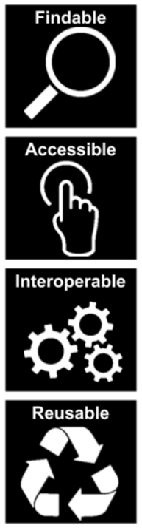
F.A.I.R. Data Principles
AI-Ready Data
“AI-Ready” = File format
The first step in (re)using data is to find it. Metadata and data should be easy to find for both humans and computers.
“AI Readiness for Data refers to a spectrum of how ready a given set of data is to be used by an AI process without need for further pre-processing or curation.”
- Kirkpatrick & Chuang @ SciDataCon2025
https://doi.org/10.5281/zenodo.17368124
Once found, need to know how it can be accessed, possibly including authentication and authorization.
Able to integrate with other data. Interoperate with applications or workflows for analysis, storage, and processing.
AI readiness is not a one-time binary state, but an ongoing process as AI methods, workflows, and data uses evolve.
Metadata and data should be well-described so that they can be replicated and/or combined in different settings.

Slide 9
We are now in a state of transition …
… the EIC will operate on the other side.
Literature is how we convey information. Especially to the next generation of scientists.
Traditionally, only small expectation that event-level data will be useful years from now.
  All the useful information was already published
  Effort it would take to access/process/analyze old data by non-expert is too high of a bar
Agentic tools are lowering this bar substantially, but only if the data is well-documented enough for the agent to figure it out.
Coding (by humans) is becoming much less valuable than it used to be
Making data accessible to auto-generated code is becoming invaluable

Slide 10
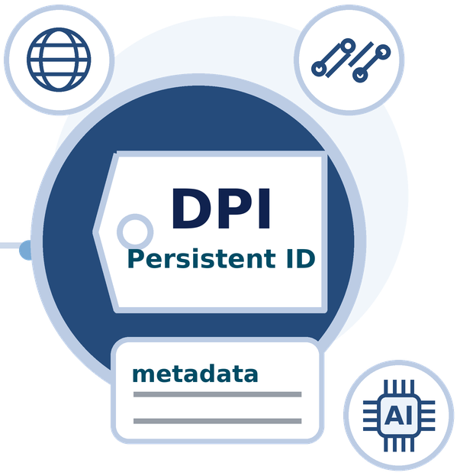
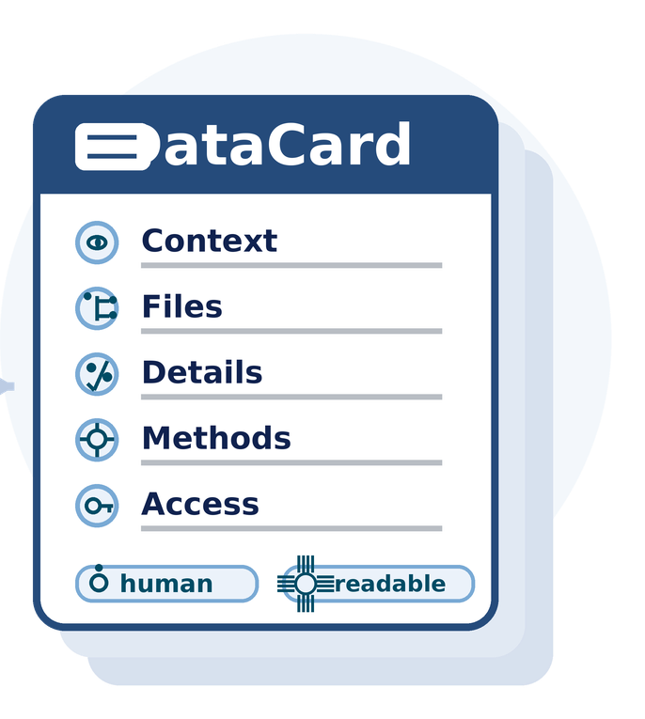
What the EIC can do
Generate DPI for data as it is acquired-
Digital persistent identifier (DPI or digital PID) – A digital identifier that is globally unique, persistent, machine resolvable and processable, and has an associated metadata schema* (like an ORCID or DOI)
* DOE Public Access Plan 2023 https://doi.org/10.11578/2023DOEPublicAccessPlan
Generate DataCards to store alongside the data as it is stored-
Includes an overview and context, organization & file structure, data details, and methodological info
Human and AI readable
Published and unpublished datasets
see Laura Biven’s talk at the recent JLab User’s Organization meeting:
https://indico.jlab.org/event/1000/

Slide 11
Large Language Models (LLMs)

Slide 12
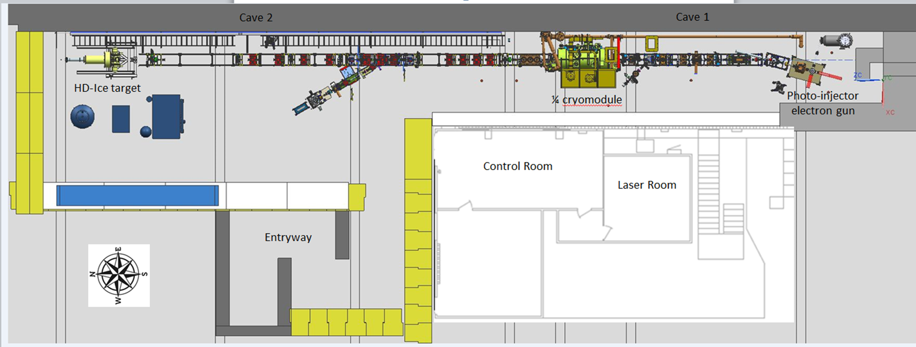
Facility Context: UITF
The Upgrade Injector Test Facility (UITF) is a test bed to evaluate new hardware destined for CEBAF
  e.g. Wien filters, 200 kV photogun, quarter cryomodule, non-invasive polarimeter
UITF is also a member of BeamNetUS – an organization of test accelerators that offers beamtime to external Users
For the AmSC Osprey Demo:
Build a channel database for most of the archived PVs
    489 PVs (BLMs, BCMs, BPMs, RF cavities, correctors, quad-rupoles, solenoids, dipoles, ion pumps, Wien filter)
Notes:
Another application I want to highlight is at UITF, UITF stands for Upgraded Injector Test Facility, it is a test bed for evaluation of new hardware designed for our bigger accelerator called CEBAF
UITF is also part of BeamNetUS - an org of test accelerators that offers beamtime to external users
UITF can also act as our playground for AI tools before we can deploy them on more complex CEBAF or any other large scale accelerators
With that being said, We’ve been integrating agentic workflows at UITF using Osprey as a tool that is being developed under American Science Cloud Infrastructure.
UITF has apparently been around for 6-7 years, but has fairly recently become a member of BeamNetUS.

Slide 13

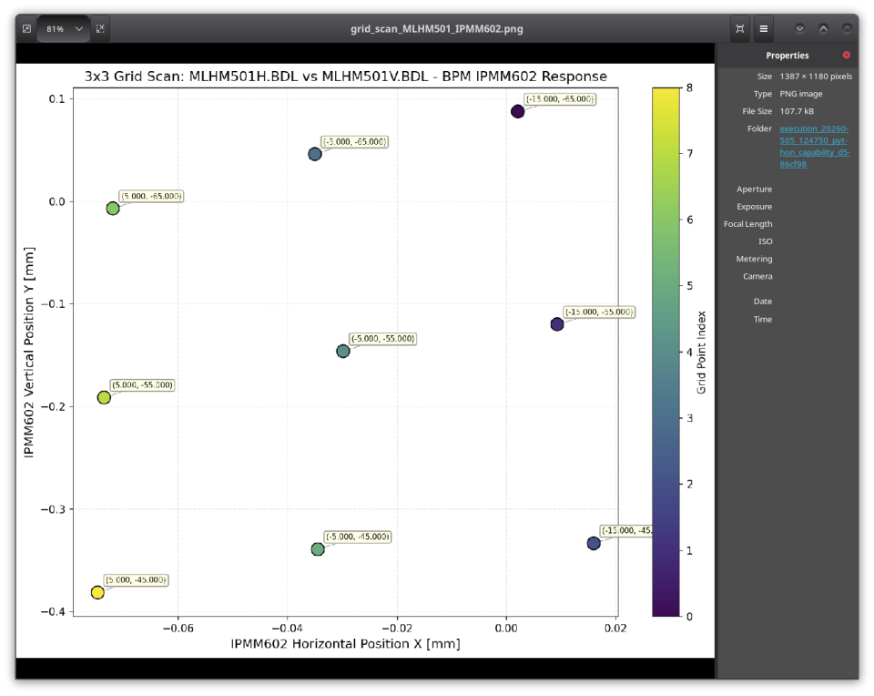

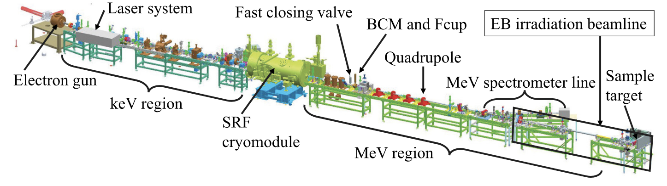
Demo: Control System WRITES
PROMPT: “Vary the integrated field of MLHM501H.BDL and MLHM501V.BDL in a 3 by 3 grid scan from their baseline values in steps of 10, e.g. for each setpoint of MLHM501H.BDL, scan three steps of MLHM501V.BDL. Before each setpoint, ask for verification. Wait 7 seconds for signals to settle and record the measured horizontal and vertical beam positions from BPM IPMM505. Return corrector values to their baseline values. Plot X vs Y for all 9 points.”
Notes:
This slide highlights an example of how the agentic workflow can be orchestrated
In this case, a user types this exact prompt that is shown here, it says …

Slide 14
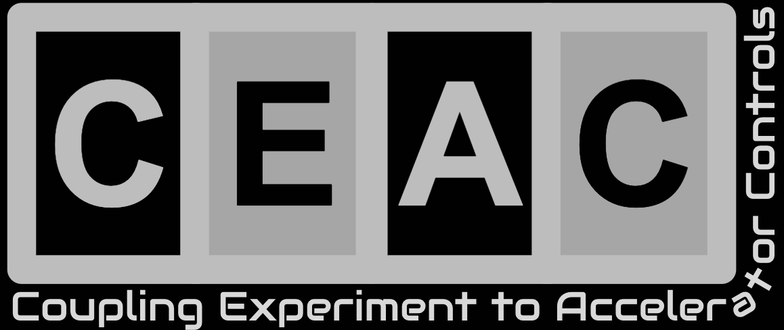
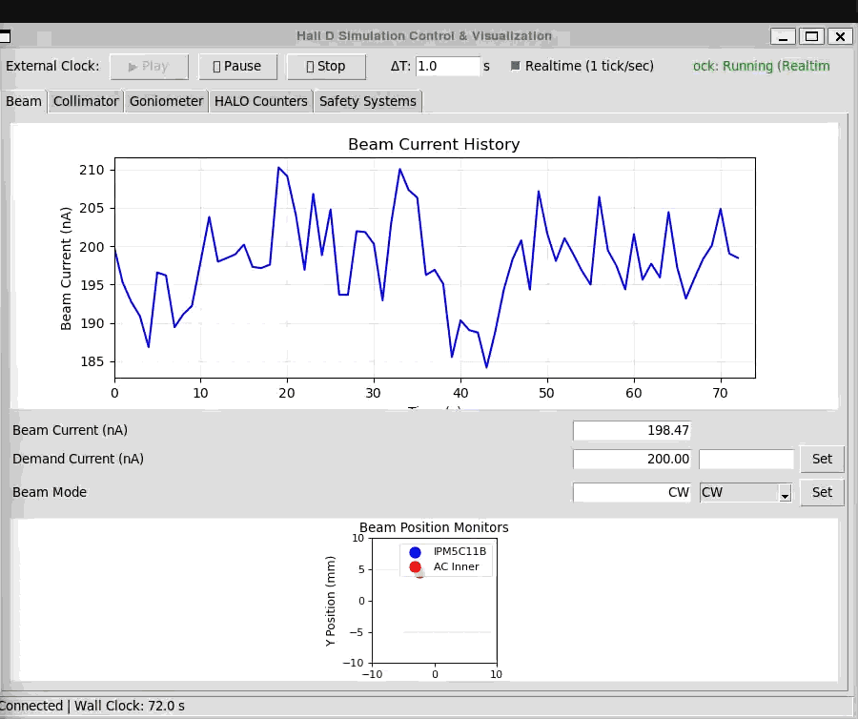
Hall-D Online Digital Twin
Natural Language is being developed as the communication protocol between multiple AI agents representing the accelerator and experiment.
Written instructions developed for human operators can be used for AI operator agents.
Each agent implements its own independent guardrails for the systems it represents.

Slide 15
Genesis Mission
and the American Science Cloud

Slide 16
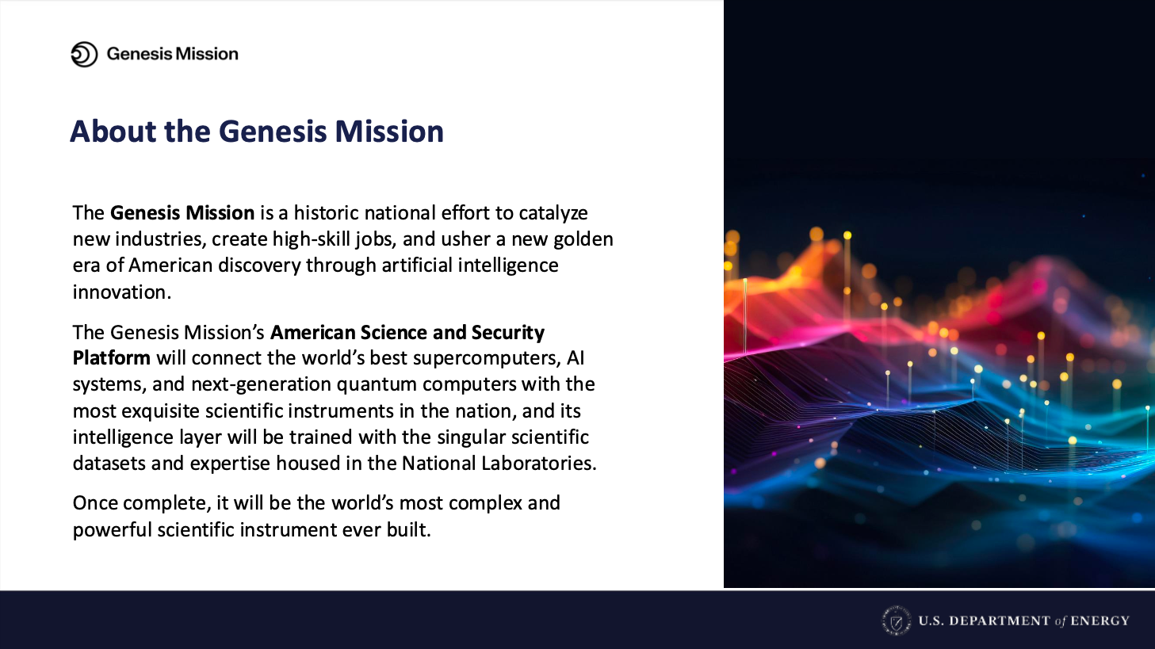

Slide 17
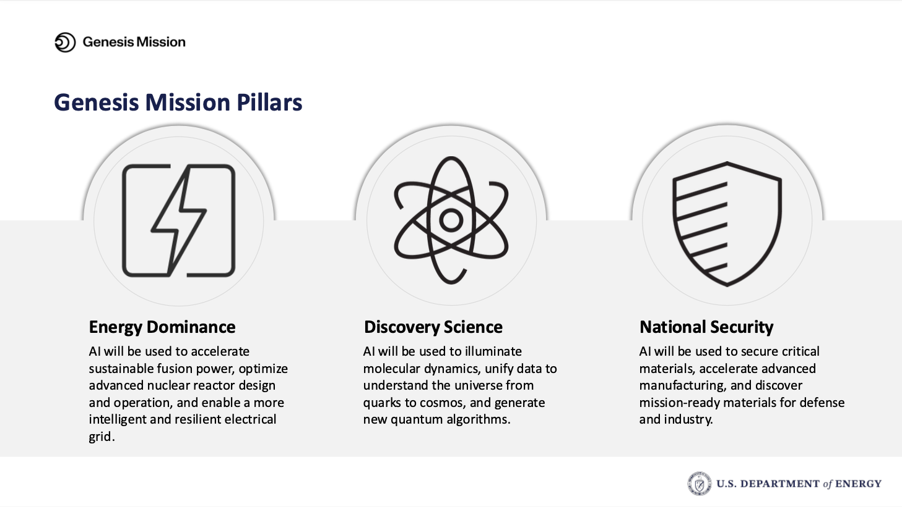

Slide 18

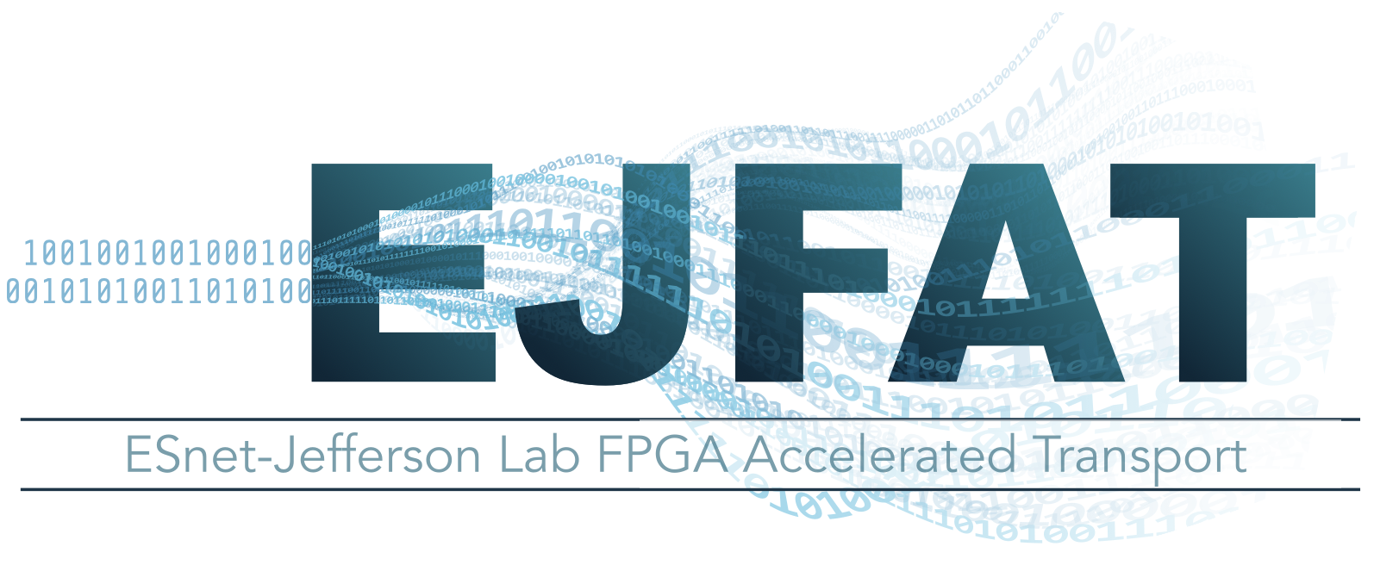

American Science Cloud Scientific User Facilities Infrastructure Partner
D2.1: NP Workflow Demonstrator
(Thrust 1: User data and science)
What this will demonstrate: Streaming large detector datasets between facilities in AI-ready format, distributing to multiple nodes in an HPC (or HTC) cluster for processing
node
node
AI model
node
node
HPC cluster
sPHENIX
(.npz)
pandas DF (Serialized Arrow)
GlueX
(.rest)
larger data volumes
low latency
real time streaming
What pieces can be supplied by AmSC:
Virtual Organization: Authentication, Access Control, Allocations
Data Services: Preprocessing, Curated S/W stacks, (Inference)
Model Services: Model Catalog
At-Scale Services: Training, Inference
IRI-API: WAN Data Fabric (ESnet) L3VPN
BNL:
Meifeng Lin
Mohammad Atif
JLab:
David Lawrence
Nathan Brei
Armen Kasparian
Raiqa Rasool
Partnerships:
This leverages data and models from the FM4NPP effort that is the basis of the NPDaPP-QCD: Nuclear Physics Data Providers Program - QCD AmSC project

Slide 19

Genesis Mission Funding
American Science Cloud: $150M OBBB Act end of FY25
$30M The Transformational AI Models Consortium (ModCon) (DE-SCL0000139)
…
$50M Data Providers Program (BER, BES, FES, HEP, NP)
$10M for NP
$3.67M BNL Preparing QCD Data for Foundation Models (DE-SCL0000128)
$4.00M JLab Developing AI-Ready Data Framework for DOE NP Particle Accelerators (DE-SCL0000128)
$1.97M LBNL AI/ML-Ready Data Labeling for Low Energy Nuclear Physics (DE-SCL0000128)
Genesis Mission RFA: $293M DE-FOA-0003612 (see Executive Order 14363)
~5k applications
Public announcement of awards expected July 22, 2026
Disclaimer: While I work at a DOE funded lab, I am not a DOE employee and the information here is not an official statement from the DOE
Notes:
Funding for AmSC came late in FY25 with insufficient time for DOE SC to exercise a normal NOFO and review process. The course of action they took varied slightly by program office, but all programs limited proposals to national labs. The OBBB was a reconciliation bill that includes $1B of additional discretionary appropriations for AI (which is unusual).
The bulk of the money (~$100M) was given to ASCR who distributed it among several projects. The main ASCR proposal included appendices for Infrastructure Partners (IP) but then they also accepted additional Appendices from “non-ASCR” IPs. This included $1.5M for BES/HEP/NP Scientific User Facilities. Other program offices received smaller allocations with HEP and NP each receiving about $10M. The NP $10M was split among 3 proposals which were strongly signaled in the funding call.
The Genesis RFA is being funded by the standard DOE SC annual budget. However, Executive Order 14363: “Launching the Genesis Mission” in November 2025 re-prioritized existing federal research dollars toward AI.

Slide 20
Predictions

Slide 21
These are my own opinions …
English will be primary programming language
Focus shifted to Data
  Much better meta-data to allow non-collaborators to access data in meaningful way
Calibrations will be done more holistically and, consequently, faster
Younger scientists will become less expert in ROOT, LaTex, bash, …
Large dependency on agents
  e-mail/messaging, scheduling, etc.
  “Reading” papers will become more conversational
Compute resources will become more in demand/scarce … or, the opposite
  easier for one or two people to create huge campaigns increasing demand
  more formally competitive process for using compute
  manufacturers may respond to current commercial demand causing excess supply
Cross-disciplinary research will become easier

Slide 22
If you take only two things from this talk …
Start thinking of data as similar to publications as a product of the experiment.
Embrace agentic coding so you can wield it professionally.
If you want to see a really cool talk on this subject check out Daniel Murnane’s site here:
https://www.danielmurnane.com/ETH-Agentic-AI-for-Collider-Physics/
Notes:
Do not think of agentic coding as a cheap shortcut that is “cheating”

Slide 23
Backups

Slide 24
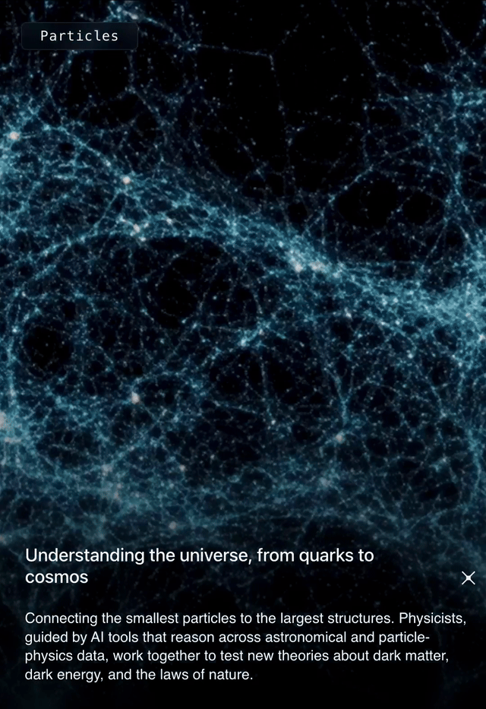
A National Mission to Accelerate Science Through Artificial Intelligence
Genesis Mission
Goal:
Genesis Mission will develop an integrated platform that connects the world's best supercomputers, experimental facilities, AI systems, and unique datasets across every major scientific domain to double the productivity and impact of American research and innovation within a decade.

Slide 25





The Labs provide leadership across five teams,
as well as leadership for the American Science and Security Platform
National S&T Challenges
Focusing on how AI, high performance computing, and data are being applied to address the U.S. government’s cross- cutting priorities.
Public-Private
Partnerships
Supporting connections and activity between DOE, NNSA, and external orgs, other government agencies, and international allies.
Data
Building a continuously evolving data ecosystem that curates, connects, and prepares DOE and NNSA data.
Infrastructure
Delivering the software and hardware infrastructure for the American Science and Security Platform.
Models
Delivering a comprehensive portfolio of AI models, agents, and tools.

Slide 26
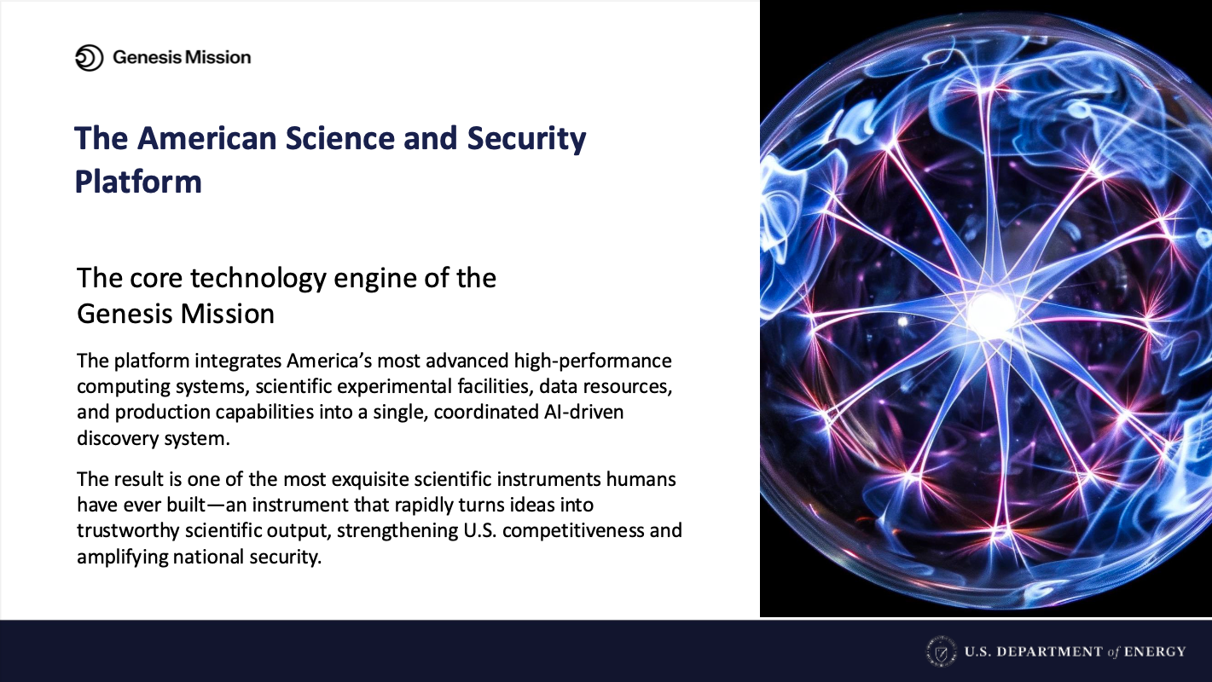

Slide 27

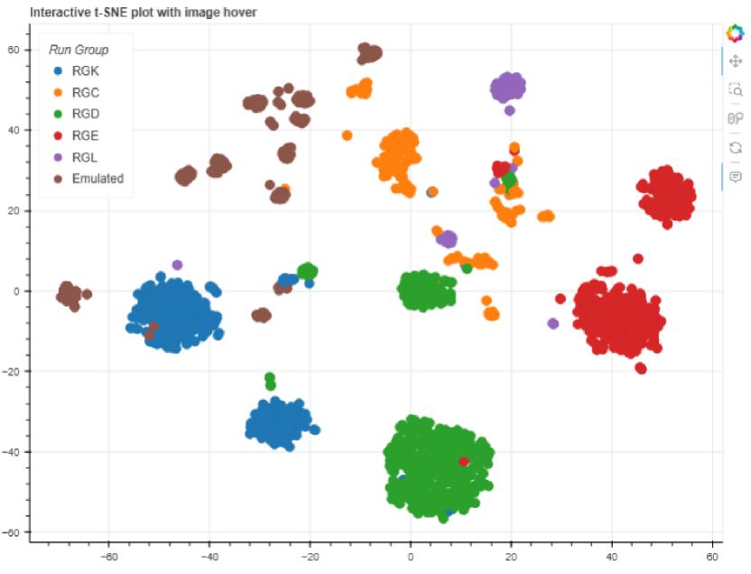
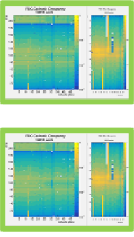
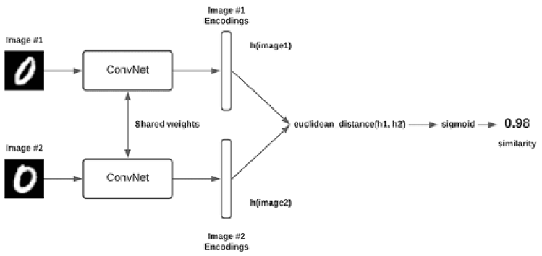


New Feature Developments in Hydra
Semi-Automated Labeling
Automating Comparison to Reference Plots
Siamese models learn to compare two inputs (in our case images) and determine how similar they are. Think of this as Hydra’s equivalent to the shift crew comparing images to their reference.
Similar
Dissimilar
t-distributed stochastic neighborhood embedding: similar objects are modeled by nearby points and dissimilar are modeled by distant points. This link, https://distill.pub/2016/misread-tsne/, contains fun visualizations and explanations.
Work being done by grad. students Darren Upton(ODU) and Jordan O’Kronley (UT)

Slide 28
Streaming Data Acquisition

Slide 29
https://indico.cern.ch/event/1471803/contributions/6910053/attachments/3282186/5865711/CHEP2026_DrSai_KeLi_V3.1.pdf
https://indico.cern.ch/event/1471803/contributions/6967027/attachments/3280639/5862516/AIE4ML_CHEP26_Dimitrios_Danopoulos.pdf
https://indico.cern.ch/event/1471803/contributions/6967268/attachments/3280862/5863122/main.pdf
https://www.danielmurnane.com/ETH-Agentic-AI-for-Collider-Physics/ Daniel Murnane “Agentic AI for Collider Physics”
What we are looking for is a comprehensive overview of how the AI revolution may change how we do nuclear physics in the time between now and when the EIC begins taking data. It can be broad in it’s approach, and not just focus on the current Genesis mission (although this is certainly a part of it). In addition, it would be helpful to consider the entire process from data taking, through calibration, analysis and data preservation. Of course, we look forward to you bringing your own approach to the topic as well.

