Slide 1
Introduction: Joint Electronics & DAQ / Streaming Readout WG Workfest
ePIC Electronics and DAQ WG Conveners
Fernando Barbosa (JLab), Jeff Landgraf (BNL)
Streaming Readout WG Conveners
Marco Battagalieri (INFN), Taku Gunji (University of Tokyo), Jeff Landgraf (BNL)
Software / Computing Management
Markus Diefenthaler (JLAB), Torre Wenaus (BNL)

Slide 2
Goals of the Workfest
Electronics and DAQ Working Group (Centered on hardware / Echelon 0)
  Responsible for the electronics / hardware / software that read out the detector
  Responsible for the aggregation of the data
  Responsible for configuring the readout, and maintaining the history of this configuration (run log / shift log)
  Responsible for the formatting and bookkeeping necessary to “synchronize” the readout. To allow proper correlation of data from the aggregated readout of all detectors.
  Sufficient QA to demonstrate the monitor validity of the above and to debug problems
  Roughly overlapping with two EIC Project CAMs: (Electronics / DAQ)
Streaming Readout Working Group (Centers on Echelon 1-2)
  Responsible for extending the streaming data concept into the computing realm
  Developing and implementing the ePIC computing model and associated infrastructure
  Event identification and selection
  Presents configuration / data formats / run log / shift log / reconstructed data to collaboration
  A main goal is to present reconstructed, calibrated data to the collaboration for analysis within about 3 weeks.
  This requires many automated or semi-automated tasks
    Distribution of data
    Calibration
    Reconstruction
    QA
  Efforts are mostly off-project, organized by the ePIC Collaboration in cooperation with the host labs (The Joint Institute), international collaborators (The Resource Review Board), and other organizations
  Significant overlap with other software / computing WGs. (particularly future distributed computing working group)
→ Goals of these sessions
  Communication between groups with very different perspectives
  Updating collaboration regarding the specific progress being made
  Feedback from collaboration

Slide 3
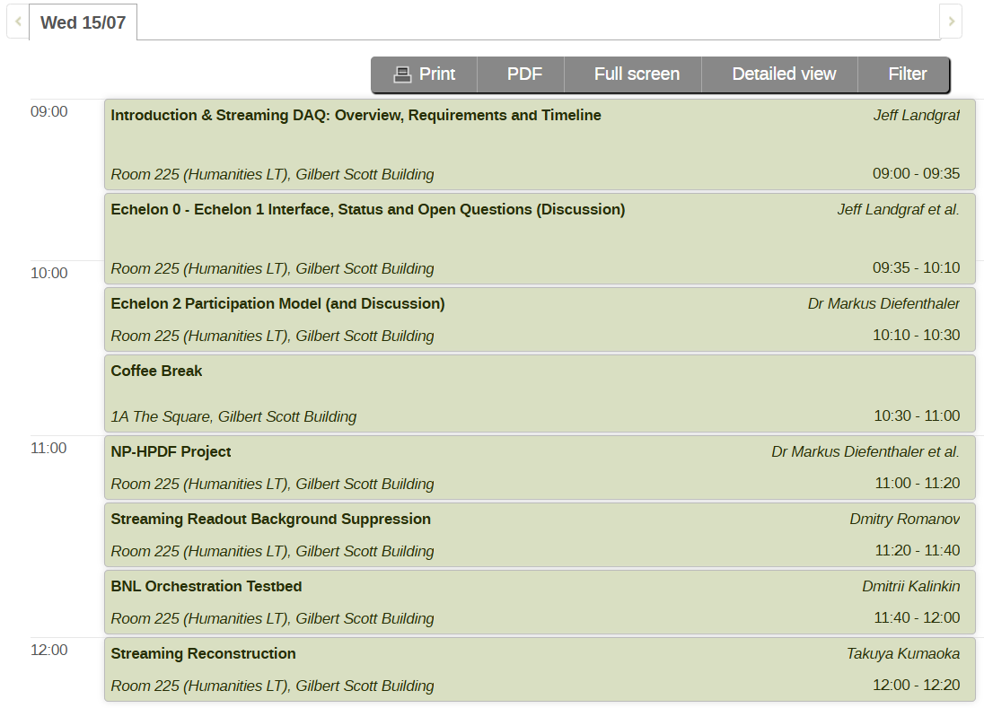
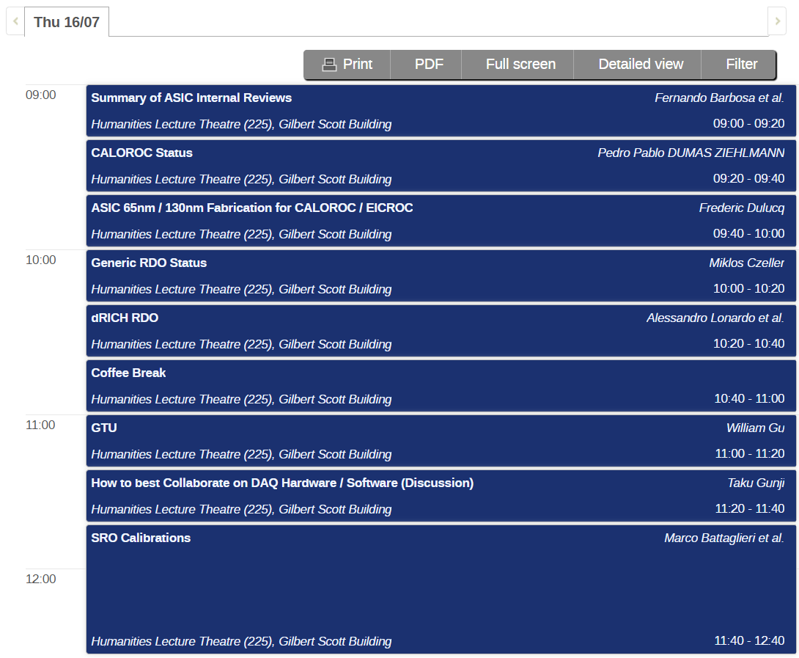
Sessions
Excursion’s

Slide 4
Introduction to streaming DAQ: Overview, Requirements, Timeline
ePIC Electronics and DAQ WG Conveners
Fernando Barbosa (JLab), Jeff Landgraf (BNL)
WBS 6.10.08 Electronics
Fernando Barbosa (JLab)
WBS 6.10.09 DAQ
David Abbott (JLab), Jeff Landgraf (BNL)

Slide 5
Overview

Slide 6
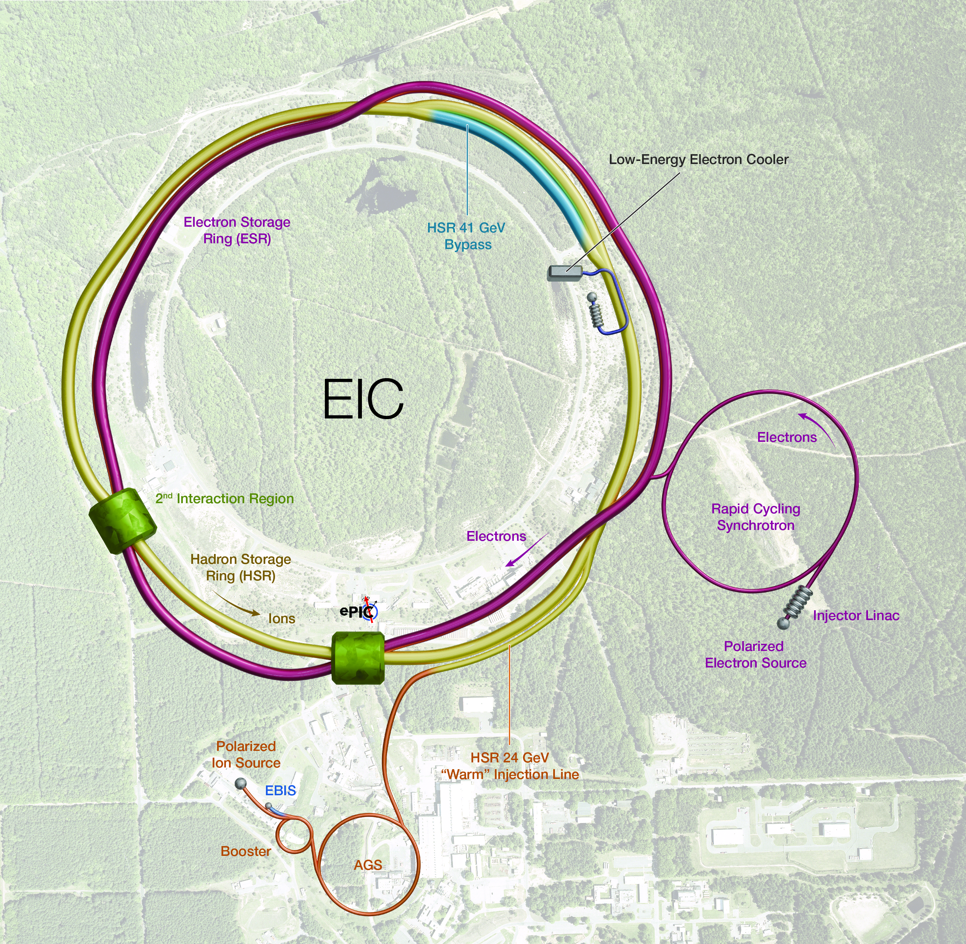
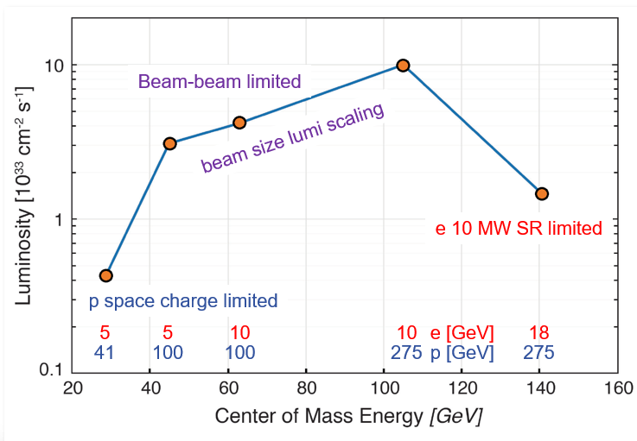
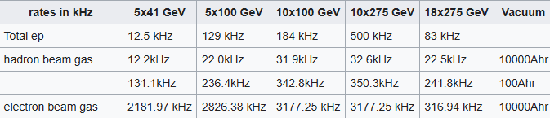
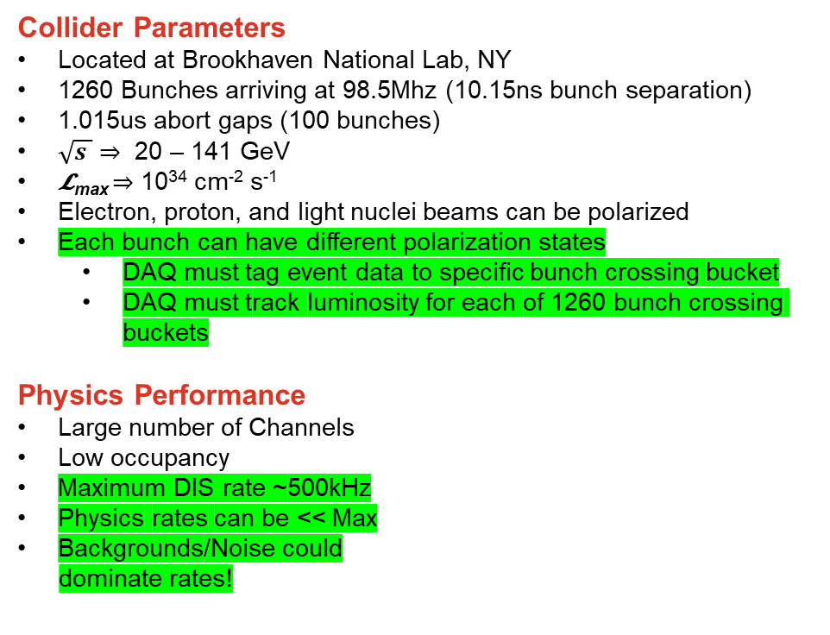
EIC Collider & DAQ Environment
Collider Parameters
Located at Brookhaven National Lab, NY
1260 Bunches arriving at 98.5Mhz (10.15ns bunch separation)
1.015us abort gaps (100 bunches)
$\sqrt{s }$ ⇒ 20 – 141 GeV
𝓛_{max} ⇒ 10³⁴ cm⁻² s⁻¹
Electron, proton, and light nuclei beams can be polarized
Each bunch can have different polarization states
  DAQ must tag event data to specific bunch crossing bucket
  DAQ must track luminosity for each of 1260 bunch crossing buckets
Physics Performance
Large number of Channels
Low occupancy
Maximum DIS rate ~500kHz
Physics rates can be << Max
Backgrounds/Noise could
dominate rates!

Slide 7
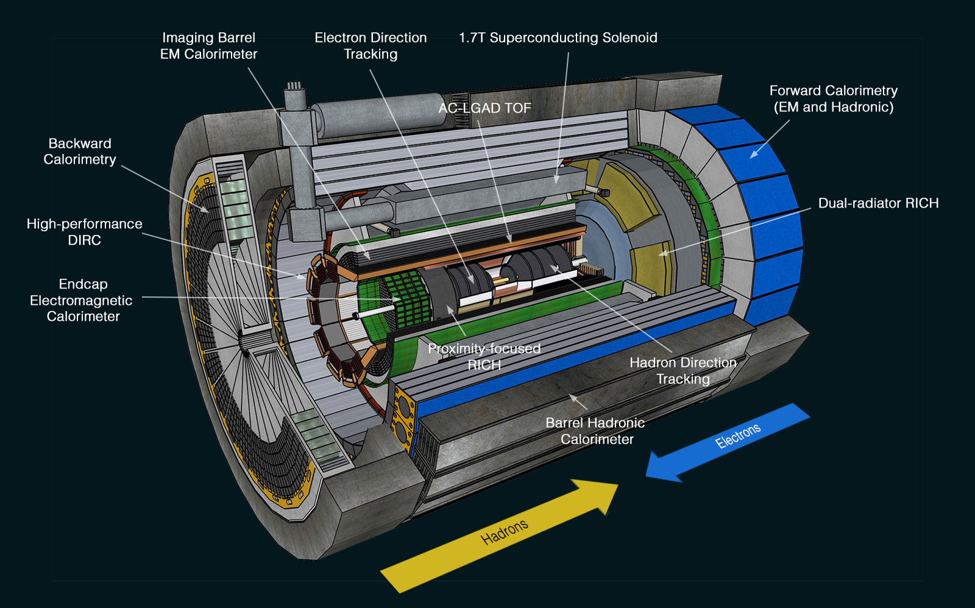
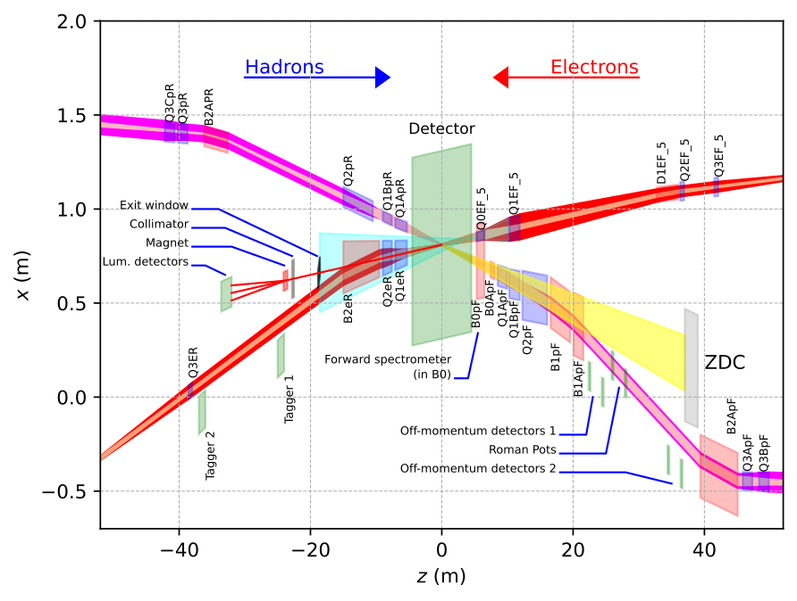
ePIC Detector Readout Technologies
~30 Detectors
Spread over +/- 40 meters
(13 bunch crossings @ c)
5 main digitization ASICs, 3 digitizing sensors, and discrete readouts
Many technologies, but effort has been made to make use of possible synergy…

Slide 8
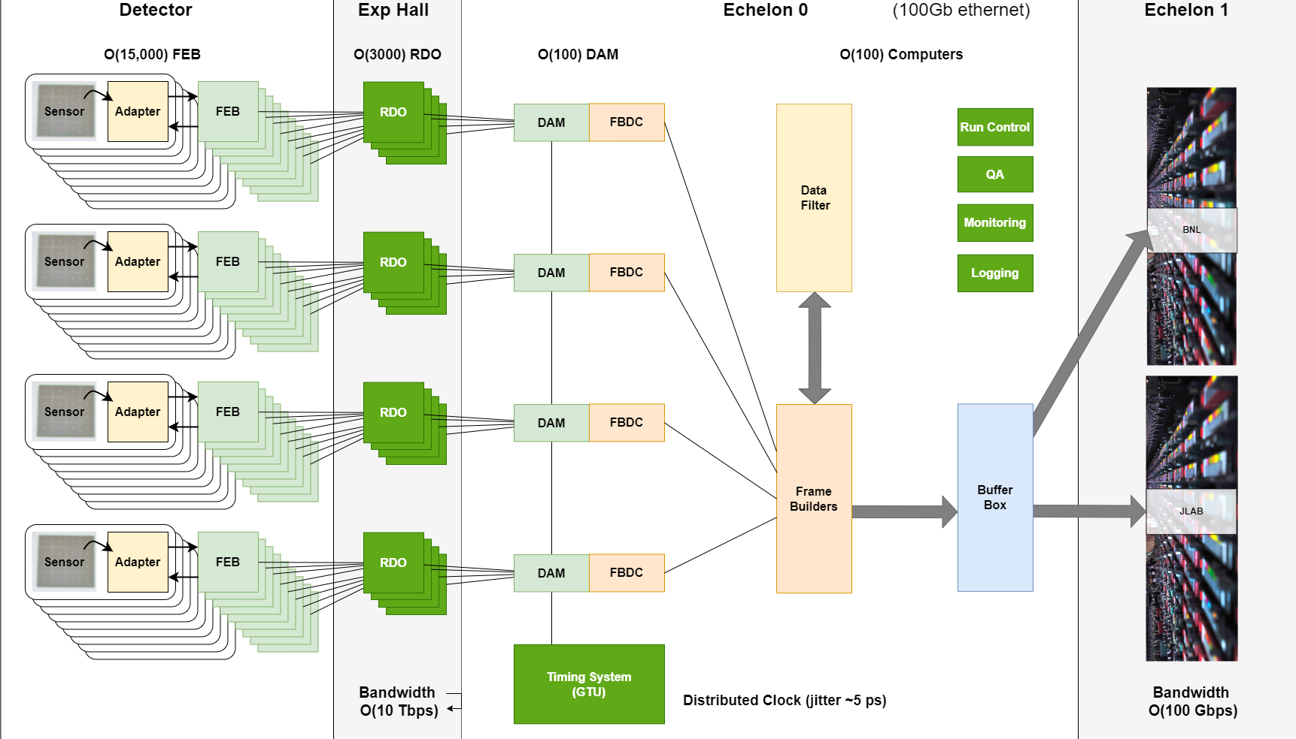
ePIC Streaming DAQ Architecture
(Online Computing)
EIC Specs
Bunch Crossing
~10.2 ns (98.5 MHz)
Interaction Rate
~ 2 us (500 kHz)
(one interaction per ~200
bunch crossings)
High Luminosity
-- up to 10³⁴ cm⁻²s⁻¹
-- Low occupancy
physics signal
-- Background and noise
significant for some
sub-systems
Frame Builder
Data Concentrator
(FBDC Server)
Controls

Slide 9
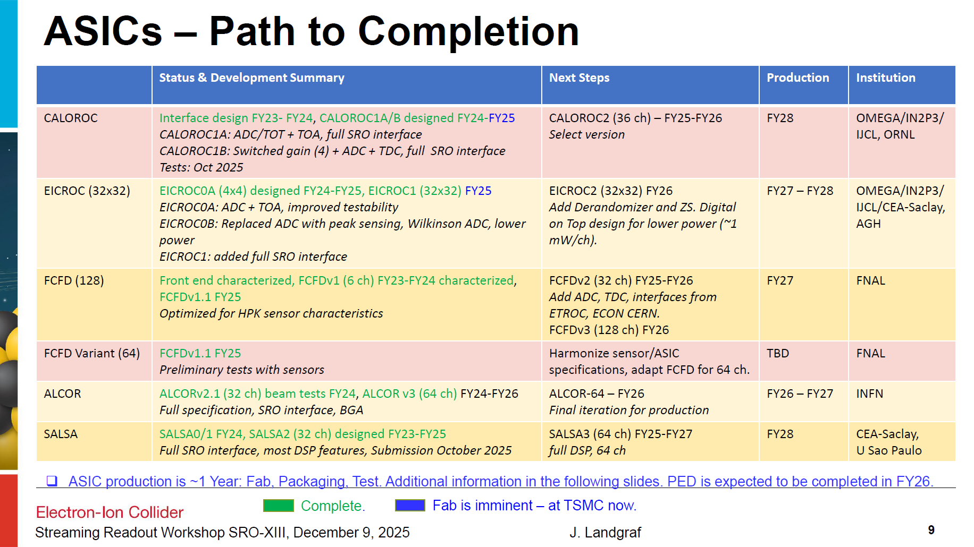
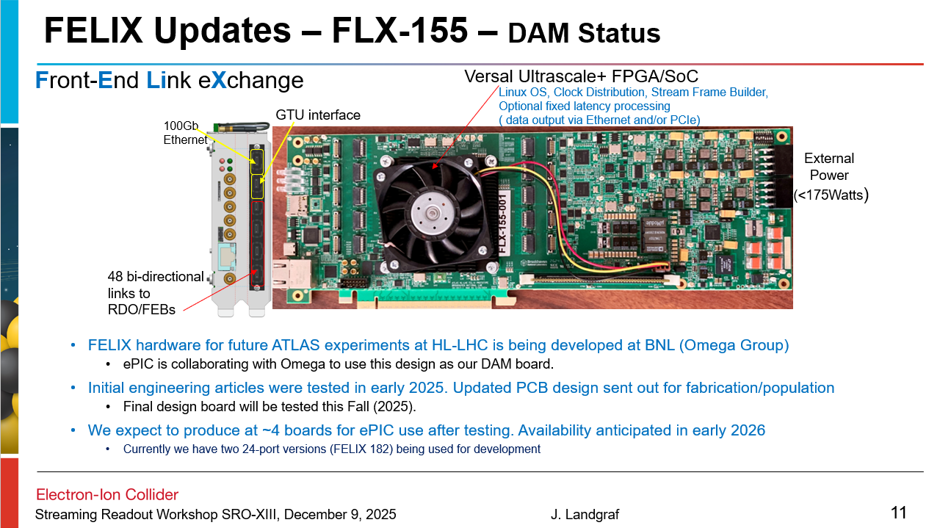
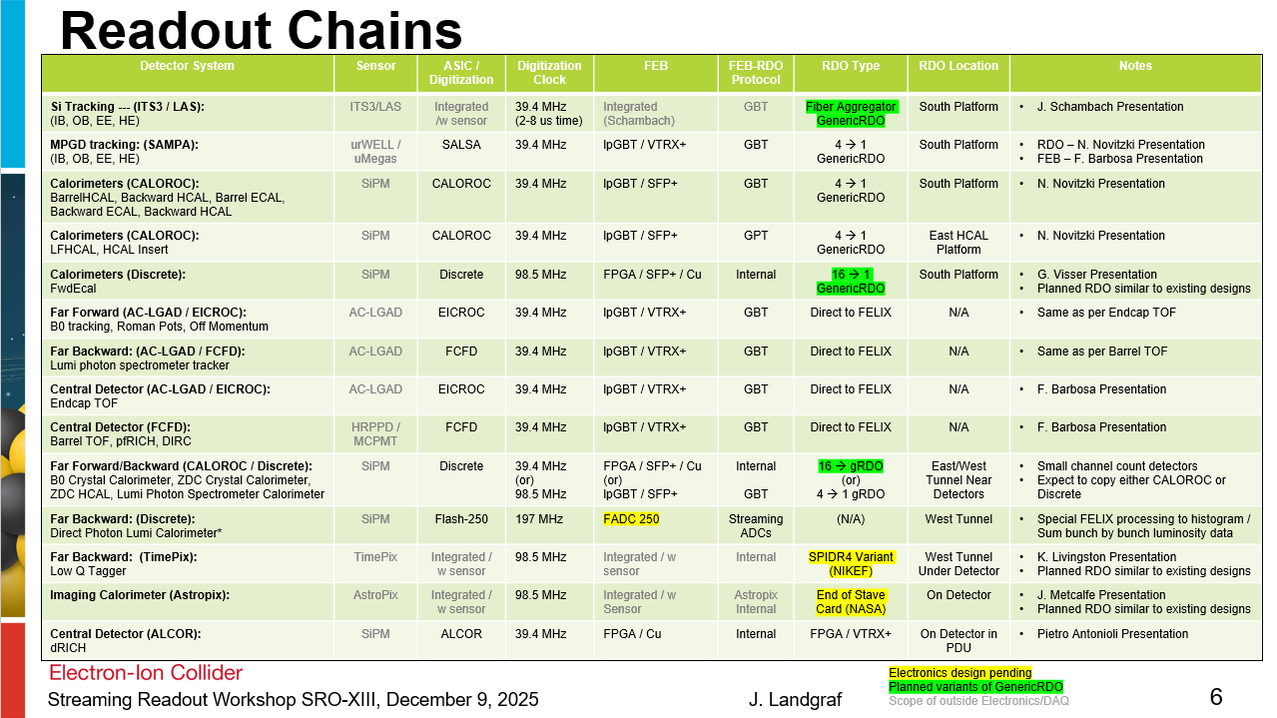
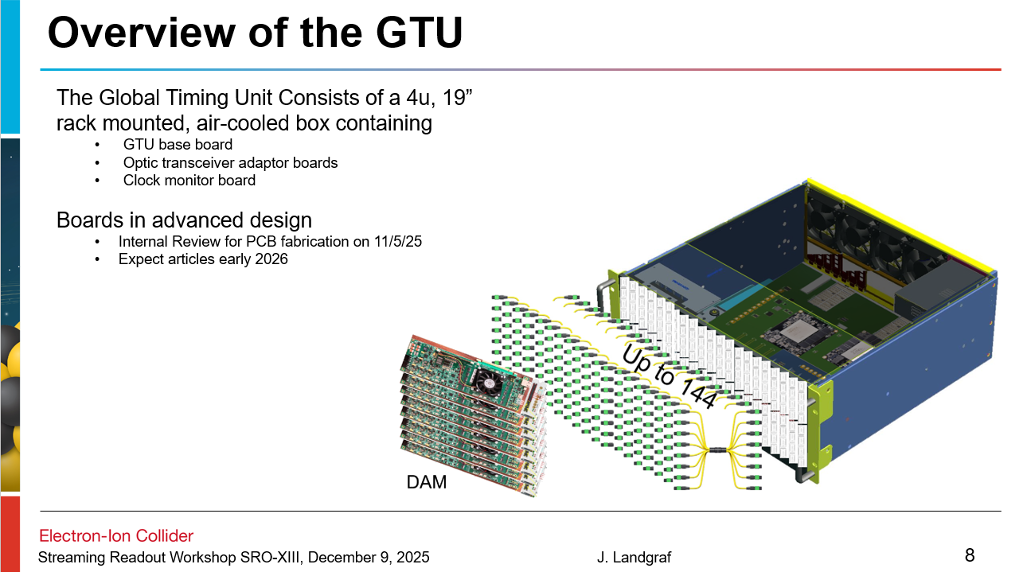
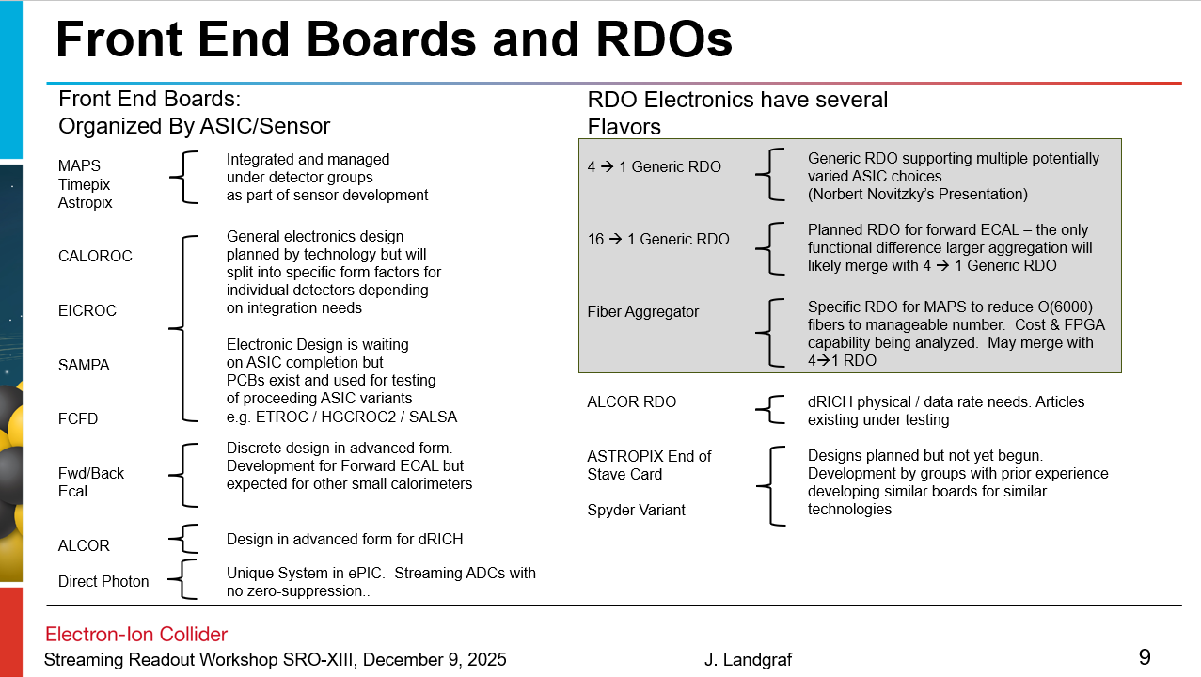
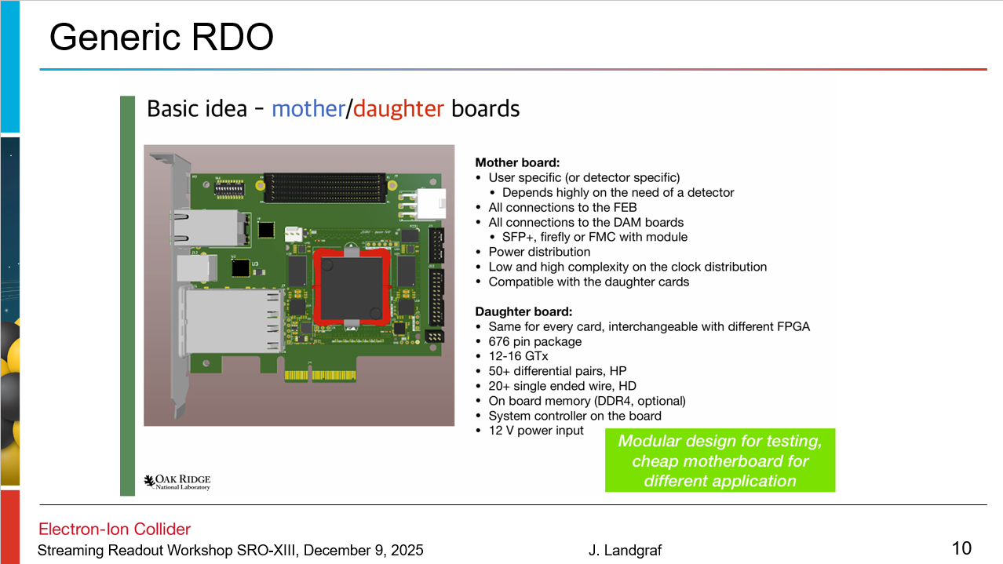
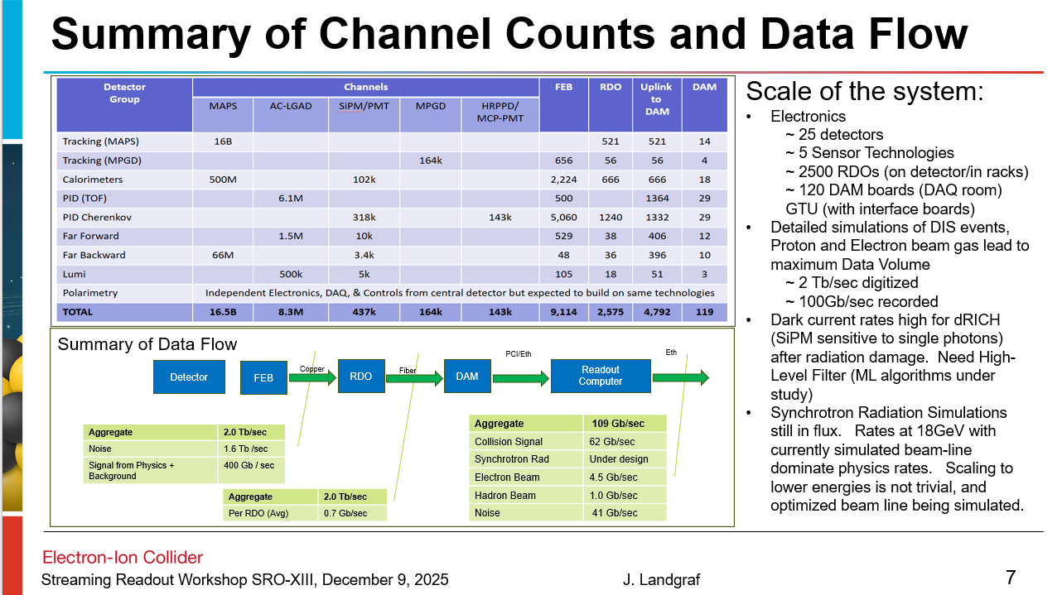
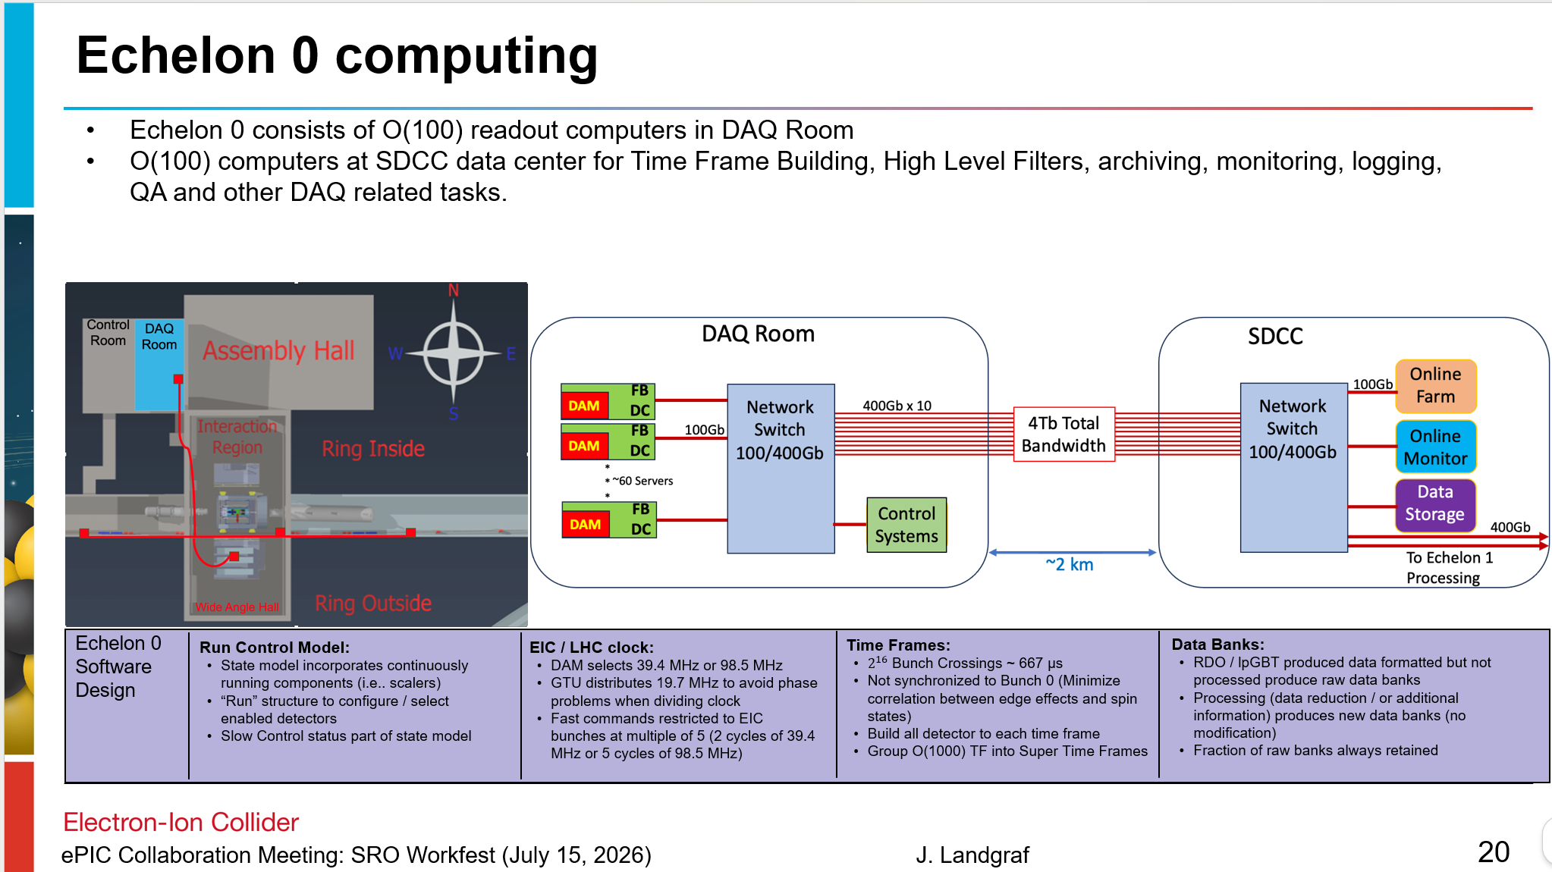
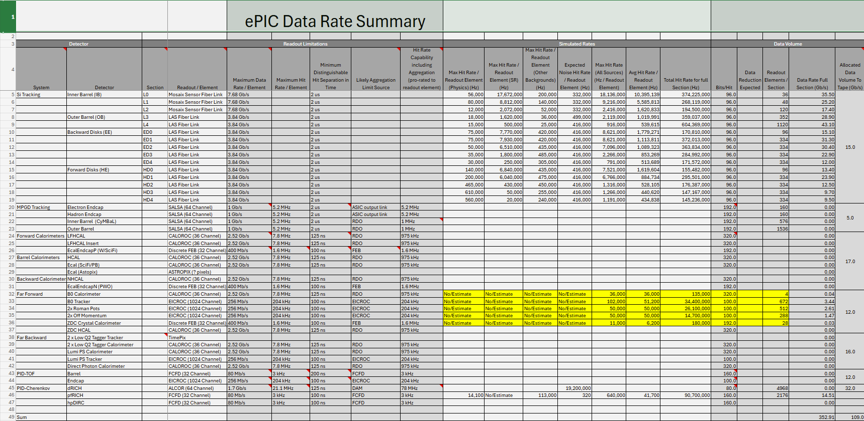
Electronics / DAQ Status
Electronics and DAQ working towards FDR early 2027
60% Design Review - 9/3/2025
ASIC internal Reviews Done
FLX155b passed ATLAS FDR
GTU/FLX155a testbed at BNL
Refinement of RDO plans in progress (MPGDs, fabrication of generic RDOs waiting on contract)
Generic RDO / carrier board
Maps of Hardware on South Platform to be iterated
Channel counts well understood
Data volume summaries becoming more clear

Slide 10
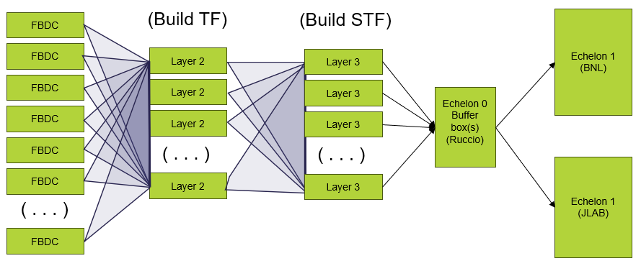
Echelon 0 – 1 interface concepts
Time Frames (TF) are buffers containing the multiplexed data from the entire detector corresponding to 0.6 ms time periods
  Integration time of MAPS is estimated to be between 2us and 8us. Simulations are often organized around MAPS integration periods which are informally described as “time frames”
  At the most fundamental level ASICs report hit times with respect to a signal (REVTIC or SYNC). This is typically reported as 2 values, the clock cycle & a fine counter dividing the clock cycles. Both the SYNC signal period and the ASICs clock cycles have different potential values for ePIC ASICS. The period between SYNC’s is also informally described as “time frames”
Super Time Frames (STF) are ordered, contiguous sets of O(1000) time frames corresponding to roughly 0.6 seconds of detector data
Likely to have independent DAQ Systems
  Polarimetry (n x 1260 values, presented infrequently)
  Luminosity Detectors (n x 1260 values, each second)
  ePIC Detector (100 Gbps)
  Independent STF streams for each
On Start/Stop Run
  Notifies Orchestration of detector/collider status via message
On production of STF DAQ:
  Writes file to Buffer Box
  Notifies Orchestration of data availability via message
Echelon 0
shared
Echelon 1

Slide 11
Requirements

Slide 12
Requirements
General
Functional
Performance
Project level requirements are broken down and linked into categories: General, Functional and Performance.
An example of data performance for fibers in DAQ/Computing is listed below:
This concept helps avoid “feature creep”. The idea is that the job of the project is to achieve a defined goal, and not pay for anything more…
G-DET-COMP.5 | The DAQ subsystem will be functionally integrated with the other detectors, with the interaction region components, and with the facility infrastructure.
F-DET-COMP.6 | The DAQ system will provide resources for communication with DET subsystems via fiber links between the experimental hall and the DAQ room. | G-DET-COMP.5
P-DET-COMP.17 | Individual fiber interfaces with all DET subsystems will support at least a 10Gb serial link to DAQ online processing. | F-DET-COMP.6

Slide 13
Scientific Motivation for DAQ requirements
Charge #3
Scientific Need
DAQ Requirement
Minimum possible trigger bias introduction from Electronics / DAQ
Triggerless Streaming Readout
Streaming Readout for All Detectors
10 Gb/s Fiber Links between DAM and RDO
TOF requires 25-35 ps timing to provide sufficient PID overlap with RICH detectors
< 10 ps Jitter for GTU
Bunch dependent polarization requires event data and luminosity monitoring to be resolved to bunch crossing
< 2 ns Absolute Clock Resolution at FEB
Timing window requirement for ALCOR ASIC requires fixed clock propagation delay from RF cavities to FEB

Slide 14
Meaning of Timing Requirements
IR:
Detector B
Detector A
Detector C
Triggered Detector (Like STAR) – “Timing in the trigger”
Timing within trigger/detector fixed by detector groups prior to beam (cable lengths, settable delays)
Adjust phase of each detectors clock so that signals align with timing window
Set delays for each detectors readout so that all signals fall into same time bucket
Set REVTIC delay so that numbering of bunches matches location of abort gaps
End Result:
DAQ Has no concept of time beyond the time of the event (Bunch number)
Time sensitive detectors (TOF) have start detector, and manage times in data format

Slide 15
Meaning of Timing Requirements
IR:
Detector B
Detector A
Detector C
In EPIC:
Timing is less sensitive to absolute delays because there is less dependence of timing windows and less manipulation of data before time corrections can be applied in software
The time of signal arrival depends upon both the time of the hit and the phase of the clock signal. We will need methods for separating these effects. We want to record the time of the hit with respect to a single clock.
The phase of the clock signals in various detector elements remains important for some detectors
  Application of timing shutters for dark current reduction (dRICH)
  Aggregation of SiPM signals (Calorimeters)
  ADC values can have digitization effects due to the phase of clock relative to signal
  Needs to be driven by detector groups even if aided by DAQ (e.g. RDO/DAM Board configuration)
There will be a function for each detector T(detector, channel, TF, clock cycle, fine clock) to obtain a time value for hits
  Basic DAQ Provided function will be measured in EIC Bunch crossings relative to the time frame (TF) start
  Hits from same event will differ in times by up to 14 clock cycles
  Return value for MAPS? Probably either the start or the end of the MAPs integration window
  This reporting is defined in software and can be adjusted by sensibility of the reconstruction group

Slide 16
Data Rate Requirements
ePICdataVolumeSummary.xlsx
Data volumes directly affect requirements, and are being studied:
  Few issues with data volume through electronics chain (we are identifying hot spots)
  Highest luminosity rates into daq computing about 450 gbps (synchrotron radiation in SVT) > Output requirement 100 gbps.
  Some detectors are more compressible than others. SVT in particular is not very compressible so we may need to be open to echelon 0 (or early echelon 1) data reduction techniques including software trigger.

Slide 17
AI Requirements
Focus on AI is intensifying
AI is not a project requirement for the DAQ
AI is a potentially enormously useful tool for attaining the project requirements
Searching for concrete ways to make the Electronics / DAQ “AI ready”
As of now there are a few specific answers to this:
  Specific ML algorithms for specific features (e.g. dRICH dark current reduction in firmware)
  MCP Servers to make data accessible to LLMs
    Slow controls readout
    EIC Controls readout (monthly discussions with EIC Controls)
    DAQ Monitoring / Logging
    Run Log Database information
  MCP Servers to provide API’s to allow LLMs (potentially) control DAQ
    Run Control features
    Use SRO WG orchestration test bed (Dmitrii’s Talk) as a model

Slide 18
Timeline

Slide 19
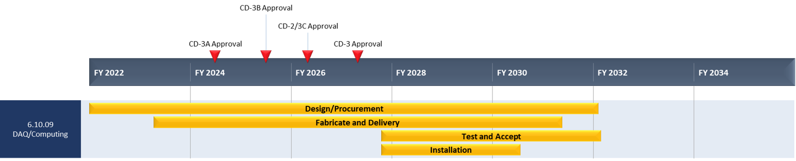
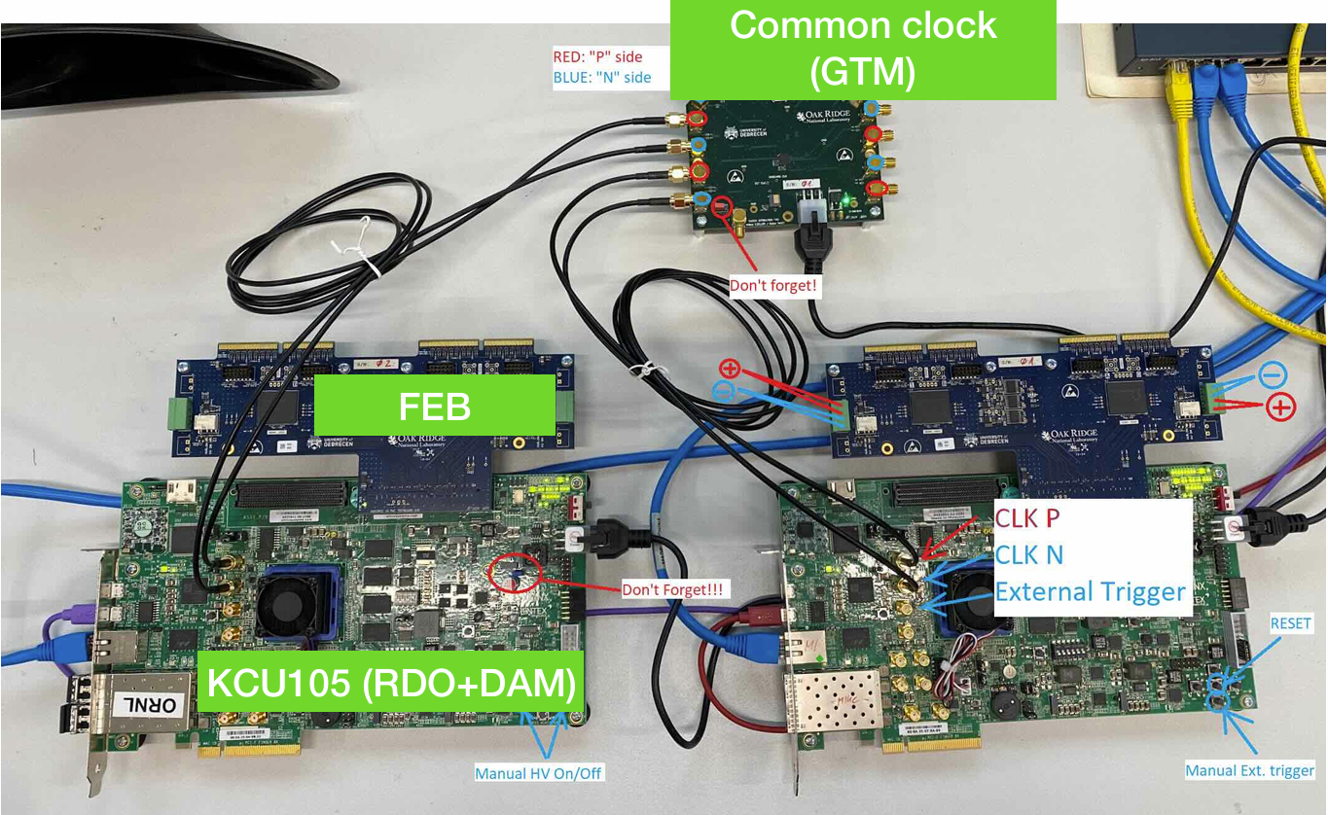
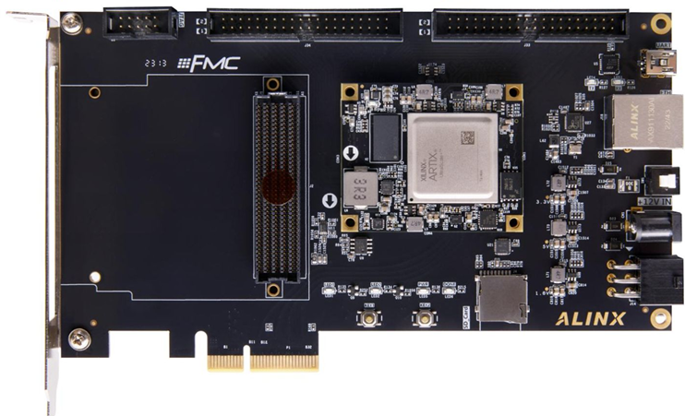
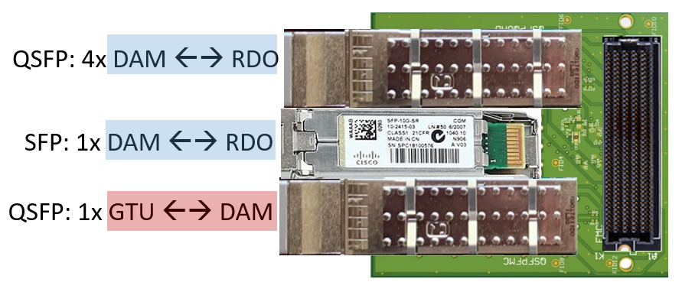
PicoDAQ / MicroDAQ
A functional DAQ will be necessary for small scale detector testing as well as commissioning and pre-ops.
Computing resources are staged to make purchases when the hardware is needed, taking advantage of price savings and performance improvements in time.
Hardware and software development early in the construction phase will involve a series of releases with increasing functionality
Detector Install: FY29Q2 - FY31Q2
Cosmics: FY31Q3
Early CD-4: FY32Q4
DAQ Releases:
PicoDAQ FY26Q2
  Basic readout test setups
MicroDAQ: FY27Q1
  Readout detector data in test stand using engineering articles
MiniDAQ: FY28Q1
  Readout detector data using full hardware and timing chain
Full DAQ-v1: FY29Q2
  Full functionality DAQ ready for full system integration & testing
Production DAQ: FY31Q3
Ready for cosmics
Pico DAQ
The focus in 2026 continues to be on the electronics and those software/firmware aspects required for developing final design.
FLX and GTU test stand is installed at BNL. Expect to install some echelon 0 computing at the SCDF computing facility in a few months, as part of MicroDAQ
Neither PicoDAQ nor MicroDAQ are expected to have direct interface between the detector components and echelon1
This does not prevent DAQ participation in echelon0-echelon1 interface test stands – for example implementing the DAQ side of transfer interfaces for the orchestration test setup
BHCAL --- (H2GCROC)
KCU105 (RDO+DAM) (kintex)
Python Config/Control
rcdaq integration
Norbert Novitzky, Miklos Czeller, Gabor Nagy, Shihai Jia, Martin Purschke
TOF DAM-Lite: (ETROC)
Alinx AXAU15 (Artix)
Reads from lpGBT FEB
Follows FELIX development scheme
(RICE)
WBS 6.03.01.08
DAQ/Computing
FMC - Q(SFP) Adapter
Allows use of prototype GTU/DAM with dev boards (such as AXAU15)
20 boards available now
Firmware under development
PDR1
PicoDAQ
MiniDAQ
Production
DAQ
PDR2
MicroDAQ
Full DAQ-V1
PDR3

Slide 20
Questions / Discussion?

Slide 21
Backup

Slide 22
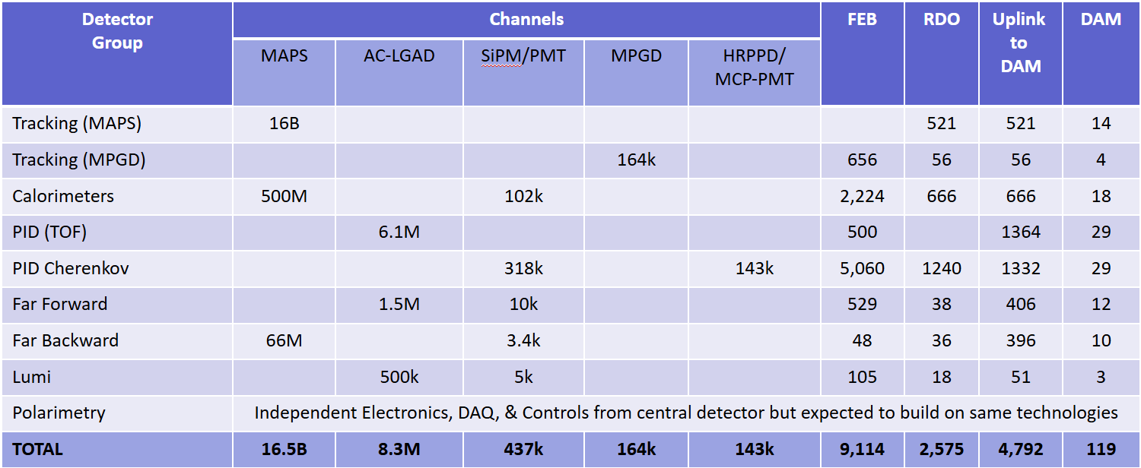
Summary of Channel Counts and Data Flow
Scale of the system:
Electronics
  ~ 25 detectors
  ~ 5 Sensor Technologies
  ~ 2500 RDOs (on detector/in racks)
  ~ 120 DAM boards (DAQ room)
  GTU (with interface boards)
Detailed simulations of DIS events, Proton and Electron beam gas lead to maximum Data Volume
  ~ 2 Tb/sec digitized
  ~ 100Gb/sec recorded
Dark current rates high for dRICH (SiPM sensitive to single photons) after radiation damage. Need High-Level Filter (ML algorithms under study)
Synchrotron Radiation Simulations still in flux. Rates at 18GeV with currently simulated beam-line dominate physics rates. Scaling to lower energies is not trivial, and optimized beam line being simulated.
Summary of Data Flow
PCI/Eth
Eth
Detector
FEB
Copper
RDO
Fiber
DAM
Readout Computer
Aggregate | 2.0 Tb/sec
Noise | 1.6 Tb /sec
Signal from Physics + Background | 400 Gb / sec
Aggregate | 109 Gb/sec
Collision Signal | 62 Gb/sec
Synchrotron Rad | Under design
Electron Beam | 4.5 Gb/sec
Hadron Beam | 1.0 Gb/sec
Noise | 41 Gb/sec
Aggregate | 2.0 Tb/sec
Per RDO (Avg) | 0.7 Gb/sec

Slide 23
Readout Chains
Detector System | Sensor | ASIC / Digitization | Digitization Clock | FEB | FEB-RDO Protocol | RDO Type | RDO Location | Notes
Si Tracking --- (ITS3 / LAS): (IB, OB, EE, HE) | ITS3/LAS | Integrated /w sensor | 39.4 MHz (2-8 us time) | Integrated (Schambach) | GBT | Fiber Aggregator GenericRDO | South Platform | J. Schambach Presentation
MPGD tracking: (SAMPA): (IB, OB, EE, HE) | urWELL / uMegas | SALSA | 39.4 MHz | lpGBT / VTRX+ | GBT | 4 → 1 GenericRDO | South Platform | RDO – N. Novitzki Presentation FEB – F. Barbosa Presentation
Calorimeters (CALOROC): BarrelHCAL, Backward HCAL, Barrel ECAL, Backward ECAL, Backward HCAL | SiPM | CALOROC | 39.4 MHz | lpGBT / SFP+ | GBT | 4 → 1 GenericRDO | South Platform | N. Novitzki Presentation
Calorimeters (CALOROC): LFHCAL, HCAL Insert | SiPM | CALOROC | 39.4 MHz | lpGBT / SFP+ | GPT | 4 → 1 GenericRDO | East HCAL Platform | N. Novitzki Presentation
Calorimeters (Discrete): FwdEcal | SiPM | Discrete | 98.5 MHz | FPGA / SFP+ / Cu | Internal | 16 → 1 GenericRDO | South Platform | G. Visser Presentation Planned RDO similar to existing designs
Far Forward (AC-LGAD / EICROC): B0 tracking, Roman Pots, Off Momentum | AC-LGAD | EICROC | 39.4 MHz | lpGBT / VTRX+ | GBT | Direct to FELIX | N/A | Same as per Endcap TOF
Far Backward: (AC-LGAD / FCFD): Lumi photon spectrometer tracker | AC-LGAD | FCFD | 39.4 MHz | lpGBT / VTRX+ | GBT | Direct to FELIX | N/A | Same as per Barrel TOF
Central Detector (AC-LGAD / EICROC): Endcap TOF | AC-LGAD | EICROC | 39.4 MHz | lpGBT / VTRX+ | GBT | Direct to FELIX | N/A | F. Barbosa Presentation
Central Detector (FCFD): Barrel TOF, pfRICH, DIRC | HRPPD / MCPMT | FCFD | 39.4 MHz | lpGBT / VTRX+ | GBT | Direct to FELIX | N/A | F. Barbosa Presentation
Far Forward/Backward (CALOROC / Discrete): B0 Crystal Calorimeter, ZDC Crystal Calorimeter, ZDC HCAL, Lumi Photon Spectrometer Calorimeter | SiPM | Discrete | 39.4 MHz (or) 98.5 MHz | FPGA / SFP+ / Cu (or) lpGBT / SFP+ | Internal GBT | 16 → gRDO (or) 4 → 1 gRDO | East/West Tunnel Near Detectors | Small channel count detectors Expect to copy either CALOROC or Discrete
Far Backward: (Discrete): Direct Photon Lumi Calorimeter* | SiPM | Flash-250 | 197 MHz | FADC 250 | Streaming ADCs | (N/A) | West Tunnel | Special FELIX processing to histogram / Sum bunch by bunch luminosity data
Far Backward: (TimePix): Low Q Tagger | TimePix | Integrated / w sensor | 98.5 MHz | Integrated / w sensor | Internal | SPIDR4 Variant (NIKEF) | West Tunnel Under Detector | K. Livingston Presentation Planned RDO similar to existing designs
Imaging Calorimeter (Astropix): | AstroPix | Integrated / w sensor | 98.5 MHz | Integrated / w Sensor | Astropix Internal | End of Stave Card (NASA) | On Detector | J. Metcalfe Presentation Planned RDO similar to existing designs
Central Detector (ALCOR): dRICH | SiPM | ALCOR | 39.4 MHz | FPGA / Cu | Internal | FPGA / VTRX+ | On Detector in PDU | Pietro Antonioli Presentation
Electronics design pending
Planned variants of GenericRDO
Scope of outside Electronics/DAQ

Slide 24
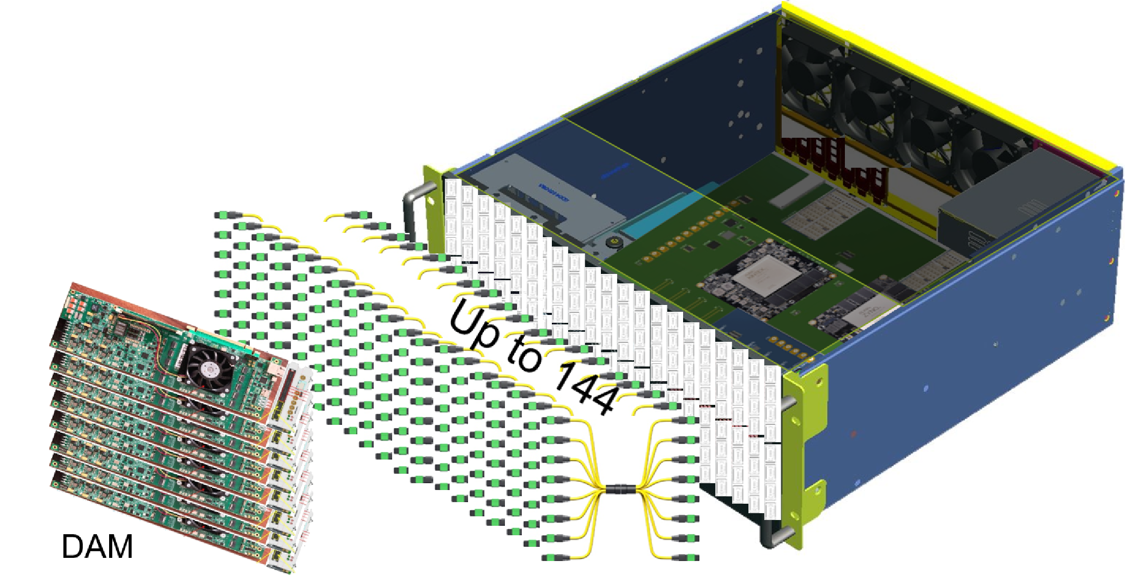
Overview of the GTU
The Global Timing Unit Consists of a 4u, 19” rack mounted, air-cooled box containing
  GTU base board
  Optic transceiver adaptor boards
  Clock monitor board
Boards in advanced design
  Internal Review for PCB fabrication on 11/5/25
  Expect articles early 2026

Slide 25
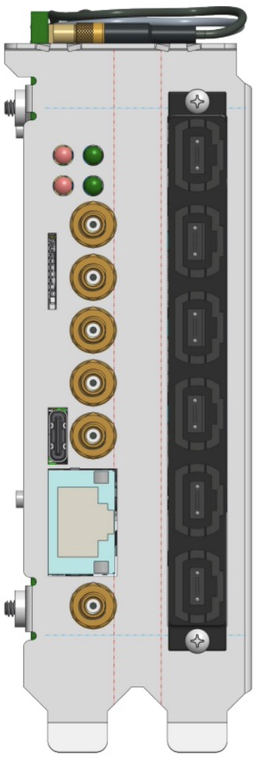
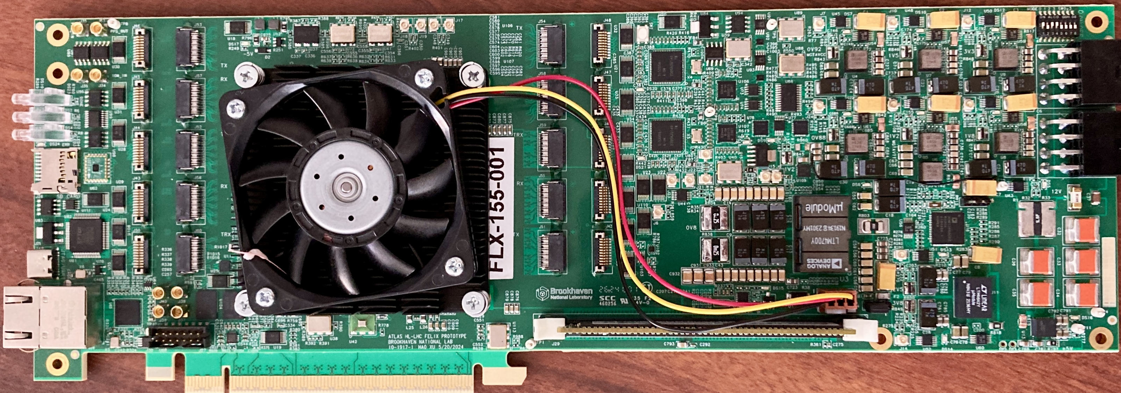
FELIX Updates – FLX-155 – DAM Status
Front-End Link eXchange
Versal Ultrascale+ FPGA/SoC
Linux OS, Clock Distribution, Stream Frame Builder, Optional fixed latency processing
( data output via Ethernet and/or PCIe)
GTU interface
100Gb
Ethernet
External
Power
(<175Watts)
48 bi-directional links to RDO/FEBs
FELIX hardware for future ATLAS experiments at HL-LHC is being developed at BNL (Omega Group)
  ePIC is collaborating with Omega to use this design as our DAM board.
Initial engineering articles were tested in early 2025. Updated PCB design sent out for fabrication/population
  Final design board will be tested this Fall (2025).
We expect to produce at ~4 boards for ePIC use after testing. Availability anticipated in early 2026
  Currently we have two 24-port versions (FELIX 182) being used for development

Slide 26
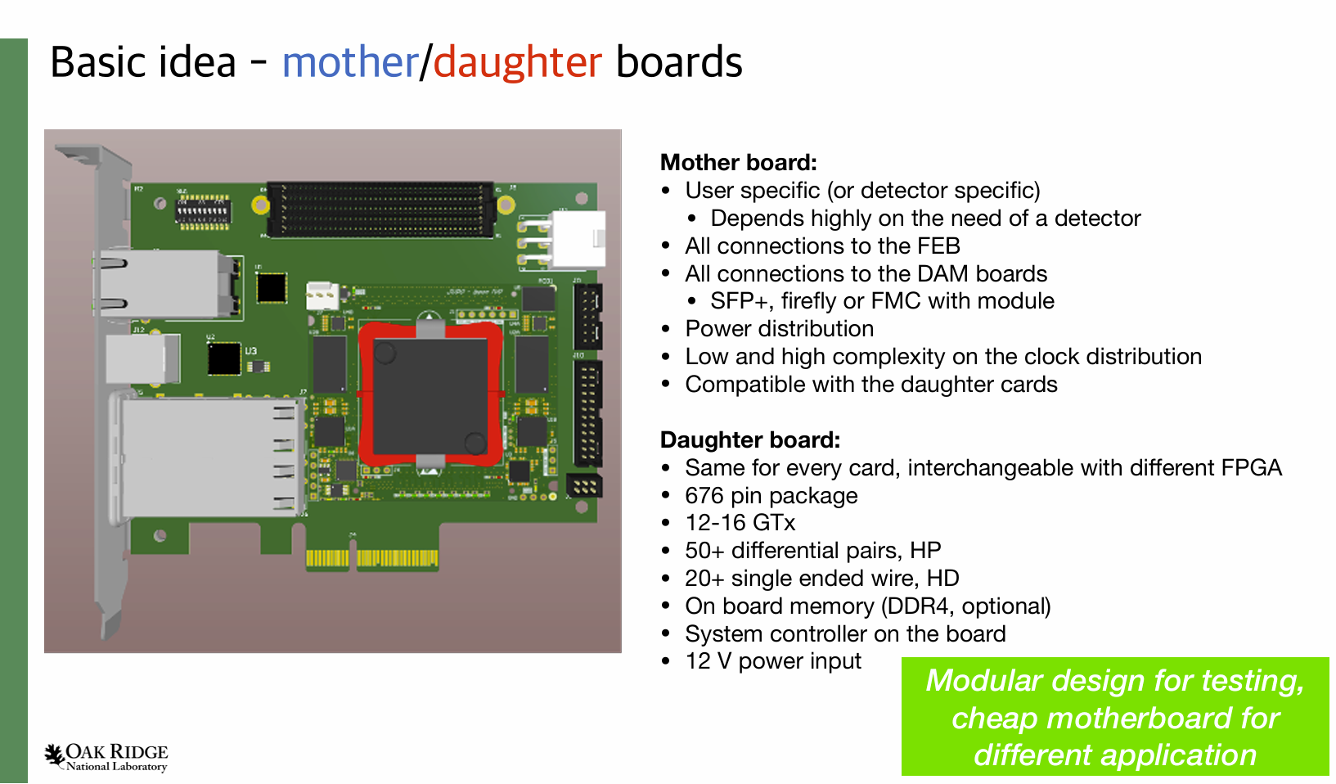
Generic RDO

Slide 27
Front End Boards and RDOs
Front End Boards:
Organized By ASIC/Sensor
MAPS
Timepix
Astropix
CALOROC
EICROC
SAMPA
FCFD
Fwd/Back
Ecal
ALCOR
Direct Photon
RDO Electronics have several
Flavors
4 → 1 Generic RDO
16 → 1 Generic RDO
Fiber Aggregator
ALCOR RDO
ASTROPIX End of
Stave Card
Spyder Variant
Integrated and managed
under detector groups
as part of sensor development
Generic RDO supporting multiple potentially varied ASIC choices
(Norbert Novitzky’s Presentation)
General electronics design
planned by technology but will
split into specific form factors for
individual detectors depending
on integration needs
Electronic Design is waiting
on ASIC completion but
PCBs exist and used for testing
of proceeding ASIC variants
e.g. ETROC / HGCROC2 / SALSA
Planned RDO for forward ECAL – the only functional difference larger aggregation will likely merge with 4 → 1 Generic RDO
Specific RDO for MAPS to reduce O(6000) fibers to manageable number. Cost & FPGA capability being analyzed. May merge with 4→1 RDO
dRICH physical / data rate needs. Articles existing under testing
Discrete design in advanced form. Development for Forward ECAL but expected for other small calorimeters
Designs planned but not yet begun. Development by groups with prior experience developing similar boards for similar technologies
Design in advanced form for dRICH
Unique System in ePIC. Streaming ADCs with no zero-suppression..

Slide 28
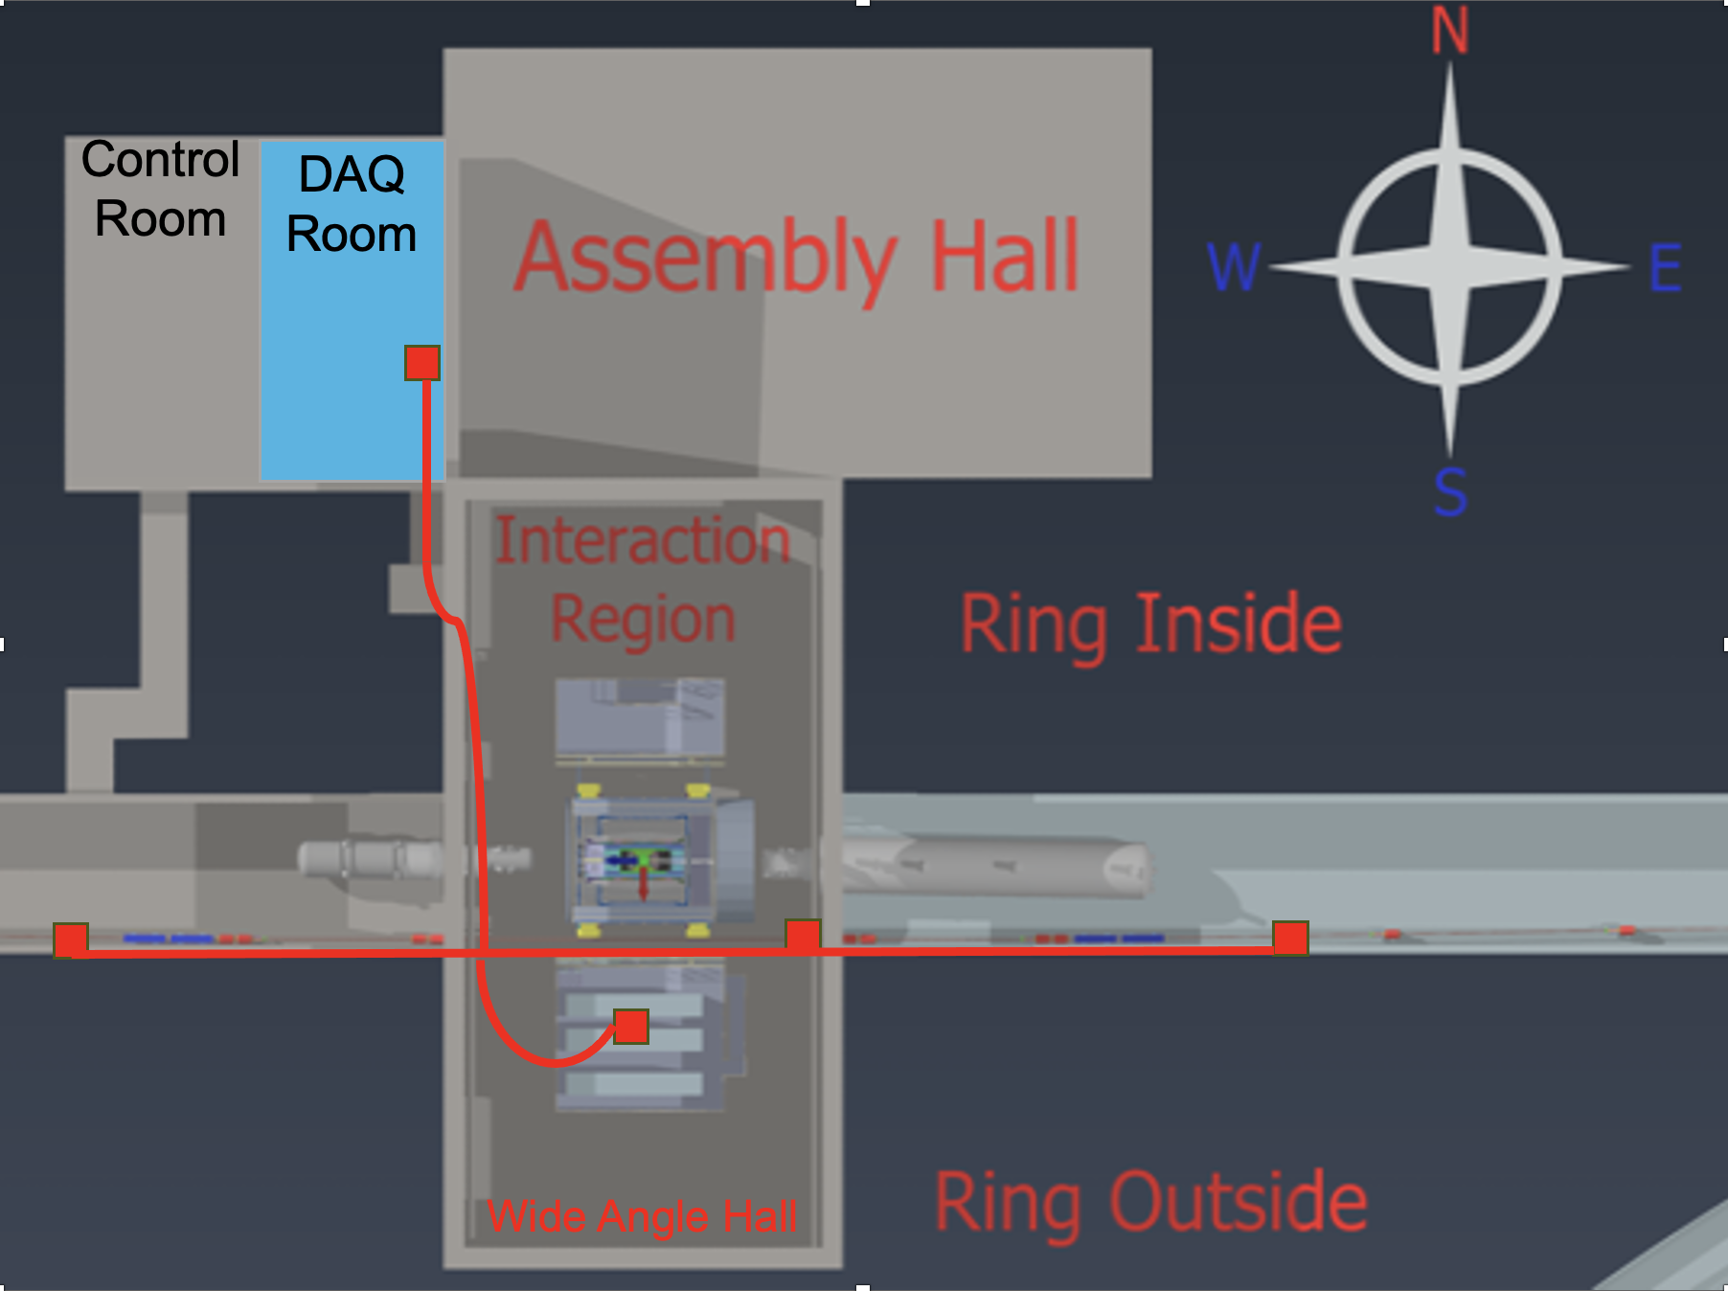
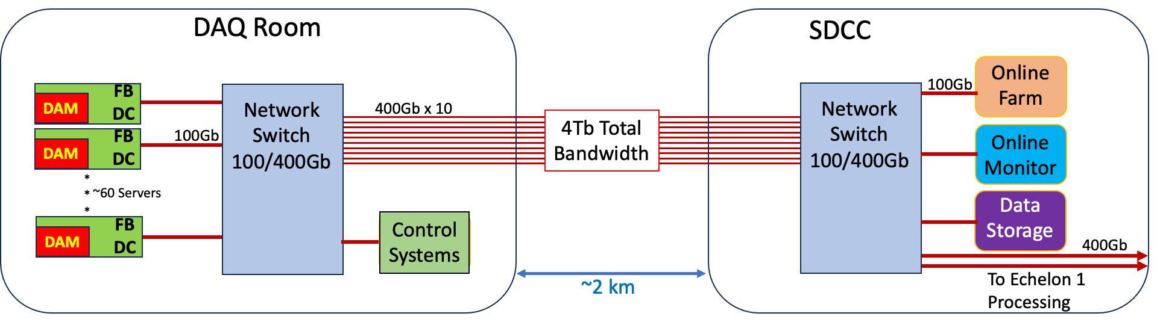
Echelon 0 computing
Echelon 0 consists of O(100) readout computers in DAQ Room
O(100) computers at SDCC data center for Time Frame Building, High Level Filters, archiving, monitoring, logging, QA and other DAQ related tasks.
Echelon 0
Software
Design
Run Control Model:
State model incorporates continuously running components (i.e.. scalers)
“Run” structure to configure / select enabled detectors
Slow Control status part of state model
EIC / LHC clock:
DAM selects 39.4 MHz or 98.5 MHz
GTU distributes 19.7 MHz to avoid phase problems when dividing clock
Fast commands restricted to EIC bunches at multiple of 5 (2 cycles of 39.4 MHz or 5 cycles of 98.5 MHz)
Time Frames:
$2^{16}$ Bunch Crossings ~ 667 µs
Not synchronized to Bunch 0 (Minimize correlation between edge effects and spin states)
Build all detector to each time frame
Group O(1000) TF into Super Time Frames
Data Banks:
RDO / lpGBT produced data formatted but not processed produce raw data banks
Processing (data reduction / or additional information) produces new data banks (no modification)
Fraction of raw banks always retained

