Slide 1
CALOROC status
July 2026
Pedro Pablo Dumas Ziehlmann – pedro.dumas-ziehlmann@omega.in2p3.fr
Ecole Polytechnique – CNRS

Slide 2
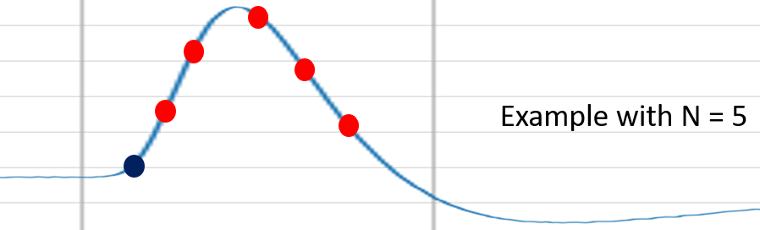
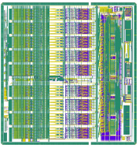
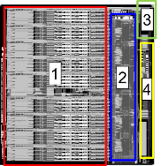
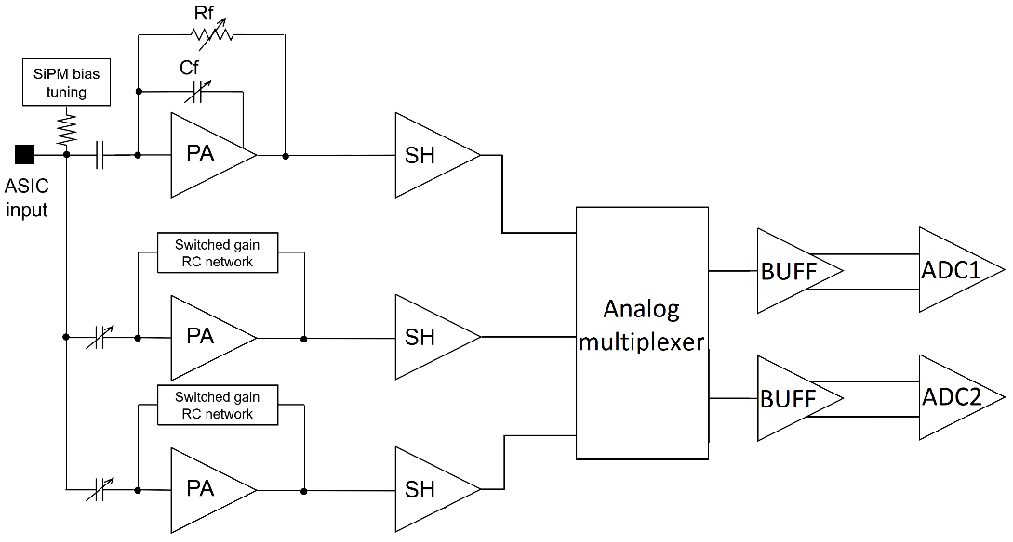
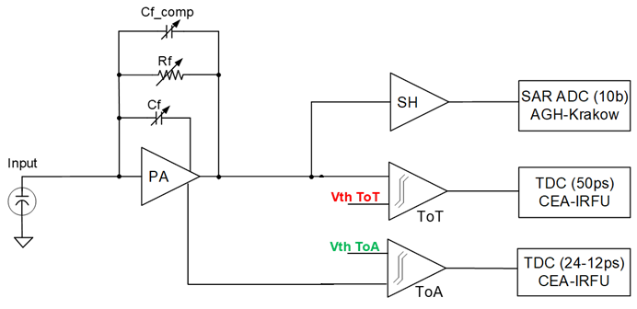
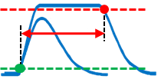
CALOROC: Waveform Digitizer for SiPM Readout
CALOROC main changes:
  Released in 2 versions: CALOROC-A and CALOROC-B
  New 6-layer substrate – BGA (common)
  New digital processing (common)
  New testboards (common)
Trigger (Time)
CALOROC 1A
CMS front-end
Low SiPM capacitance
CALOROC 1B
New switched-gain front-end
High SiPM capacitance
Measurements in progress
Measurements in progress

Slide 3
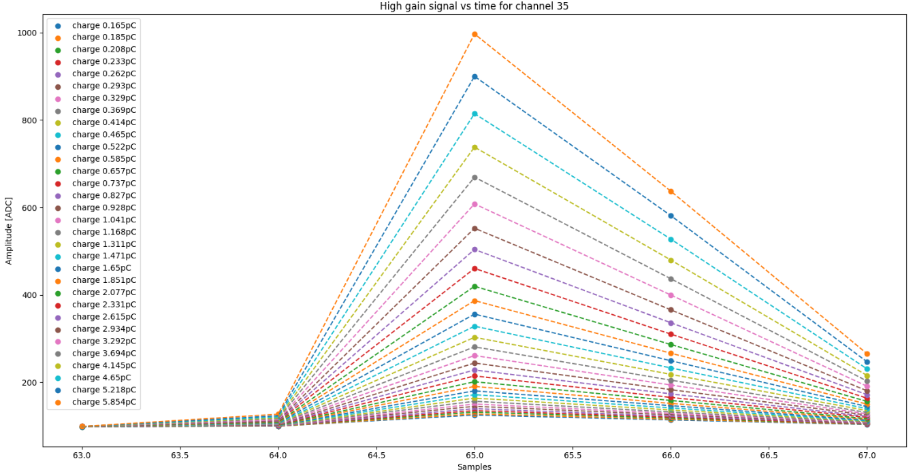
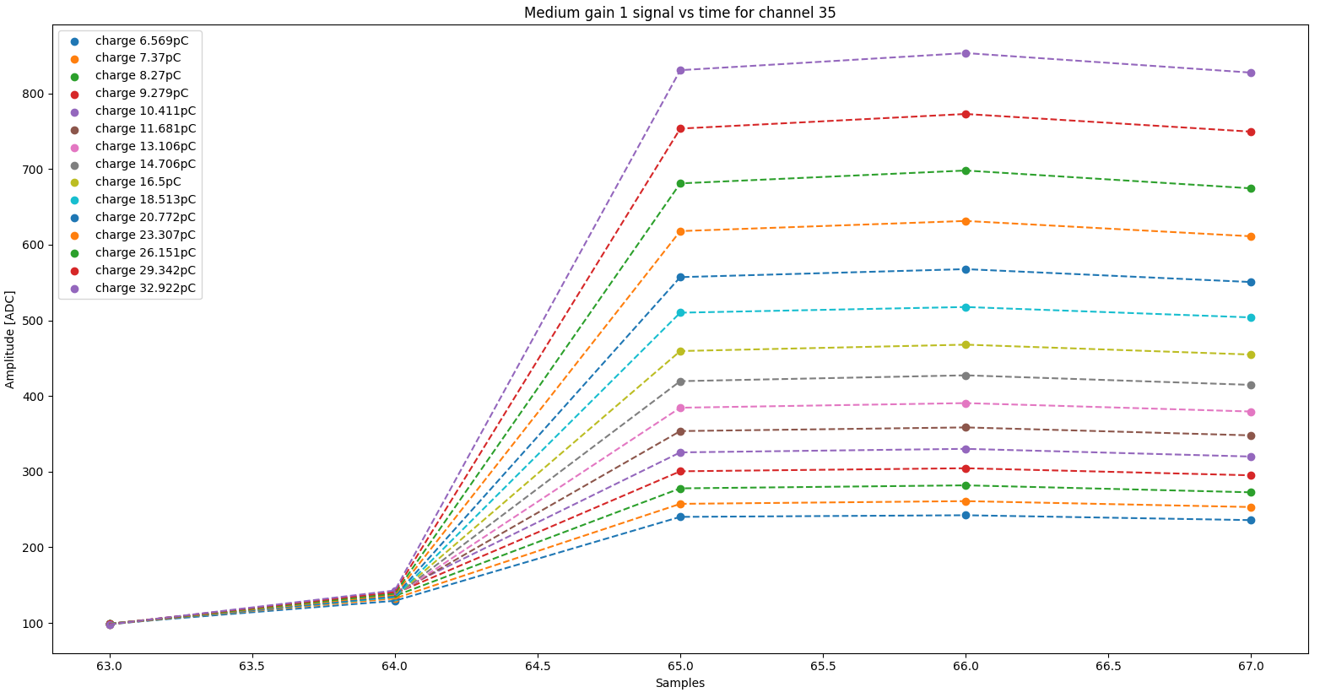
High Gain and gain switching Waveform Measurements
Using internal injection of the ASIC:
  Without autotrigger
  Using fast commands to force autotrigger
Using 5 samples (1 baseline + 4 signals)
Time to peak of 25ns for the high gain signal
When using the gain switching, the signal becomes wider as expected .
Full waveforms available in the backup

Slide 4
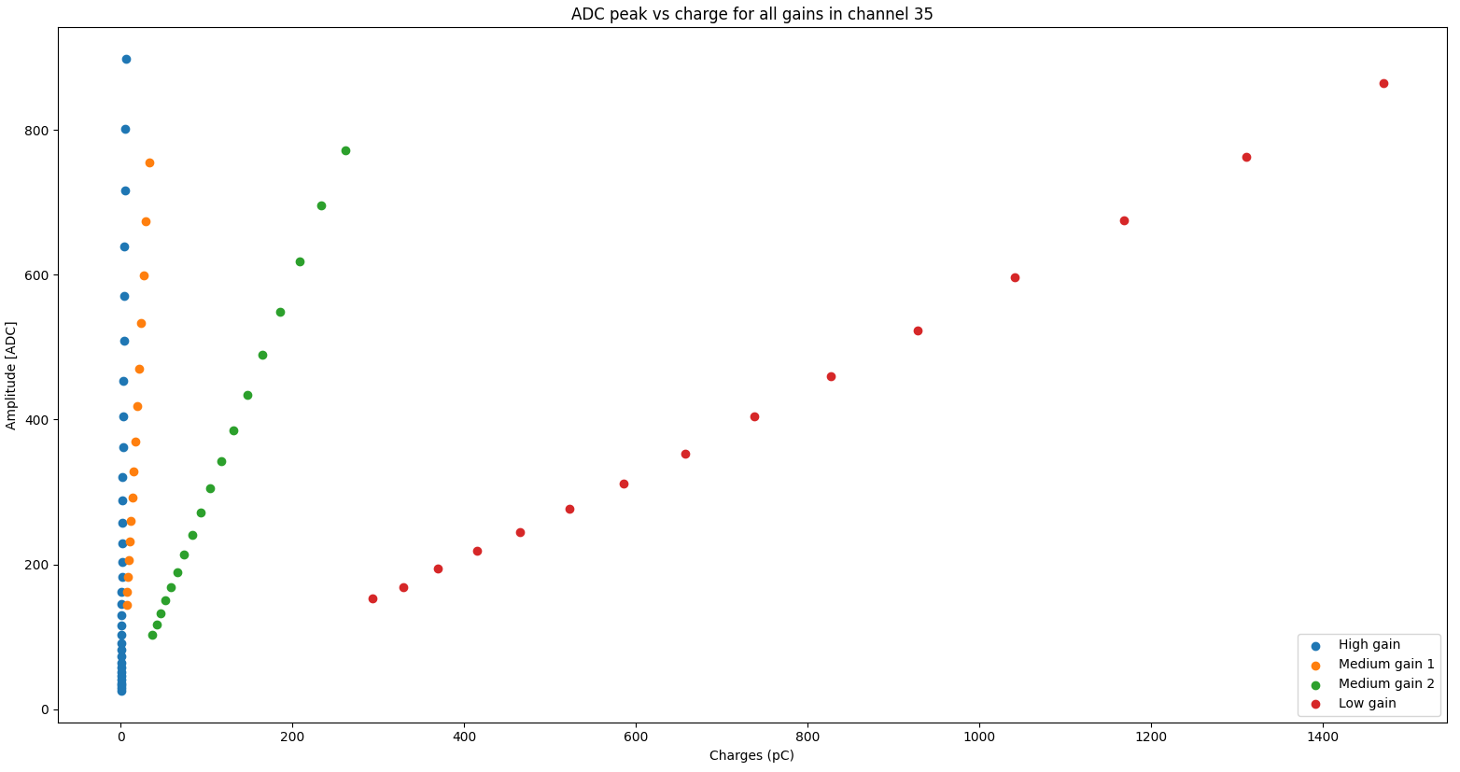
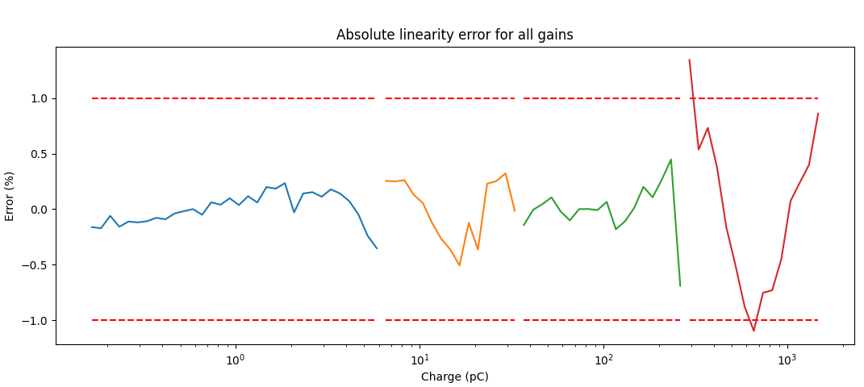
Linearity and full dynamic range
External charge injection setup:
  2.2nF detector capacitance
  330pF injection capacitance
Results:
  Dynamic range of up to 1.5nC
  Linearity error of less than 1% for all gains except the low gain
  Linearity error close to 1% for the low gain
Results are well within the requirements
  1.5nC
  1%
  -1%

Slide 5
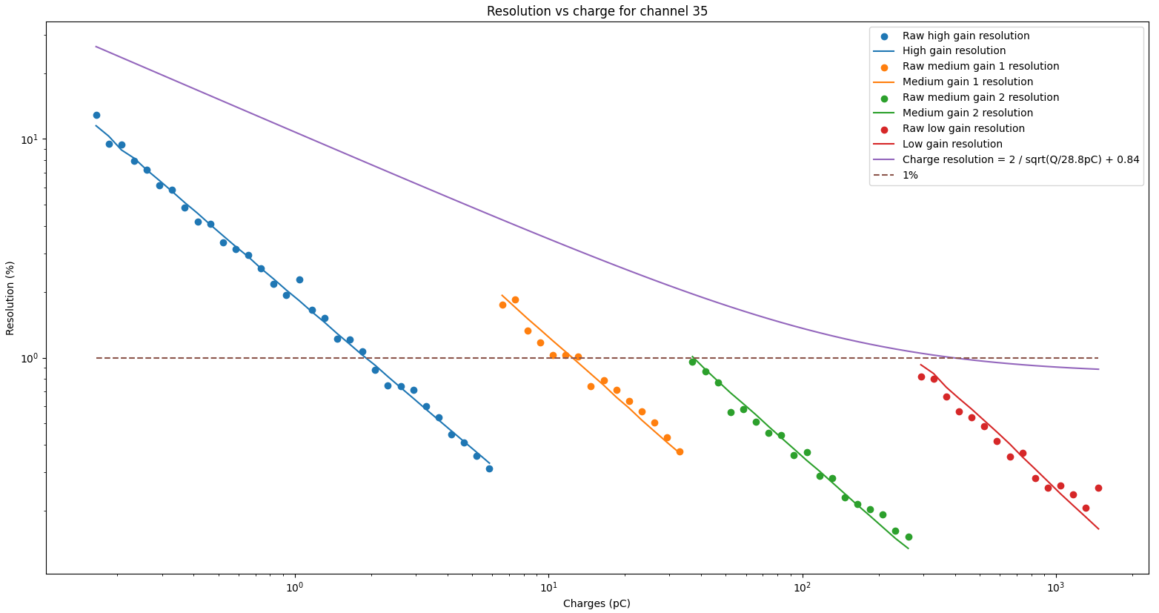
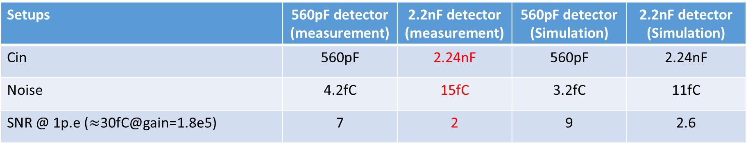
Charge resolution as a function of the charge (Cd = 2.2nF)
Resolution results:
  Medium gain 1 higher noise than expected (50% more than on the previous PCB).
  High gain has a lower gain than usual due to the slower injection signal.
  RMS noise under 1% of the signal for the medium gain 2 and low gain.
  RMS noise of 15fC in high gain
  1%
  10pC
Setups | 560pF detector (measurement) | 2.2nF detector (measurement) | 560pF detector (Simulation) | 2.2nF detector (Simulation)
Cin | 560pF | 2.24nF | 560pF | 2.24nF
Noise | 4.2fC | 15fC | 3.2fC | 11fC
SNR @ 1p.e ($≈$30fC@gain=1.8e5) | 7 | 2 | 9 | 2.6

Slide 6
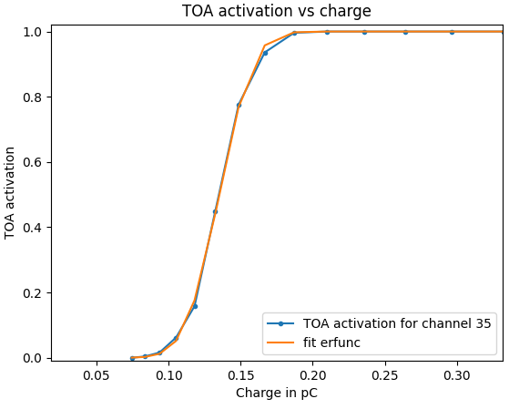
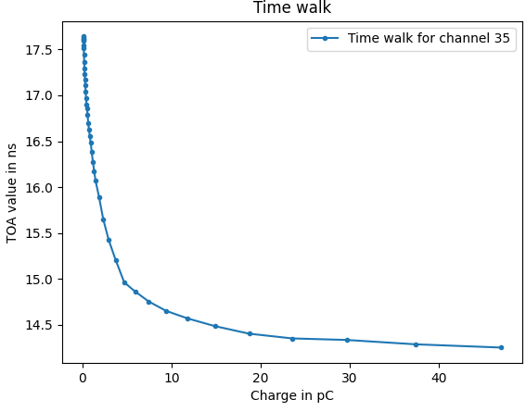
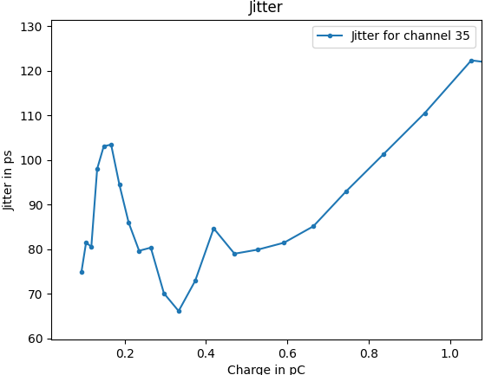
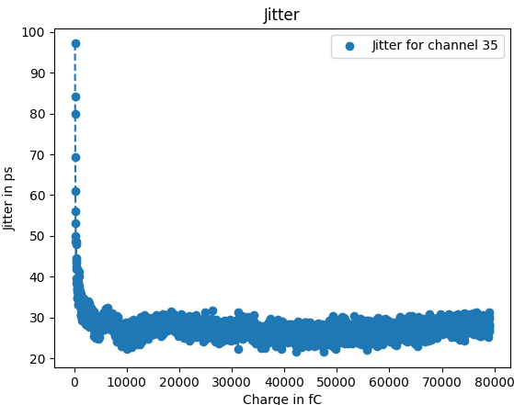
Timing measurements
External injection setup:
  2.2nF detector capacitance
  49pF injection capacitance
External injection results:
  TOA threshold at 180fC
  3ns Time walk
  Jitter under 100ps for the MIP (432fC)
  Jitter saturates at 125ps (it should saturate at 25ps)
Regarding the jitter issue:
  Jitter saturates at 5 times the expected value
  The error was identified and reproduced in simulations
  A fix has been proposed for CALOROC2
  When reducing the noise of the preamplifier (by reducing the gain), the jitter saturates at 25ps. This shows that the TDC is working correctly and that the issue is slew-rate related.
  MIP = 0.43pC
  Timewalk of 3ns
  Jitter of 25ps when noise is minimized.

Slide 7
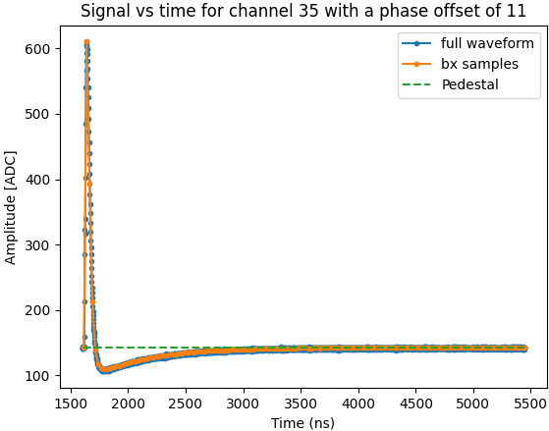
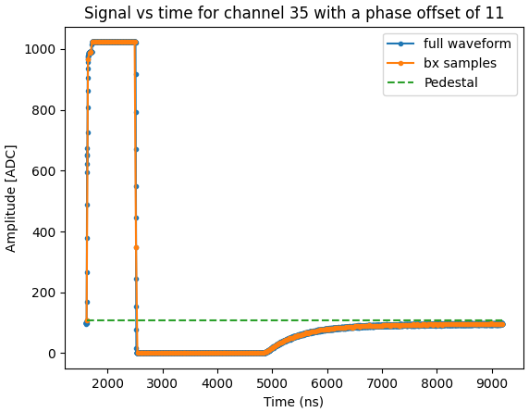

Time to baseline measurements
Time to baseline is given by the time constant $τ=R_{in}C_{det}=500ns$
Low charge inputs take up to 1$μ$s to go back to the baseline due to the undershoot.
For large signals over the dynamic range capabilities of the ASIC, the time to baseline can take up to 6$μ$s
Remainder: Per channel hit rate is 100kHz (10$μ$s)

Slide 8
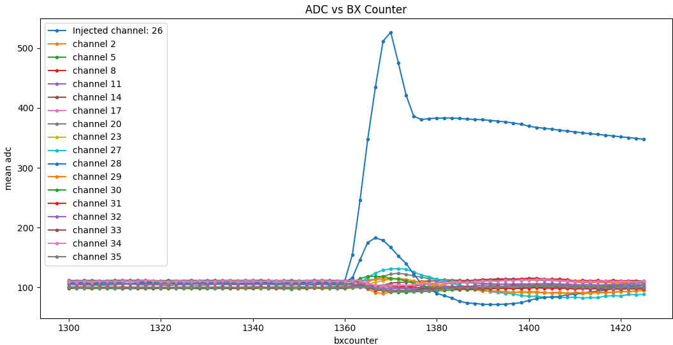
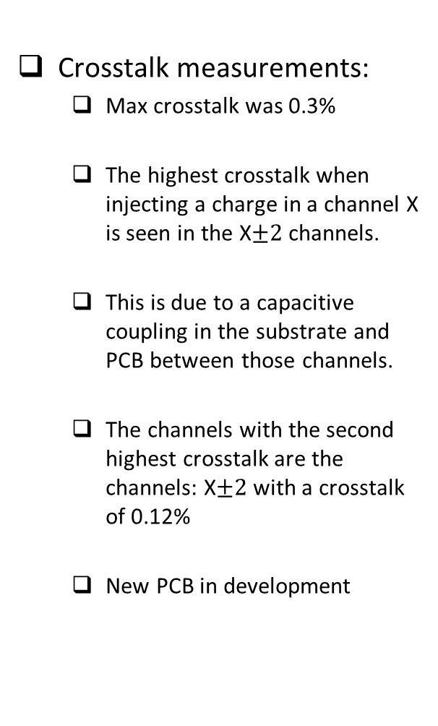
Crosstalk measurements
Crosstalk measurements:
  Max crosstalk was 0.3%
  The highest crosstalk when injecting a charge in a channel X is seen in the X$±2$ channels.
  This is due to a capacitive coupling in the substrate and PCB between those channels.
  The channels with the second highest crosstalk are the channels: X$±2$ with a crosstalk of 0.12%
  New PCB in development

Slide 9
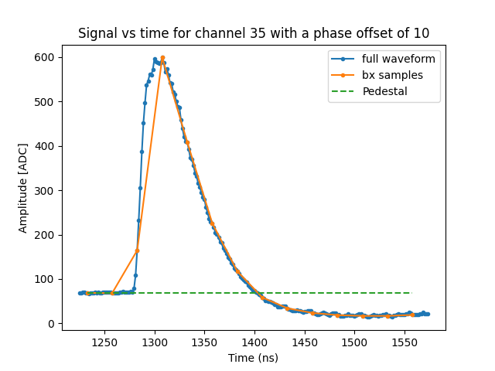
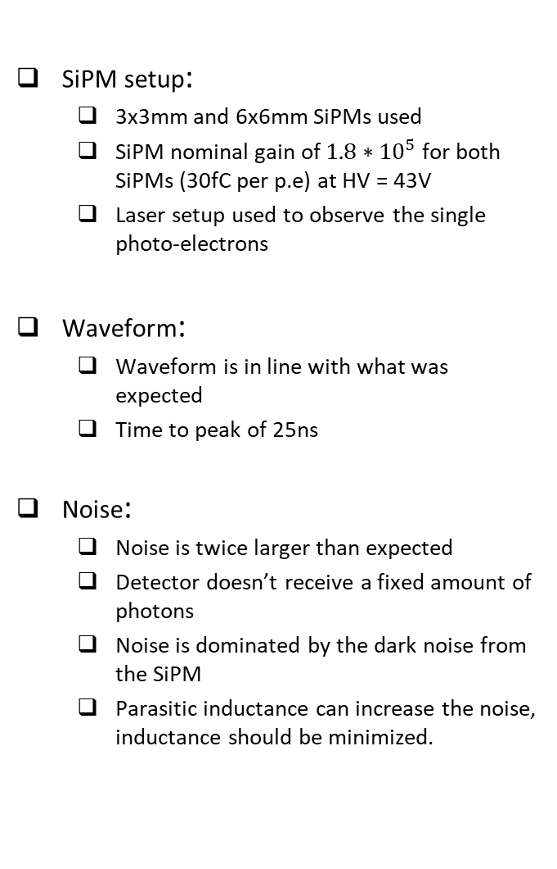
SiPM measurements
SiPM setup:
  3x3mm and 6x6mm SiPMs used
  SiPM nominal gain of $1.8∗{10}^{5}$ for both SiPMs (30fC per p.e) at HV = 43V
  Laser setup used to observe the single photo-electrons
Waveform:
  Waveform is in line with what was expected
  Time to peak of 25ns
Noise:
  Noise is twice larger than expected
  Detector doesn’t receive a fixed amount of photons
  Noise is dominated by the dark noise from the SiPM
  Parasitic inductance can increase the noise, inductance should be minimized.

Slide 10
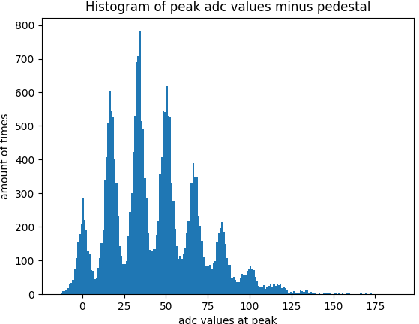
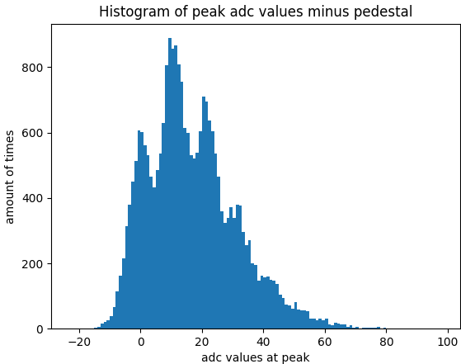
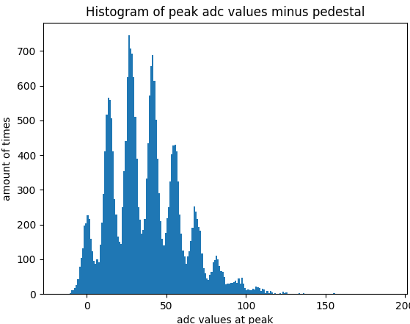
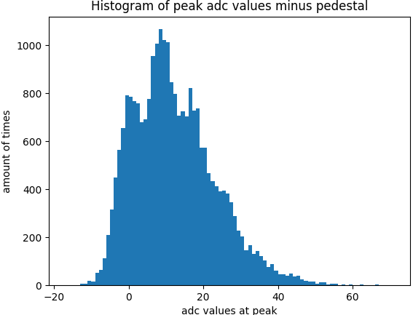
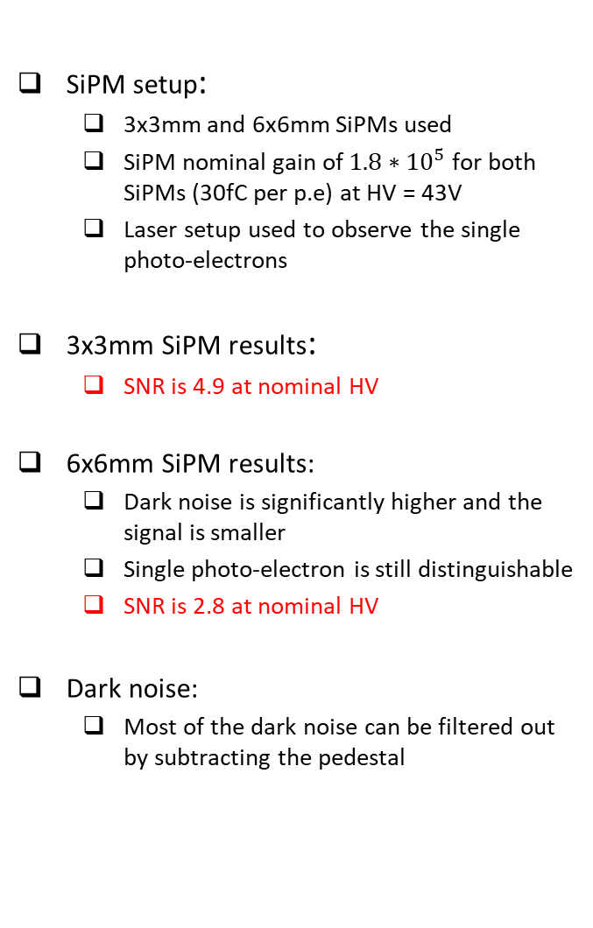
Single photo-electron measurements
SiPM setup:
  3x3mm and 6x6mm SiPMs used
  SiPM nominal gain of $1.8∗{10}^{5}$ for both SiPMs (30fC per p.e) at HV = 43V
  Laser setup used to observe the single photo-electrons
3x3mm SiPM results:
  SNR is 4.9 at nominal HV
6x6mm SiPM results:
  Dark noise is significantly higher and the signal is smaller
  Single photo-electron is still distinguishable
  SNR is 2.8 at nominal HV
Dark noise:
  Most of the dark noise can be filtered out by subtracting the pedestal
  3x3mm
  HV of 43V
  6x6mm
  HV of 43V
  3x3mm
  HV of 42V
  6x6mm
  HV of 42V

Slide 11
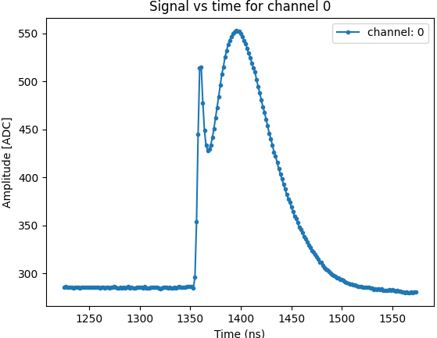
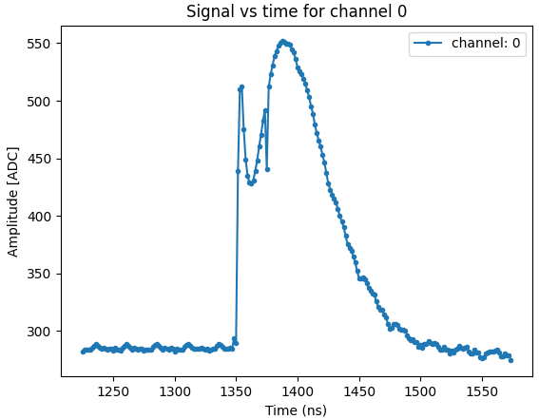
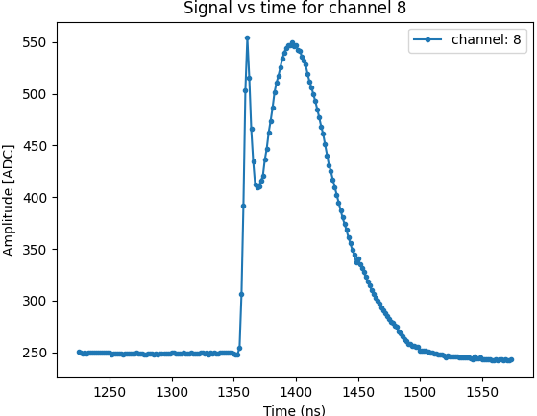
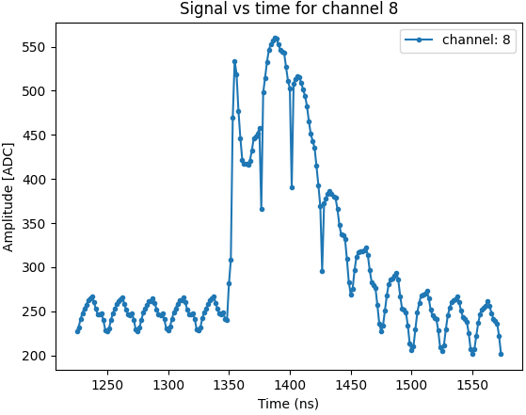
Current issues under study
Setup:
  Using the internal injection
Large digital noise:
  When doing a non-synchronized sampling, a large digital noise appears
  The noise correlates strongly with the routing of the channels in the PCB (layer 6 has more noise due to being close to the digital power layer)
Double peak at waveform:
  Only when doing the internal injection
  Issue related the parasitic inductance between the channel and the detector capacitance.
The issue is understood and related to the PCB, a new PCB is under development to solve this issue
FEB design should consider:
  Channels should be routed between gnd layers to avoid digital coupling
  Inductance should be minimized
  Synchronized sampling
  Non-synchronized sampling
  Synchronized sampling
  Non-synchronized sampling

Slide 12
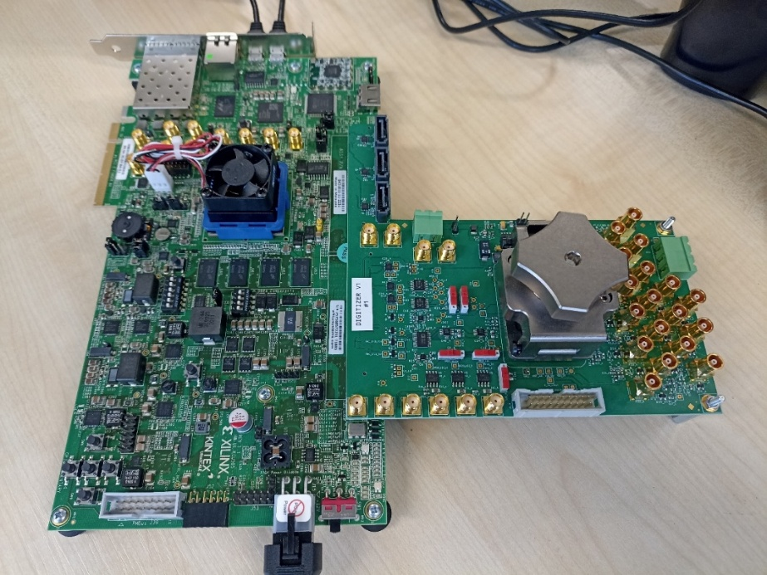
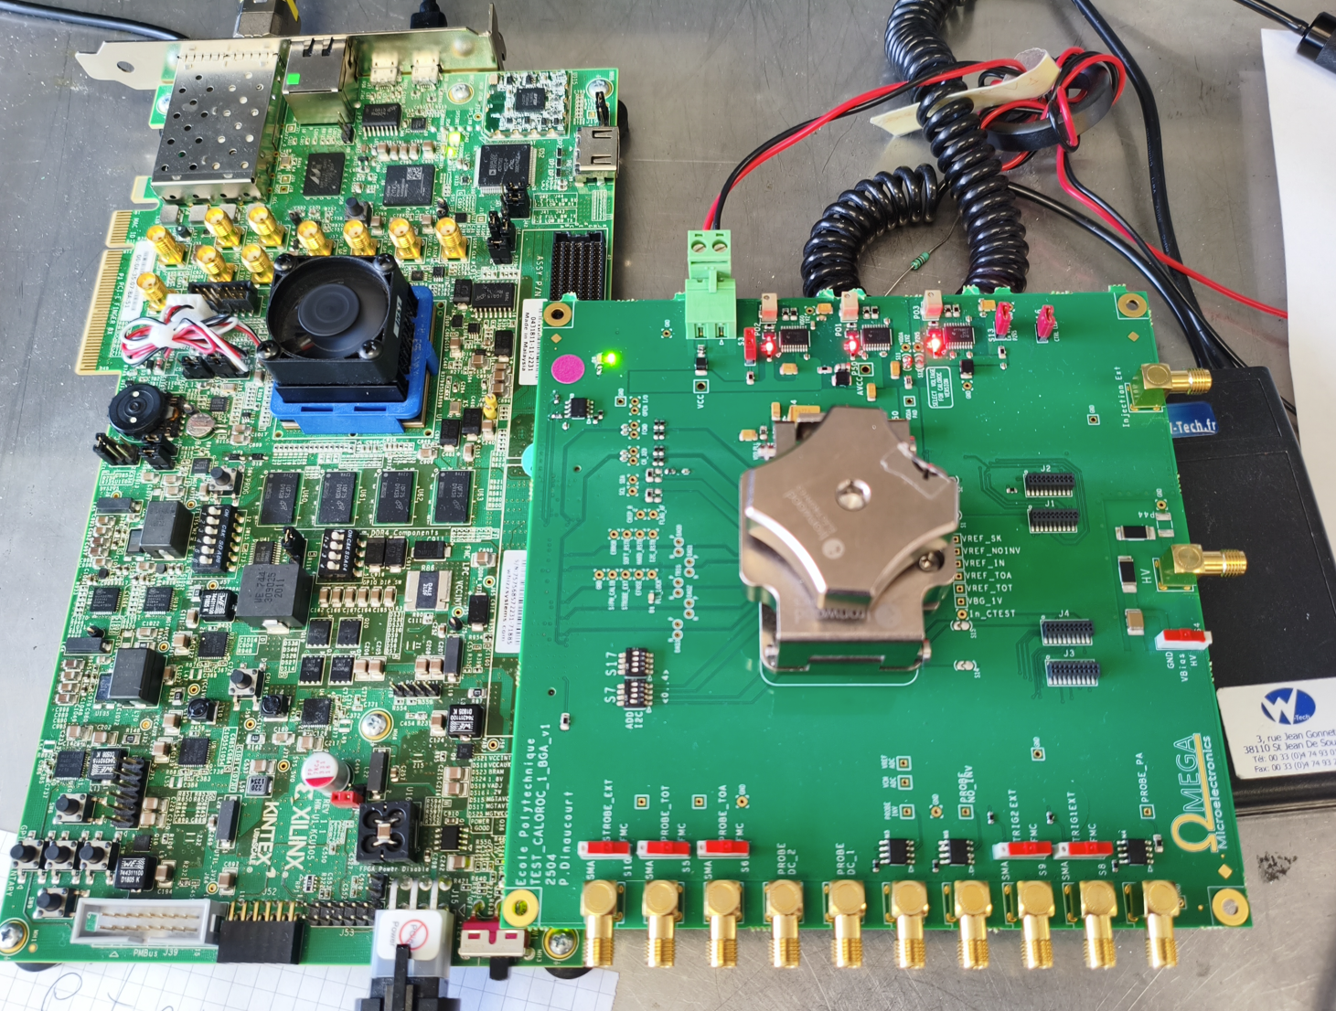
Summary and next steps
CALOROC-A analog measurements underway, first results similar to H2GCROC
CALOROC-B first measurements are encouraging:
  Dynamic range of 200fC up to 1.5nC using a 2.2nF detector
  Jitter under 125ps for all samples with a trigger efficiency of 1 (the origin of this error was identified and should be corrected for CALOROC2B)
  SNR of 5 using a 3x3mm SiPM and 3 using a 6x6mm SiPM, both with a gain of 30fC per photon
Possible actions for investigation
  New PCB in development, schematic already finished
  FEB crosschecks
  Zero suppress measurements and 39.4MHz tests
CALOROC2 timeline (next presentation)
  If TSMC130nm is available in March 2027
  Otherwise there would be a 12 to 18 month delay due to the migration to a new technology

Slide 13
Backup

Slide 14
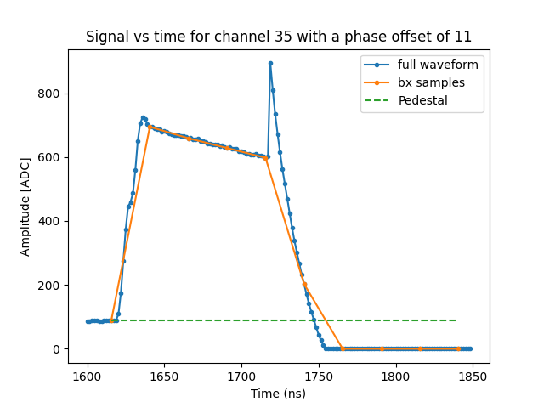
First gain switching waveform

Slide 15
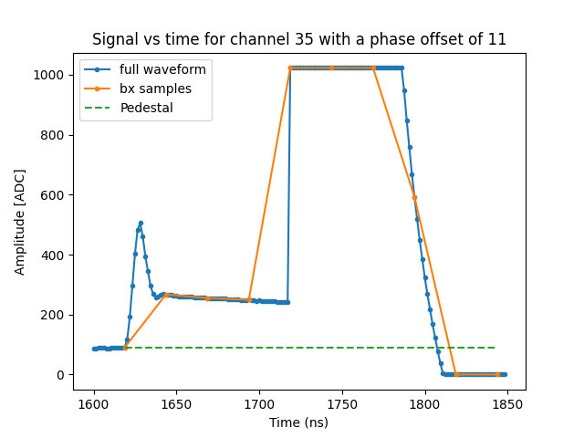
Second gain switching waveform

Slide 16
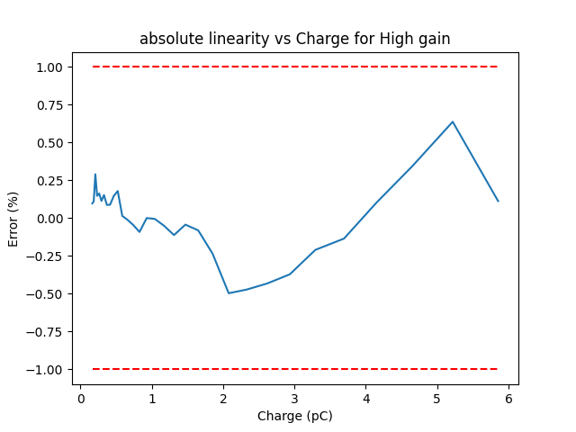
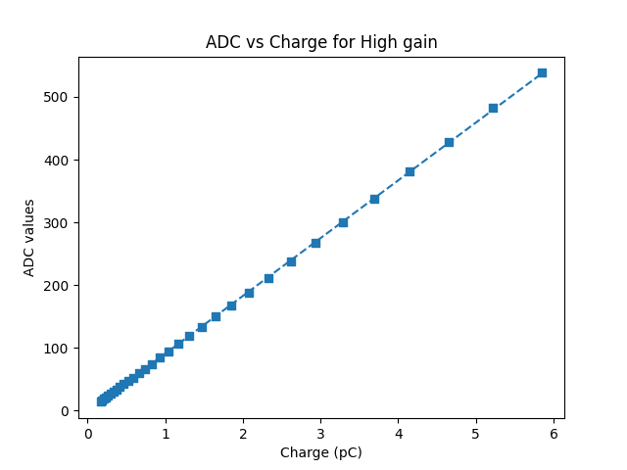
Absolute linearity for the high gain second point
We tested the linearity of the second point of the high gain waveform (after the peak) to see if the linearity is consistent for all the points of the waveform.
Amplitude is lower and nonlinearities are slightly higher, yet well within the requirements

Slide 17
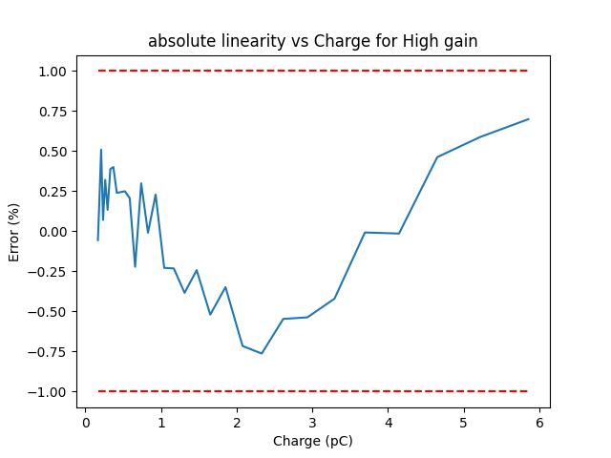

Absolute linearity for the high gain third point
Amplitude is even lower, yet we still keep a good linearity

Slide 18
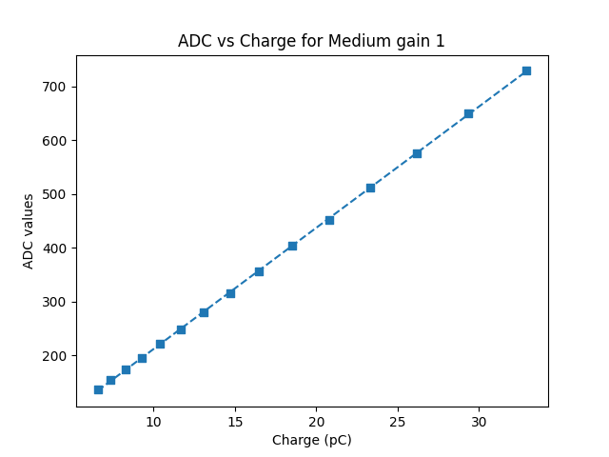
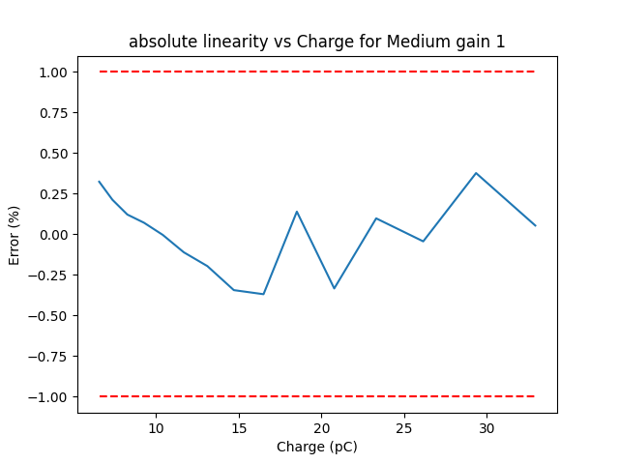
Absolute linearity for the Medium gain 1 third point
We did the same tests for the medium gain 1, 2 and low gain

Slide 19

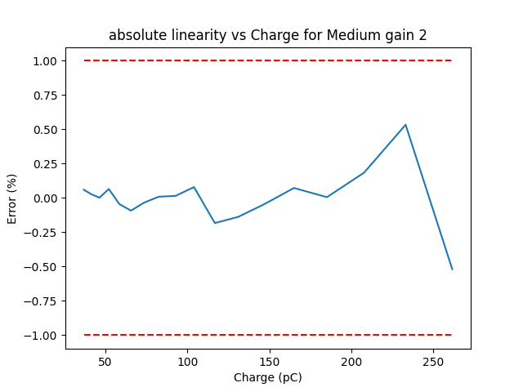
Absolute linearity for the Medium gain 2 third point

Slide 20
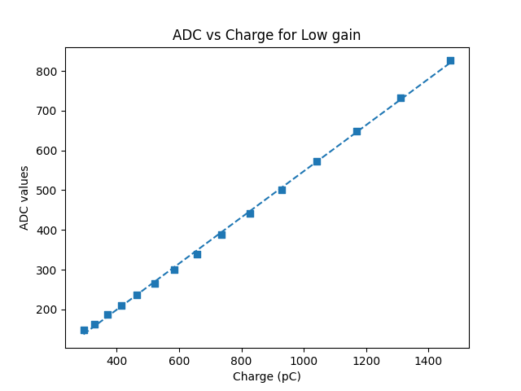
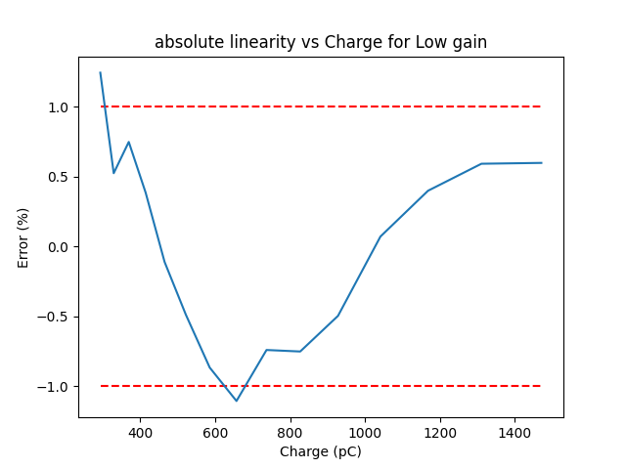
Absolute linearity for the Low gain third point

Slide 21
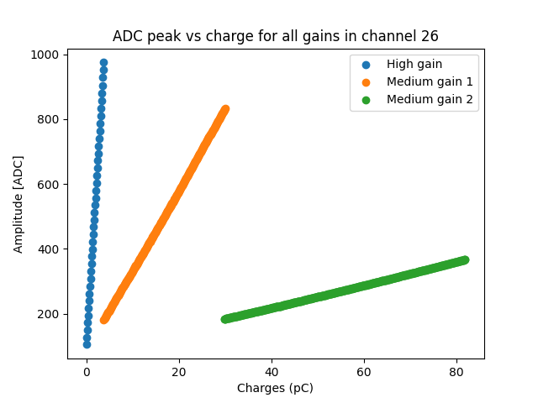
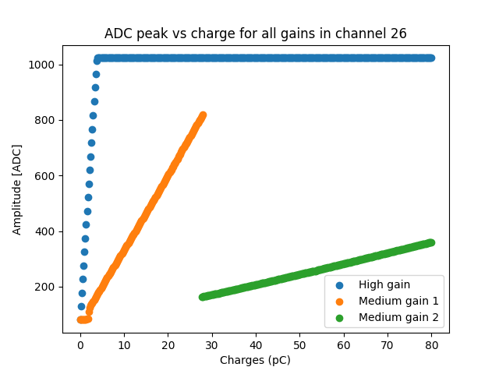
2ADC mode
Using the 2ADC mode with the first ADC set to HG and the second ADC set to the gain switching we obtain similar results with the addition of an overlap for low charges.
For low charges the second ADC show some nonlinearities, which is expected due to the resistance switching.
1ADC mode
2ADC mode

Slide 22
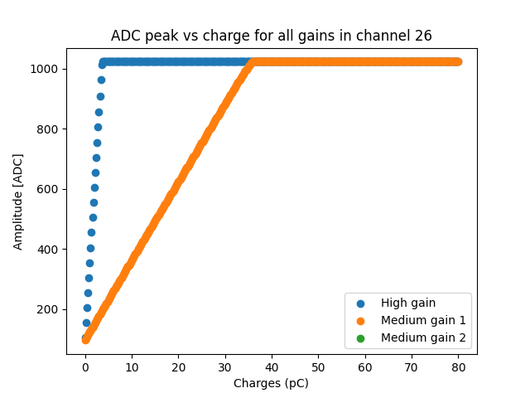
2ADC mode without gain switching
The “no gain switching” mode was tested, we keep a good linearity although the dynamic range is quite limited.

Slide 23
Short term plans regarding the technology issue
Prepare CALOROC2 in TSMC 130nm (just in case)
  If TSMC 130nm is still available we will have a CALOROC2 prepared for submission by march 2027
UMC 110nm:
  NDA was signed in preparation for a possible technology shift
  If UMC 110nm is chosen we expect an 18 month delay
  Rad hard only up to 1 Mrad
TSMC 65nm:
  PDK already available
  All programs installed for being able to start working using the 65nm
  If TSMC 65nm is chosen we expect a 12 month delay
  Price is 2.5 times more expensive
  We may risk having the same issues as with TSMC 130nm

