Slide 1
GTU updates
ePIC DAQ introduction
ePIC GTU design
The ePIC DAQ setup
Some test results
Works to do

Slide 2
ePIC
1. ePIC DAQ introduction - general structure
System Clock: 19.7 MHz
GTU: Global Timing Unit
  control encoding, status decoding.
  The interface for machine clock source,
  Data acquisition control and monitor etc.
DAM: Data Aggregation Module: (FLX155)
  The clock/control fan out, and status/busy accumulation.
  local control over the RDO boards connected, though the main function of the DAM is for Data Acquisition.
RDO: optical interface of detector ReaDOut
  control decoding, status encoding.
  The clock/control interface to the frontend electronics.
  Data collection from Frontend boards, and data transmission to the DAM
FEB:
  Detector dependent Front End / ASIC carrier boards.
Online computer
Status
GTU
GTU (O)1
Control
EIC
Common
Platform
Clock
Data Acquisition
DAM
(O)100
DAM
DAM
RDO
(O)1000
RDO
RDO
RDO
RDO
FEB
FEB
FEB
4

Slide 3
1. ePIC DAQ Introduction - Detailed signal implementations
1.1 Clock Distribution
EIC
common platform
RunControl computer
1.2 RunControl and DAQ
Ethernet
PCB and fanouts:
Additive Jitter <1ps
Phase: fixed
System clock
(98.5MHz in, 19.7 MHz out)
two-level fanout
Beam orbit
Beam Orbit synchronized RunControl
RunControl: Run_Start/Stop, Run_type, config, Reset, Synchronization, SRO time_start/stop, Throttling…
GTU
Status: Buffer busy, out of sync …
Fiber cable (one per DAM):
Additive Jitter <1ps
Phase: fixed
(two fibers per DAM):
control/Downlink, Data_Status/uplink
Host PC
DAM to PC: 2xPCIe5x8, DAM to switch: 100 GBE
PCB and fanouts:
Additive Jitter <1ps
Phase: fixed
Clock reconstruct
(& jitter cleaner)
DAM
Control config, status
DAQ
RunControl: forward or ‘hijack’ the GTU control;
DAM, RDO, FEB/ASIC configuration, readout backpressure
RefClk
TX/RX
Status: Buffer, sync, etc.
GTY
Optic fiber cable:
Additive Jitter <1ps
Phase: fixed
(two fibers per RDO):
control/Downlink, Data_Status/uplink
GTY REC Clock:
Or LpGBT rec clock
Clock recovery
(iitter cleaner)
Clock fanouts
RefClk
TX/RX
Control
Config
DAQ
Config synchronized with beam orbit, FEB/ASIC readout and control
RecClk
GTY
RDO
Status: Buffer, sync, etc.
FEB/ASIC
DAQ time slice/window aligned
Beam Crossing phase aligned

Slide 4
2. ePIC GTU Design - The ePIC clocks:
Single clock source, distributed to the whole system
* * * * * * * *
* * * * * * * *
* * * * * * * *
1 1 1 1
1 1 1 1 1 1 1 1 1 1 1 1
1 1 1 1
2 2 2 2
1 1 1 1 1 1 1 1 1 1 1 1
2 2 2 2
EIC_beam_orbit
5 5 5 6
5 5 5 5 5 5 5 6 6 6 6 6
5 5 5 6
Beam crossing: 98.5MHz
Orbit period: 12.7886 µs
7 8 9 0
1 2 3 4 5 6 7 8
3 4 5 6 7 8 9 0 1 2 3 4
7 8 9 0
1 2 3 4
1160 (all or 1/4 with beam)
100 (no-beam /gap)
EIC_BX_Clock, 98.5 MHz
GTU→DAM, 19.7 MHz
(Frequency divided by 5)
ePIC system clock
252 clock_cycles per Orbit
Fixed delay (divider, cable, PCB delays)
The phase (divider) is determined by the orbit information
39.4 MHz
DAM rec. Clock
98.5 MHz
others
n*252 clock_cycles per Orbit
All the reconstructed clocks are synchronized (same frequency, fixed phase)

Slide 5
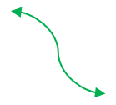
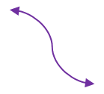
2. ePIC GTU Design - run-control (downlink) and Data/status (uplink)
ePIC system clock
(19.7 MHz)
GTU→DAM
GP_{N+1}
GP_{N-1}
GP_{N}¹
GP_{N}²
GP_{N}³
GP_{N}⁴
GP_{N}⁵
GP_{N}, Five 64-bit words, 8b/10b encoding, ➔ 7.88 Gbps, 320-bit per ePIC system clock cycle
DAM → LpGBT (39.4 MHz)
DgP_{N-1}
DgP_{N}¹
DgP_{N}²
DgP_{N+1}
DgP_{N}
LpGBT and VTRx+ dictated package format, extracted (repackaged) from GP_{N}
DAM → RDO (non-LpGBT) (98.5 MHz for example)
DrP_{N-1}
DrP_{N}¹
DrP_{N}²
DrP_{N}³
DrP_{N}⁴
DrP_{N}⁵
DrP_{N+1}
DrP_{N}
RDO dictated package format, extracted (repackaged) from GP_{N}

Slide 6
2. ePIC GTU Design - DAQ partition (multiple run-control support)
Hardware: Each MGT transceiver corresponds to one DAM. It can be ‘controlled’ independently.
Firmware: supports 32 run-control processes, (ID#0-31), with ID#0 and #31 reserved for global run.
Software: to be developed
Run-control-N requests for a new system ID (1 to 30) by reading the sub-system (bookkeeping) register (32-bit, offset 0x200) from GTU, and set the bit#ID to ‘1’ (means that subsystem#ID is being used);
Run-control loads the corresponding DAM/MGT with the sub-system ID. (the DAM/MGT with the same ID numbers belong to the same sub-system, and controlled by the run-control-N, N and ID can be different);
The ID will be propagated from the GTU_MGT to the corresponding DAM via the GTU_DAM downlink;
The DAM remembers its sub-system ID, and direct the data to run-control-N;
At the end of run-control-N, release the DAM/MGT by unloading the sub-system ID (reverse the step#2 above), release the subsystem ID (set bit#ID to ‘0’ in sub-system bookkeeping register, reverse the step#1 above).
Maximum sub-system can be running simultaneously: 30
Number of DAMs per sub-system: min: 1, max: 148 (not to overlap with other sub-systems)

Slide 7
2. ePIC GTU Design - DAQ partition (multiple run-control support)
Firmware implementation:
One 32-bit sub-system (bookkeeping) register (offset 0x200) in GTU;
One set of Beam-crossing counters (64-bit, up to 4000 years), beam-crossing number within the orbit (11-bit, from 0 to 1159), and the first beam-crossing signal (BX0) in the orbit;
32 (sub system ID#0~31) sets of: orbit counters (32-bit, up to 14 hours), streaming time intervals (or windows, 14-bit at 19.7 MHz, up to 800 µs), streaming START/STOP/PAUSE etc.
Sub-system ID tagged run control command (8-bit code, run-start, run-stop, various resets etc.), which affects the DAM with the specific ID only.
RUN_CONTROL_USER_0
GTU_FPGAs
CROSS-POINT
switch
MGT/DAM_1
RUN_CONTROL_USER_1
MGT/DAM_2
RUN_CONTROL_USER_2
MGT/DAM_148
RUN_CONTROL_USER_31

Slide 8
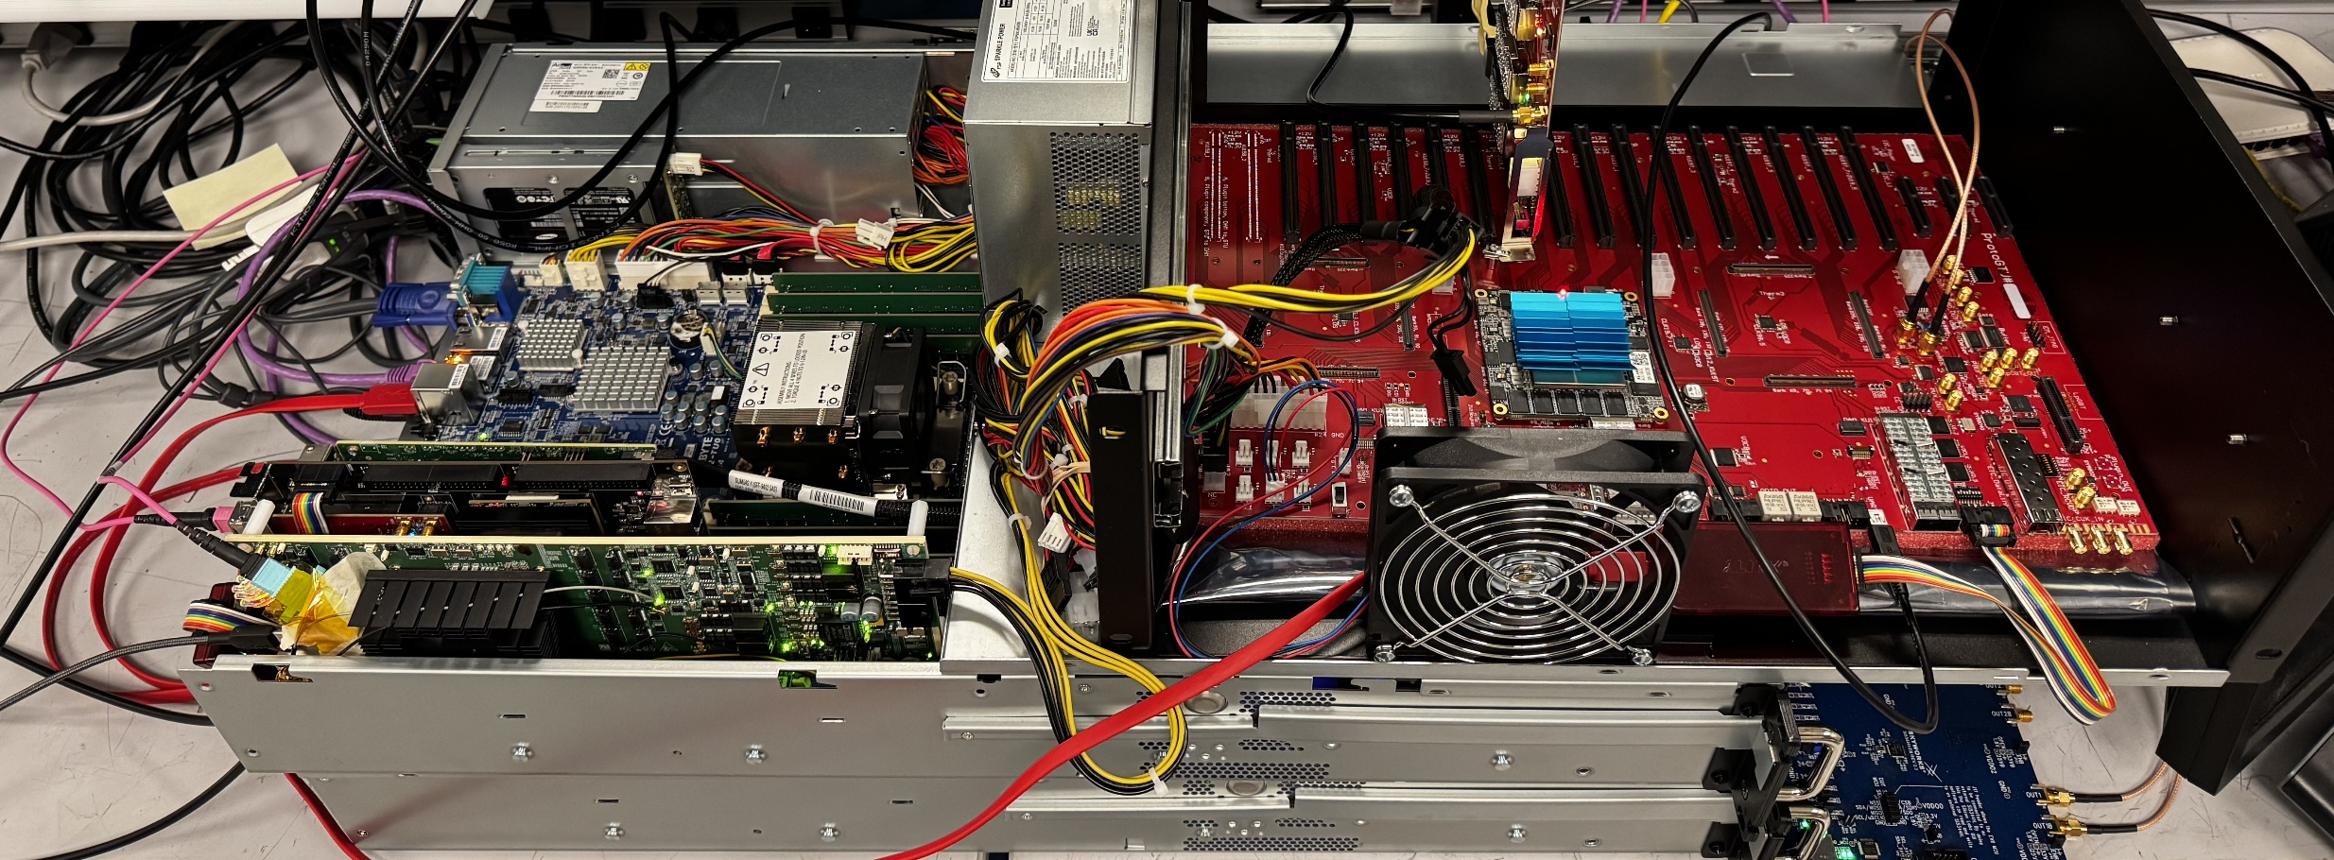
3. The ePIC DAQ setup - at BNL (510_1-231)
protoGTU
opticPlugInGTU
JTAGcables
GTU02.phy.bnl.gov
GTU01.phy.bnl.gov
FLX155a
FADEonAXU15
Si5344H

Slide 9
3. The ePIC DAQ setup - at BNL (510_1-231)
AlmaLinux 10
/tools/Xilinx/Vivado & Vitis 2024.1 license @maia.phy.bnl.gov
/data/PCIeControl/Axu15DAM on GTU02 xdma software/driver
/data/fpga_v2024/GTUzu19 on GTU01 xczu19EG firmware
Axu15DAM on GTU02 xcau15p firmware
Flx155DAM on GTU02 xcvp1552 firmware
GTU01.phy.bnl.gov
GTU02.phy.bnl.gov
USB
JTAG
USB
UART
USB
JTAG
PCIe3x4
USB
(JTAG)
PCIe4x8
PCIe4x8
Si5344H
Clock
protoGTU
FADEonAXU15
FLX155
opticPlugInGTU
MTP fibers
Implemented
To be implemented
RDOs
RDOs

Slide 10
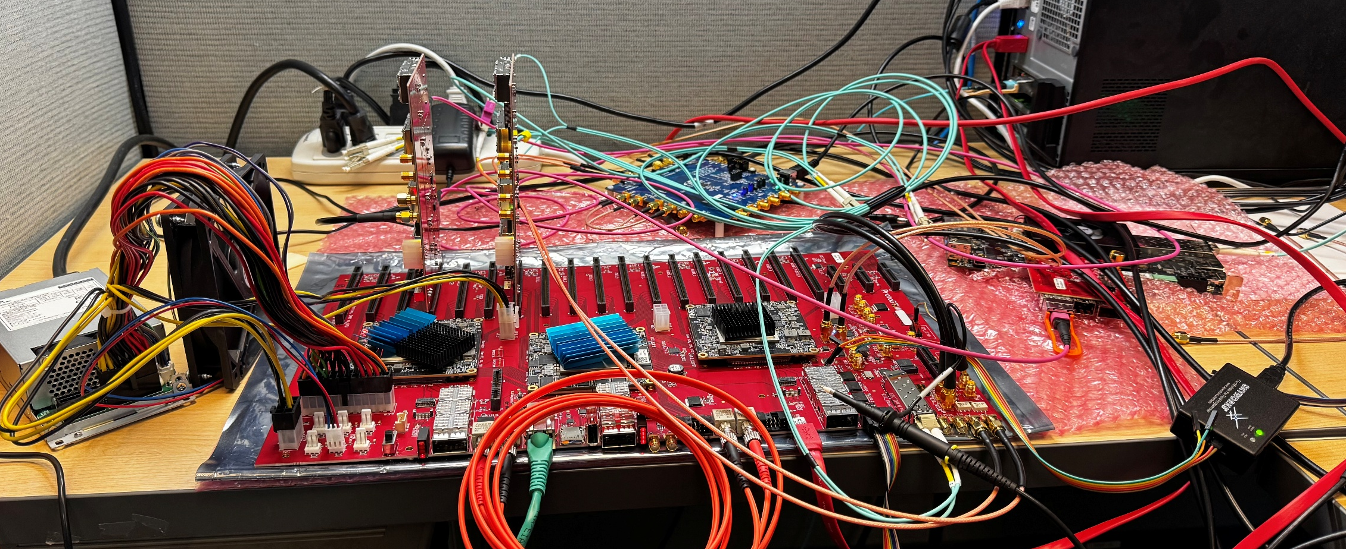
3. The ePIC DAQ setup - at JLAB (to be moved to CC/F109)
Si5394A
FLX182
gu-pc2.jlab.org
opticPlugInGTU
protoGTU
JTAGcables
GBE
UART
FADEonAxzu5

Slide 11
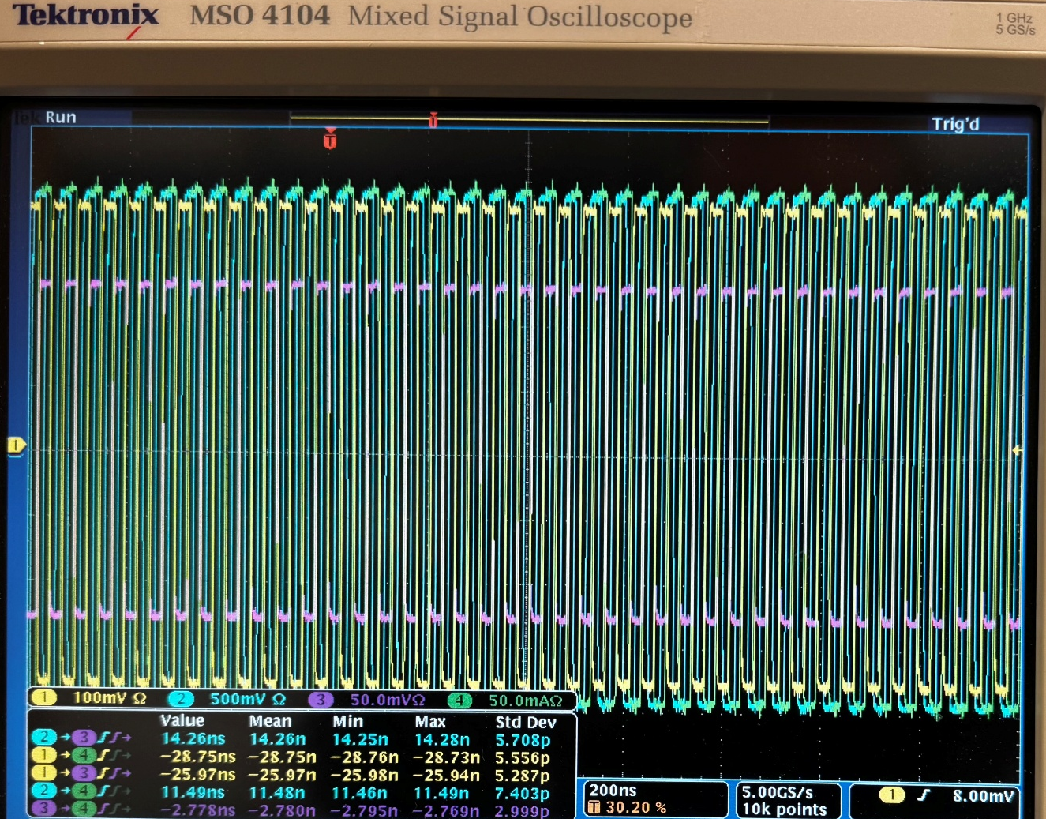
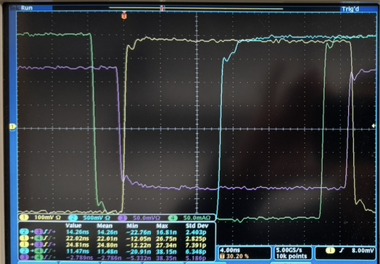
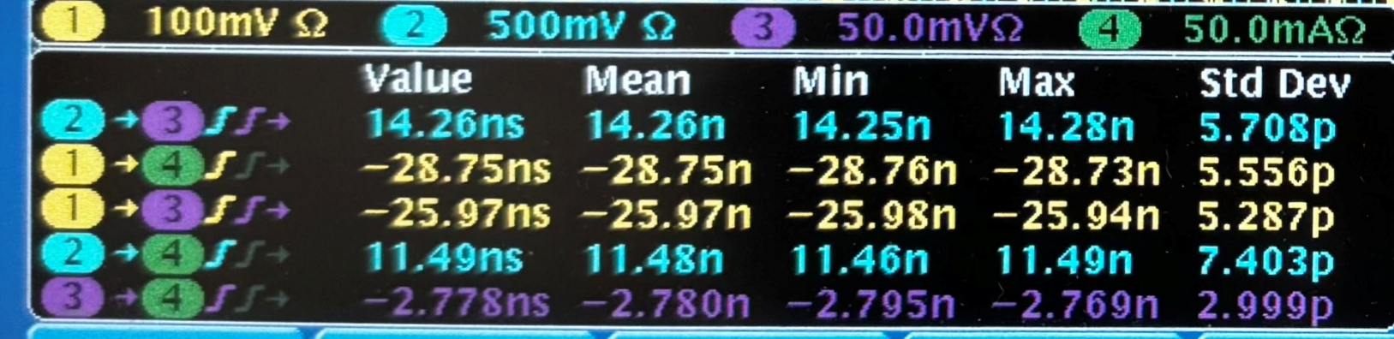
4. Some test results - Clock distribution
Measurement @ Mar. 27, BNL
Oscilloscope 5 GS/s ➔ 200 ps sampling
DAM clock
FLX155a
CH#3
EIC clock
SI5344H
CH#1
ePIC Clock
GTU
CH#2
DAM clock
FADE
CH#4

Slide 12
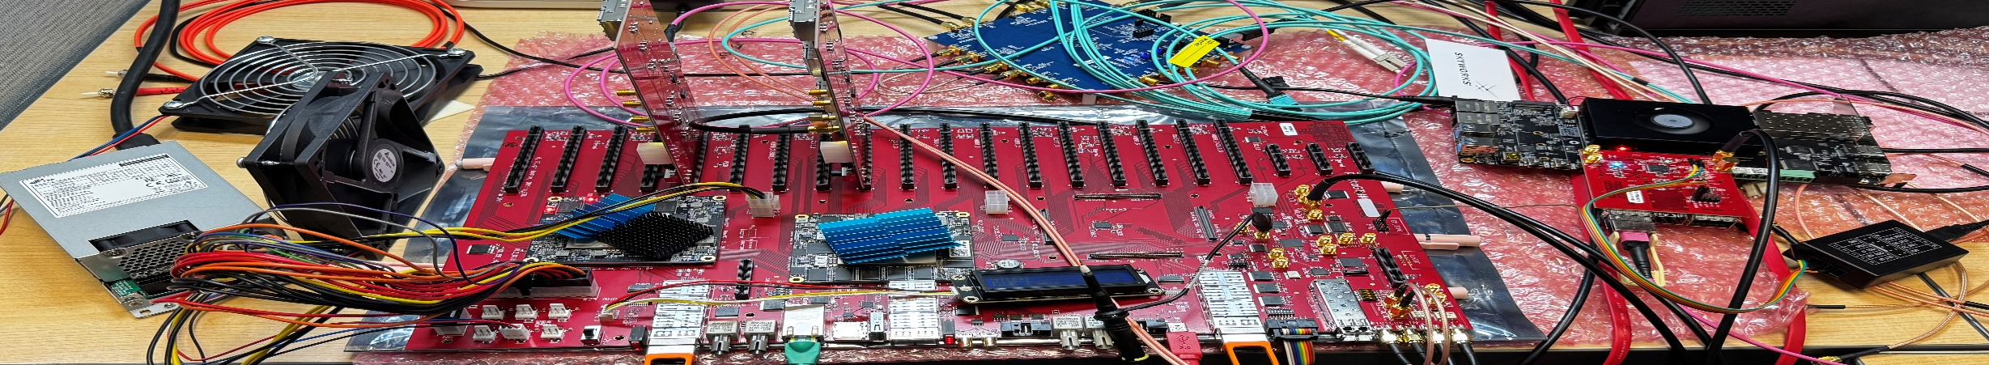
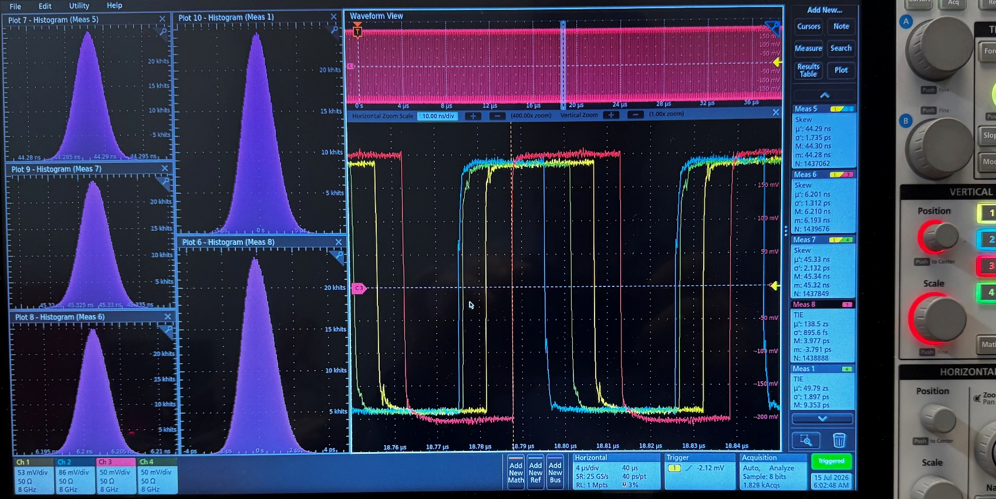
4. Some test results - Clock distribution
Measurement @ July 15th, Jlab
Oscilloscope 25 GS/s
‘EIC’ clock
SI5394A
CH#1
Single ended
50 Ω clock receiver
Differntial
100 Ω clock receiver
Mux and fanout
Clock divider
AD9510
Jitter cleaner MGT clkRef
SI5395A
Clock fanout
SI53302/GTU
SI53302/optic
DAM
(FLX155a,
FADE…)
98.5M
98.5M
98.5M
19.7M
19.7M
(40/60)
(50/50)
19.7M
CH#2
CH#3
CH#4
CH#3
ePIC system clock (19.7 MHz) from GTU (to DAM):
CH#4: TIE: σ = 1.9 ps, FWHM: 4.5 ps
Latency of CH#4 vs CH#1: Phase stability:
  45.328ns ± 2.1 ps, FWHM: ~6 ps
ePIC system clock (19.7 MHz) recovered on (FADE) DAM:
CH#3: TIE: σ = 0.9 ps, FWHM: ~2 ps
Latency of CH#3 vs CH#1: Phase stability:
  6.2015ns ± 1.3 ps, FWHM: ~4.5 ps
Clock divider AD9510 output:
  CH#2: 44.288 ns ± 1.7 ps, FWHM: ~4.5 ps
GTU Jitter cleaner and clock synthesizer SI5395 output:
  CH#3: 21.0162 ns ± 1.36 ps, FWHM: ~4 ps
The system clock divider (98.5 MHz/5) works

Slide 13
4. Some test results - GTU → DAM communication (Downlink)
packet | One packet at 19.7 MHz, (or five 64-bit words at 98.5 MHz)
Word# | 1 | 2 | 3 | 4 | 5 | five words per package
Bit(7:0) | K28.1_3C 0011111001 | K28.2_5C 0011110101 | K28.3_7C 0011110011 | K28.4_9C 0011110010 | K28.5_BC 0011111010 | Bit alignment, word alignment, and packet alignment
Bit(15:8) | GTU_RC | GTU_RC | GTU_RC | GTU_RC | GTU_RC | Synchrnous Run_control codes
Bit(31:16) | BX(15:0) | OrbitC(31:0) |  | SRO_T(13:0) | BX(63:16), Orbit(47:16), etc. Global and subsystem counters
Bit(36:32) | subSysID | subSysID | subSysID | subSysID | subSysID | Partition this DAM to subsystem (ID) run-control
Bit(63:37) | USER | USER | USER | USER | USER | Extras
GTU_RC: 8-bit codes for BX_0, Data Acquisition START, STOP, Sync_RESET, SRO_TIME etc.
The data are 8b/10b encoded, which results in 7.88 Gbps downlink,
This is tested with the fiber loopbacks : port_A_Tx → port_A_Rx;
                port_A_Tx → port_B_Rx, port_B_Tx → port_A_Rx;

Slide 14
4. Some test results - GTU → DAM communication (Downlink)
ePIC system clock
(19.7 MHz)
GTU_Tx
GP_{N-1}
GP_{N}¹
GP_{N}²
GP_{N}³
GP_{N}⁴
GP_{N}⁵
GP_{N+1}
DAM_Rx (7.88 Gbps)
GP_{N-1}
GP_{N}¹
GP_{N}²
GP_{N}³
GP_{N}⁴
GP_{N}⁵
GP_{N+1}
GP_{N}¹
DAM_Parallel (19.7 Mbps)
GP_{N}²
GP_{N-1}
GP_{N}³
GP_{N+1}
GP_{N}⁴
GP_{N}⁵
DAM to LpGBT (2.56 Gbps)
LpGBT_GP_{N-1}
LpGBT_GP_{N}¹
LpGBT_GP_{N}²
LpGBT_GP_{N+1}
DAM to non-LpGBT (RDO) (6.4 Gbps)
RP_{N-1}
RP_{N}¹
RP_{N}²
RP_{N}³
RP_{N}⁴
RP_{N}⁵
RP_{N+1}
* To be implemented and tested (98.5 MHz instead of 40 MHz ➔ 6.4 Gbps)

Slide 15
4. Some test results – GTU, zynqMP
ARM-cortex-A53, quad core with 4/5 GB DDR4 memory
Gigabit Ethernet: DHCP to Jlab’s DAQ network;
UART: serial port terminal emulator;
JTAG: ZU19EG, KU15P firmware loading, logic analyzer;
USB2.0 with type A connector;
32 GB EMMC;
SD (TF) card reader;
PS-QSPI, PS-SPI (clock divider AD9510 setting)
PS_I²C-0, PS_I²C-1 (GTU thermistor readout, QSFP status readout, EEPROM R/W…)
Character display with I²C control
All these features are tested, and working

Slide 16
5. Works to do
5.1: to test/debug the chip-to-chip communication between the zynqMP (zu19eg) and the KU15p FPGAs;
5.2: to implement the GTU downlink receiving firmware in DAM (flx155a, flx182, FADE, etc.);
5.3: DAQ software development (on the two hardware setups);
5.4: sub-system run-control test;
5.5: to connect with real RDO (with or without LpGBT chip);
5.6: to make a clock phase monitoring board.

Slide 17
Thank you

Slide 18
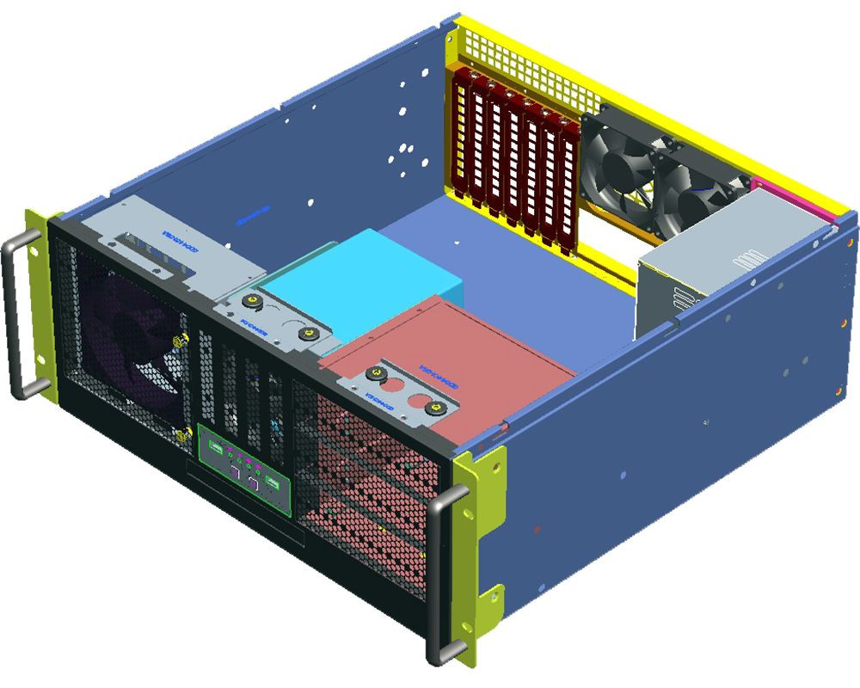

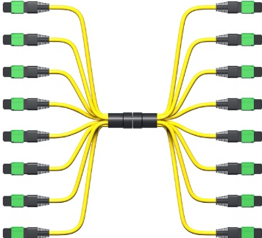
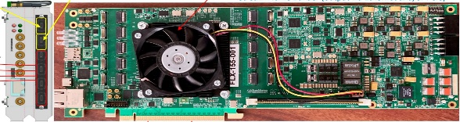
GTU
Up to 144
4U tall, 19” rack mounted
DAQ Room-air cooling
GTU base board
Optic transceiver adaptor boards
Clock monitor board
DAM

Slide 19
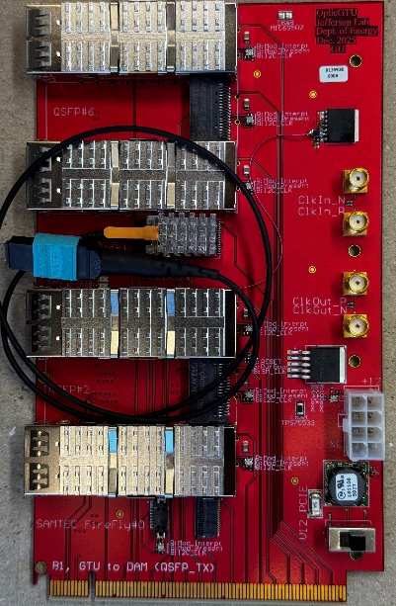
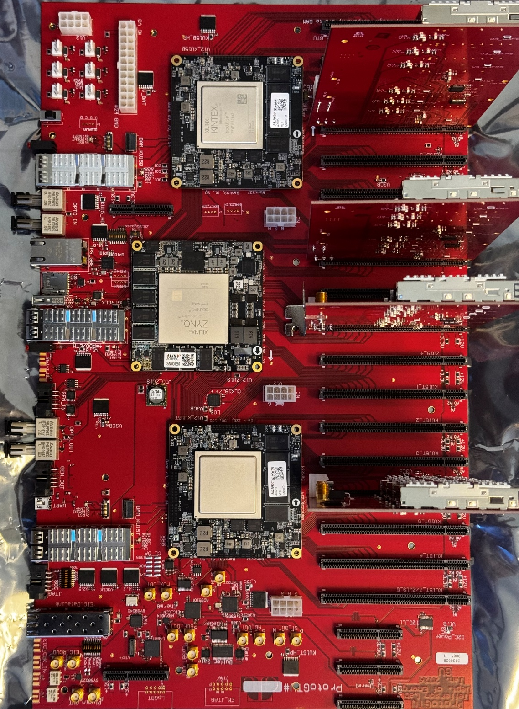
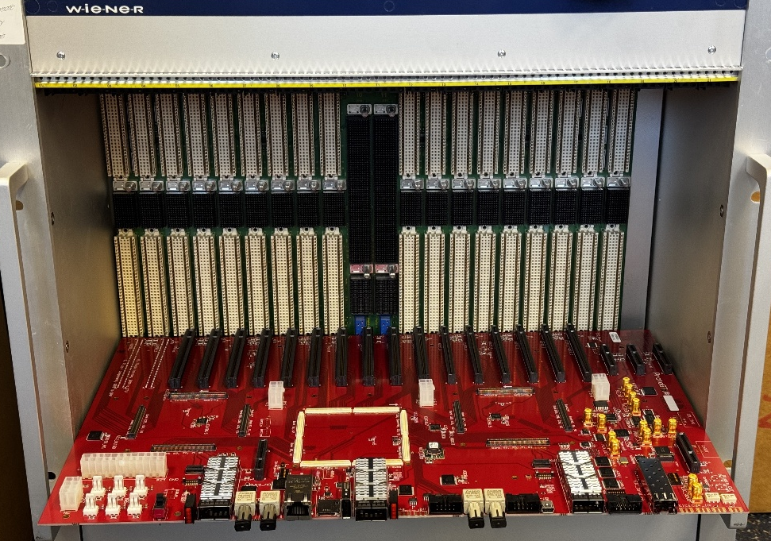
ProtoGTU

Slide 20
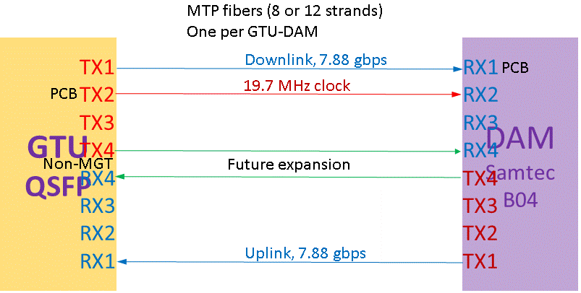
GTU functional requirements
GTU required:
EIC common platform interface;
Run Control;
~150 DAM interface
Risk mitigation:
Beam vs clock phase monitoring;
Dedicated clock fanout
Dest#1
Dest#2
Dest#600
Between GTU and DAM (Quad LTI)
Same-length Multimode fibers: 4 Tx/4 Rx (inexpensive, standard, commercially available)

Slide 21
DAM control link (downlink/uplink)
XCKU15P
2 x DAM
2 x MGT
4 x d_IO
Plugin Cards for 144 DAM
XCZU19EG
1 x MGT
40 x IO
52 x MGT
104 x d_IO
Supports:
148 DAM
4 RDO (or 40GBE)
40 x MGT
80 x d_IO
40 GBE
Or 4 x RDO
4 x MGT
XCKU15P
52 x MGT
104 x d_IO
1 x MGT
40 x IO
2 x MGT
4 x d_IO
2 x DAM

Slide 22
The actual implementation of DAQ partition (multiple subsystem run-control)
RUN_CONTROL_USER_0
KU15P_A
FPGA
MGT/DAM_1
RUN_CONTROL_USER_1
MGT/DAM_2
RUN_CONTROL_USER_31
MGT/DAM_54
ZU19EG
zynqMP SoC
MGT/DAM_55
RUN_CONTROL_USER_0
RUN_CONTROL_USER_1
MGT/DAM_56
MGT/DAM_94
RUN_CONTROL_USER_31
RUN_CONTROL_USER_0
KU15P_B
FPGA
MGT/DAM_95
RUN_CONTROL_USER_1
MGT/DAM_96
RUN_CONTROL_USER_31
MGT/DAM_148

Slide 23
Clock monitoring (another GTU plugin module)
Clock
Fanout
(4)
QSFP opticTRx
(2)
Clock_A
(1)
(2)
Clock_B
(12)
FPGA (SOM)
Clock phase measurement
Clocks’ phases
Clock
Fanout
(10)
FireFly opticTRx
(1)
Clock_C
Fiber loopback, either the spares between GTU and DAM, or the spares between DAM and RDO
Clocks from the GTU base board, and the phase measurement results to the GTU base board

Slide 24
Beam pickup signal: stand alone PCB design
GTU: Phase Correction
PhaseOrbit (average)
RF-SoC (?)
Phase adjustment:
Si5395 (I2C) : ~70 ps steps
AD9510 (SPI) : ~25 ps steps
Phase#1
Phase#2
Phase#1160
Phase#1
RDO(area) Clock
e⁻ Beam pickup

Slide 25
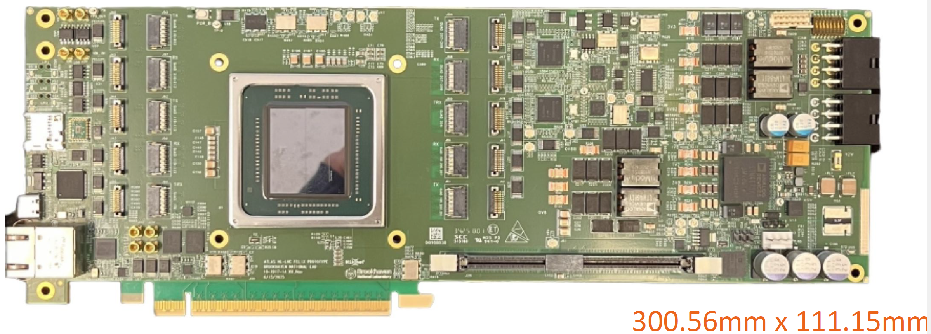
FLX155a – without the Firefly modules and front panel

Slide 26
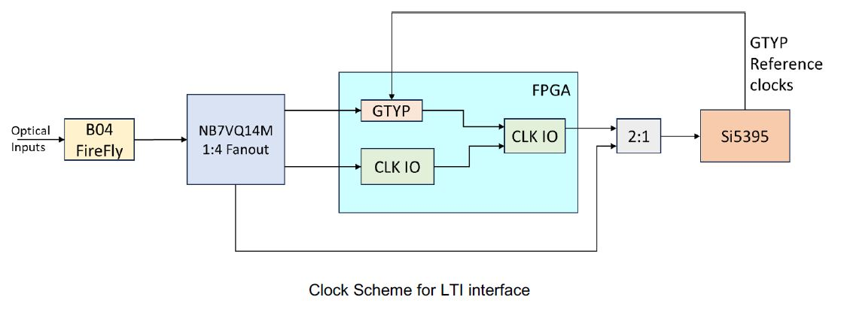
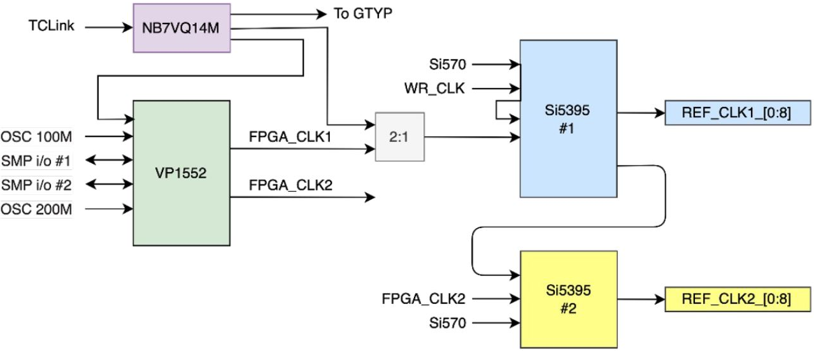
DAM (FLX155) clock interface
Dedicated Clock input,
up to three MGT lanes (Tx/Rx)
MTP multimode 850µm optical
* These two diagrams are from FLX155 presentations
* DAM implementation
NB7VQ14M (and 2:1): not on FLX182, FLX712

Slide 27
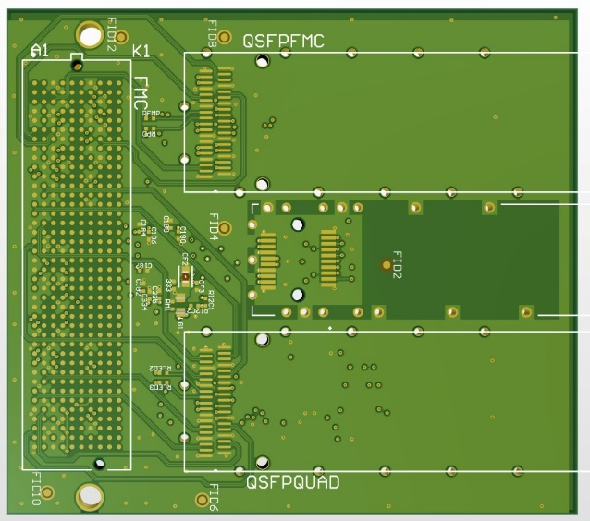
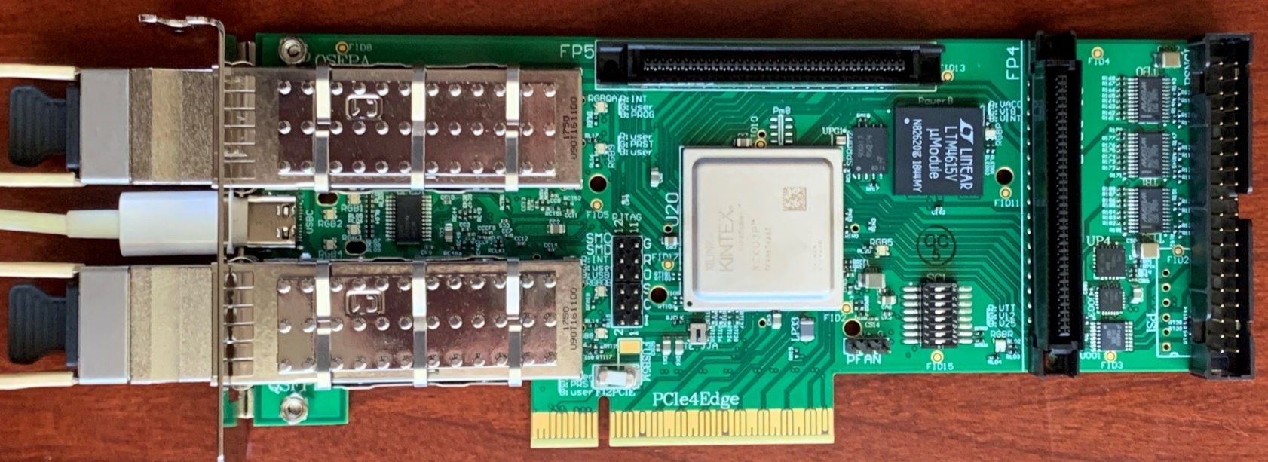
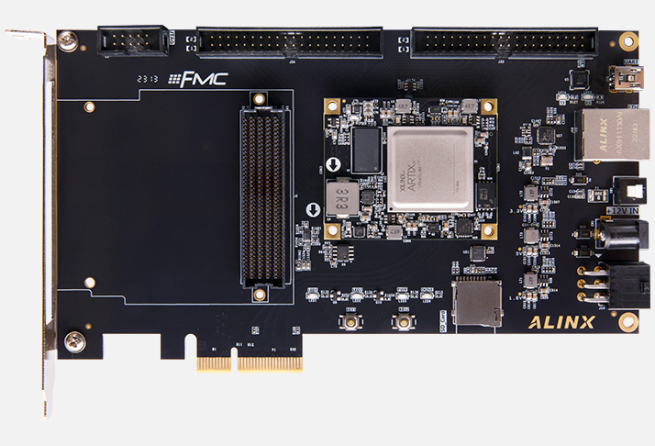
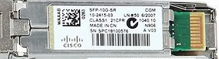

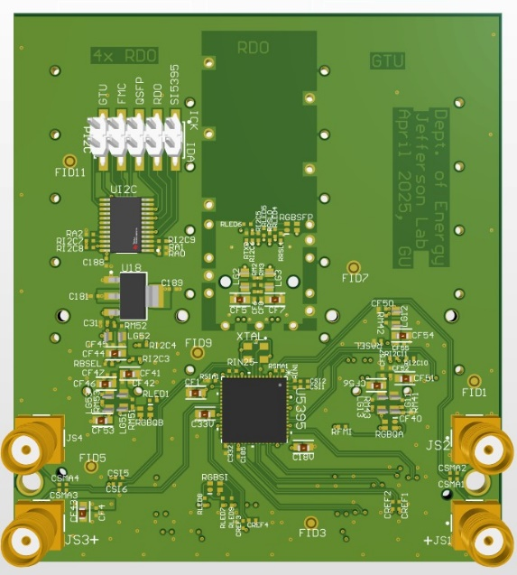
FADE on Axau15p
With this FMC adaptor ( 20 pieces in hand ), the Axau15P can be GTU, DAM, or RDO.
Platform For DAQ software development
Platform for firmware development
Mini-daq for detector/FEB/ASIC test

