Slide 1
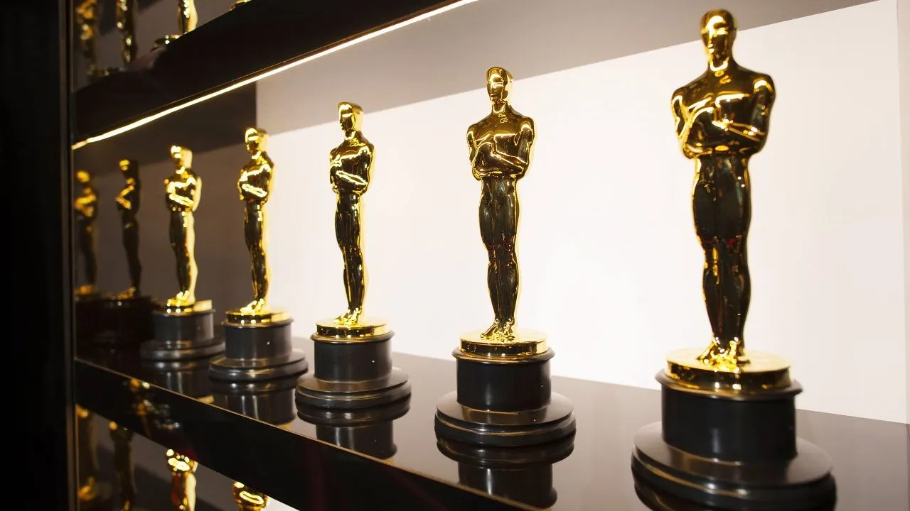
Thank you everybody for voting
We had 169 votes for the photo contest
And the Winners are

Slide 2
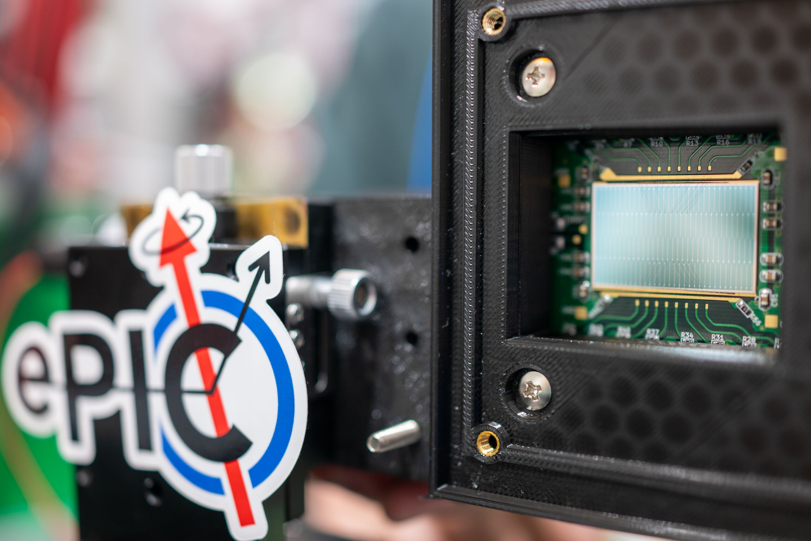
On Target for 35 ps

Slide 3
4th ePIC Photo Contest
3rd Place
Bong-Hwi Lim
July 13 - 17, 2025

Slide 4
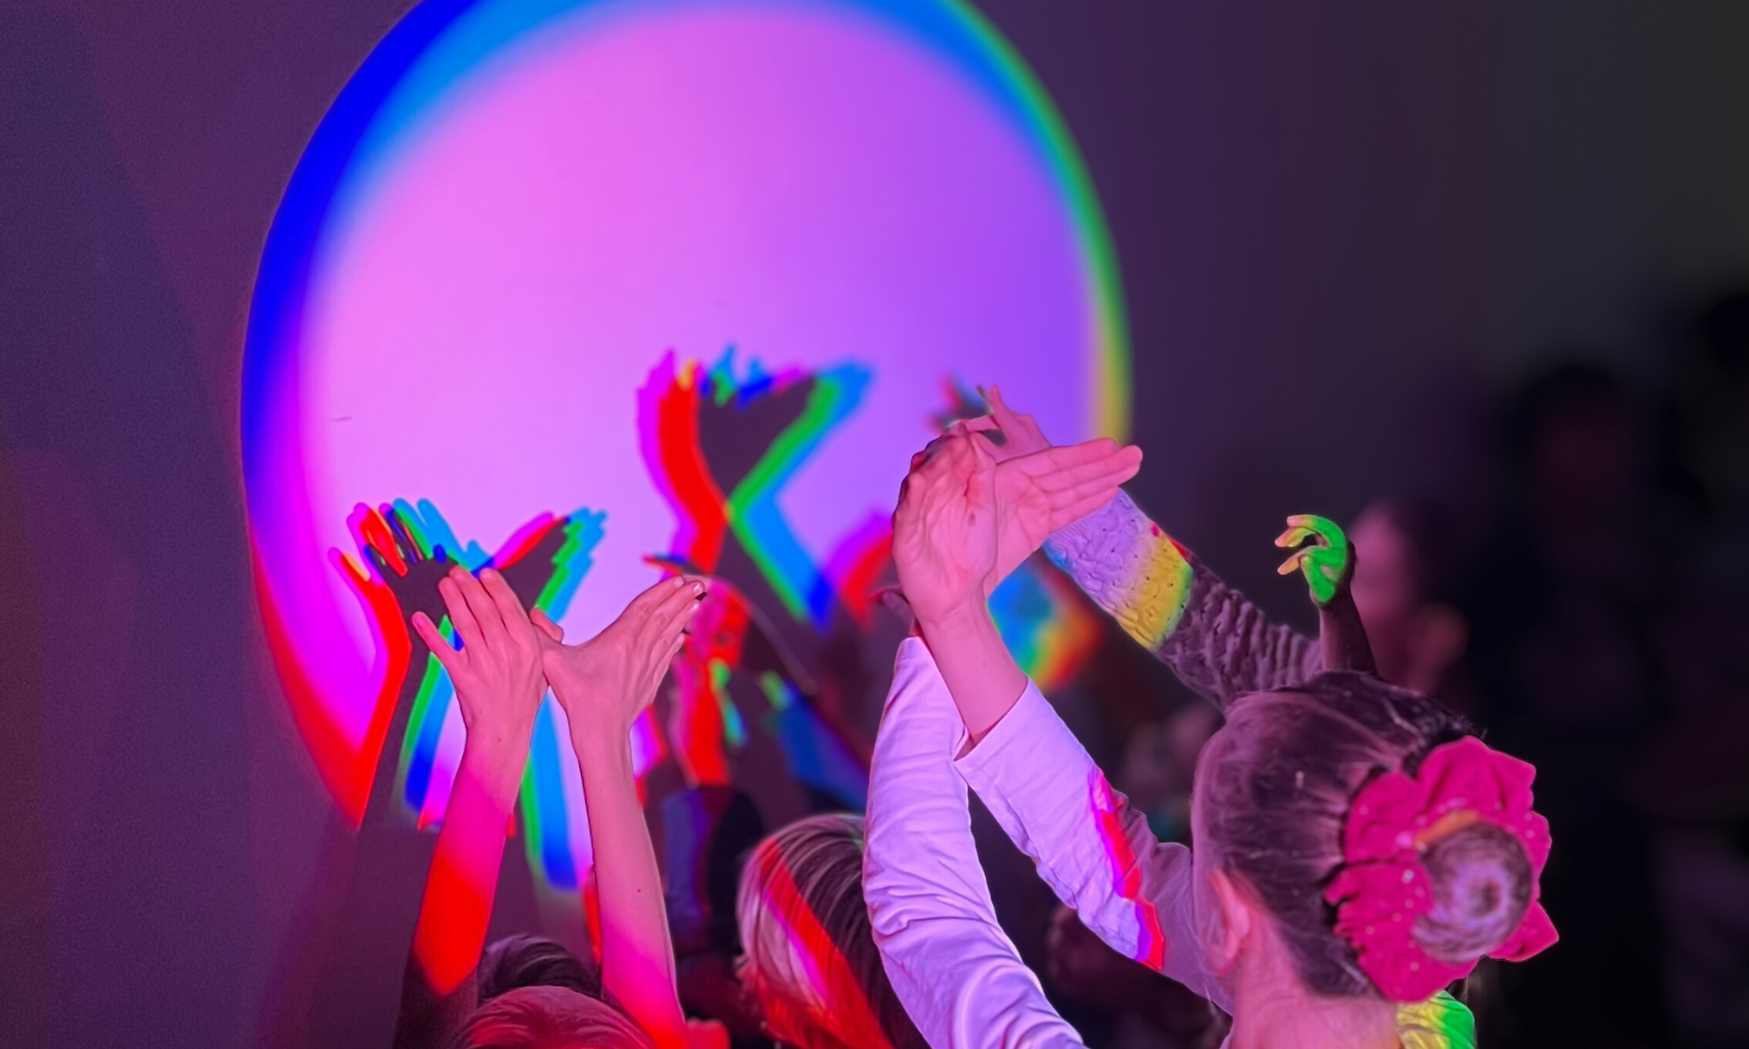
From RGB to QCD:
When Color becomes
a force for Outreach

Slide 5
4th ePIC Photo Contest
2nd Place
Roberto Preghenella
July 13 - 17, 2025

Slide 6
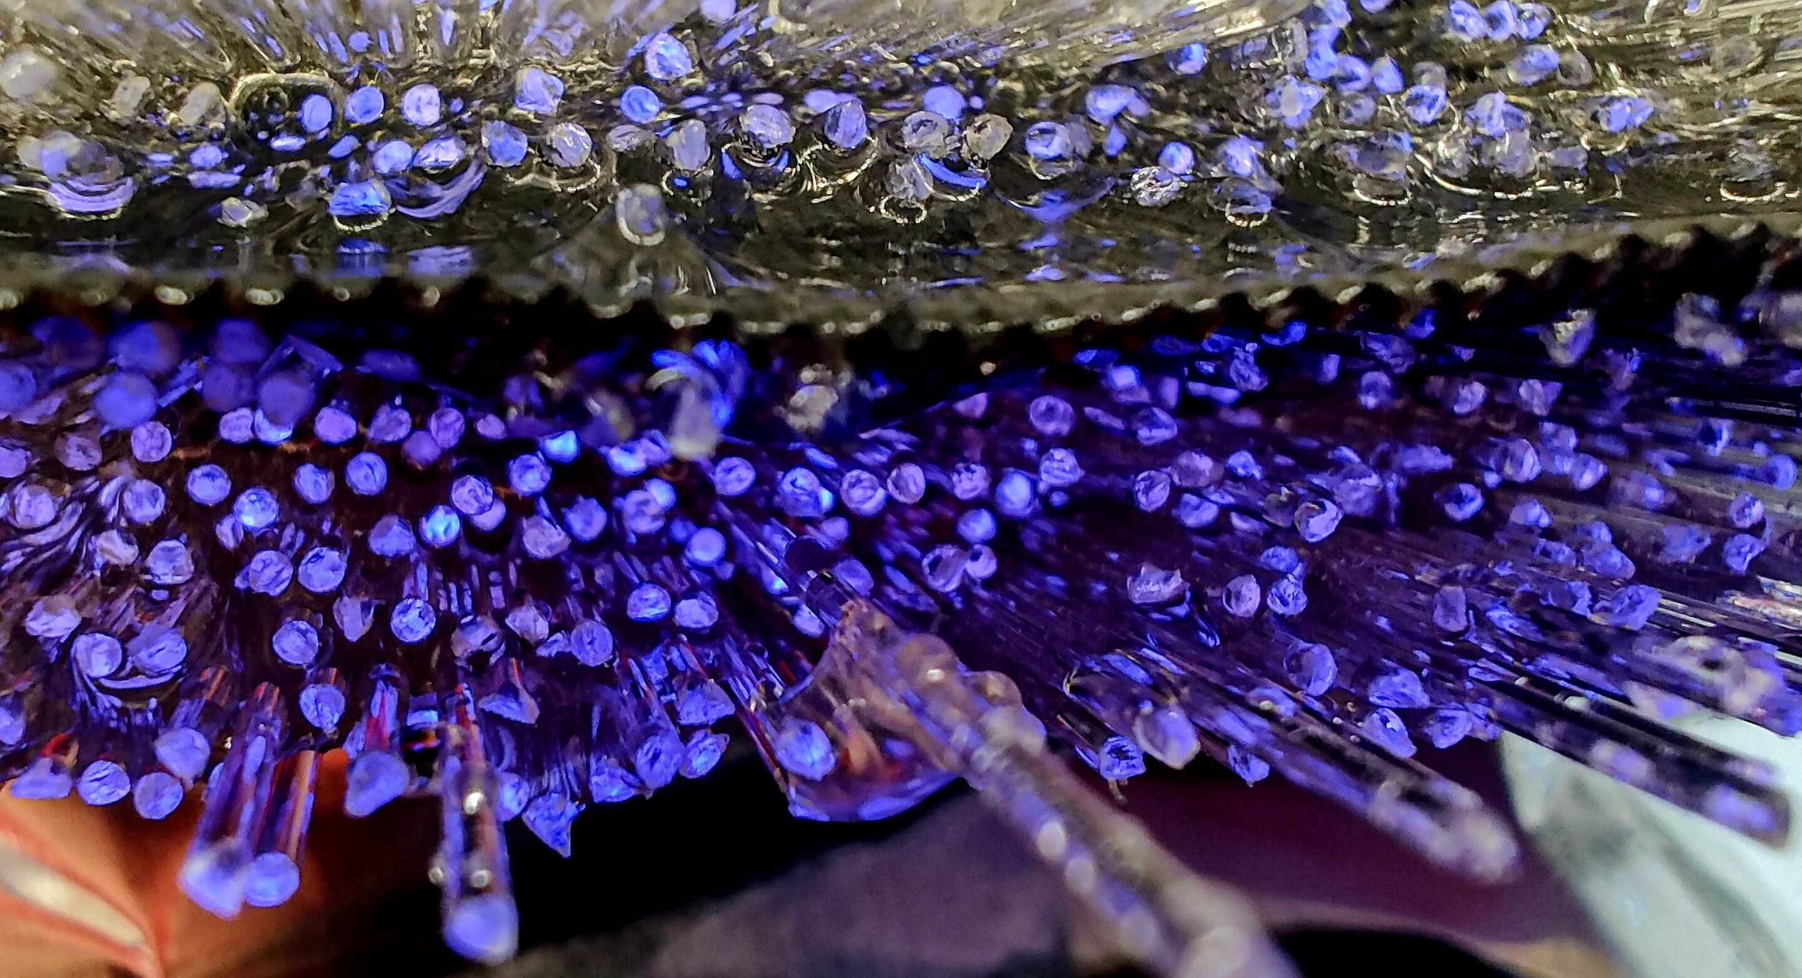
Layers of light:
Barrel Imaging Calorimeter
in the making

Slide 7
4th ePIC Photo Contest
1st Place
Kevin Bailey
July 13 - 17, 2025

Slide 8

A big Thank You to everybody
for all the help

