Slide 1
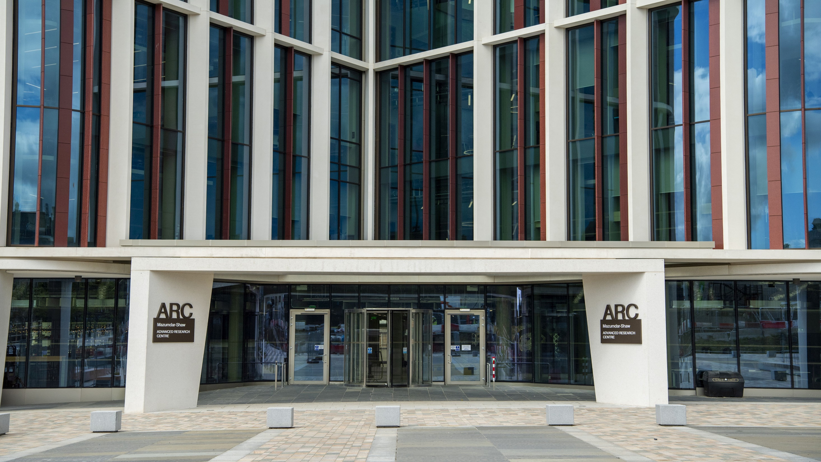
University of Glasgow
Established in 1451
New Principal – Professor Andy Schofield
Member of the Russell Group of research-intensive UK universities
Over 35,000 students from140 countries
4 Colleges
Eight Nobel Laureates, 3 Prime Ministers,
3 First Ministers of Scotland

Slide 2
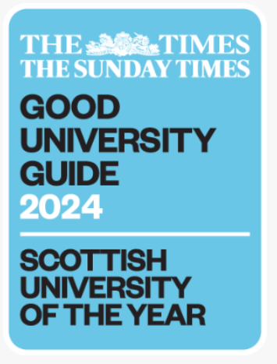



University Rankings
Ranked 79th in the 2025 QS World Rankings.
Ranked 12th in the UK in the annual global university league table
84th in the Times Higher Education (THE) World University Rankings
Ranked 12th in the world in the Times Higher Education (THE) Impact Rankings
The Times & Sunday Times’ Scottish University of the Year for 2024

Slide 3
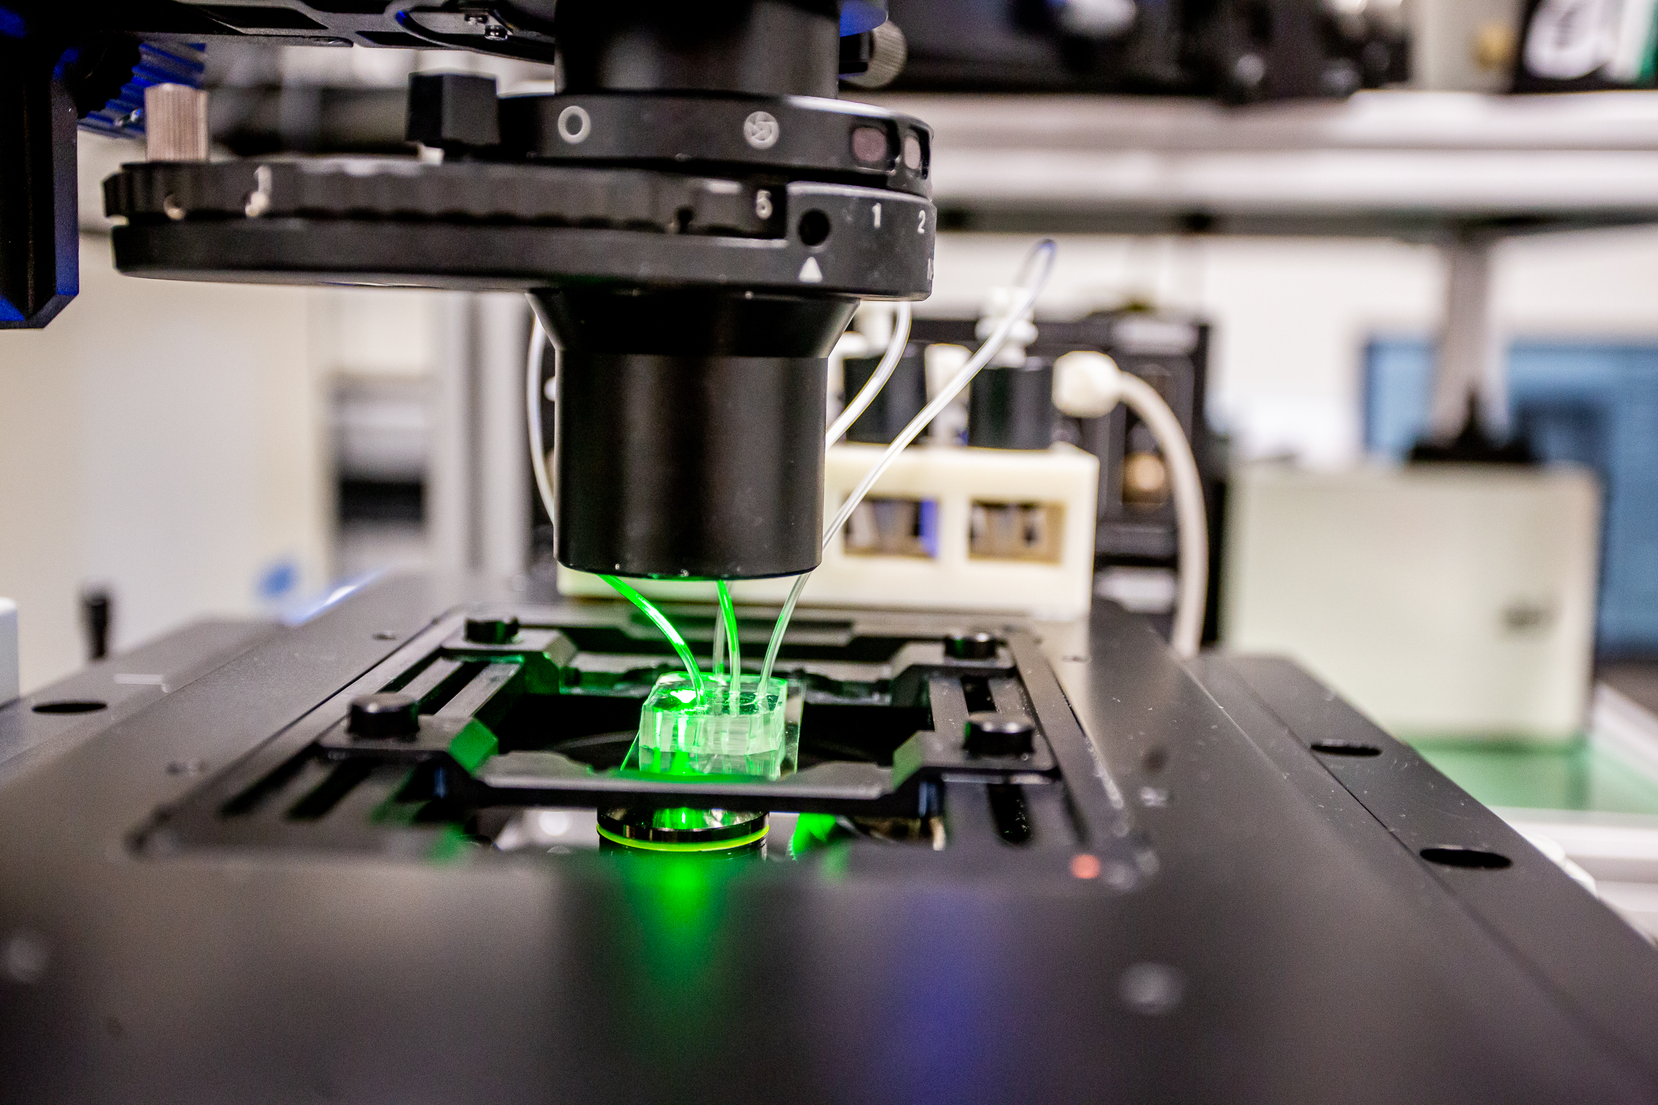
College of Science & Engineering
Six Schools:
School of Chemistry
School of Computing Science
James Watt School of Engineering
School of Geography & Earth Sciences
School of Mathematics & Statistics
School of Physics & Astronomy
People:
Academic staff ~450
Research staff ~510
Professional staff ~330
PGR students 1,135
UG students 5,633
PGT students 1,792
Notes:
Four Colleges
CoSE: 6 Schools
Links to UESTC University of Electronic Science and Technology of China and
SIT , Singapore Institute of Technology
MVLS: 7 Schools & Institutes
CoSS: 6 Schools & Institutes
CoA: 5 Schools

Slide 4
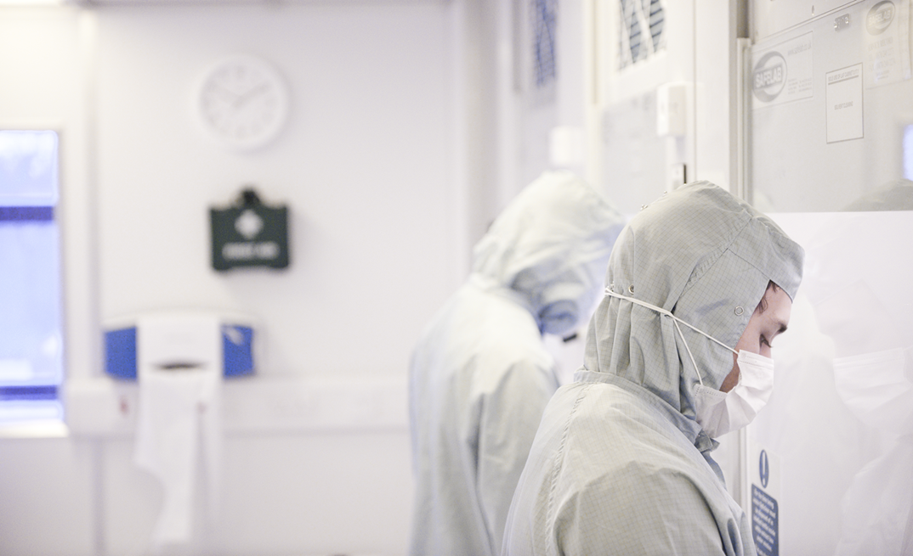






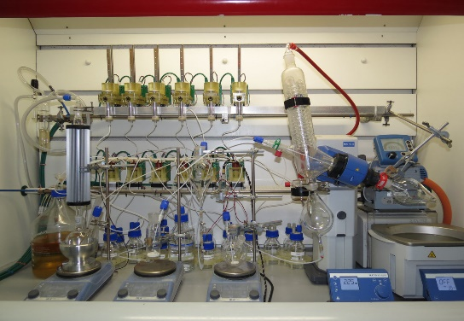
Research Themes
Quantum & Nano Technologies
Healthcare Technologies
Sustainability &
Net Zero Future
Physical & Mathematical Sciences Powerhouse
Communications
Data Science & AI
Autonomous Systems
Digital Chemistry

Slide 5


Transnational Education Programmes
Singapore Institute of Technology (SIT):
4 Joint Degrees in Engineering and Computing Science
~ 400 students/year
17 academic staff based in Singapore
University of Electronic Science and Technology of China (UESTC):
Double degrees in Engineering
~ 660 students/year
~ 50 Glasgow-based academic staff

Slide 6
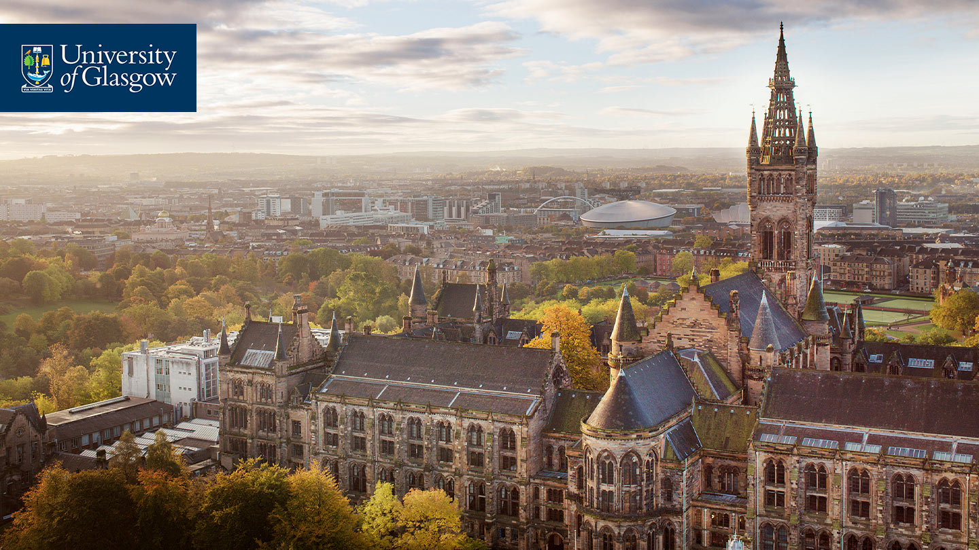
Our city, our partner
The University was founded for the benefit of the city and its people.
Our staff and students are engaged in strong, enduring research and community partnerships to improve health, boost the economy, and build a better future for those living in Glasgow.
The University is a key player in the city’s ambitious plans for the regeneration of the River Clyde and in the development of a Glasgow Riverside Innovation District.

