Slide 1
Introduction: Joint Electronics & DAQ / Streaming Readout WG Workfest
ePIC Electronics and DAQ WG Conveners
Fernando Barbosa (JLab), Jeff Landgraf (BNL)
Streaming Readout WG Conveners
Marco Battagalieri (INFN), Taku Gunji (University of Tokyo), Jeff Landgraf (BNL)
Software / Computing Management
Markus Diefenthaler (JLAB), Torre Wenaus (BNL)

Slide 2
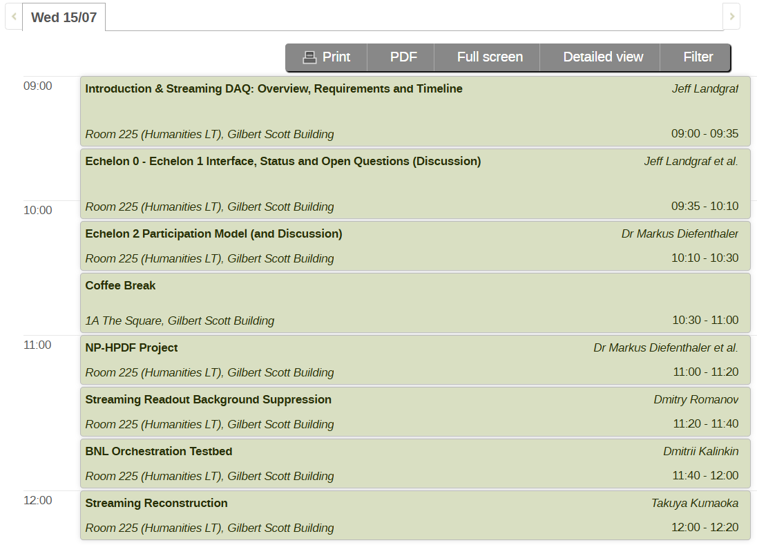
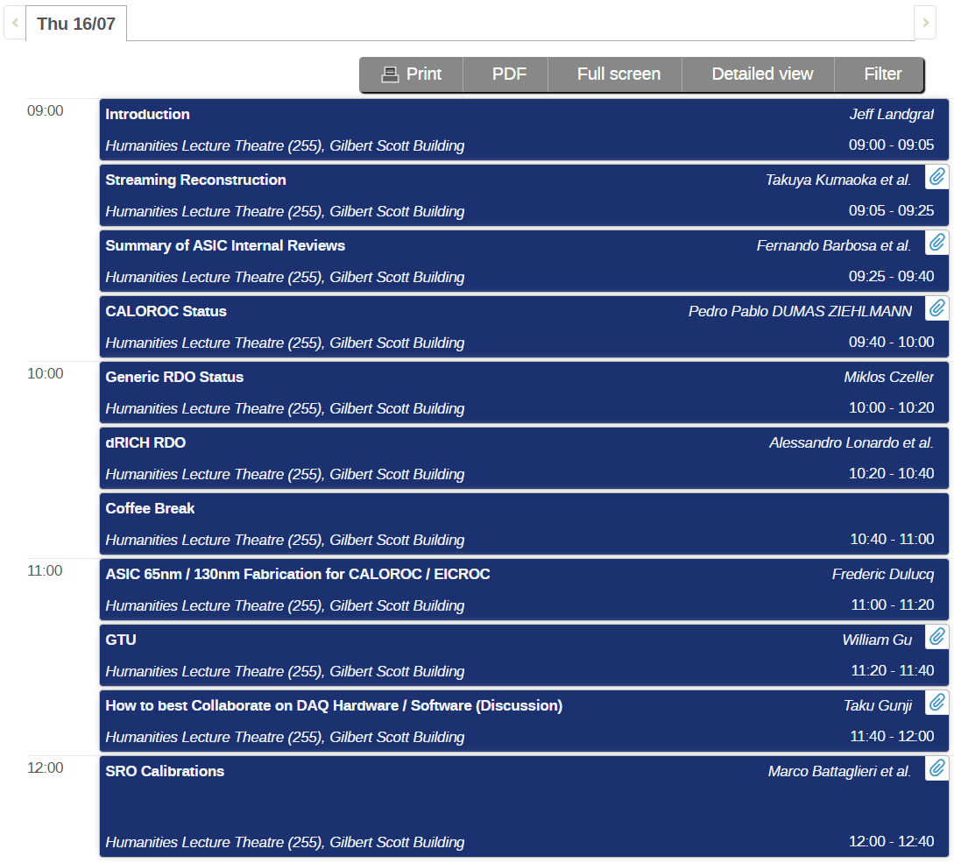


Sessions
Excursion’s

